Slide 1
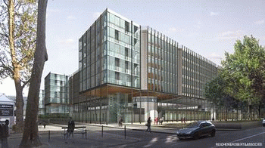
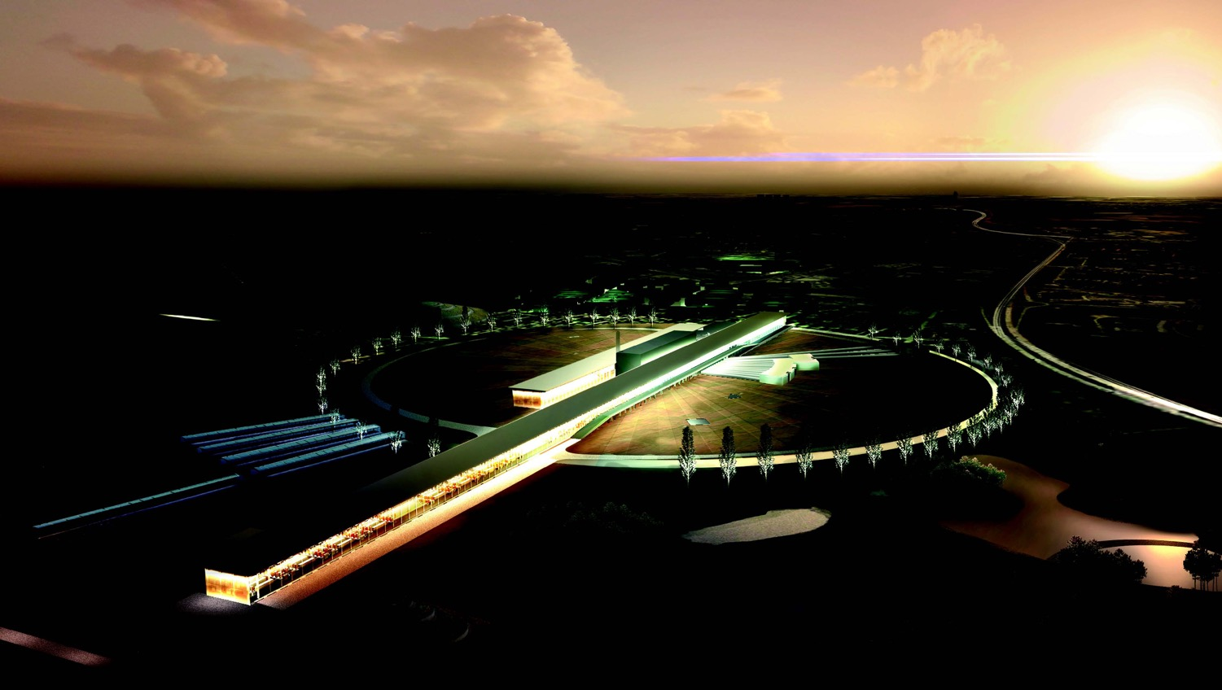

Neutrino CP Violation with the European Spallation Source neutrino Super Beam
Marcos Dracos
IPHC-Strasbourg
IRN Neutrino meeting December 1-2 2021

Slide 2
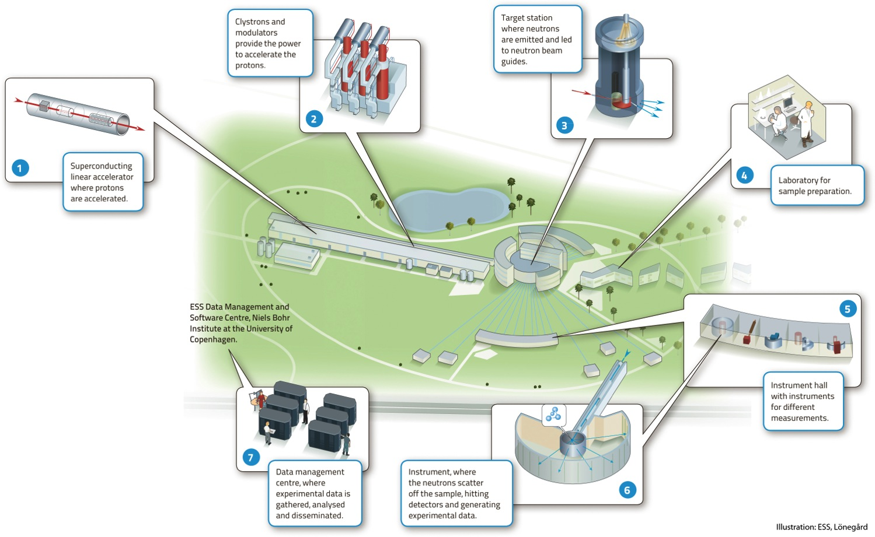

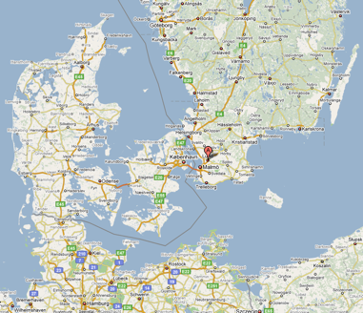
European Spallation Source
Neutron facility
(equivalent to SNS in the USA)
under construction phase
(~1.85 B€ facility)

Slide 3
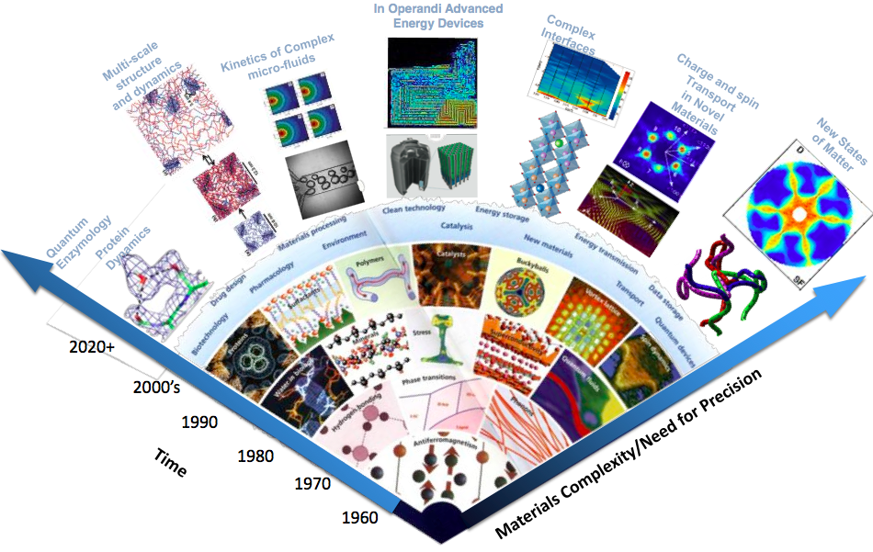
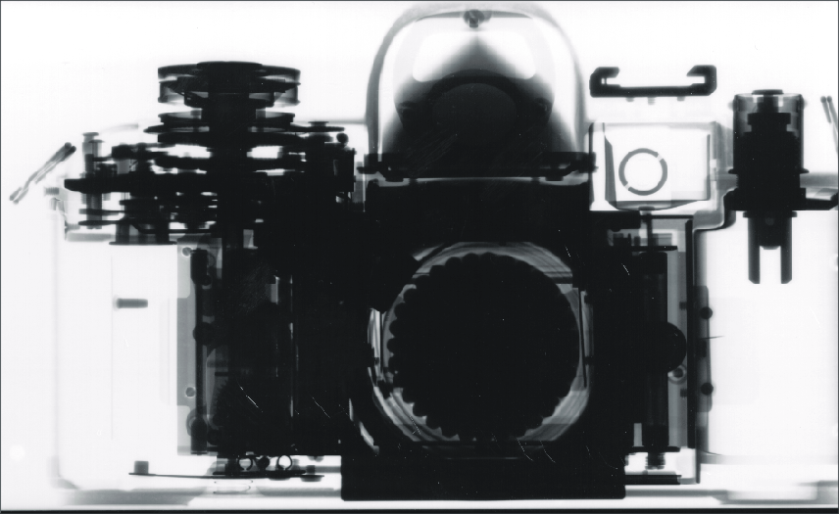
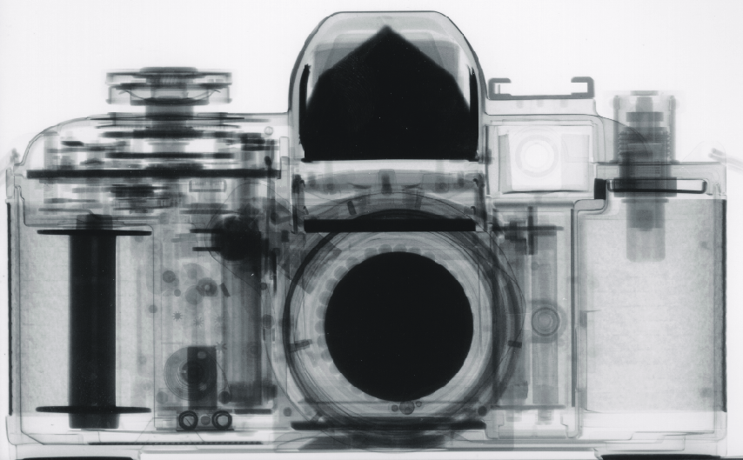
Applications of neutrons
Multi-disciplinary science applications
Transmutation of radioactive (waste) material
  Accelerator-driven Systems
Industrial applications:
  materials analysis and non-destructive testing tools in many industries
    heavy mechanical production
    art conservancy
    Medicine
    …
X-Ray Image
Neutron radiograph

Slide 4
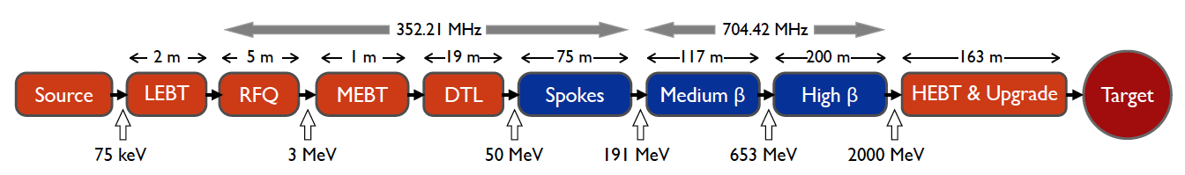
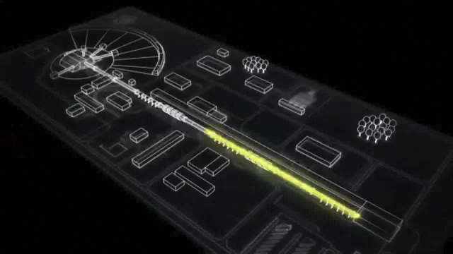
ESS proton linac
empty space for energy upgrades
The ESS will be a copious source of spallation neutrons.
5 MW average beam power.
125 MW peak power.
14 Hz repetition rate (2.86 ms pulse duration, 10¹⁵ protons).
Duty cycle 4%.
2.0 GeV protons
  up to 3.5 GeV with linac upgrades
>2.7x10²³ p.o.t/year.
8
x10¹⁴
ESS 5 MW
2015 design
7
λ = 1.5 Å
6
5
Brightness (n/cm²/s/sr/Å)
4
3
ESS 5 MW
2012 design (TDR)
2
UK TS2
32 kW
SNS
1-2 MW
JPARC
0.3-1 MW
1
UK TS1
128 kW
ILL 57 MW
0
time (ms)
1
2
3
4

Slide 5
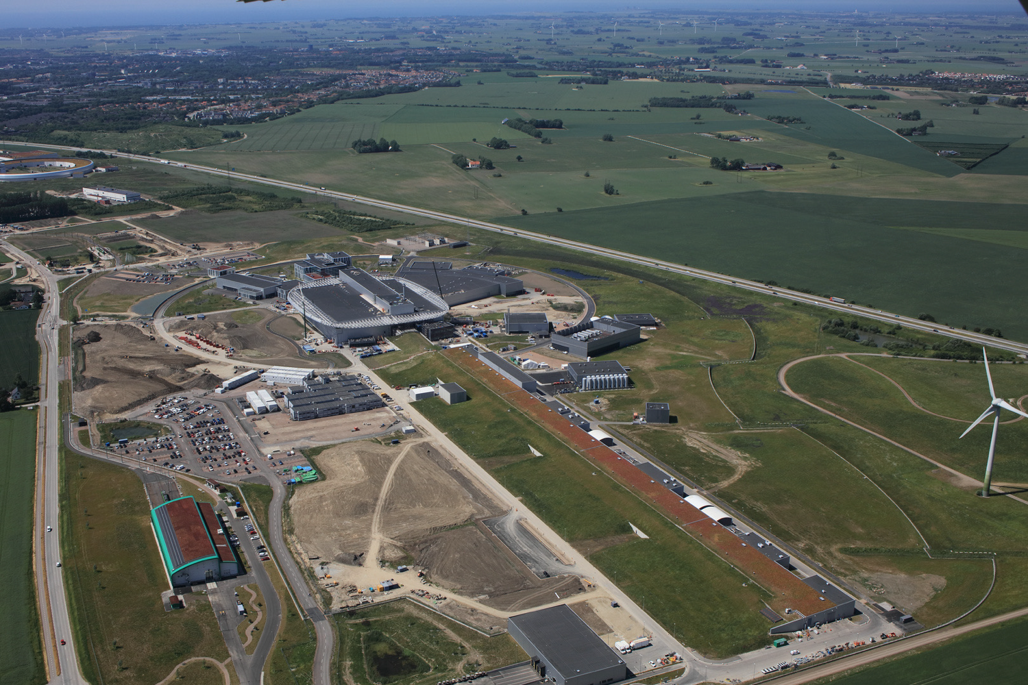

European Spallation Source
target
instruments
utility buildings
linac
European Research Infrastructure Consortium (ERIC) since 2015
July 2021

Slide 6
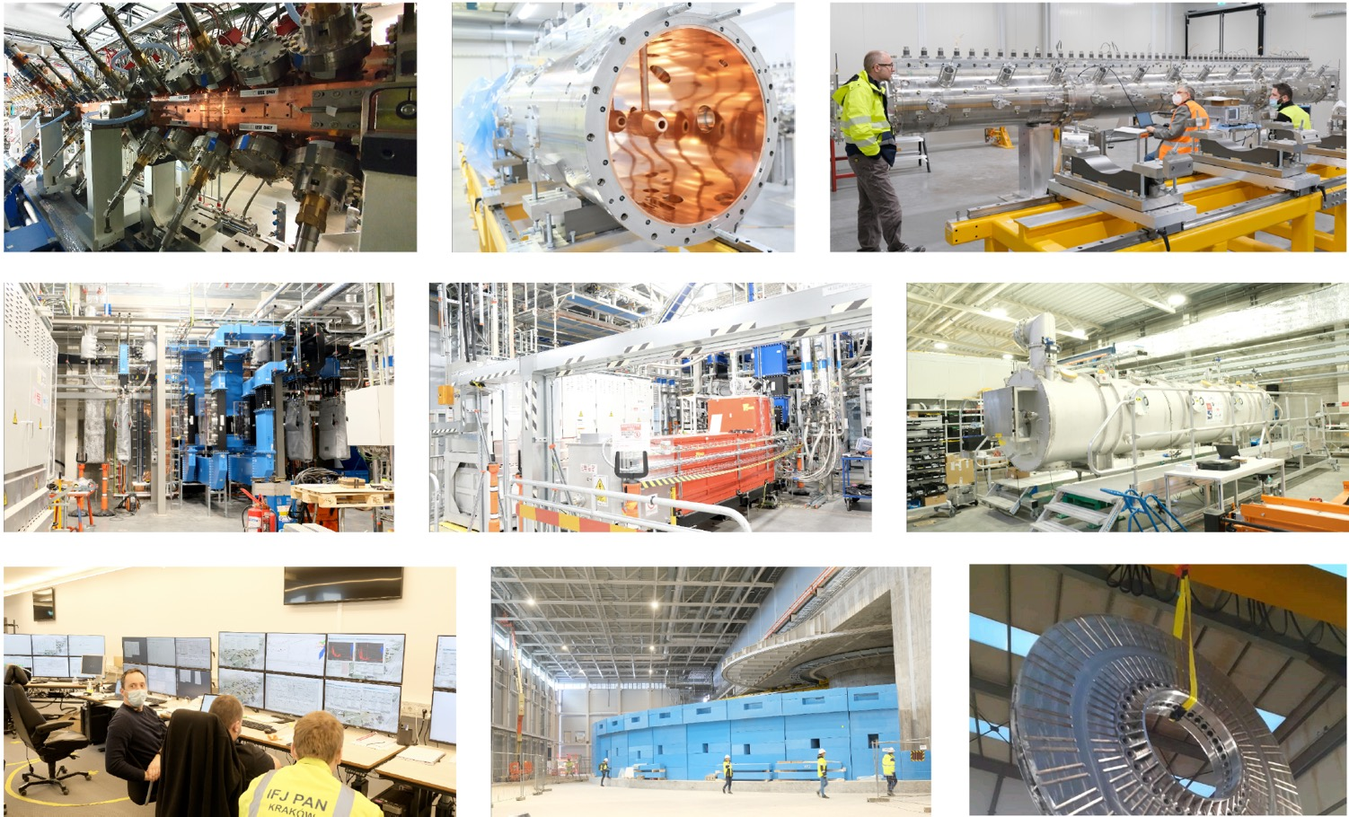
European Spallation Source

Slide 7
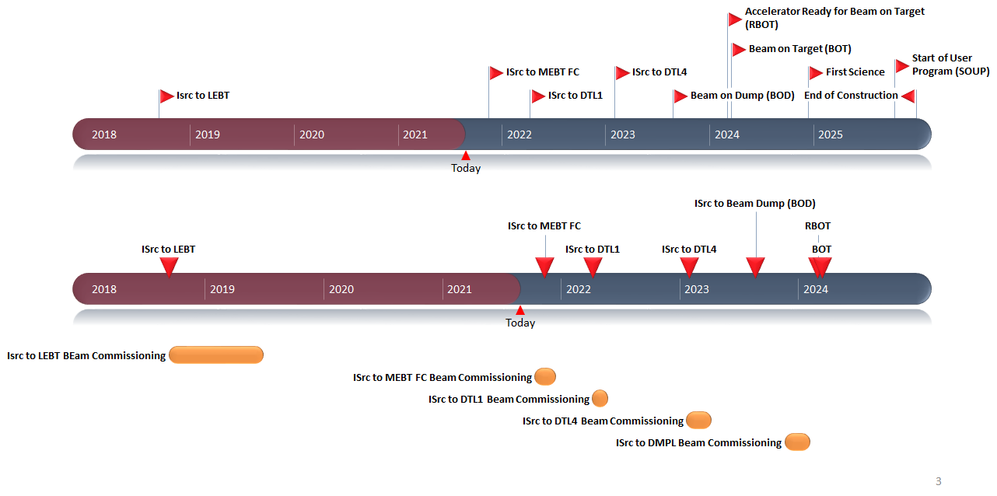
ESS schedule
Linac schedule
Overall schedule

Slide 8
European Spallation Source as Neutrino Facility for CP violation observation
(2nd Oscillation maximum)
ν_{μ}→ν_{e}

Slide 9
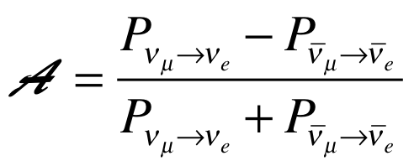
Oscillation probability
(neutrino beams)
"atmospheric"
"interference"
"solar"
matter effect
for antimatter: δ_{CP} →-δ_{CP} and a→-a
fake matter/antimatter asymetry due to matter effect
δ_{CP} dependence,
sizable matter effect for long baselines
Matter-antimatter asymmetry

Slide 10

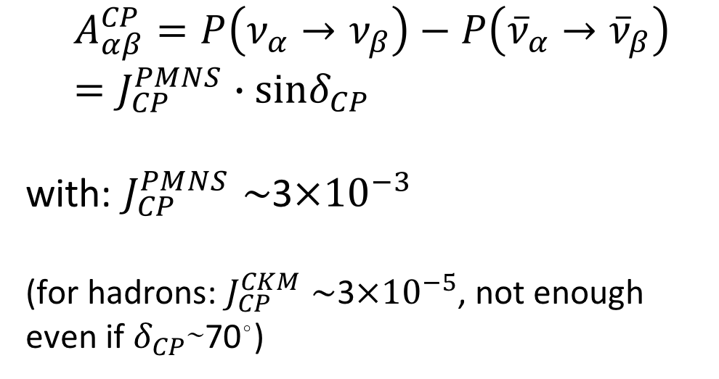
δ_{CP} and matter-antimatter asymmetry magnitude
(Jarlskog invariant)
(from the already observed CP violation in the hadronic sector)
Theoretical models predict that if |sinδ_{CP}|≳0.7 (45°<δ_{CP}<135° or 225°<δ_{CP}<315°), this could be enough, under assumptions, to explain the observed asymmetry.
(Nucl.Phys.B774:1-52,2007, arXiv:hep-ph/0611338)

Slide 11
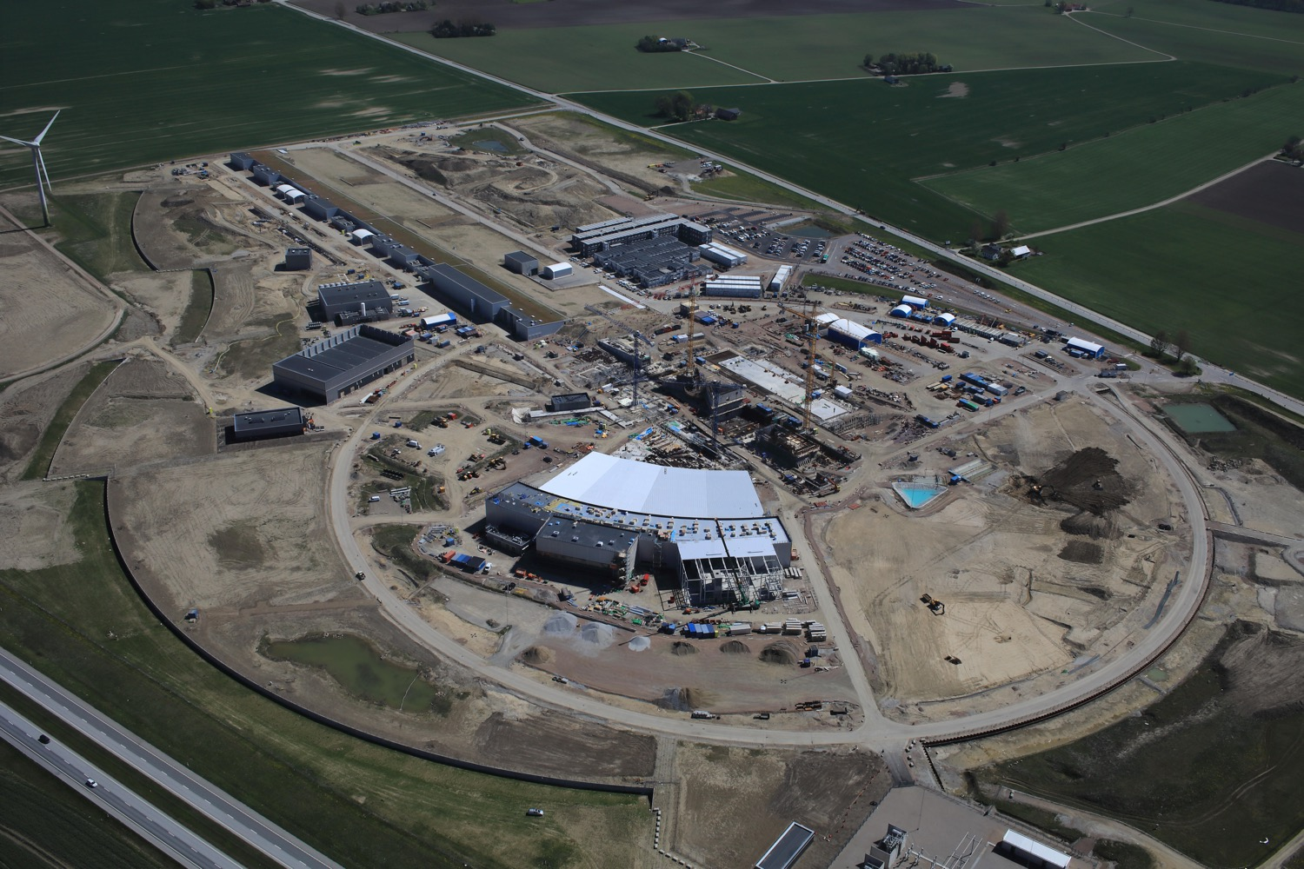
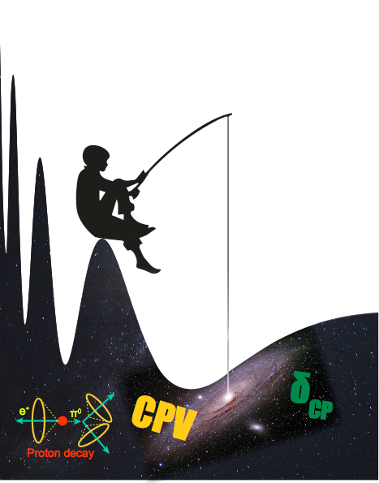
Use all this ESS linac power to go to the second oscillation maximum
but why?

Slide 12
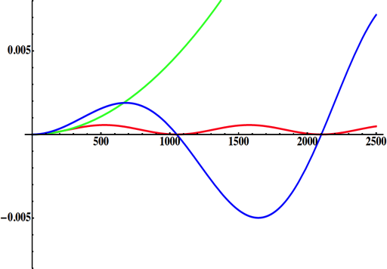
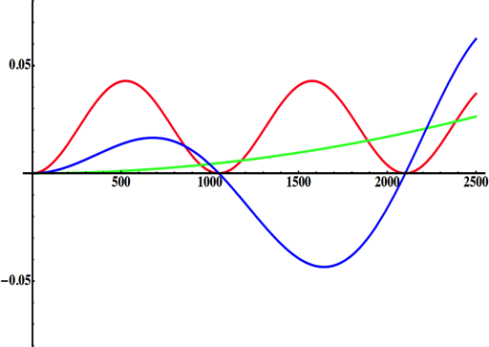
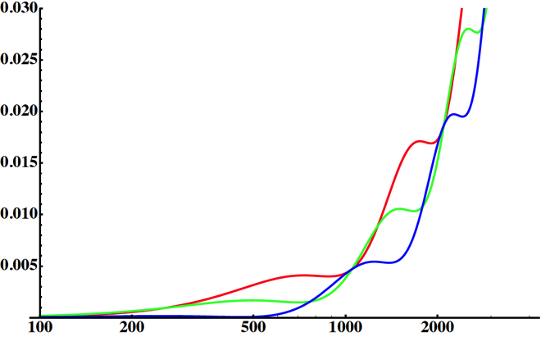
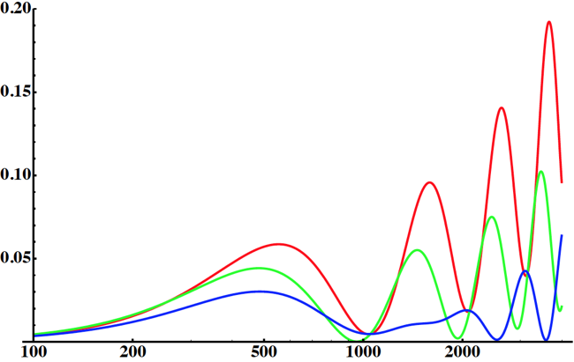
Neutrino Oscillations with "large" θ₁₃
solar
(after 2012)
(before 2012)
atmospheric
for "large" θ₁₃ 1st oscillation maximum is dominated by atmospheric term
for small θ₁₃ 1st oscillation maximum is better
atmospheric
solar
L/E
L/E
CP interference
(arXiv:1110.4583)
θ₁₃=1º
CP interference
θ₁₃=8.8º
solar
2nd oscillation maximum
P(ν_{μ}→ν_{e})
1st oscillation maximum
θ₁₃=1º
("small" θ₁₃)
δ_{CP}=-90
δ_{CP}=0
δ_{CP}=+90
θ₁₃=8.8º
("large" θ₁₃)
L/E
L/E
1st oscillation max.: A=0.3sinδ_{CP}
2nd oscillation max.: A=0.75sinδ_{CP}
more sensitivity at 2nd oscillation max.
(see arXiv:1310.5992 and arXiv:0710.0554)

Slide 13
Production of a neutrino beam
What can we do with:
5 MW power
2 GeV energy
14 Hz repetition rate
10¹⁵ protons/pulse
>2.7x10²³ protons/year
proton beam
decay tunnel
p
hadrons
physics
π
ν
⨂B
target
hadronic collector
(focusing)
Detector
conventional neutrino (super) beam

Slide 14
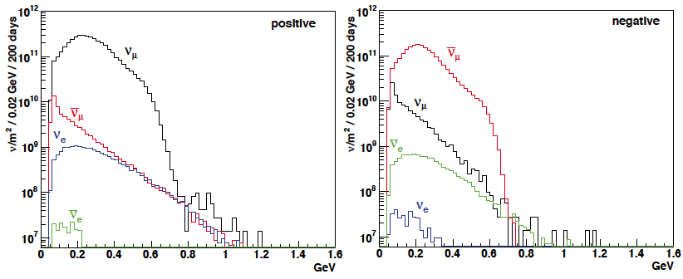
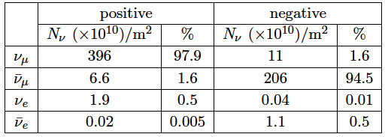
ESSνSB ν energy distribution
neutrinos
anti-neutrinos
almost pure ν_{μ} beam
small ν_{e} contamination which could be used to measure ν_{e} cross-sections in a near detector
at 100 km from the target, per year (in absence of oscillations)
(Nucl. Phys. B 885 (2014) 127)

Slide 15
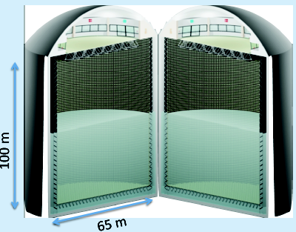
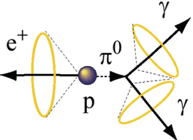
Can we go to the 2nd oscillation maximum using our proton beam?
Yes, if we place our far detector at around 500 km from the neutrino source.
MEMPHYS like Cherenkov detector
(MEgaton Mass PHYSics studied by LAGUNA)
(arXiv: hep-ex/0607026)
Neutrino Oscillations
Proton decay
Astroparticles
Understand the gravitational collapsing: galactic SN ν
  Supernovae "relics"
Solar Neutrinos
Atmospheric Neutrinos
500 kt fiducial volume (~20xSuperK)
Readout: ~240k 8” PMTs
30% optical coverage
New 20" PMTs with higher QE and cheaper (see JUNO), the detection efficiency will improve the detector performance keeping the price constant, not yet taken into account.

Slide 16
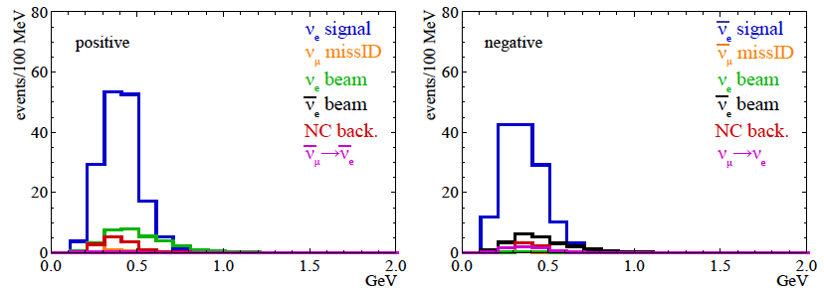
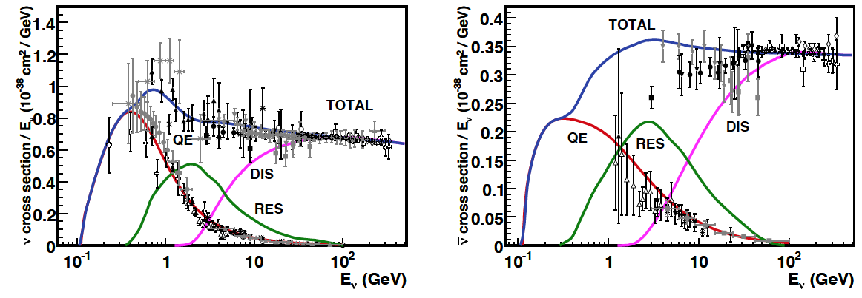
Neutrinos in the far detector
540 km (2 GeV), 10 years
neutrinos
anti-neutrinos
δ_{CP}=0
2 years
8 years
Below ν_{τ} production, almost only QE events, not suffering too much by π⁰ background.

Slide 17
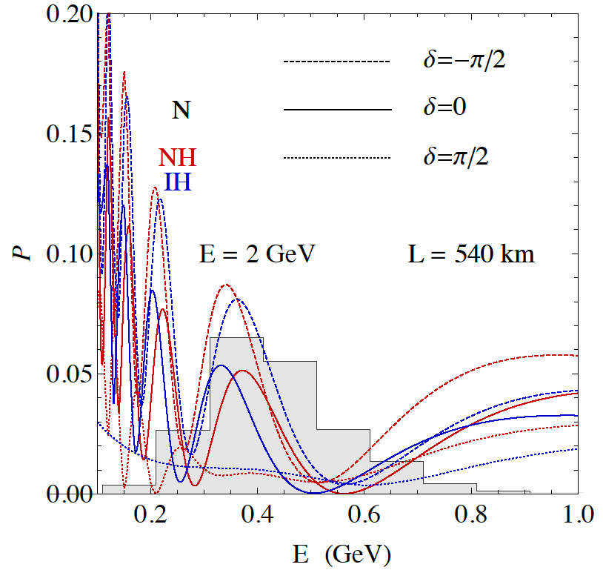
2nd Oscillation max. coverage
2nd oscillation max.
well covered by the ESS neutrino spectrum
1st oscillation max.
full coverage of the 2nd oscillation max.

Slide 18
Required modifications of the ESS accelerator for ESSνSB
Better to go to 2.5 GeV

Slide 19

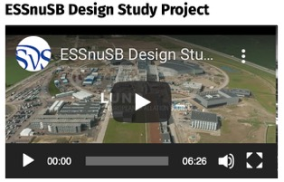


ESSνSB Consortium
COST Action EuroNuNet (CA15139): 2016-2020
  https://euronunet.in2p3.fr
  video for scientists: https://www.youtube.com/watch?v=PwzNzLQh-Dw
EU-H2020 Design Study ESSνSB: 2018-2022 (3 months extension due to COVID19)
  https://essnusb.eu
  video for general public: https://www.youtube.com/watch?v=qAnvft0nAlg

Slide 20
The H2020 ESSνSB Design Study
A H2020 EU Design Study has been submitted March 2017 (Call INFRADEV-01-2017)
Title of Proposal: Discovery and measurement of leptonic CP violation using an intensive neutrino Super Beam generated with the exceptionally powerful ESS linear accelerator.
Duration: 4 years
Total cost: 4.7 M€
EU funding received: 3 M€
15 participating institutions from
11 European countries including CERN and ESS
6 Work Packages
ESSνSB
BENE (2004-2008)
ISS (2005-2007)
EUROν (2008-2012)
LAGUNA (2008-2010)
LAGUNA-LBNO (2010-2014)
COST Action CA15139 (2015-2019)

Slide 21
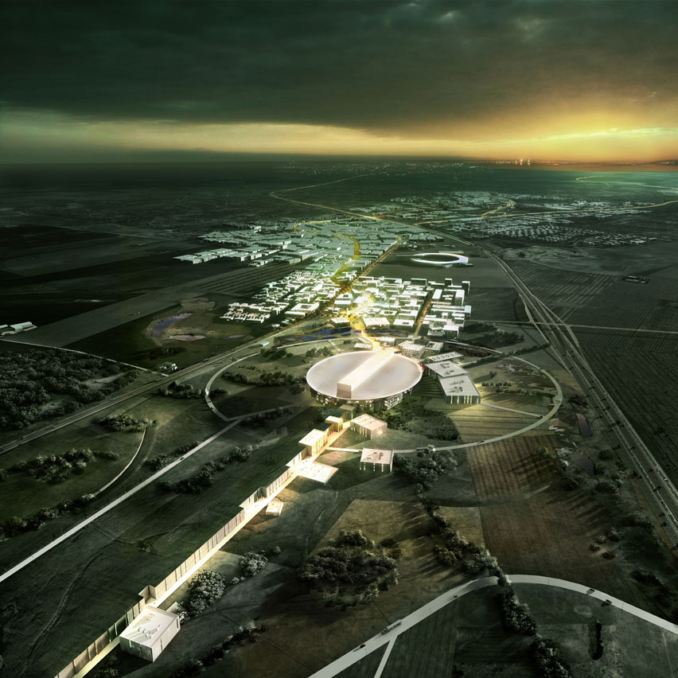
ESS modifications to produce a neutrino Super Beam
European Spallation Source Linac

Slide 22
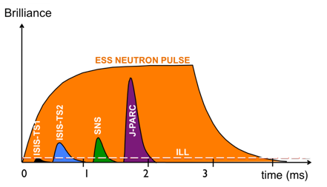
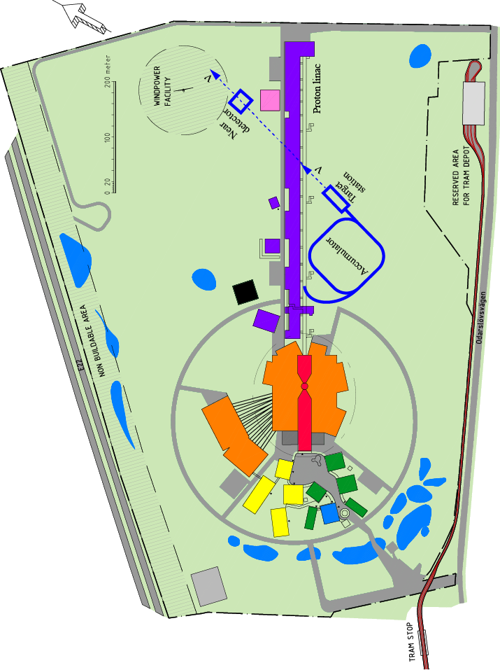
How to add a neutrino facility?
The neutron program must not be affected and if possible synergetic modifications.
Linac modifications: double the rate (14 Hz → 28 Hz), from 4% duty cycle to 8%.
Accumulator (C~400 m) needed to compress to few μs the 2.86 ms proton pulses, affordable by the magnetic horn (350 kA, power consumption, Joule effect)
  H⁻ source (instead of protons),
  space charge problems to be solved.
~300 MeV neutrinos.
Target station.
Underground detector.
Short pulses (~μs) will also allow DAR experiments (as those proposed for SNS) using the neutron target.

Slide 23
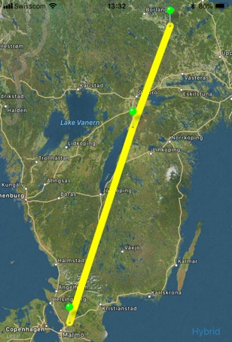
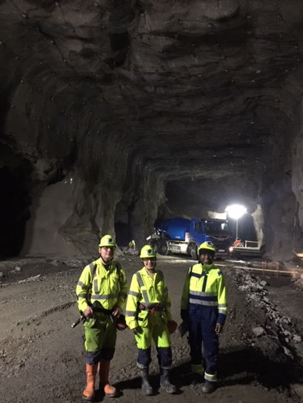
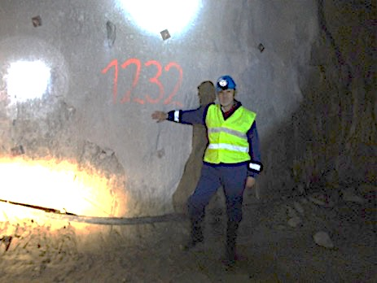
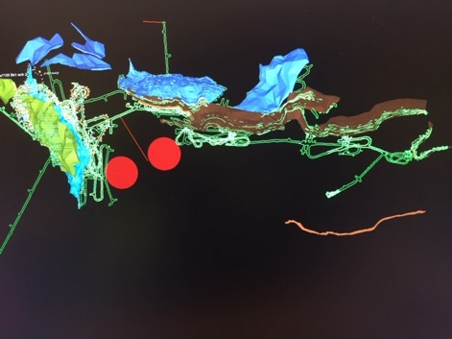
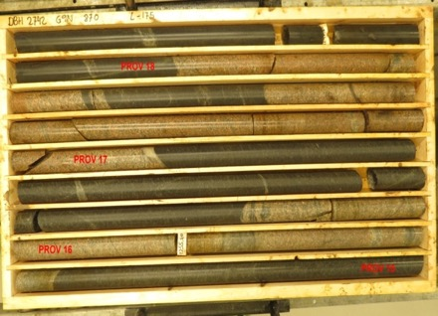
Candidate active mines
Garpenberg mine
  Distance from ESS Lund 540 km
  Depth 1200 m
  Truck access tunnel
Zinkgruvan mine
  Distance from ESS Lund 360 km
  Depth 1500 m
  Truck access tunnel
Garpenberg
(540 km)
Zinkgruvan
Zinkgruvan
(360 km)
Lund
possible location of MEMPHYS in
Zinkgruvan mine
Garpenberg
Granite drill cores

Slide 24
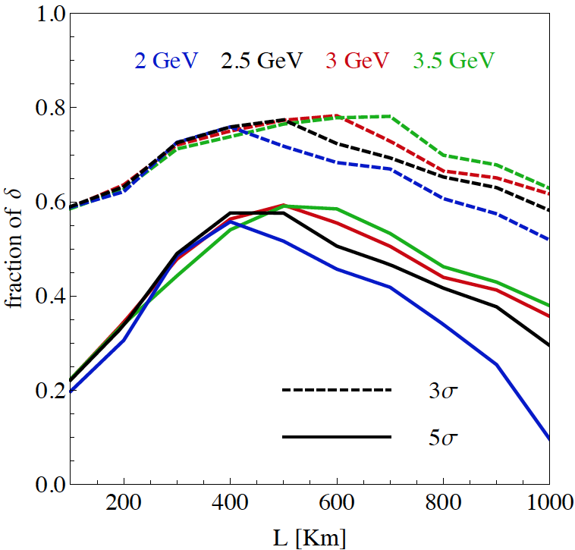
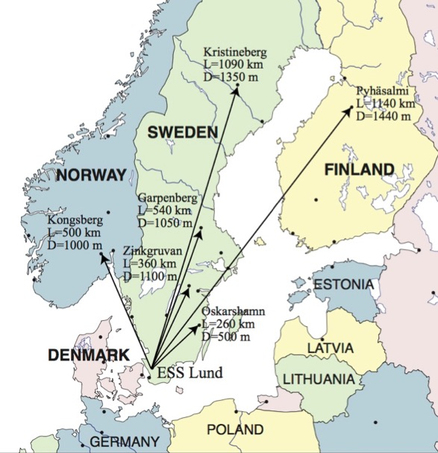
Which baseline?
CPV (Nucl. Phys. B 885 (2014) 127)
Garpenberg
Zinkgruvan
~60% δ_{CP} coverage at 5 σ C.L.
>75% δ_{CP} coverage at 3 σ C.L.
systematic errors: 5%/10% (signal/backg.)
Candidate active mines

Slide 25
Physics Performance
(CPV discovery)
540 km
little dependence on mass hierarchy,
δ_{CP} coverage at 5 σ C.L. up to 60%,
δ_{CP} accuracy down to 6° at 0° and 180° (absence of CPV for these two values),
not yet optimized facility,
5/10% systematic errors on signal/background.

Slide 26
Physics Performance
(accuracy)
5/5 yrs
δ_{CP} accuracy down to 6° at 0° and 180°
12° accuracy at δ_{CP}= -90° and 10° at δ_{CP}= 90°
5/10% systematic errors on signal/background.

Slide 27
The Linac modifications and operation
H⁻ source options
Into linac
P
_{H}⁻
_{H}⁻
_{H}⁻
_{H}⁻
P
_{H}⁻
_{H}⁻
_{H}⁻
_{H}⁻
14 Hz
100 µs
0.65 ms
Into ring
H⁻
H⁻
H⁻
H⁻
H⁻
H⁻
H⁻
H⁻
14 Hz
~1.4 kHz
~1 µs
~0.75 ms
Into horn
_{H}⁻
_{H}⁻
_{H}⁻
_{H}⁻
_{H}⁻
_{H}⁻
_{H}⁻
_{H}⁻
14 Hz
time operation option
Horn 1
Horn 4
Horn 2
Horn 3

Slide 28
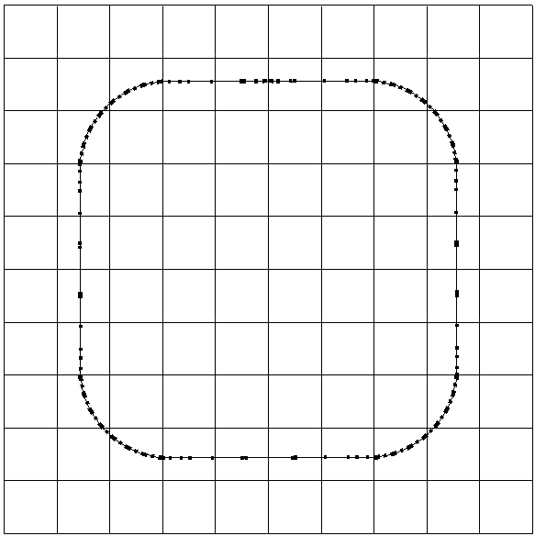
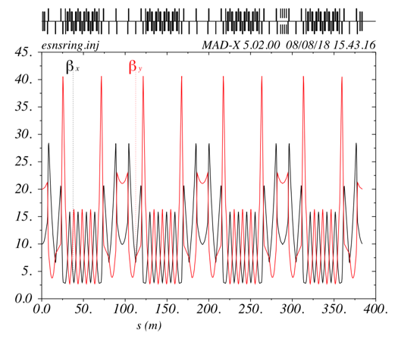
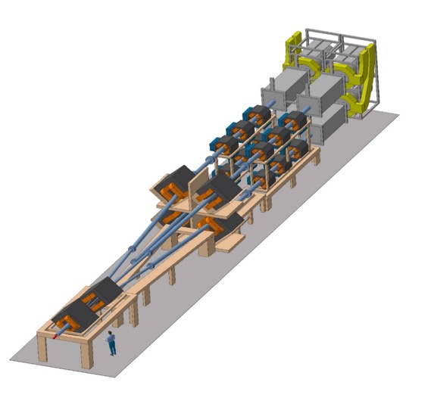
The Accumulator
lattice development
injection
4 superperiods
RF
extraction
FODO cells
H⁻ stripping
collimation
Dispersion-free straight sections
Switchyard

Slide 29
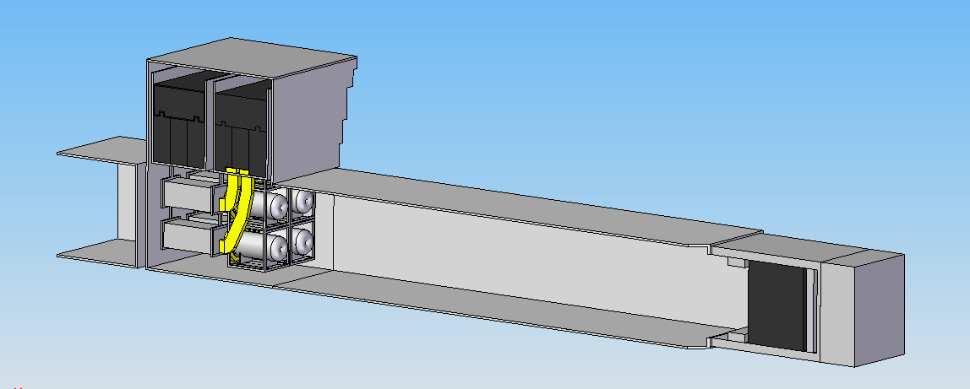
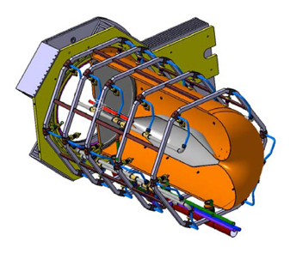
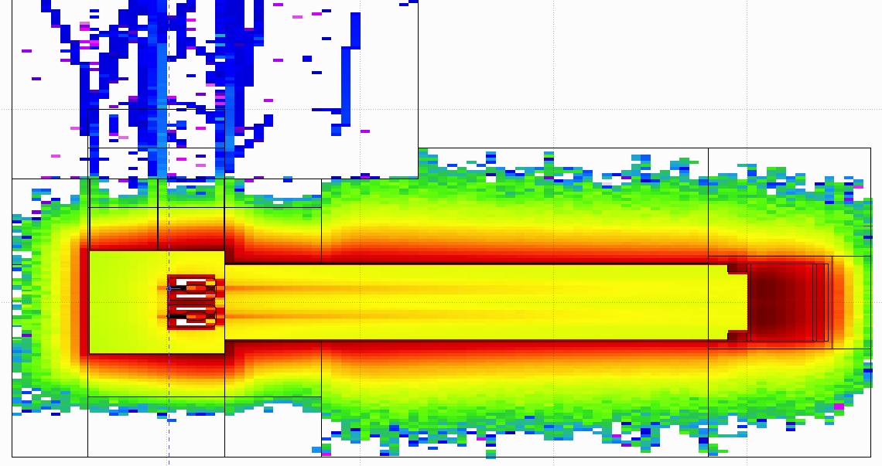
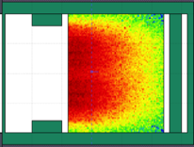
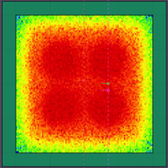
General Layout of the target station
8 m concrete
Split Proton Beam
Horns and Targets
Collimators
Decay Volume
(He, 4x4x25 m³)
Neutrino Beam Direction
Beam Dump

Slide 30
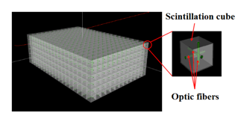
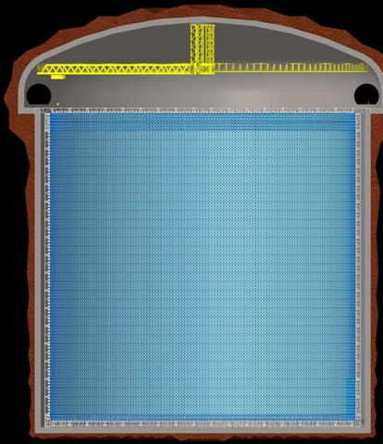
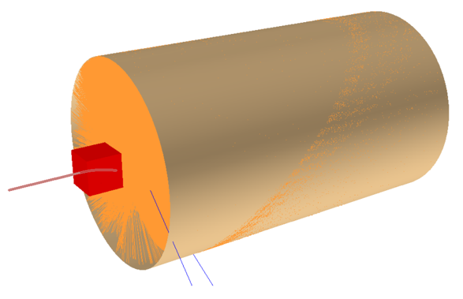
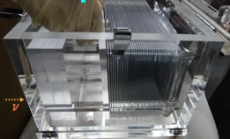


Detectors
Far Detector
Near Detector
Super-FGD like detector
- 1 t target mass
Beam
77 m
0.5 kt fiducial volume
water Cherenkov detector
NINJA-like water-emulsion detector
75 m
30% photocathode coverage
~500 kt
20" PMT

Slide 31





Latest Improvements
New Magriation Matrices for the far detector compared to those of MEMPHYS
Genetic Algorithm for Target Station optimisation
(using WCSim and fiTQun)
30% photocathode coverage
MEMPHYS WC detector
new far detector reconstruction algorithm
(publication is coming)
Phys. Rev. ST Accel. Beams 16, 061001 (2013)
horn optimisation
20"
x2
~500 kt
77 m
75 m

Slide 32
Physics Performance Improvement
540 km
360 km
current
performance
initial performance
ESSnuSB
θ₁₂ = 33.44°
θ₁₃ = 8.57°
θ₂₃ = 49.2°
Δm²₂₁ = 7.42e-5
Δm²₃₁ = +2.517e-3
2nd osc. max.
507 ktons far detector
contribution of atm. neutrinos still to be included
Neurino Factory
ESSnuSB
EUROnu
θ₁₂ = 33.2°
θ₁₃ = 9.2°
θ₂₃ = 45°
Δm²₂₁ = 7.64e-5
Δm²₃₁ = +2.45e-3
1st osc. max.
10 years
https://arxiv.org/abs/2107.07585
best version of NF

Slide 33
Improvements (discovery potential)
current
performance
540 km
360 km
initial performance
~more than 70% after 10 years
discovery potential at the level of the Neutrino Factory!
EUROnu performance
10 years

Slide 34
Improvements
(precision measurements)
540 km
360 km
initial performance
current
performance
Precision measurements
ESSnuSB
EUROnu
10 years
more in https://arxiv.org/abs/2107.07585
Neurino Factory

Slide 35
Choice to be done soon between the two mines
70% δ_{CP} coverage at 5σ!
https://arxiv.org/abs/2107.07585
CPV discovery
precision measurement
better than 8° precision on δ_{CP} for all values!

Slide 36

What to do after?

Slide 37


Muons at the level of the beam dump
2.7x10²³ p.o.t/year
y (cm)
muons at the level of the beam dump
(per proton)
more than 4x10²⁰ μ/year from ESS compared to 10¹⁴ μ used by all experiments up to now (10¹⁸ μ for COMET in the future).
4.2x10²⁰ μ/year
(16.3x10²⁰ for 4 m²)
x (cm)
10⁻³
4.1x10²⁰ μ/year
input beam for future 6D μ cooling experiments (for muon collider),
low energy nuSTORM,
Neutrino Factory,
Muon Collider.
muons/proton
<E_{μ}>~0.46 GeV
<L_{μ}>~2.9 km

Slide 38



Muons at the level of the beam dump
<E_{μ}>~0.5 GeV
<L_{μ}>~3 km
$L_{dt}$ ($m$) | $N_{μ}$ ( ${μ^{+}}/{pot}$ ) | $N_{μ}$ ( ${μ^{+}}/s$ ) | $N_{μ}$ ( ${μ^{+}}/{200d}$) | $\left\langle P_{μ}\right\rangle$ ($GeV/c$)
$$25$$ | $$0.02$$ | $$2.5×{10}^{14}$$ | $$4.3×{10}^{21}$$ | $$0.48$$
$$50$$ | $$0.01$$ | $$1.2×{10}^{14}$$ | $$2.1×{10}^{21}$$ | $$0.56$$
$$100$$ | $$4.5×{10}^{−3}$$ | $$0.6×{10}^{14}$$ | $$1.0×{10}^{21}$$ | $$0.64$$
decay tunnel length

Slide 39
ESSνSB and (R&D) synergies
2.7x10²³ p.o.t/year
ν_{μ} + ‾ν_{e}
ν_{μ} or ‾ν_{μ}
ν_{e} + ‾ν_{μ}
Super Beam
nuSTORM
+Decay At Rest and Coherent scat.
(with short pulses)
Neutrino Factory
Muon Collider

Slide 40
Coming EU Applications
The natural path after a CDR is to focus the work on prototyping and detailed engineering towards full demonstration of the concepts and the production of a TDR.
  this is difficult to obtain at this stage and the EU INFRADEV/DESTINATION calls are not adapted to these requirements.
The ESSnuSB project is too extensive and complex for it to be possible to prepare in only 4 years a sufficient basis for an application to be included in the ESFRI list as required for an INFRADEV-02 application (R&D).
Remaining coming possibilities:
  INFRADEV-01 (taking example of FCC)
  ERC-Synergy grant

Slide 41
INFRADEV EU Call
HORIZON-INFRA-2022-DEV01
Developing European Research Infrastructures to maintain global leadership
Deadline: 20 April 2022
Topics | Type of Action | Budgets (EUR million) | Expected EU contribution per project (EUR million) | Number of projects expected to be funded
 |  | 2022
Opening: 19 Jan 2022
HORIZON-INFRA-2022-DEV-01-01 | RIA | 24.00 | 1.00 to 3.00 | 10
Overall indicative budget |  | 21.80 |  | 7

Slide 42
What to do more?
Further important studies needed before start ESSnuSB construction.
  new studies must be significantly different to those already done,
  supplementary studies required for the present proposal (according to present WP conclusions),
  site specific civil underground engineering: at ESS-site and far detector site,
  detailed studies of the safety and licensing requirements needed for the later approval by the authorities as well as how to take environmental protective measures into account
  preparation of the R&D phase before TDR,
  Muons (synergies): design studies of an ESS-based low energy nuSTORM and a Muon Collider Proton Complex Test Facility.

Slide 43
Proposed scenario for 2022-2025
Accumulator ring to be complemented
with a Compressor ring

Slide 44
Preliminary Design Study Structure
Possible WPs:
Management
Civil engineering at ESS and mine sites, safety, licensing and environment preservation.
Linac, accumulator/compressor and LEnuSTORM race-track.
  muon collider proton complex test facility: 2 ns bunches of 10¹⁴ protons at 14 Hz.
¼ Target Station, hadron/muon production and muon extraction for Low Energy nuSTORM, targets for 2 ns proton bunches.
Detectors and physics performance (synergies between ESSnuSB and LEnuSTORM).
preparation of the R&D phase

Slide 45



ESS site and mine site civil engineering
WP2
Far Detector
Design Study of civil engineering
  ESS site, all installations are underground
    design will be done by ESS (free of charge)
  cavern constructions at Garpenberg and/or Zinkgruvan at 1000 m overburden
    diamond drillings at significant cost necessary
Licencing
Safety
Environment protection

Slide 46
Linac, accumulator, race-track and muon activities
WP3
study of the muon race-track
ESSnuSB
Near
Detector
nuSTORM
Near
Design study of a nuSTORM race-track storage ring located on the ESS site and study how the uniquely high flux of pions and muons from the ESSnuSB targets station can be injected into such a ring to produce a high flux of equal amounts of electron and muon neutrinos of low energy for neutrinos cross-section measurements and sterile neutrino searches using
a dedicated small close nuSTORM near detector and the ESSnuSB Near Detector
as a far detector for the nuSTORM beam.

Slide 47




Targetry, hadron production, muon extraction
WP4
including studies using 2 ns proton bunches
+prepare target R&D
muon extraction at the level of the ESSnuSB beam-dump

Slide 48

Detectors and Physics performance
WP5
Near (LEnuSTORM) and Far (ESSnuSB near) detectors
  cross-section measurements
Physics performance
  LEnuSTORM (sterile neutrinos)
astroparticle physics program with the Far Detector

Slide 49
Schedule of the application preparation
By November:
  preliminary list of participants
  preliminary WP coordinators
    better definition the WP's contour
    preliminary task definition and sharing among the participants
    preliminary budget sharing
End 2022:
  finalise the list of participants and partners
  preliminary list of deliverables and milestones
  good draft of the application text
February 2022:
  final list of deliverables and milestones
  list of tasks/WP/participant according to deliverables and milestones
  manpower/WP/participant
  budget sharing and subcontracting
April 2022: Finalise the text and Submission

Slide 50

New participants are welcome

Slide 51
Conclusions
The ESS proton linac will be soon the most powerful linac in the world.
ESS can also become a neutrino facility (ESSνSB ) with enough protons to go to the 2nd oscillation maximum and increase significantly the CPV sensitivity and precise measurement of δ_{CP}.
The European Spallation Source will be ready by 2025, upgrade decisions by this moment.
Rich muon program for future ESS upgrades
  Low energy nuSTORM
  Muon Collider R&D
Excellent conditions for DAR and Coherent Scattering experiments
New applications under preparation,
  please join!

Slide 52

Backup

Slide 53
ESSnuSB structure and participating institutions
Starting date: 01/01/2018
Ending date: 31/12/2021 → 31/03/2022,
Duration: 48+3 Months,
3 months extension due to COVID19
Kick-off meeting: 15 January 2018, Lund (ESS),
90% of the budget already received,
All deliverables and milestones ready on time (some rescheduling due to COVID19 has been arranged with the EU Project Officer)
11 countries

Slide 54



Possible ESSνSB schedule
(2nd generation neutrino Super Beam)
2022: End of ESSνSB Design Study, CDR and preliminary costing
2012: inception of the project
2016-2019: beginning of COST Action EuroNuNet
2018: beginning of ESSνSB Design Study (EU-H2020)
2022-2025: Preparatory Phase, TDR
2025-2027: Preconstruction Phase, International Agreement
2027-2035: Construction of the facility and detectors, including commissioning
2035-: Data taking
Nucl. Phys. B 885 (2014) 127

Slide 55

High Intensity Frontier Initiative (HIFI)
HIFI Uppsala Workshop 2-3 March 2020

Slide 56


Muon Collider as Higgs Factory
Carlo Rubbia
arXiv:1908.05664

Slide 57

Muons at ESS (ESSμSB)

Slide 58

Muons at ESS (ESSμSB)

Slide 59

Muons at ESS (ESSμSB)

Slide 60
Low Energy nuSTORM at ESS
Sterile Neutrino searches
Neutrino cross sections measurements with unprecedented precision
LBL performance improvement by systematic error mitigation
To be adapted for lower muon energies (~0.5 GeV)
Proposed at FERMILAB and CERN (~3.8 GeV muons)
preliminar studies for ESS
sterile neutrino searches

Slide 61

Decay At Rest at ESS
Possible if short pulses (~μs)
π⁻
~99%
capture
ν_{e}
Well known neutrino spectra (DAR).
Very high neutrino intensities ~ 5x10¹⁵ ν/s.
Separate neutrinos of different flavors by time cut.
Role that neutrino-nucleus interactions play in the supernova explosion process and subsequent nucleosynthesis.
Accurate knowledge of neutrino-nucleus cross sections is important (almost no data exist).
This lack of knowledge significantly limits our understanding of supernovae and of terrestrial observations of cosmic neutrinos to probe the deepest layer of these powerful explosions.
p
A
μ⁺
τ ≈ 2.2 μs
DAR
e⁺
π⁺
τ ≈ 26 ns
ν_{μ}
Fragments
ν_{μ}

Slide 62

Coherent Scattering at ESS
SNS
sterile neutrinos,
neutrino magnetic moment,
non-standard interactions (NSI) mediated by new particles,
probes of nuclear structure,
improved constraints on the value of the weak nuclear charge,
reduction in neutrino detector mass may lead to a number of technological applications as non-intrusive nuclear reactor monitoring.
CEνNS is also expected to dominate neutrino transport in neutron stars, and during stellar collapse.
…

Slide 63


Coherent Scattering at ESS
JHEP 02 (2020) 123
ESS can generate the largest pulsed neutrino flux suitable for the detection of Coherent Elastic Neutrino-Nucleus Scattering (CEνNS ).
Innovative detector technologies able to profit from the order-of-magnitude increase in neutrino flux provided by the ESS, along with their sensitivity to a rich particle physics phenomenology accessible through high-statistics, precision CEνNS measurements, are under study.

Slide 64
How the CPV coverage and resolution curves have been produced
T2HK:
  Same curves that Hyper-K has showed at the Neutrino Town Meeting at CERN and the one that was showed at Neutrino 2018.
  Systematics are said by T2HK to be between 3% to 4%.
  sin² 2θ₁₃ =0.1 and θ₂₃= π /2.
DUNE:
  Public globes file released by the DUNE collaboration with the CDR, the only change is to increase the number of years from 7 to 10.
  sin²2θ₁₃ =0.1 and θ₂₃=π/2, to be compatible with the T2HK line.
ESSnuSB:
  Instead of considering as usual “Opt. Snowmass errors" it is only assumed an overall 3% systematic error in the different signal and background channels, more in line with T2HK assumptions.
  sin²2θ₁₃ =0.1 and θ₂₃= π /2, to be compatible with the T2HK line.

Slide 65

Beyond DUNE, JUNO, HyperK:
ESSνSB, P2O and Neutrino factory
European Neutrino "Town" meeting and ESPP 2019 discussion, CERN, 24.10.2018
Roumen Tsenov
Department of Atomic Physics, University of Sofia

Slide 66

Systematic errors
Phys. Rev. D 87 (2013) 3, 033004 [arXiv:1209.5973 [hep-ph]]

Slide 67


CPV performance comparison between ESSnuSB, DUNE and Hyper-K
assuming 3% systematic errors for ESSnuSB in line with the other two.
ESSνSB 500 kt tank at 540 km.
ESSνSB 500 kt tank at 360 km.
(degrees)
ESSνSB 250 kt tank at 540 km
and 250 kt tank at 360 km.

Slide 68
Fraction of δ_{CP}
Garpenberg
(540 km)
(E. Martinez-Fernandez)
Zinkgruvan
(360 km)
Lund
2 active mines aligned…
My personal opinion:
these scenarios are too optimistic for all facilities

Slide 69
Comparisons
Comparison using the same systematic errors
Phys. Rev. D 87 (2013) 3, 033004 [arXiv:1209.5973 [hep-ph]]

Slide 70

Possible locations for far detector
ESS
Kongsberg
Løkken
CERN
LAGUNA sites

Slide 71
nuSTORM
sterile neutrino searches
Proposed at FERMILAB and CERN (~3.8 GeV muons)

Slide 72

Optimisations

Slide 73

Expected event spectrum

Slide 74

Expected event spectrum

Slide 75


Expected event spectrum

Slide 76

Expected event purity

Slide 77

Expected event purity

Slide 78


Coverage

Slide 79


Systematics
We included additional bin-to bin uncorrelated nuisance parameter for all signal and background channels (uncorrelated)

Slide 80


Atmospherics
before optimisation
after optimisation

Slide 81



PMNS Unitarity

