Slide 1
Focal plane
Pierre Antilogus, Claire Juramy

Slide 2
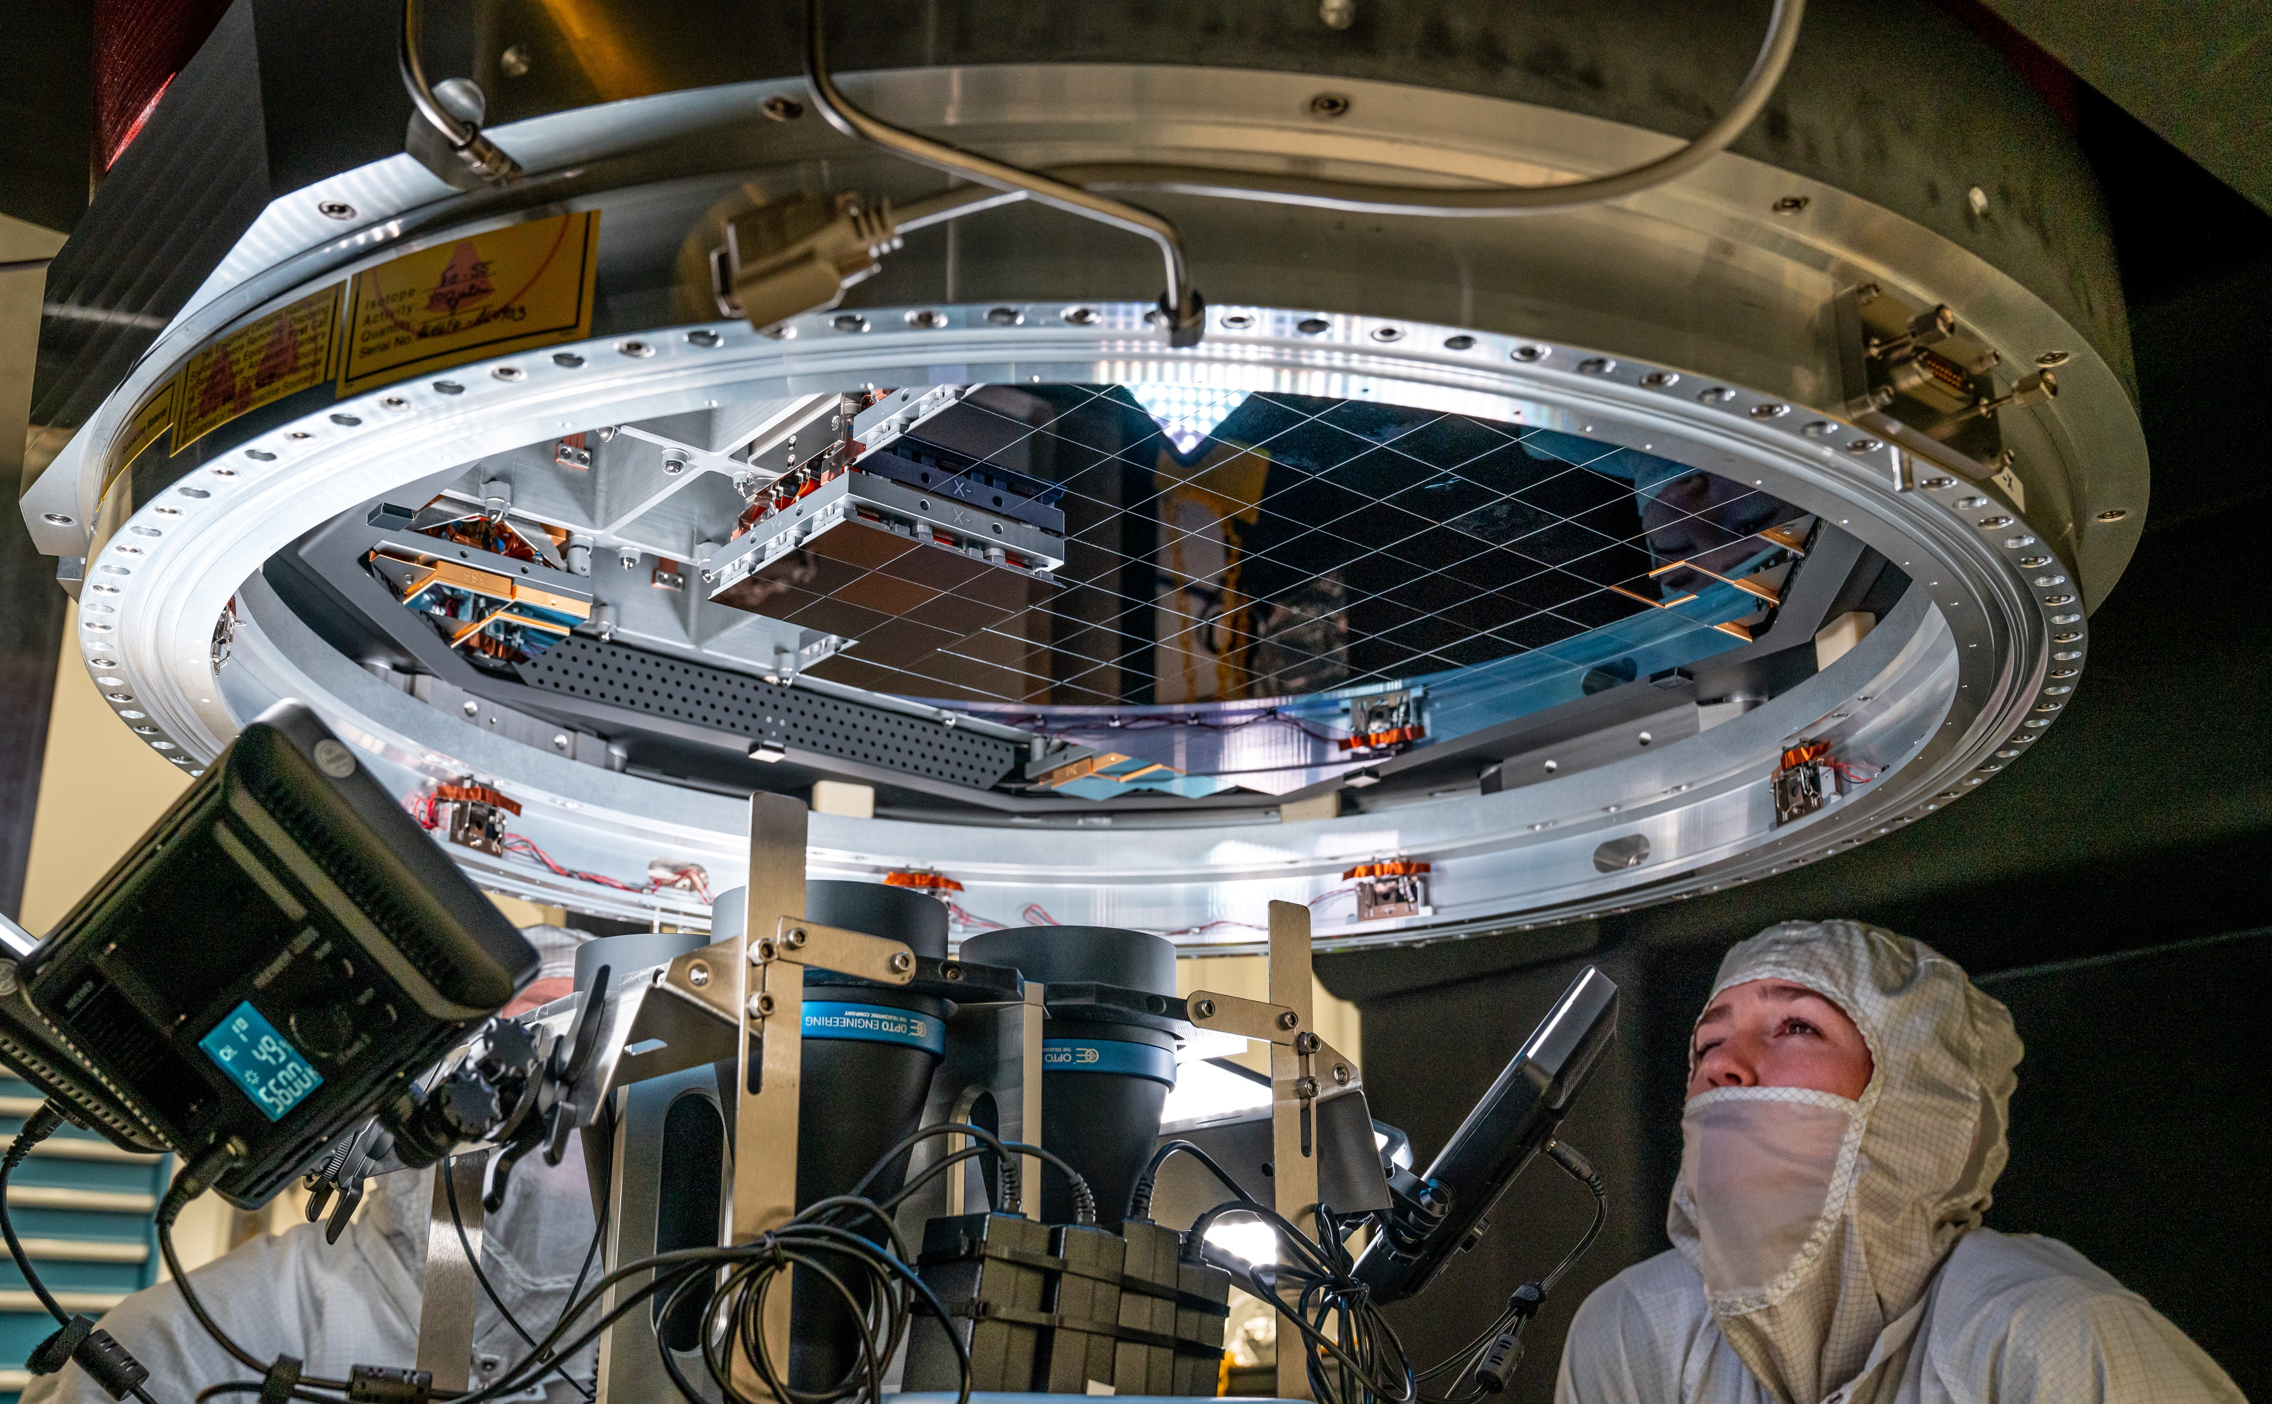
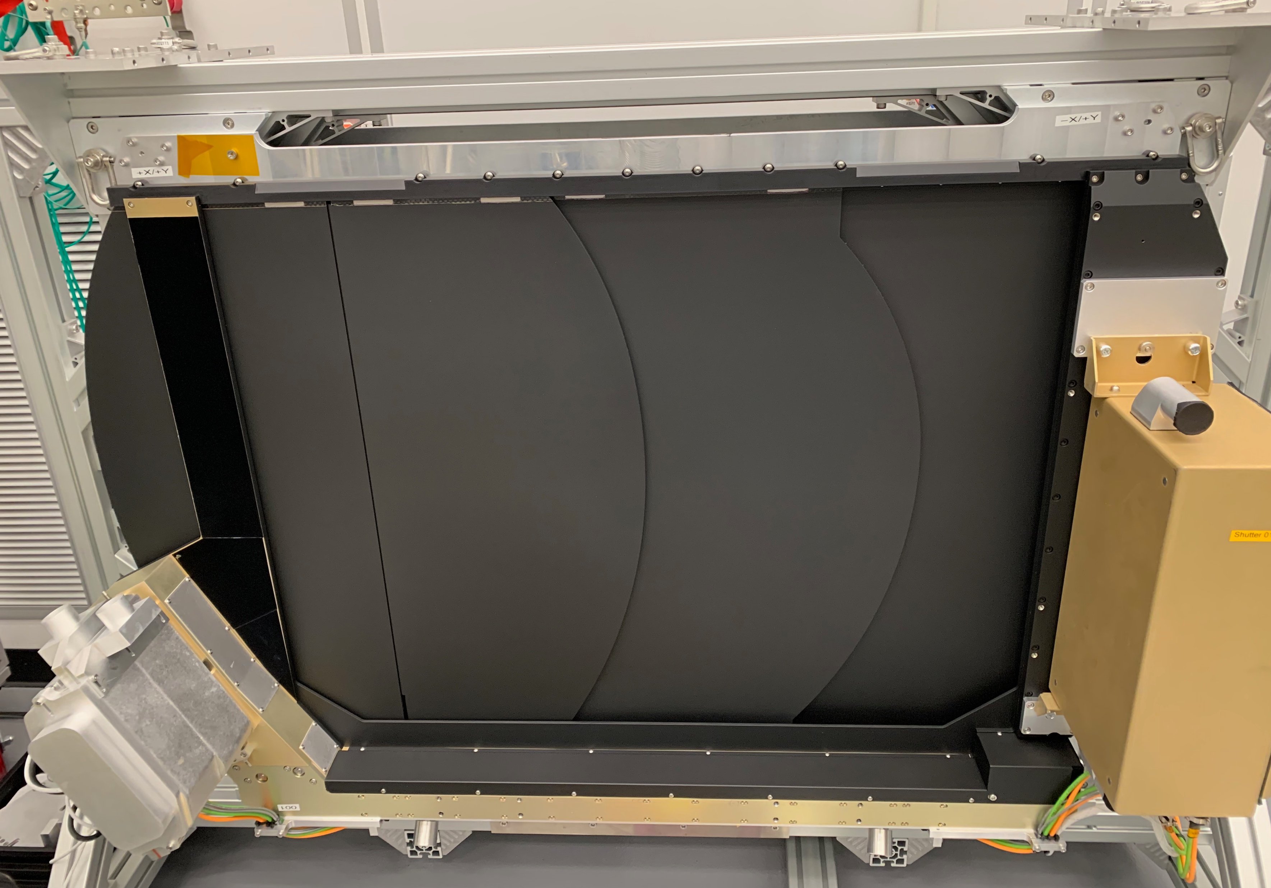
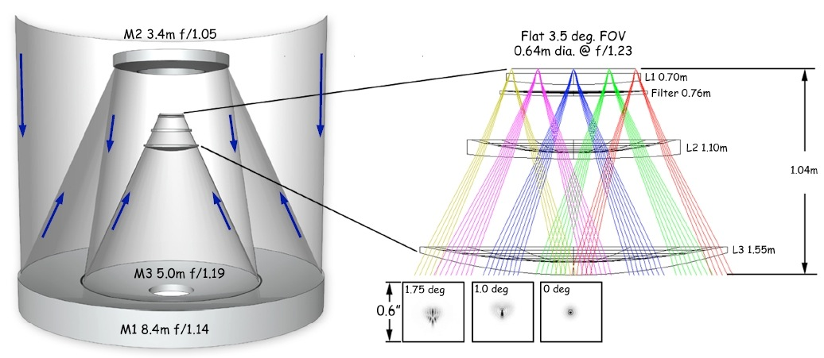
Camera assembly
Achieved 10 µm planeity across focal plane
4k x 4k CCDs
21 ‘science rafts’ (3 x 3)
4 ‘corner rafts’ (2 + 1)
Two vendors: 13 T-e2v rafts, rest with ITL

Slide 3
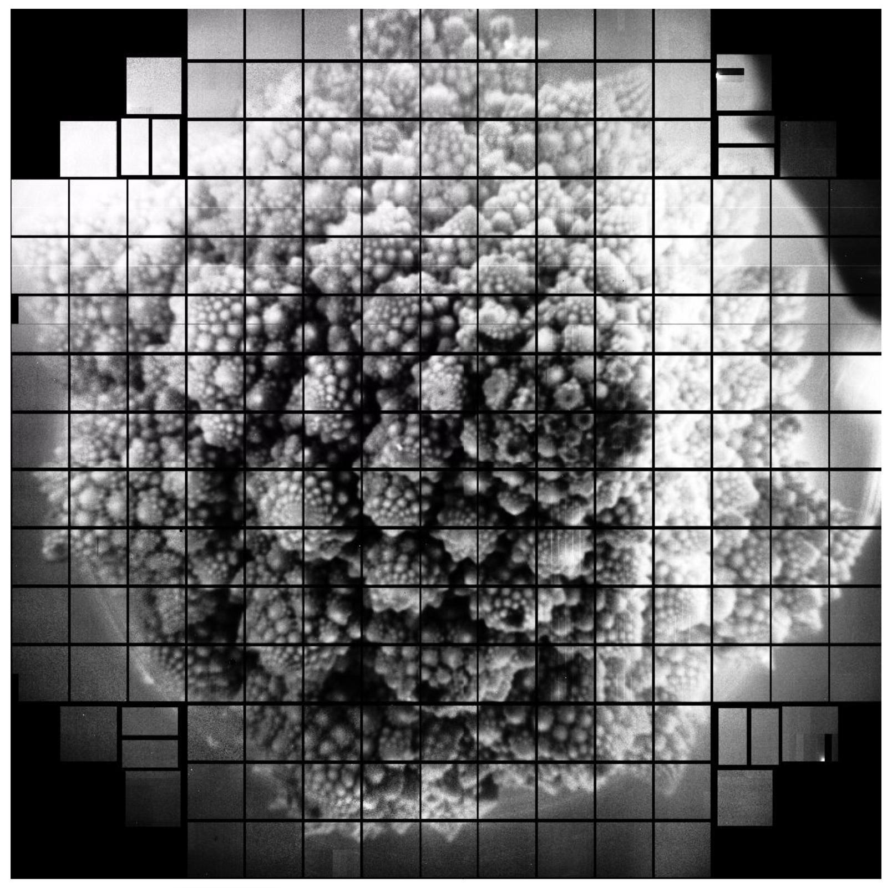
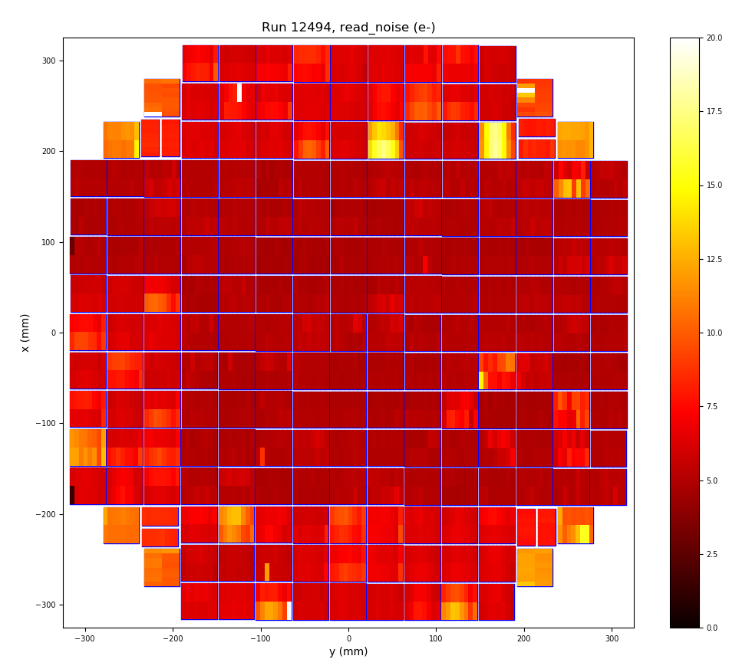
Full focal plane
First light September 2020, several runs

Slide 4
Sensor and electronics effects
Intrinsic sensor effects:
Defects: bright, dark
Quantum Efficiency, fringes
Static effects: tree rings, edges, midline
Dynamic effect: brighter-fatter
Sensor management effects:
Clock-induced: tearing
Charge Transfer Efficiency: clocking, traps, PTC dip, full well
Clock injections: noise, bias
Bias drift
CCD output stage: gain stability, noise
Readout speed: noise
Readout electronics:
Gain stability
Linearity
Crosstalk
Memory
Bias shift
Acquisition :
ADU favoritism
DAQ scrambling

Slide 5
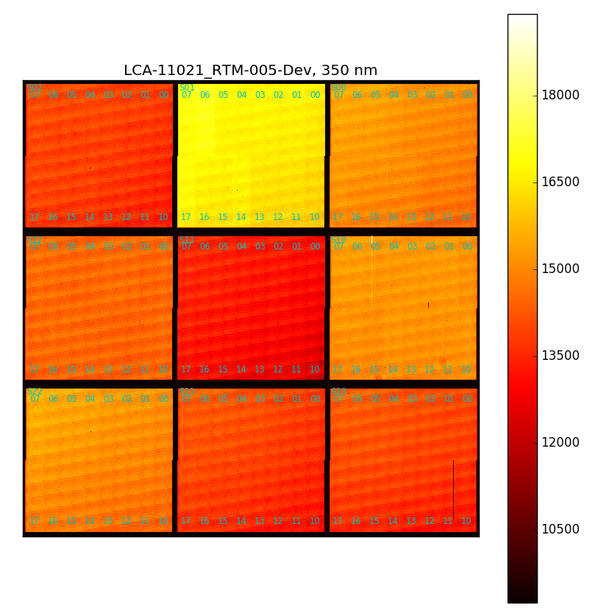
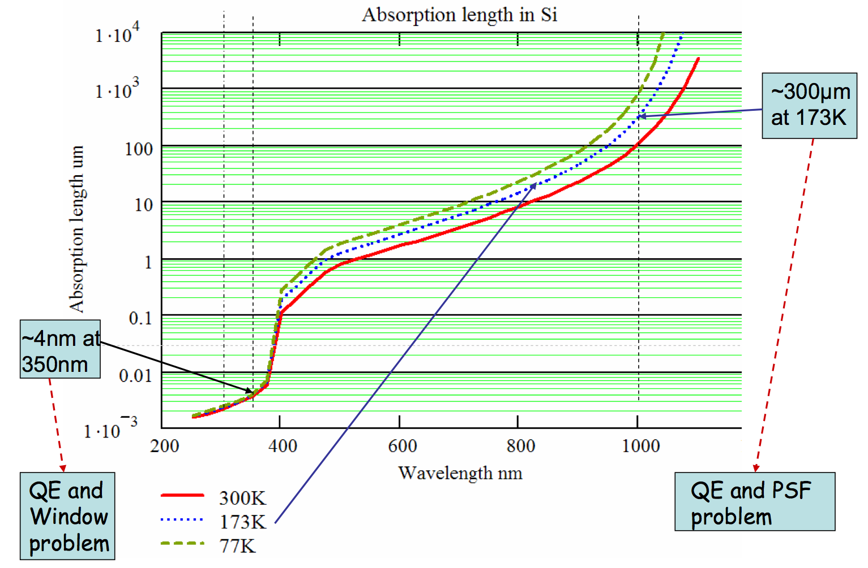
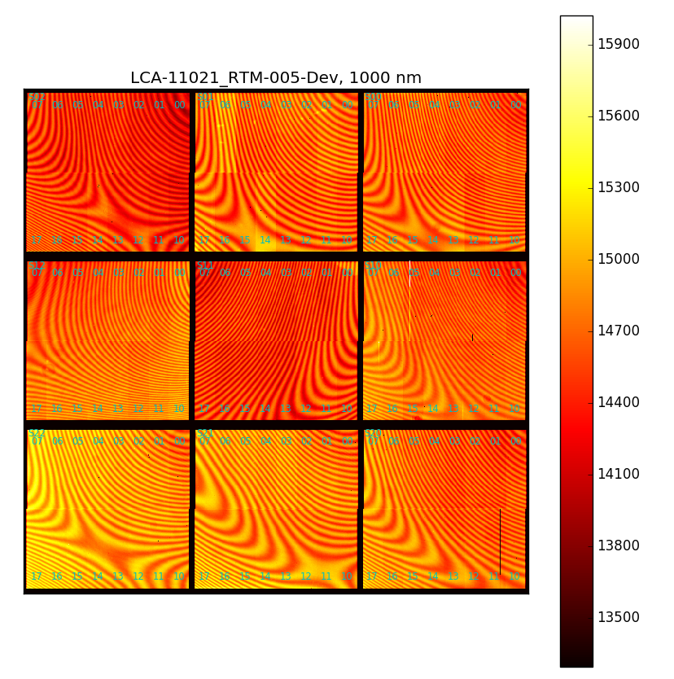
Quantum efficiency
Scan of all sensors, rafts
Not absolutely calibrated
CCOB

Slide 6
Parallel transfer efficiency
Parallel clocks in e2v: 4 phases, crossing
Delay rise / fall, propagation over sensor area
No overlap in parallel clocks
1 µs overlaps

Slide 7
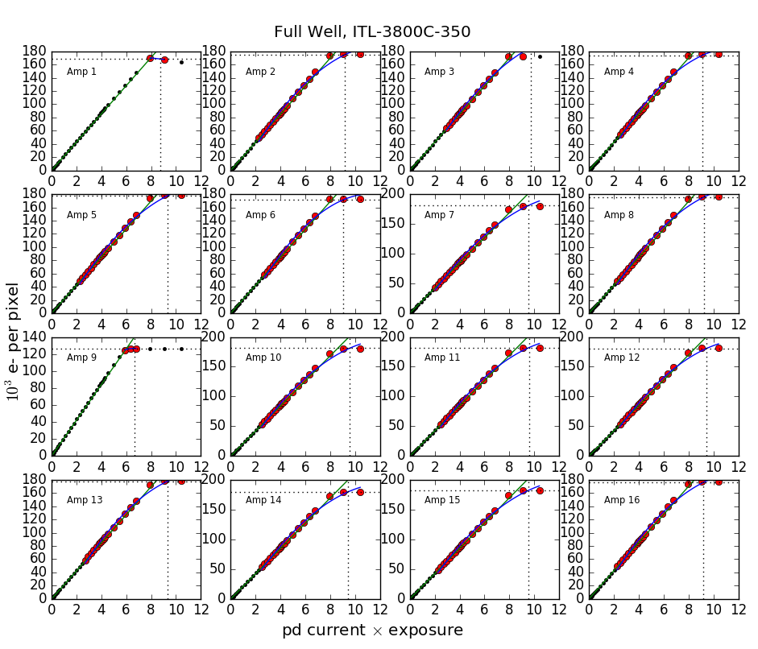
Dynamic range and PTC dip
Parallel (mainly) transfer efficiency at high flux
Voltage range + timing
Measured on flat fields, narrow beam CCOB?

Slide 8
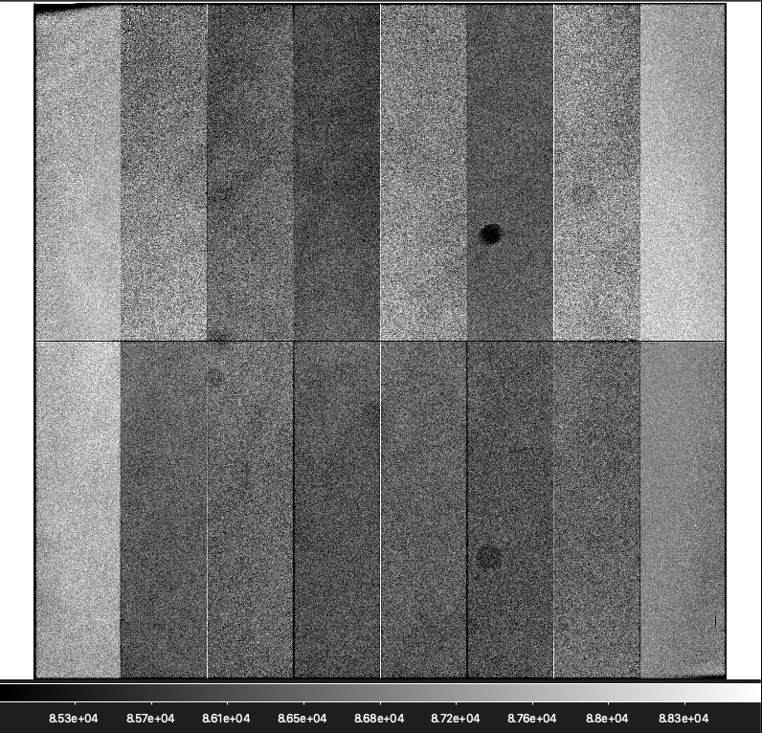
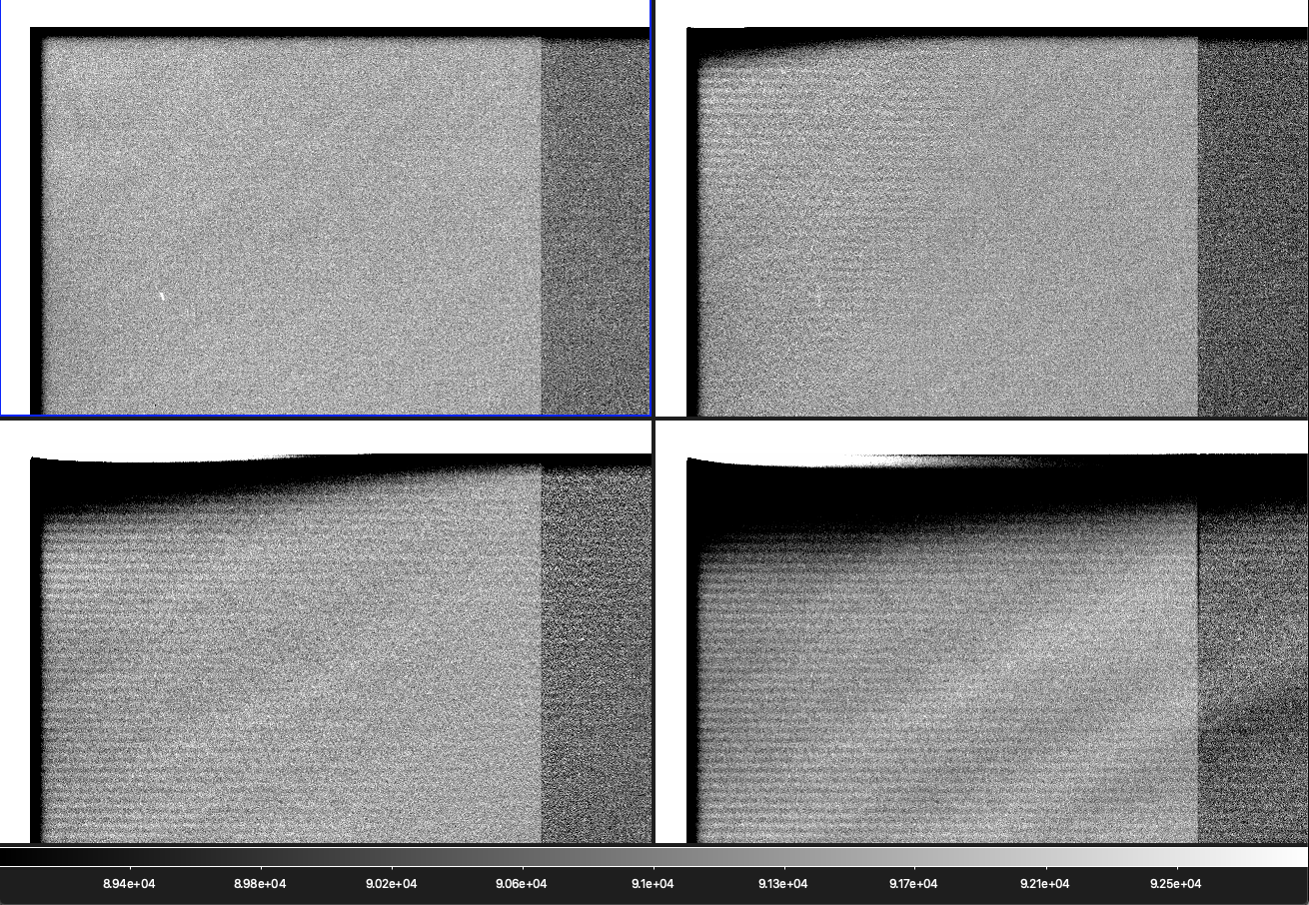
Dark corner
Appeared in early focal plane frames with light
Propagation of parallel clocks
Simulate glitch time after flat exposure (0 / 200 ns / 500 ns / 1 µs)
Bug in sequencer management

Slide 9
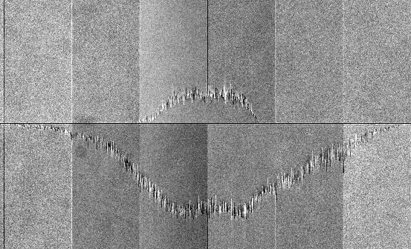
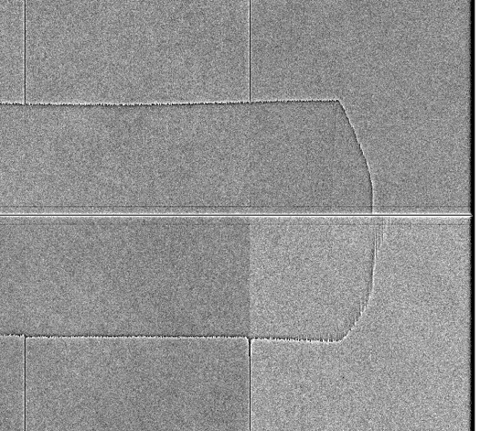
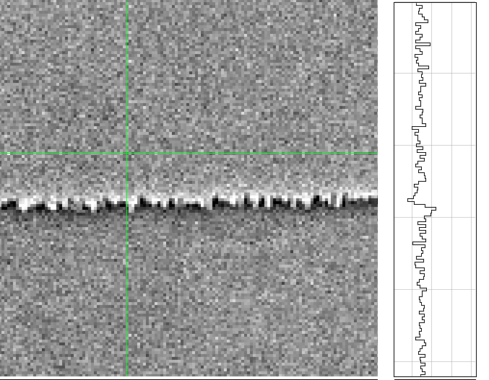
Original tearing patterns
Skyline pattern: observed at high deltaP (> 9.5V), builds up from middle of sensor
Thin tearing: excess of charges comes before deficit in readout: not an issue with parallel transfer
Divisadero
9

Slide 10
Testing on full focal plane
Bipolar mode: variety of structures depending on working conditions and sensor
Without inversion (< -7V), same conditions as unipolar mode

Slide 11
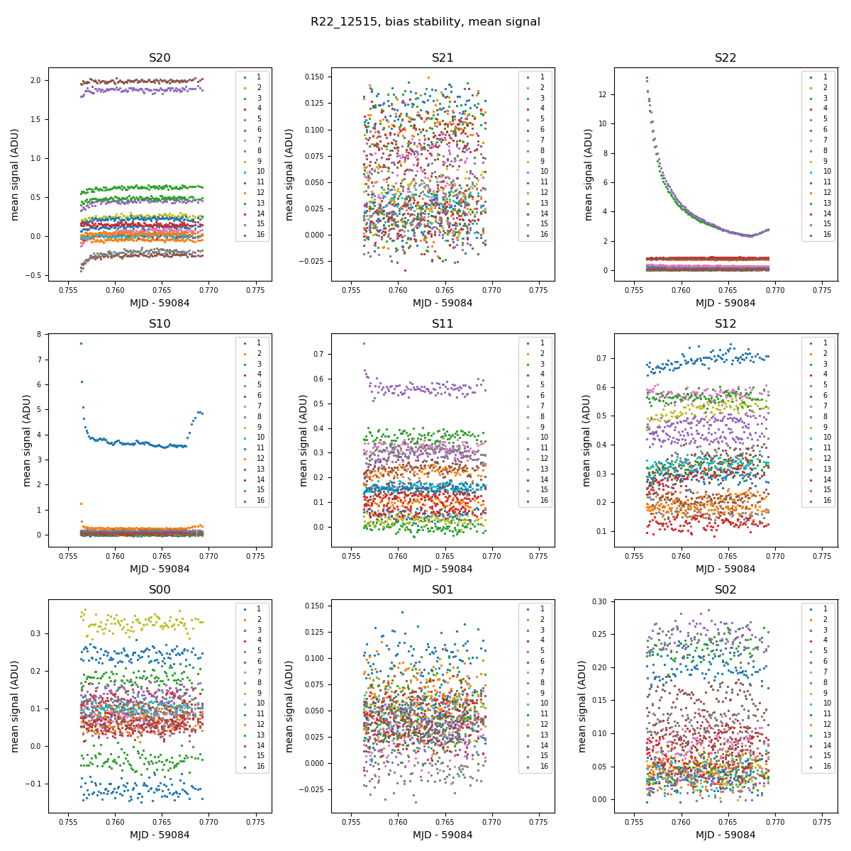
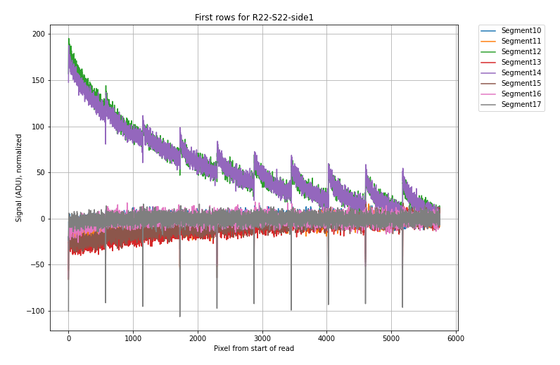
Bias drift
Bias 2D structure: all sensors
Specific to some e2v sensors: time-dependent structure

Slide 12
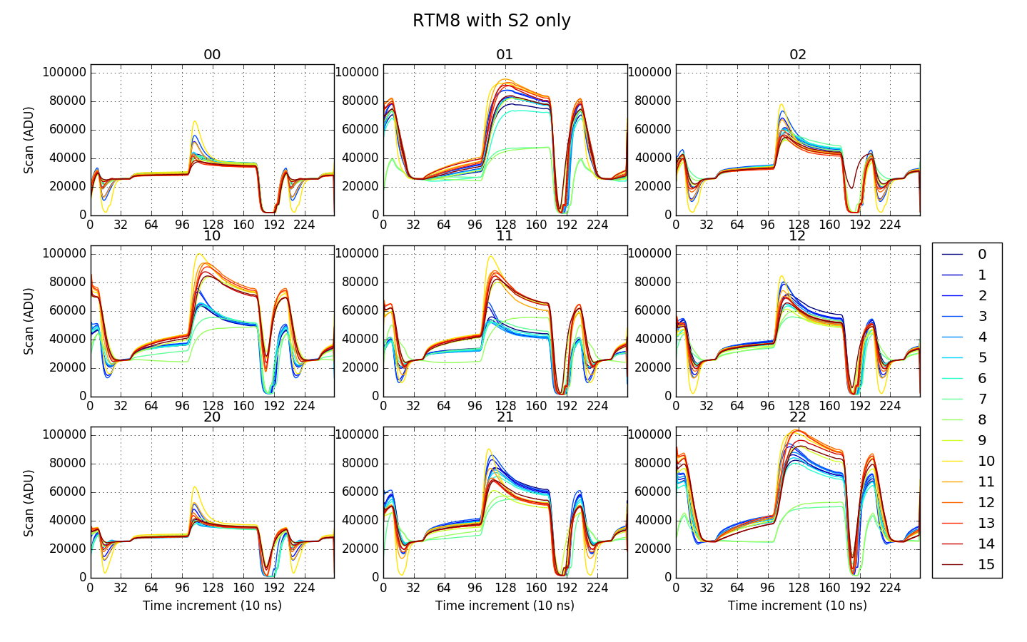
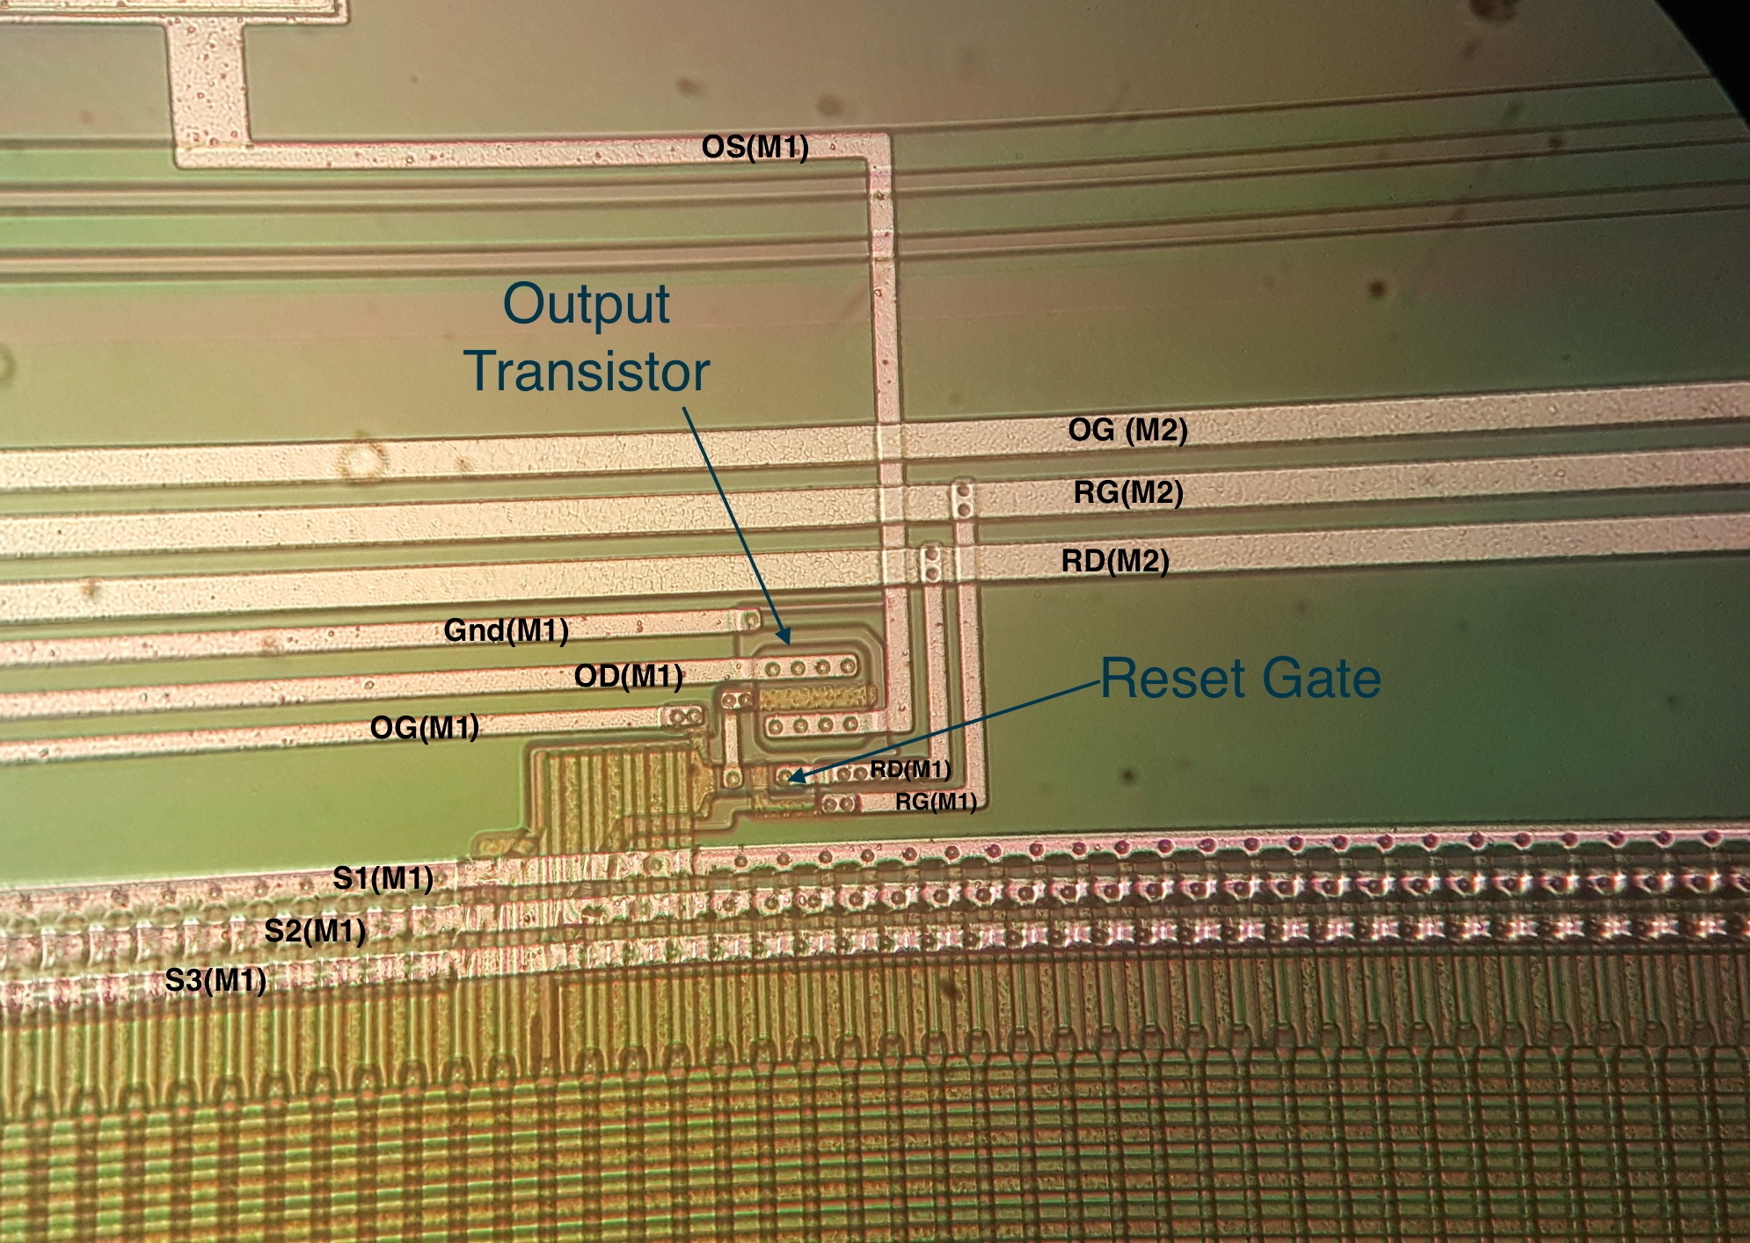
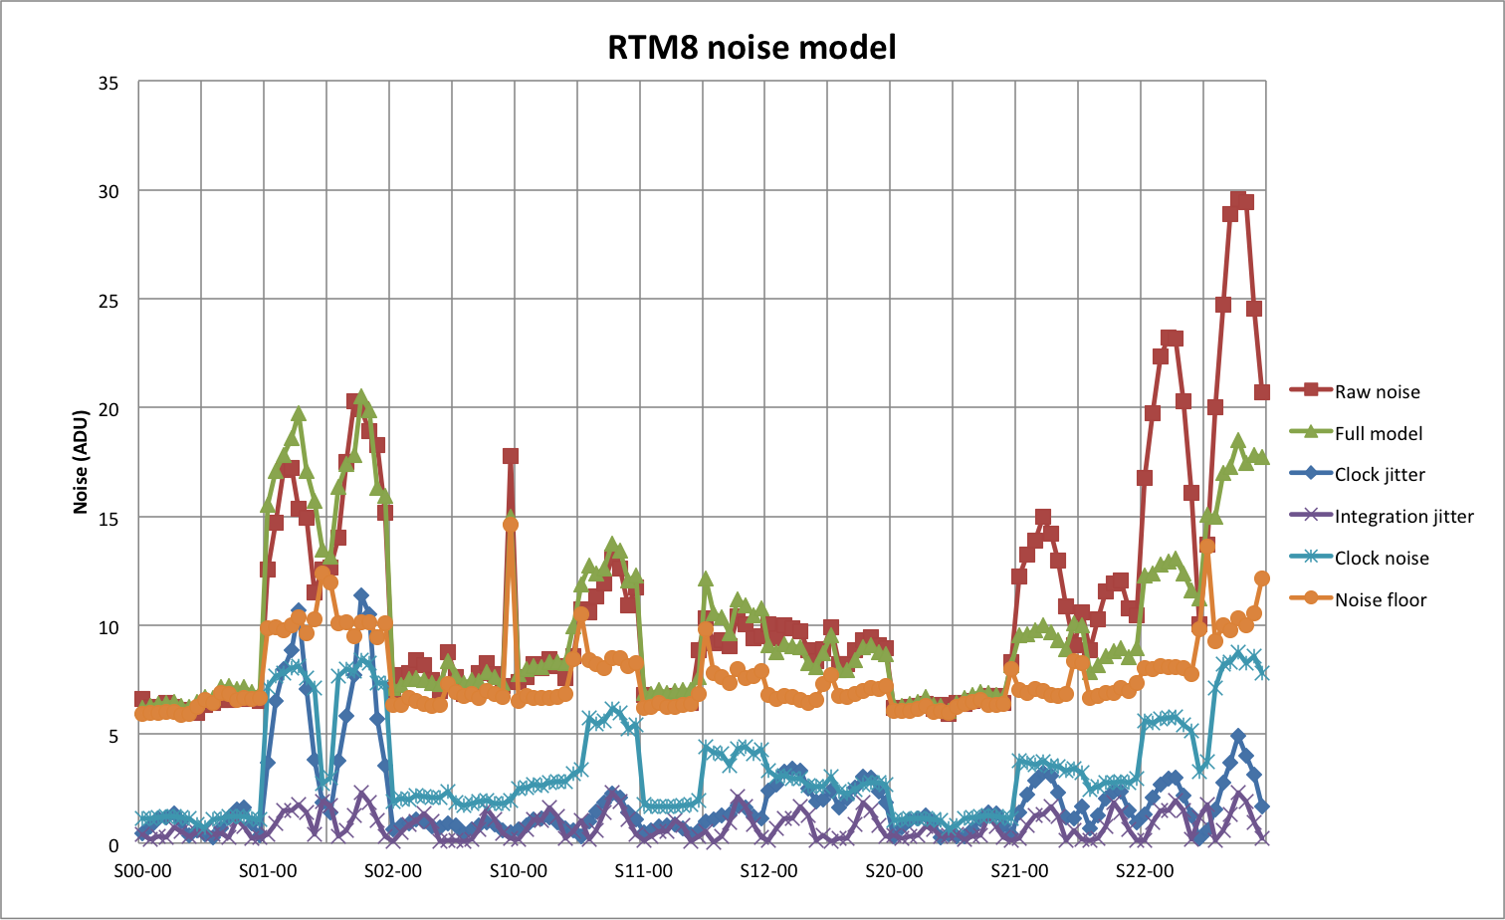
Clock injection in ITL rafts
Individual clock injections: S1 > S2 > S3
Affects bias level: combination of clock injection
Injects noise

Slide 13
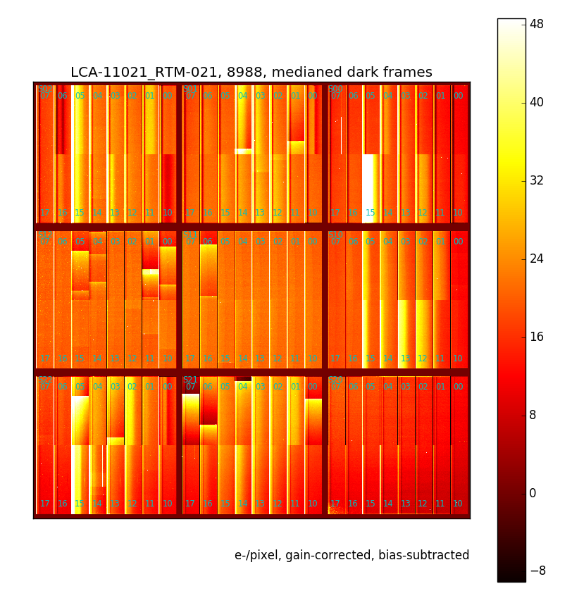
Bias shift
Seen from bright defects
Very long relaxing time
Threshold ~ 190 kADU (raw)
Adjustement to ASPIC gain + RC + integration time

Slide 14
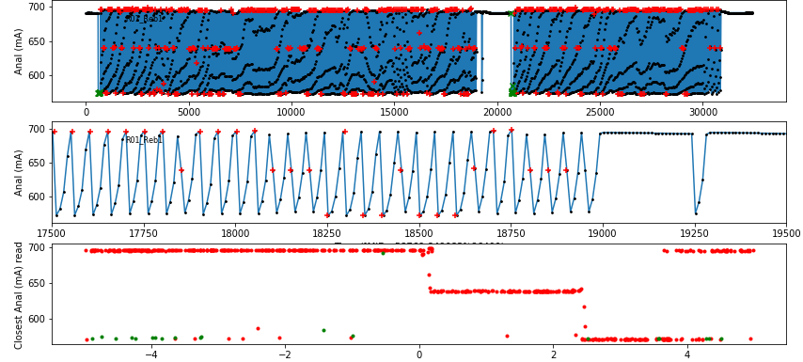
Electronic gain variations
Fine reconstruction of monitoring values
Current consumption increased in ASPIC when not running
Need to clamp (restore ASPIC first stage) regularly

Slide 16
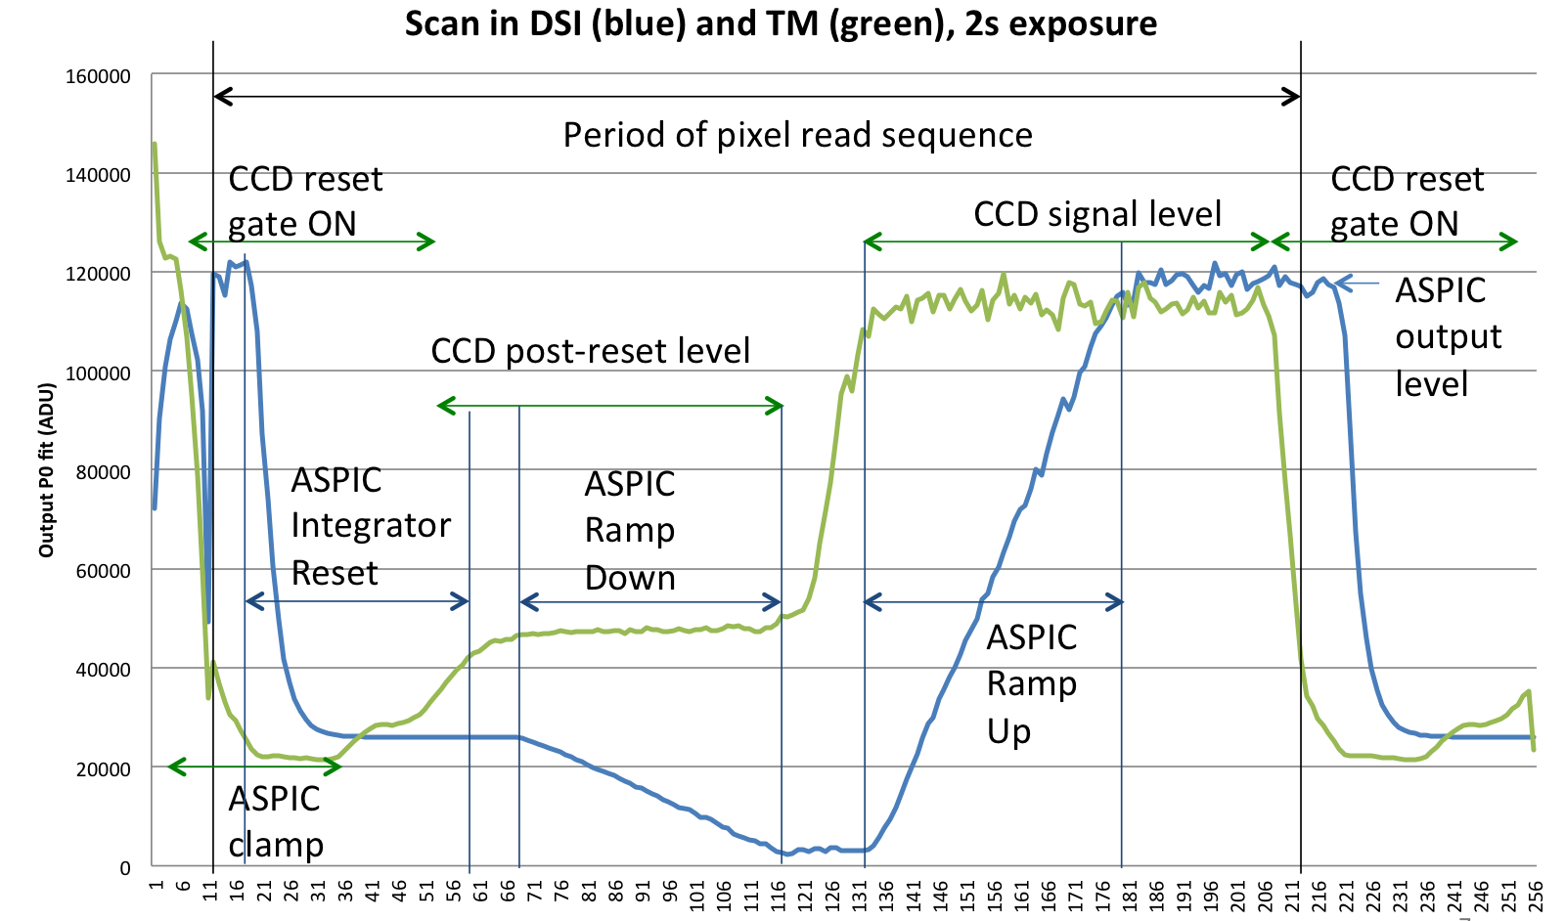
Scan de la lecture

Slide 17
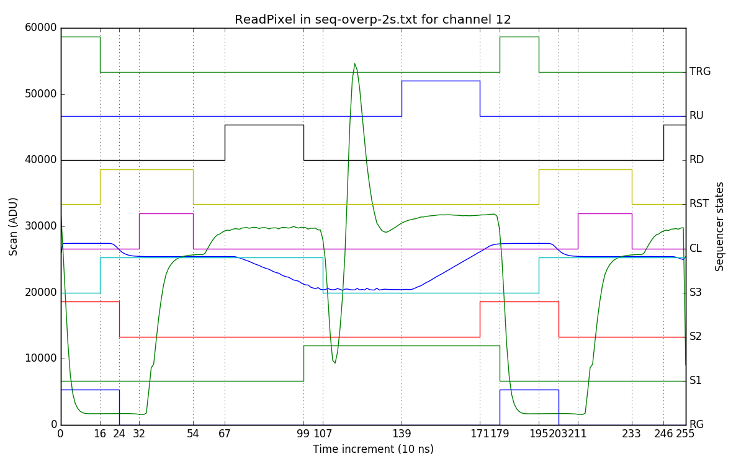
Horloges et scan
Raw OS
Integrated
ADC trigger
ASPIC signals
CCD serial clocks

