Slide 1
WP2 lapp status
Frederic Gillardo, Berkay Turk, Arturo Sanchez
Lapp/CNRS
13 Sept 2021

Slide 2
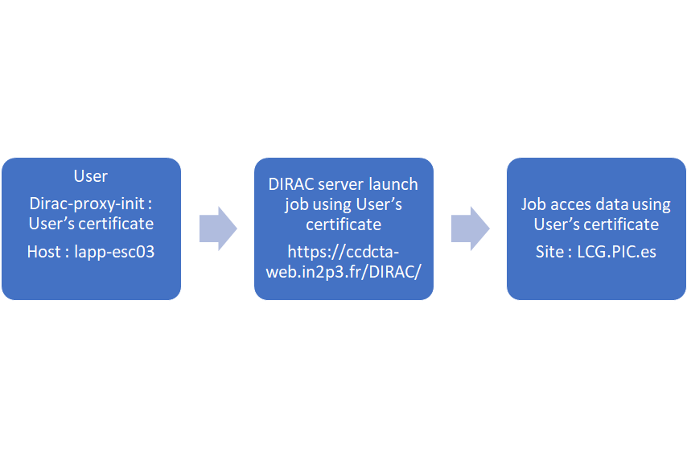
Data Access Challenge (DAC21) CTA
  Use Case 2 : Reprocessing raw data
    Meeting on 09/09/2021 with PIC , LAPP, Luisa A and Gareth H:
    OutCome : PIC will provide a “generic User” that has access to the PIC Data Lake and authorized to launch reprocessing jobs.
    Run CTA pipe from DL0 to DL1 using DIRAC
    https://docs.google.com/document/d/1C_rcmutNvmVqd287ulQ5h0H-OFnMrNeRdc6jO0198-A/edit?usp=sharing
  Cloud
    Can not use Commercial cloud facility until a solution for the payment is found
    Step 1 : create a report on the tests I did so far.
      https://docs.google.com/document/d/10gP6KLBlQxGVf5iEcVwA78OjzogkaZfCOTO1mQaCon4/edit?usp=sharing
    Step 2 : Validate s3 protocol using the LAPP datacenter using the s3 connector from Ceph (and use this end point for DAC21?)

Slide 3
Data Access Challenge (DAC21)
  ATLAS
    A substantial amount of work relative to: the consolidation of the idea for ATLAS (Open Data) in DAC21.
    Multiple interactions with the QoS team to understand each other. Our proposal is now divided in tasks: ATLAS001 and ATLAS0002
    This documented in wiki https://wiki.escape2020.de/index.php/ESCAPE_ESFRI_facilities_use_cases
    Containers at DLaaS can be used standalone and in other JupyterHub via spwanner.

