Slide 2
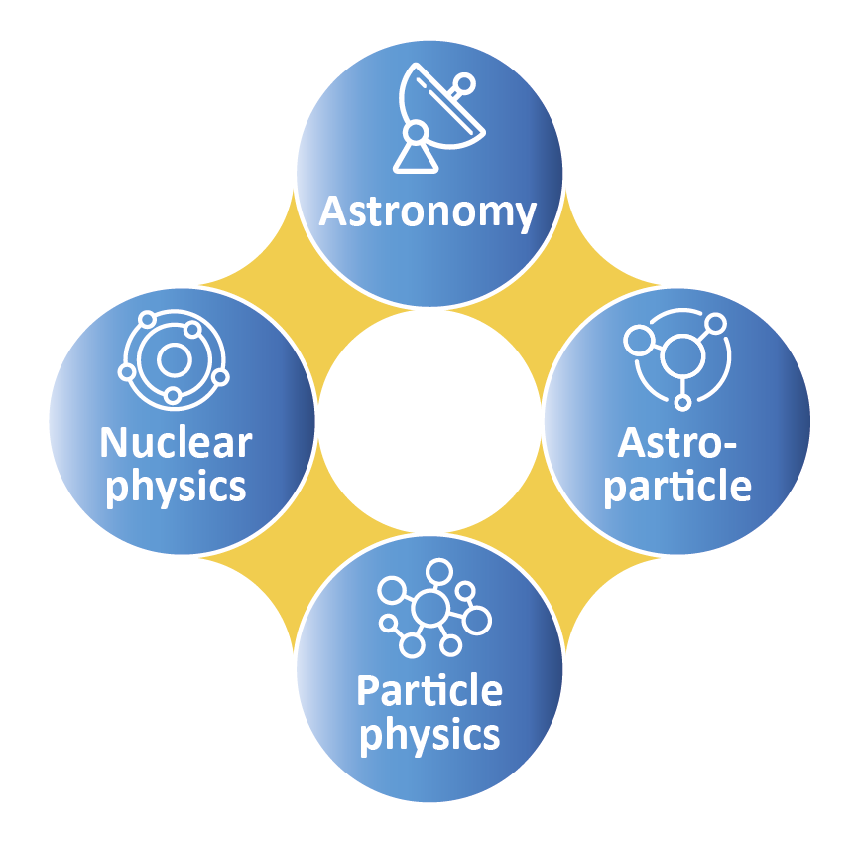
BRING TOGETHER COMMUNITIES
European Science Cluster of Astronomy & Particle physics ESFRI research infrastructures

Slide 3
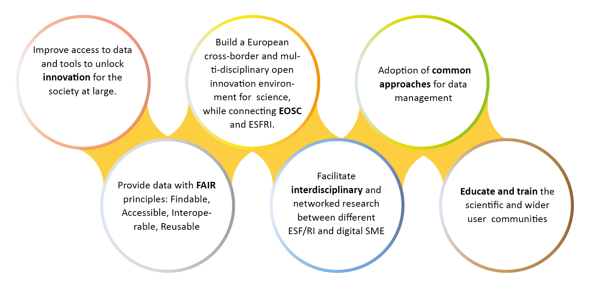
MAIN GOALS

Slide 4
INTERNATIONAL CONSORTIUM
31 partners including 2 SMEs
10 ESFRI projects & landmarks: CTA, EST, FAIR, HL-LHC, KM3NeT, SKA, LSST, VIRGO, ESO, JIVE
2 pan-European International Organizations: CERN, ESO with their world-class established infrastructures, experiments and observatories
2 European Research Infrastructures: EGO and JIV-ERIC
1 involved initiative/infrastructure: EURO-VO
4 supporting European consortia: APPEC, ASTRONET, ECFA and NuPECC
Budget: 15.98 M€
Started: 1/2/2019
Duration: 48 months (end date 31/1/2023)
Coordinator: CNRS-LAPP

Slide 5
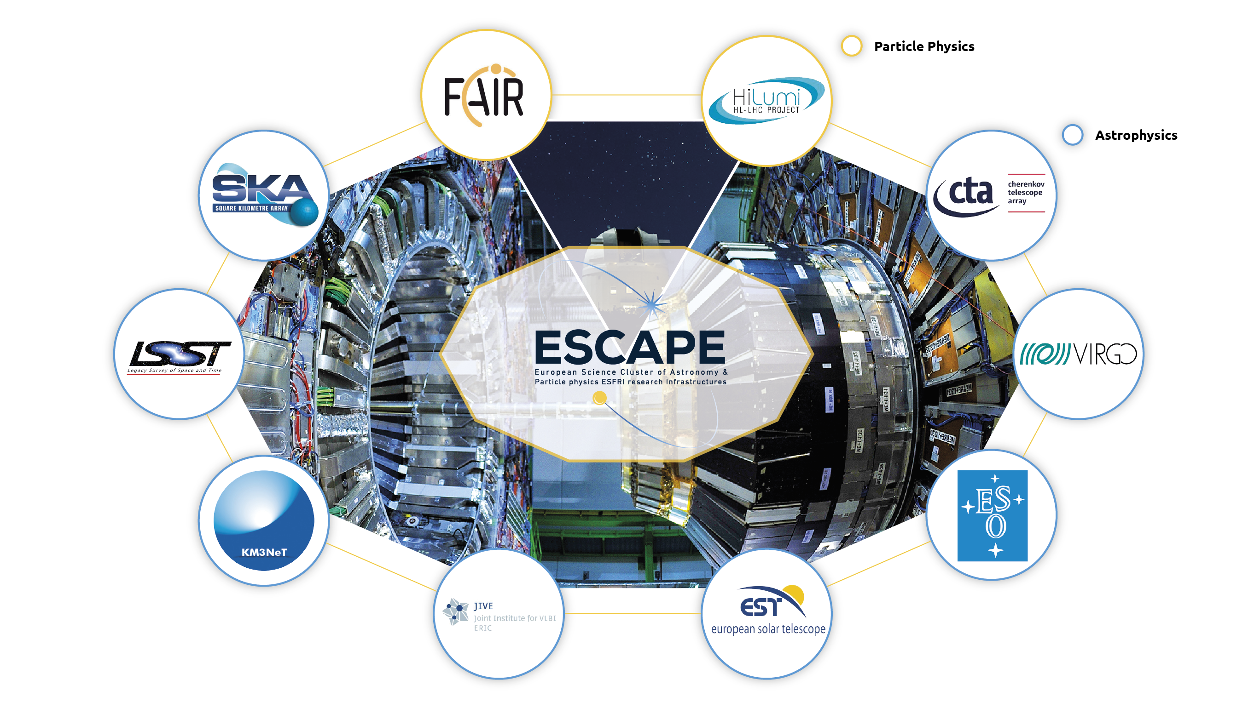
ESFRI PROJECTS PARTNERS

Slide 6
WORK PROGRAMME

Slide 7
WORK PROGRAMME IN DETAILS
Data Lake:
Build a scalable, federated, data infrastructure as the basis of open science for the ESFRI projects within ESCAPE.
Software Repository:
Repository of "scientific software" as a major component of the “data” to be curated in EOSC.
Virtual Observatory:
Extend the VO FAIR standards, methods and to a broader scientific context; prepare the VO to interface the large data volumes of next facilities.
Science Platforms:
Flexible science platforms to enable the open data analysis tailored by and for each facility as well as a global one for transversal workflows.
Citizen Science:
Open gateway for citizen science on ESCAPE data archives and ESFRI community

Slide 8
WORK PROGRAMME
Data Lake:
Build a scalable, federated, data infrastructure as the basis of open science for the ESFRI projects within ESCAPE.
Software Repository:
Repository of "scientific software" as a major component of the “data” to be curated in EOSC.
Science Platforms:
Flexible science platforms to enable the open data analysis tailored by and for each facility as well as a global one for transversal workflows.
Virtual Observatory:
Extend the VO FAIR standards, methods and to a broader scientific context; prepare the VO to interface the large data volumes of next facilities.
Citizen Science:
Open gateway for citizen science on ESCAPE data archives and ESFRI community

Slide 9
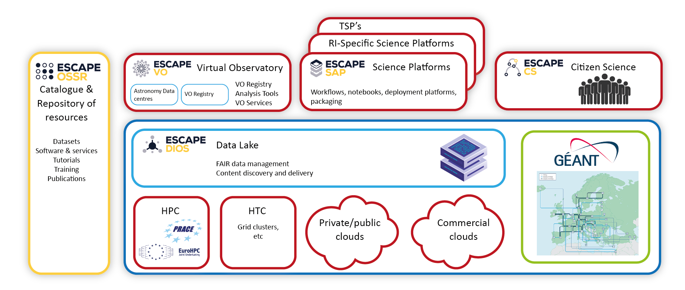
EOSC CELL
Notes:
Data Lake:
Build a scalable, federated, data infrastructure as the basis of open science for the ESFRI projects within ESCAPE. Enable connection to compute and storage resources.
Software Repository:
Repository of "scientific software" as a major component of the “data” to be curated in EOSC. Implementation of a community-based approach for the continuous development of shared software and for training of researchers and data scientists.
Virtual Observatory:
Extend the VO FAIR standards, methods and to a broader scientific context; prepare the VO to interface the large data volumes of next facilities.
Science Platforms:
Flexible science platforms to enable the open data analysis tailored by and for each facility as well as a global one for transversal workflows.
Citizen Science:
Open gateway for citizen science on ESCAPE data archives and ESFRI community

Slide 10
CLUSTERS CONTRIBUTIONS
Build a Community
Interdisciplinary
Virtual Research Environment in EOSC framework
Cross-Domain R&D
FAIR data
Open to External Stakeholder (digital SME)
Support synergies
Enhance researchers’ participation in EOSC
Reaching new communities and Research Infrastructures
Future prospective for sustainability
Notes:
The Science “Cluster” is a very powerful concept:
Recognising synergies to build a coordinating community platform;
Integrating Physicists , data-scientists, computer science researchers, and digital SMEs;
ESCAPE is Virtual Research Space for Open Science, committed to EOSC implementation and sustainability;
ESCAPE is a platform for cross-domain R&Ds and FAIR-data uptake in response to the European Data Strategy.
The ESCAPE communities support the evolution of the work-programme:
supporting synergies (strong inter-cluster dialogue towards a shared vision)
enhancing researchers’ participation in EOSC
leveraging synergies, reaching new communities and Research Infrastructures (RIs)
evaluating future prospective for sustainability and role of the cluster

Slide 11
ENHANCE RESEARCHERS’ PARTICIPATION IN EOSC
Test Science Projects – TSPs
TSPs are multi-domain science integration across ESCAPE.
Originally part of the ESCAPE work programme, proposed to validate ESCAPE services for Open Science at the end of the project, ESCAPE-TSP concept finds consensus and evolves for a larger impact.

Slide 12
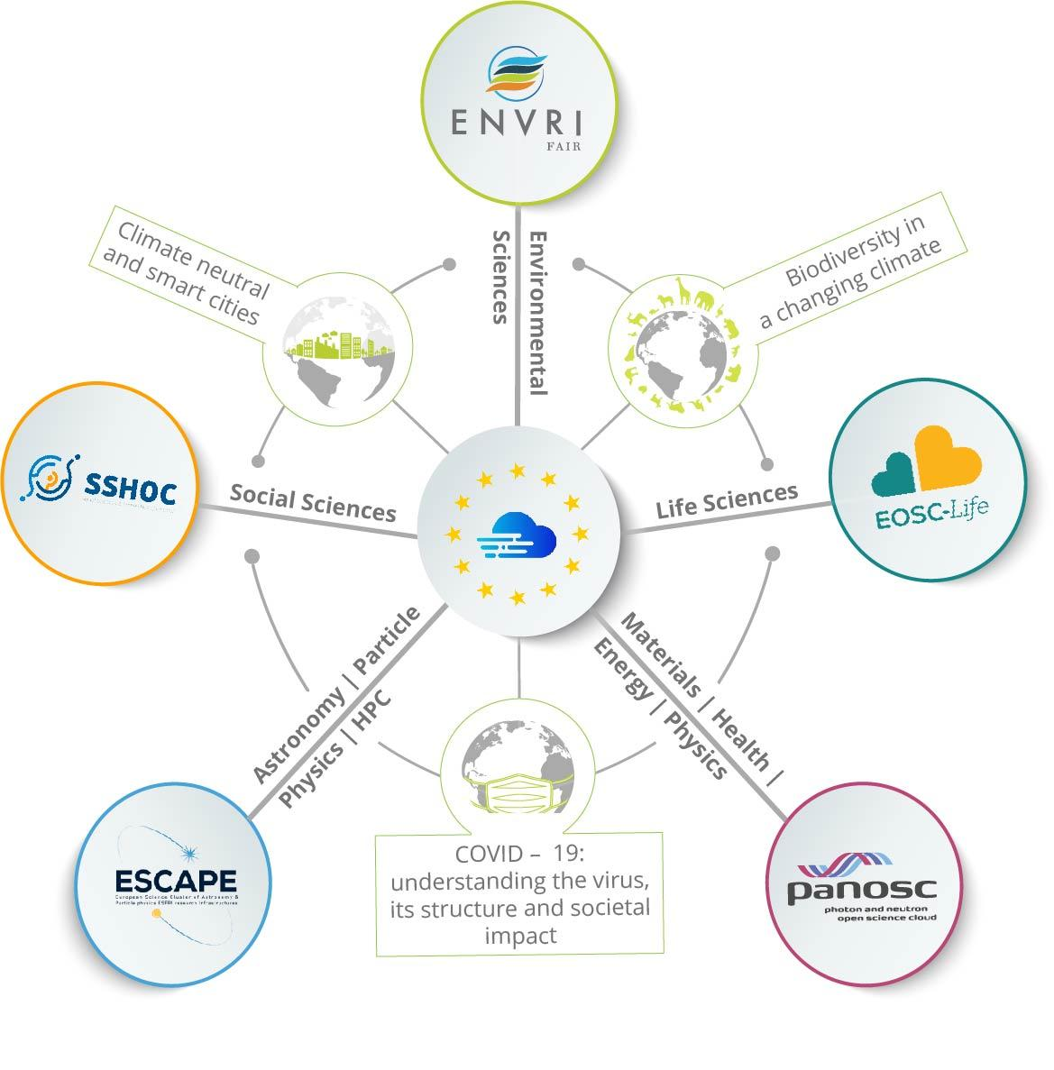
REACHING NEW RESEARCH INFRASTRUCTURES
Synergy between
Clusters & e-infrastructures
EOSC Service Delivery
Innovation capacity and procurement
Architecture and Interoperability
Design and Development of Portal Layers
Training and Skills
Integration of Community Services and Products

Slide 13
REACHING NEW COMMUNITIES
Co-developments with digital SMEs, e.g.
Wavefier: real-time Machine Learning Classifier for transient signals in Gravitational Waves
Gamma-Learn: real-time Machine Learning pipeline for Gamma-ray astronomy
Combining ESCAPE with European Regional Development Fund programme (ex. cooperation, training and innovation schemes for Society and Economy - IDEFICS @ LAPP)
Leveraging industrial ICT cooperation schemes (within ESCAPE ESFRI RIs)
ESCAPE results and actions for Open Science are reaching out (ex. Discussions in progress with ASTRI, DUNE, GANIL-SPIRAL2, FCC et al.) and becoming global (e.g. USA, Japan, etc.)

Slide 14
FUTURE: PROSPECTIVE FOR SUSTAINABILITY
ESCAPE community proposals for EOSC connections with the Common European Data Spaces:
Industrial (manufacturing), health and skills data space
Green deal and Energy data space
Certified open archive to be exploited by any new Big Science research facility to share innovation, practices and methods.
Any digital object from R&D and innovation works within the ESCAPE community should be FAIR and accessed from a single entry point
“Science Cluster” scheme is a potential model of “coordinating structure”, because it combines the top-down and bottom-up
Towards a sustainable large domain platform, shaping and operating within EOSC
Synergies:
Communities overlap (astro/pp/np), new experiments mix communities
Common Funding Agencies
Co-located computing facilities

Slide 15
STRENGTH AND BENEFITS FOR FUTURE
Consortia: ECFA, APPEC, NuPECC, Astronet, ( + JENAA) coordinate at a high level, and oversee ESCAPE
Strong coordinated voice and support to EC and EOSC Association.
European Strategy for Particle Physics had strong input from ESCAPE domains
Federated, collaborative infrastructures optimise use of available funding

Slide 16
LONG TERM VISION
ESCAPE intends to remain as a collaboration after the end of the current project → Sustained thematic consortium for the sustainability of EOSC → Additional thematic RI’s are interested in participating | Many potential collaborative actions → Data Management at Exascale → Common software challenges → Cross-fertilisation of software tools and services → Building a platform for multi-messenger astronomy and cross-domain collaborations → Connection of data infrastructure to heterogeneous computing
Services for integration of the Exabyte scale data infrastructure supporting Open Science and FAIR data
Interoperable data-analysis platform
Development and sustainability of the services for the software catalogue and workflow
Partnership with EuroHPC/Prace/FENIX to provide the services for integration of Data-Lake with HPC resources
Collaborative scientific environment. Include new ESFRI and SME
Global integration of some of the above with global partners in USA, Australia and Africa

Slide 17
SUMMARY
Broader synergies within a large scientific community and for innovation/society
Broader synergies with the other Science Clusters, e-infrastructures for EOSC
ESCAPE BRINGS TOGETHER
ASTRONOMY, ASTROPHYSICS, ASTROPARTICLE, HIGH ENERGY & NUCLEAR PHYSICS COMMUNITIES

