Slide 1

Calling TAIKONG（太空）
⎯ A summary from the Report of China’s Medium and Long Term Plan (2010-2025) for Space Science Missions
On behalf of Prof. Ji WU (吴季), director of Center for Space Science and Applications, Chinese Academy of Science
2010.03.26 at ASEPS, Epochal Tsukuba

Slide 2
Astronomy
&
Astrophysics
Particle Astrophysics
&
Astro-Particle Physics
Space Science
Physics
Shuang-Nan ZHANG （张双南）
Key Laboratory of & Center for Particle Astrophysics
Institute of High Energy Physics
and
Division for Space Science Research
National Astronomical Observatories of China
Chinese Academy of Sciences

Slide 3

Contents
Overview
Ancient Chinese Observations and Learning of Space
Main themes and questions need to be answered
Science Programs
Roadmap to 2025 of Chinese Space Science Missions

Slide 4

Overview
In 2006, the study of “Medium and Long Term Development Plan for Space Science Missions”（funded by CAS）, was launched, which includes the following items:
  Ancient Chinese observations and learning of space
  Research teams and development status of space science in China
  Forefronts, trends and strategies of space science in other countries
  National demands for space science
  Main scientific themes & questions
  Programs and missions
  Supporting technologies
  Roadmap
Report : “Chinese Medium and Long Term Plan for Space
Science Missions (2010-2025)”
The research has lasted for two and half years, 20 scientists in the fields have intensively participated in the study, and more than 100 scientists have participated in discussions.

Slide 5
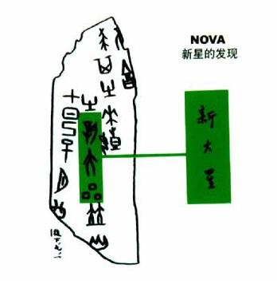

Ancient Chinese Observations and Learning of Space
Observations of Solar Eclipse:
“The Book of History: Yinzheng” as the earliest observation record
of a solar Eclipse (2042 BC) in China
Observations of Nova:
  The oracle bones of Yin Dynasty Ruins (1300 BC)
  as the earliest records of Nova in the world
  “The Astronomy Part of the Records of Song Dynasty”:
  Supernova Explosion (1054 AD)
  Remnant: Crab Nebula

Slide 6
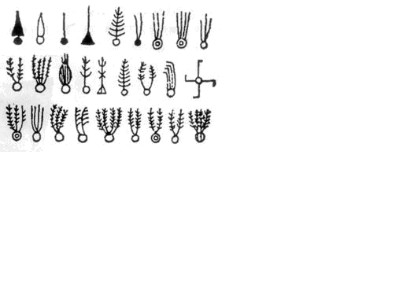
Ancient Chinese Observations and Learning of Space
Observations of Comet:
  Halley’s Comet: two earliest observations (613 BC & 476 BC)，Recorded in “Spring and Autumn Annals”.
  The 28 returns of Halley’s Comet (240 BC~ 1910 AD) : all found in ancient Chinese books.
    Observation from Halley: in 1682 AD, period of 76 years
  Ancient Chinese first pointed out that
  the direction of a Comet tail was always
  against the sun.
  No less than 500 records of Comets
  can be found in ancient Chinese
  books.
29 Comet pictures were found in the silk books unearthed from Hunan Mawang Dui in 1973.

Slide 7
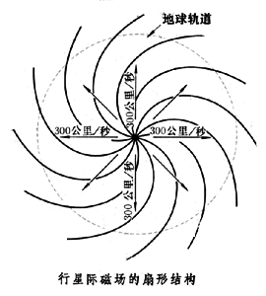

Ancient Chinese Observations and Learning of Space
Observations of Sun-Spots: the most complete records are found in China.
  Observations: started from 28 BC, 1000 years earlier than the Western world.
  Size: close to a “copperplate” or an “egg”…
  The Sun God Bird images (3000 years ago): found in Chengdu Jinsha Relic (unearthed in 2001).
  -----It resembles the spiral structure of interplanetary magnetic field.

Slide 8
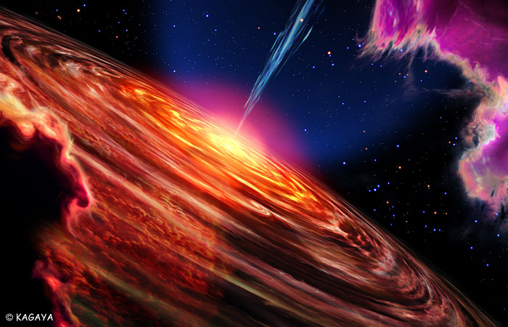
Main Themes and Questions Need To Be Answered
Two Themes of Space Science in 10~20 years
Theme 1. How did matter originate (universe and life),
how does it evolve and move?
Theme 2. What is the relationship between the solar
  system and human beings?
Notes:
相关计划表加入到PPT中
8

Slide 9
Questions to be answered under the themes
Theme 1: How did matter originate, how does it evolve and move?
How did the universe originate and how does it evolve？
How did life originate and how does it evolve？
What are the law of motion of matter and the law of life activity in space environment?
Title
What is the Universe made of and how does it evolve?
What are the origins of the structures and objects of different scales in the Universe and how do they evolve?
Is there new physics beyond the current basic physical theories?
How did life originate and how does it evolve?
Acquiring evidence of life elsewhere
What is the law of motion of matter in space environment?
What is the law of life activity in space environment?

Slide 10
Questions to be answered under the themes
Theme 2: What is the relationship between the solar system and human beings?
What is the origin and evolvement of the solar system, and its relationship with the sun?
What is the nature of solar activity?
How does the earth system evolve?
How did the planets in the solar system originate and how do they evolve?
How does solar activity transmit and evolve in interplanetary space ?
How does solar activity affect earth space environment ?
How do the various spheres of Earth interact and evolve?
What will the earth system develop in the future?
Can human beings live beyond the earth system?
What is the nature of solar micro-phenomena?
What is the nature of solar macro-phenomena?

Slide 11
Themes | Science Questions | Sub-questions | Science programs
Theme 1: How did matter originate, how does it evolve and move? | 1. How did the universe originate and how does it evolve? | What is the Universe made of and how does it evolve? | Black Hole Probe Program Diagnostics of Astro-Oscillations Program Portraits of Astro-Object Program Dark Matter Detection Program
 |  | What are the origins of the structures and objects of different scales in the Universe and how do they evolve? | Black Hole Probe Program Dark Matter Detection Program
 |  | Is there new physics beyond the current basic physical theories? | Fundamental Physics Experiments in Space Dark Matter Detection Program
 | 2. How did life originate and how does it evolve? | How did life originate and how does it evolve? | Life Exploration Program Mars exploration Program Diagnostics of Astro-Oscillations Program Planetary Scientific Laboratory
 |  | Acquire the evidence of life elsewhere | Diagnostics of Astro-Oscillations Program Mars Exploration Program Planetary Scientific Laboratory
 | 3. What are the laws of motion of matter and life activity in space? | What is the law of matter motion in the space environment? | Microgravity Science Program Manned Space Program
 |  | What is the law of life activity in the space environment? | Life Exploration Program Planetary Scientific Laboratory Manned Space Program
Notes:
ESES: Experimental Satellites for Earth Science
CESS: Constellation for Earth Science Sensing or China constellation for the Earth System Science

Slide 12
Themes | Science Questions | Sub-questions | Science programs
Theme 2: What is the relationship between the solar system and human beings? | 1. What is the nature of solar activity? | What is the nature of solar micro-phenomena? | Solar Microscope Program Solar Panorama Program Solar-terrestrial Connection Program
 |  | What is the nature of solar macro-phenomena? | Solar Panorama Program Solar-terrestrial Connection Program
 | 2. What is the origin and evolvement of solar system, and its relationship with the sun? | How did the planets of solar system originate and how do they evolve? | Lunar Exploration Program Mars exploration Program Planetary Scientific Laboratory
 |  | How does solar activity transmit and evolve in interplanetary space ? | Solar Panorama Program Solar-terrestrial Connection Program
 |  | How does solar activity affect earth space environment ? | Solar-terrestrial Connection Program
 | 3. How does the earth system evolve? | How do the various spheres of Earth interact and evolve? | Solar-terrestrial Connection Program Experimental Satellites for Earth Science Constellation of Earth Science Satellites
 |  | What will the earth system develop into in the future? | Experimental Satellites for Earth Science Constellation of Earth Science Satellites
 |  | Can human beings live beyond the earth system? | Manned Space Program Life Exploration Program Mars Exploration Program Planetary Scientific Laboratory
Notes:
ESES: Experimental Satellites for Earth Science
CESS: Constellation for Earth Science Sensing or China constellation for the Earth System Science

Slide 13
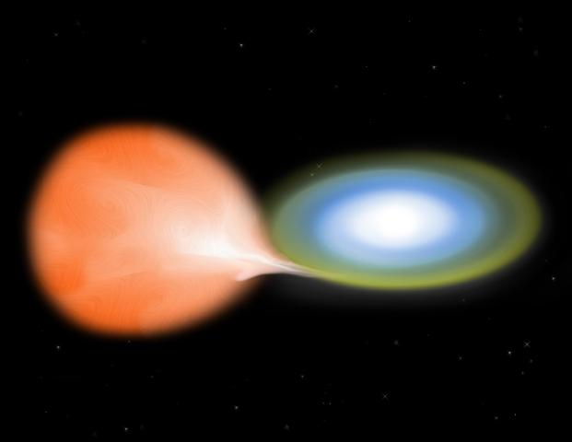
Science Programs
1) Black Hole Probe Program (黑洞探针BHP)
By observing black holes and other compact objects, as well as gamma-ray bursts, study cosmic high energy processes and black hole physics with black holes and other extreme objects as probes of the evolutions of stars and galaxies, in order to understand the extreme physical processes and laws in the Universe.
Missions:
  Hard X-ray Modulation Telescope (HXMT)
  Space multi-band Variable Object Monitor (SVOM)
  Gamma-ray burst POLARization experiment (POLAR)
  Participation in international collaboration (IXO)

Slide 14
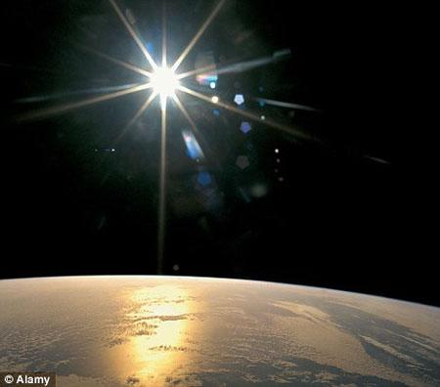
Science Programs
2) Diagnostics of Astro-Oscillations Program (天体号脉DAO)
By detecting electro-magnetic and non-electro-magnetic radiations of astrophysical objects with high photometric and high timing precisions, reveal their internal structures and activities.
Missions：
  X-ray Timing and Polarization telescope （XTP）
  PLAnetary Transits and Oscillations of stars （PLATO）
  Astrodynamical Space Test of Relativity using
  Optical Devices （Astro-D）
  Participation in collaboration ( Gaia & LISA )

Slide 15
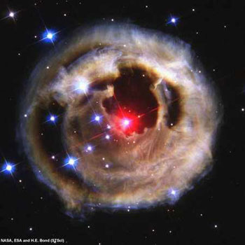
Science Programs
3) Portraits of Astro-Object Program (天体肖像PAO)
Obtain direct pictures (portraits) of solar-like stars, exoplanets, white dwarfs, neutron stars, black holes, etc.
Missions:
High Resolution X-ray Interferometer Telescope
Interferometer telescope array
  Space VLBI (Very Long Baseline Interferometer)
  telescope array
  Lunar based telescope array
  Moon-Earth combined array
  Telescope arrays at L1 and L2

Slide 16

Science Programs
4) Dark Matter Detection Program (暗物质探测DMD)
Based on space platforms, detect dark matter annihilation products predicted by various kinds theoretical models.
Missions:
  Dark matter particle detection satellite（DMD-I)
  Dark matter particle detection experiment
  aboard manned space station (DMD-II)

Slide 17
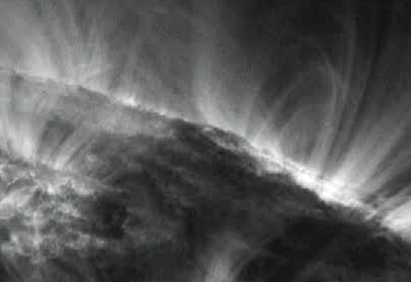
Science Programs
5) Solar Microscope Program（太阳显微）
In order to investigate the solar structure and its evolution, magnetic origin, coronal construction and its dynamics, we need to observe the Sun:
With higher spatial resolution
From various visual angles
With a good combination of multi-wavebands.
Closer to the Sun
Missions:
  Space Solar Telescope (SST)
  Super High Angular Resolution Principle X-ray telescope (SHARP-X)
  Space Optical Interferometer Telescope (SOIT)

Slide 18
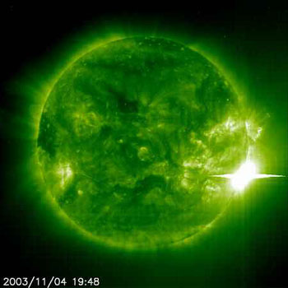
Science Programs
6) Solar Panorama Program（太阳全景）
Besides emphasizing the local areas with high spatial resolution, the global
behavior of the Sun is more important in relation to humankind.
Diagnose the variation of the Sun with multi-waveband tools
Study the connections between small-scale
structures and the large-scale eruptions
Explore the mechanisms of solar activities
Missions:
  Small Explorer for Solar Eruptions (SMESE?)
  Solar Explorer at High Energy and Far Infrared (SEHEFI)
  Solar Radio Array with very Low Frequency (SRALF)
  Global Solar Explorer (GSE)

Slide 19
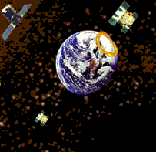
Science Programs
7) Solar-terrestrial Connection Program（日地联系）
Study the origin and law of the solar activity
Understand the variation processes and rules of solar-terrestrial space weather
Understand how solar activity influence geospace and human society
Forecast the space weather accurately in real time
Missions:
  KUAFU
  Small Explorer for Solar Eruptions (SMESE?)
  Solar Polar Orbit Radio Telescope (SPORT)
  Magnetosphere-Ionosphere-Thermosphere
  coupling (MIT)

Slide 20
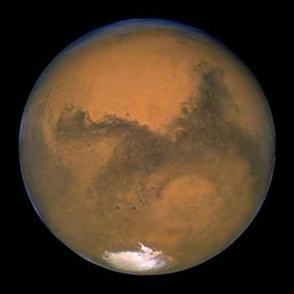
Science Programs
8) Mars Exploration Program（火星探索）
Study Mars, focus on the life detection on Mars
Missions:
Orbiting Exploration
  YH-1: Martian Space Environment Exploration Obiter
  Multi-Target and Multi-Task Mars Exploration
Soft landing and roving exploration

Slide 21
Science Programs
Series of sustainable , comprehensive and unmanned planetary exploration program
Focus on the Earth and human activity by in-situ precise analysis and experiments.
Science Objectives：
  Life elsewhere and survival of earth life elsewhere
  The in-situ processing and utilization of the resources on planetary surfaces
  The comparable study of surface, atmosphere, environment between the Earth of planets.
9）Planetary Science Laboratory (行星科学实验室PSL)

Slide 22
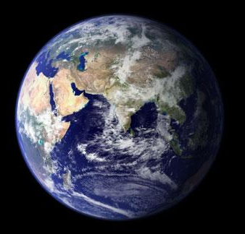
Science Programs
10) Experimental Satellites for Earth Science (ESES)
Observe the key parameters of the Earth-atmospheric system
Discover new parameters that indicate the global change
Support the development of the earth system model
Missions:
Near Space Atmosphere Research Satellite （NSARS）
Global Observations of Cloud, Aerosols, and Radiation (GOCAR)
Bathymetry & Disaster Monitoring by small satellite Constellation （BDMC）

Slide 23
Science Programs
11) Constellation of Earth Science Satellites (CESS)
Launch a series of earth-science satellites
Form CESS, obtain 3-dimension observation capability for the most important earth system components
Achieve the quantitative description and parameterization
of major features and processes in the earth system

Slide 24
Science Programs
12) Research Programs for Microgravity Sciences
Developing a balanced overall system of Microgravity experimental platform which integrates parabolic flights (aircraft), sounding rockets, recoverable satellites, and space station for microgravity science.
Sub-programs :
  “Qingying” 轻盈Program － Fluid Physics Experiments
  “Qingyan” 轻焰Program － Microgravity Combustion Experiments
  “Qingyang” 轻飏Program－ Materials Science experiments under
  Microgravity

Slide 25
Science Programs
13)Fundamental Physics Experiment in Space Program (FPES)
Experiment in the laboratory scale the theories beyond general relativity
Search for new interaction between macroscopic object spin and the Earth gravitational field, which is possible to affect the center of mass movement.
Search for possible deviation in the micron scale to the Newton gravitation law of inverse squares.
Develop fundamental physics research in space based on the cold atomic physics.
Missions and Experiments:
Quantum Science Experiment Satellite
Experiment of New-Type Equivalence Principle for Gyroscope-Gravity Meter
Experiment of the Newton gravitation law of inverse squares.
Experiment of Cold Atom Space Clock on Manned Space Station

Slide 26

Science Programs
14) Life Science Exploration Program
Explore the origin of life and search for life elsewhere
Study biological effects in space environment
Experiments on programs and missions:
  Experiments on Recoverable Satellites
  In situ experiments on Mars Exploration Program/ Planetary
  Science Laboratory Program
  Signal analysis with Diagnostics of Astro-Oscillations Program
  Experiments on Manned Space Life Research Program

Slide 27
Roadmap of Chinese Space Science Missions
HXMT
SVOM
POLAR
Quantum Science Experiment Satellite
XTP
DMD-I
Test of the Short Distance Non-Newtonian Gravitation
High Resolution X-ray Interferometer Telescope
DMD-II
Drag-free Scientific Satellite
How did the universe originate and how does it evolve ?
Multi-target and Multi-task Mars Exploration
In-situ Experiment Research on Astrobiology
PSL
Space Experimental Platform and Research Base of Space Life Science
PSL
Mars Soft Landing and Roving Exploration
How did life originate and how does it evolve ?
SJ-10
Manned Space Program
Recoverable Satellite
Manned Space Program
PSL
PSL
Space Laboratory
What are the laws of motion of matter and life activity in space ?
Theme 1: How did matter originate, how does it evolve and move?
2010 2015 2020 2025
Notes:
HXMT: Hard X-ray Modulation Telescope
SVOM: Space multi-band Variable Object Monitor
POLAR: Gamma-ray burst POLARization experiment
XTP: X-ray Timing and Polarization telescope
DMD: Dark Matter Detection Program
PSL: Planetary Scientific Laboratory
SST: Space Solar Telescope
SMESE: Small Explorer for Solar Eruptions
SHARP-X: Super High Angular Resolution Principle X-ray telescope
SPORT: Solar Polar Orbit Radio Telescope
MIT: Magnetosphere Ionosphere Thermosphere coupling
NSARS: Near Space Atmosphere Research Satellite
GOCAR: Global Observations of Cloud, Aerosols, and Radiation
BDMC: Bathymetry & Disaster Monitoring by small satellite Constellation
CESS: Constellation for Earth Science Sensing or China constellation for the Earth System Science

Slide 28
Roadmap of Chinese Space Science Missions
SST
SMESE(?)
KUAFU
SHARP-X
High Energy and far - Infrared Detection
Space Extremely low-Frequency Array
SPORT
What is the nature of solar activity?
Lunar Exploration Program (landing)
KUAFU
Multi-target and Multi-task Mars Exploration
Lunar Exploration Program (Sample return)
MIT
PSL
PSL
SPORT
Mars Soft Landing and Roving Exploration
What is the origin and evolvement of the solar system, and its relationship with the sun?
NSARS, KUAFU
Multi-target and Multi-task Mars Exploration
Manned Space Program
GOCAR
BDMC
MIT
PSL
CESS
Space Laboratory
Mars Soft Landing and Roving Exploration
PSL
How does the earth system evolve?
Theme 2: What is the relationship between the solar system and human beings?
2010 2015 2020 2025
Notes:
HXMT: Hard X-ray Modulation Telescope
SVOM: Space multi-band Variable Object Monitor
POLAR: Gamma-ray burst POLARization experiment
XTP: X-ray Timing and Polarization telescope
DMD: Dark Matter Detection Program
PSL: Planetary Scientific Laboratory
SST: Space Solar Telescope
SMESE: Small Explorer for Solar Eruptions
SHARP-X: Super High Angular Resolution Principle X-ray telescope
SPORT: Solar Polar Orbit Radio Telescope
MIT: Magnetosphere Ionosphere Thermosphere coupling
NSARS: Near Space Atmosphere Research Satellite
GOCAR: Global Observations of Cloud, Aerosols, and Radiation
BDMC: Bathymetry & Disaster Monitoring by small satellite Constellation
CESS: Constellation for Earth Science Sensing or China constellation for the Earth System Science

Slide 29
Roadmap of Chinese Space Science Missions
HXMT
SVOM
POLAR
Quanta Science Experiment Satellite
XTP
DMD-I
Test of the Short Distance Non-Newton Attraction
High Resolution X-ray Interferometer Telescope
DMD-II
Drag-free Scientific Satellite
How did the universe originate and how does it evolve ?
Multi-target and Multi-task Mars Exploration
In-situ Experiment Research on Astrobiology
PSL
Space Experimental Platform and Research Base of Space Life Science
PSL
Mars Soft Landing and Roving Exploration
How did life originate and how does it evolve ?
SJ-10
Manned Space Program
Recoverable Satellite
Manned Space Program
PSL
PSL
Space Laboratory
What are the law of matter motion and the law of life activity in the space environment?
Theme 1: How did matter originate, how does it evolve and move?
Theme 2: What is the relationship between solar system and human beings?
SST
SMESE
KUAFU
SHARP-X
High Energy and far –Infrared Detection
Space Extremely low-Frequency Array
SPORT
What is the nature of solar activity?
Lunar Exploration Program (landing)
KUAFU
Multi-target and Multi-task Mars Exploration
Lunar Exploration Program (Sample return)
MIT
PSL
PSL
SPORT
Mars Soft Landing and Roving Exploration
What is the origin and evolvement of solar system, and its relationship with the sun?
NSARS
KUAFU
Multi-target and Multi-task Mars Exploration
Manned Space Program
GOCAR
BDMC
MIT
PSL
CESS
Space Laboratory
Mars Soft Landing and Roving Exploration
PSL
How does the earth system evolve?
2010 2015 2020 2025
Notes:
HXMT: Hard X-ray Modulation Telescope
SVOM: Space multi-band Variable Object Monitor
POLAR: Gamma-ray burst POLARization experiment
XTP: X-ray Timing and Polarization telescope
DMD: Dark Matter Detection Program
PSL: Planetary Scientific Laboratory
SST: Space Solar Telescope
SMESE: Small Explorer for Solar Eruptions
SHARP-X: Super High Angular Resolution Principle X-ray telescope
SPORT: Solar Polar Orbit Radio Telescope
MIT: Magnetosphere Ionosphere Thermosphere coupling
NSARS: Near Space Atmosphere Research Satellite
GOCAR: Global Observations of Cloud, Aerosols, and Radiation
BDMC: Bathymetry & Disaster Monitoring by small satellite Constellation
CESS: Constellation for Earth Science Sensing or China constellation for the Earth System Science

Slide 30
Summary
With this plan, we start to knock the door of Taikong (太空）
Many questions there are waiting us to answer
China should make adequate contribution in this area while the economy is continuously developing

Slide 31
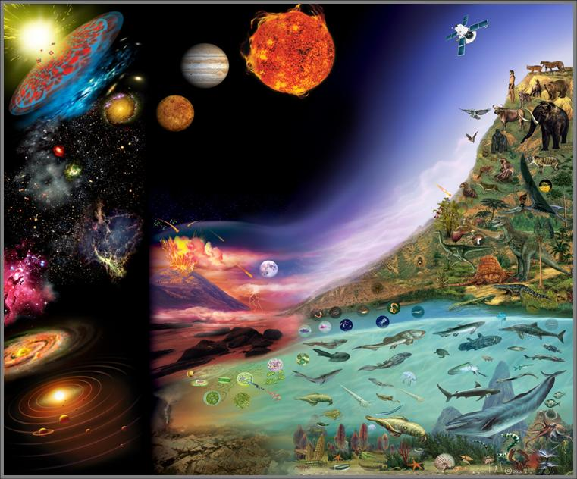
Calling TAIKONG
（太空）

