Slide 1

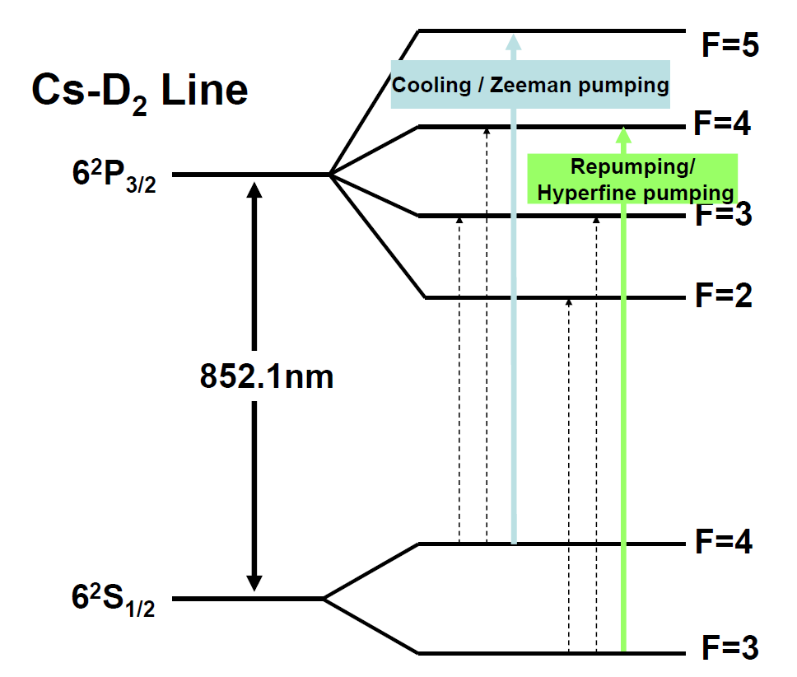
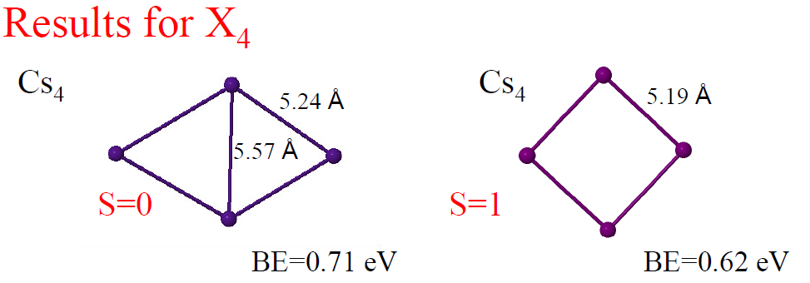
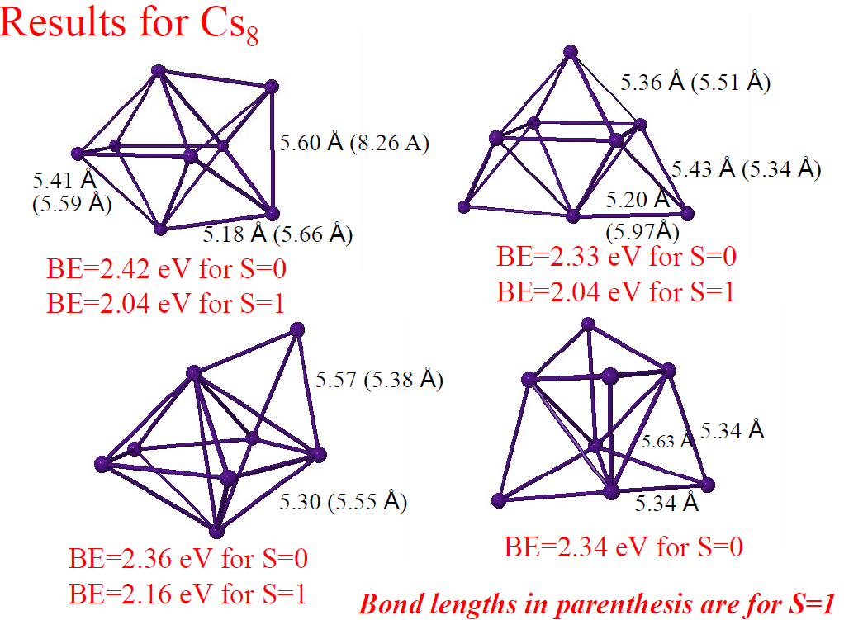
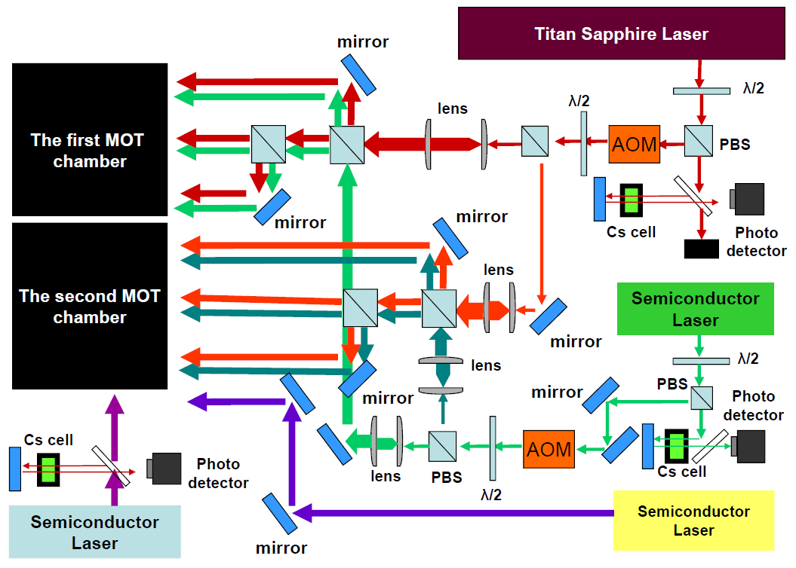
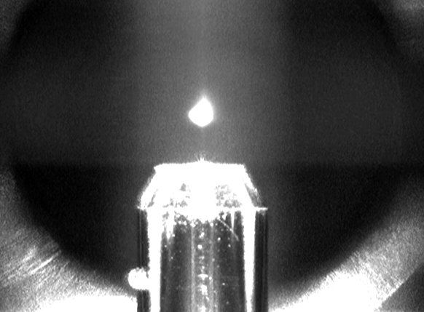
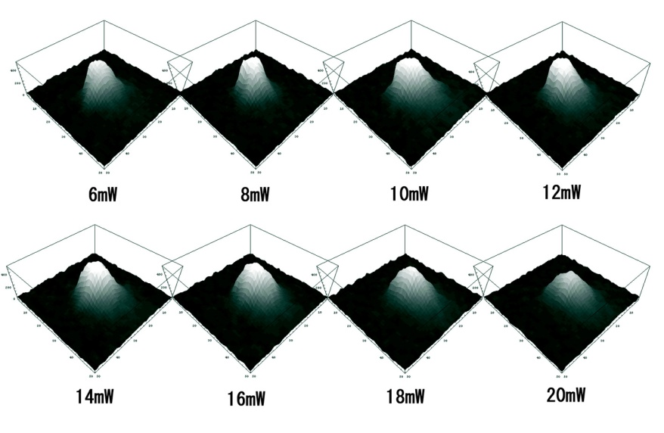
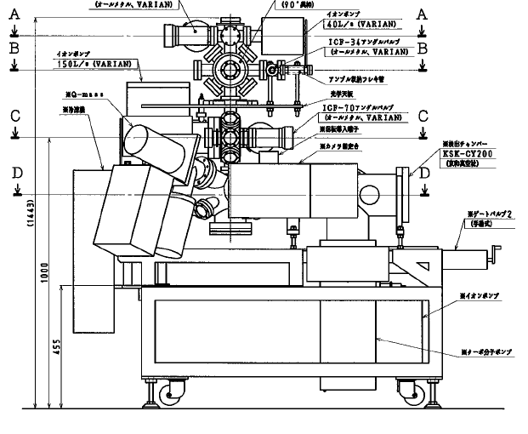
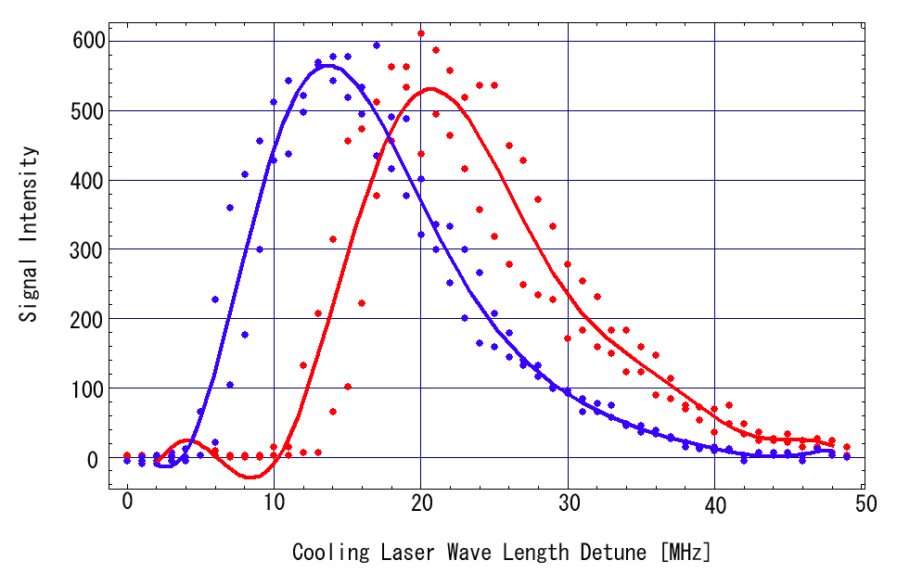
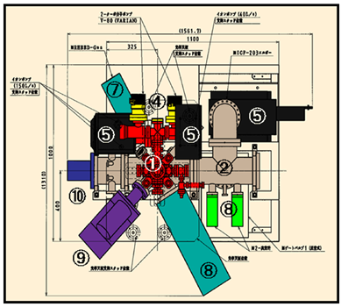
Are spin-polarized atoms clustering ?
TANAKA, Masamitsu, KOBAYASHI, Yukiharu, HASHIMOTO, Tomohiko, NOZAWA, Takeshi, WATANABE, Ryoji, NAKASHIMA, Natsuki,
SHIRAKI, Ichiro, YAMADA, Shungo^{a)}, SATO, Tomohiro^{a)}, ITO, Haruhiko ^{a)}, and TORIKAI, Eiko
Interdisciplinary Graduate School of Medicine and Engineering, University of Yamanashi,
^{a)} Interdisciplinary Graduate School of Science and Engineering, Tokyo Institute of Technology
1. Introduction
The interplay between spin and structure is a problem of interest in the field of nanomagnetism and cluster/surface physics. While this effect is less dominant in bulk materials, the ground state physical properties (including the geometry) of finite systems like clusters are strongly influenced by the spin, and different optimal ground state geometries are possible for different spin states of size-specific clusters (spin isomers). Further, the nature of bonding in finite systems is strongly influenced by the spin states of the constituent atoms. Of particular interest in finite systems is the question of what we can expect if a small number of spin-polarized atoms are placed on a plane, and allowed to assemble (or disassemble). Would clustering or self-assembling occur?
If spin-polarized atoms are clustering, they will exhibit a spin-dependent functional property which is applicable for a quantum device. In such a system, observation of the atomic arrangement will give information on spin arrangement and vice versa.
For the experimental clarification, spin-polarized cold atoms of cesium are soft-landed randomly on a van der Waals solid and spin clusters of cesium are expected to form through self-assembly. Solid argon is selected as a candidate of the ideal substrate , because the non-wetting phenomena of argon observed on cesium suggests negligibly small interaction between them.
rare gas thin film
(a) Spin polarized atoms
Substrate
(b) Unpolarized atoms
Characteristic molecule? Spin cluster
fcc island formation
Fig. 1 Concept of the free clustering of (a) spin-polarzed atoms, and (b) unpolarized atoms.
2. Magneto-optical Trapping of Cold Cs Atoms
* Theoretical modeling of the structures and spin states of Cs_{n} clusters suggests that low-and high-spin states are competitive for n . 4, 5 and 6. For these sizes, planar geometries are favored for the low-spin states, while compact 3-D geometries are favorable for the high-spin states of Cs₅ and Cs₆. Spin states higher than the triplet are not energetically favorable. High spin states are not favored for Cs₂ and Cs₃.
Fig. 3 Principle of the magneto-optical trapping in the two level system.
Fig. 4 Energy Scheme of Cs-D2 Line.
Fig. 2 Examples of the low-lying structures of Cs_{n} clusters predicted by the density functional model. (J.M.M.M 310(2007) 2390.)
3. Experimental Procedure
Cesium atoms are cooled and trapped in the magneto-optical trap(MOT) and spin-polarized by the successive hyperfine and Zeeman pumping method. Spin-polarized molasses are dropped onto the solid argon substrate and form clusters. We used double MOT to increase the number density of the cold atoms of the order of 10¹⁰ [cm⁻³].
Fig. 5 Image of the experimental procedure.
Fig. 6 Experimental Setup.
Fig. 7 Laser system for double MOT and optical pumping.
4. Current Result: Cold Molasses Trapped by Double MOT
● Optimization of laser for higher number density of cold molasses in the 1-st MOT:
laser power: 10～12mW
detuning : 13 MHz on increasing freq.
● Cold atoms are trapped successfully in the 2-nd MOT by laser-off, further detuning of laser frequency, or magnetic field turning off in the 1-st MOT after trapping.
● Luminescence of the 2-nd MOT increases by repetition of laser-off in the 1-st MOT after trapping.
●Measurement of the temperature and absolute number densities are now under execution.
Fig. 9 luminescence of cold Cs atoms trapped in the 2-nd MOT. The intensity increases with repeating drops of molasses from the 1-st MOT.
Fig. 8 Luminescence of cold Cs atoms trapped in the 1-st MOT observed by the infrared sensitive CCD camera(upper left), and their intensity profiles depending on the cooling laser power(lower left). Laser power dependence(upper right) and the detuning-frequency dependence(lower right) of the number density of atoms trapped in arbitrary units.
5. Summary
In order to understand the interplay between spin arrangement and atomic arrangement that are originated from the exchange interaction, we are performing the experimental study on the nature of clustering of spin-polarized Cs atoms. Cold atoms are trapped successfully and ready for the experiment for free clustering.

