Slide 1
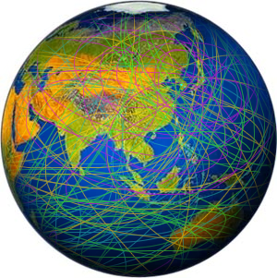
ASEPS 2010
Establishing
Large International Research Facilities
Dong-Pil MIN
Chairman of KRCFST
ⓒ2010, Korea Research Council for Fundamental Science & Technology

Slide 2
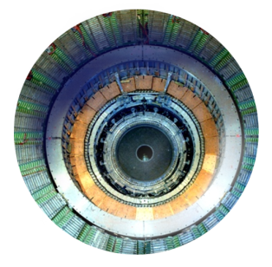
Introduction
Large Facilities for Increase of Knowledge
Significance of science advancement and experimental tools
Large facilities for more profound, detailed measurements : increased knowledge
Share both cost and the benefit: LHC
Plan and coordinate: www, grid computing

Slide 3
Necessity of international collaboration
To plan for, manage, utilize research facilities
To share both cost and the benefit:
To optimize utility of infrastructure, int’l cooperation
Europe - CERN: since 1950 - ESFRI: since 2002, talk by B. Girard - GSF: since 1999, talk by S. Michalowski

Slide 4
Advancement in Asia
Growth of GDP
Hi-Tech goods
Growth of R&D: 30% of world sum

Slide 5
Increase of R&D:
New Efforts to Make the Scientific Progress
Light Sources in Asia-Pacific Area
Armenia: CANDLE (3.0 GeV)
Australia: AS (3.0 GeV)
China: SSRF (3.5 GeV), HLS(0.2 GeV), etc.
India: Indus-2 (2.5 GeV)
Japan: Photon Factory (6.5 GeV), Spring-8 (8.0 GeV),
NewSUBARU (1.5 GeV), Saga-LS (1.4 GeV), etc.
Jordan: SESAME (2.5 GeV)
Korea: PLS (2.5 GeV)
Singapore: SSLS (0.7 GeV)
Thailand: SPS at SLRI (1.0 GeV)
Taiwan: TLS (1.5 GeV), TPS (3.0 GeV)

Slide 6
Increase of R&D:
New Efforts to Make the Scientific Progress
Electron-positron Collider
- China: BEPC (2.5 GeV)
- Japan: KEKB (3.5+8.0 GeV)
Rare Isotope Beam & Heavy Ion
- China: HIRFL
- Japan: RIBF
- Korea: KoRIA (provisional name)

Slide 7
Organization Chart of
26 Korean National Research Institutes
for Science & Technology
President
Ministry of Education,
Science & Technology
Ministry of Knowledge Economy
KRCFST
ISTK*
13 Institutes
13 Institutes
KIST
KRIBB
KASI
KIOM
KBSI
- NFRI
- NIMS
KISTI
KRISS
KARI
KAERI
KORDI
-KOPRI
KIIT
ETRI
- NSRI
KICT
KRRI
KFRI
KIGAM
KIMM
- KIMS
KIER
KERI
KRICT
- KITOX
* ISTK: Korea Research Council for Industrial Science & Technology

Slide 8
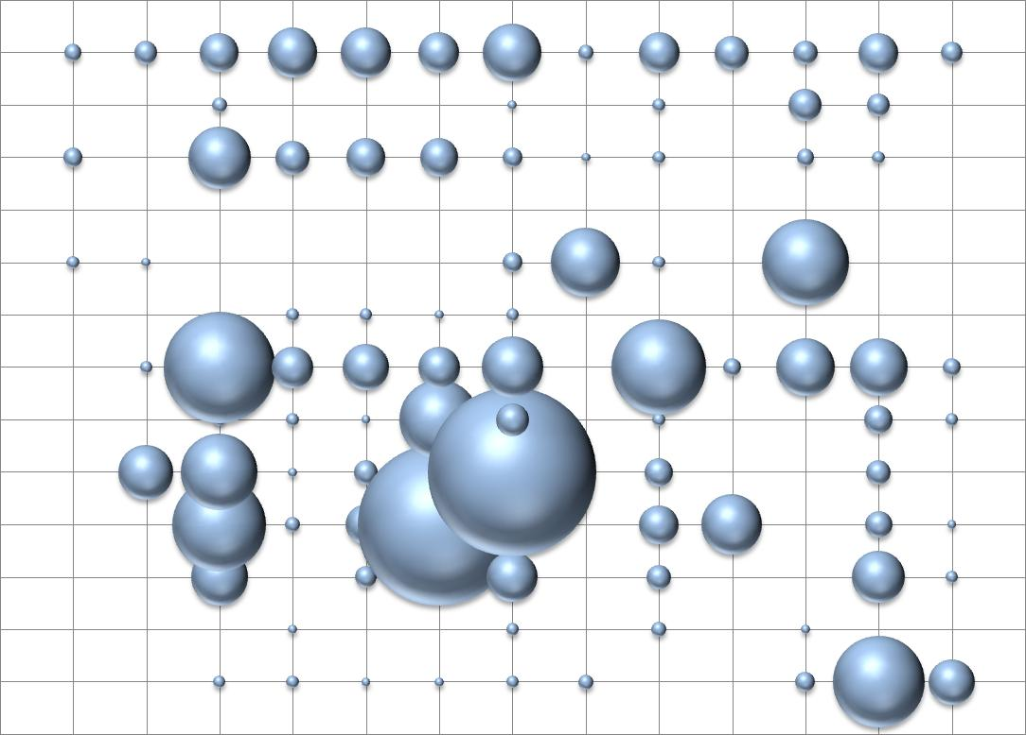
Research Field by Affiliated Institutes (2008)
National Defense
Miscellaneous
Non-O. Research
Co-work w/ Univ.
Space
Society
Industrial Tech.
Agricultural Tech.
Energy
Life Science
Environment
Land
Earth
NIMS
NFRI
KIST
KISTI
KBSI
KAERI
KASI
KRISS
KIOM
KARI
KRIBB
KORDI
KOPRI

Slide 9
2008 / 2009 Budget KRCFST & 13 National Labs
2008
2009
Contract 959,099
Grant 564,702
Sum 1,523,801
Contract 943,417
Grant 669,283
Sum 1,612,700
(unit : kilo US$ )

Slide 10
New Plan of Korea
Governmental Plan
- ISBB: International Science Business Belt
Large Facilities
- KoRIA
- PLS-II

Slide 11
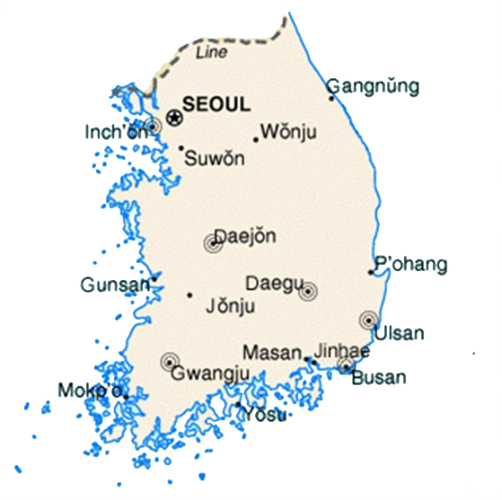
Sejong City : 世宗市
SEJONG City

Slide 12
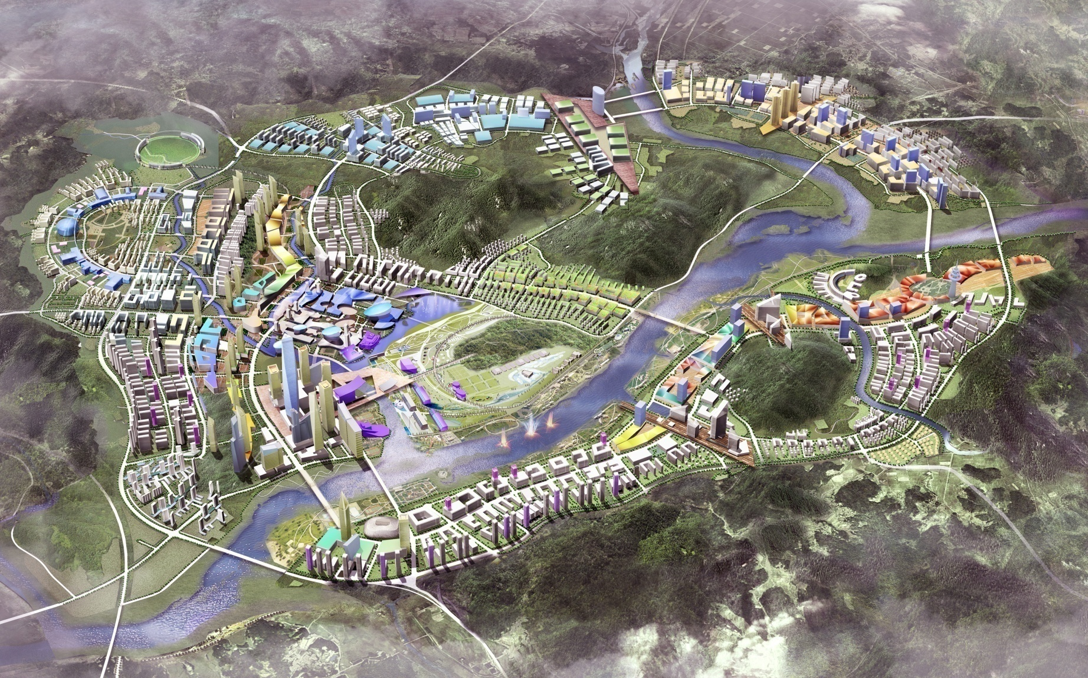
An Artist’s View of
Sejong City

Slide 13
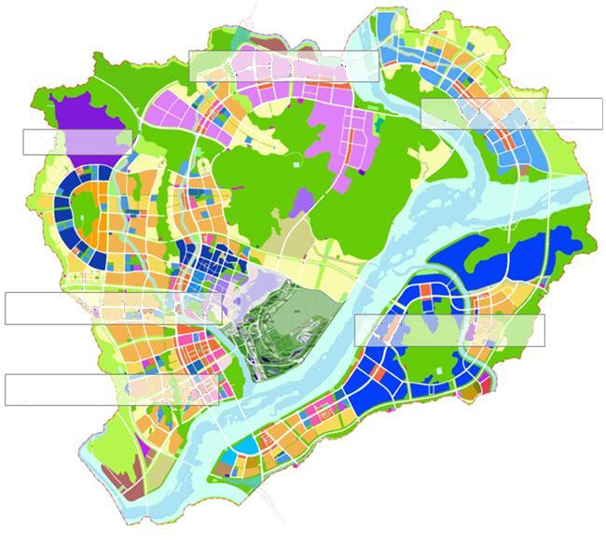
Design of Sejong City
High-tech & Green Industry ZONE
Global ZONE
Heavy-Ion Accelerator
Research & Venture ZONE
University & Research ZONE
Commercial & Culture ZONE

Slide 14
Large Facilities in Korea 1 KoRIA: Cornerstone for Int’l Science Business Belt
2020
2000
2005
2010
2015
Year
TRIUMF/ISAC І, ISA Ⅱ
500MeV/A, 100ℳA, Proton
RIKEN RIBF
350MeV/A, 1pℳA, Heavy ion
SPIRAL2
15MeV/A, 1000pℳA, Heavy ion
GSI/FAIR
1.5GeV/A, 0.2pℳA, Heavy ion
KoRIA
ISOL
In Flight
In Flight, ISOL
200MeV/A, 2pℳA, Heavy ion
FRIB
200MeV/A, Conceptual designing, Heavy ion
6) EURISOL

Slide 15
Basic Concepts of KoRIA
Multipurpose
Both ISOL & In Flight Fragmentation
for production of rare isotope beams
(In Flight Fragmentation after ISOL: more exotic beams)
Maximum use of (stable & RI) beams
Pump and Probe

Slide 16
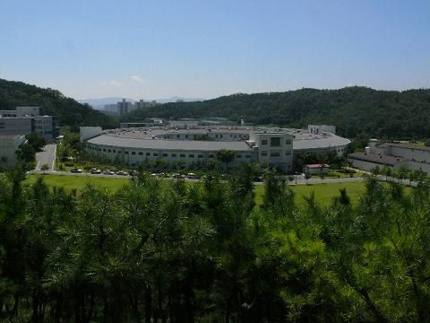
Large Facilities in Korea 2 PLS : PLS-II Upgrade (2009-2011)
Energy
2.5 GeV -> 3.0 GeV
Current
200 mA -> 400 mA
Emittance
18.9nm rad -> 5.9 nm rad
- 10 more Invacuum Undulator

Slide 17
For Effective Contribution by AP
Asia-Pacific region should find efficient research infra.
- The region’s role in the advancement
- The region can access to better infras & talents
Asia-Pacific region needs co-strategy
- from fragmented investment
- to strategic multilateral cooperation needed
- APCTP, ACFA, ANPhA

Slide 18
Wisdom and Capabilities
What to do:
- To achieve regional coordination and agreement
- To convert agreement to national policy
- To extend to global issues first

Slide 19
For effective contribution by Asia-Pacific
Suggestion: Asia-Pacific Area Need to Establish
- Panel of experts to develop unified strategy and recommendation (in AAPPS)
- Intergovernmental science policy forum
- Cooperation with ESFRI, GSF, AAAS, etc.

Slide 20
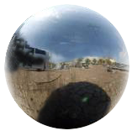
Principles for Operating
International Large Facilities
(ICFA 1980, IUPAP 1996)
Open at planning stage of collaborating facilities
Operating in view of users facility,
but with host benefits
Clear principles and agreement for IPR, etc.
Discussing under the spirit of cooperation

Slide 21
Summary
Asia-Pacific region must contribute more to global science society
Asia-Pacific region must overcome the problem of fragmentation
Asia-Pacific region must develop common strategy
The role of AAPPS and the cooperation with Europe are important for the region.

Slide 22
Thank You

