Slide 1
Gravitational waves: review of LIGO-Virgo results, current interpretations, and prospects
Tania Regimbau, Annecy, November 22th

Slide 2
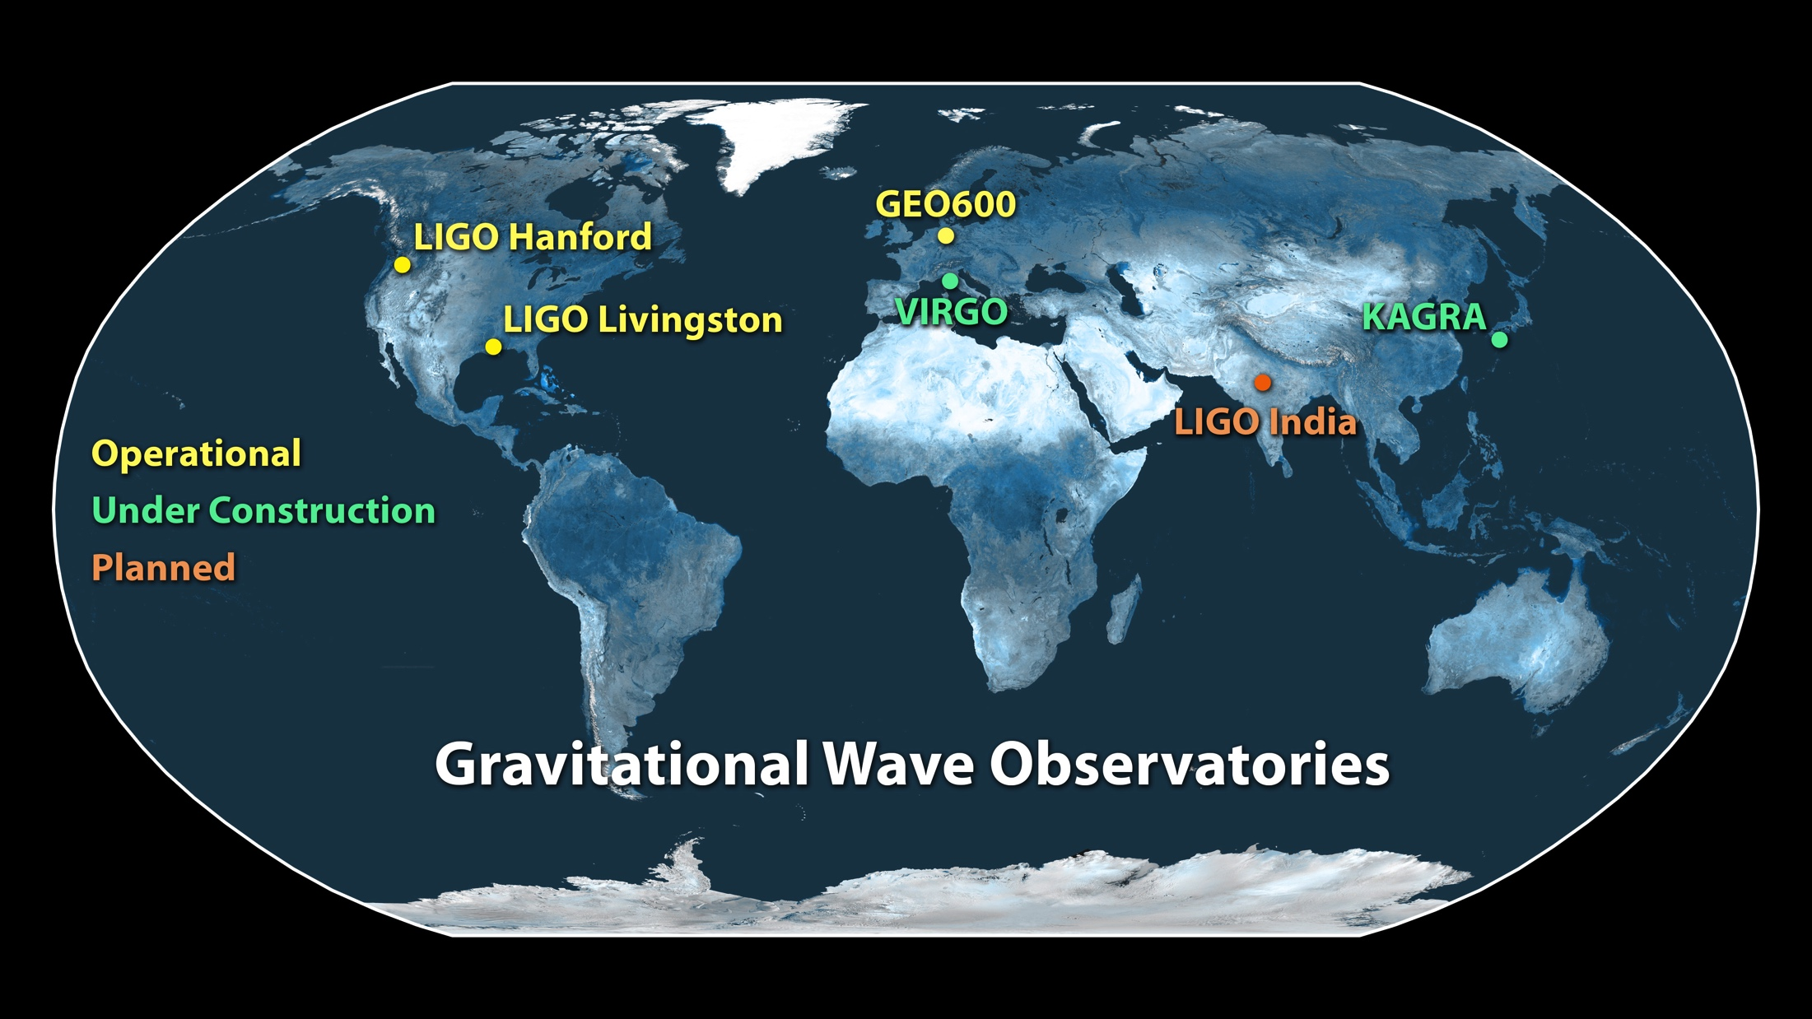
The terrestrial detector network

Slide 3
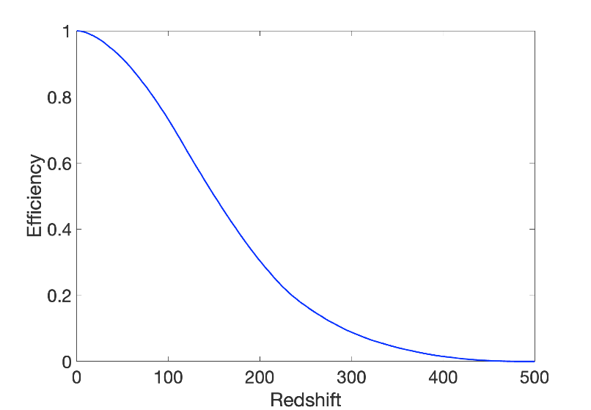
Detection range and observing scenario
Provides an estimate of the sensitivity of a detector, as the average distance at which a NS-NS binary with masses 1.4+1.4 can be observed with an SNR=8.
Distance (Mpc)

Slide 4
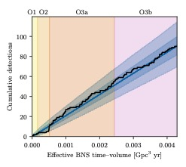
Detections
arXiv:2111.03606
35 new detections in O3b with p_{astro} >0.5
90
55
11
3

Slide 5
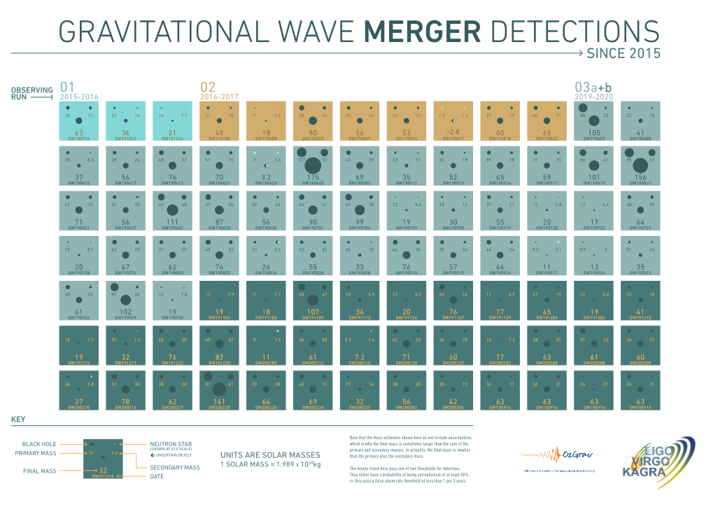

Slide 6
GWTC-3 papers
GWTC-3: Compact Binary Coalescences Observed by LIGO and Virgo During the Second Part of the Third Observing Run; arXiv:2111.03606
The population of merging compact binaries inferred using gravitational waves through GWTC-3; arXiv:2111.03606

Slide 7
The run O3b
from April 1st 2019 to March 27th 2020 divided in 6 months chunks.
3 pipelines based on match filtering GstLAL, PyCBC, MBTA + unmodelled CWB
39 sources reported in low-latency searches (18 survived) and 17 sources detected in offline searches.
- first observations of NS-BHs, no BNS
- no coincident observation with EM
- number of detections in agreement with predictions at the end of O3a

Slide 8
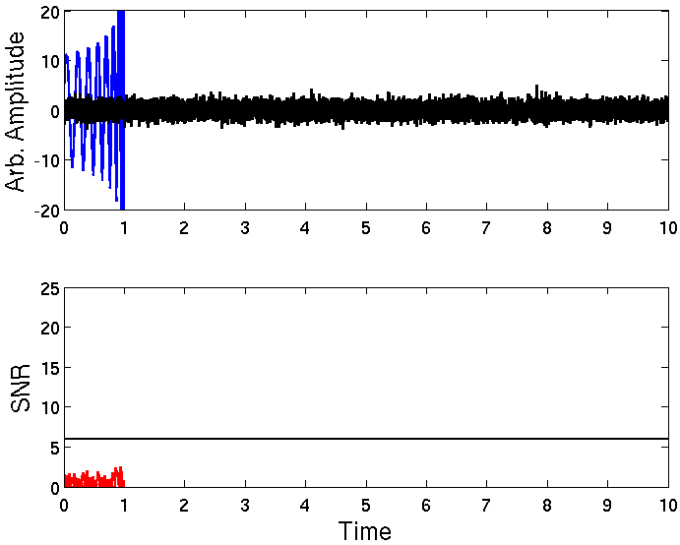
Match filtering

Slide 9
Some measured quantities
Chirp mass:
Effective spin:

Slide 10
Less massive NS

Slide 11
P_{astro} =35% but clearly above the background

Slide 12
Evidence for BH spin opposite to the orbital angular momentum. Dynamical formation channel?

Slide 13
In the NS/BH mass gap like GW190814 in O3a

Slide 14
Most massive in O3b (less than GW190521 and GW190426_190642 in O3a).

Slide 15
Smallest total mass for a BBH

Slide 16
Confident positive effective spin

Slide 17
One of the most massive event of the catalog. Negative effective spin with 90% probability

Slide 18
Most massive in O3b (less than GW190521 and GW190426_190642 in O3a).

Slide 19
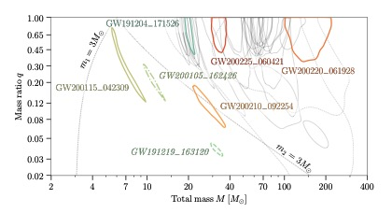
The masses
BNS
m₁ =87
m₂ =1.44
BBH
BH-NS
m₂ =2.83
m₂ =1.17

Slide 20
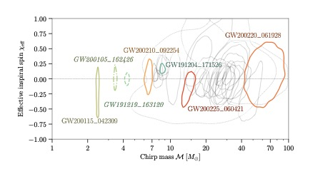
The spins

Slide 21
Astrophysical implications
We use a reduced sample of 67 events with higher significance out of which one may not be astrophysical for combined population studies and a sample of 76 events out of which 4-5 may not be astrophysical for BBH studies.
  Mass distributions
  Mass gaps
  Spin distribution
  Rates
  Background

Slide 22
Mass distribution
Few events to reconstruct the NS mass distribution but no evidence for a peak around 1.35 M_{Solar} . Consistent with a uniform distribution.
Dearth of observation between 3-5 M_{solar} but some events larger than the maximal mass supported by dense matter EOS about 2.2-2.5 M_{solar} .
No evidence for presence or absence of a mass gap

Slide 23
Mass distribution
substructure in the BBH mass distribution
no evidence for an upper pair-instability mass gap from (40-70) M_{solar} to 120 M_{solar}

Slide 24
Spin distribution
small spin aligned with the orbital angular momentum for most systems.
evidence for non zero spins
evidence for non aligned spins could indicate dynamical formation
evidence for mass ratio/magnitude spin correlation
broadening of the spin distribution above 30 M_{Solar}

Slide 25
Rate
Local rate estimates:
BNS: (13-1900) Gpc⁻³ yr⁻¹
BHNS: (7.4-320) Gpc⁻³ yr⁻¹
BBH: (16-130) Gpc⁻³ yr⁻¹
Increase of the rate with redshift consistent with (1+z) ³ but small volume

Slide 27
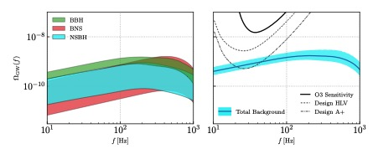
Background

Slide 28
Properties in the time domain

Slide 29
Conclusions
GWTC3 includes 90 events with p_{astro} >0.5
BHNS observed for the first time
no evidence for NS-BH mass gap or PI mass gap
structure in the mass distribution for BHs
non zero and non aligned spins that can probe dynamical formation
background from unresolved CBCs may be detected with A+

