Slide 1
WP3 – ESCAPE Open-source Software and Services repository
Technical overview, 28-10-2021, Thomas Vuillaume, Enrique Garcia*

Slide 2
Outline
OSSR goals
Entry point / OSSR portal
OSSR itself
Onboarging process and status.
EOSSR library.
OSSR Metadata.
CI and implementation intro OSSR.

Slide 3
Goals of the OSSR
Provide software and services following the FAIR* principles:
Findable : Rich metadata, unique and persistent identifier
Accessible : Metadata and data are understandable to humans and machines. Data is deposited in a trusted repository.
Interoperable : Metadata use a formal, accessible, shared, and broadly applicable language for knowledge representation.
Reusable : Data and collections have a clear usage licenses and provide accurate information on provenance.
Provide the infrastructure and services to foster FAIR (effortless) contributions
ESCAPE Virtual Environment (see Arturo's presentation)

Slide 4
OSSR entry point
OSSR portal
http://purl.org/escape/ossr
Browse and search by projects
Find all the required information to use the services and contribute to the OSSR
Tutorials, tools...
Accessible from https://projectescape.eu/
You should start here

Slide 5
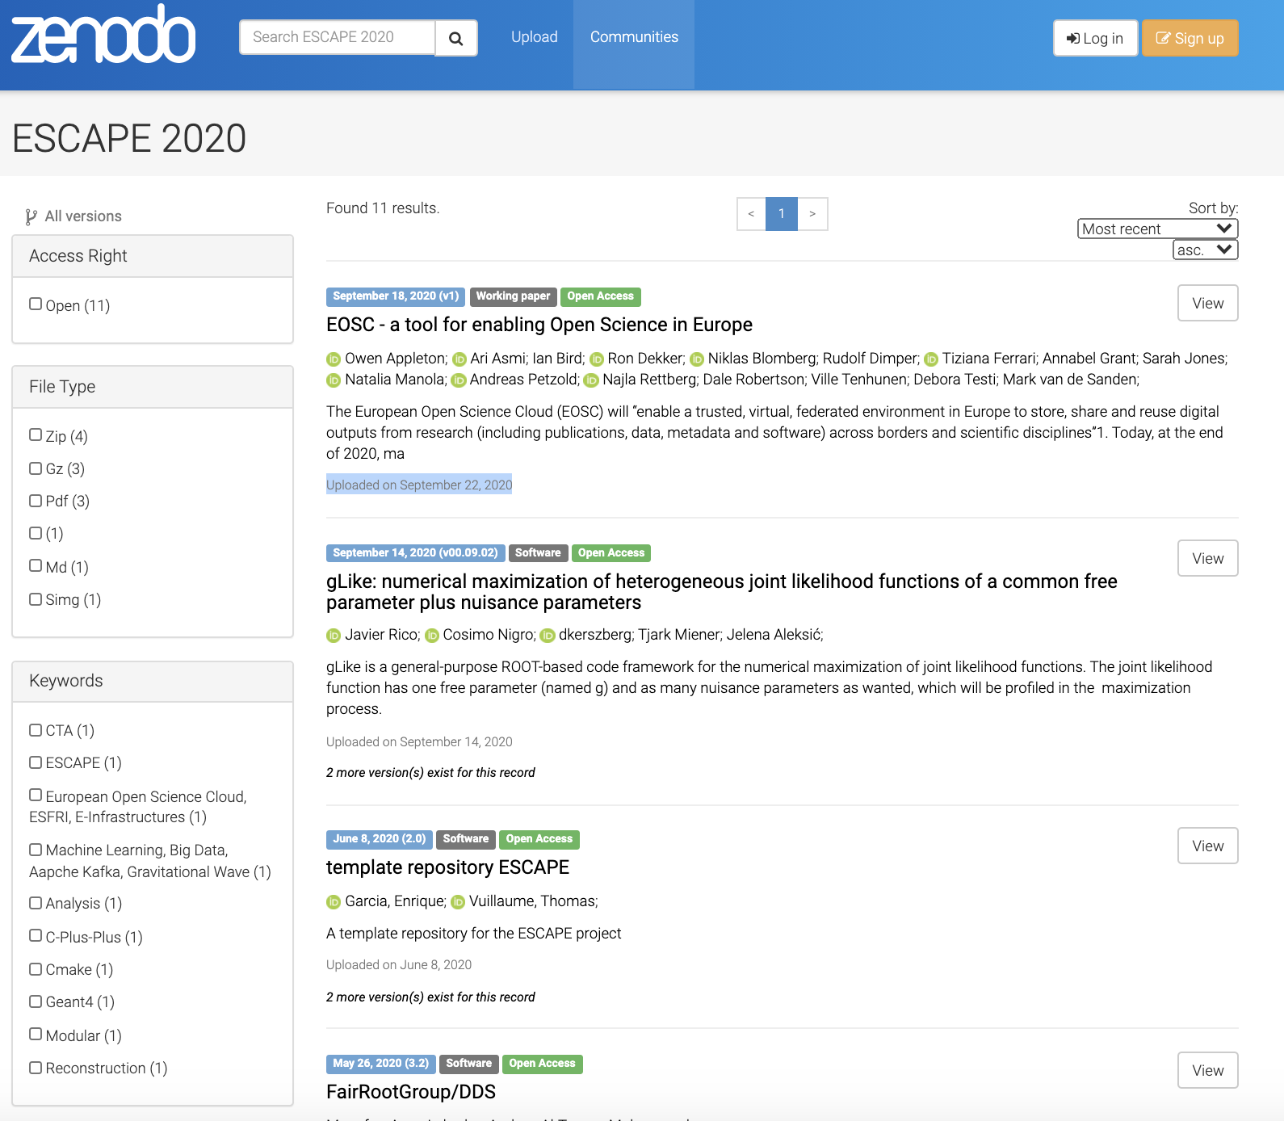
OSSR technology choice: Zenodo community
https://zenodo.org/communities/escape2020/​
General purpose repository developed by the OpenAIRE program.
Maintained and hosted by CERN.
Follows and enforces FAIR principles.
Trusted repository.
Provides web interface with search and filters.
Provides api for automated requests.

Slide 6
Curation and onboarding process
Guidelines
Part of deliverable D3.7 License, provenance and metadata guidelines for the software and service repository
The digitial resource must contain a license
Preferably a persmissive and open-source one
Minimal metadata must be provided
Preferably through a codemeta.json file (more on that later)
Checklist and procedure
Code source and stable release
License
Virtualisation container / image (optional)
Codemeta.json file
Registration form
Registered onboarding presentation during WP3 FG1 call
Technical report
Upload to OSSR: Zenodo escape2020 community
Curation process and acceptance if meets all the requirements and procedure is complete

Slide 7
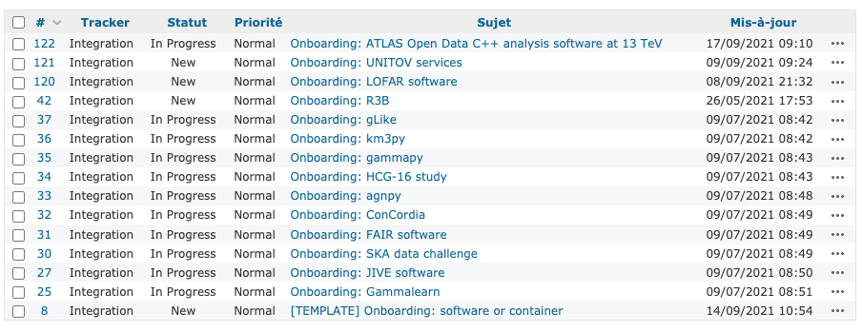
Onboarding status
Accessible from the OSSR portal
15 on-going onboarding
Most of which are at 80% and need a little push / reminder to get done
Dedicated pages produced automatically per project on the portal

Slide 8
OSSR entry categorization (draft)
Scientific analysis software
fully installable software packages, e.g. gammypy
Service environments
Projects for data and service providers, which offer e.g. a platform, GUI, or middleware for the computing environment (e.g. ConCordia)
dedicated scientific products (analysis, data)
repositories of data or workflows: projects that provide a certain class of data objects and serve as repository for this class of data, e.g. jupyter notebooks, or certain analysis results (if not provided in datalake or VO), e.g. CME database
self-contained analysis environments: repositories which provide full workflows and data (access), e.g. to reproduce a given analysis (e.g. SKA data challenge, HCG-16 study)

Slide 9
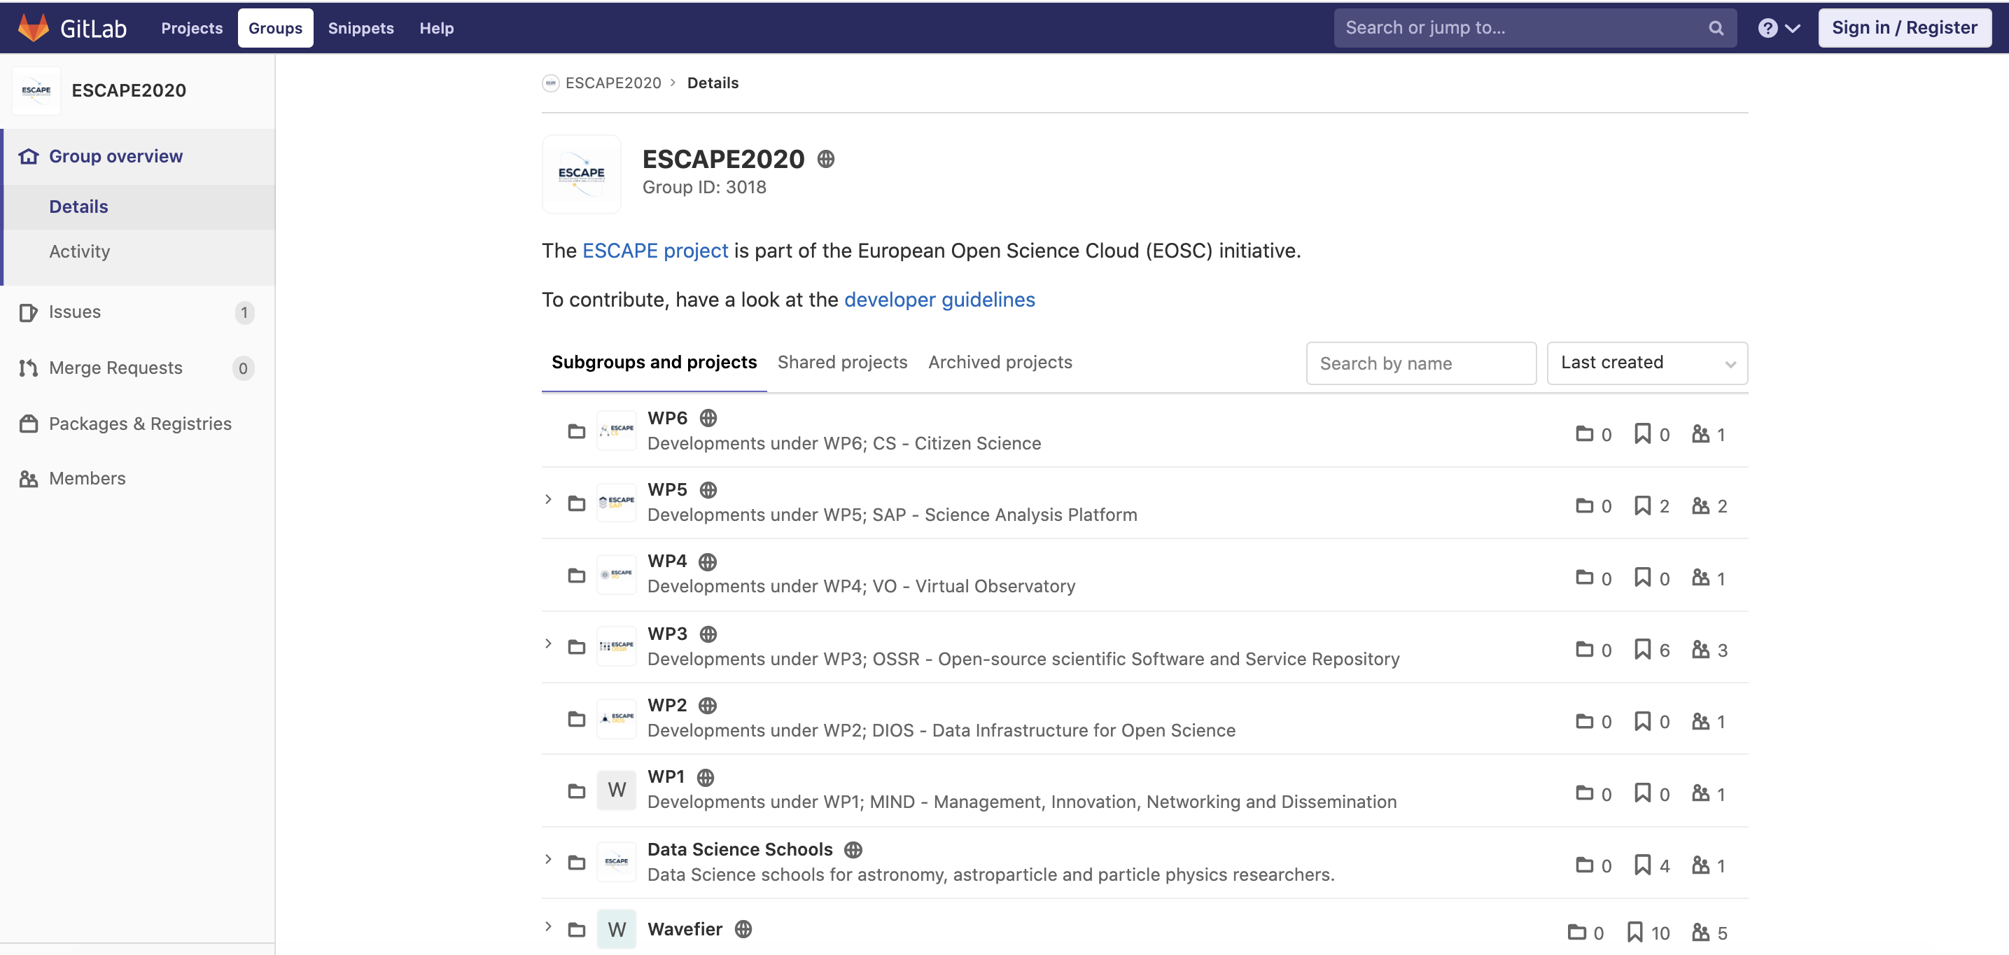
Tools
Development platform : https://gitlab.in2p3.fr/escape2020/
EOSSR library
Dev: https://gitlab.in2p3.fr/escape2020/wp3/eossr
Doc: https://escape2020.pages.in2p3.fr/wp3/eossr/
Regroup all previous and current OSSR developments
Python3
OSSR API : send request to the OSSR, find and filter software and services, upload new entries, update existing entries
CI : automated upload / update using gitlab CI
Metadata : schema definition, crosswalk between CodeMeta and Zenodo
Should be used by other (automatised) services to access the OSSR
pip install eossr==0.2

Slide 10
eossr walkthrough
`eossr.api.Record`
https://escape2020.pages.in2p3.fr/wp3/eossr/examples/ossr_api-Explore_the_OSSR.html
> DEMO <
`eossr.api.zenodo.ZenodoAPI`
Manage user entries
upload new entry
modify/update existing ones
used by the CI to upload entry based on CodeMeta.json

Slide 11
OSSR Metadata
CodeMeta Project
implemented by adding codemeta.json file at the root of the project.
Defines a standard metadata syntax (schema),
designed to describe important information about software (license, purpose, authors, dependencies…) to facilitate discovery, adoption, and credit.
Based on Schema.org developed by major search engines (Google, Bing, Yahoo)
Can be easily crosswalked to other metadata schemas if needed.
Used by other services such as Software Heritage
Can be expanded/refined if needed (starting with Schema.org `Type`s)
Ongoing discussions about extending schema
Container metadata
Indicate which service can run the entry

Slide 12
Generate your CodeMeta file
codemeta.json file at the root of the project
online generator: https://codemeta.github.io/codemeta-generator/
a similar custom escape codemeta generator could be built if we extend the schema. At the moment, use the official one.
Generate it using existing tools from your already existing package (in Ruby, Python, R)
WIP: from GitHub repository
by hand, following the schema describe here or here (not recommended, unless you want to add metadata not covered by these tools)

Slide 13
Note on Zenodo metadata
Codemeta
<subset>
zenodo
Zenodo does not use codemeta
it uses an internal specific metadata schema, implemented in a .zenodo.json file at the root of the entry
you can add the .zenodo.json file yourself to provide all information to Zenodo, or use Zenodo’s web interface to provide the necessary metadata when creating a record
the CI uses eossr codemeta2zenodo (developed in WP3) to crosswalk codemeta.json into .zenodo.json
Zenodo is exploring the possibility to use / read codemeta directly
When interrogating the OSSR through Zenodo API, we are limited to zenodo metadata at first
but once an entry has been found, we can retrieve the codemeta.json alone and thus have access to the more complete metadata
With eossr library: `Record.get_codemeta()`

Slide 14
Going beyond CodeMeta
The issue has been raised (here, here) that we (in particular ESAP) might have specific queries needs (notebooks, containers) to identify OSSR entries that are not (at least not clearly) implemented in CodeMeta or Schema.org schemas
The issue is not new and we are not alone (see discussions from 2018 to extend schema.org to containers). Spoiler alert: the discussion is still open…
But we don’t need to solve the problem for the entire world right now, let’s solve it for us ☺. Possibilities;
extend schema
use specific keywords
Opened points and discussion in the eossr issues

Slide 15
Continuous Integration at your service
Uses codemeta.json in the code repository and eossr library
at the moment using GitLab CI (WIP: using github actions)
Upon software release:
update OSSR entry (through api)
build a container
Singularity or Docker image → can be added into Zenodo entry
Docker containers → added to the gitlab registry (acts as docker hub)
See the ESCAPE template project for a working example

Slide 16
Implementation into the OSSR environment
Publishes source code (updates your existing record with new versions)
Long term archived
Findable
Citable
AUTOMATISED
publishes to OSSR
builds images
Make a new tag (release)
Let the CI do the rest
registry
Publishes on registries

Slide 17
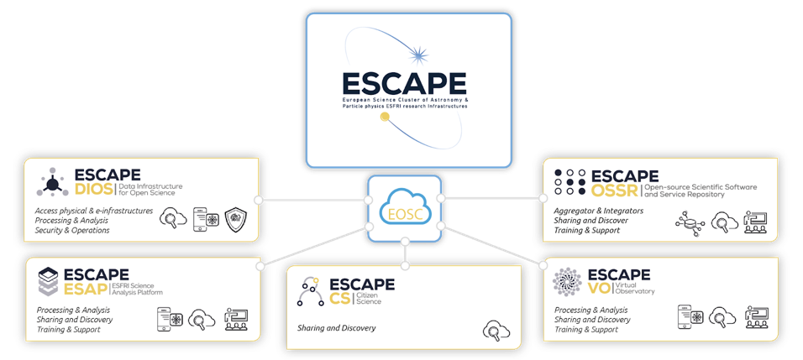
Using containers to feed the ESAP (or any other production environment) with:
Reproducible analysis
No installation hassle

Slide 18
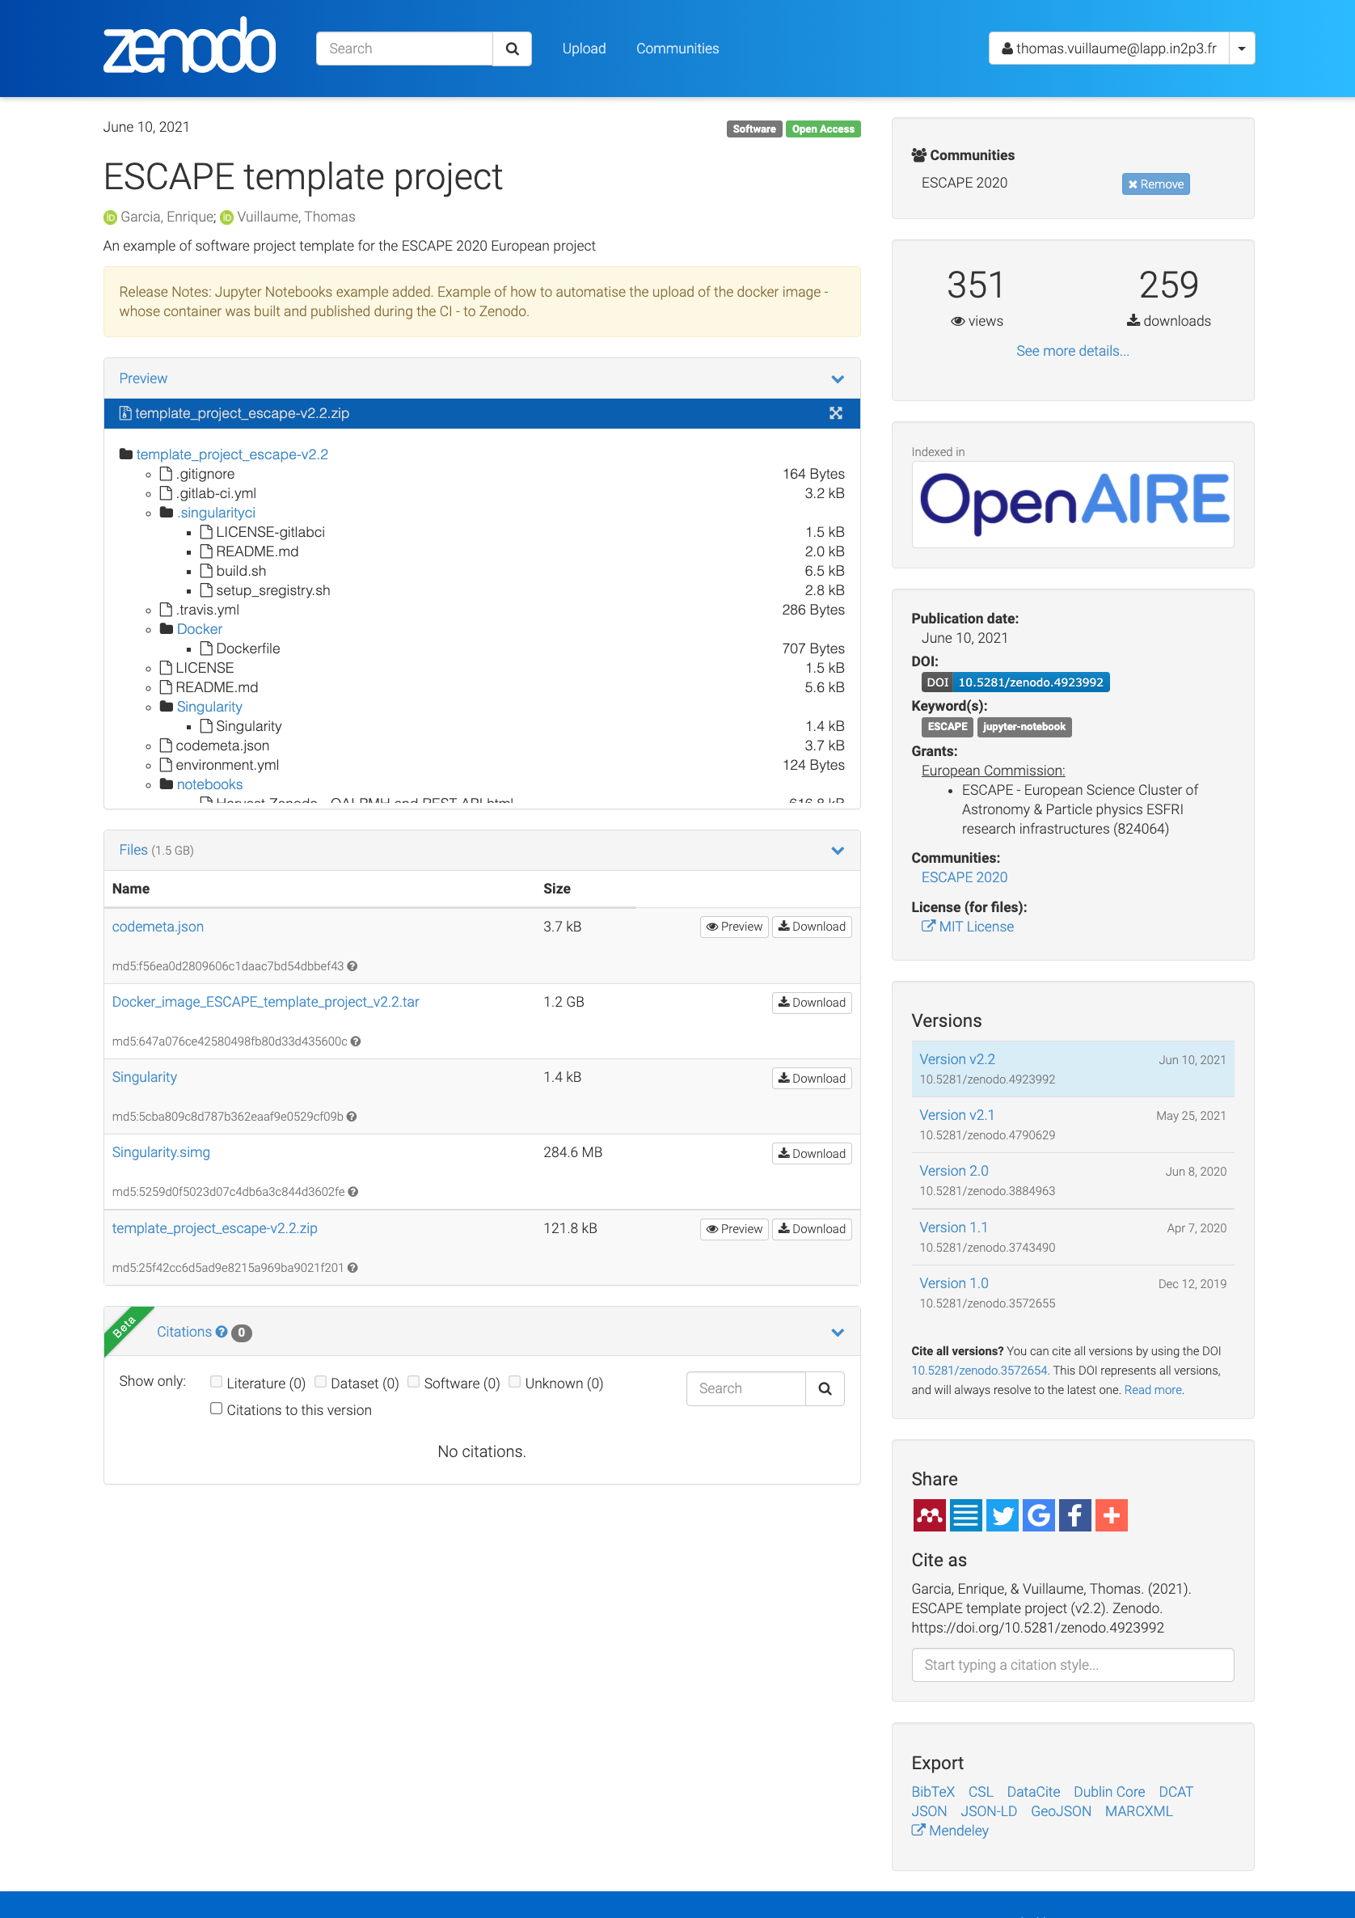
OSSR record example: ESCAPE template project
Communities
Views and downloads
DOI: persistent identifier
keywords
Source code preview
Funding
License
Record content
Versions
Cited by
Share
and cite
https://zenodo.org/record/4923992#.YUxKXmYzZB2
Docker: gitlab-registry.in2p3.fr/escape2020/wp3/template_project_escape:v2.2

Slide 19
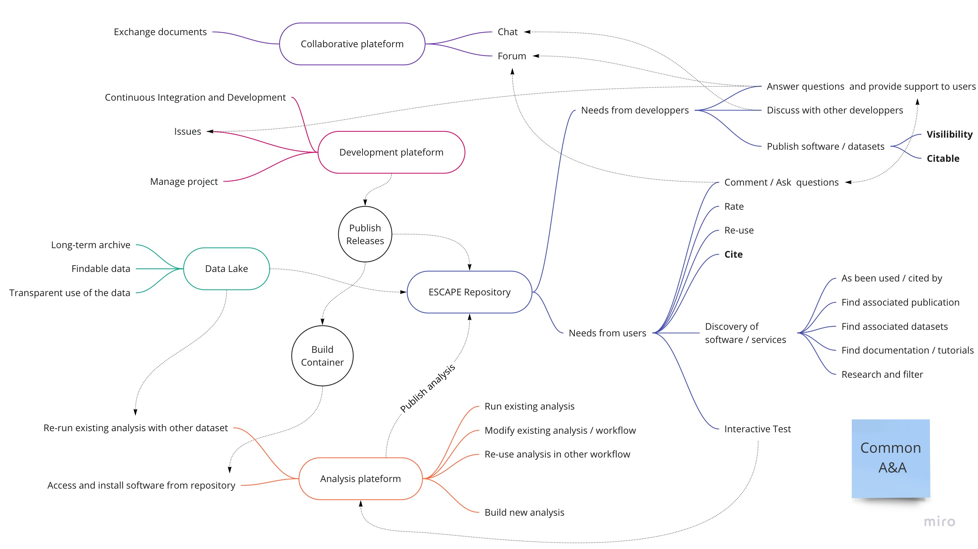
Conclusion
Aim: ESCAPE virtual environment
A lot of technical developments to create an integrated environment and ease the use of the OSSR
WIP: Connection with other services
see WP3-WP5 discussion
WIP: Integrating the OSSR in the research virtual environment
See Arturo's presentation
Discussions and contact point:
https://escape2020.pages.in2p3.fr/wp3/ossr-pages/page/contact/

Slide 20
Appendix

Slide 21
OSSR entry categorization (draft)
Scientific analysis software
fully installable software packages, e.g. gammypy
Service environments
Projects for data and service providers, which offer e.g. a platform, GUI, or middleware for the computing environment (e.g. ConCordia)
dedicated scientific products (analysis, data)
repositories of data or workflows: projects that provide a certain class of data objects and serve as repository for this class of data, e.g. jupyter notebooks, or certain analysis results (if not provided in datalake or VO), e.g. CME database
self-contained analysis environments: repositories which provide full workflows and data (access), e.g. to reproduce a given analysis (e.g. SKA data challenge, HCG-16 study)

Slide 22
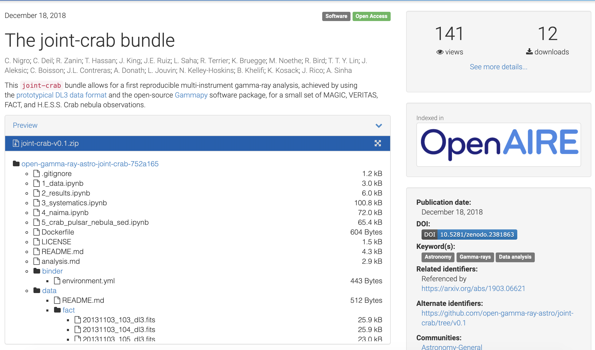
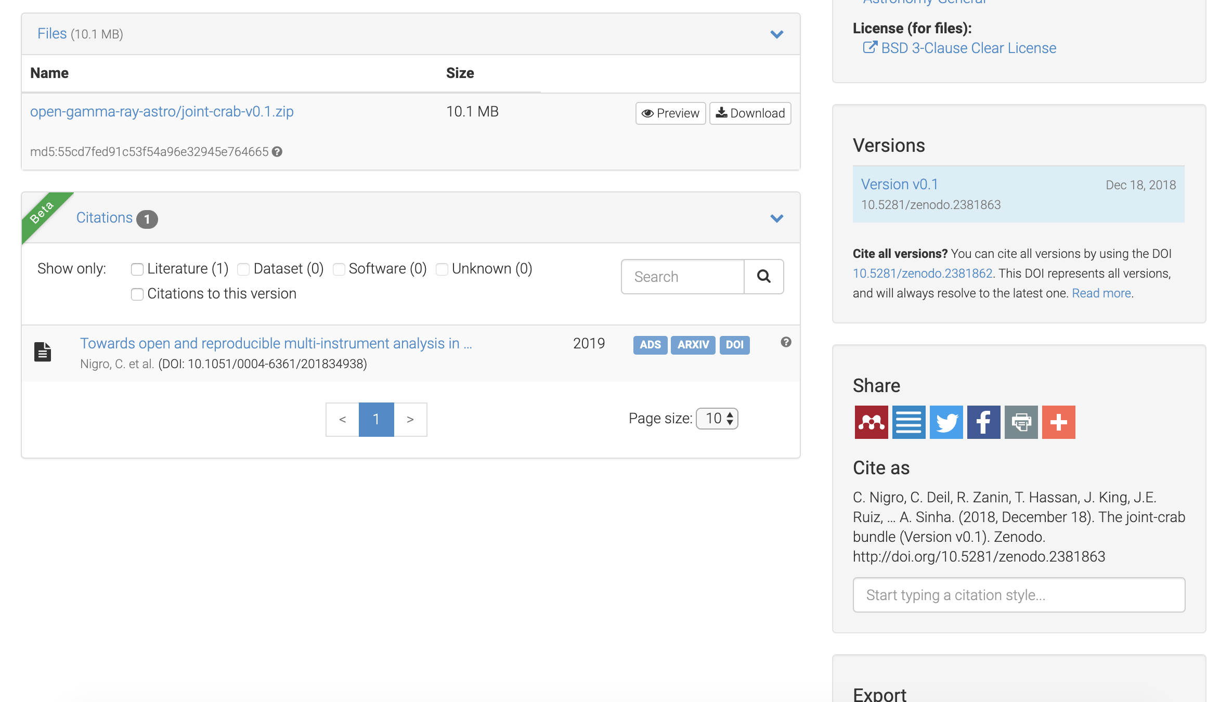
An example of target project : The Crab bundle
The Crab multi-instrument gamma-ray analysis with MAGIC, VERITAS, FACT and H.E.S.S.
https://zenodo.org/record/2381863#.XkxcD5NKhhA
https://github.com/open-gamma-ray-astro/joint-crab/tree/v0.1
license
Cited by
Link to project and article
Cite as
Source code and data

Slide 23
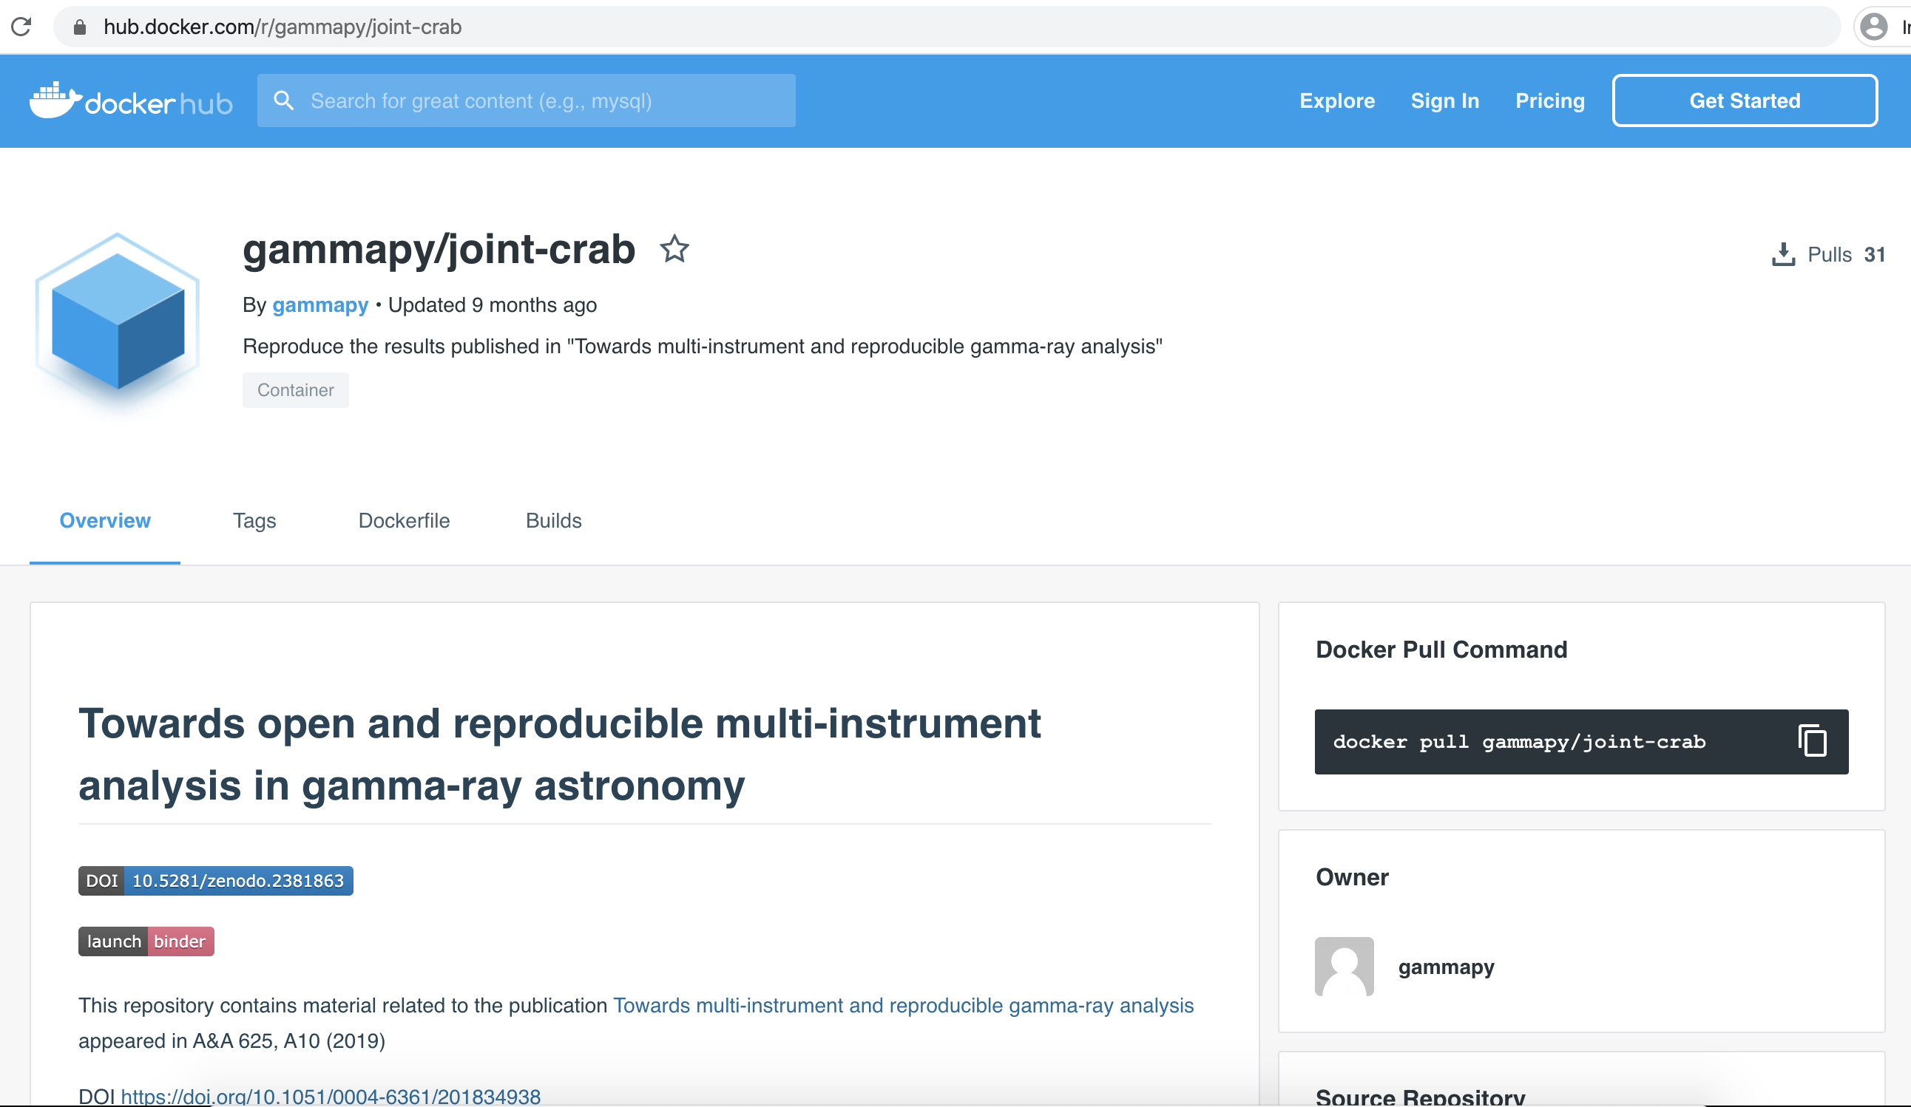
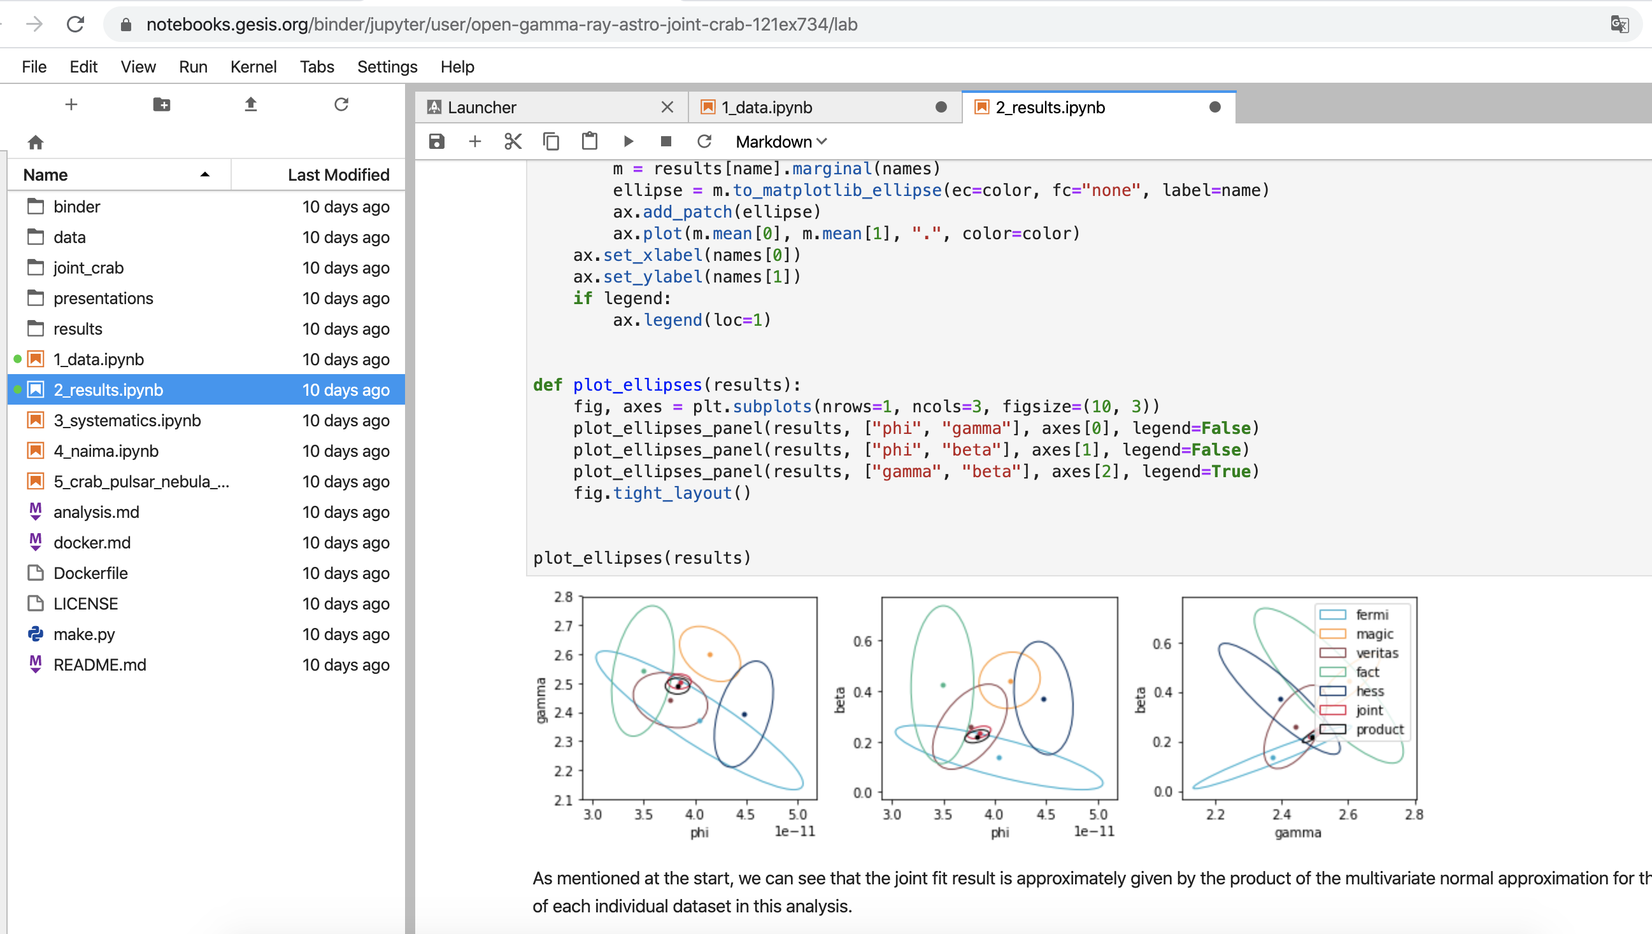
An example of project : The Crab bundle
The Crab multi-instrument gamma-ray analysis with MAGIC, VERITAS, FACT and H.E.S.S.
https://zenodo.org/record/2381863#.XkxcD5NKhhA
https://github.com/open-gamma-ray-astro/joint-crab/tree/v0.1
Binder to test
and run analysis
interactively online
Docker to ensure reproducibility and ease of use

