Slide 1
Et si nous parlions
du premier collisionneur de hadrons
et de son héritage ?
Hadron colliders:
The legacy of ISR at CERN
and the future.
François Vazeille LPC, 17 décembre 2021.

Slide 2

Science is the domain of ″Long time″ (particularly true in our activities in Physics).
It does not comply with urgency…
even though if it often happens to solve urgently many difficulties.
The general public does not fully understand this notion of ″Long time″
… but the researchers are also not immune!
Long time is conducive to forgetting and even to not knowing
(Le temps long est propice à l’oubli et même à la non connaissance).
We are going to ask the today physicists a question.

Slide 3
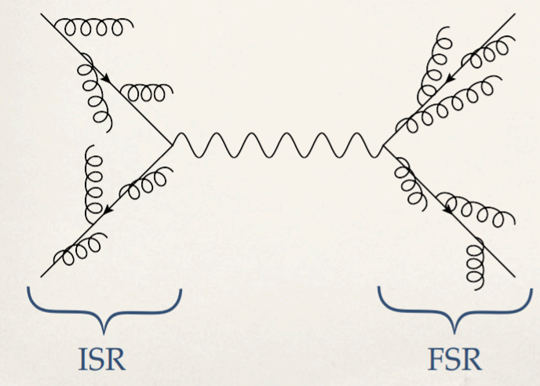
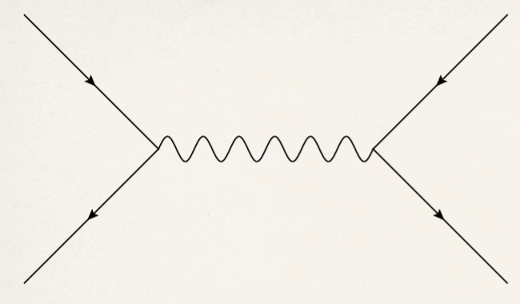
What does mean ″ISR″ ?
a b → c d
Parasitic processes:
Radiation emission (Photon, gluon)
a
c
Initial
State
Final
State
b
d
ISR: Initial State Radiation
FSR: Final State Radiation

Slide 4
ISR: Initial State Radiation

Slide 5

It is perhaps fun to go back in time…

Slide 6
Saturday
February 17,
1968
Visit of CERN organized by the
″Laboratoire de Physique Nucléaire Fondamentale et Développement″*
* Old name of our laboratory
A traditional visit ?
Yes … and no !
Discovery of impressive open-air works…

Slide 7
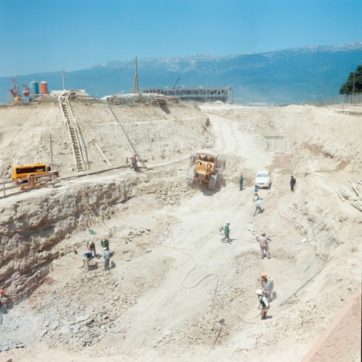
CERN

Slide 8
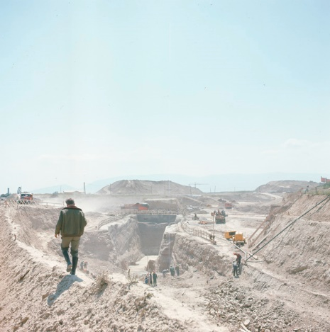
CERN

Slide 9
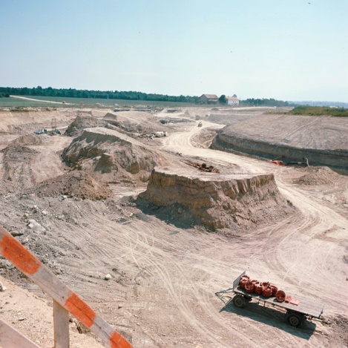
Construction civil works
of the first hadronic collider:
ISR
Intersecting Storage Rings.
12 years later,
we will contribute to one of its last experiments …
and ″perhaps″ to the last one in 1984 !
CERN

Slide 10
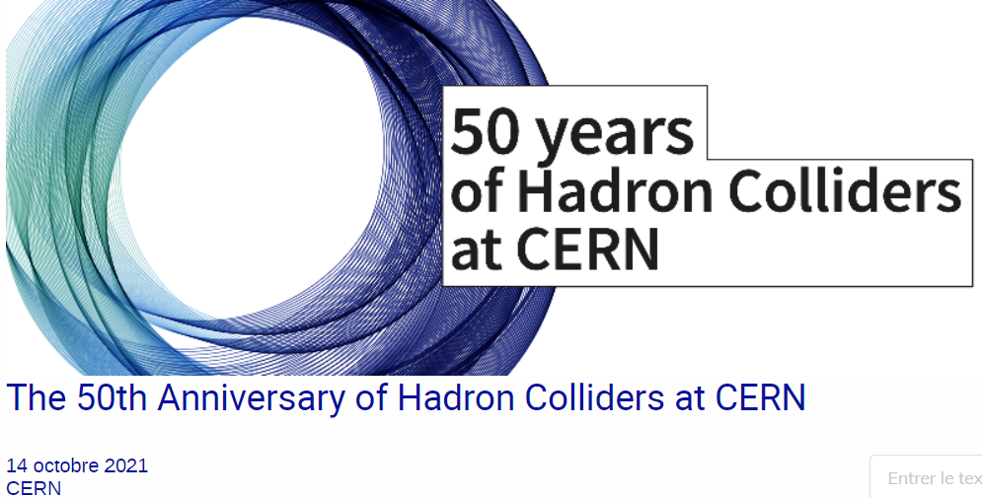
1. Welcome: Frederick Bordry, Joachim Mnich (CERN)
2. Overview: Carlo Rubbia (Gran Sasso Science Institute)
3. The ISR machine: Steve Myers
4. ISR physics: Ugo Amaldi (TERA Foundation)
5. The SPS and LHC machines: Lyn Evans (Imperial College)
6. SPS collider physics: Felicitas Pauss (ETH Zurich)
7. The LHC project: Chris Llewellyn Smith (Oxford University)
8. LHC physics: 3 young researchers
9. The view from the USA: Young-Kee Kim (University of Chicago )
10. HL-LHC and beyond: Fabiola Gianotti (CERN)
14 October 2021
https://indico.cern.ch/event/1068633/
Very interesting symposium
… even though I do not agree on some points outlined by the speakers.
I will pick up some information from it … and other sources,
in particular our own experience from the R608 experiment at ISR.

Slide 11
The quest for higher and higher energies:
WHY and HOW ?

Slide 12
The story of hadron colliders is strongly associated to
the quest of well controlled higher and higher energies
From the cosmic rays to the first accelerators.
See the excellent paper of Ulrike Mersits: CHS 17, March 1985.
https://cds.cern.ch/record/158939/files/CERN-CHS-17.pdf
″High-energy physics from 1945 to 1952-53″
Discovery of interesting information: who first use the terms ″elementary particles″ ?
Niels Bohr (Cambrige conference, 1946):
″Problems of elementary particle physics″.
Accelerators → better reproducibility of conditions and results, and better precisions.
… BUT why and how to reach high energies
… and also accessing to high counting rates of the expected physics ?

Slide 13
1. To ″have a chance″ to interact with the target
- Depending from the studied physics channel
with its probability given in term of production cross section σ
expressed in ″barn″ units with 1 barn = 10⁻²⁴ cm² and sub-units: 1 µb = 10⁻⁶ barn
1 nb = 10⁻⁹ barn
1 pb = 10⁻¹² barn
1 fb = 10⁻¹⁵ barn …
- Depending from the available energy E_{CM} in the collision of a et b (center of mass of a-b).
Fixed target:
a
b
E_{CM} = √ 2 M (E + M)
with b = a
E = E_{a} and T_{b} = 0
M = mass of a and b
Collider:
a
b
E_{CM} = E_{a} + E_{b}
with E_{a} = E_{b}
Example: collider proton-proton with beams of 15 GeV → E_{CM} = 30 GeV.
For the same center of mass energy on a fixed target → Should request a Beam of 479 GeV.
Such a collider would be very efficient … if it was possible to build it!

Slide 14
2. To have sizeable counting rates N
N proportional to n_{a} n_{b} x σ
(σ can be differential)
Must be large if σ is very small (rare process)
Fixed target: solid (Example: Lead), liquid (Example: liquid hydrogen), gas (Example: Helium).
→ Easy possibility with dense targets, except for a gas (unless at high pressure).
→ May request a high intensity beam.
Collider
→ Requests both intense beams … and high technologies leading to efficient head on collisions
… not yet invented at the beginning of this story.
N = L σ
with L = Luminosity proportional to (k I_{a} I_{b} /S) S = active beam crossing area
I_{a} I_{b} : the beam intensities
k : corrective factors
(Crossing angle, finite bunch length…)
Instantaneous L is given in cm⁻² s⁻¹

Slide 15
The first revolution: cyclotrons
→ beams on fixed targets
Cyclotron: Spiral trajectory of particles.

Slide 16
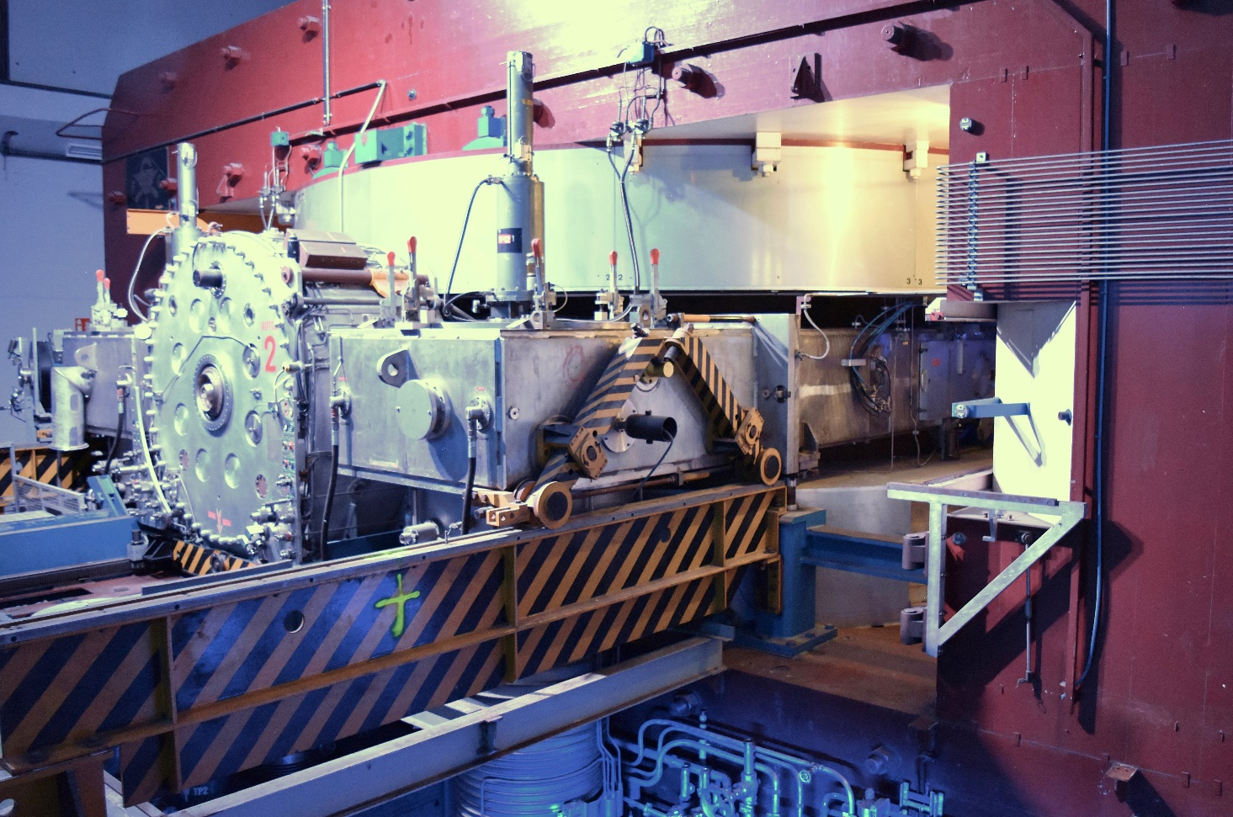
Cyclotrons then Synchrocyclotrons
SC at CERN (600 MeV Synchrocyclotron)
(1957, 1990)
→ 1.26 GeV protons.
built … pending the PS construction at CERN
(Proton Synchrotron)
Several LPC teams worked on SC.
Z22

Slide 17
The second revolution: synchrotrons
→ beams on fixed targets
Synchrotron: Fixed circular trajectory of particles.

Slide 18

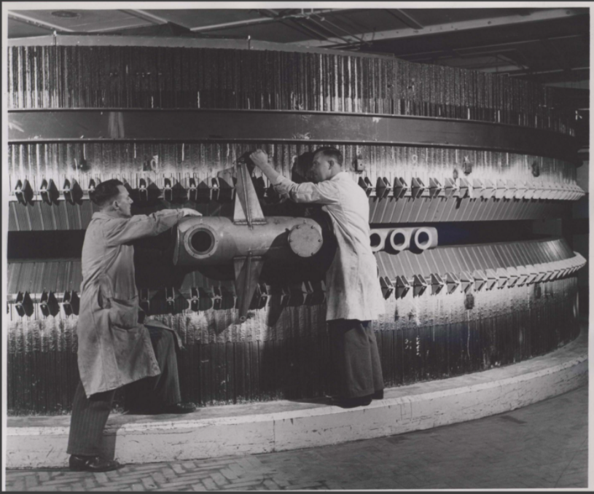
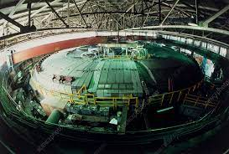
… always on fixed targets with increasing energy.
Increasing energies ? Dont ’t laugh !
Birmingham's synchrotron
(inaugurated 1953)
D. Oliphant: synchrotron principle
→ 1.3 GeV.
Cosmotron
(BNL:
Brookhaven National Lab.)
(1953-1966)
→ 3.3 GeV.
Bevatron/Bevalac
(LBL:
Lawrence Berkeley Lab.)
(1954-1993/2009)
→ 6.2 GeV and 10 GeV.
En France, Saturne à Saclay (1958, 2002): Protons de 3 GeV au début → 3.8 GeV maximum par la suite.

Slide 19
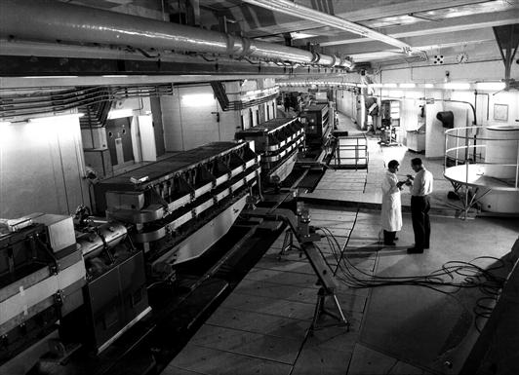
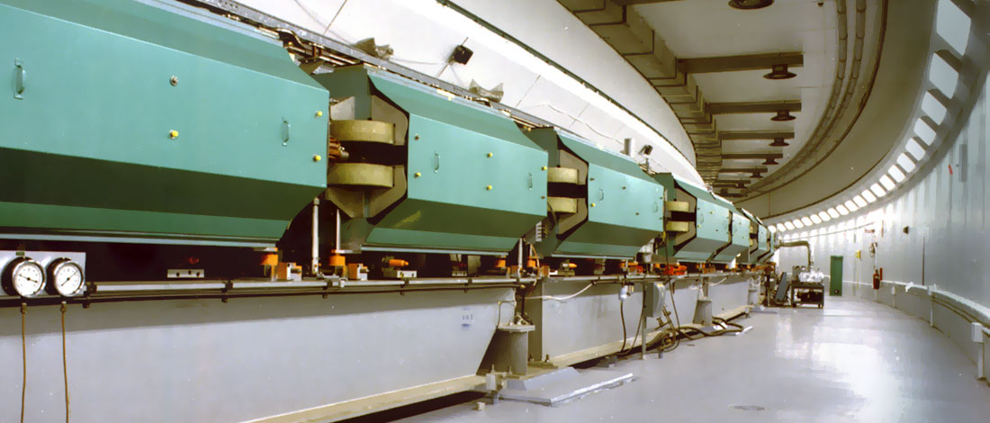
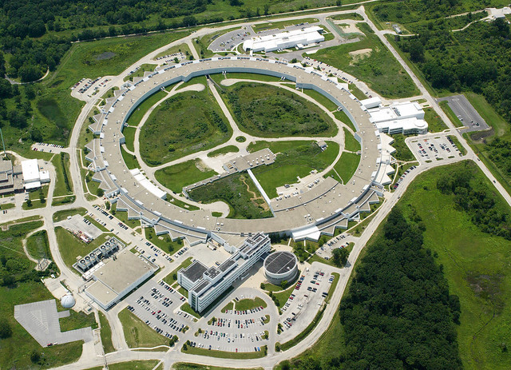
CERN PS (Synchrotron Proton)
24 GeV (November 1959)
(Principle of the AGS:
Alternative Gradient Synchrotron*)
28 GeV later
… always working!
AGS at Brookhaven (BNL)
→ 33 GeV (July 1960)
Serpukhov accelerator
→ 76 GeV (1968)
*Analogy of focusing and defocusing in optics:
here, placing alternate magnet return yokes
outside the orbit in order to balance the
magnetic field saturation.
The year we discovered the
civil works for the ISR!

Slide 20
The third revolution:
the first hadron collider.

Slide 21
Its genesis … started a long time ago.
1943: Rolf Widerøe (Norwegian engineer) → First idea of colliding beams.
BUT beams of high intensities are needed.
1950-1956 at CERN: Donald Kerst (MURA: Midwestern Universities Research Association)
→ idea of stacking particles in beams … BUT not yet storage rings.
Instead of having bunches of particles (″particules en paquets″),
particles would be stacked (″empilées″): debunched (″désempactées″).
1956, at the same conference of 1956 at CERN: Gerry O’Neill (Princeton)
→ Use of storage rings for electrons
taking benefit of damping of particule amplitude by synchrotron radiation.
1958: Design then construction of electron colliders: 500 MeV (Princeton-Stanford),
140 MeV (Budker at Novosibirsk).
1960: Bruno Touschek (Laboratori Nazionali di Frascati)
→ Seminar about an e⁻ e⁺ collider in a single ring: 250 MeV in a ring of 60 cm circumference
→ ADA operational one year later: the first stored electron and positron beams !

Slide 22
1960: ″A step into the unknown″ for higher energies of protons.
Opinions divided in 2 camps: Larger proton synchrotron on fixed targets
versus proton collider … never built tiil now !
1961: Study of a 300 GeV proton carried out, but the ISR would be constructed first.
1964: Meeting at CERN of 50 European physicists
→ birth of ECFA, chaired by Edoardo Amaldi
(European Committee for Future Accelerators).
15 December 1965: Unanimous approvement of CERN council of the construction of the ISR,
with the strong support of Edoardo Amaldi … and the best wishes of Heisenberg.
1966: Starting of the ISR construction.

Slide 23
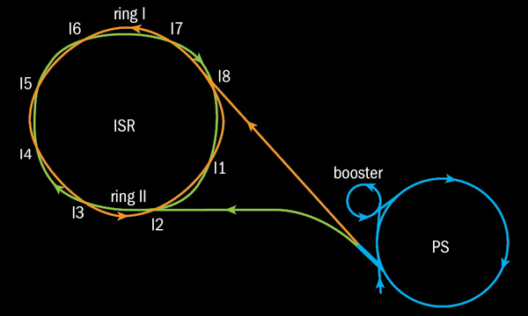
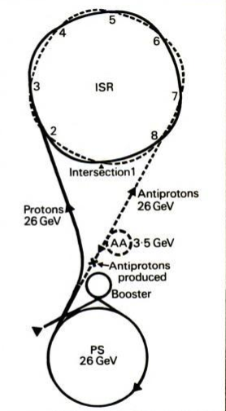
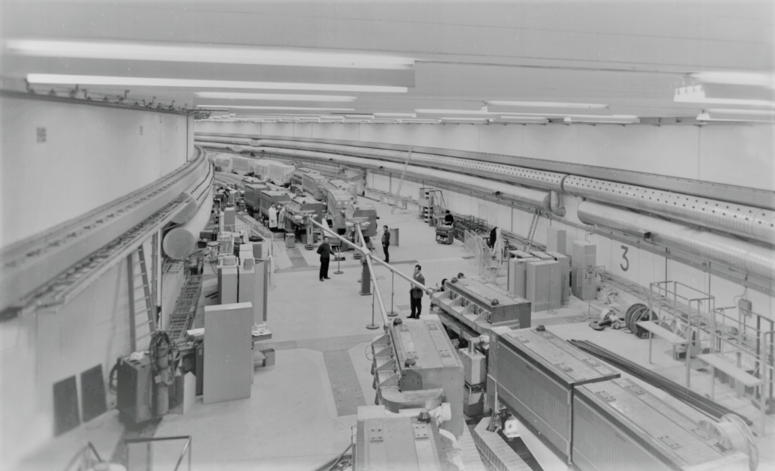
Additional machines
are used for antiprotons
Additional machines are used
for antiprotons.
One produced and selected
from the PS beam on a target,
antiprotons are stored in the AA
(Antiproton Accumulator)
then re-injected in PS,
to be accelerated,
and eventually sent to ISR.
2 interlaced rings each with a diameter of 300 metres.
8 intersecting regions for colliding beams:
6 for experiments, 2 for the machine.
Crossing angle of 14.77 ° → collisions are not ″purely″ head on.
Large available space for the experiments
(Not a tunnel like the LEP/LHC tunnel).

Slide 24
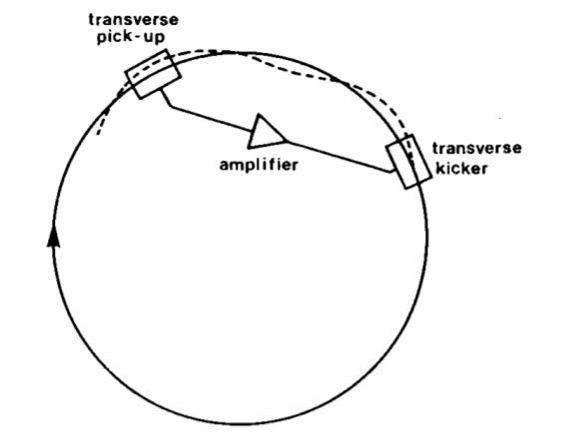
Many innovations
High beam intensities of stored particles taking benefit of both
- the high PS beam intensity (> 10¹² protons/burst),
- the new technics of RF (Radio Frequency) stacking,
[ previously tested in 1964 on a CERN Electron Storage and Accumulation Ring (CESAR)]
→ Particles are debunched and so accumulated like a flat ribbon covering about 2/3 of each ring
→ Permanent crossing of the 2 beams … and so permanent counting in experiments.
♦ Additional accelerations can be given: PS energy (11-28 GeV) of inlet particles
→ ISR energy particles up to 31.4 GeV/beam.
♦ Stochastic cooling (Wolfgang Schnell and Simon Van Der Meer)
→ continuous correction of mean transverse motion of particle samples
(taking benefit of the Shottky noise).

Slide 25
♦ Luminosity scan (Van der Meer) … using the shottky noise.
♦ World record of Luminosity over a long time:
10 times above the foreseen design value of 2.5 10³⁰ cm⁻² s-1
(we will see the evolution later),
taking benefit from the ultravacuum … itself continuously improved,
by far the biggest ultra-high vacuum system in the world along 2 km.
Insertion of superconducting magnets on each side of the collision points to decrease beam sizes:
the first time using superconducting magnets on an accelerator.
♦ … and a lot of other very technical points …

Slide 26
BUT, what was the state of particle physics before ISR starting?
♦ Status of the theory in the years 1960.
- Very good theory of Electromagnetic interactions: QED (Electrodynamique quantique).
- Major progresses of the theory of Weak interactions.)
- No achievement of a theory of Strong interactions:
Mainly described by the S matrix (invented by Werner Heisenberg… in 1943),
in terms or Regge poles:
(S matrix: analytic function in the complex plane in which the angular momentum is complex also.)
or by Thermodynamical models.
1971: Everything above true at the ISR start,
but for the quark/parton considerations: possible substructure of particules.
- Theory: quarks (1964: Gell-Mann and Zweig), partons (1969: Feynman).
- Experiment (1969): Deep inelastic scattering of electrons on protons-neutrons (Kendall, Friedman,Taylor)
via QED process → discovery of partons … later identified as quarks and gluons.

Slide 27
The first collisions

Slide 28
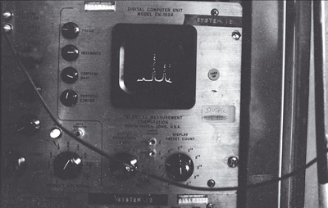
27 January 1971: the first collisions with 15 GeV/beams.
Particles detected from
both sides of an experiment
As we saw:
equivalent to a beam of 479 GeV on a fixed target,
well above the starting energy of 300 GeV of the future SPS!

Slide 29
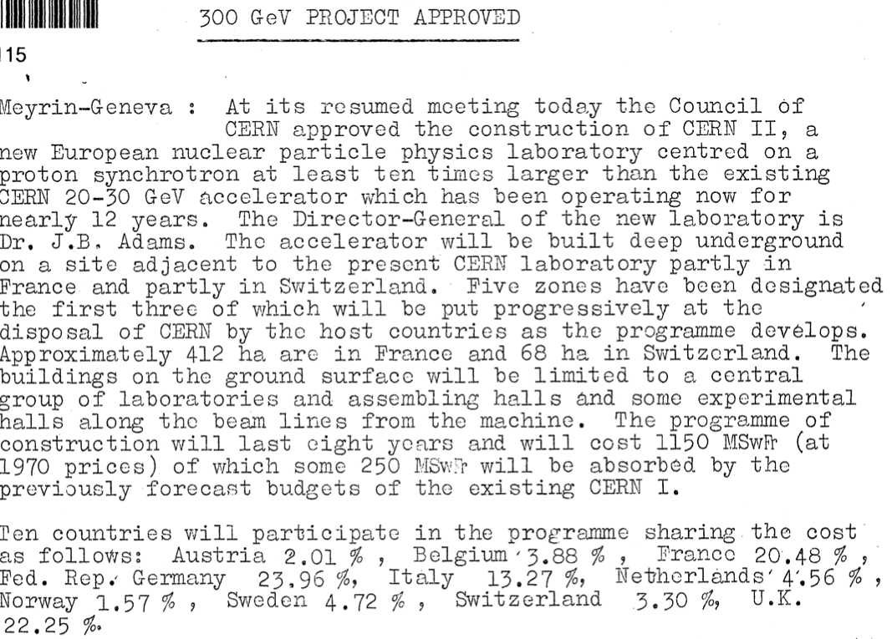
19 February 1971: CERN Council approved 300 GeV SPS.

Slide 30
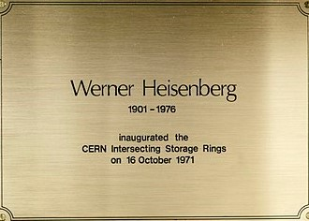
16 October 1971:
the inauguration of ISR
… some months after the first collisions.

Slide 31
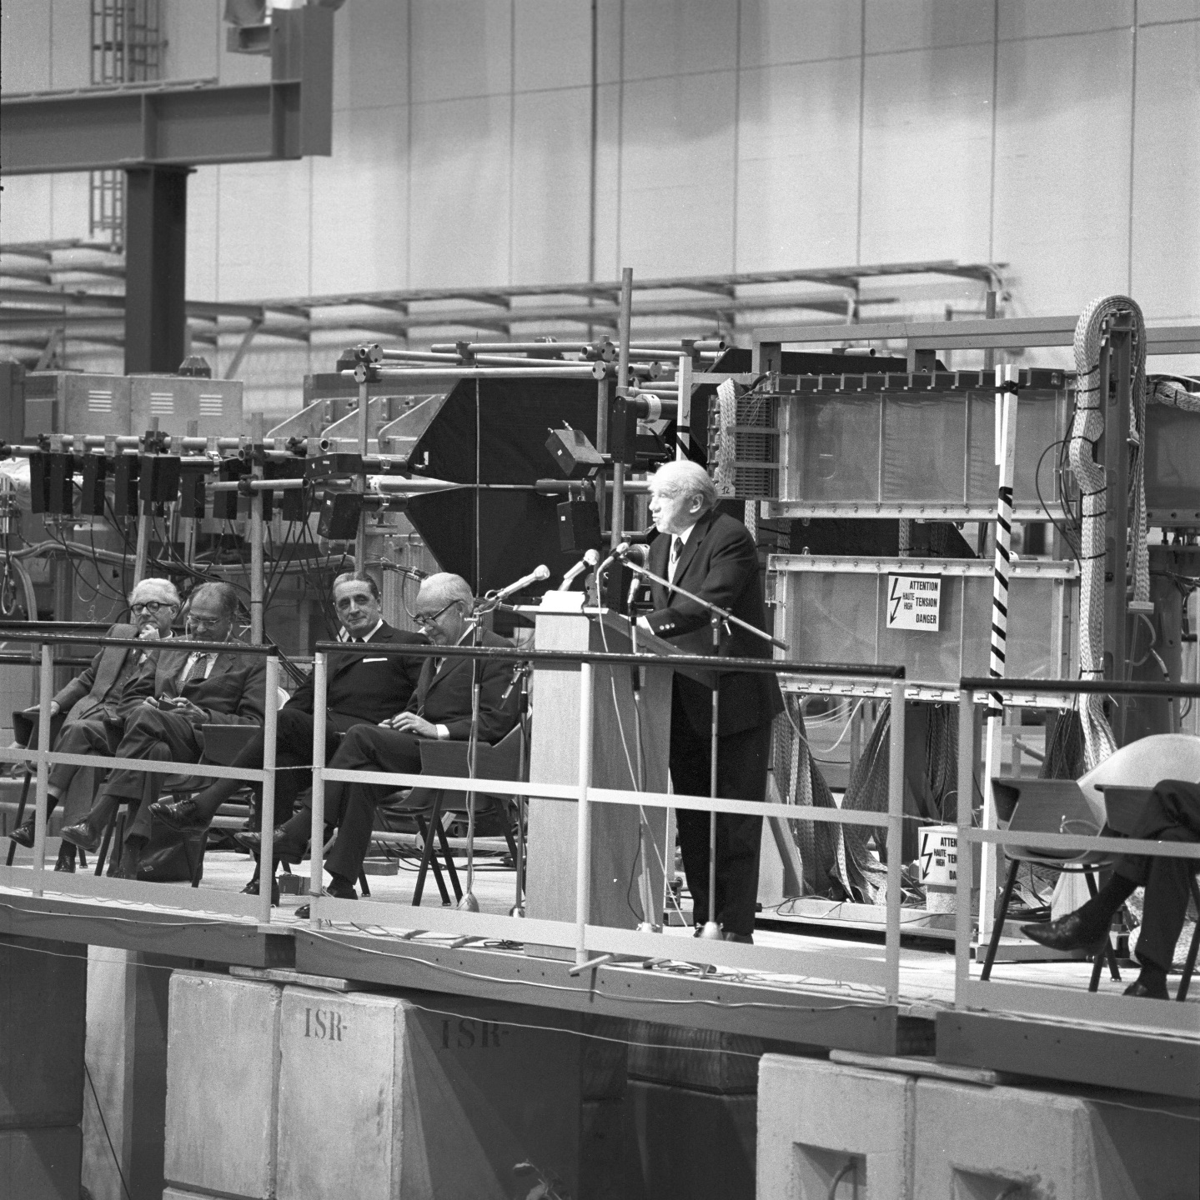
Willibald Jentschke
(1911, 2002)
first chairman of the
ISR Experiments Committee,
founder of DESY Hamburg.
Marcel Anthonioz
(1911, 1976)
Ministre…,
maire de Divonne-les-Bains
Werner Heisenberg
(1901,1976)
1932 Nobel Prize
″for the creation of
quantum mechanics"
Victor Weisskopf
(1908, 2002)
CERN Director 1961-1966
Edoardo Amaldi
(1908, 1989)
founder of INFN
and Frascati,
CERN Council president
(1970,1971) …

Slide 32
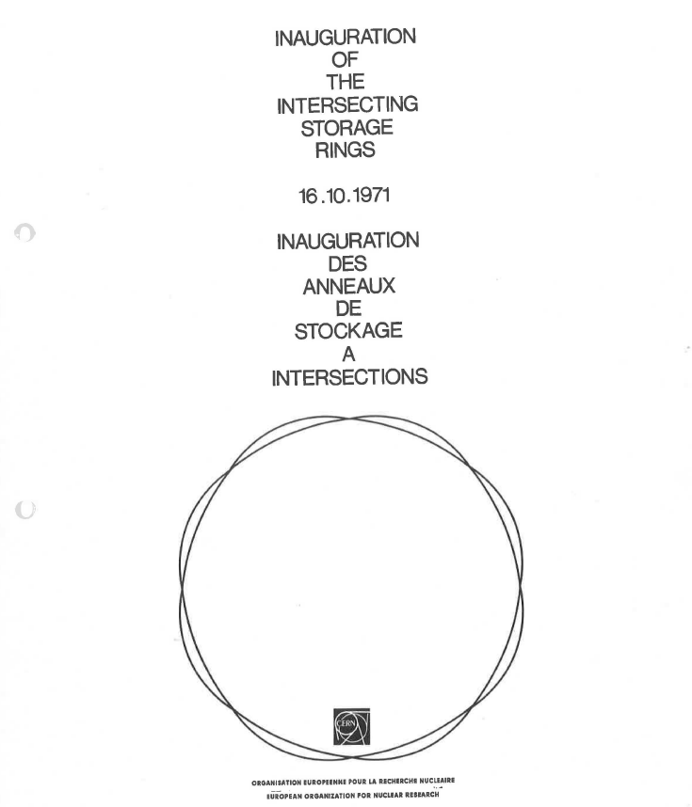
Official speeches accessible
in this paper
(put on indico
of the today seminar)
Some excerpts from Heisenberg's speech
″… two instruments were under consideration: the Storage Rings and the 300 GeV
Accelerator. I was most interested in the storage Rings mainly for two reasons:
… extremely high energies … construction cost not too high … to interfere with
other national projects.″
″… scientific hopes…
… At the time [of these] discussions… that period had revealed a fairly consistent
picture of the world of elementary particles…
… [the theory] seems not to disagree with the more recent observations… the
so-called asymptotic part …″
″A step into a higher energy region had always led to now to unexpected
discoveries; why should it not be so this time…
… so-called quark particles or entirely new types of showers or quite new features of weak radioactive interactions or the like.″
https://cds.cern.ch/record/59525/files/ISR%20Inauguration%20brochure%20.pdf
″ The Storage Rings give CERN
a leading position
in high energy physics.″
″… Experiments with Storage Rings are very difficult… I have always been very
optimistic with regard to … the inventive capacity of experimental physicists
when they try to make the best use of a new instrument.″

Slide 33
An aside inspired by Weisskopf’s speech…
in its second part in French
″Nous vivons dans un temps ou il y a de fortes tendances contre la science, contre le rationalisme, contre la culture de la recherche objective et rationnelle. Le CERN devrait être un rempart important contre ces courants dangereux.″
″We live in a time where there are strong tendencies against science, against rationalism, against the culture of objective and rational research. CERN should be an important bulwark against these dangerous currents.″
″Il faut mettre en valeur le romantisme de la recherche fondamentale et le romantisme de la coopération internationale.″
″We must highlight the romanticism of fundamental
research and the romanticism of international
cooperation.″

Slide 34
Let us resume these talks
Status of Physics and Sciencein 1971
50 years later, same comments !
1. Experiments and theories are not in conflict.
2. Strong wishes for surprises thanks to the ISR.
1. The Standard Model of particle physics is working
too much, far away its energy domain
… despite its known defaults.
2. Surprises are expected from the LHC
… but they late to come !
Hopes of Heisenberg will be fullfilled
3. Strong tendencies against Science, rationality
and objectivity.
4. CERN is a parfait example of worldwide cooperation
on fundamental research and the illustration of
what Science is meaning.
3. True in the general public, and unfortunately true also
in the academic spheres (Education, University,
Research…) ← Postmodern ideology.
4. The LHC Start was a worldwide event …
but we must go on everywhere, in particular thanks
our laboratories and scientific organizations.

Slide 35
What kinds of experiments
and collaborations at ISR ?

Slide 36
At the beginning:
- Specialized experiments (not general purpose experiments), mainly soft interactions studies.
- Detectors in the Forward direction (like in the fixed target experiments).
- Collaborations of a small number of laboratories (< 10).
Afterwards:
- Interest of measuring hard interactions → detectors in transverse directions.
- General purpose experiments coming … with growing detectors.
Example of a 4-π detector: The SFM
( Split Field Magnet: 2 dipole magnets of opposite polarity) at the I4 point.
- proposed by Jack Steinberger in 1969.
- operational by the end of 1973 ″for exploring terra incognita″.
- Used as a general ISR facility.

Slide 37
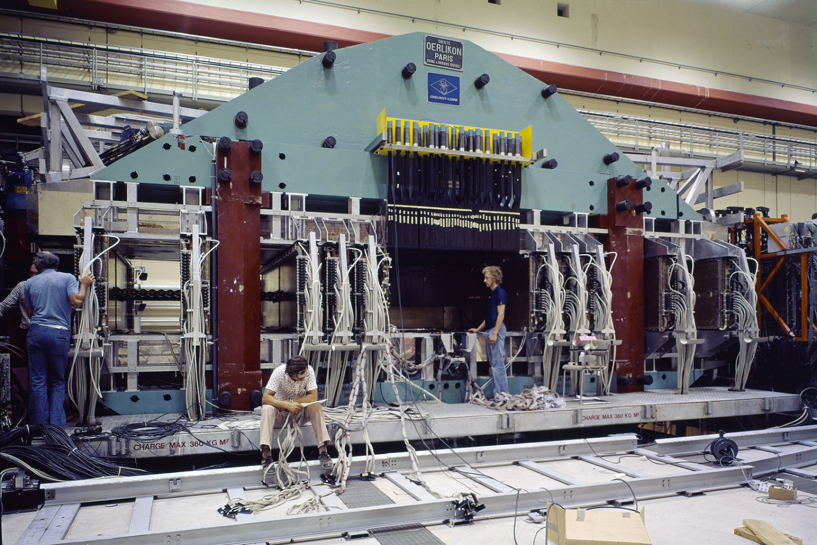

Slide 38
Our experiment at ISR:
R608.

Slide 39
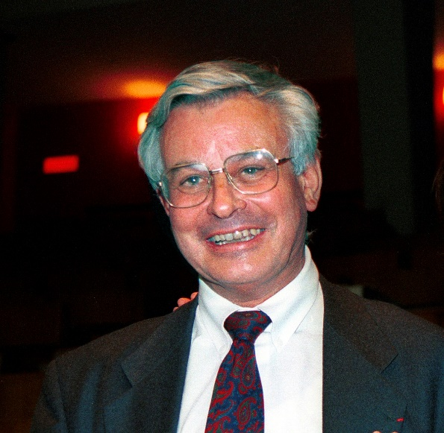
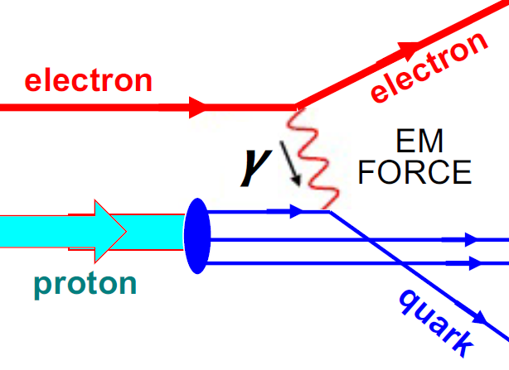
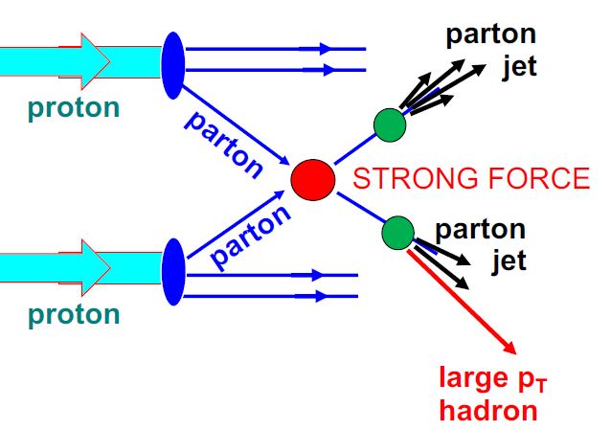
BUT before…
a few words reminiscent of Maurice Jacob
who played a major role in the ISR and on our activity in an experiment.
◊ French theorist, CERN staff.
◊ Leader of the Theoretical Physics Division of CERN (TH: 1982-1988),
and other positions close to the CERN General Director.
◊ Member of the ISRC (ISR Committee) at the time of our experiment.
◊ Expert in the phenomenology of strong interactions: key contributions
- with Giancarlo Wick: creation of the helicity formalism,
- with Sam Berman: prevision that high-transverse-momentum processes
in proton-proton collisions (subsequently observed at the ISR) should
correspond to the point-like parton structures in deep-inelastic scattering.
Maurice Jacob
(1933, 2007)
parton
- and many other things (Quark Gluon Plasma, etc.).

Slide 40
Organized the ECFA workshop at Lausanne (1994),
crucial in the LHC story.
President of the SFP (Société Française de Physique)
and of the European Physical Society.
◊ Member of the Scientific CNRS council, etc.
Maurice Jacob
Recognized as being close to both the Accelerator people and Experiment people,
with strong humam qualities.

Slide 41
He knew we had a good practice of experiments at 90°
[measuring recoils close to 90°,
at SC (SC26, SC32), PS (P17, S143), SPS (WA9)…]
and on studies of diffractive processes (elastic and inelastic).
He
He gave us very useful advices on Physics
and supported us at all times …
and even in the most difficult moments.
Maurice Jacob

Slide 42
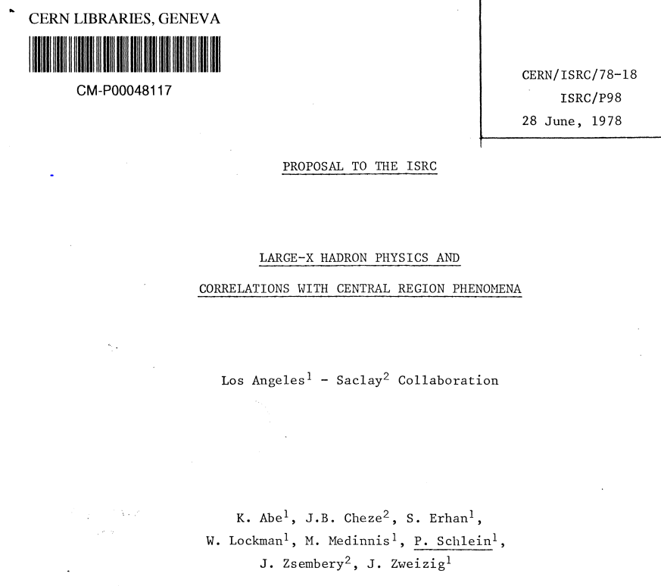
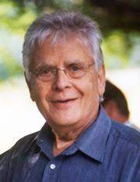
He suggested that we join the ISR R608 collaboration
and made us meet its spokesman Peter Schlein
LARGE-X HADRON PHYSICS AND
CORRELATIONS
WITH CENTRAL REGION PHENOMENA
Peter Schlein
(1932,2008)
UCLA
R608 Spokesman
Maurice Jacob
Only few physicists from UCLA and Saclay (CERN not yet represented)
→ Strenghts only on the Forward spectrometer …
and works not yet performed on a 90° Spectrometer.

Slide 43
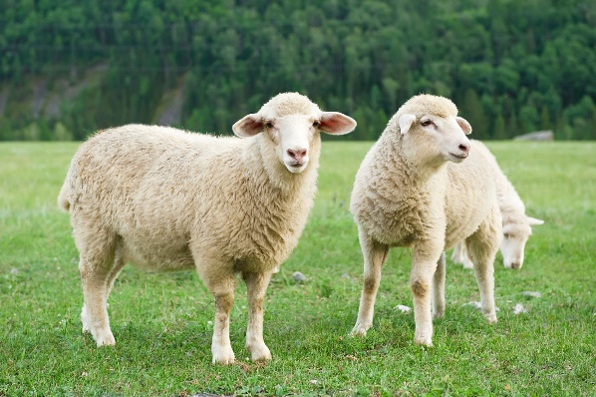
Electronics
roomS*
R608
* Very often with sheep around the building

Slide 44
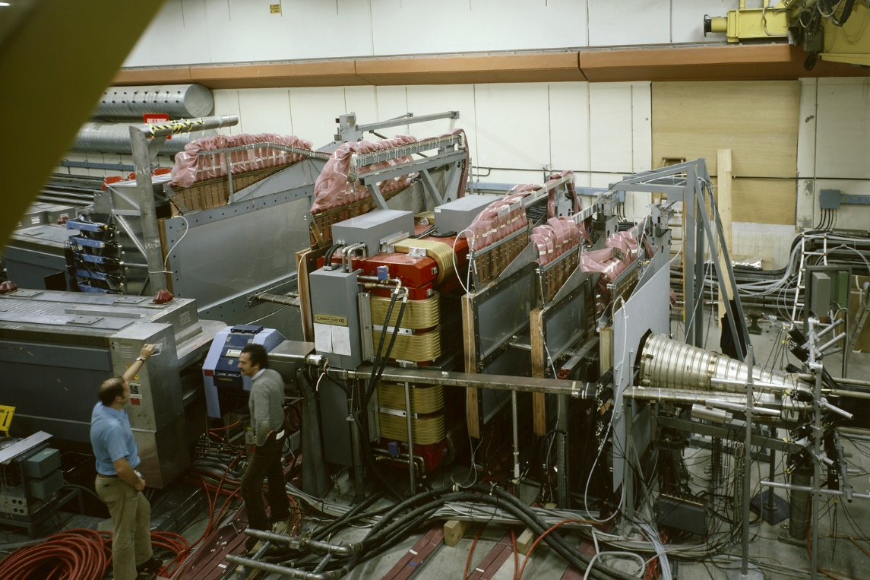
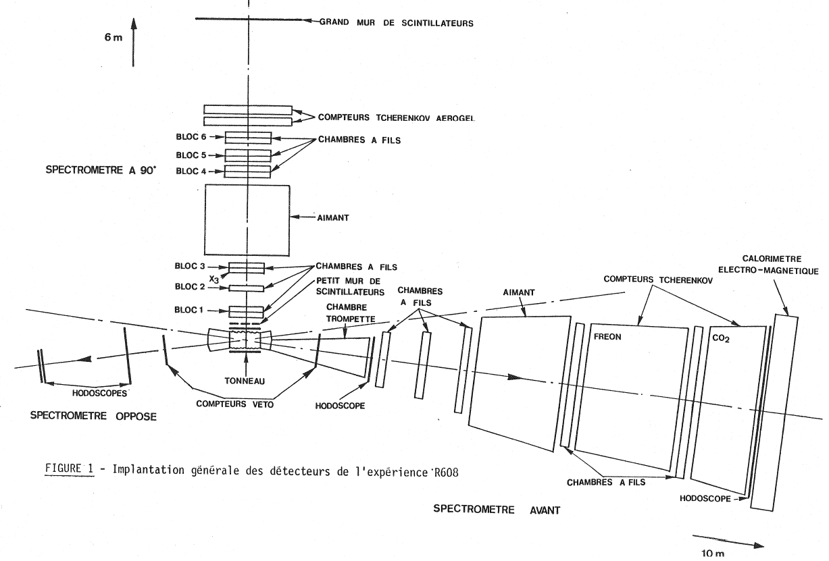
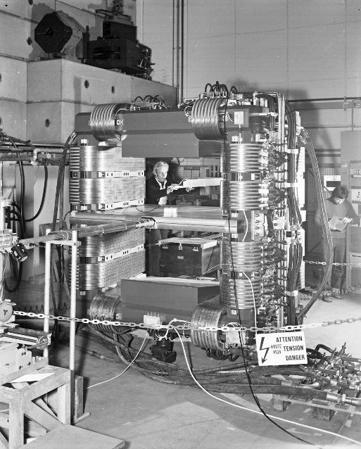
Initially
… with an
original
double-septum
Magnet
(So-called
″Lamp Shade″
(abat-jour)
9O° Spectrometer
Picture seen from
this location
R608 status in March 1980
O° Spectrometer

Slide 45
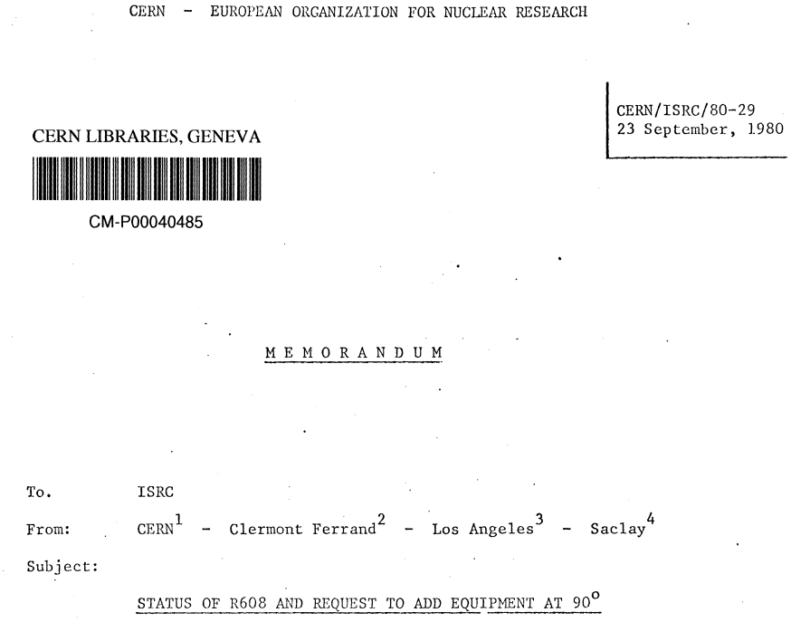
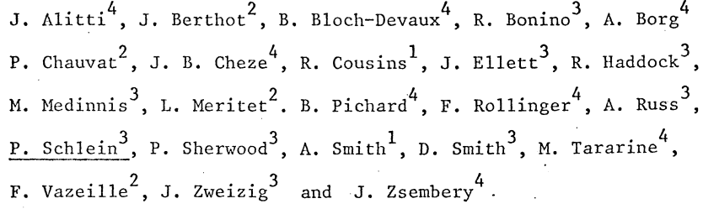
March 1980: Official integration of the LPC team
in the R608 experiment (Memorandum CERN/ISRC/80-10).
10 September 1980: Request to add equipment at 90°
( Memorandum CERN/ISRC/80-29).
17 October 1980: Recommendation ISRC
( Memorandum CERN/ISRC/80-29).
″ISRC decided to recommend for approval the addition
of this spectromter at 90° under the assumption that the particle identification provided by the
aerogel counters can be made to work as described″.
20 October 1980: Final approval of the CERN Researh Board (CERN/RB46).

Slide 46
Initially
Our team will be the project manager of the extension
and of its connections to the Forward Spectrometer
and other parts (Backward, Barrel, Veto counters)
and of its working.
9O° Spectrometer
O° Spectrometer

Slide 47
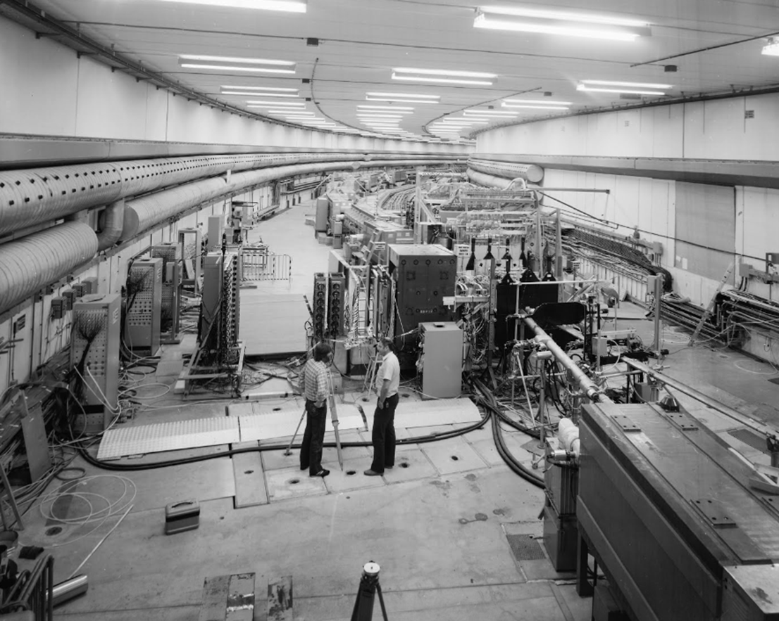
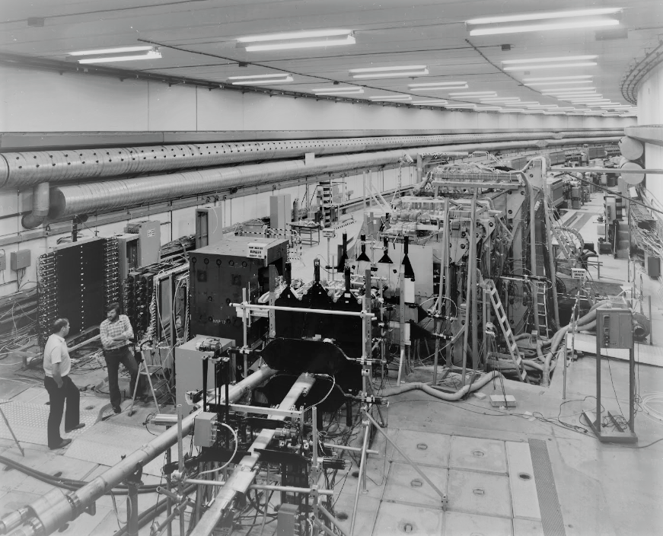

Slide 48


LPC team over the whole activity period
J. Arnold (Electro-mechanics), J. Berthot (CNRS), R.Bonino (UCLA, CNRS CDD), R. Chadelas (Electronics), P. Chauvat (Fellow CERN), M. Crouau (Electronics), S. Mayade (Mechanics), A. Mahrousseh (Student) ,
L. Méritet (University), M. Reyrolle (Student), E. Sahuc (Electronics), G. Savinel (Mechanics),
F. Vazeille (CERN/CNRS), A. Ziane (Student),
with the contribution of P. Bertin (CNRS).
As usually, major role of technicians and engineers,
in particular through the job and thesis
of Robert Chadelas…
BUT strong difficulties with the LPC management
during the proposition of the experiment and its official CERN agreement,
its preparation, assembly, realization and analysis
… and even later in its possible continuation at the SPS collider.

Slide 49

The rate of production of theses is not yet that of future experiences (SPPS, LEP, Tevatron, LHC).
Pascal Chauvat (1979): ″Possibilités offertes par la méthode dite du recul appliquée à l‘étude des interactions
inélastiques à haute énergie et très bas transferts sur cible gazeuse″.
It is not a work in R608 … but a prospective job just before: this led to the fruitful meeting of Maurice Jacob.
Then Pascal obtained a fellow position in R608.
Robert Chadelas (1984): ″Contribution à l’électronique, assistée par microprocesseurs, d’une expérience réalisée
auprès d’un accélérateur de très haute énergie″.
Michel Reyrolle (1984): ″Mise en œuvre d’un spectromètre magnétique auprès des anneaux de stockage à
intersections du CERN (Extension à 90° de l’expérience R608)″.
(Later: CERN fellow in ALEPH)
Abdelhamid Ziane (1986): ″Etude expérimentale des invariances CR et CP dans des collisions proton-antiproton
à très courte distance, auprès des anneaux de stockage (ISR) du CERN″.
Awarded the prize for the best CNRS thesis for developing countries (official ceremony at Paris…).
Ahmed Mahrousseh (1988): ″Résultats inclusifs à 90°, aux ISR, en faveur d’une sous-structure diquark du proton,
et prévisions de la Chromodynamique quantique (Expérience R608)″.

Slide 50
♦ Main results of R608
First evidence of quark-antiquark annihilations in proton-antiproton collisions.
Evidence of interactions Pomeron-quark.
Test of CP invariance in the Λ° decay, in the Forward spectrometer.
Test of CR/CP invariance in the comparison of p-p and p-p collisions, in the 90° Spectrometer.
Inclusive cross sections of production of p, π et K at 90°.
Flavour quark correlations between forward protons and 90° triggers at 90°.
Etc.
A good illustration of point-like hadronic interactions as Heisenberg wished !
Rich results of all ISR experiments
taking benefit of the highest obtained energies, up to 62 GeV in center of mass,
equivalent to a beam of on a fixed target of 2.05 TeV.

Slide 51
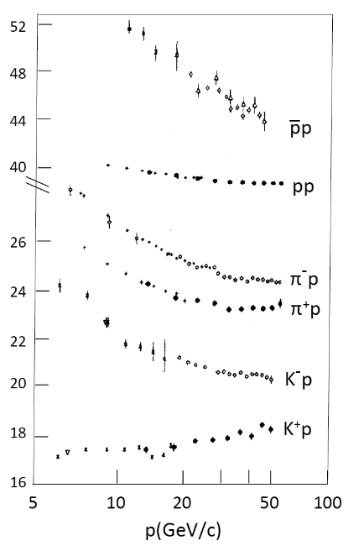
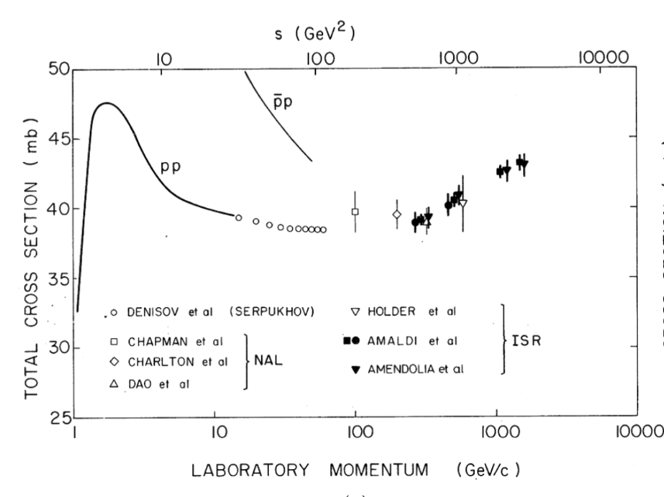
Cross sections
before ISR:
Towards asymptotic
regimes…
as specified by Heisenberg.
Rising cross sections in p p
(Afterwards: previsions at higher energies
using Dispersion relations)
The wish of Heisenberg
of unforeseen results.

Slide 52
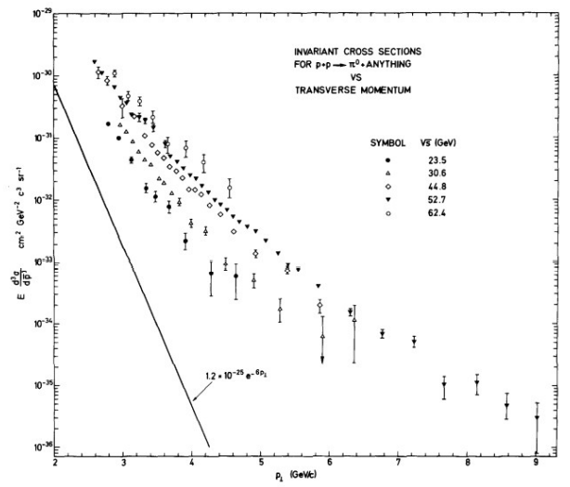
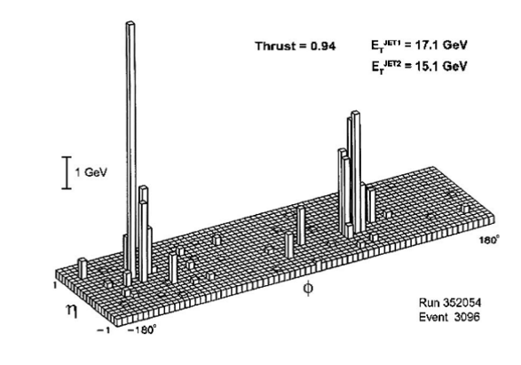
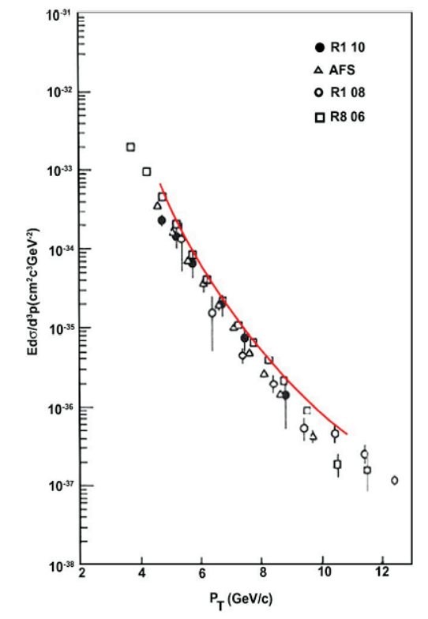
Evidence of large
transverse momentum phenomena:
caracteristic of parton scatering.
Lego plot of a
two-jet structure
(AFS)
Direct photons

Slide 53
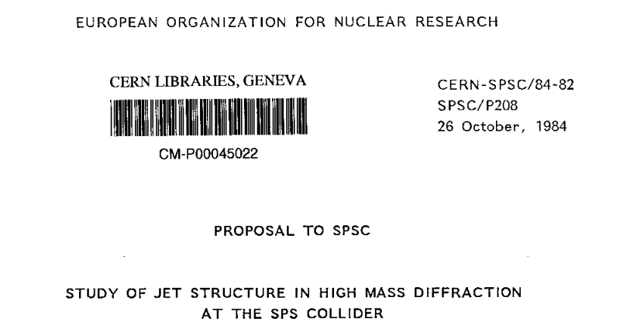
Our proposition to continue collaboration with UCLA (and Saclay)
in an experiment at SPPS at CERN
Goal: Show a possible partonic structure of Pomeron (in terms of gluons ?).
LPC team asked for contributions from UCLA team
in spring 1987:
→ FV proposal to a LPC ″special committee″ (???):
Physics, technical works, manpower/funds
(Very realistic and not expensive)
+ a foreseen seminar to LPC
Experiment added at 0° to the UA2 experiment,
using detectors in ″Roman pots″, also used as triggers.
Veto of our laboratory…
that disturbed our collaboration.
- Accepted for UCLA/CEA as the UA8 experiment:
→ many results, in particular:
evidence of the Pomeron in terms of 2 gluons.
- The first time triggering on a collider with ″Roman pots″.

Slide 54
TOWARDS THE ISR CLOSING
in 1984

Slide 55

- Propositions of all experiments to continue beyond 1984 were rejected…
except a ″curious″ experiment using only one beam:
the last running antiproton beam … on a gas target.
Study of charmonium states
(Annecy / CERN / Genoa / Lyon / Oslo / Rome / Turin)
- BUT an even more extraordinary proposal will propose to go further
… and we will be concerned.
Elastic scattering of high energy protons
on …
Vacuum.

Slide 56
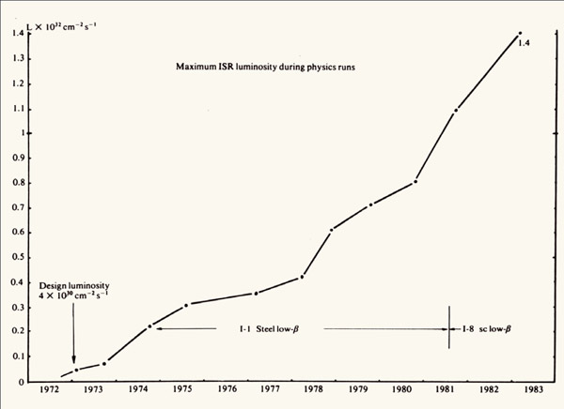
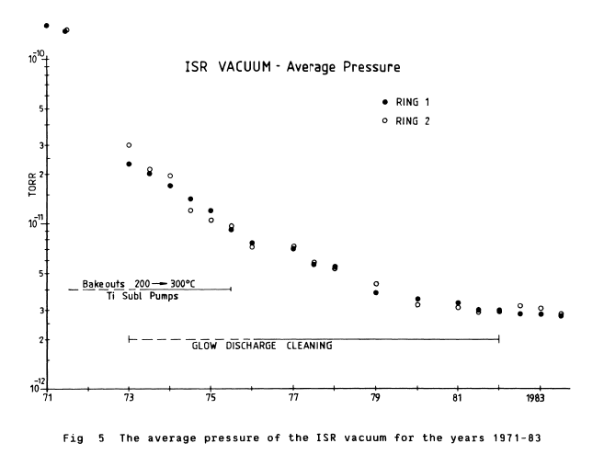
Reminder: rising Luminosity thanks to the regular vacuum improvements
VERY VERY GOOD … BUT …

Slide 57
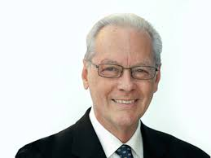
LPC team:
- Many experiments based on recoil detections
( SC26, SC32, P17, WA9, S143…).
- In charge of the 90° R608 spectrometer
→ Kinematic calculations supposing various masses.
Observations of Ugo Amaldi
Peter Schlein
R608 Spokesman
Proposition to CERN
to delay more the ISR closing!
4 facts at ISR
1. One of the highest ultravaccum in a large volume.
2. The highest intensity of high energy proton beams.
• What if these ″objects″ were very massive particles?
Remnant particules from Big Bang?
(The concept of Dark matter was not yet invented)
3. The live times of stored proton beams are high
… but slightly lower than expected.
4. Efficiency of the vaccum pumping system very high
… BUT very heavy ″objects″ could be not trapped
and would stay in beam pipes.
• Possible detection?
- Recoils from ONE ISR BEAM colliding VACUUM.
- ISR experiment having a 90° spectrometer ?
The R608 experiment

Slide 58
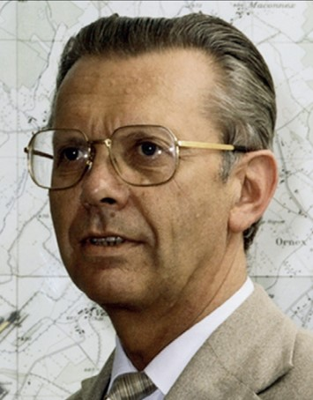
LPC team:
- Many experiments based on recoil detections
( SC26, SC32, P17, WA9, S143…).
- In charge of the 90° R608 spectrometer
→ Kinematic calculations supposing various masses.
Observations of Ugo Amaldi
4 facts at ISR
Peter Schlein
(R608 Spokesman)
Herwig Shopper
(CERN Director General)
Seriously considered …
but finally rejected !
1. One of the highest ultravaccum in a large volume.
2. The highest intensity of high energy proton beams.
• What if these ″objects″ were very massive particles?
Remnant particules from Big Bang?
(The concept of Dark matter was not yet invented)
3. The live times of stored proton beams are high
… but slightly lower than expected.
4. Efficiency of the vaccum pumping system very high
… BUT very heavy ″objects″ could be not trapped
and would stay in beam pipes.
• Possible detection?
- Recoils from ONE ISR beam colliding vacuum.
- ISR experiment having a 90° spectrometer?
The R608 experiment

Slide 59
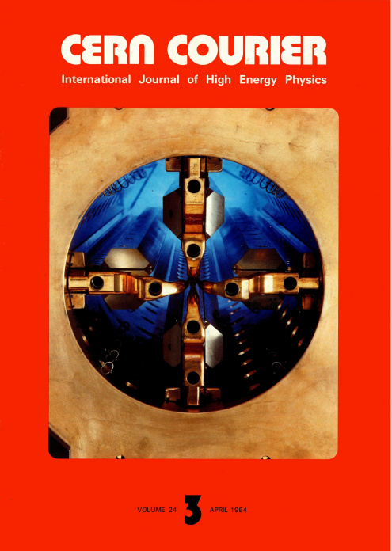
CERN Courier of April 1984
reporting on the ISR closing
″Intersecting Storage Rings bow out 92
World's first hadron colliding beam machine closes down″
″Les anneaux de stockage à intersections prennent le large.
Le premier collisionneur du monde de faisceaux de hadrons
ferme ses portes″

Slide 60
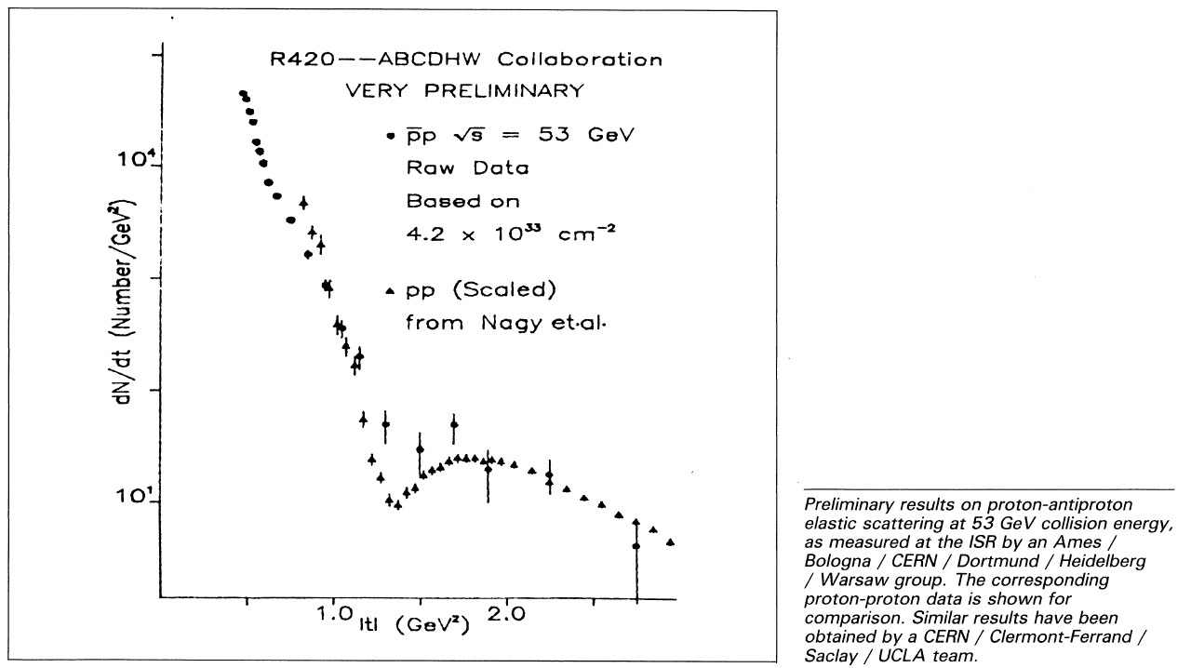
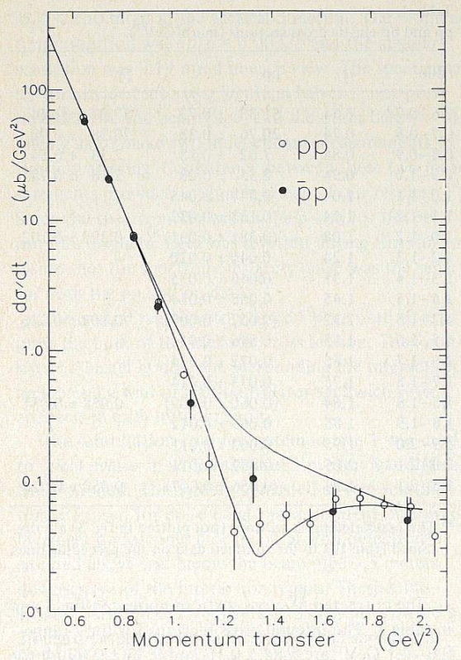
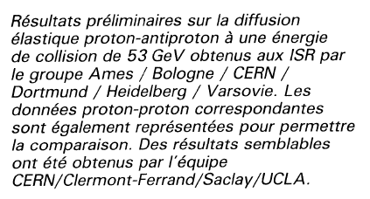
Curiously, only one physical result is given on a Figure:
Elastic scatering of p-p and p-p
Our results
[Physics Letters B 152 (1985) 131]
Upper curve:
one possible pp
theoretical
estimate.
Lower curve:
Fit of left
pp data.

Slide 61
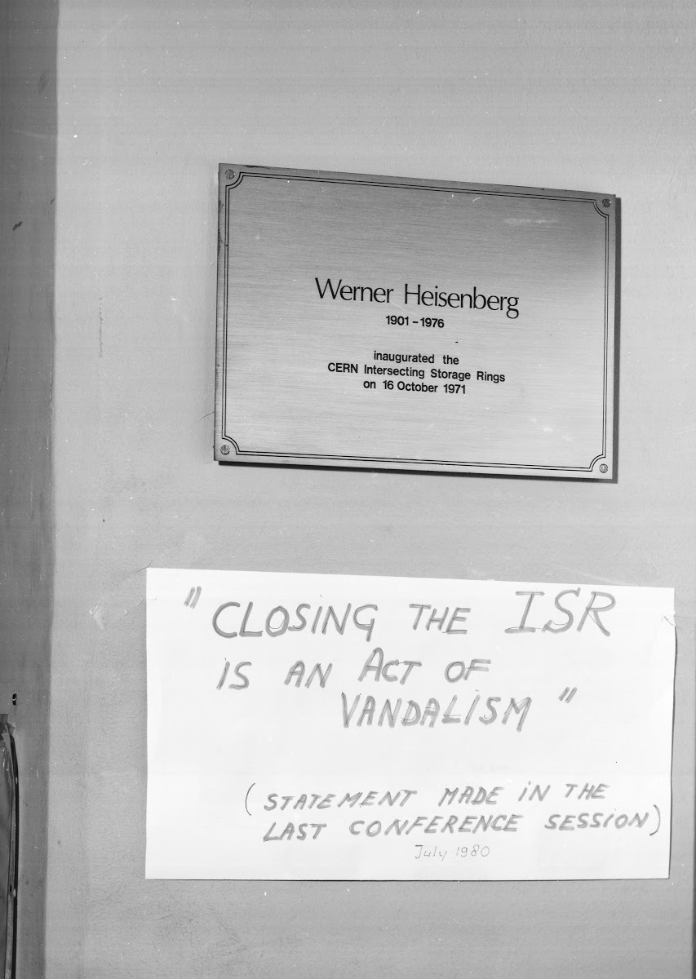


This closure is resented by ISR physicists
Closing ceremony (26 June 1984)
A boycott on the grass
Giorgio Belletini (Chairman ISRC…)
Wiki Weisskopf
Kjell Johnsen
Herwig Shopper
???

Slide 62
Closing ceremony (26 June 1984)
″First considered a window into the future, ISR turned out to be more”
Giorgio Belletini (Chairman ISRC…)
Wiki Weisskopf
Kjell Johnsen
Herwig Shopper
???

Slide 63
“First considered a window into the future, it turned out to be more
Closing ceremony (26 June 1984)
″D'abord considéré comme une fenêtre sur l'avenir, il s'est avéré bien plus″
Giorgio Belletini (Chairman ISRC…)
Wiki Weisskopf
Kjell Johnsen
Herwig Shopper
???

Slide 64
… or else, with a lot of humor
“I come to bury Caesar,
not to praise him.
The evil that men do live after them, the good is often interred with
their bones.
So let it be with Caesar.”
Maurice Jacob, casting himself in the role
of Mark Antony in Shakespeare's ″Julius Caesar″,
Caesar being … ISR !

Slide 65
″Je viens enterrer César,
non pas le glorifier.
Le mal que font
les hommes leur survit,
leurs bienfaits sont souvent enterrés avec eux.
Qu'il en soit ainsi de César.″
Maurice Jacob, casting himself in the role
of Mark Antony in Shakespeare's ″Julius Caesar″,
Caesar being … ISR !

Slide 66
The Heirs
(Les Héritiers)

Slide 67
50 Years of Hadron Colliders (1971 – 2021)
1971 - 1981
1981 - 1991
1991 - 2001
2001 - 2011
2011 - 2021
2021 - 2031
ISR (62 GeV p-p)
_
SppS
(630 GeV proton-antiproton)
Tevatron (2 TeV proton-antiproton)
RHIC (ion-ion)
LHC (13 TeV proton-proton)
Korean Proverb:
″In ten years, even rivers and mountains change″.

Slide 68

FCC-hh
HL-LHC
FCC: Future Circular Collider (80 km)
hadron-hadron …. in 2070: 100 years after the ISR start!
Fabiola Gianotti, 50th Anniversary of Hadron Colliders at CERN, 14 Oct 2021

Slide 69
From the ISR to the LHC ?
Comments of speakers at this 50 years anniversary.

Slide 70

For Lyn Evans (CERN/Imperal College): ″The long road to the LHC″
… with dips and bumps (my comment).

Slide 71

For Abideh Jafari (DESY): It is not a straight road.
More realistic (my comment) BUT …
ISR
LHC

Slide 72

The truth ?
A long and winding mountain road with obstacles and ravines
Obstacles?
♦ Understandable because of difficulties in Physics, instrumentation, analysis, time scale… … valid in every domain, particularly in this one of the Sciences.
♦ Never justified … when coming from our own Laboratorie(s)
or Organizations (CNRS/IN2P3, University…).

Slide 73
Epilogue

Slide 74
ISR …
1971
SppS …
Tevatron …
LHC …
HL LHC …
FCC …
2030-2090+
2045-60/70-90+: ee/hh
RHIC …
HE LHC ? …
A long time story of Hadronic colliders,
and of their experiments:
it is the way Science is going on!
Well known physicists worked at ISR
Nobel prizes:
Samuel Ting (1976)
Simon Van der Meer and Carlo Rubbia (1984)
Jack Steinberger (1988)
And also: Hugo Amaldi, Giorgio Belletini, Chris Fabjan,
Peter Jenni, Paul Musset, Tarcisio del Prete,
Peter Schlein, Antonio Zichichi…

Slide 75

ISR …
1971
SppS …
Tevatron …
LHC …
HL LHC …
FCC …
2030-2090+
2045-60/70-90+: ee/hh
RHIC …
HE LHC ? …
A long time story of Hadronic colliders,
and of their experiments:
it is the way Science is going on!
… and Pierre Dariulat
Former UA2 spokesman
We tend to see the ISR and the proton-antiproton colliders, both at CERN and at the Tevatron, as a lineage, father and sons, the success of the latter being indissociable from the achievements of the former
(May 2012).

Slide 76
ISR …
1971
SppS …
Tevatron …
LHC …
HL LHC …
FCC …
2030-2090+
2045-60/70-90+: ee/hh
RHIC …
HE LHC ? …
A long time story of Hadronic colliders,
and of their experiments:
it is the way Science is going on!
Pierre Dariulat
Former UA2 spokesman
Nous avons tendance à voir les ISR
et les collisionneurs proton-antiproton,
au CERN et au Tevatron, comme une dynastie, le père et ses fils, le succès de
ces derniers étant indissociable de la réussite du premier d’entre eux.

Slide 77

Blaise Pascal
(born in Clermont in 1623)
… 4 centuries ago.
A long time story of Hadronic colliders,
and of their experiments:
it is the way Science is going on!
« La succession de chercheurs
est comparable à un seul homme
qui apprend indéfiniment »
The succession of reseachers
is like a single man
who learns endlessly

Slide 78
BACK UP

Slide 79
To be able to probe the target (Nucleus, particle): ″to see inside″.
Wave length of probe (λ) < Size of target (Radius: R)
Particle momemtum p (~ energy) → corresponds wave length λ (de Broglie particle wave duality).
h
λ =
h = Planck constant
1 GeV* corresponds to 1.24 10⁻¹⁵ meter
or 1.24 femtometer.
p
1 GeV = 10⁹ eV
= 1000 MeV
Example: Helium 4 nucleus R = 1.68 femtometer → p > 0.74 GeV
The incoming proton should see the nucleons.
But at the beginning of the story, this concern of probing a target was only about the substructure of nuclei,
and not about the so-called ″elementary particles″ like protons, pions, etc.
considered as being … actually elementary.

