Slide 1
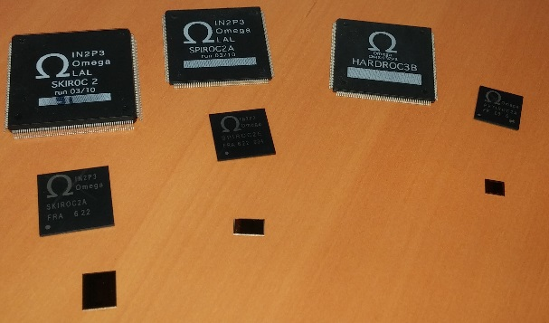


OMEGA ROC ASICs : Integrated Readout Electonics for Gazeous detectors
Salleh AHMAD, Stéphane CALLIER, Selma CONFORTI DI LORENZO,
Frederic DULUCQ, Julien FLEURY, Christophe de LA TAILLE, Gisèle MARTIN-CHASSARD, Ludovic RAUX, Nathalie SEGUIN-MOREAU, Damien THIENPONT
OMEGA microelectronics
Ecole Polytechnique & CNRS IN2P3
http://omega.in2p3.fr
& WEEROC SAS
http://weeroc.com
Notes:
I will talk about SPACIROC asic
SPACIROC stands for Spatial…….

Slide 2
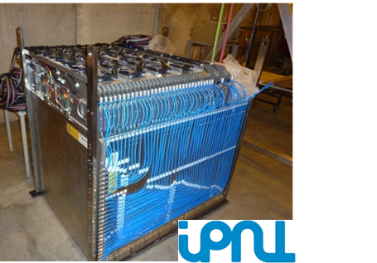
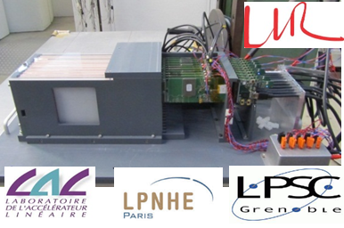
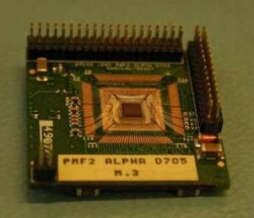
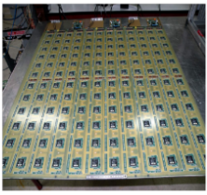




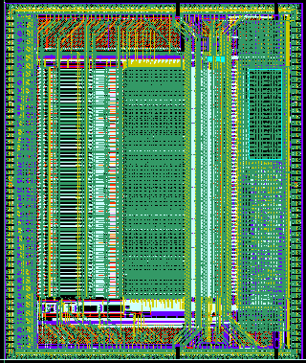
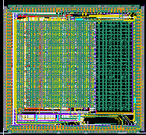
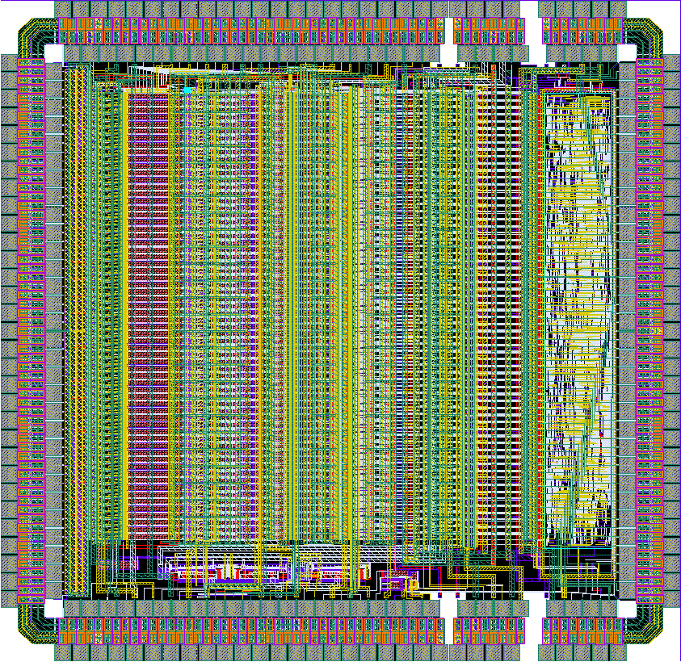
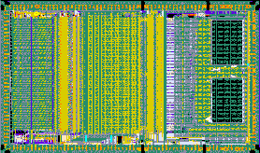
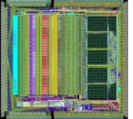
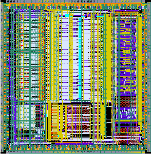
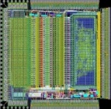








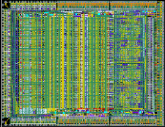



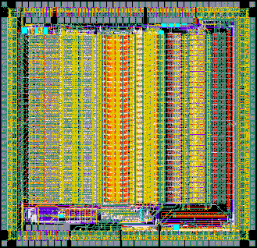

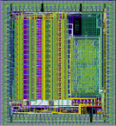
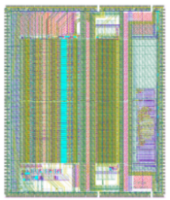
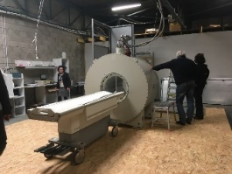
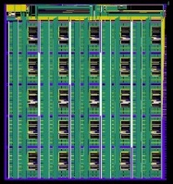
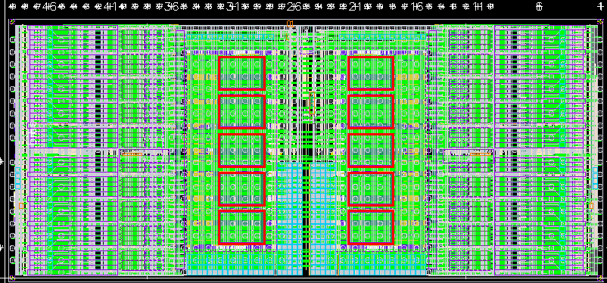
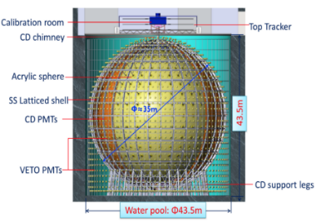


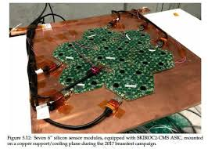
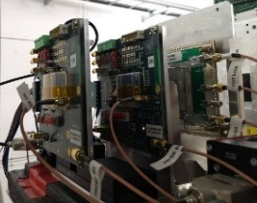
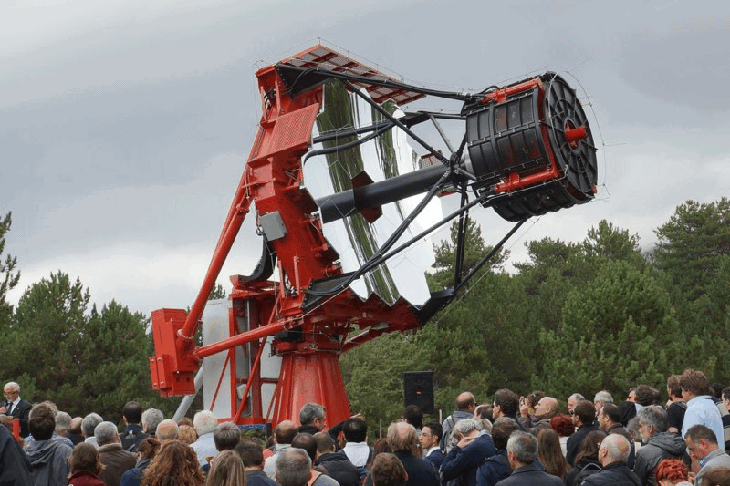
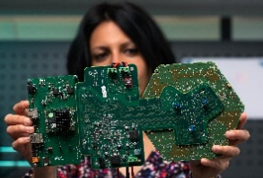
OMEGA ASICs : manufactured & used ASICs
SKIROC
SPIROC
MAROC3
HARDROC
2006
MICROROC
SPACIROC
PETIROC
AMS 350nm SiGe
TSMC 130nm
TRIROC
CITIROC
CATIROC
SKIROC2_CMS
ALTIROC
HGCROC
2021

Slide 3
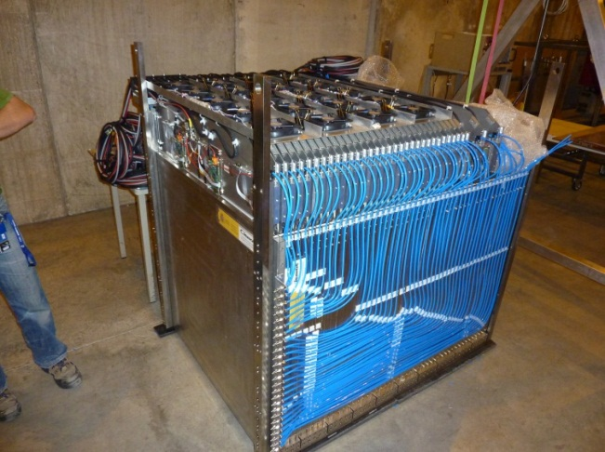
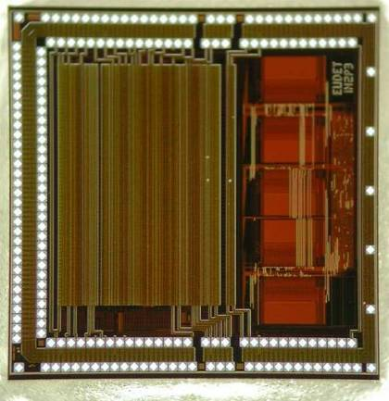
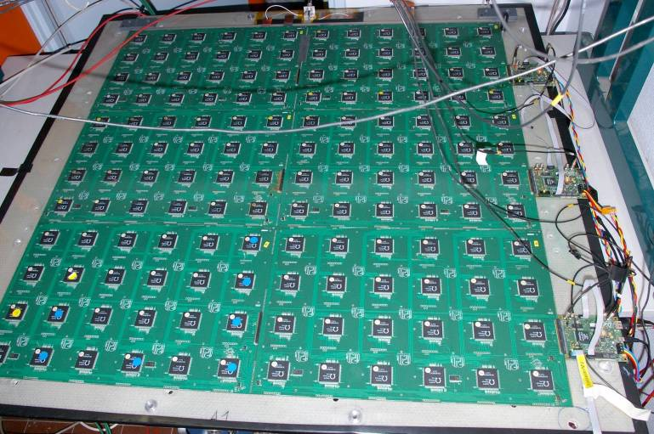
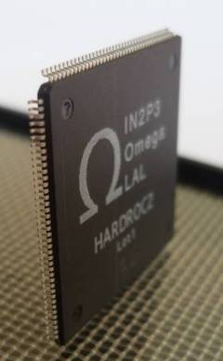



HARDROC2 for RPC readout
1 m³ RPC detector, 40 layers
370 000 channels
HARDROC2: 64 channels (RPC DHCAL)
  preamp + shaper+ 3 discri (semi digital readout)
  Auto trigger on 10fC up to 20 pC
  five 0.5 Kbytes memories to store 127 events
  Full power pulsing => 7.5 µW/ch
  Fully integrated ILC sequential readout
  10 000 chips produced to equip 400 000 ch
  SDHCAL technological proto with 40 layers (5760 HR2 chips) built in 2010-2011.
    Successful TB in 2012 : 40 layers in AutoTrigger with Power Pulsing mode
      High Granularity ( PAD size : 1 cm x 1 cm )
@IPNL Lyon
Cosmic hadronic shower
X
X
Y
Z
Y
Blue : 150 fC
Green : 2 pC
Red : 18 pC
@IPNL
Z

Slide 4
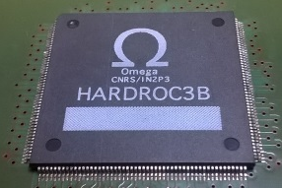
HARDROC3: Simplified schematics
64 channels with current preamplifiers
Trigger less mode (auto trigger 15fC up to 50pC)
Gain correction (max factor 2)
3 shapers + 3 discriminators (encoded in 2 bits for readout)
I2C link with triple voting for Slow Control Parameters
64 Independent channels with zero suppress
Max 8 events / channel with 12-b time stamping
Integrated clock generator: PLL
All bias and reference voltage internal (with power pulsing)
  No decoupling capacitances required on bias and references voltages
Token Ring ReadOut

Slide 5
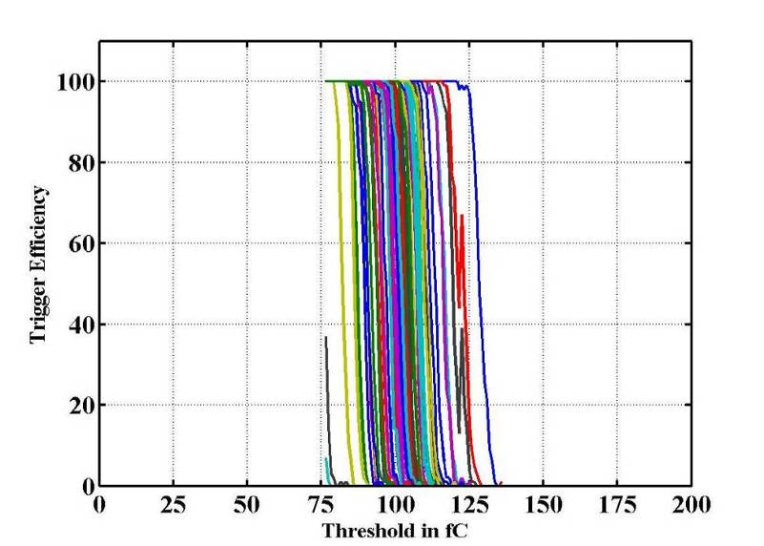
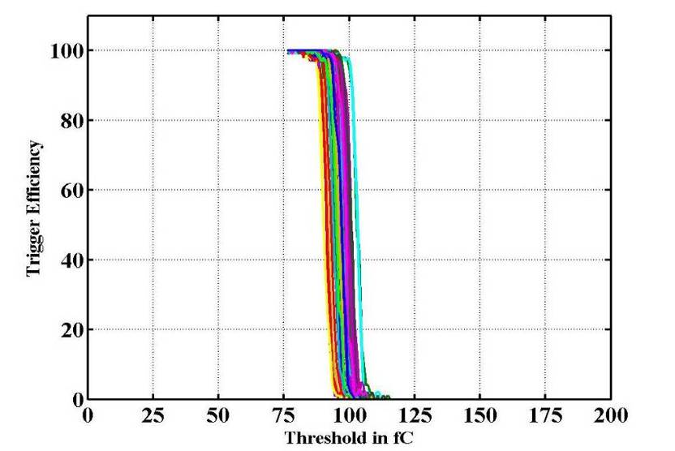
Gain correction / Scurves
Qinj=100fC
HR2 gain correction
50% point
± 25fC
50% point
± 5fC
HR3
50% trig. Eff. (DAC units) vs Qinj (fC)
ASIC Dynamic range: 15fC - 50pC
FSB0: 5σ noise limit= 15fC
23

Slide 6
Zero suppress: Memory mapping
Chip ID is the first to be outputted during readout (MSB first)
MSB of each word indicates type of data:
  “1”: general data (Hit ch. number and number of events)
  “0”: BCID + encoded data
A parity bit/word
Up to 9232 bits (577x16) during readout
Example of number of bits during readout:
 | HR2 | HR3
1 chn hit | 160 | 48
8 chn hit | 1280 | 272
4 chn hit @ same time | 160 | 144
10 chn hit @ same time | 160 | 336

Slide 7
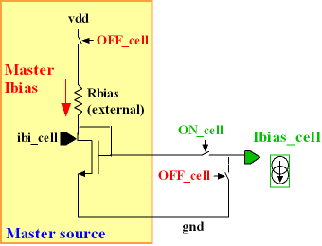
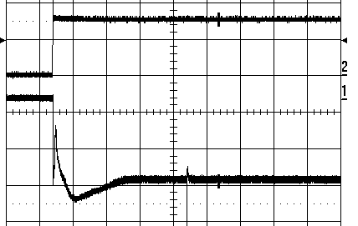
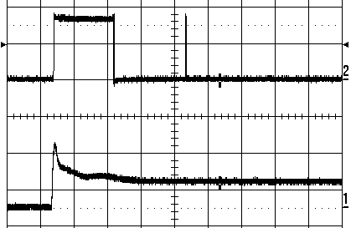
Power pulsing in HR chips
Power pulsing:
  Bandgap + ref Voltages + master I: switched ON/OFF
  Shut down bias currents with vdd always ON
  No decoupling capacitance on bias and voltage references
Compared to HR2, HR3 power consumption is higher due to:
  The extended dynamic range (from 15pC to 50pC)
  The integration of the zero suppress algorithm
If the PLL is used, the power consumption is increased by 3% (due to the PLL VCO)
PWR ON
25 µs
Power supply | HR3 with LVDS (5M + 40M) µW / channel | HR2 with LVDS (5M + 40M) µW / channel
PowerOnA (Analog) | 1650 | 1325
Only PowerOnDAC | 55 | 50
Only PowerOn D | 725 | 50
Power-On-All | 2430 | 1425
Power-On-All @ 0,5% duty cycle | 12,2 | 7,5
HR2
Trigger
DAC output (Vth)

Slide 8
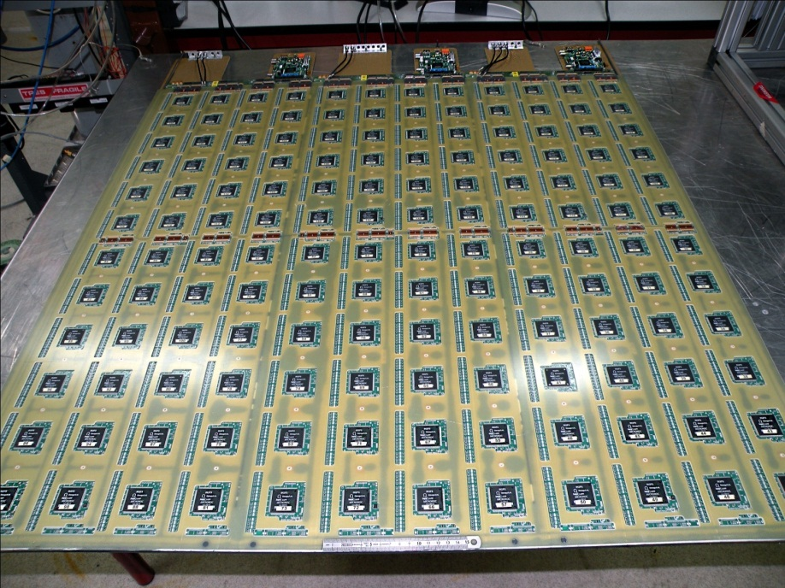

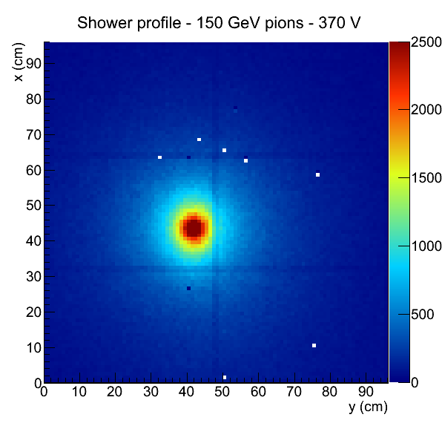
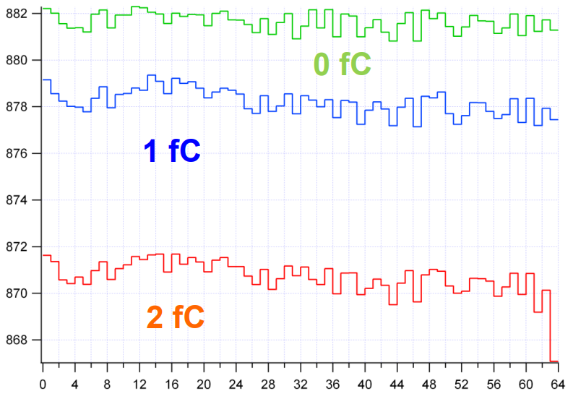

MICROROC (GEMROC)
@LAPP Annecy
64 channels for µMegas (sDHCAL ILC)
  Very similar to HARDROC except :
    Input (charge) preamp
    Slower shapers (100-150 ns)
    HV Spark protections
  Noise: 0.2fC (Cd=80 pF). Auto trigger on 1fC up to 500fC
  Pulsed power: 10 µW/ch (0.5 % duty cycle)
  4 Micromegas prototypes of 1x1 m2 were constructed in 2011-2012 and tested in particle beams inside the DHCAL steel structure in 2012
  Test Beam :
  Very good performance
  of the electronics
  and detector
  (Threshold set to 1fC)
1m² Micromegas detector
144 Microroc : 10 000 channels

Slide 9
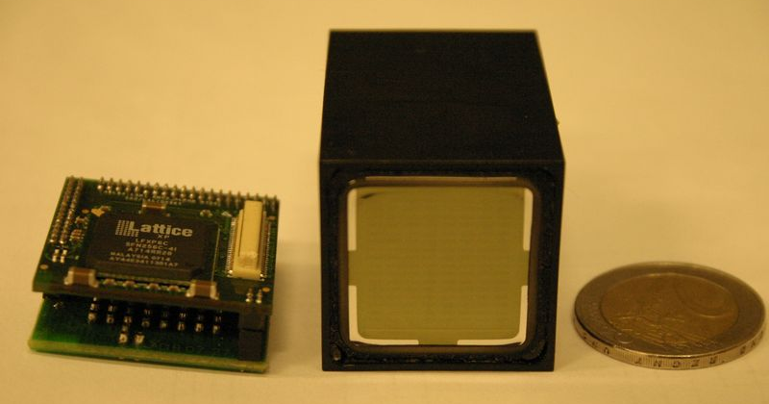

MAROC3 : MultiAnode Read-Out Chip
Complete front-end chip for 64 channels multi-anode photomultipliers
  6bit-individual gain correction
  Auto-trigger on 1/3 p.e. at 10 MHz
  12 bit charge output with internal ADC
  SiGe 0.35 µm, 12 mm², Pd = 5 mW/ch

Slide 10
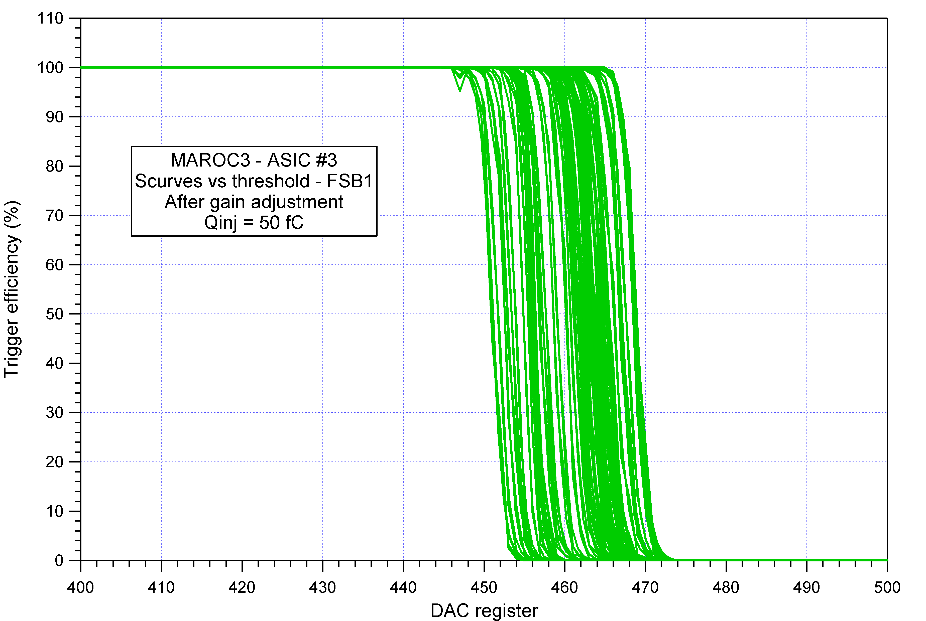
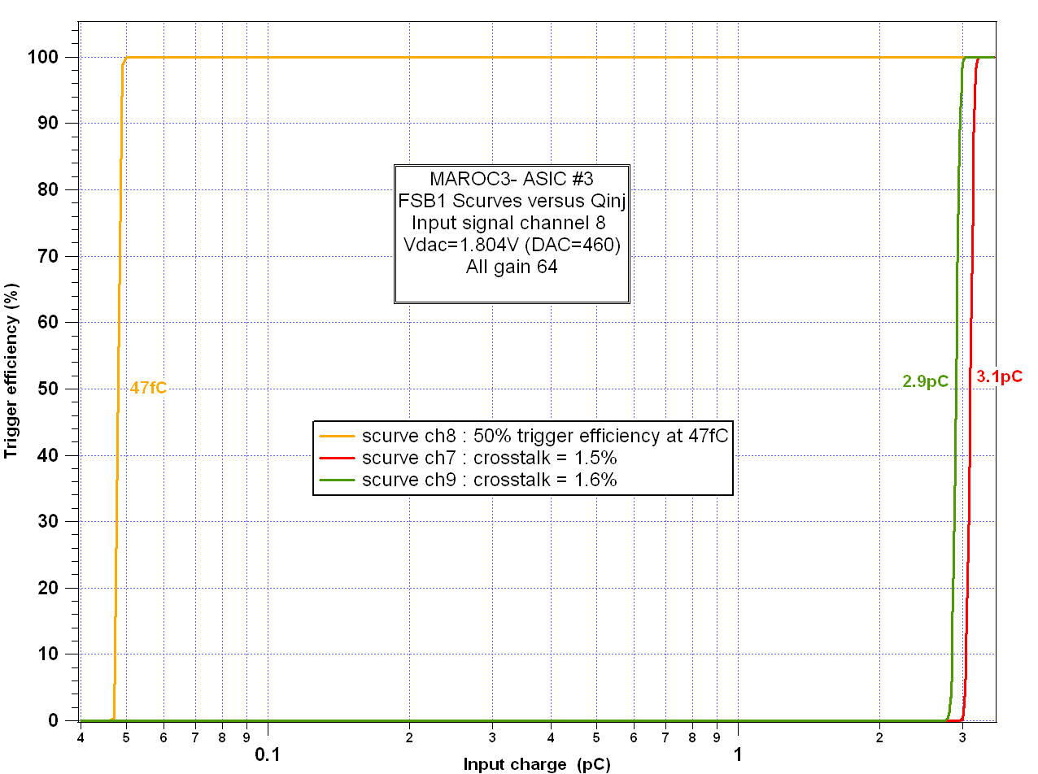
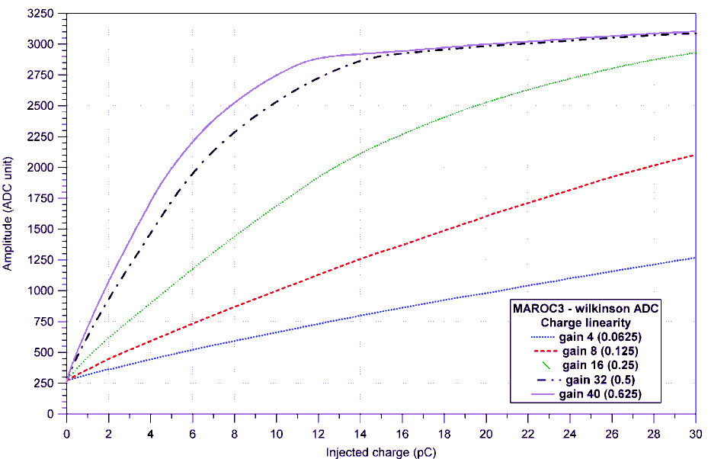
MAROC3 performance
Threshold = 50 fC = 1/3 pe
Jitter < 100 ps
Jitter (ps rms)
Time walk (ns)
Rms = 3.5 fC
Qin = 50 fC = 1/3 pe
Input charge (fC)
crosstalk ~1%
Charge readout 20 pC

Slide 11
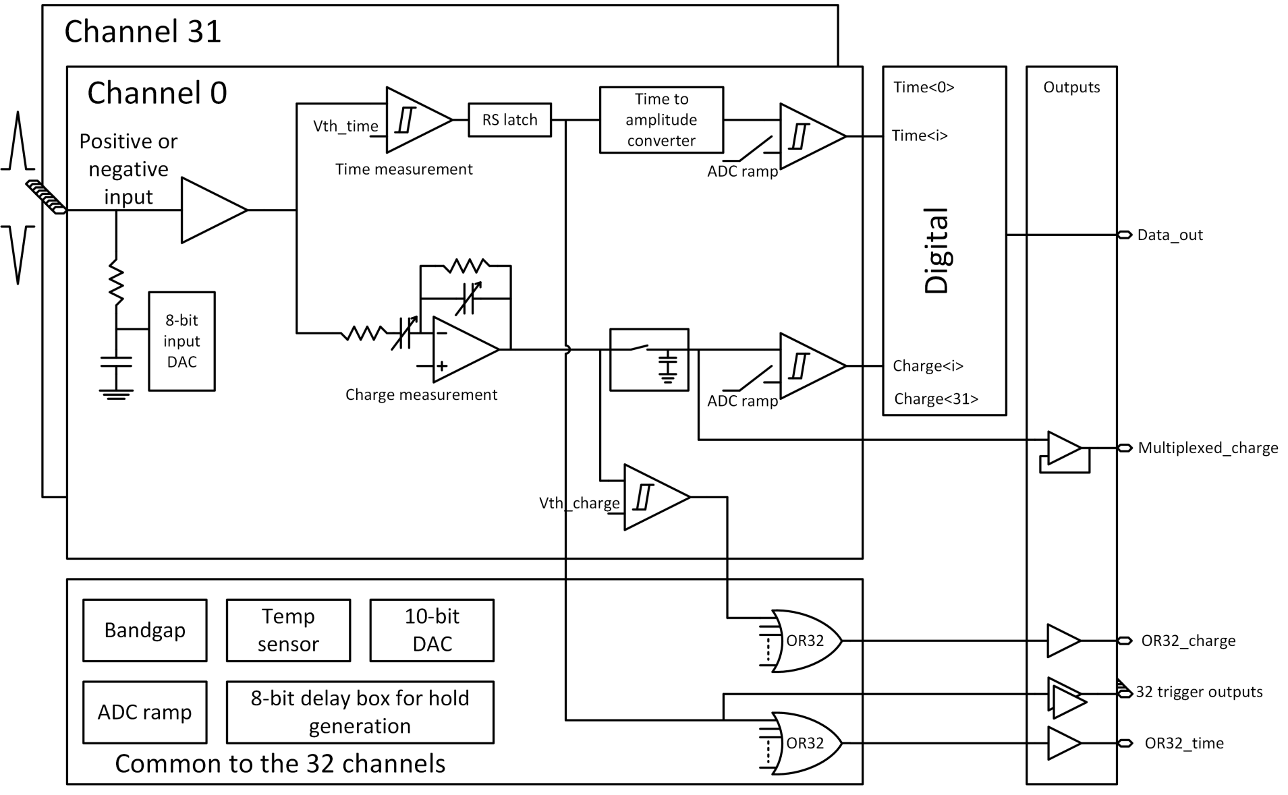
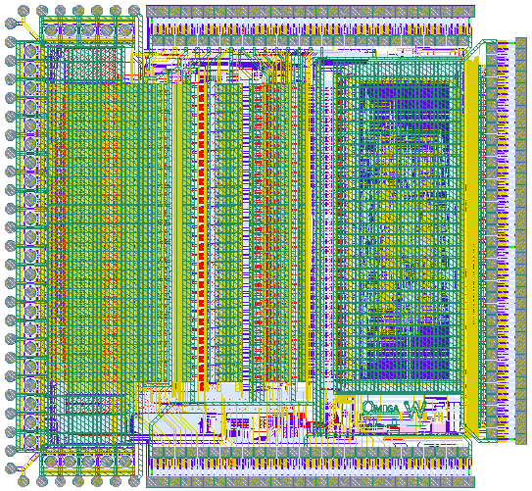
PETIROC2
32 ch SiPM GHz readout ASIC, dual polarity, 100 fC-400 pC, 6 mW/ch
32 trigger outputs and multiplexed data output
Embedded 10-bit ADC and 50 ps TDC
Dual threshold : first photons and energy

Slide 12
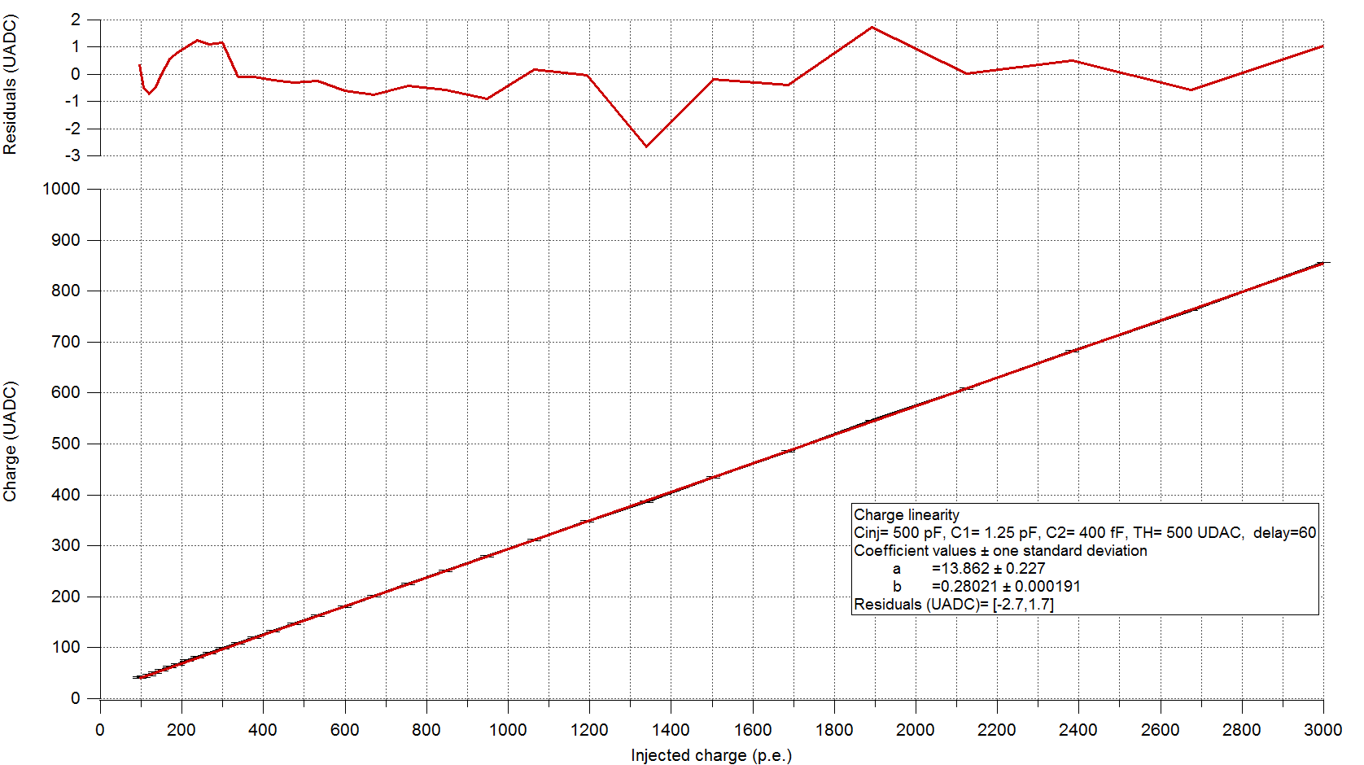
PETIROC2A : SCURVES with and w/o clock
Injection of a step (1mV, 2mV, 3mV, 4mV, 5mV and 10mV)

Slide 13
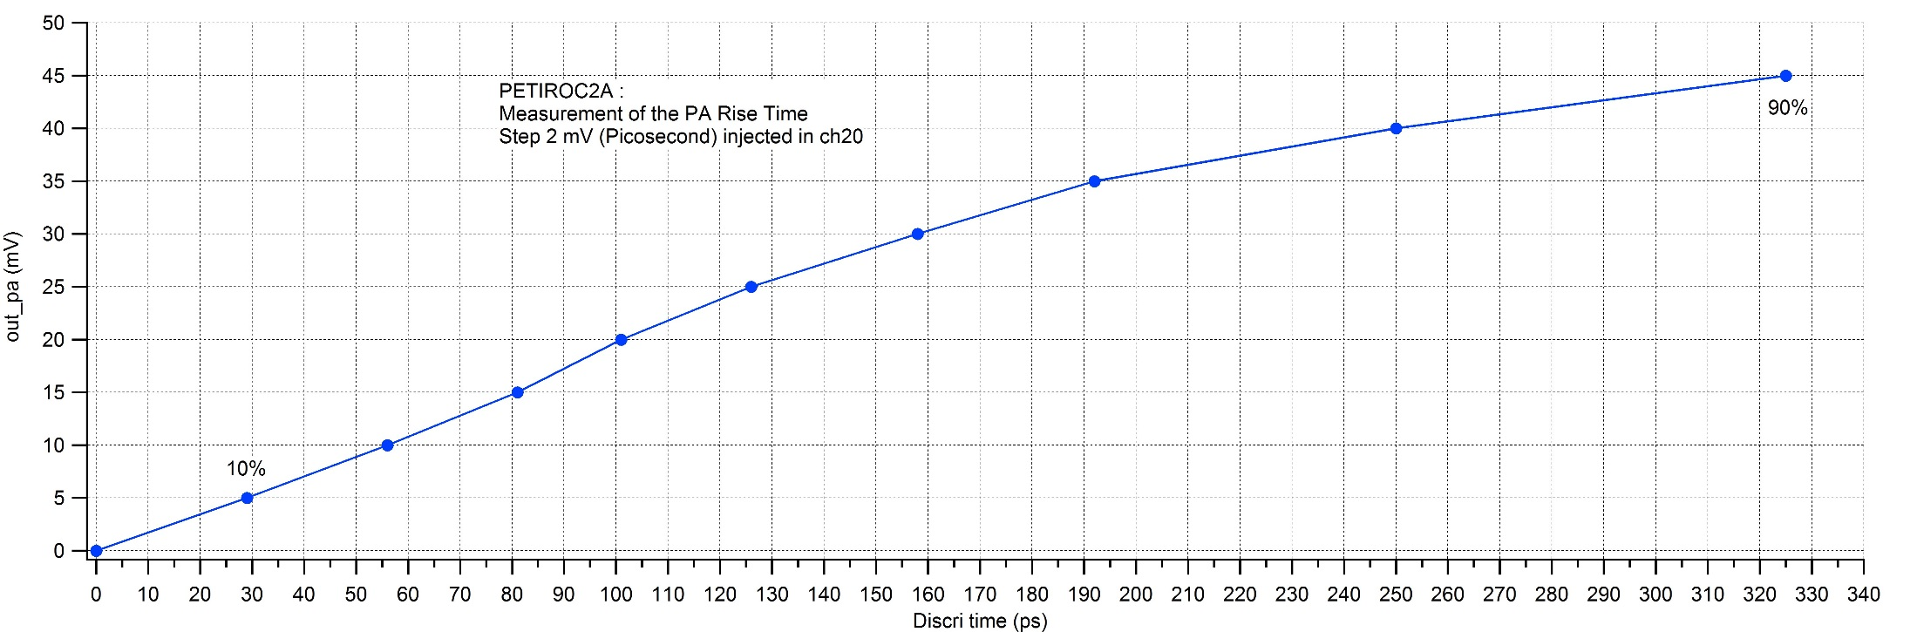
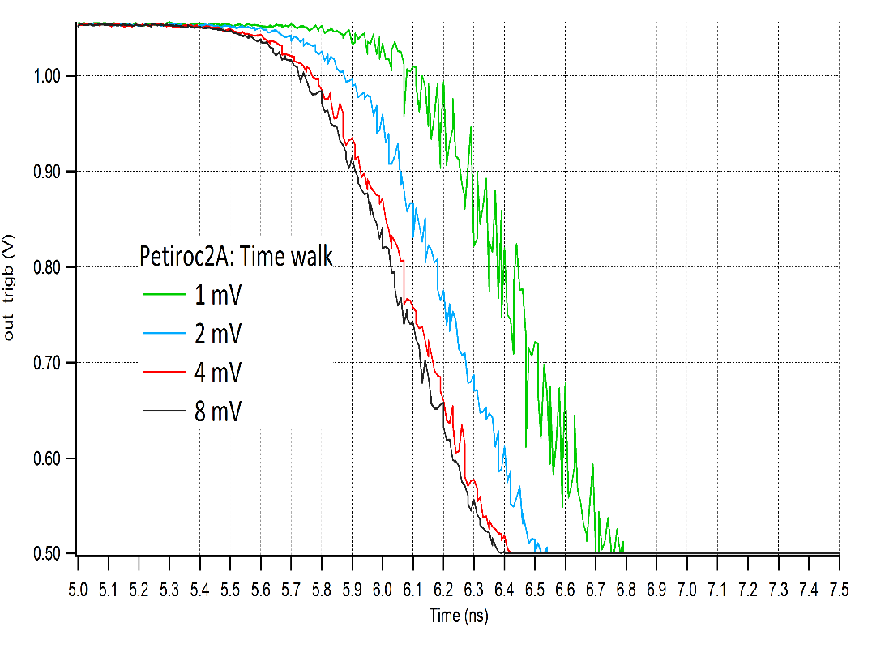
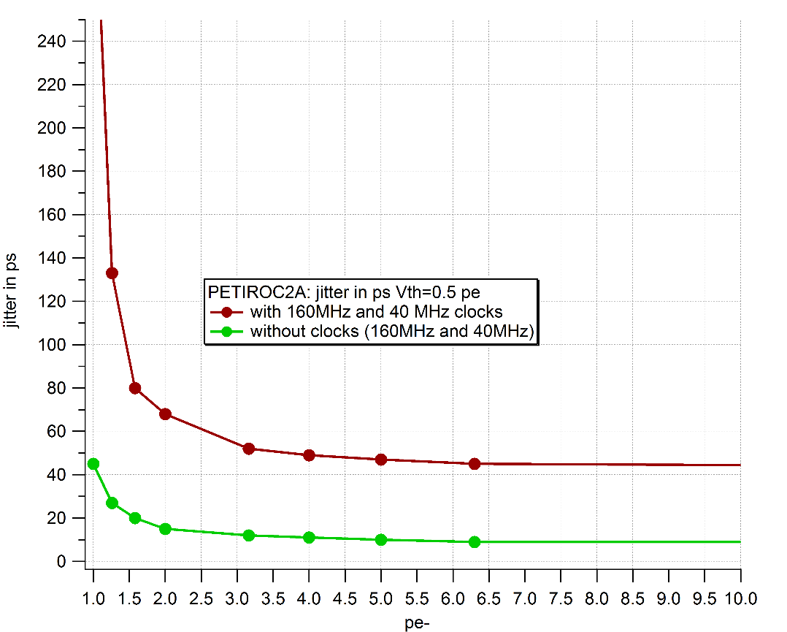
PETIROC2A: performance
Preamp Rise Time reconstruction
TW
Scope measurement
90%
out_PA (mV)
400 ps
10%
300 ps
Time (ps)
TOT measurement
Jitter (ps)
Vin (mV)

Slide 14
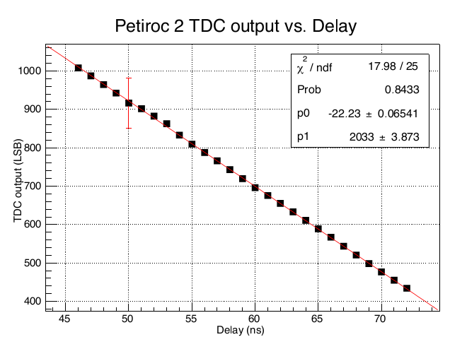
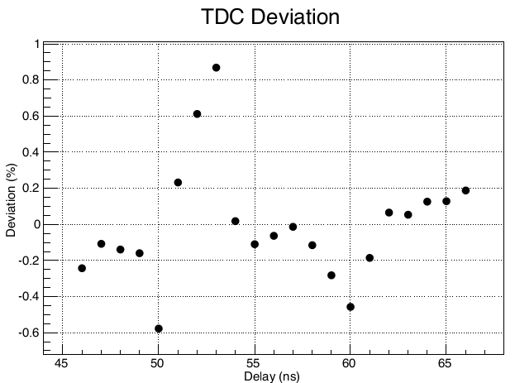
PETIROC2: TAC measurement
TAC
Slope dispersion:
~1% rms or 10ps/1ns
or 250ps/25ns
=> Calibration
Due to digital coupling
Non Lin: ~0.25% or ±50ps
Intercept dispersion:
~1% rms => Calibration

Slide 15
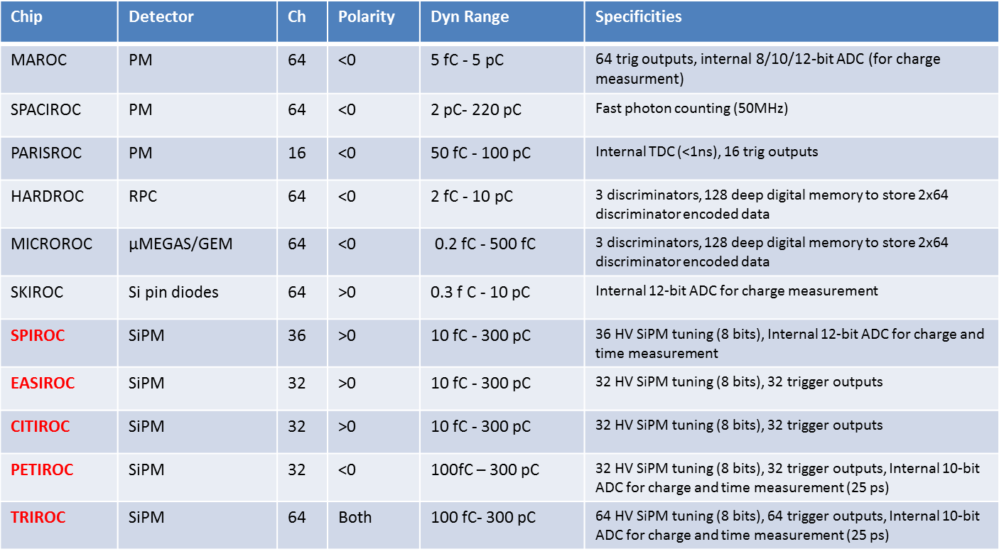
SUMMARY
http://omega.in2p3.fr/
http://www.weeroc.com/

Slide 16
Notes:
I will talk about SPACIROC asic
SPACIROC stands for Spatial…….

Slide 17






OMEGA ROC chips
Use of Silicon Germanium AMS 0.35 µm BiCMOS technology since 2004
Readout for MaPMT and SiPM for ILC calorimeters and other applications
Very high level of integration : System on Chip (SoC)
http://omega.in2p3.fr
Chip | detector | ch | DR (C)
MAROC | PMT | 64 | -2f-50p
SPIROC | SiPM | 36 | 10f 200p
SKIROC | Si | 64 | 0.3f 10p
HARDROC | RPC | 64 | -2f-50p
PARISROC | PM | 16 | -5f-50p
SPACIROC | PMT | 64 | -5f-15p
EASI/CITIROC | SiPM | 32 | 10f 200p
MICROROC | µMegas | 64 | -0.2f-0.5p
PETIROC | SiPM | 32 | 50f 300p
TRIROC | SiPM | 64 | 50f 300p
MAROC3
HARDROC2
MICROROC1
SKIROC2
SPIROC2
SPACIROC
GEMROC
PARISROC2

Slide 18
MOS and Bipolar
© K. Torki (CMP)
http://cmp.imag.fr/aboutus/slides/Slides2011/02_Runs_2011.pdf

Slide 19



SiGe technology
Faster bipolar transistors for RF telecom
  Better mobility and FT
  Better current gain (beta)
  Better Early voltage
  Interesting improvement at low T
  Compact CMOS (0.25 or 0.35µm) for mixed-signal design
© R. Hermel

Slide 20



Power and speed with SiGe
BJT : best g_{m} /I ratio (1/U_{T})
  Large transconductance with small devices
Speed goes as F_{T}= g_{m} /2πC
  C~10 fF g_{m} typ mA/V
  F_{T} ~60 GHz for SiGe 0.35µm
  Interesting for fast preamps
Not forgetting 100V Early voltage and matching performance (A~mV*µm)
V_{BE}=V_{T}Ln(I_{C}/I_{S})
Large swing : V_{CEsat} ~3 U_{T}

Slide 21

Evolution of technologies in practice
Performant design is at transistor level
More and more functions are integrated inside chips (ASICs)
Evolution of technologies make them more and more performant but more and more complex
10 ans d'évolution des spécifications techniques pour la réalisation d' ASIC
© G. Deptusch FNAL
G. Deptuch, Fermilab

Slide 22

Design Groups – Current Status
© G.L. de Geronimo (BNL) TIPP2014
  design groups ≈ 30-40
  active designs ≈ 30-40
  Average one design per group
  institutions leading collaborative efforts
  institutions performing R&D on technologies
  One FE-ASIC design currently requires
  2-4 full-time designers and 2-4 years
  average, from concept to ready-for-production

Slide 23
HR3: Analog linearity
Fast shaper outputs (mV) vs Qinj (fC)
FSB0
FSB1
Up to 10 pC
50% trig. Eff. (DAC units) vs Qinj (fC)
FSB0: 5σ noise limit= 15 fC
FSB2
Up to 50 pC
Dynamic range: 15fC - 50 pC

Slide 24
PETIROC2: efficiency uniformity
Trigger efficiency measurements: Linearity
One 10-bit DAC Unit= 923 µV
10-bit DAC linearity
923µV/DAC code

Slide 25

PETIROC2: « S-curves »
Trigger efficiency measurements:

Slide 26


With SiPMs : SPTR [JINST 11 P10016]
SPTR
  FWHM ~200 ps
  Rms ~ 80 ps

Slide 27


Going to lower SPTR
Expect ~ 20 ps/pe
NINO risetime ~1 ns
Test with PETIROC2 (tr = 300 ps)
  SPTR = 67 ps rms (180 ps FWHM)
Possible effect of stray inductance
Further studies in FAST framework
Preamp Rise Time reconstruction
90%
out_PA (mV)
10%
300 ps
Time (ps)
© J. Fleury TIPP17

