Slide 1
ROC ASICs for timing at OMEGA
RD51 workshop 15 jun 2021
Christophe de La Taille
OMEGA CNRS/IN2P3 Ecole Polytechnique

Slide 2
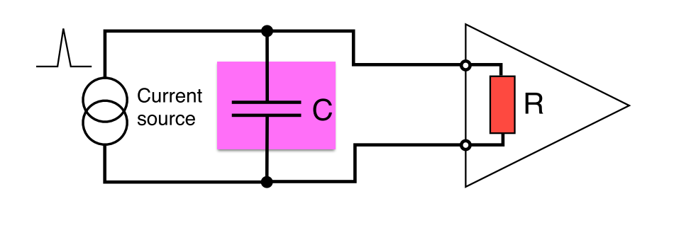
Timing optimization : common view
Jitter due to electronics noise:
also presented as j = tr / (S/N)
dV/dt prop to BW, N prop to √ BW => jitter prop to 1/√BW
« the faster the amplifier, the better the jitter ? »
« High speed preamps need to be low impedance (50 Ω or less) ? »
  minimize R_{PA} : small time constant R_{PA}.Cd « Minimize « charge time transfer »
NB : tr = t_{10-90%} = 2.2 tau.
f_{-3dB} = 1/2πtau = 0. 35 / t₁₀₋₉₀
f_{-3dB} = 1 GHz <-> t_{10-90%} = 300 ps
1 ps = 300 µm in vaccum

Slide 3
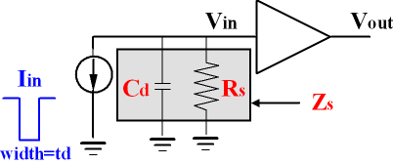
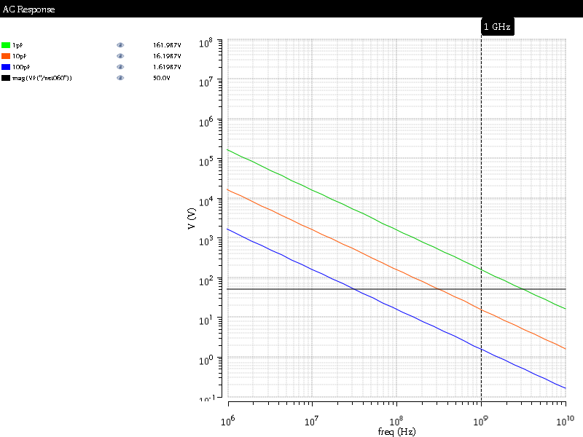
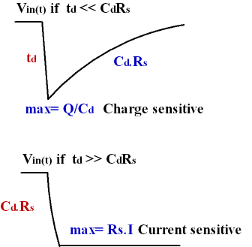
Detector impedance and input voltage
1 GHz, Cd=few tens of pF, input signal width <1ns
Cd>1 pF, Zs@1GHz dominated by Cd
Rise time: tr= td when td<< R_{S} C_{d} and tr= R_{S} C_{d} when td>> R_{S} C_{d}
At HF : difficult to beat the capacitance => signal integrated on Cd
1 GHz
1pF
10 pF
50Ω
100pF

Slide 4
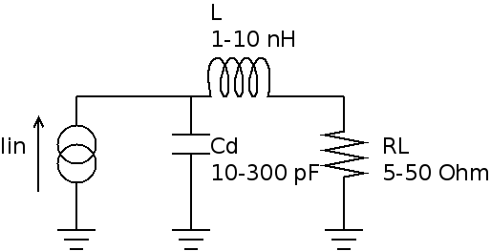
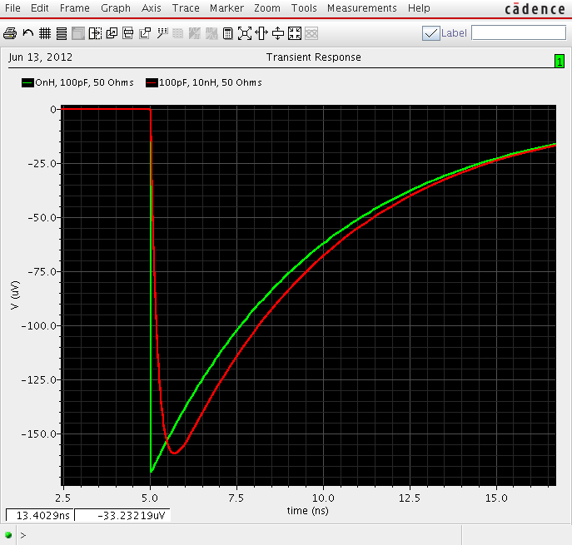
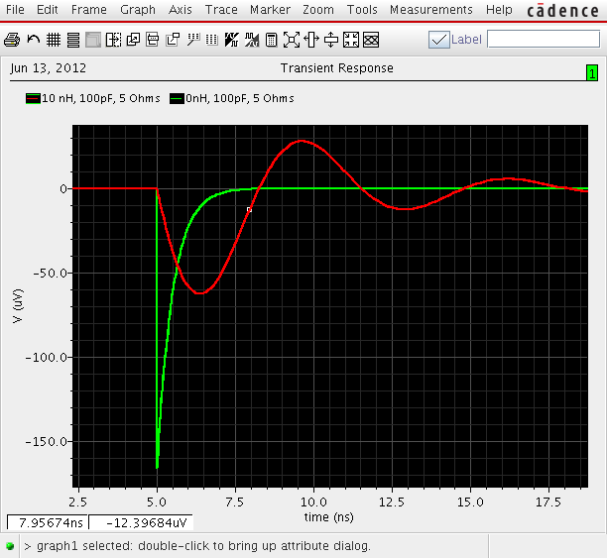
Examples of pulse shapes
SiPM pulse : Q=160 fC, Cd=100 pF, L=0-10 nH, R_{PA}=5-50 Ω
Sensitivity to parasitic inductance
Choice of R_{PA} : decay time, stability
Small R_{PA} not necessarily the fastest
Convolve with current shape… (here delta)
L/R
RC
C=100 pF
L=10 nH
R=50 Ω
C=100 pF
L=10 nH
R=5 Ω
Q/Cd

Slide 5
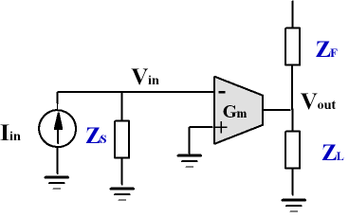
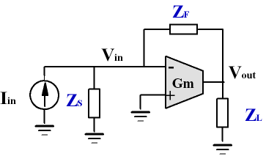
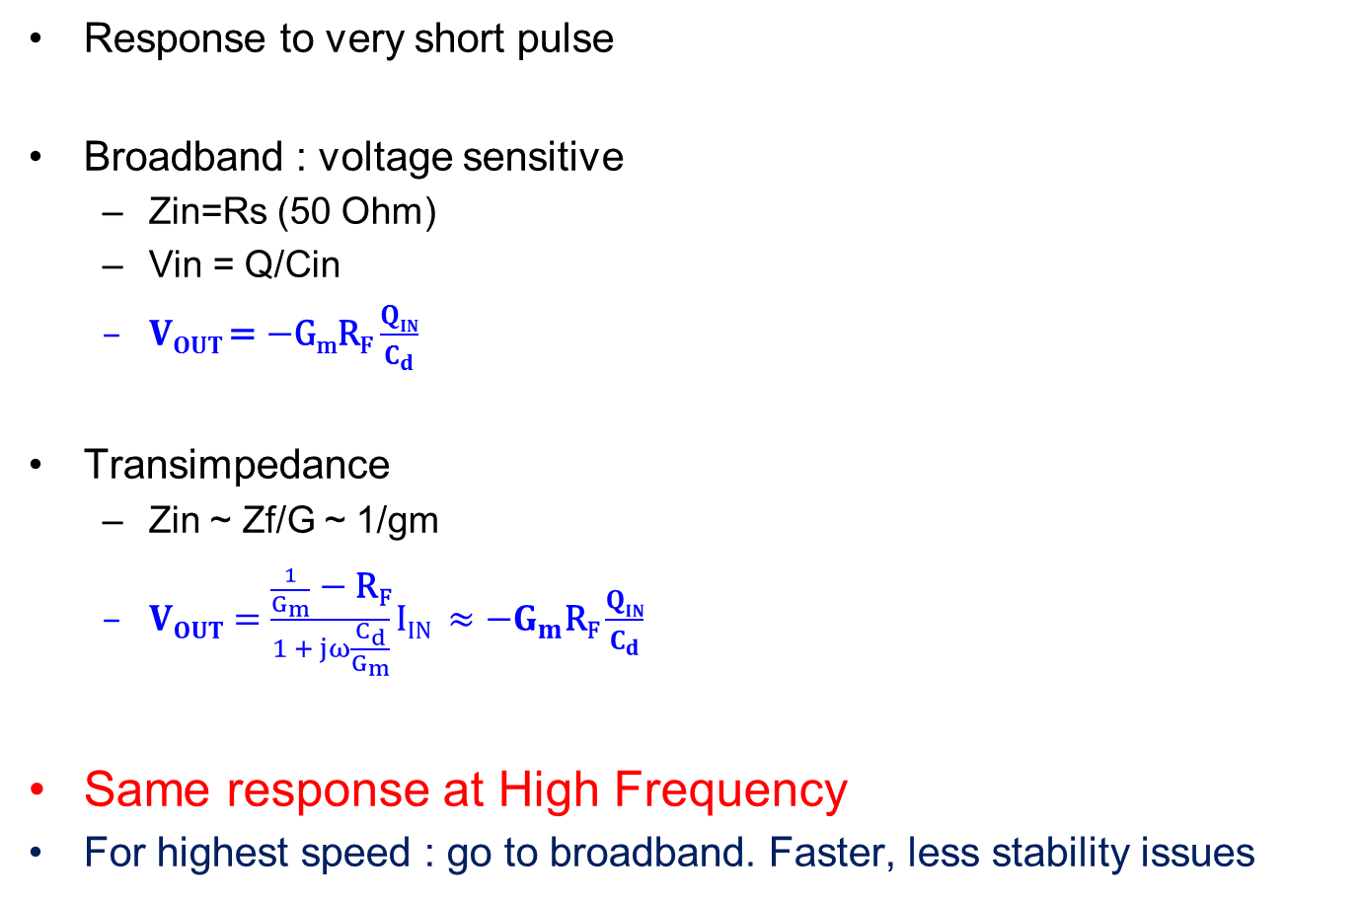
High speed amplifiers
Response to very short pulse
Broadband : voltage sensitive
  Zin=Rs (50 Ohm)
  Vin = Q/Cin
  $VOUT$= $−\text{G}\text{m}\text{R}\text{F}$ $\frac{QIN}{C_{d}}$
Transimpedance
  Zin ~ Zf/G ~ 1/gm
  $VOUT=\frac{\frac{1}{G_{m}} \text{−} \text{R}\text{F}}{1 + jω\frac{C_{d}}{G_{m}}}$ $IIN ≈{−G}_{m}\text{R}\text{F}\frac{QIN}{C_{d}}$
Same response at High Frequency
For highest speed : go to broadband. Faster, less stability issues

Slide 6
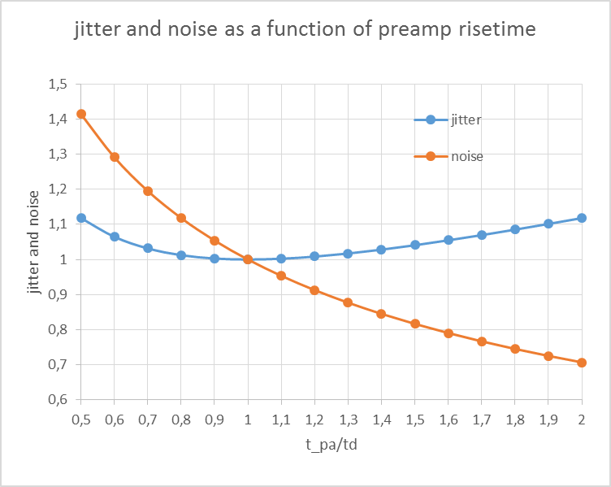
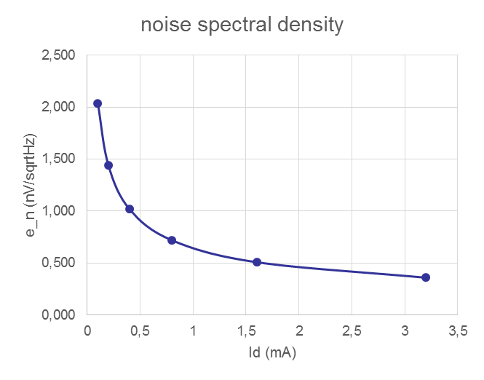
Signal and noise in Broadband amplifiers
Jitter is given by :
Optimum value: t_{10-90_PA}= t_{d} (current duration)
Gives ps/fC as scales with 1/Qin : « factor of merit »
Electronics noise e_{n} given by the input transistor transconductance g_{m}:
Jitter optimum is rather shallow with preamp risetime
But noise and minimum threshold goes up quickly with speed (as sqrt)
Dominated by sensor
Electronics only gives en
Cd: detector capacitance
t _{10_10_PA} : rise time of the PA
t_{d}= detector current duration
e _{n} preamp noise density

Slide 7
OMEGA timing chips
See also presentation by Stéphane Callier on Thursday (Hardroc et al.)

Slide 8
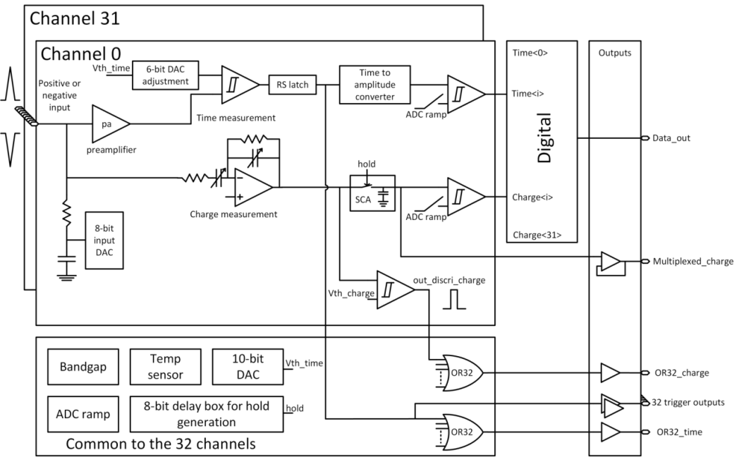

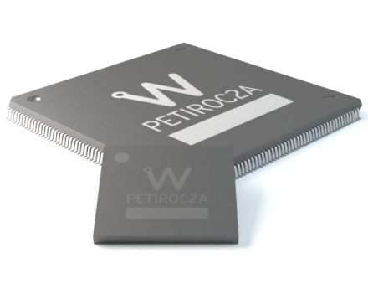
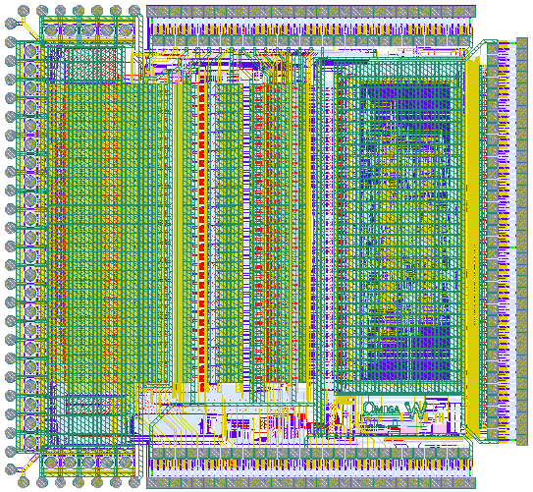
PETIROC2A
SiPM read-out for time-of-flight PET
SiGe 350 nm
Detector Read-Out | SiPM, SiPM array
Number of Channels | 32
Signal Polarity | Positive or Negative
Sensitivity | Trigger on first photo-electron
Timing Resolution | ~ 35 ps FWHM in analogue mode (2pe injected) - ~ 100 ps FWHM with internal TDC
Dynamic Range | 3000 photo-electrons (10⁶ SIPM gain), Integral Non Linearity: 1% up to 2500 ph-e
Packaging & Dimension | TQFP160 – TFBGA353

Slide 9
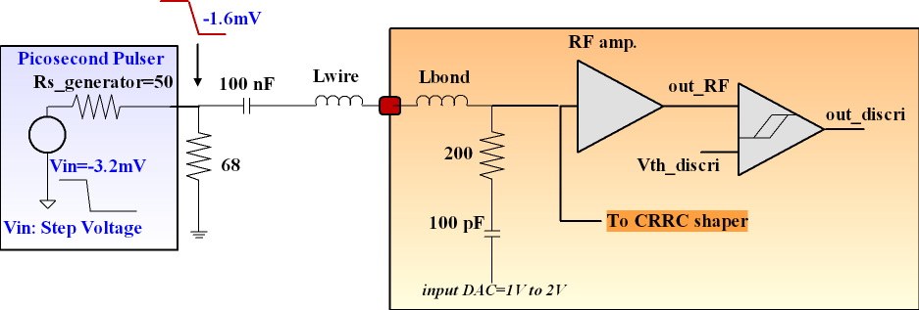
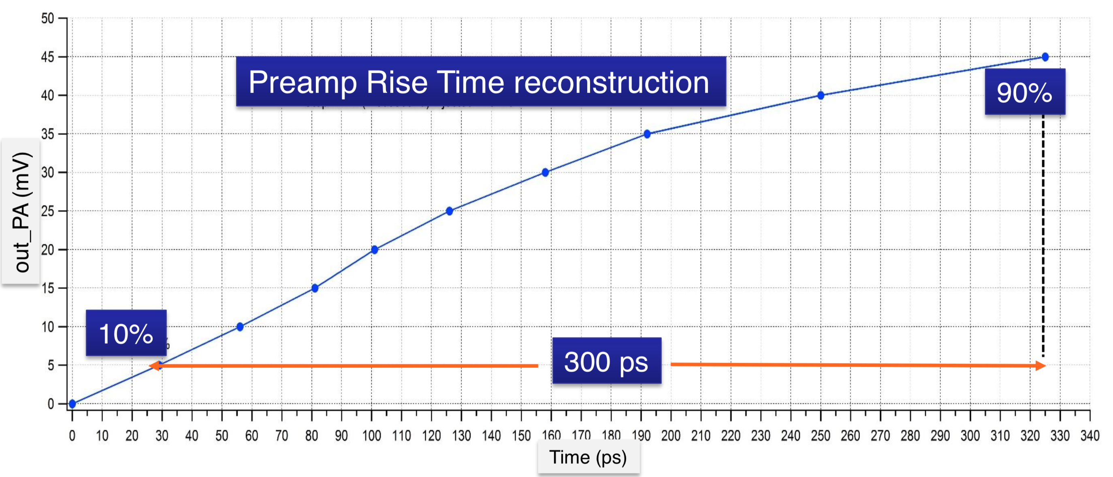
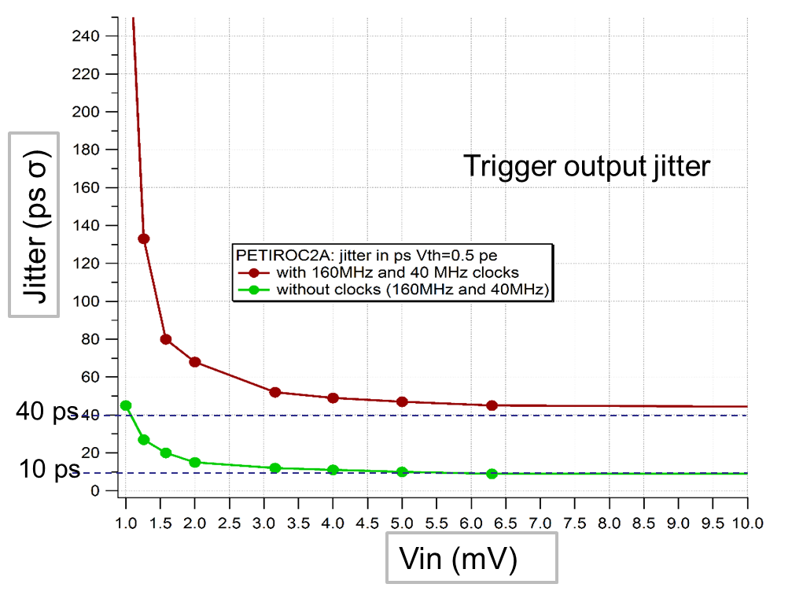
Petiroc2A bandwidth measurement
Preamp + discriminator bandwidth
reconstruction of pulse by discriminator
tr 10%-90% = 300 ps,
BW = 0.35 / tr ~ 0.9 GHz
can also use BW = 0.1 / (t_{50%} - t_{10%})

Slide 10
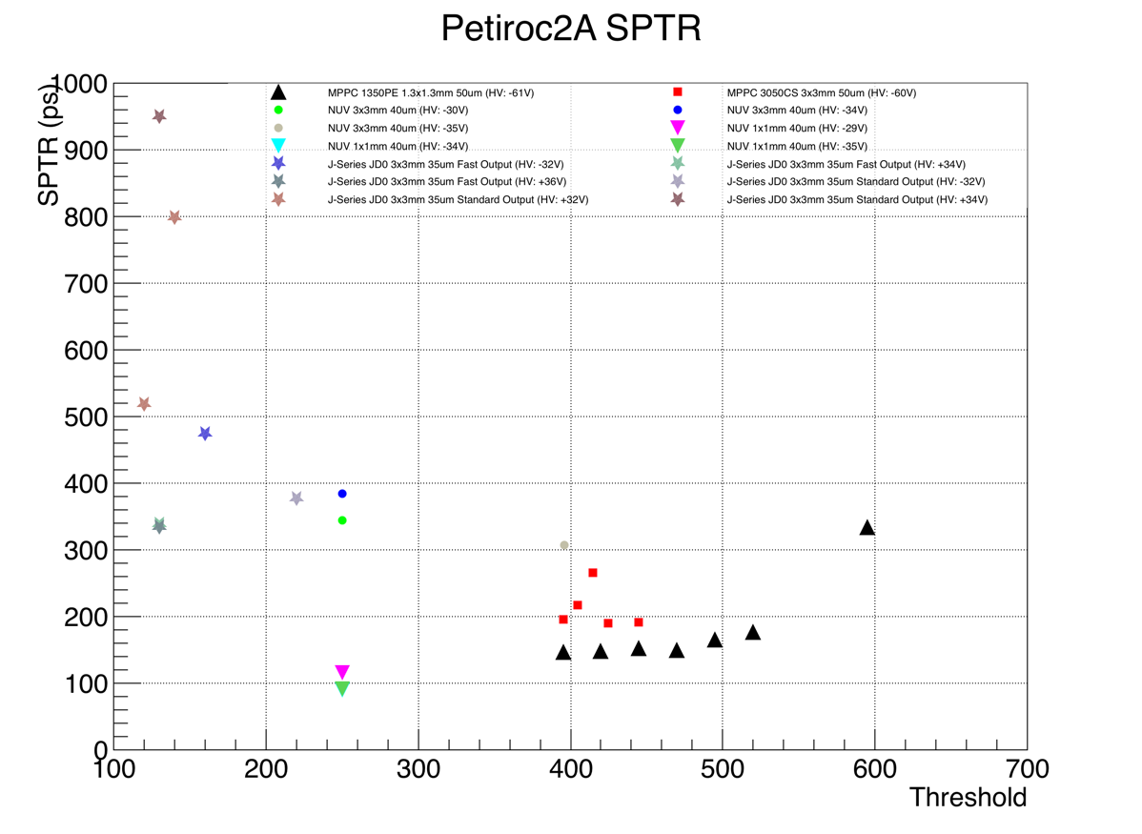
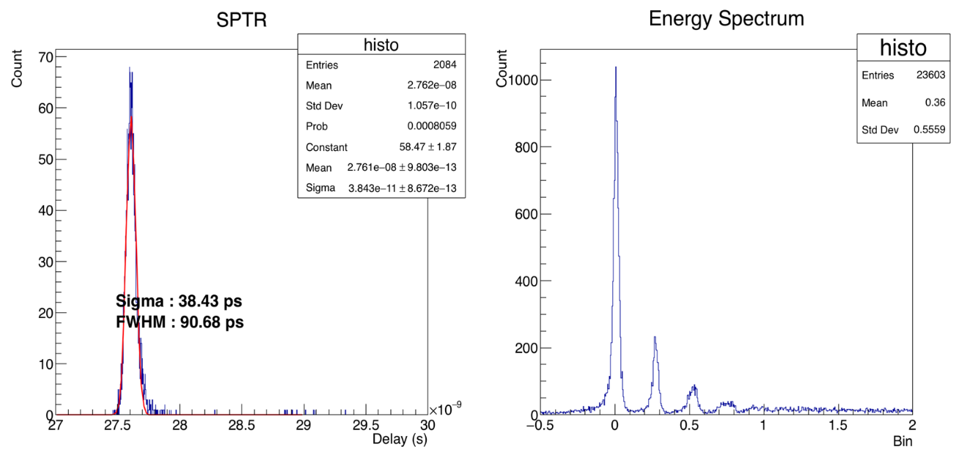
SPTR measurement : Petiroc2A trigger outputs
SPTR : 90 ps FWHM (40 ps rms)
3x3mm² JDO
3x3mm² MPPC
FBK NUV 1x1 mm² : 90.7 ps FWHM
1.3x1.3mm² MPPC
90 ps
1x1mm² NUV
Source : Laser
SiPM : Various model (FBK, Hamamatsu, Sensl)
HV : Various value

Slide 11
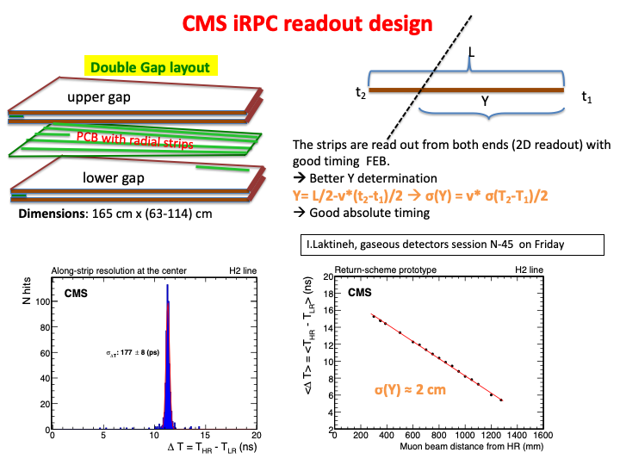
Petiroc2 for CMS RPC readout [I. Laktineh et al.]
.

Slide 12
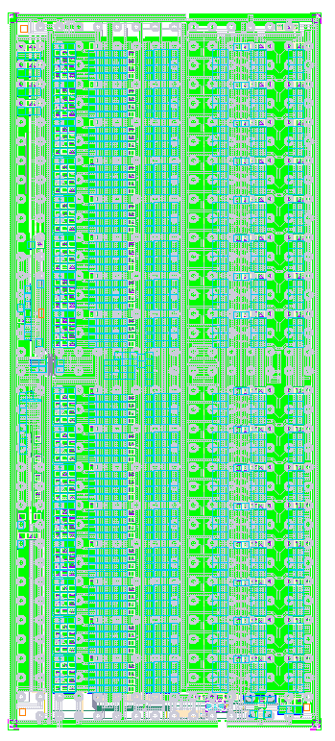
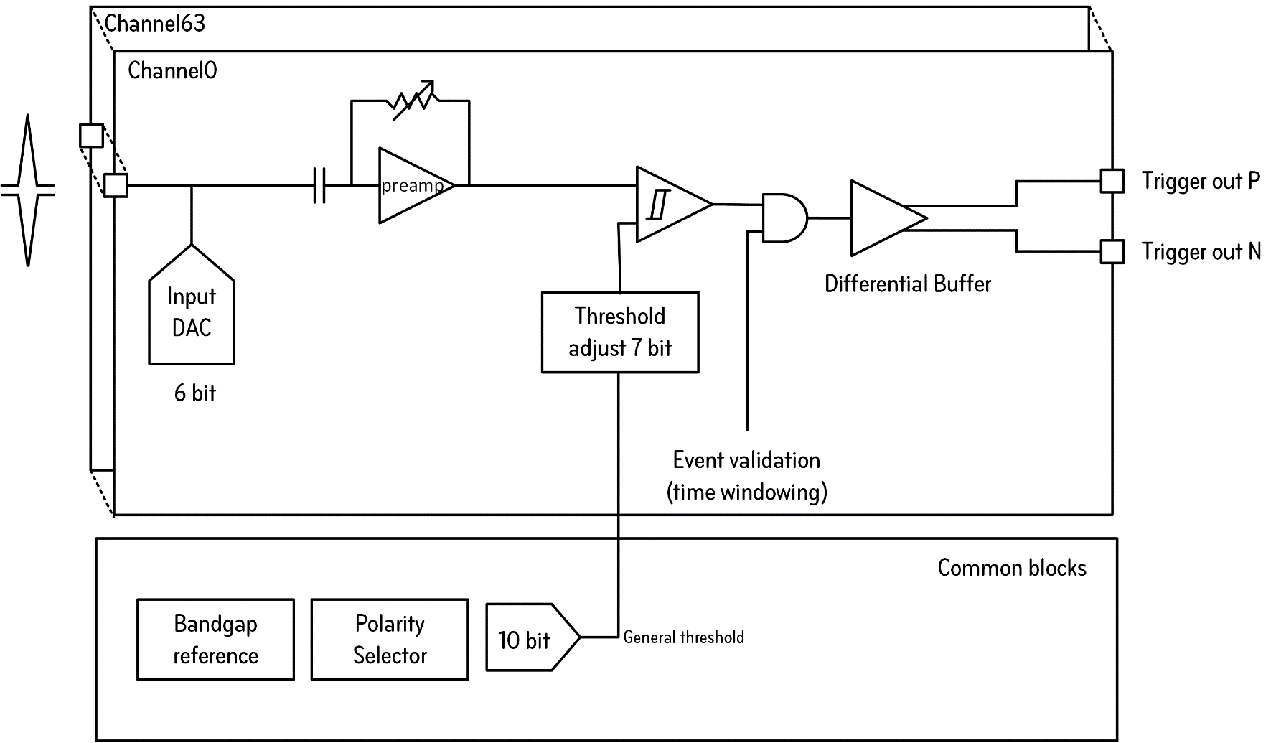

LIROC : SiPM read-out for Lidar
SiPM read-out for LIDAR
TSMC 130 nm
Collaborative design between Weeroc & Omega
Funding from ATTRACT EU H2020 Research & Innovation Program

Slide 13
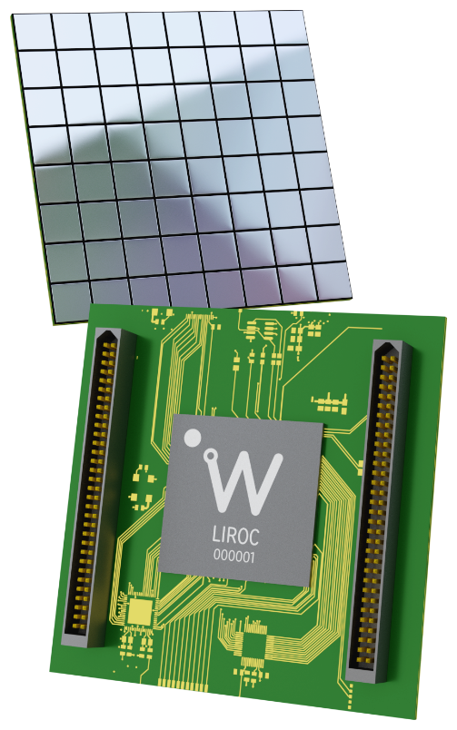
Parameters & Performances
Detector Read-Out | SiPM, SiPM array
Number of Channels | 64
Signal Polarity | Positive or Negative (selectable ASIC-wise)
Sensitivity | Trigger on 1/3 of photo-electron
Timing Resolution | Better than 20 ps FWHM on single photo-electron Better than 5ns double-peak separation on single photo-electron
Dynamic Range | Over 100MHz photon counting rate
Packaging & Dimension | BGA 20x20 mm² Flip-Chip low inductance packaging technology
Power Consumption | 210mW – Supply voltage : 1.2 V
Inputs | 64 analogue inputs with independent SiPM HV adjustments
Outputs | 64 low-common-mode LVDS triggers (CLPS) – compatible with CERN picoTDC and all LVDS FPGA I/Os
Internal Programmable Features (I²C) | 64 HV adjustment for SiPM (64 x 6 bit), trigger threshold programming (10bits), 64 x 7 bit channel-wise threshold adjustment, ASIC-wise polarity selector, preamp pole-zero cancellation adjustment, individual trigger masking and cell powering.

Slide 14
Jitter and timewalk
TW : 800 ps
Metrology chain limit. 6.2ps rms
Threshold: 40 fC
1 photoelectron - Gain 10⁶

Slide 15
Time Over Threshold – Measuring amplitude
Trade-off beetween double peak separation (see consecutive photons) and time over threshold. Tuneable.
Optimized for double-peak separation in that measurement (3ns separation measured)

Slide 16
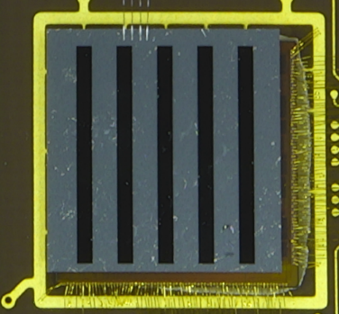

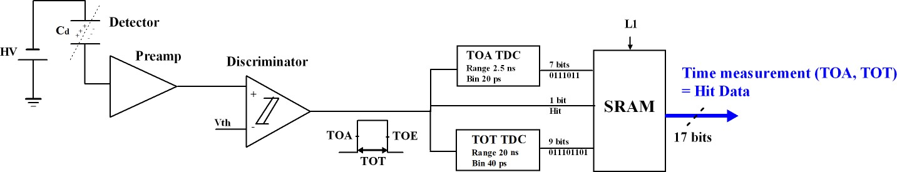
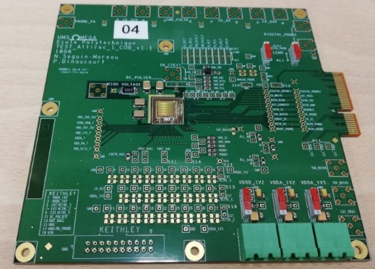

ALTIROC : ATLAS LGAD ReadOut Chip for HGTD
Altiroc0
2 mm
ALTIROC0 (2017) : contains only PA + discriminator – for 2x2 1x1 mm2 sensors
  4 channels VPA and 4 channels TZ analog readout optimized for Cd=2pF
  Bandwidth tunable (0.3-0.8 GHz)
  Power : 2 mW/ch TSMC 130 nm
ALTIROC1 (2018) : 5x5 complete readout channels (PA, discri, TDC, SRAM) to readout 1.3 x 1.3 mm2 LGAD pixels , 15 channels with VPA, 10 with Transimpedance amplifier (TZ)
ALTIROC2 (2021) : 15x15 final size and functionnality
2 mm
~ 7,7 mm
Altiroc1 tesboard
C. de La Taille RD51 workshop 15 jun 2021

Slide 17
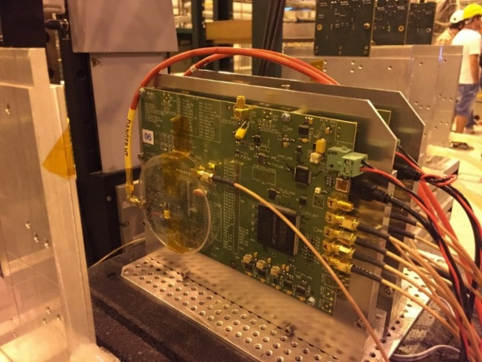
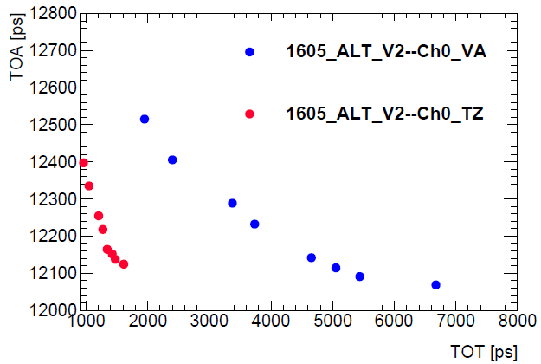
ALTIROC0 measurements
Testbench (left) and testbeam (right) measurements
ALTIROC0_V2
Time resolution of a 2x2 x1x1 mm2 LGAD array bump bonded on an Altiroc0 ASIC as a function of the discri threshold (DAC Units) before (black points) and after TW correction (red points)
TZ
VPA
VPA
VPA
TZ
VPA
30 % improvement after TW correction
Jitter around 35 ps
VPA
C. de La Taille RD51 workshop 15 jun 2021

Slide 18
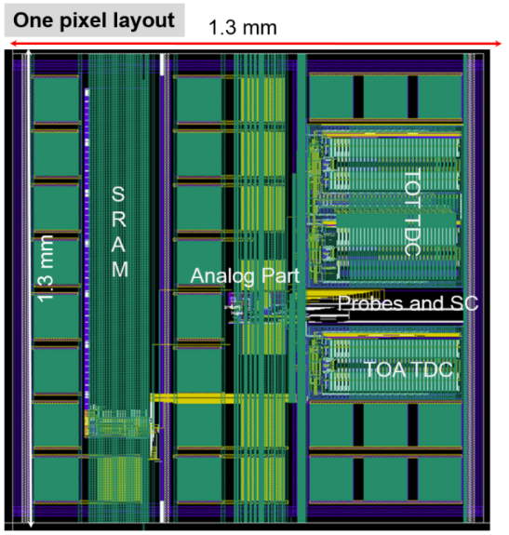
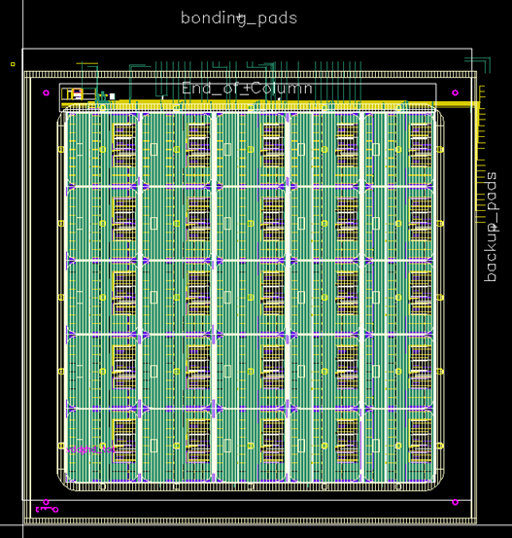
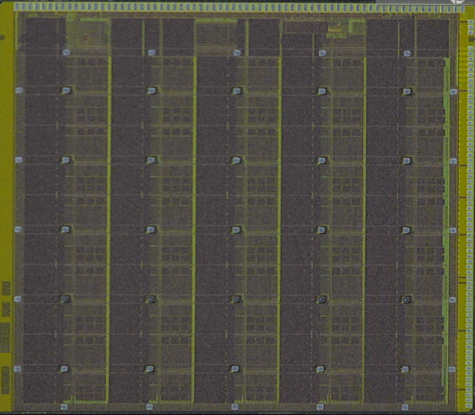
ALTIROC1
Altiroc1 layout
ZOOM of one pixel
~ 8 mm
VPA
VPA
VPA
TZ
TZ
VPA
VPA
VPA
TZ
TZ
VPA
VPA
VPA
TZ
TZ
VPA
VPA
VPA
TZ
TZ
VPA
VPA
VPA
TZ
TZ
VPA: Voltage preamp
TZ: Transimpedance preamp
C. de La Taille RD51 workshop 15 jun 2021

Slide 19
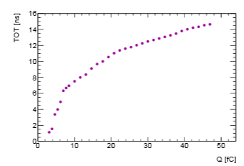
ALTIROC1_V2 - TDC performance
Specifications:
TOA: 20 ps ± 10%, range 2.5 ns
Specifications:
TOT: 160 ps ± 10%, range 20 ns
LSB /<LSB> vs channel
<TOA> vs delay
ASIC + sensor
<TOA_LSB> = 22.5 ps
<TOT_LSB> = 171 ps
ASIC + sensor
TOA_LSB and TOT_LSB can be adjusted to 20 ps and to 160 ps (respectively) using per channel Slow Control parameters
Some of the DLLs don’t lock properly => use of external R to set control voltages of the TDC
<TOA> vs delay: Small discontinuities due to LSB bin size that can be calibrated with Random Programmable Generator
=> Altiroc1_V3: integrates a Random Programmable Generator

Slide 20
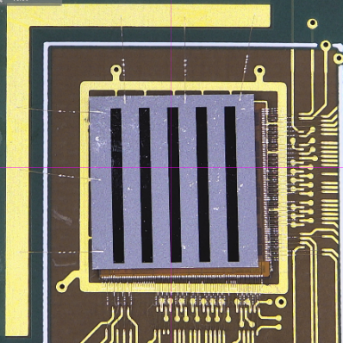
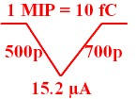
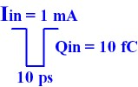
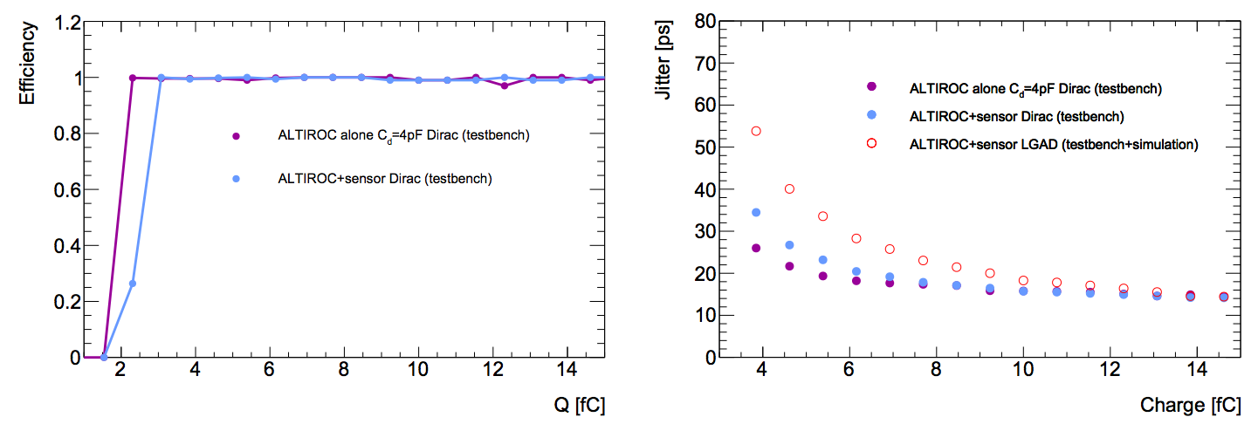
ALTIROC1_V2- performance at system level
out_preamp simulation
ALTIROC1_V2
+ LGAD sensor
LGAD input
Dirac input
ε ~100% for ASIC alone and ASIC+Sensor at 4fC
Jitter ~ 25 ps (55 ps) for ASIC alone (ASIC+sensor) at 4fC
Estimated jitter using LGAD signal,
using calibration data and simulation
Specifications:
Minimum Vth <2 fC

Slide 21



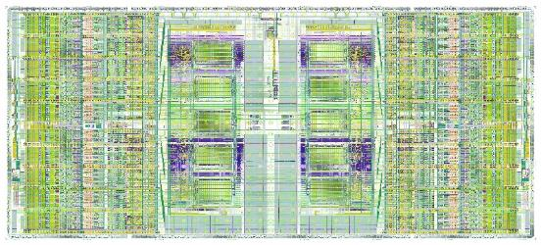


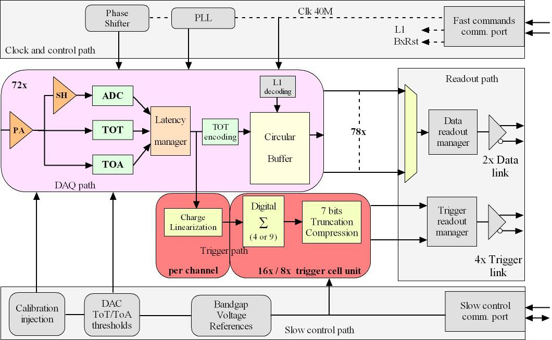
HGCROC2 : CMS HGCAL readout chip
Overall chip divided in two symmetrical parts
1 half is made of:
  39 channels: 18 ch, CM0, Calib, CM1, 18 ch (78 channels in total)
  Bandgap, voltage reference close to the edge
  Bias, ADC reference, Master TDC in the middle
  Main digital block and 3 differential outputs (2x Trigger, 1x Data)
Measurements
Charge
  ADC (AGH): peak measurement, 10 bits @ 40 MHz, dynamic range defined by preamplifier gain
  TDC (IRFU): TOT (Time over Threshold), 12 bits (LSB = 50ps)
  ADC: 0.4 fC resolution. TOT: 2.5 fC resolution
Time
  TDC (IRFU): TOA (Time of Arrival), 10 bits (LSB = 25ps)
Two data flows
DAQ path
  512 depth DRAM (CERN), circular buffer
  Store the ADC, TOT and TOA data
  2 DAQ 1.28 Gbps links
Trigger path
  Sum of 4 (9) channels, linearization, compression over 7 bits
  4 Trigger 1.28 Gbps links
Control
Fast commands
  320 MHz clock and 320 MHz commands
  A 40 MHz extracted, 5 implemented fast commands
I2C protocol for slow control
Ancillary blocks
Bandgap (CERN)
10-bits DAC for reference setting
11-bits Calibration DAC for characterization and calibration
PLL (IRFU)
Adjustable phase for mixed domain

Slide 22
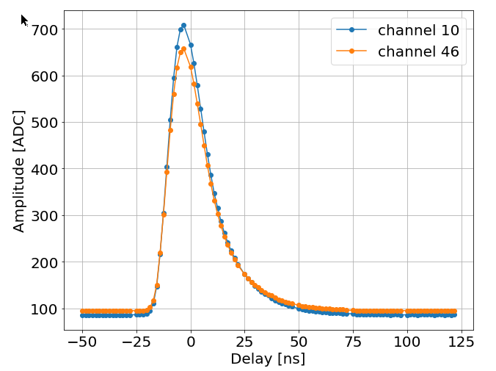
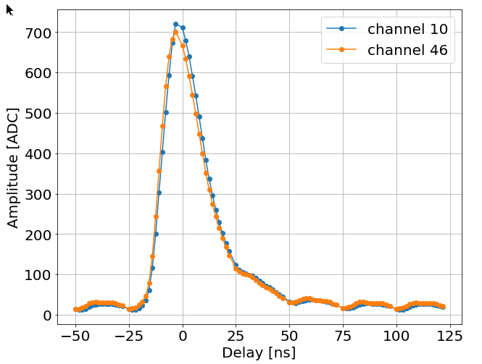
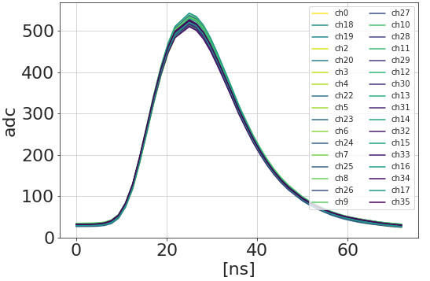
Test boards and signal
Flip-Chip on mezzanine
HD BGA board
HD BGA on mezzanine
Version 2
125 fC
Gain = ~0,18 fC/ADCU
Separates effects from the BGA substrate and PCB
Rising time (10-90 %): ~ 15 ns
Falling time (10-90 %): ~ 30 ns, < 20 % at BX+1
Good uniformity over the channels
Digital 40 MHz clock coupling on the analog signal on the HD BGA board: digital noise (slide 11)

Slide 23
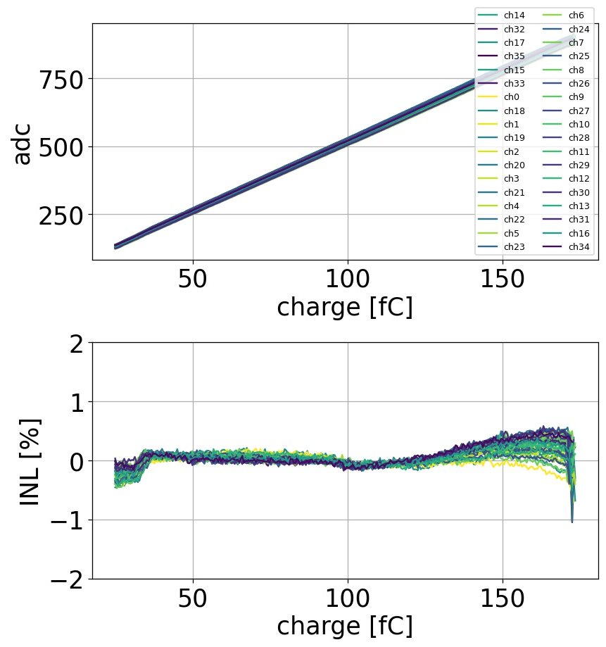
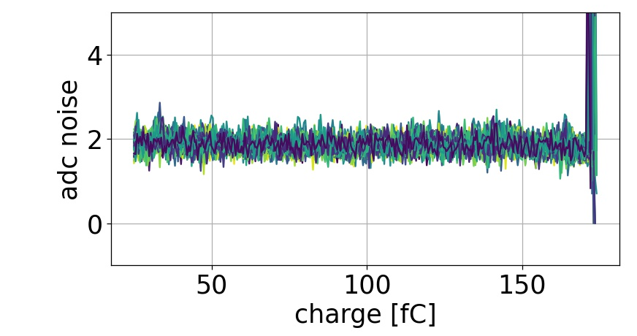
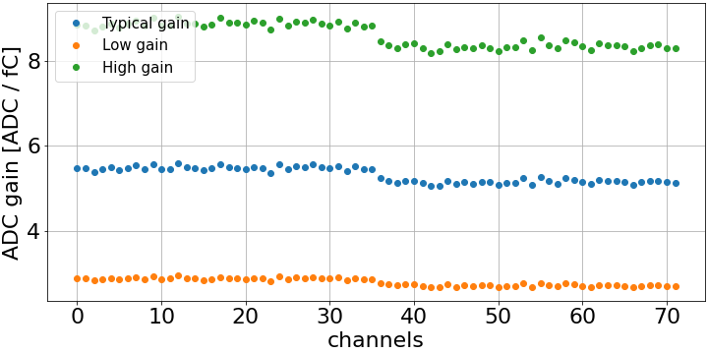
Charge ADC (0 – 160 fC)
Two 10b-DAC to globally set the pedestal to a wanted level
5b-DAC to reduce dispersion per channel
  From ~ 100 ADCu dispersion to ~ 5 ADCu
Good linearity within +/- 0.5%
  1.6 fC (~1 MIP) linearity for the typical gain
~ 0.3 fC resolution with 50 pF input capacitor
~ 0.3 fC

Slide 24
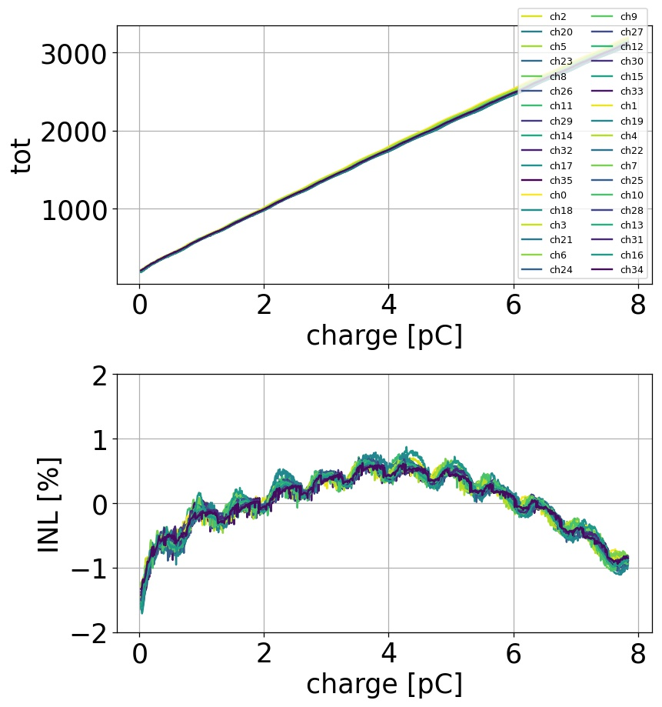
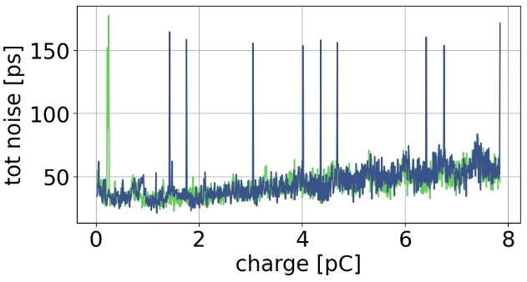
Charge: TOT range (160 fC – 10 pC)
Charge measurement from TOT when preamplifier saturates
160 fC to 10 pC (for the typical preamplifier gain)
  12 bits over 200 ns
  50 ps binning
Linearity
  < 2% linearity
  Better with input capacitor (as expected)
  Small residual wiggles on TOT due to digital noise on preamplifier input
Resolution around the LSB (~ 50 ps)
  Some peaks due to outliers (understood and fixed)
150 ns
0,1 %
1 LSB

Slide 25
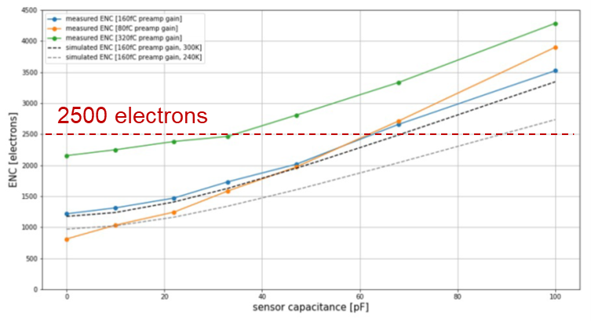
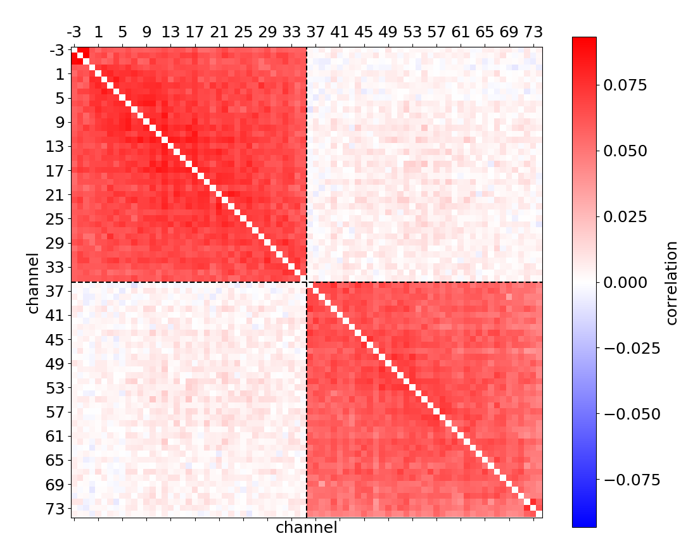
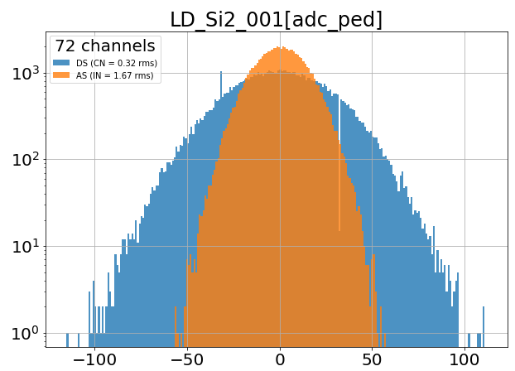

Noise
Measured noise with 50 pF input cap = 0.3 fC (~ 2000 electrons) (0.7 nV / √Hz)
Very low correlated noise contribution: ~ 0.1
Coherent noise extracted by comparing direct and alternate sums on n channels (n = 72):
$DS= \sum{ped\left[i\right]}$ ; $AS= \sum{\left({−1}^{i}\right)ped[i]}$
  Incoherent noise $IN=rms(AS)/√n$
  Coherent noise $CN= \sqrt{var\left(DS\right)−var\left(AS\right)}/n$
Equivalent Noise Charge wrt. sensor capacitance
Correlation matrix
Coherent vs. incoherent noise
IN: 0.3 fC
CN: 0.06 fC

Slide 26







Timing performance
Minimum Charge providing a TOA measurement is 20 fC, limited by the digital coupling
$Time Walk= \frac{170 [ps]}{Q [fC]}+400 [ps]$ : 2.5 ns w/o detector cap., ~ 5 ns with 50 pF input capacitor
$Jitter= \frac{2[ns]}{Q[fC]} \left(+\right) 22 [ps]$
Time Walk
20 fC
Timing jitter

Slide 27



Timing performance – S-curve
S-curves show the ToA efficiency as a function of the charge
Minimum charge providing ToA events is 20 fC
  Limited by the digital coupling

Slide 28

Analog Channel Overview: SiPM version
H2GCROC2 (SiPM version) = HGCROC2 + input current conveyor
  Heidelberg university design
2.5 V input stage for overvoltage adjustment

Slide 29

SiPM version measurements
H2GCROC2 measurements:
Good shape as expected
Adjustable conveyor gain
Dynamic range as expected: TOT (12bit) – 300pC aimed
Single-Photon Spectra (SPS):
  4V overvoltage, conveyor gain = 12
  Gain: ~ 10 ADC counts
1 pe.
2 pe.
ped.
3 pe.
~10 ADC tics

Slide 30
Conclusion
Lots of interest for ~10 ps timing resolution
Most of our work (so far) focused on Si, LGADs and SiPMs
Studies of PETIROC and LIROC with MGRPCs by Imad et al.

Slide 31
backup

Slide 32



voltage vs current sensitive
Example : 10 fC – 1 ns => i = 10 uA
signal from 1-10-100 pF sensors into 50 Ω (current) or 50k (voltage) preamp
1 mV
100 µV
10 mV
C=1 pF
C=10 pF
C=100 pF
1 ns

Slide 33



Signal : detector current
PN diode w =200µm
Very short rise time : tr~10ps
Relatively long «drift time» : td~2ns
LGAD sensor w =50µm
rise time : tr~500ps
Decay time» : td~700ps
SiPM detector (10pe-)
very short rise time : tr~10 ps
Short duration : td~100ps),
I SiPM
td=100 ps
tr
  3600x22.5fF (80 pF), Gain=1M, Rquench=125K, Cquench=5fF, CL=10pF
I holes
© Harmut Sadrozinski (Santa Cruz) “the beautiful risetime of the detector is spoilt by the electronics”

Slide 34


Examples [measurements from testbeam studies]
NA62 tracker : PIN diode thickness 300 µm A=0.09 mm²
  C_{d} = 0.1 pF e_{n} = 11 nV/√Hz t_{d} = 3 ns σ = 60 ps/Q(fC)
  1 MIP = 3 fC => σ = 20 ps/#MIP (~60-200 ps measured)
CMS HGCAL : PIN diode thickness 300 µm A=25 mm²
  C_{d} = 8 pF e_{n} = 1 nV/√Hz t_{d} = 3 ns σ = 420 ps/Q(fC)
  1 MIP = 3.8 fC => σ = 110 ps/#MIP (~200 ps measured)
ATLAS HGTD : LGAD diode thickness 50 µm A= 2 mm² G = 10
  C_{d} = 2 pF e_{n} = 2 nV/√Hz t_{d} = 0.5 ns σ = 50 ps/Q(fC)
  1 MIP = 5 fC (G=10) => σ = 10 ps/#MIP (~40 ps measured)
SiPM G = 1E6
  C_{d} = 300 pF e_{n} = 1 nV/√Hz t_{d} = 100 ps σ = 3 ns/Q(fC)
  1 pe = 160 fC => σ = 20 ps/#pe (~60 ps measured)
SiGe preamp © N. Spencer (UCSC)

Slide 35


Digital noise
A 40 MHz modulation is visible on the analog signals
  Comes from digital current spikes on preamp ground node
    10 µV on ground give 1 ADC count
  BGA worse than flip chip
  BGA substrate optimised, improvements made by optimizing decoupling & the pcb ground impedance
  Further improved by removing decoupling caps !
    Reduces digital current spikes (inductance)
This provides recommendations for the Hexaboard design
  Very delicate design!
[ns]
[ns]

