Slide 1
EOSC-Future - Roadmap

Slide 2
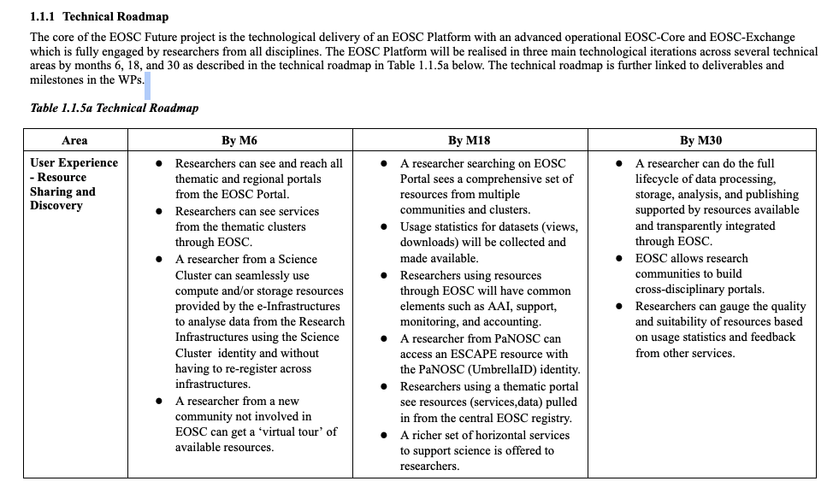

Slide 3
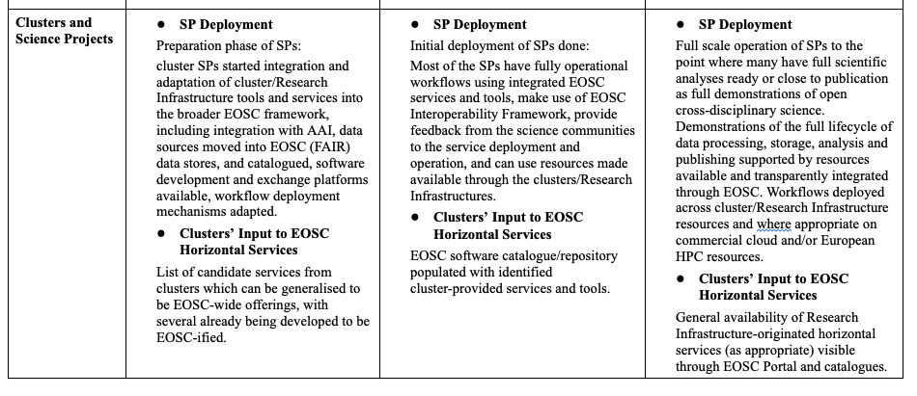

Slide 4
