Slide 1





HGCROC: the front-end readout ASICs for the CMS High Granularity Calorimeter
Damien Thienpont, on behalf of the CMS collaboration
G. Bombardi, F. Bouyjou, E. Delagnes, P. Dinaucourt, F. Dulucq, M. El Berni, M. Firlej, T. Fiutowski, J. Gonzalez, F. Guilloux, M. Idzik, C. de La Taille, A. Marchioro, J. Moron, L. Raux, K. Swientek, D. Thienpont, T. Vergine

Slide 2
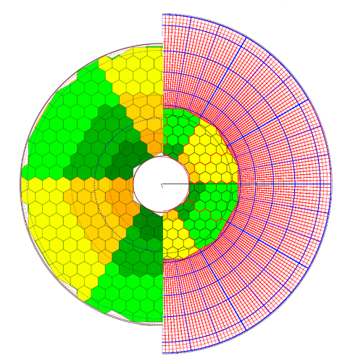
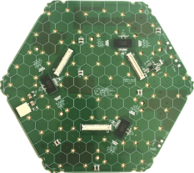
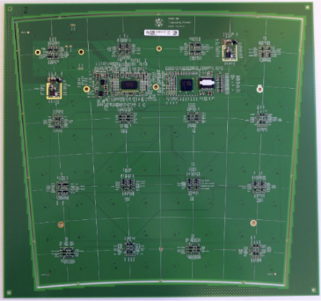

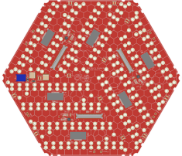

HGCAL: CMS EndCap Calorimeters for the LHC Phase-II upgrade
HGCAL covers 1.5 < eta < 3.0
Full system maintained at -30°C
  ~ 640 m² of silicon sensors, 6.1M Si channels, 0.5 or 1.1 cm² cell size
  ~ 370 m² of scintillators, 240k scint-tile channels
Data readout from all layers
Trigger readout from alternate layers in CE-E and all in CE-H
Active Elements
  Electromagnetic calorimeter (CE-E): Si, Cu/CuW/Pb absorbers
  Hadronic calorimeter (CE-H): Si & scintillator, steel absorber
New Front-end electronics
  Two versions: Silicon and SiPM
  Rad.tolerant (200 Mrad, 1.1016 neq / cm²)
  Power consumption: 20 mW per channel
  Noise: 0.4 fC
  Charge: 0.2 fC to 10 pC
  Pileup mitigation: Fast shaping (peak < 25 ns), precise timing capability (25 ps)
LD HB
x3 HGCROC
Tile board
x1 H2GCROC
HD HB
x6 HGCROC

Slide 3
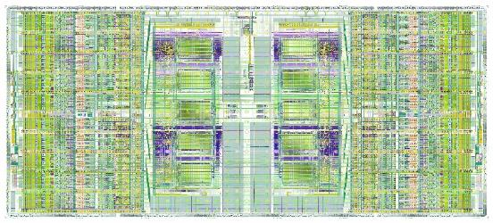

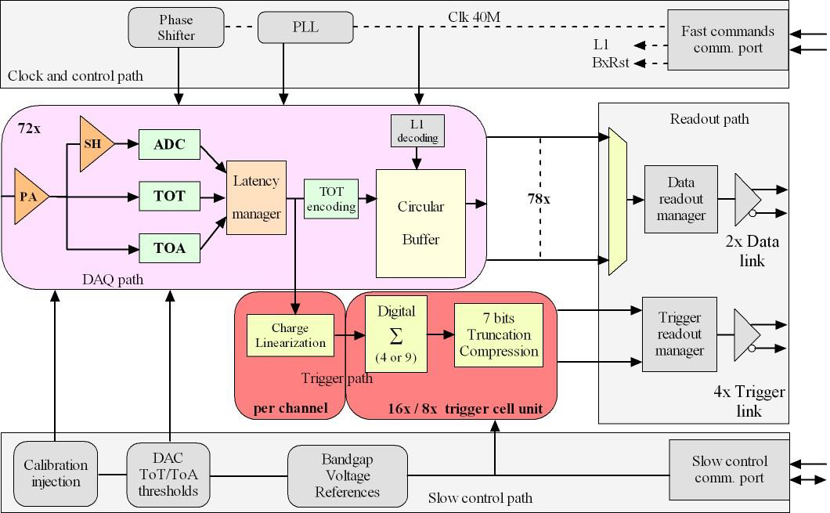
HGCROC2 overview
Overall chip divided in two symmetrical parts
1 half is made of:
  39 channels: 18 ch, CM0, Calib, CM1, 18 ch (78 channels in total)
  Bandgap, voltage reference close to the edge
  Bias, ADC reference, Master TDC in the middle
  Main digital block and 3 differential outputs (2x Trigger, 1x Data)
Measurements
Charge
  ADC (AGH): peak measurement, 10 bits @ 40 MHz, dynamic range defined by preamplifier gain
  TDC (IRFU): TOT (Time over Threshold), 12 bits (LSB = 50ps)
  ADC: 0.4 fC resolution. TOT: 2.5 fC resolution
Time
  TDC (IRFU): TOA (Time of Arrival), 10 bits (LSB = 25ps)
Two data flows
DAQ path
  512 depth DRAM (CERN), circular buffer
  Store the ADC, TOT and TOA data
  2 DAQ 1.28 Gbps links
Trigger path
  Sum of 4 (9) channels, linearization, compression over 7 bits
  4 Trigger 1.28 Gbps links
Control
Fast commands
  320 MHz clock and 320 MHz commands
  A 40 MHz extracted, 5 implemented fast commands
I2C protocol for slow control
Ancillary blocks
Bandgap (CERN)
10-bits DAC for reference setting
11-bits Calibration DAC for characterization and calibration
PLL (IRFU)
Adjustable phase for mixed domain

Slide 4
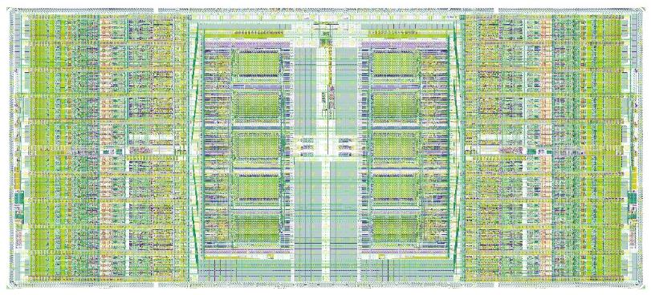
HGCROC2 floorplan
Two half-chips + common digital blocks (I2C, fast commands, PLL, 1.28 Gb serializers)
  Each half hosts 8 blocks of 4 channels + 2 common mode blocks
  Digital data processing : trigger sums and (partial) data storage in DRAM
  TSMC 130 nm
14 mm
4 channels + SC
I2C FC
references
PLL
7 mm
bias
serializers

Slide 5
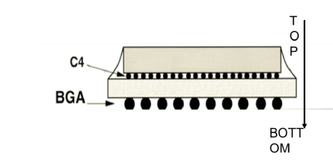
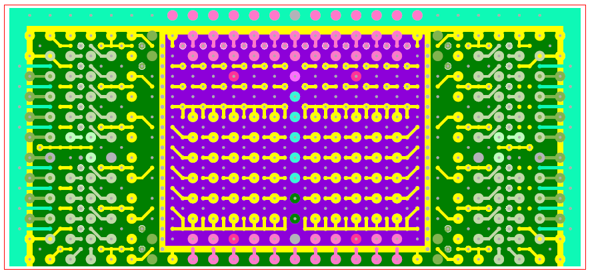
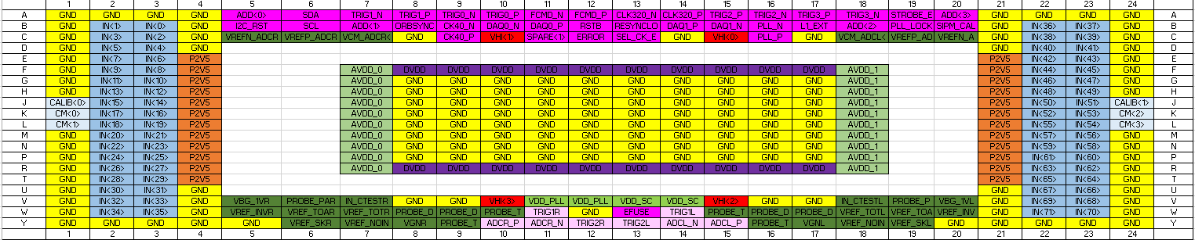
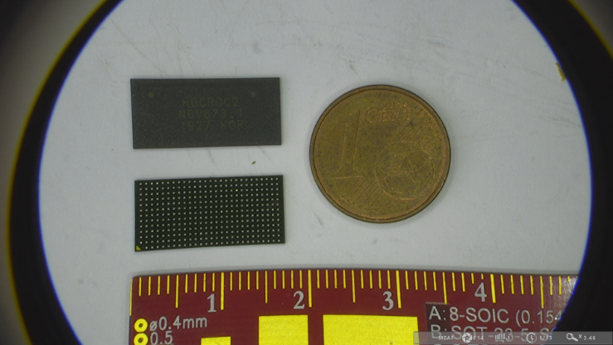
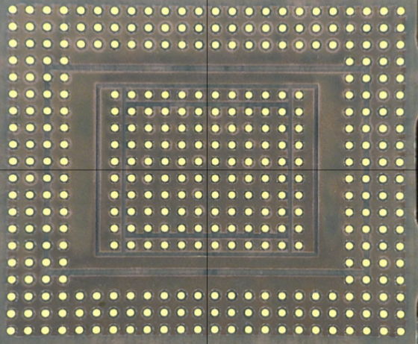
Packaging
C4 bump bonding
2 BGA packages fabricated:
  High Density (0.6 mm pitch) for Hexaboard with ~400 channels (120 µm Si sensors)
  Low Density (0.8 mm pitch) for Hexaboard with ~200 channels (200 µm and 300 µm Si sensors) and Tileboards with ~70 channels

Slide 6
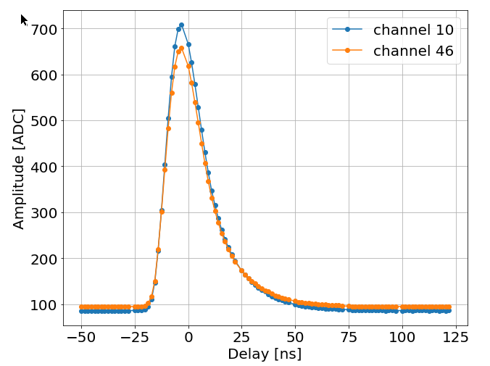
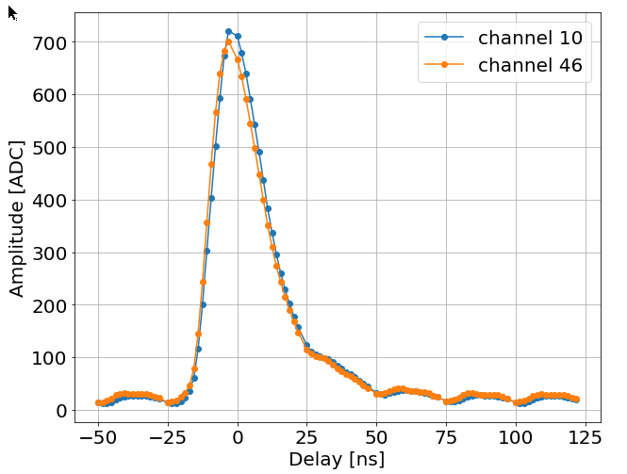
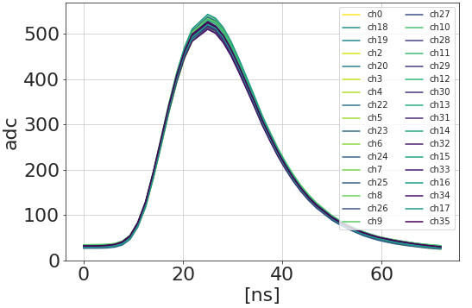
Test boards and signal
Flip-Chip on mezzanine
HD BGA board
HD BGA on mezzanine
Version 2
125 fC
Gain = ~0,18 fC/ADCU
Separates effects from the BGA substrate and PCB
Rising time (10-90 %): ~ 15 ns
Falling time (10-90 %): ~ 30 ns, < 20 % at BX+1
Good uniformity over the channels
Digital 40 MHz clock coupling on the analog signal on the HD BGA board: digital noise (slide 11)

Slide 7
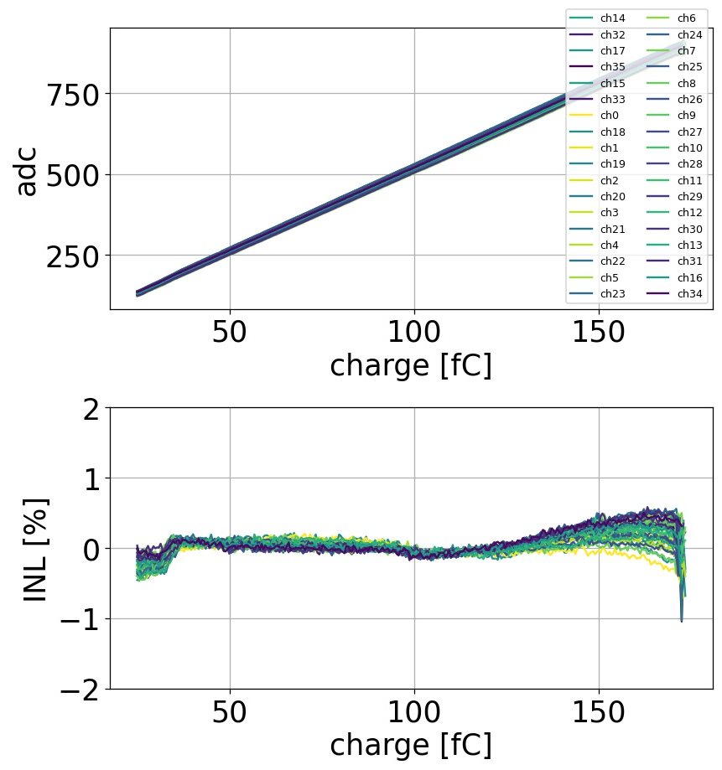
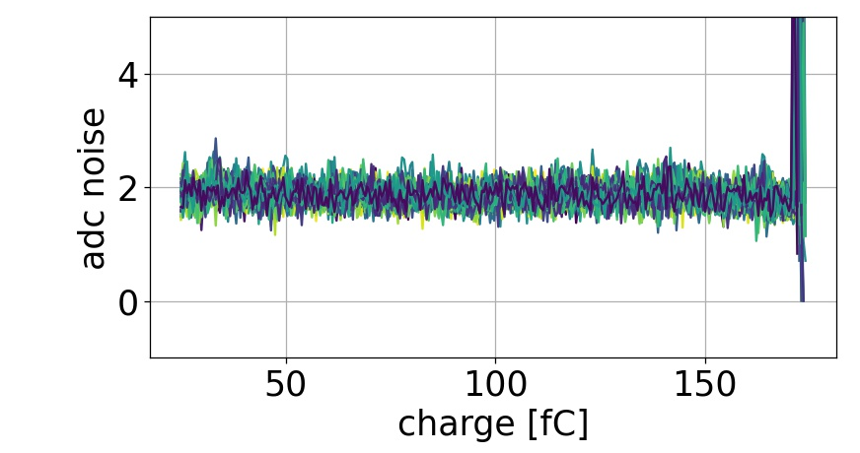
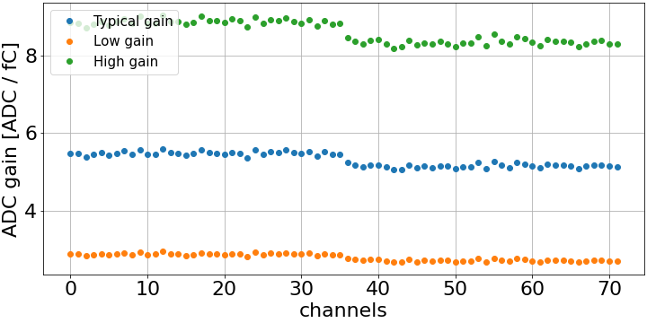
Charge ADC (0 – 160 fC)
Two 10b-DAC to globally set the pedestal to a wanted level
5b-DAC to reduce dispersion per channel
  From ~ 100 ADCu dispersion to ~ 5 ADCu
Good linearity within +/- 0.5%
  1.6 fC (~1 MIP) linearity for the typical gain
~ 0.3 fC resolution with 50 pF input capacitor
~ 0.3 fC

Slide 8
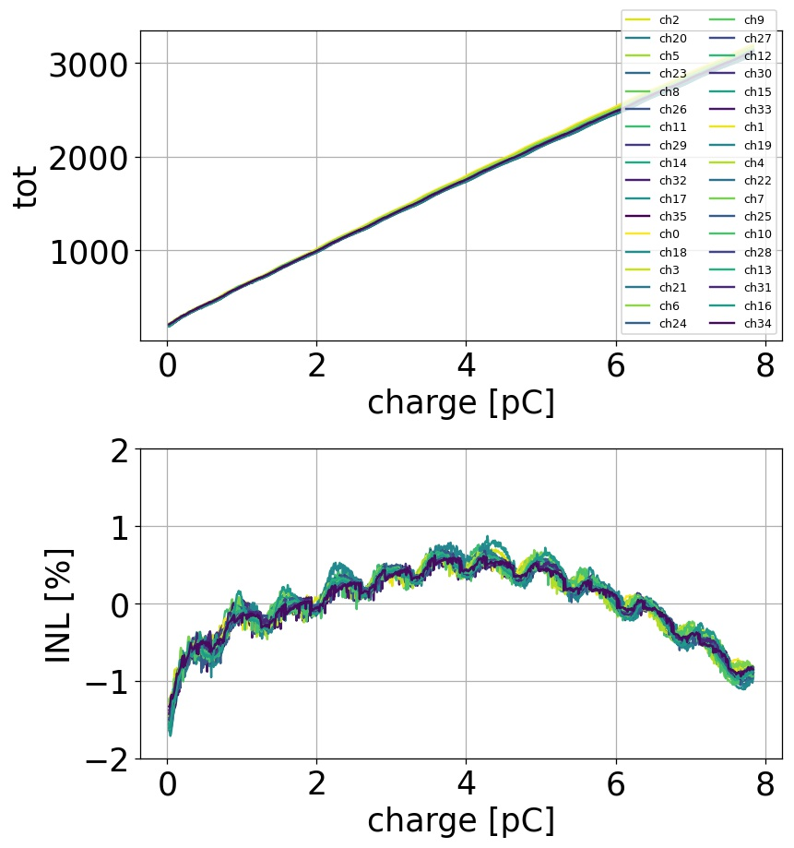
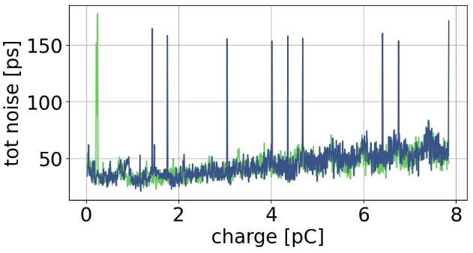
Charge: TOT range (160 fC – 10 pC)
Charge measurement from TOT when preamplifier saturates
160 fC to 10 pC (for the typical preamplifier gain)
  12 bits over 200 ns
  50 ps binning
Linearity
  < 2% linearity
  Better with input capacitor (as expected)
  Small residual wiggles on TOT due to digital noise on preamplifier input
Resolution around the LSB (~ 50 ps)
  Some peaks due to outliers (understood and fixed)
150 ns
0,1 %
1 LSB

Slide 9
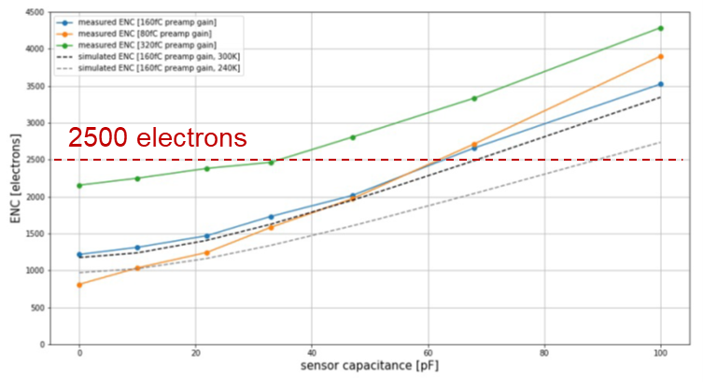
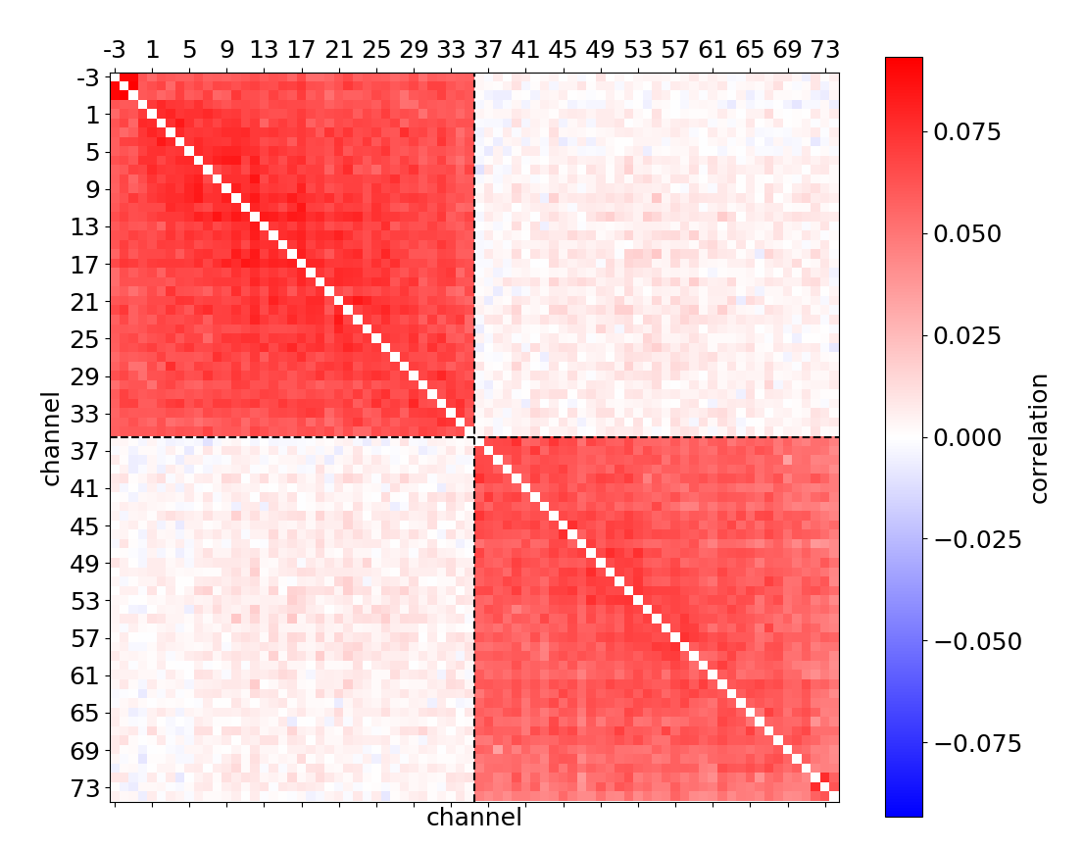
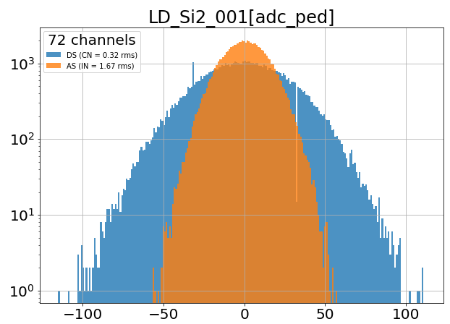
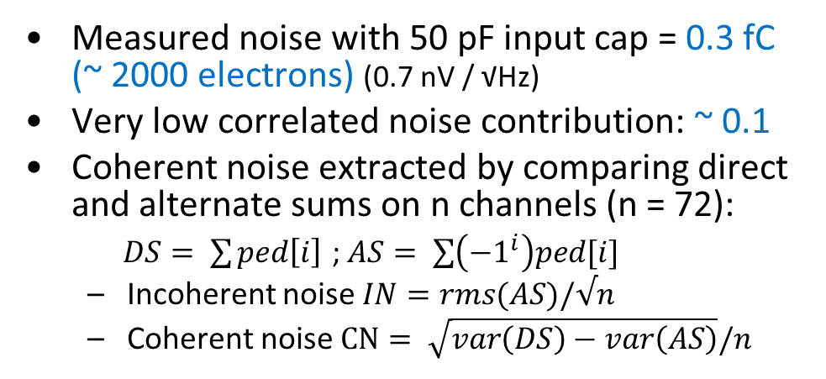
Noise
Measured noise with 50 pF input cap = 0.3 fC (~ 2000 electrons) (0.7 nV / √Hz)
Very low correlated noise contribution: ~ 0.1
Coherent noise extracted by comparing direct and alternate sums on n channels (n = 72):
$DS= \sum{ped\left[i\right]}$ ; $AS= \sum{\left({−1}^{i}\right)ped[i]}$
  Incoherent noise $IN=rms(AS)/√n$
  Coherent noise $CN= \sqrt{var\left(DS\right)−var\left(AS\right)}/n$
Equivalent Noise Charge wrt. sensor capacitance
Correlation matrix
Coherent vs. incoherent noise
IN: 0.3 fC
CN: 0.06 fC

Slide 10
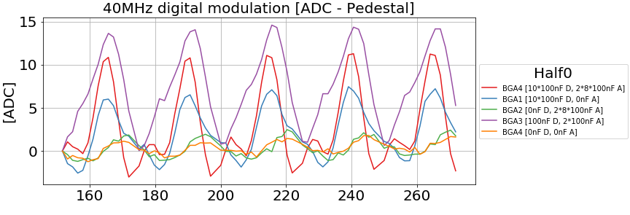
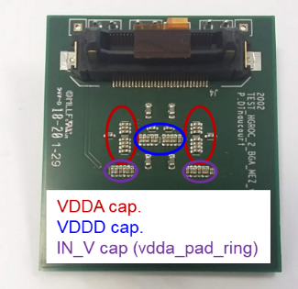
Digital noise
A 40 MHz modulation is visible on the analog signals
  Comes from digital current spikes on preamp ground node
    10 µV on ground give 1 ADC count
  BGA worse than flip chip
  BGA substrate optimised, improvements made by optimizing decoupling & the pcb ground impedance
  Further improved by removing decoupling caps !
    Reduces digital current spikes (inductance)
This provides recommendations for the Hexaboard design
  Very delicate design!
[ns]
[ns]

Slide 11
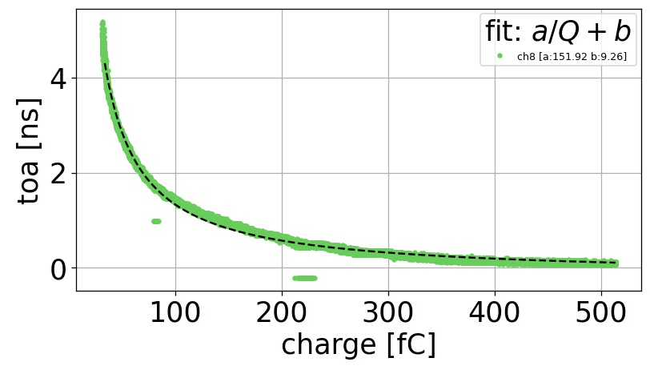
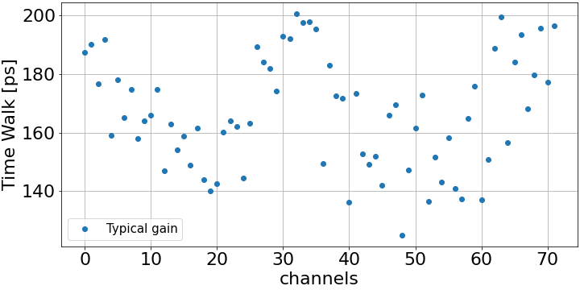
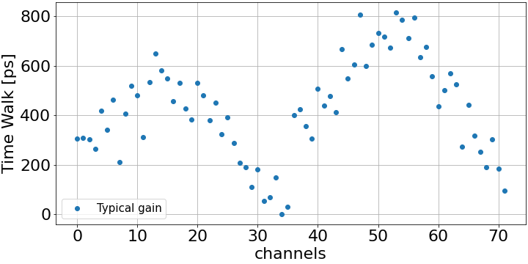
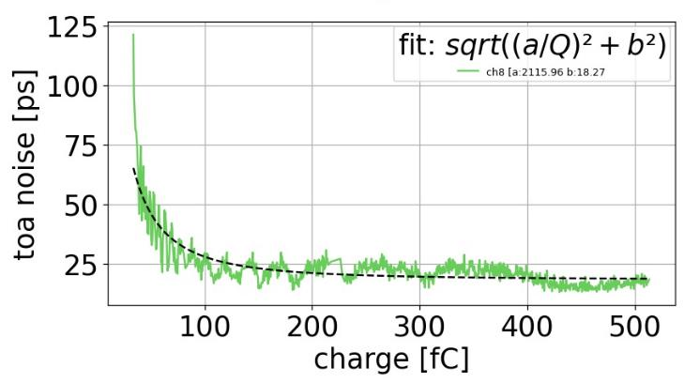
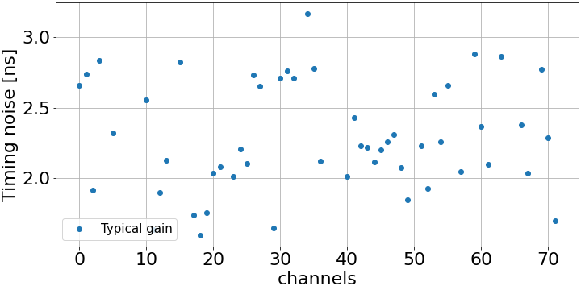
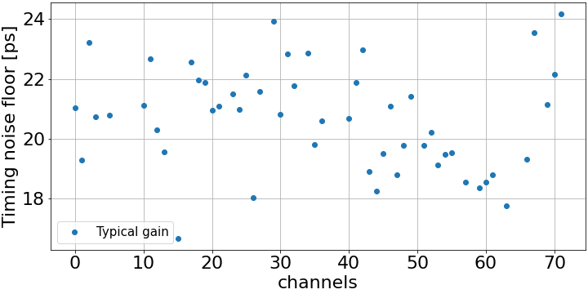
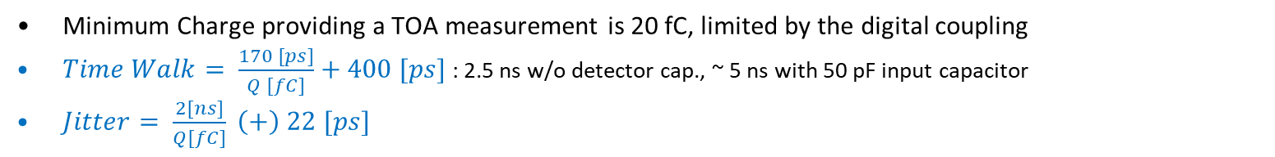
Timing performance
Minimum Charge providing a TOA measurement is 20 fC, limited by the digital coupling
$Time Walk= \frac{170 [ps]}{Q [fC]}+400 [ps]$ : 2.5 ns w/o detector cap., ~ 5 ns with 50 pF input capacitor
$Jitter= \frac{2[ns]}{Q[fC]} \left(+\right) 22 [ps]$
Time Walk
20 fC
Timing jitter

Slide 12
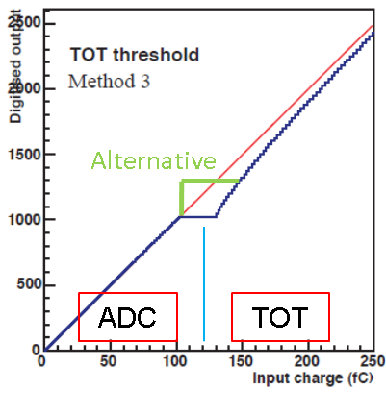
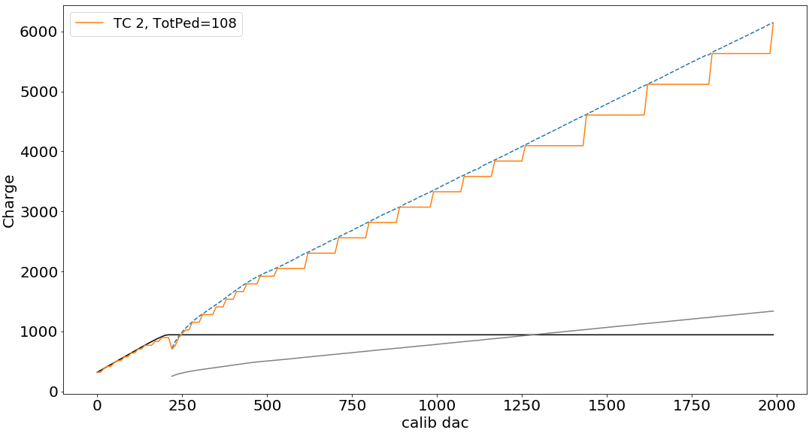
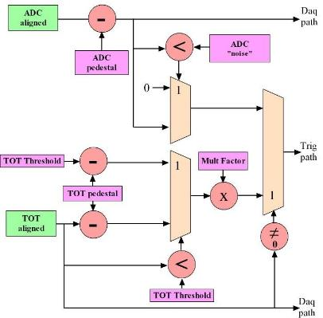
Trigger characterization
Charge linearization over ADC and TOT range
Sum by 4 / 9 (19b / 21b)
Compressed to 7 bits: 4b exponent + 3b mantissa
‘-’ : ADC [ADC counts]
‘-’ : TOT [TOT counts]
‘- - ’: Trigger data before compression (calculated from DAQ data)
‘-’ : Trigger Data [ADC counts]
ADC counts
160 fC
1.2 pC

Slide 13
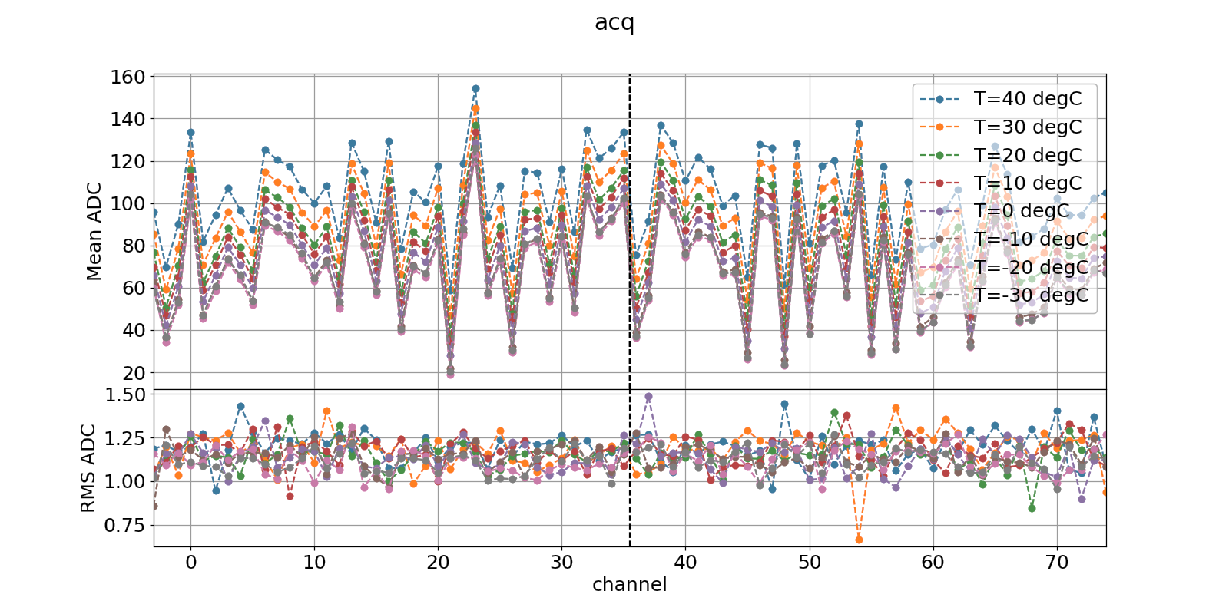
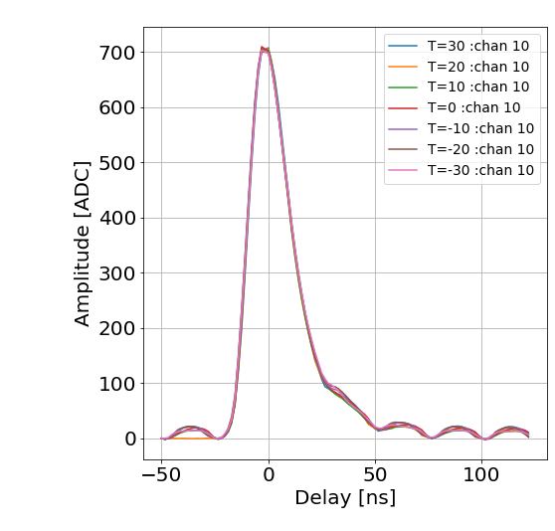
Bandgap and temperature measurements
Readout is DC coupled to the shaper output ➔ temperature sensitivity mitigation mandatory
Bandgap value moves over 2mV between -40°C and +40°C, but lower shift around -20°C
  Increasing to ~ 6-8 mV after 300 Mrad
Pedestals
  1 ADC/°C at room temperature
  ~ 0.4 ADC/°C around -30°C (Would be around 5 ADC/°C without mitigation)
Pedestals value as a function of temperature
Gain as a function of temperature
BGA

Slide 14
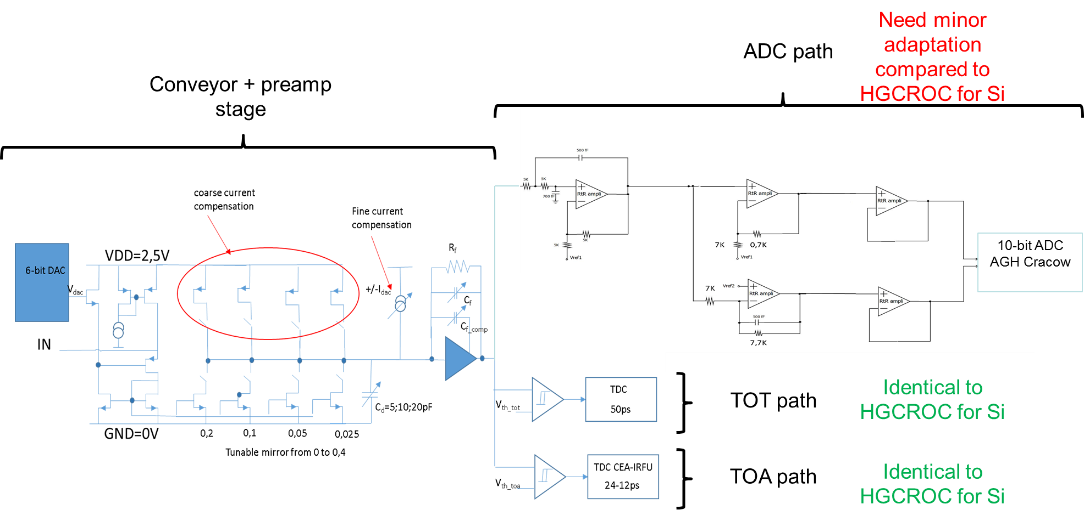
Analog Channel Overview: SiPM version
H2GCROC2 (SiPM version) = HGCROC2 + input current conveyor
  Heidelberg university design
2.5 V input stage for overvoltage adjustment

Slide 15
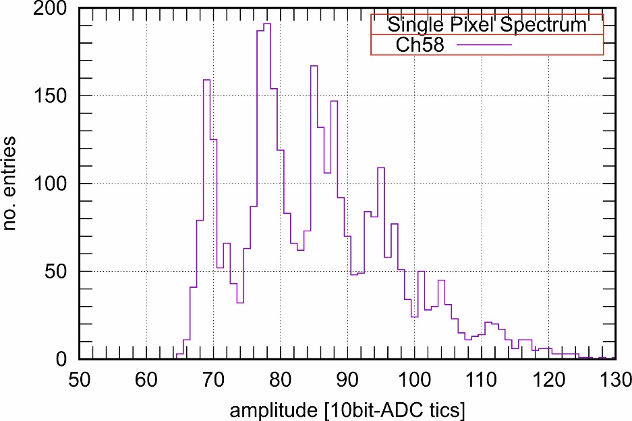
SiPM version measurements
H2GCROC2 measurements:
Good shape as expected
Adjustable conveyor gain
Dynamic range as expected: TOT (12bit) – 300pC aimed
Single-Photon Spectra (SPS):
  4V overvoltage, conveyor gain = 12
  Gain: ~ 10 ADC counts
1 pe.
2 pe.
ped.
3 pe.
~10 ADC tics

Slide 16
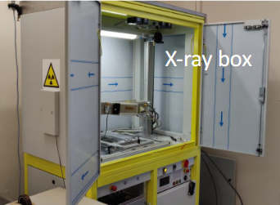
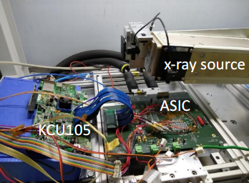
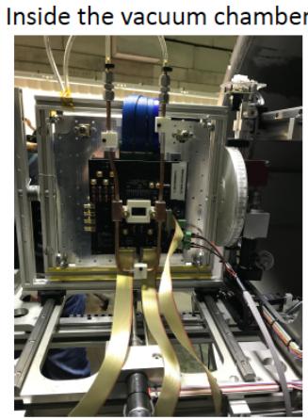
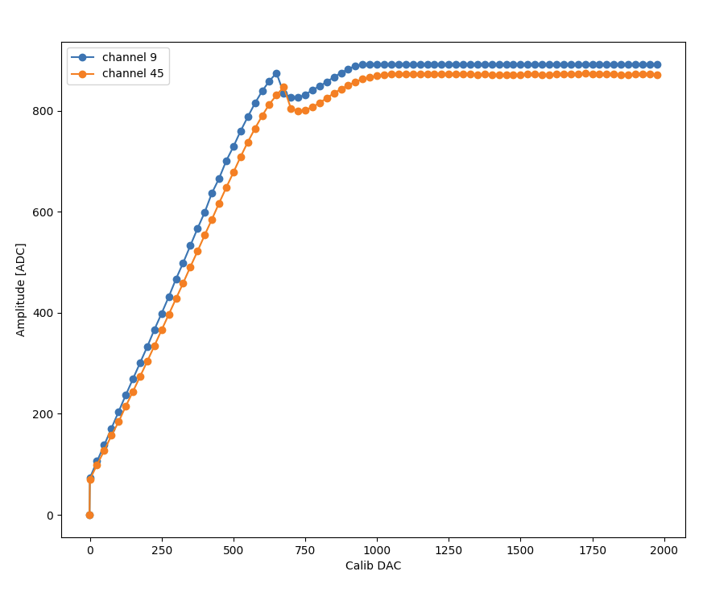
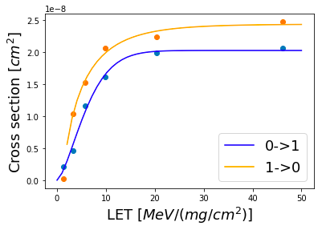
TID and SEU tests
TID: thinned chip (70 µm)
3 campaigns at CERN:
  Si-version at room temperature (Oct 2019)
  Si-version at cold (Mar & Jun 2020)
  SiPM-version at room temperature (Aug 2020)
Irradiation up to 310 Mrad (5 Mrad for SiPM)
The chip still works after annealing
SEE: 2 campaigns at Louvain (Nov 2019 & Feb 2020)
Heavy ions LET 5 – 45 MeV
I2C acted as expected: cross section follows the usual curve and no errors recorded when auto-correction set. Flips < 2 E-7 Hz/chip
Bit shifting in the DAQ link (no triplicated Serializer in HGCROCv2)
No signs of latch-up effects
No flips seen in ADC/TOA/TOT data
Last run after 318 Mrad

Slide 17
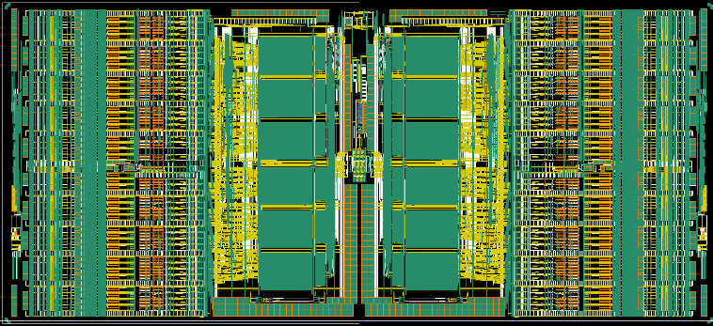
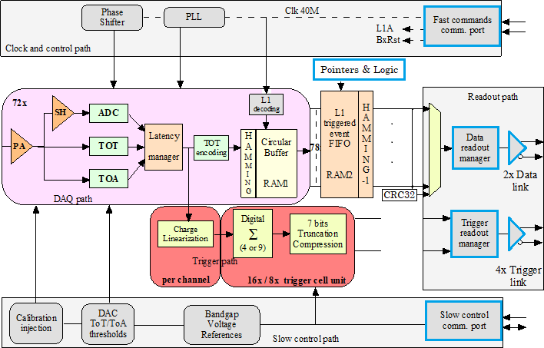
HGCROC3: final version
Analog Upgrades:
Increased sensor leakage current compensation
Increase resolution (12bit) of DAC and phase shifter for calibration
TOA calibration with a Randomized Pulse Generator
Triplicated Logic
Memory pointers and calculation logic
High Speed Serial links
SEE tolerant
Control
SEU tolerant Fast commands
SEU tolerant I2C Module for slow control
Memory blocks
Adds trigger derandomizing buffer for DAQ path
Custom Hamming Encoding at the entry of Circular Buffer
Hamming Decoding after the L1 FIFO
Checksum
CRC-32 Checksum Encoding before serialization
Submitted mid-Dec 2020
: Tripled Module

Slide 18
Summary
With HGCROC2, a big step has been taken to reach the HGCAL’s requirements. It is probably one of the most complex chips ever designed for imaging calorimetry: high dynamic charge, precision timing measurements, high speed links, a lot of digital, harsh radiation environment…
Measurements now well advanced on both Silicon and SiPM versions @CERN, LLR, IRFU, Desy and OMEGA
  Charge performance reaches the specification: 1 % linearity, for both ADC and TOT
  Timing performance: time walk calibration feasible, jitter below 25 ps
Digital coupling
  Good performance at chip level
  Stringent requirement on PCB design: low ground impedance and optimized power decoupling
  First studies on the Hexaboard and Tileboards started
TID and SEE campaign show very good performance
  SEEs appear only in the non-triplicated parts of the chip (as expected)
  SEU errors on the slow-control parameters < 1e-7 Hz
HGCROC3 will be the final version…
  Now at packaging, awaited end-May

Slide 19
Backup slides

Slide 20
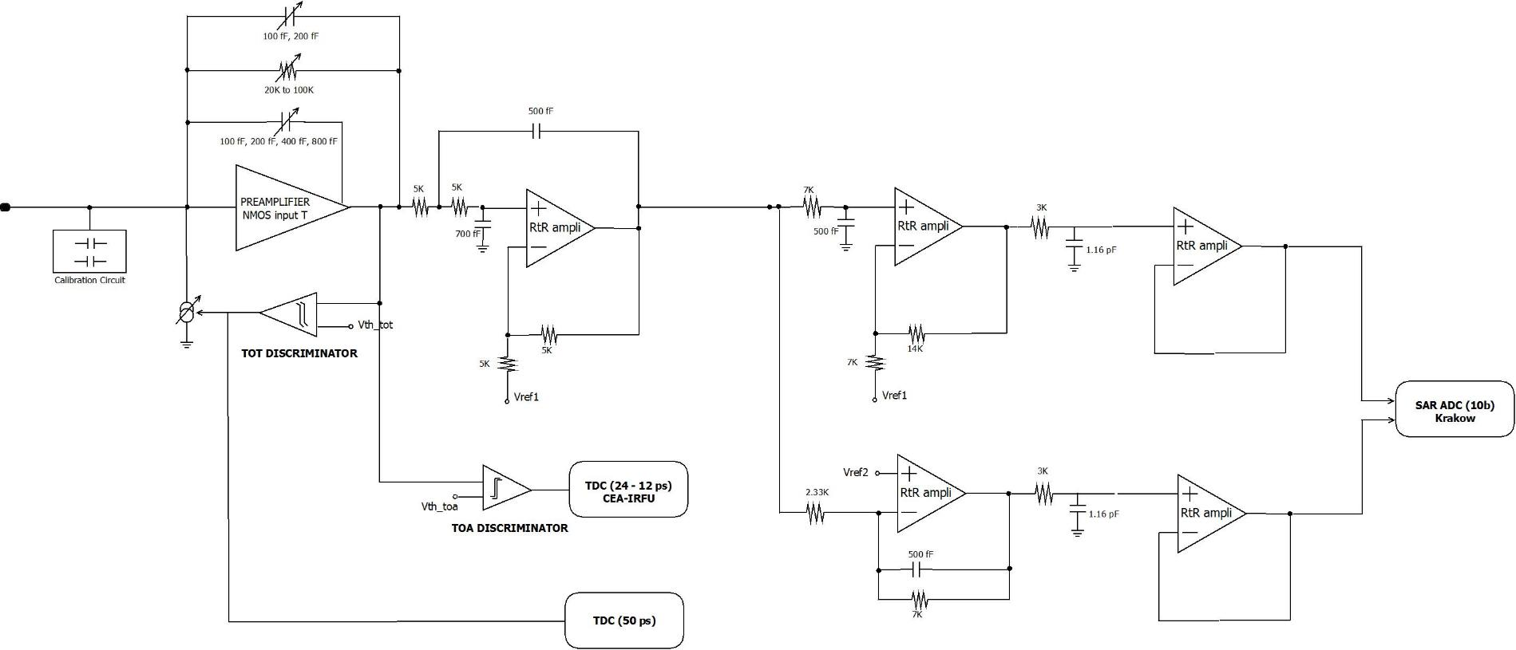
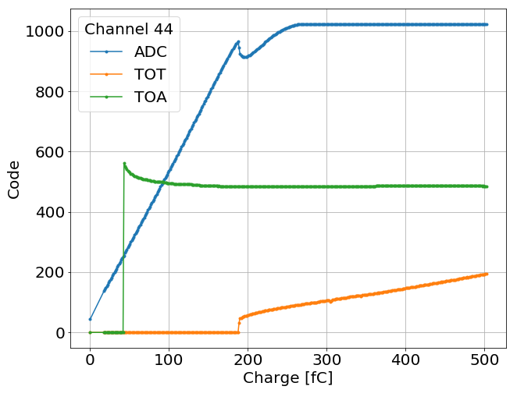
Analog Channel Overview: Silicon version
Calibration pulser, 0.5pF and 8 pF calibration cap.
Preamp : adjustable gains for 80, 160 and 320 fC ranges
Tunable TOT threshold
Compensation for the leakage current, 10 µA max. (not shown in the figure)
Sallen Key shaper RC4, tp < 25 ns, tunable (~20%) with 2 bits, BX+1/BX<0.2
Temperature sensitivity mitigation
10 bit ADC from Krakow AGH
TOT and TOA TDCs from CEA-IRFU
Total analog power (static, without ADC and TDCs): 5.5 mW (typ)

Slide 21
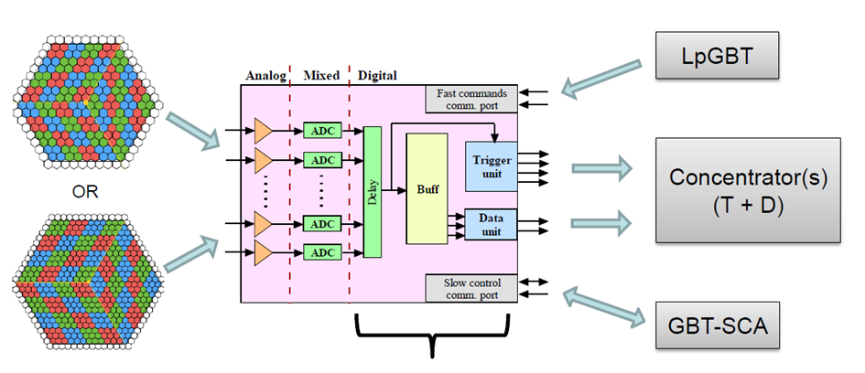
Trigger path
The chip provides compressed data of the charge to the L1 trigger processing
  Charge linearization over ADC / TOT range
  Sum of 4 (or 9) channels (depending on the sensor)
  Charge compression to fit the bandwidth (4b Exponent + 3b Mantissa)
  4 E-link transmitters, CLPS @ 1.28 Gbps
HGCROC2 integrates 72 channels to readout
192 channels sensor with a 64-ch configuration
432 channels sensor with a 72-ch configuration

Slide 22


From HGCROC2 to HGCROC3
V2
Sharp eye needed to distinguish the differences!
  Same size/pinout/package
  Small improvements in analog part
  Adds derandomizer after L1 DRAM
  SEU mitigation done in digital part
  More robust I²C and fast command decoder
  Final functionality
Completed end-october
  Reviewed Dec 1st
  Submitted mid-Dec
V3

Slide 23



TDC calibration
Channel-wise TDC made of a fine TDC (3 bits), a coarse TDC (5 bits) and a counter (2 bits)
  Works only when a ToA (or a ToT) occurs
Two servo-controlled master TDCs allow to control speed of channel-wise TDCs
  First adjustment allow to configure the Master TDC (1 ➔ 2)
  External pulse injection used here : will be replaced by a Random Pulse Generator (RPG) in V3
Then channel-wise adjustment allows
to achieve the best performances (~1 LSB INL)
1
2
3

Slide 24



Timing performance – S-curve
S-curves show the ToA efficiency as a function of the charge
Minimum charge providing ToA events is 20 fC
  Limited by the digital coupling

