Slide 1


Handling frames status
Pixel Meeting | 04/05/2021

Slide 2
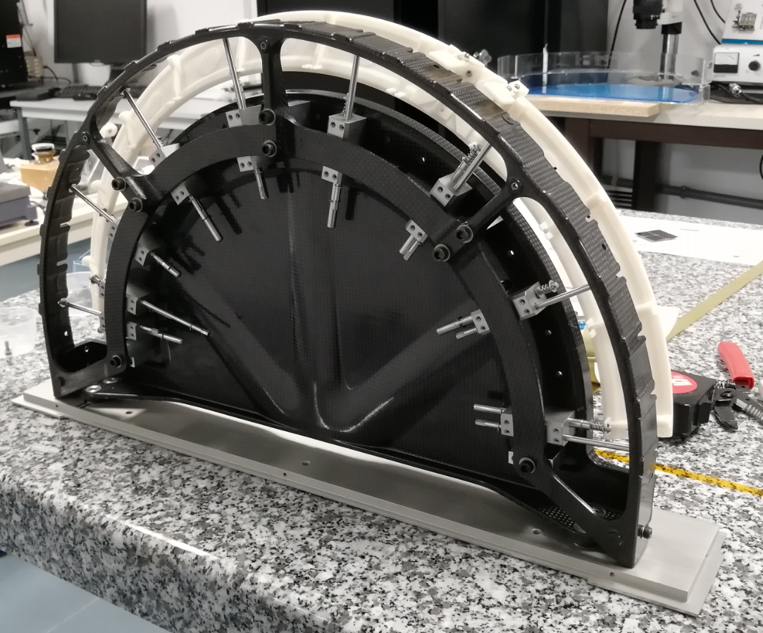

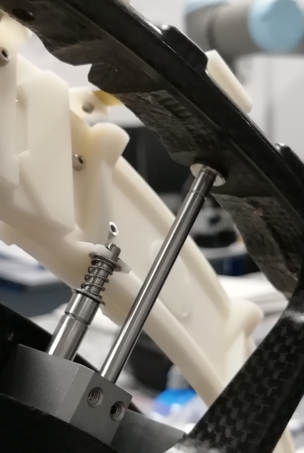
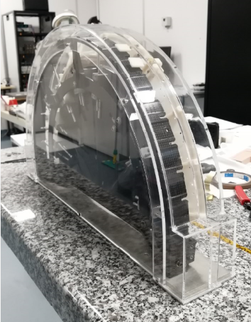
Handling frames status
Handling frame half ring
  Prototype received
    High quality from the supplier (as usual)
    Carbon structure stiffness as expected
    Mounting test with ring mock-up done
    Adjustments / accuracy ok
    Meeting with CERN to validate the prototype
  Remaining tests
    Flex-PCB mounting test with part from CERN
    Carbon arch metrology
    Vibrations : half-ring dummy ?
  Further steps
    Design modifications following functionnal tests (in progress)
    CAD model CPPM version (in progress)
    CAD declination to other layers : L2 & L4
    Order pre-production HF (budget ? PUMA ?)
      → to be done before summer
04/05/2021
2

Slide 3
Handling frames status
Handling frames public market
  Specification document
    First version issued
    2 splited batches : HF longerons | HF half-rings
    Declination in different variants for each detector layer (L2, L3, L4)
    Technical specifications with carbon parts detailed design left to the candidates
    Amount of HF needed + production rates
    Schedule for pre-production and validation steps
    Schedule for production supplies
  Budget
    Estimations for unitary costs/amount of HF should fit the global budget
    Public market entirely managed by IN2P3
  Further steps / schedule
    Meeting with DR12 to set up the market
    Refine technical specification (carbon material and process, stiffness level…)
    Final specification document + validation with DR12
    Sept 2021 → Market submission
    Oct 2021 → Bare support FDR
    Feb 2022 → Market notification (T0)
    June 2022 → Production start (T1)
    Feb 2024 → End of production
✓
Fits ITK planning
04/05/2021
3

