Slide 1
ESFRI Science Clusters' Long Term Commitments to Open Science
11 June 2021

Slide 2
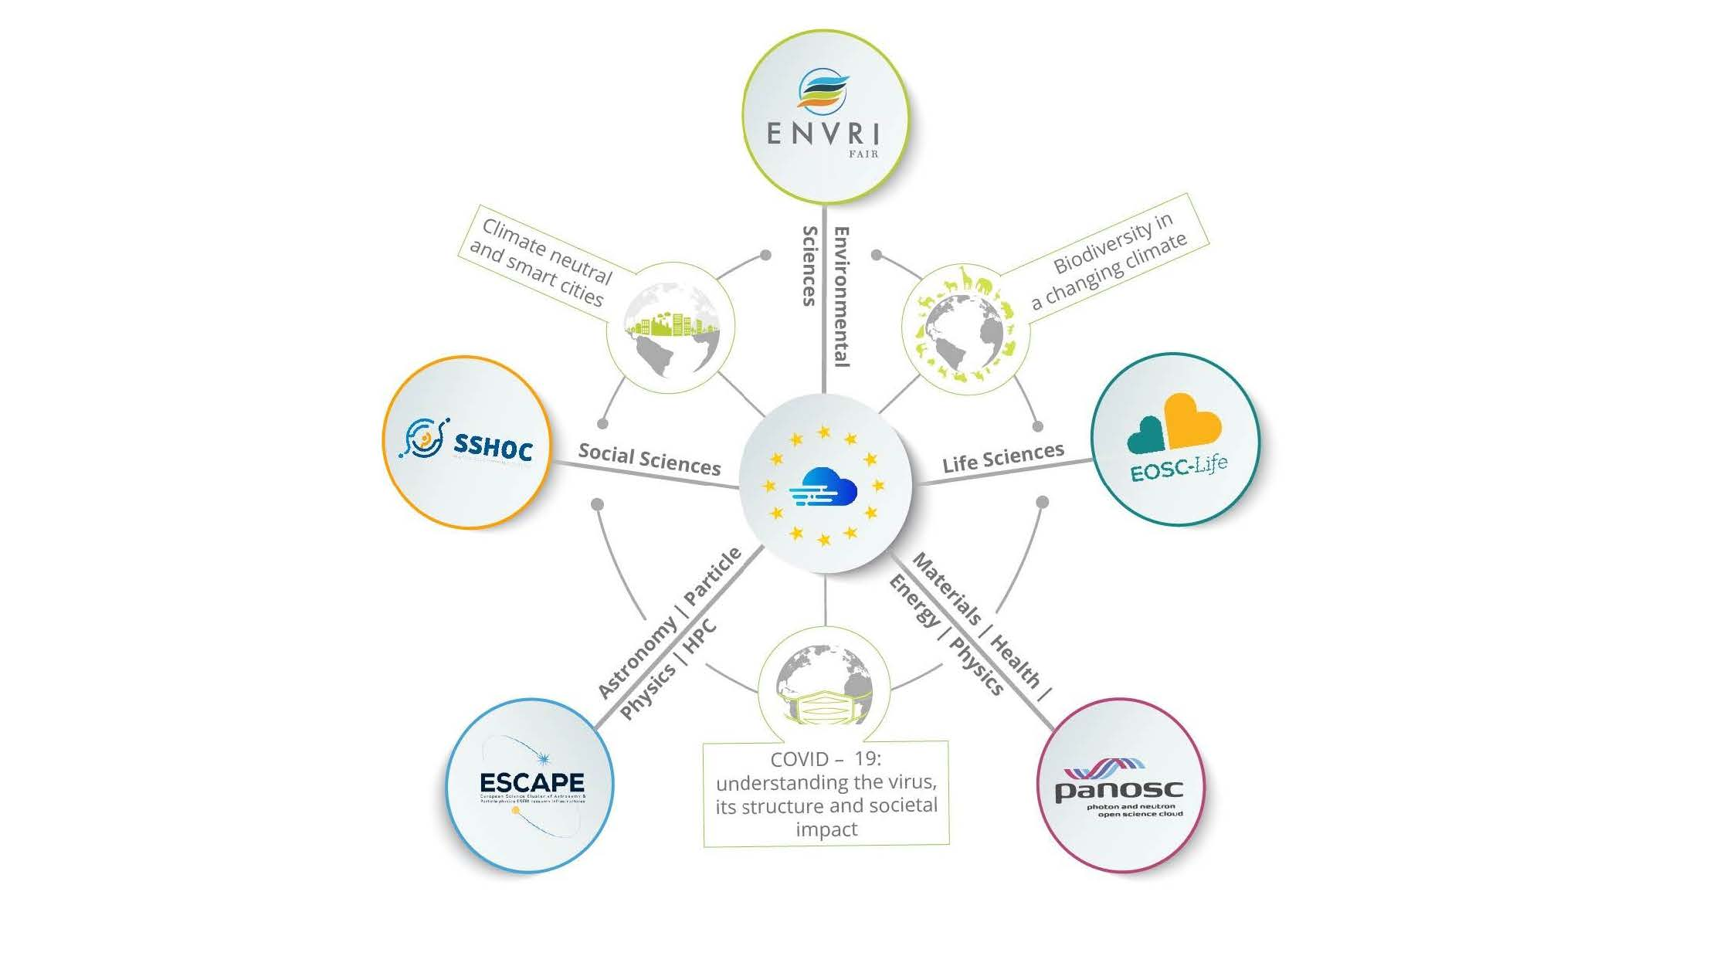

Slide 3
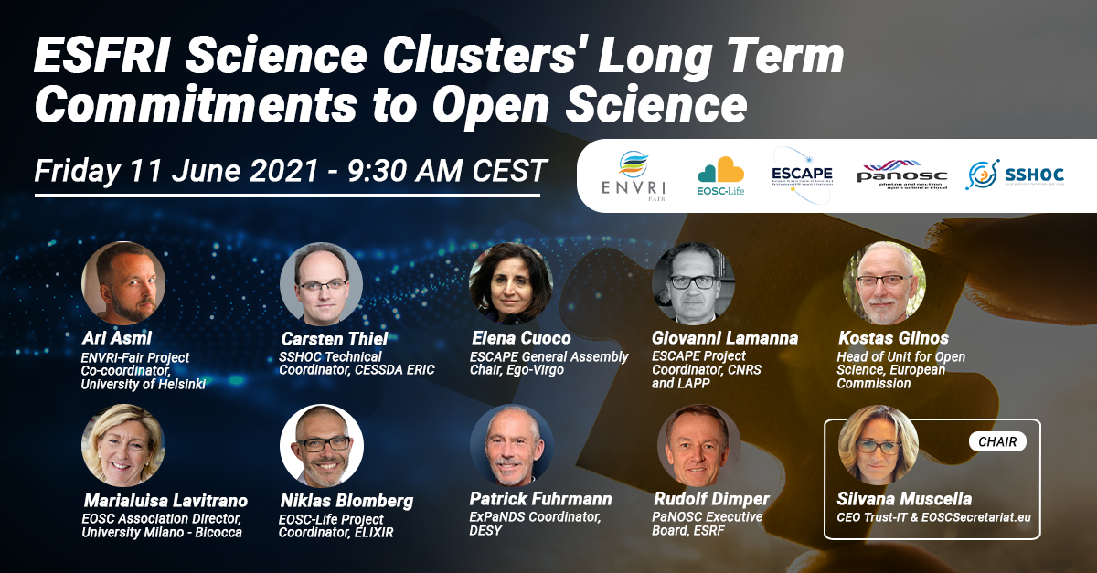

Slide 4
ESFRI Science Clusters
position statement on expectations
and long-term commitment in Open Science
Giovanni Lamanna
11 June 2021

Slide 5

The Science Clusters
Science Clusters of Research Infrastructures (RIs) proposed in 2018 in response to the dedicated H2020 call
Five Science Clusters to ensure the connection of the ESFRI RIs with European Open Science Cloud (EOSC)
Expected impact:
Improve access to data and tools leading to new insights and innovation
Facilitate access of researchers to data and resources for data driven science.
Create a cross-border open innovation environment.
Rise the efficiency and productivity of researchers through open data services and infrastructures for discovering, accessing, and reusing data.
Foster the establishment of global standards.
Develop synergies and complementarity between involved research infrastructures.
Adopt common approaches to the data management for economies of scale.
Working together making data FAIR …

Slide 6
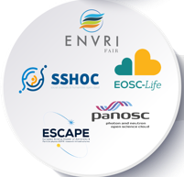
An important path of cooperation and synergies
A natural and reinforced collaboration among the ESFRI RIs’ management boards in each Science Cluster.
From dialog to a structural cooperation among Science Clusters Boards.
Starting up inter-cluster synergies and bridging on technologies.
Continuous synergies with EC, ESFRI-EOSC task force and EOSC Secretariat
Science Clusters as an integral part of EOSC:
- interpreting and guiding the thematic implementation of EOSC concept;
- their outcomes are now forming the core of the emerging EOSC fabric;
- essential and key role for the science-content and science-goal of EOSC;
- gathering together their concerned scientific communities.
Five thematic
Science Clusters
More than 80% of ESFRI RIs,
plus other world-class RIs and new emerging ones.

Slide 7



An important path of cooperation and synergies

Slide 8
Workshop
This first Science Cluster Workshop addressing an outlook for the future:
- an introduction to the programmes of the Science Clusters, their current structural value,
their present and future collaboration actions;
- potential paths to consolidate the cluster work programmes and sustain EOSC;
- presenting to (and discussing with*) the European Commission, EOSC Association and ESFRI
Boards a longer-term vision to support the uptake of Open Science by the global scientific
community.
* A dedicated (restricted) afternoon session is organized.

Slide 9
Workshop
By the way.…. We say ‘ESFRI Science Clusters’ but there are “3 distinct objects”:
ESFRI: European Strategy Forum on Research Infrastructures;
(ESFRI) RIs: A set of domain-based pan-European (in the ESFRI Roadmap) and other world-class RIs;
ESFRI Science Clusters: Current five H2020 projects supported by consortia of scientists from RIs, Universities and Institutes. The ESFRI label recalls the commitment of ESFRI RI legal entities in the Cluster action as originally requested.

Slide 11
Workshop
To start with, we are happy to count on the presence of Kostas Glinos for an overview talk about Open Science, terms, ambitions and challenges in Europe.
Kostas Glinos leads the unit in charge of Open Science in the directorate general for Research & Innovation at the European Commission. Kostas Glinos holds a PhD in engineering, he has been developing EU policy and managing R&D programmes in the area of Science, Technology and Innovation (STI) since 1992.
The Science Clusters acknowledge a constant and fruitful dialog and cooperation with EC DG-RTD and DG-CNECT and especially with Kostas Glinos (et al.), producing a series of reflexions and actions, including this Workshop.
(… We learn about policies and we tell about the diversity of the scientific research world!)

Slide 12
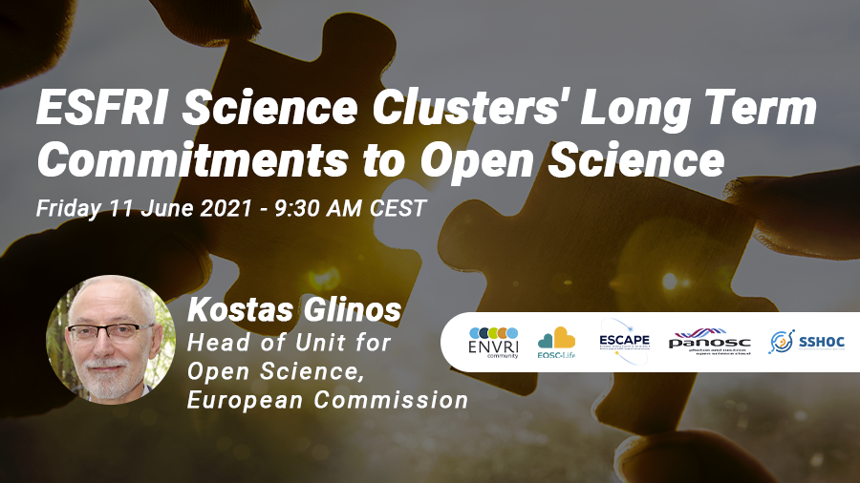

Slide 13
Open Science the new “modus operandi” for research
ESFRI Science Clusters' Long Term Commitments to Open Science
11 June 2021
Kostas GLINOS
Head of Open Science RTD.G4
Directorate-General for Research and Innovation
European Commission

Slide 14
1. Why we need Open Science
To make Science
more efficient (better sharing of resources),
more reliable and robust (better reproducibility, open scrutiny),
more responsive to societal demands (involvement of societal actors)
more trusted by society
Covid-19 illustrates both the necessity and success of practicing open science

Slide 15
2. The EC commitment to Open Science
Improve the practice of R&I
Openly accessible scholarly publications
Early sharing of all research outputs
All data FAIR, RDM
Reproducible results
Societal engagement and responsibility
Develop proper enablers
Rewards and incentives to adopt Open Science practices, with appropriate metrics
Appropriate skills and education, including for research integrity
Open Research Infrastructures including the European Open Science Cloud (EOSC)
ERA Communication
Provisions on Open Science under Horizon Europe
EOSC in the Horizon Europe RI WP
EOSC and other data strategies

Slide 16
2.1 Open Science in the ERA Communication
Deepening the ERA
The Commission will: (Action 9)
Incentivise open science practices by improving the research assessment system.
Launch, via the Horizon Europe Programme, a platform of peer-reviewed open access publishing;
Analyse authors’ rights to enable sharing of publicly funded peer-reviewed articles without restriction;
Ensure a European Open Science Cloud that is offering findable, accessible, interoperable and reusable research data and services (Web of FAIR); and
Citizen Engagement
The Commission will: (Action 13)
Organise with Member States and stakeholders Europe-wide participatory citizen science campaigns to raise awareness and networking, crowdsourcing platforms and pan-European hackathons, in particular in the context of Horizon Europe Missions. The Commission will develop with Member States best practices to open up science and innovation to citizens and youth.

Slide 17
2.2 Towards a new ‘modus operandi’ for Science
The dominant current system
Rewarding individual competing scientists
Publish as much and as fast as possible
Excellence defined largely on the basis of where scientists publish
Incentivises researchers to produce specific outputs (mainly publications)
  - Use of quantitative metrics
Increasing influence of commercial players from access to publications
  - supported by proprietary services and analytics
FROM → TO
Open Science
Rewarding collaboration and sharing
Share knowledge/data as early and as openly as possible
Composite definition of excellence
Incentivises researchers to share, collaborate, increase quality and impact;
  - Use of qualitative and quantitative metrics
Avoid lock-in over public-funded R&I output, ensuring autonomy of RPOs
  - supported by open services, analytics and science graphs
→
→
→
→
→
Notes:
• There is concern about the increasing influence of commercial players over many aspects of research and education, from access to publications, to supply of data storage, search functionalities and information gathering. A level playing field needs to be maintained so that the independent role of universities in the knowledge system is not eroded.
• Universities play a crucial role in generating and diffusing knowledge, and preserving their autonomy is fundamental for them to fulfil their research and teaching mission, to advance science and maintain EU leadership in R&I and to foster a vibrant economy.
• The Commission is committed to implement actions that will help universities maintain control and avoid lock-in over information that is of vital importance for their strategic autonomy and to preserve the public knowledge space.
• The Commission is committed to improve and maximise access to and re-use of research data, and to support a public infrastructure to secure knowledge and data sharing as a public good.

Slide 18



2.3 Open Science under HE
Open Science embedded across the FP
(OA, RDM, Citizen Engagement, etc.)
  Evaluation of proposals
  (excellence –methodology-, quality & efficiency of implementation )
  Grant Agreement, guidelines
  Reporting—during the project’s lifetime
  Work programmes
Strengthening of the obligations with respect to open access and focus on responsible RDM in line with FAIR
  → to foster the adoption of
  Open Science practices
    providing open access to research outputs
    early and open sharing of research
    research output management
    participation in open peer-review
    measures to ensure reproducibility of research outputs
    involving all relevant knowledge actors including citizens, civil society and end users in the co-creation of R&I agendas and contents (such as citizen science)
    …

Slide 19

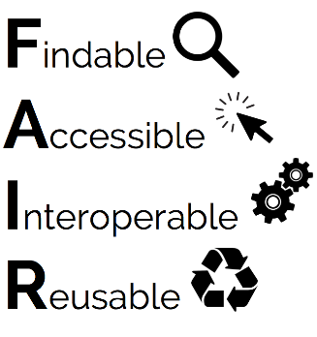
2.3 Open Science under HE - requirements
  OA to peer-reviewed publications under Horizon Europe
    deposition in a trusted repository and immediate open access
    retain IPR and open licences [CC BY (or equivalent)]
    publication fees (APCs/BPCs) refundable only in full open access publishing venues
    Metadata of deposited publications open under CC0 or equivalent
  OA to research data, in line with the FAIR principles
    Data Management Plan (DMP) as a living document constantly updated
    deposit data in a trusted repository (federated in EOSC if required) and link to publications
    ensure open access ASAP under CC BY or CC0 (or equivalent), unless exceptions apply
    → “as open as possible, as closed as necessary”
  OA to other research outputs (software, algorithms, protocols, workflows, models)
    If required by the call conditions: provide digital or physical access
    It is recommended to include other research outputs in the DMP

Slide 20
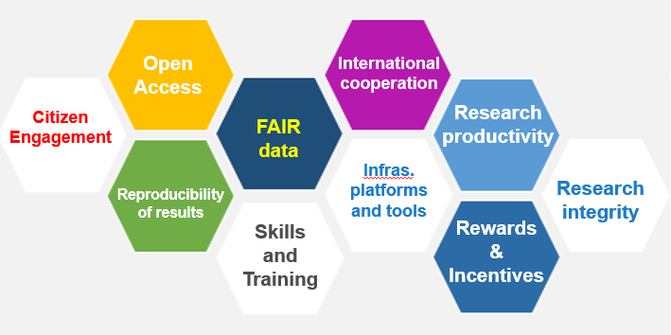
2.4 EOSC in the HE Research Infrastructures WP
INFRADEV
Developing , consolidating and optimizing the European Research Infrastructures landscape
INFRAEOSC
Enabling an operational, open and FAIR, EOSC ecosystem
European Open Science Could
Enable Open Science Commons
INFRASERV
Research Infrastructure services to support health research, accelerating the green and digital Transformation, and advance frontier knowledge
INFRATECH
Next generation of scientific instrumentation, tools and methods and advanced digital solutions
through the EOSC European
Co-Programmed partnership
INFRANET
Network connectivity in research and education – enabiling collaborations without boundaries

Slide 21

2.4 EOSC in the HE Research Infrastructures WP
European Co-Programme partnership and Horizon Europe programming
Implementation of the SRIA
Implementation levels
EC MS
Strategic R&I Agenda
SO1. Open Science practices becoming ‘the new normal
SO2. Sustainable and federated infrastructures
SO3. Standards, tools and services to find access, reuse and combine results
Destination INFRAEOSC / EOSC-Association
Partnership
Governing Board
Partnership MoU
European
National
EOSC
Association
Institutional

Slide 22











2.4 EOSC and other data strategies
The European Data Strategy
The EU will create a single market for data by:
Setting clear and fair rules on access and re-use of data;
Investing in next generation standards, tools and infrastructures
to store and process data;
Joining forces in European cloud capacity;
Pooling European data in key sectors, with EU-wide common and interoperable data spaces;
Giving users rights, tools and skills to stay in full control of their data.
“EOSC is the basis for a science, research and innovation data space that will bring together data resulting from research and deployment programmes and will be connected and fully articulated with the sectoral data spaces.”
(European Data Strategy, COM(2020) 66 final)
Health
Industrial &
Manufacturing
Agriculture
Finance
Mobility
Green Deal
Energy
Public
Administration
Skills
EOSC: a crosscutting data space for Research and Innovation
Notes:
Creating a single market for data will make the EU more competitive globally and will enable innovative processes, products and services.
Industrial and commercial data are key drivers of the digital economy. The European Data Strategy will make more data available for use in the economy and society, while keeping those who generate the data in control.

Slide 23
3. RIs in the EOSC ecosystem
2020 ESFRI WHITE PAPER - MAKING SCIENCE HAPPEN
RIs major promoters of Open Science providing FAIR and quality certified Open Data
Continue to support the development of EOSC
  increased FAIR and open data sharing
  facilitate the cross disciplinary research and the exploitation of data interoperability
  availability to stimulate inter-disciplinary and transdisciplinary research to achieve the societal goals
EOSC to take full advantage of ESFRI best practices and services
  data management, storage and curation….
RIs are major data-producers
ESFRI science clusters
ESFRI individual infrastructures
EOSC-ESFRI cluster projects
Will achievements be sustainable?
Challenge: interoperability of data and services

Slide 24
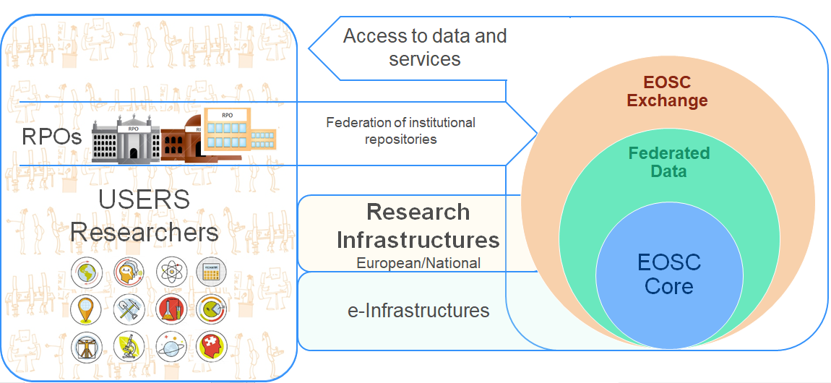
3. RIs in the EOSC ecosystem
EOSC-Core
generic services common to all
are they common yet?
→ different AAI among RIs?
EOSC-Exchange
generic services
domain specific services
(1) RIs are providers of data and services (e.g. data services, research products..)
(2) RIs are users of data and services provided by/through EOSC
increasing interdisciplinary research → increasing cross-domain use? → access? cost? scalability?
services in federated environments → more access and use? → AAI? cost? scalability?
maintenance of domain specific services → an in-kind contribution to EOSC?

Slide 25

Thank you
© European Union 2020
Unless otherwise noted the reuse of this presentation is authorised under the CC BY 4.0 license. For any use or reproduction of elements that are not owned by the EU, permission may need to be sought directly from the respective right holders.
Notes:
Update/add/delete parts of the copy right notice where appropriate.
More information: https://myintracomm.ec.europa.eu/corp/intellectual-property/Documents/2019_Reuse-guidelines%28CC-BY%29.pdf

Slide 26
EOSC in H2020
infraEOSC
INFRAEOSC-04-2018 - Connecting ESFRI infrastructures through Cluster projects
INFRAEOSC-02-2019 - Prototyping new innovative services
INFRAEOSC-06-2019-2020 - Enhancing the EOSC portal
INFRAEOSC-03-2020 - Integration and consolidation of the EOSC Portal
INFRAEOSC-05-2018-2019 - Support to the EOSC Governance
ENVRI-FAIR
EOSC-Life
ESCAPE
PaNOSC
SSHOC
FAIRsFAIR EOSCsecretariat
EOSC-Nordic EOSC-Pillar EOSC-synergy ExPaNDS NI4OS-Europe
COS4CLOUD
CS3MESH4EOSC
INODE NEANIAS
TRIPLE
INFRAEOSC-07-2020 - Increasing the service offer of the EOSC Portal
C-SCALE
DICE
EGI-ACE
OpenAIRE Nexus
RELIANCE
EOSC Enhance
EOSC-Future
24 e-Infra prj
25 infraEOSC prj
400M€
INFRAEOSC-04
  95 M€
Building blocks:
AAI
Portal
Services
FAIR principles impl.
Interoperability among clusters
e-Infrastructures
EINFRA-1-2014 - Managing, preserving and computing with big research data
EINFRA-22-2016
User driven e-infrastructure innovation
AARC2 AGINFRA PLUS HIRMEOS MSO4SC OpenAIRE-Connect OpenRiskNet
EINFRA-8-2014
GÉANT
EarthServer-2 EGI-Engage EUDAT2020 INDIGO-DataCloud OpenMinTeD PhenoMeNal
EINFRA-21-2017 - Platform-driven e-infrastructure innovation
DARE DEEP-HybridDataCloud EUXDAT FREYA PPI4HPC PROCESS XDC
EINFRA-12-2017 - Data and Distributed Computing e-Infrastructure for Open Science
EOSC-hub
OpenAIRE-Advance
policy
international cooperation
RDA

Slide 28
Environmental research infrastructure cluster
Ari Asmi, Co-coordinator ENVRI FAIR
Andreas Petzold, Coordinator ENVRI FAIR
Notes:
Very good day to everyone present here and welcome to the first session of ENVri week 2021. This session will walk you through what happened in the world of EOSC during last year. Despite the Corona virus pandemic and the sudden change in everybody’s lifestyle, EOSC activities didn’t drop or cease. Au contraire. EOSC realm has been very very active. We will have three speakers today (Andreas, Ari and myself), each will have 10 minutes for his presentation, saving 15 minutes at the end for discussions, which I encourage you participate. Please raise your hand or post your question in the chat.
That being said, allow me to introduce our first speaker: me! My presentation will provide you a general overview of EOSC 2020 and will set the stage for Andreas and Ari, who will go into a bit more detailed information on a couple of specific EOSC activities..
Let’s start with what has ended and finish with what has began.

Slide 29
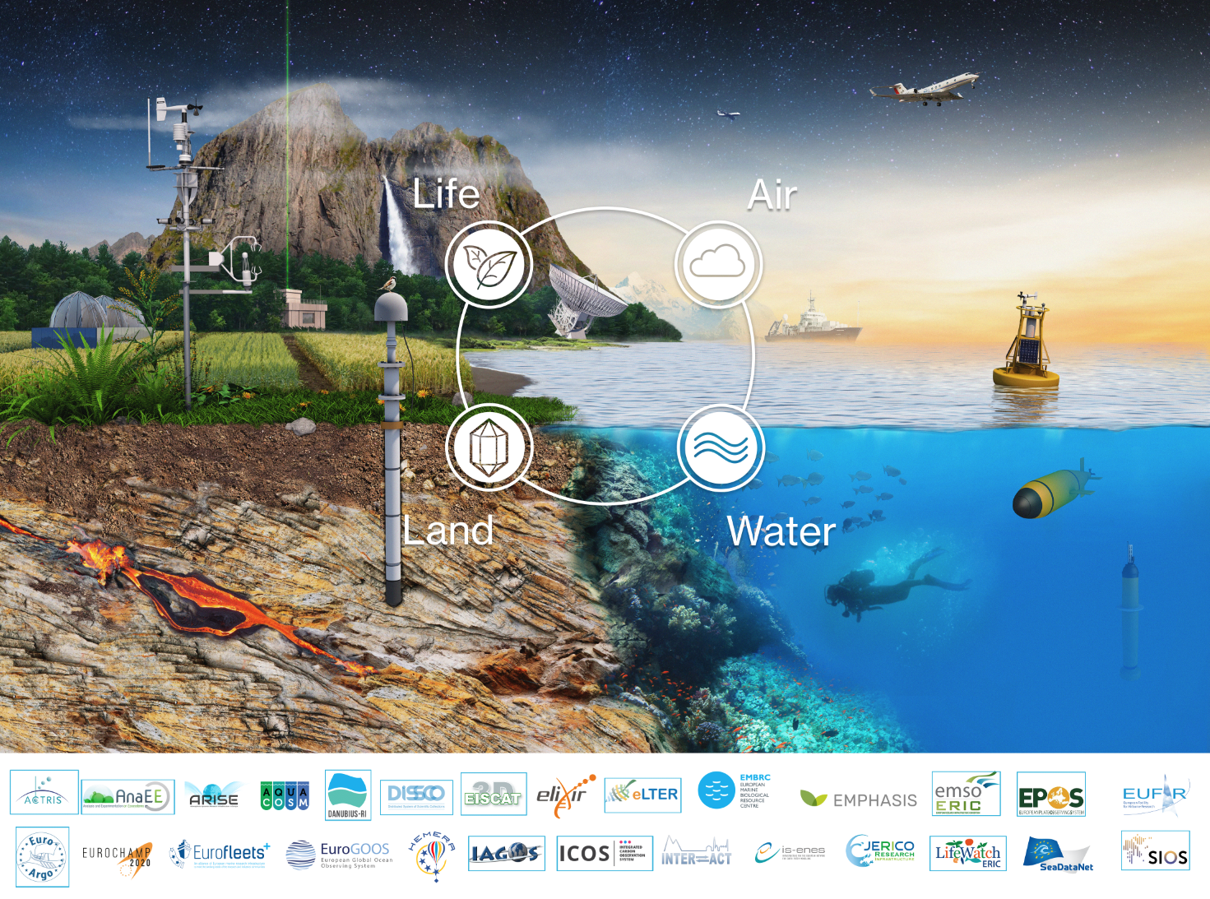
Characteristics of Environmental R. infrastructures
Interdisciplinarity highly relevant
Answering societal needs is only possible via collaboration
Wide range of disciplines
Societal challenges need multidisciplinary methods
Multiple infrastructures
High importance to society, economy and resilience
High level of specialization requires each RI to concentrate on their main tasks and user communities
Observations often unique - huge datasets

Slide 30


























ENVRI Cluster
ENVRI FAIR does not include all ENVRI community cluster RIs
  Products of ENVRI FAIR are shared to all
  All are in the strategic integration activities
There are also many development activities for new RIs, and RI extensions underway

Slide 31



Cluster projects in ENVRI domain
2011-2014
2015-2019
2019-2023
Data service harmonization
Joint observation technologies
Societal impact enchancement
Access harmonization
(virtual, data)
Common strategic alignment, visibility & stakeholder engagement
Notes:
Key messages: Long history of collboration
Much more activites beyond data – good experiences on most
Projects have increased in size, but participation from RIs was limited in last call

Slide 32


ENVRI in the landscape

Slide 33






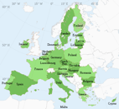
Overview of ENVRI in the landscape
ESFRI RIs
OPEN SCIENCE
SOCIETY
SCIENCE COMMUNITIES
Joint development and harmonization
Supporting interdisciplinarity
Create potential for new user communities
Direct technical support
Training and education
Connection to wide user communities
Disciplinary best practices and standards
Creating RI services from generic services
Demonstrators and documentation
Platforms for discovery and interdisciplinary workflows
Harmonization of interfaces and access across ENVRI Ris
More advanced RI services across ERA
Resilience and adaptation services
Commercial and societal use of RI services
Operationalization of key services
Societal engagement
ESFRI RIs
EOSC & OS
Science
Society

Slide 34
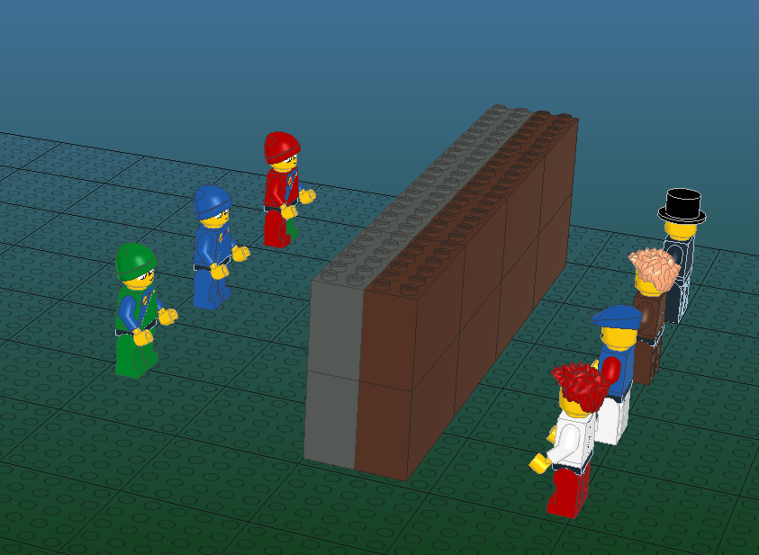
“Overcoming barriers” metaphor
Research infrastructures
User communities
…
Not understandable
Hard to access
Hard to find

Slide 35
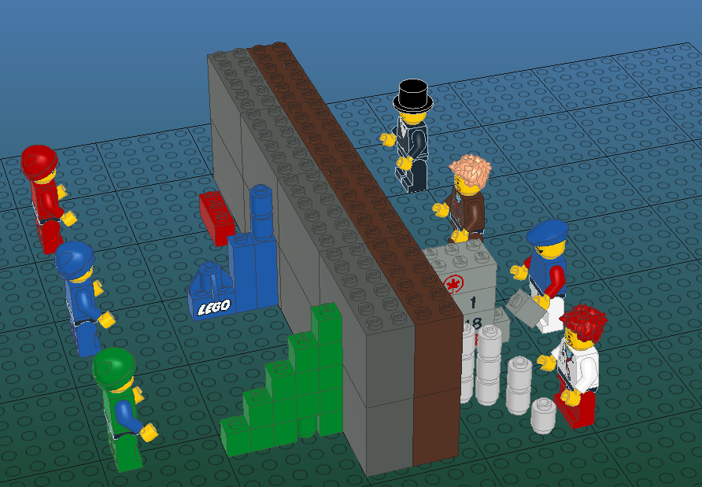
Overcoming barriers (Before ENVRIs)
The main infrastructure mission is to provide
Specialized services for
Specialized users
This is mandated by funders and solutions were often ”narrow” in the sense of provision and usability
Lack of use
Provision under
construction
specialized provision
Specialized or ad-hoc
usage

Slide 36
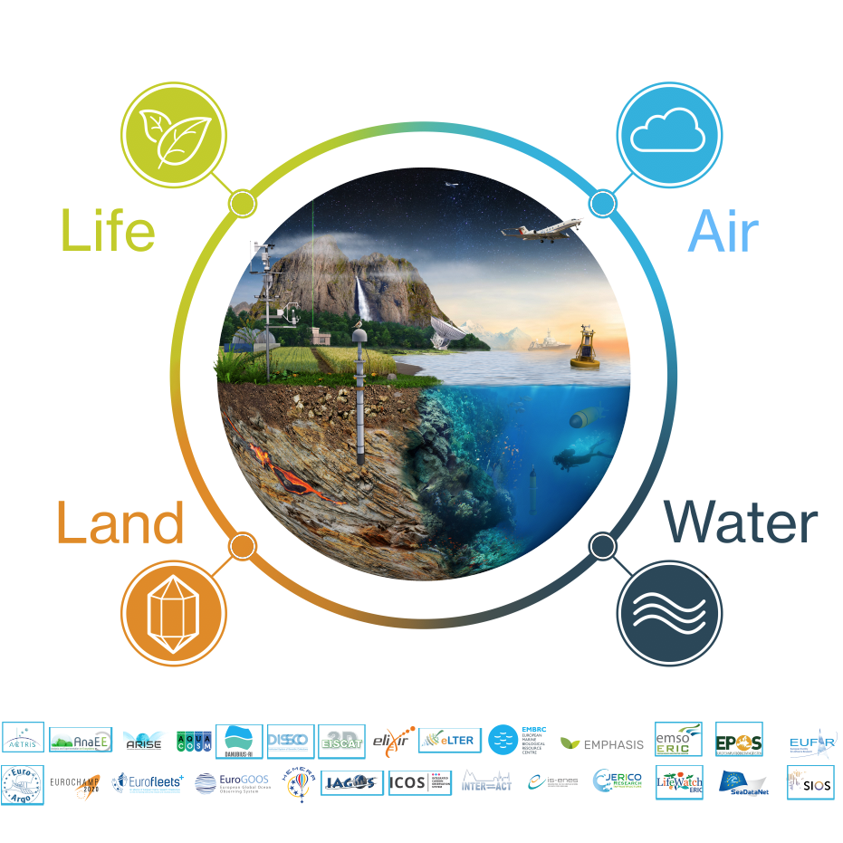
What has ENVRI FAIR
(and previous ENVRI projects) achieved?

Slide 37
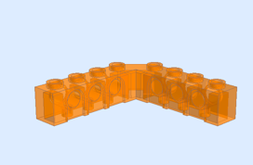


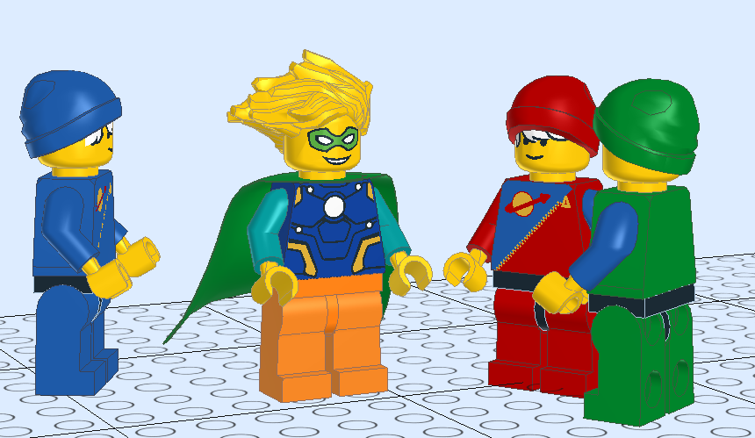
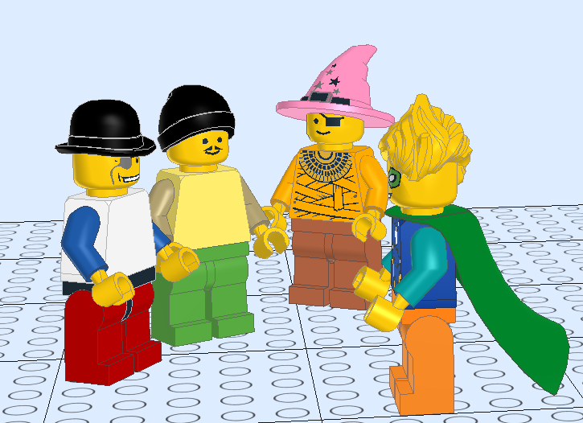
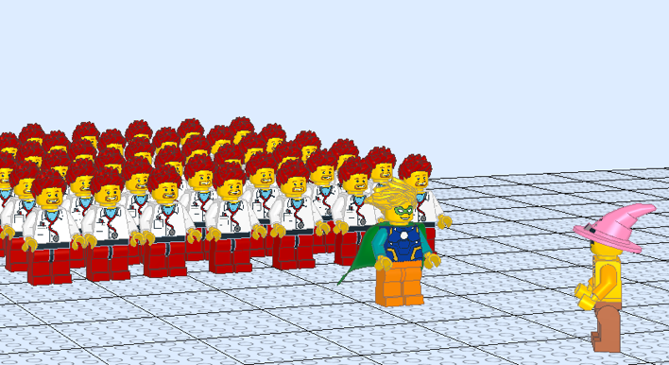
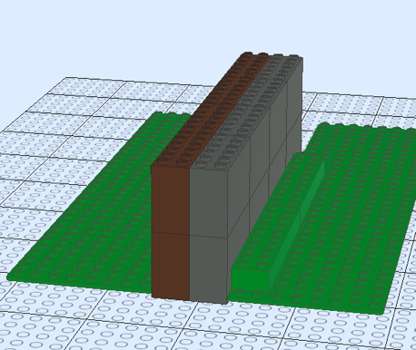
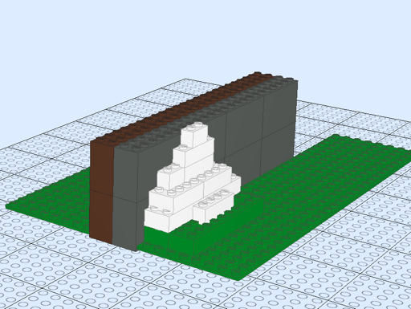
EOSC and Open science
REPRESENTING ENV NEEDS &
PARTICIPATING IN DEVELOPMENT
DOMAIN HARMONIZATION
BRINGING EXISTING USER COMMUNITIES
FROM GENERIC EOSC SERVICES TO SPECIFIC DOMAIN SOLUTIONS

Slide 38

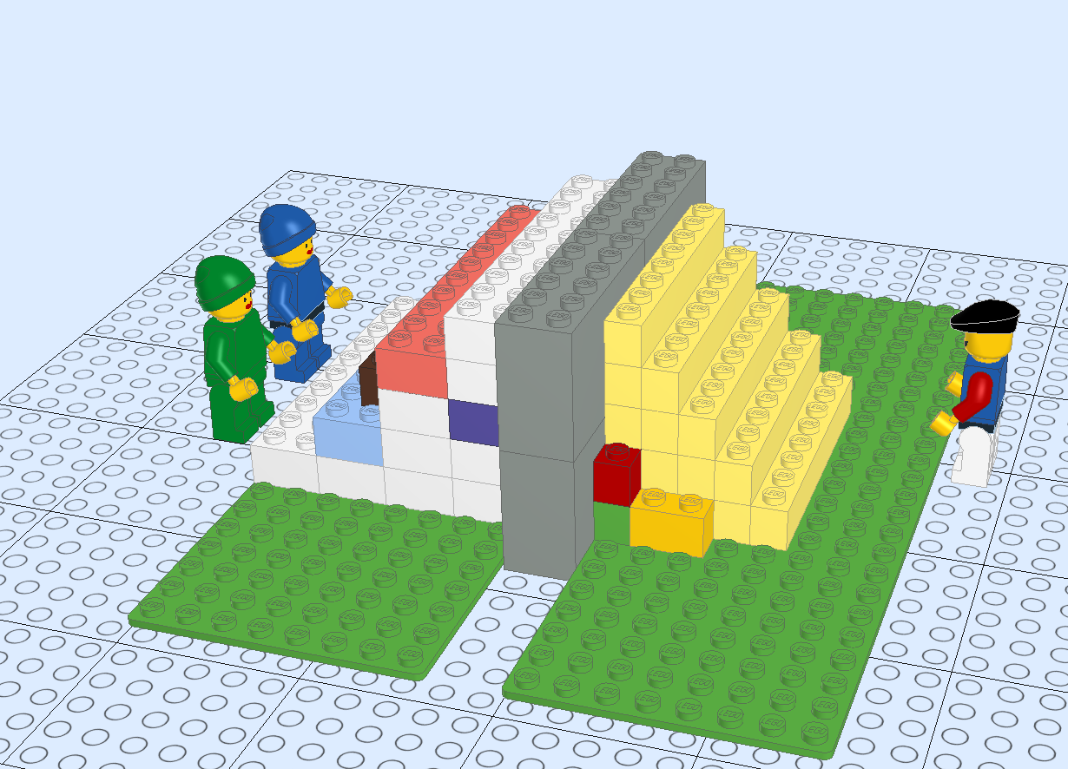
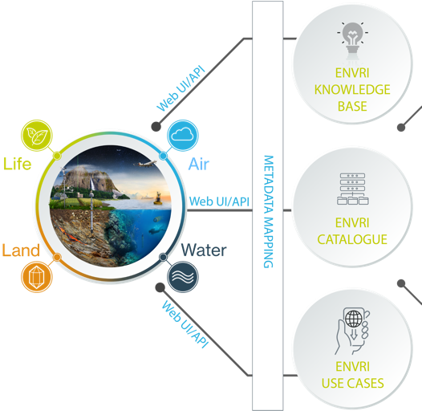

ENVRI-hub
Resource for knowledge, services and digital assets
quick discovery of data, services and assets
sharing of engineering practices, technologies and knowledge
ENVRI Community Research Infrastructures
Machine actionable interface to the ENVRI ecosystem
cataloguing all RIs in the ENV domain
accessing RIs datasets via metadata search
interface to EOSC and other users (e.g. Copernicus)
RI repositories host their own data
SEARCH
NOTEBOOKS
KNOWLEDGE
METADATA
DISCOVERY
EOSC CORE
Scientific demonstrators and use cases
Made accessible as executables and VREs in Jupyter notebooks
EOSC PLATFORM

Slide 39
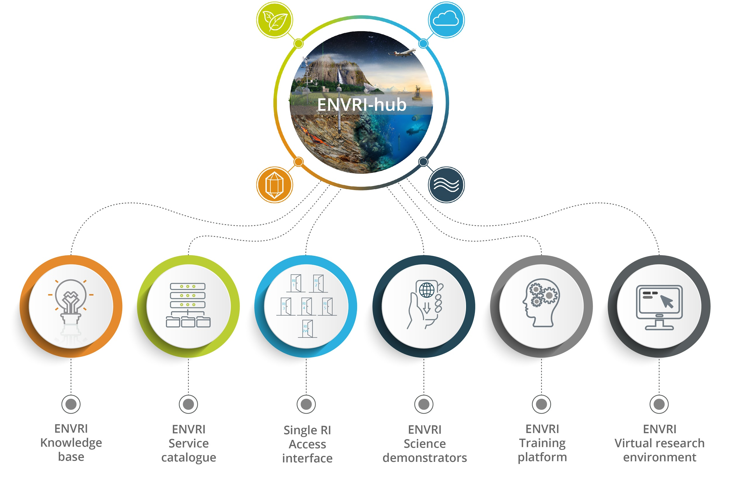

Slide 40
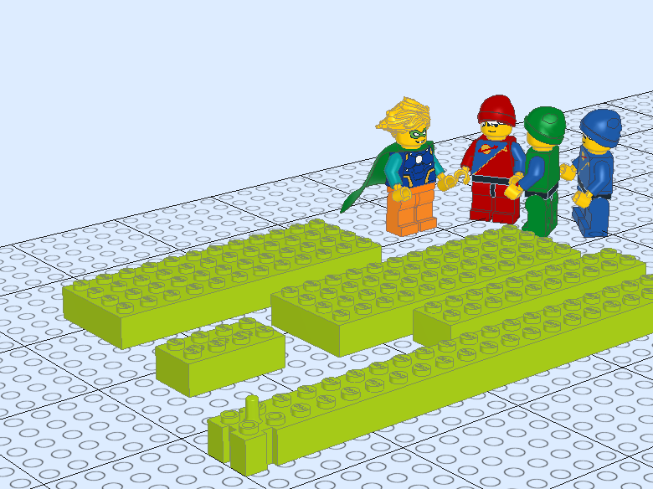
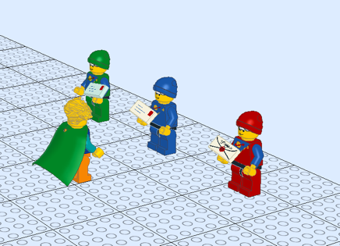
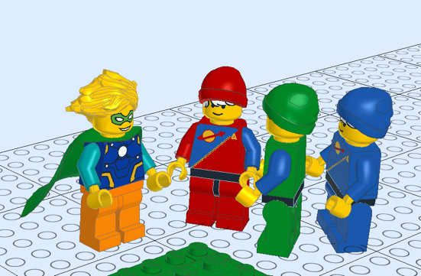
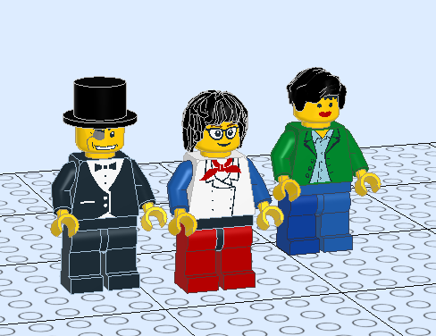
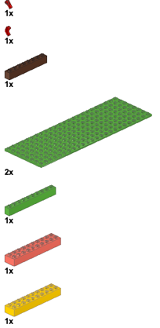

For ESFRI infrastructures
DOMAIN HARMONIZATION
TRAINING DOCUMENTATION
JOINTLY DEVELOPED INTEROPERABLE
TOOLS
NEW USER GROUPS FROM
MULTIDICIPLINARY SERVICES
EXISTING “PARTS LIST” FOR SOLUTIONS

Slide 41










Interdisciplinarity: Dashboard on the State of the Environment
Upcoming demonstrator in the EOSC FUTURE
Easily understandable real-time environmental indicators which inform public and policy makers on the state of the environment.
An input of environmental indicators to SSHOC Science Project (Climate neutral and smart cities)

Slide 42




From science to operational services and decision support
Science is based on curiosity and ingenuity, but societal support need operational and sustained services
ENVRI Cluster platforms can help to create the interdisciplinary services, which can combine the RI services for operationalization
Uptake to e.g. COPERNICUS programme is an important way for long term decision making support
ENVRI RIs
Other RIs
Research
Scientists
Workflows
Research products
Service contracts
Operational and international services
Society
Citizens
Companies
Decision making

Slide 43

Looking into future

Slide 44
END OF THE CLUSTER
REINFORCEMENT OF THE CLUSTER
Existing RI-adopted services will keep running and contribute to EOSC
The developed “pieces” exist and can be used further
HUB platform sustainability still undecided
Potential divergence in new RI services particularly on new RIs
Decreased potential for interdiciplinary societal, economic benefits
Decreased societal resilience
HUB platform can be extended to national level RIs, researchers
HUB can support Horizon Europe projects
New ESFRI RIs and new RI services can be made multidisciplinary more efficiently
Convergence of RI services for societal benefit
Increased potential for societal, economic interfaces
Increased societal resilience

Slide 45
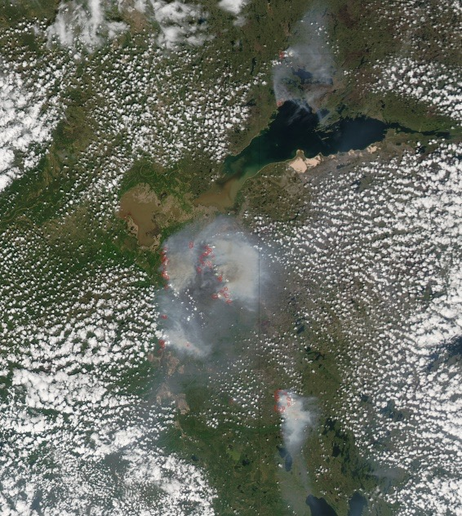
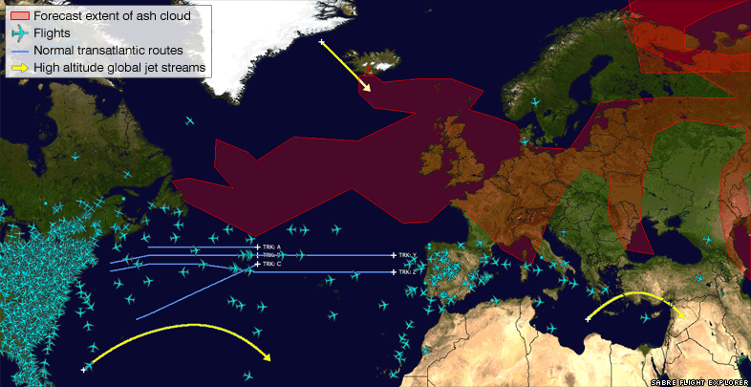

Societal resilience – Volcanic ash & forest fire smoke
In 2010 Europe was not prepared for quick response to the Volcanic Ash Crisis
  Capability to respond exists now in ENVRI RIs
  Common platforms, collaboration networks, methods, plans
New challenges can come any time – requiring an interdisciplinary framework
Alberta fires May – June 2019
https://eoimages.gsfc.nasa.gov/images/imagerecords/50000/50947/Canada_amo_2011159_lrg.jpg
Raikoke eruption 22 June 2019
https://earthobservatory.nasa.gov/images/145226/raikoke-erupts

Slide 46
Overview of ENVRI in the landscape
ESFRI RIs
User communities
Best practices and standards
Science services from EOSC services
Demonstrators and documentation
Joint development and harmonization
Supporting interdisciplinarity
Create potential for new user communities
Direct technical support
Training and education
OPEN SCIENCE
Resilience and adaptation services
Commercial and societal use of RI services
Operationalization of key services
Societal engagement
Platforms for discovery and workflows
Harmonization of interfaces and access
Advanced RI services across ERA
SOCIETY
Science
communities
Joint development and harmonization
Supporting interdisciplinarity
Create potential for new user communities
Direct technical support
Training and education
Connection to wide user communities
Disciplinary best practices and standards
Creating RI services from generic services
Demonstrators and documentation
Platforms for discovery and interdisciplinary workflows
Harmonization of interfaces and access across ENVRI Ris
More advanced RI services across ERA
Resilience and adaptation services
Commercial and societal use of RI services
Operationalization of key services
Societal engagement
ESFRI RIs
EOSC & OS
Science
Society

Slide 47




Specialization and generalization
Disciplinary
excellence
Disciplinary
excellence
Joint cluster action
Helping RIs to provide for generalized users
Direct RI linking
Multidiciplinary answers
Scales poorly &
misses connections
Ad hoc solutions
Temporary and hard to repeat
Societal needs
Disciplinary
excellence
Disciplinary
excellence

Slide 48
Questions & Anwsers
Ari Asmi
ENVRI Fair Project Co-coordinator
Andreas Petzold
ENVRI Fair Project Co-coordinator

Slide 50
Populating EOSC for the Life Sciences
Niklas Blomberg, Project Coordinator
Michael Räß, WP8 lead

Slide 51
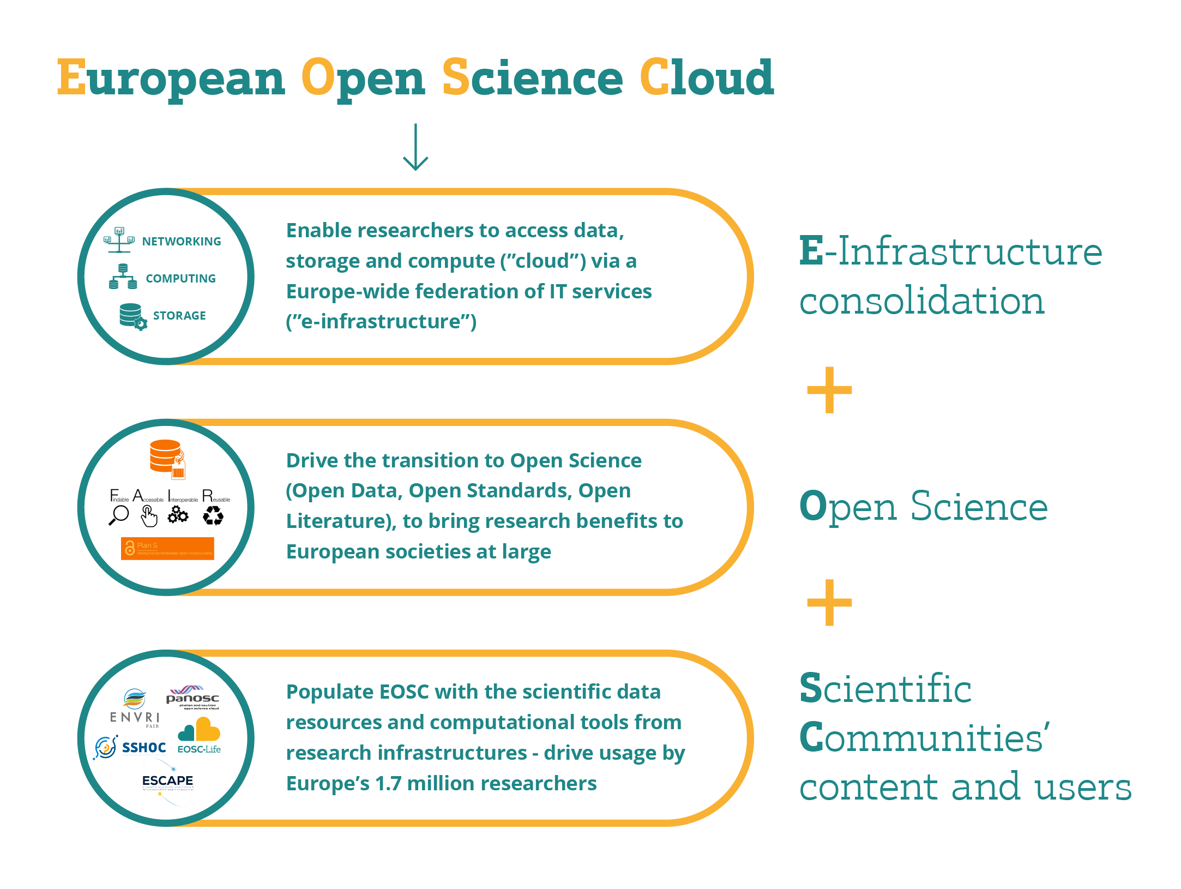
  EOSC landscape consolidating – and EOSC-Life is integral to this consolidation

Slide 52
Life science data is rich and diverse
Connecting digital life science data will allow us to address major challenges facing humanity
EOSC-Life provides solutions so that life scientists can make use of data, tools and workflows in the cloud
Notes:
Life science data is rich and diverse
The Life Science Research Infrastructures provide access to ad- vanced instruments and research facilities that describe biology from single molecules to ecosystems and long-term population cohorts.
Connecting digital life science data will allow us to address major challenges facing humanity
These include the 5 EU missions in Horizon Europe:
• Cancer
• Adaptation to climate change including societal transformation • Healthy oceans, seas, coastal and inland waters
• Climate-neutral and smart cities
• Soil health and food
EOSC-Life provides solutions so that life scientists can make use of data, tools and workflows in the cloud
Vast amounts of data are processed and analysed daily in the life sciences. EOSC-Life aims to make data, tools and analysis work- flows more findable, accessible, interoperable and reusable (FAIR) through cloud deployment of these resources.

Slide 53
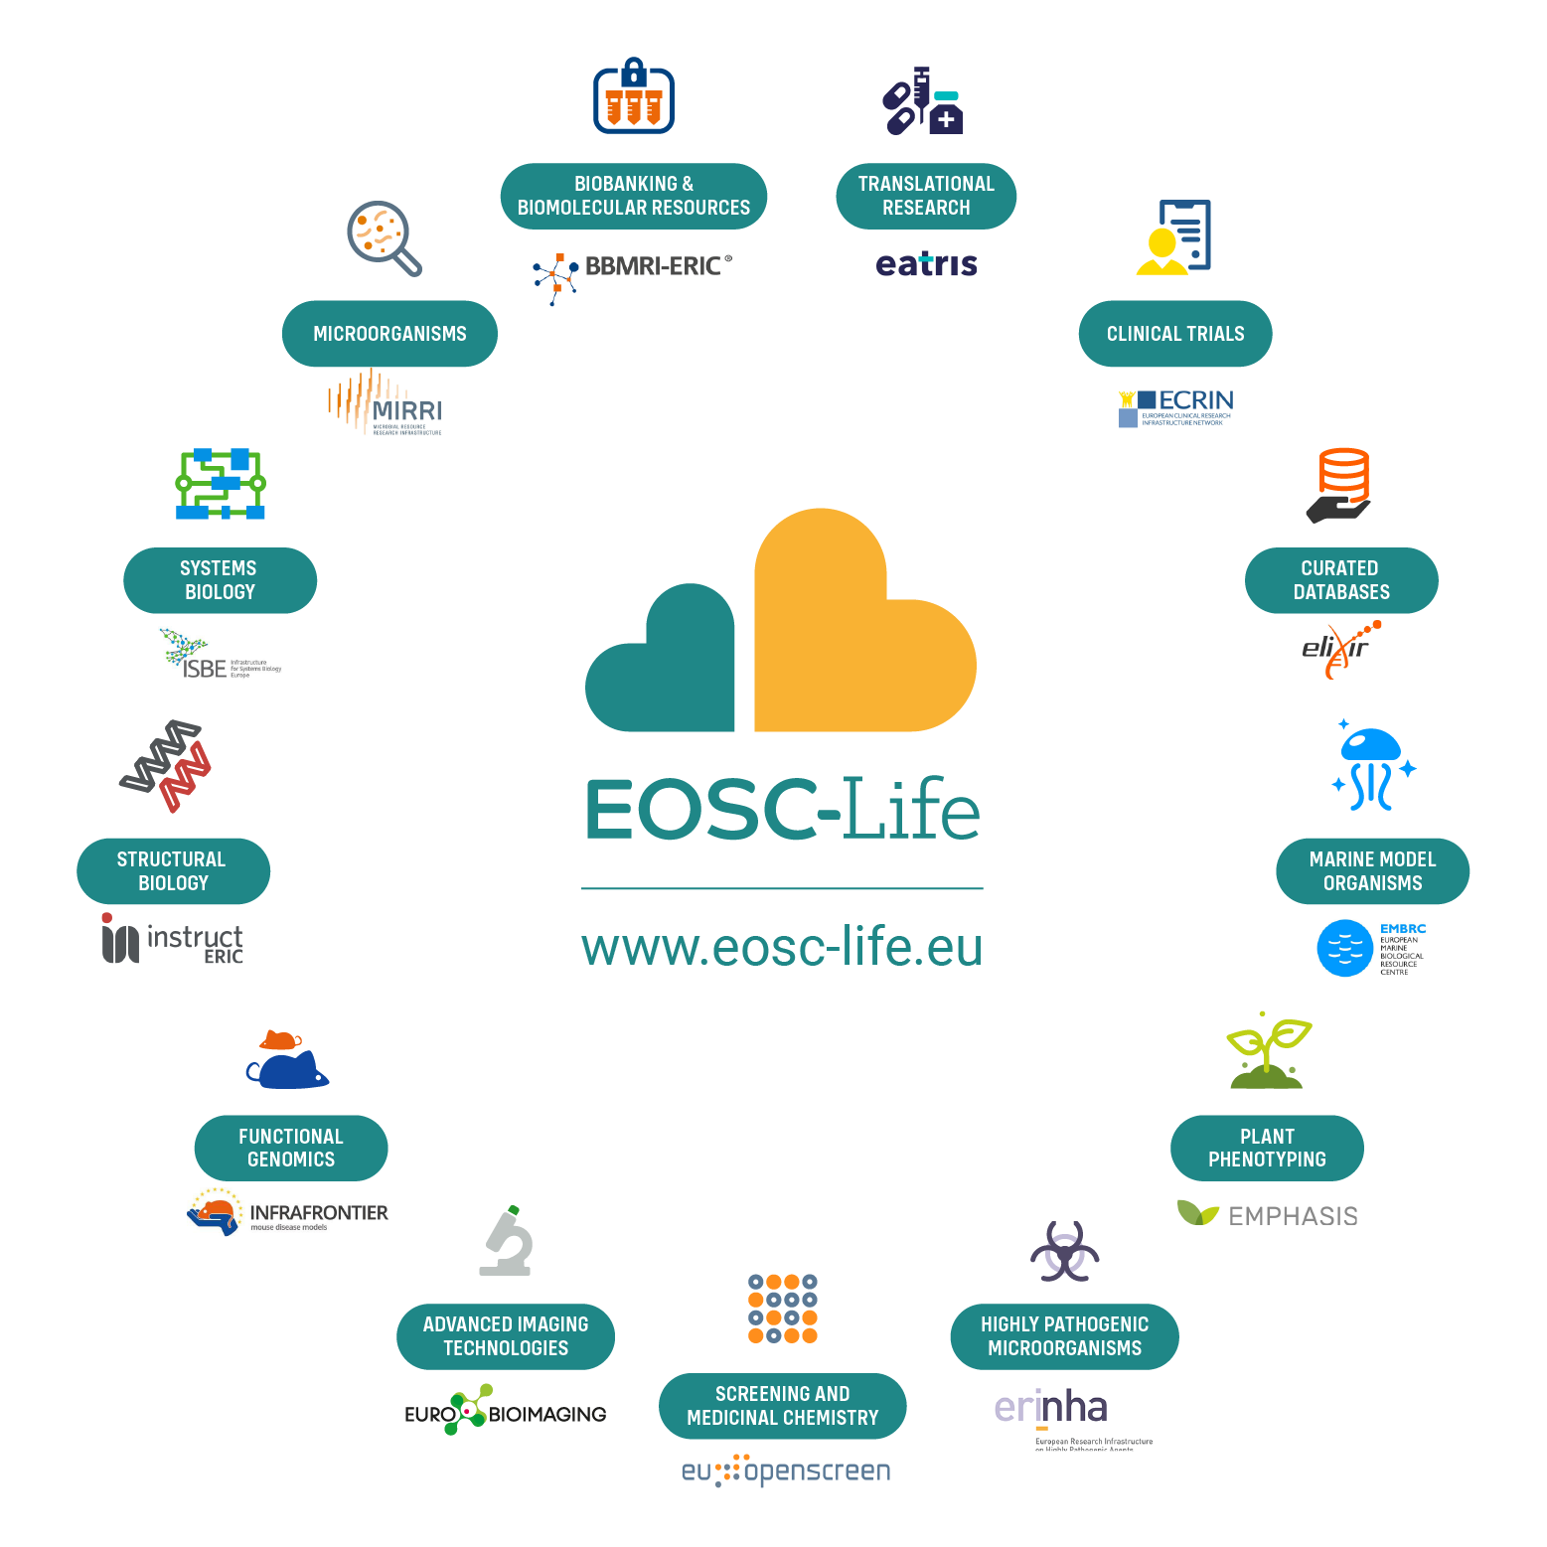
EOSC-Life
Establish EOSC-Life by publishing FAIR life science data resources in EOSC
Provide the policies, guidelines and processes for secure and ethical data reuse
Populate an ecosystem of innovative life science tools in EOSC
Enable data-driven research in Europe by connecting life scientists to EOSC via open calls for participation
Notes:
For example – we had a call before summer for datasets; work to publish the first cohort of FAIR RI data resources in the cloud is now underway
And
Resleased guideline documents on FAIR, secure data access with mapping of national capabilities
Several training events and hackathons to build capacity in RI’s for federated, cloud-based analytics in our tools work-package

Slide 54
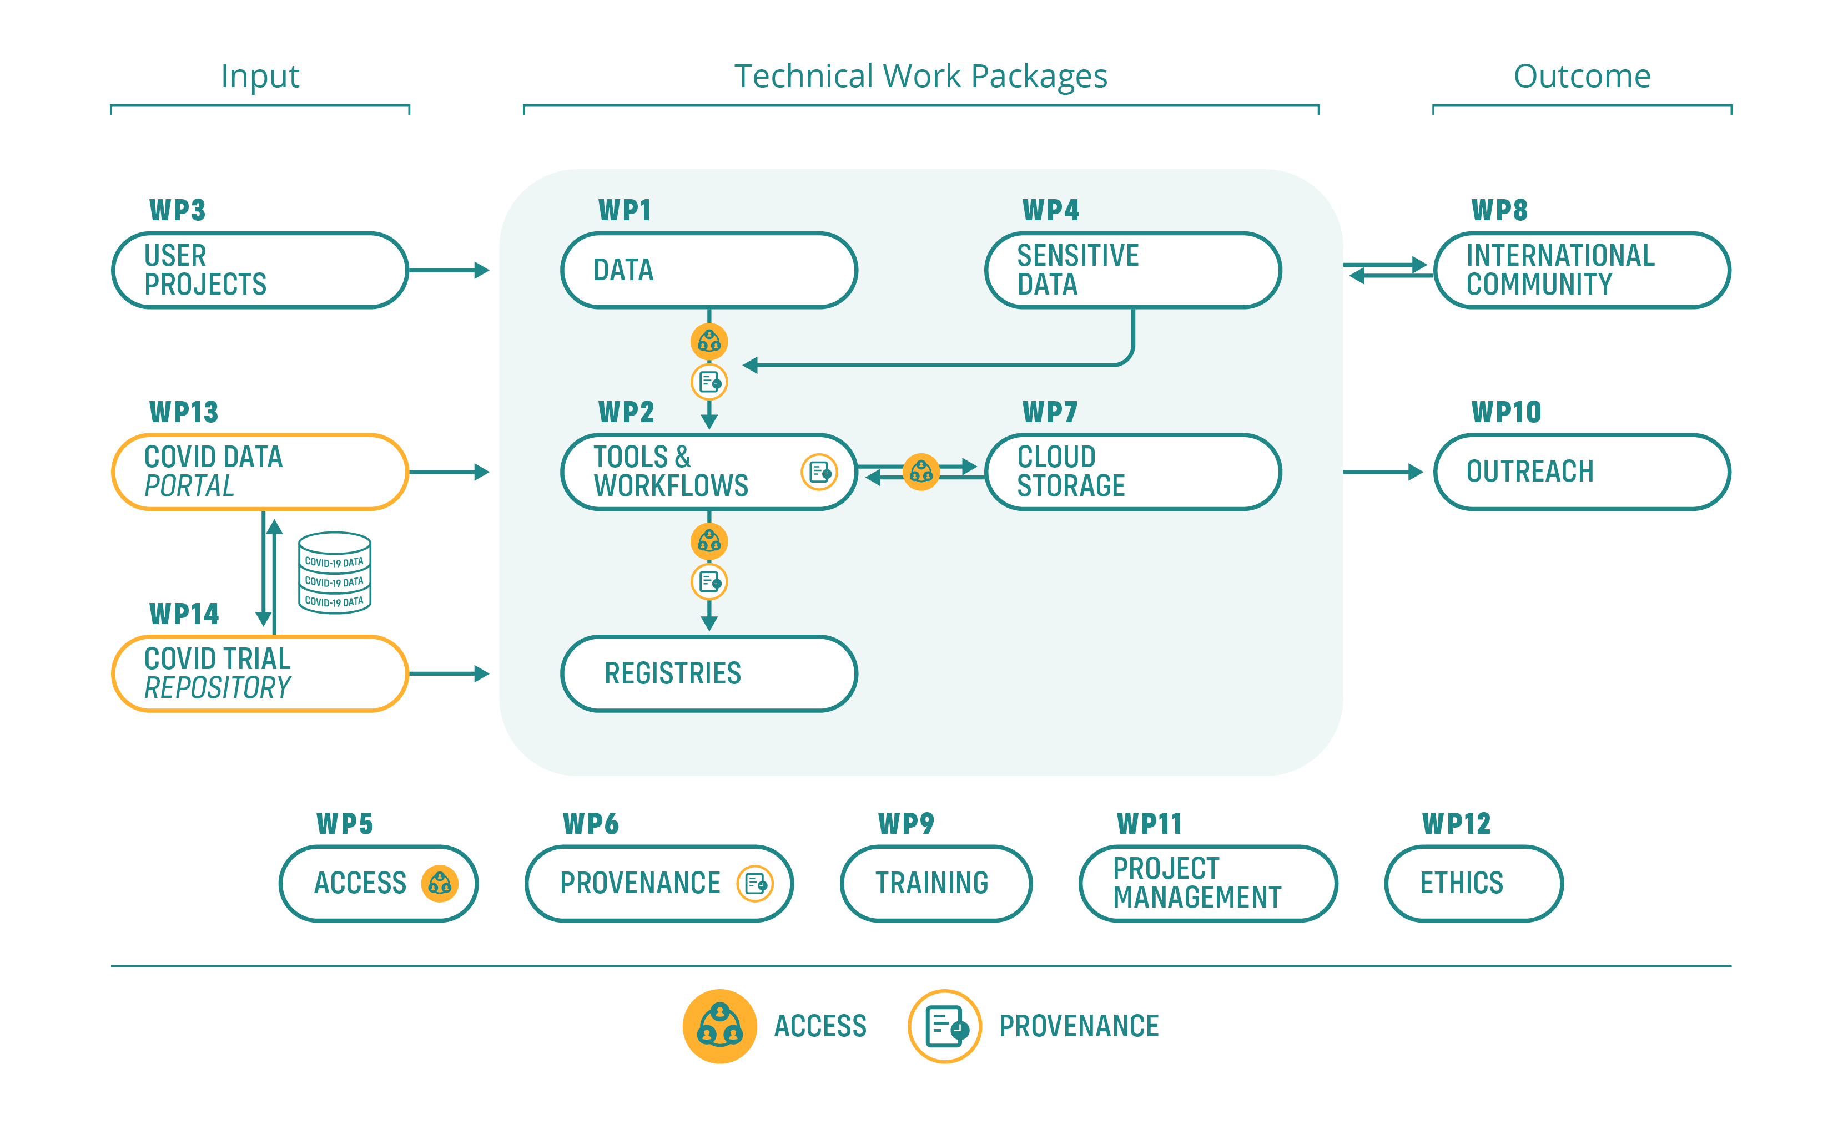
EOSC-Life prepares European life science for a new way of working
    People: skills, new capabilities and networks
    Experience and processes for consolidated RI service delivery
    Life science data resources, workflows, registries and other services
    Training materials, policies, guidelines (FAIR, Sensitive data)
Notes:
By populating EOSC-Life, we are not merely fulfilling a project’s goals—we are building tools and training people to make this the new normal for life science data. European scientists should be able to collaborate and reuse data regardless of where they are based. Training programmes, workshops and hackathons help to prepare our users for a new way of work- ing. Open calls and demonstrator projects guide our developments and create examples for other projects—illustrating the capabilities of EOSC-Life.

Slide 55
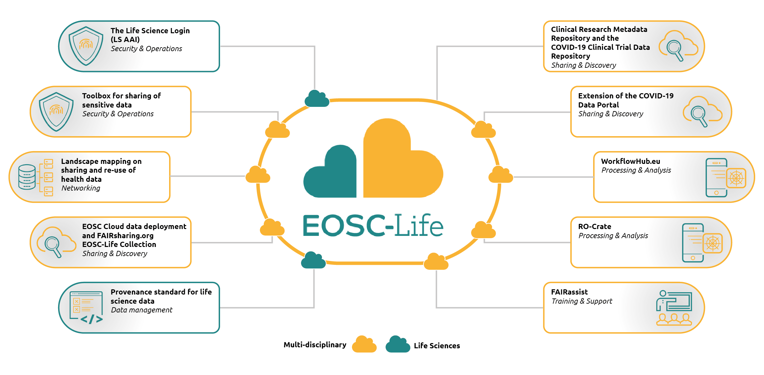
Exploitable results – EOSC Life

Slide 56
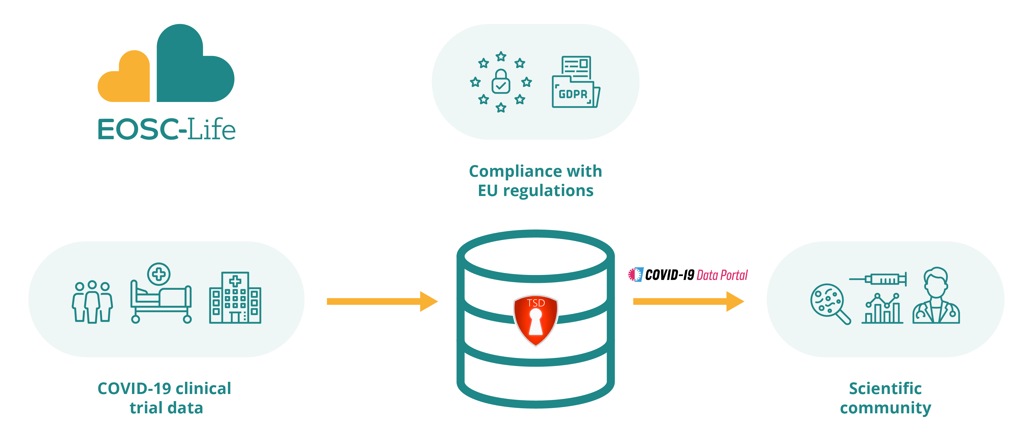
EOSC-Life’s response to the COVID-19 pandemic
    Supported International COVID-19 biohackathon with cloud resources
    Released WorkflowHub.eu 1 year early
    Building a repository to host COVID-19 clinical trial data
    Extension of the COVID-19 Data Portal
Notes:
Data sharing and digital tools are critical for the response to the pandemic. EOSC-Life partners and solutions were well positioned to respond quickly to the needs of our community with efforts such as:

Slide 57
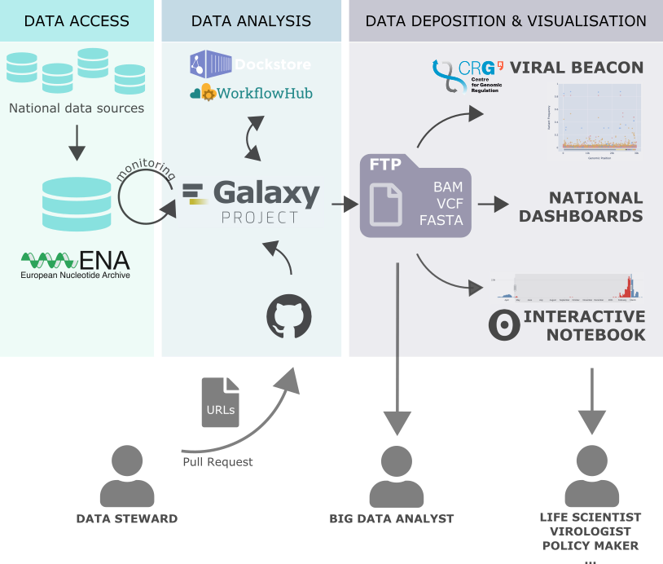
Galaxy for COVID: covid19.galaxyproject.org
Notes:
Take you through one example – on COVID, as very timely, but this is true in many other fields; we are starting a project with Historic England on

Slide 58


















Need from Users, Developers and Infrastructure administrators
Drive the ELIXIR & EOSC-Life Tools ecosystems
Data
Various data sources
End User
Sys Admin
Tool Developer
Authentication
Infrastructure
Tools
Workflows
Cv
Packaging
…
Registries
Testing
c
OpenEBench
Galaxy WF-testing
Life monitor
BioContainers
Bio.Tools
Powered By

Slide 59
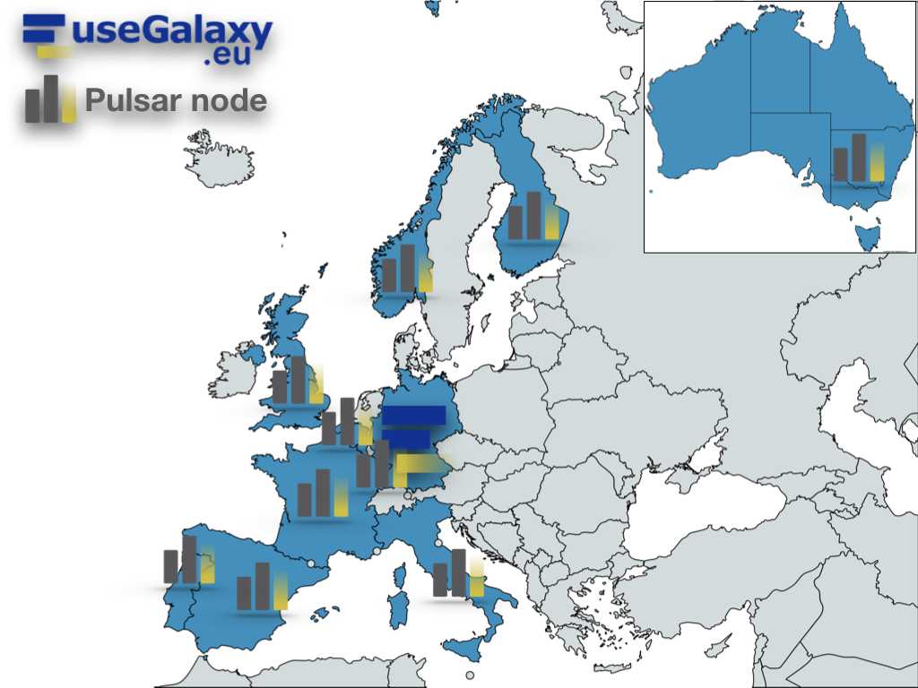
Distributed analysis
Pulsar network
The most innovative computing centers across
Europe are currently interested to share their
remote computation power to support the UseGalaxy.eu load:
DE, de.NBI cloud
IT, ReCaS-Bari
BE, Vlaams Supercomputer Centrum (VSC)
PT, Tecnico ULisboa
ES, Barcelona Supercomp. Center (INB-BSC)
NO, University of Bergen
CZ, CESNET
FI, CSC
UK, Diamond Light Source
FR, GenOuest
https://pulsar-network.readthedocs.io/en/latest/project/partners.html

Slide 60
EOSC-Life “Toolbox for sensitive data sharing”
Documented requirements for hosting/distributing and access control for sensitive data
Landscape analysis of national legal and ethical requirements for sensitive data sharing
Compile current assets into the EOSC-Life Toolbox for sensitive data sharing
Assembled from existing resources to create a toolbox for cloud management of sensitive data in general, and the European Open Science Cloud in particular.
Agreed Categorisation system with an initial 110 tagged resources
All reports and materials are Open Access and on Zenodo: 10.5281/zenodo.4483693, 10.5281/zenodo.4311093, 10.5281/zenodo.4311113, 10.5281/zenodo.4591010

Slide 61
EOSC-Life
Established EOSC-Life by publishing FAIR life science data resources in EOSC
Providing the policies, guidelines and processes for secure and ethical data reuse
Populating an ecosystem of innovative life science tools in EOSC
Enabling data-driven research in Europe by connecting life scientists to EOSC via open calls for participation
Notes:
For example – we had a call before summer for datasets; work to publish the first cohort of FAIR RI data resources in the cloud is now underway
And
Resleased guideline documents on FAIR, secure data access with mapping of national capabilities
Several training events and hackathons to build capacity in RI’s for federated, cloud-based analytics in our tools work-package

Slide 62
EOSC-Life - Points for discussion
Transition the focus in EOSC from principles and organisation to operations. Incorporate production services ‘as part of EOSC’
“Practicality” - focus on practical implementations, evidence of usability and concrete use cases rather than the sunlit uplands of theoretical perfection
Consider the roles of EOSC actors – b2b services and entry points for users (e.g. workflows as first-class citizens)
ESFRI have large established user-communities and production services – EOSC-Life and our other "cluster activities" build operational processes that link research outputs from RI services to the missions objectives and the open data targets of EOSC
ESFRIs have established solutions for domain-specific needs (e.g. data protection, ethics, compliance with Nagoya protocol)
Notes:
For example – we had a call before summer for datasets; work to publish the first cohort of FAIR RI data resources in the cloud is now underway
And
Resleased guideline documents on FAIR, secure data access with mapping of national capabilities
Several training events and hackathons to build capacity in RI’s for federated, cloud-based analytics in our tools work-package

Slide 65
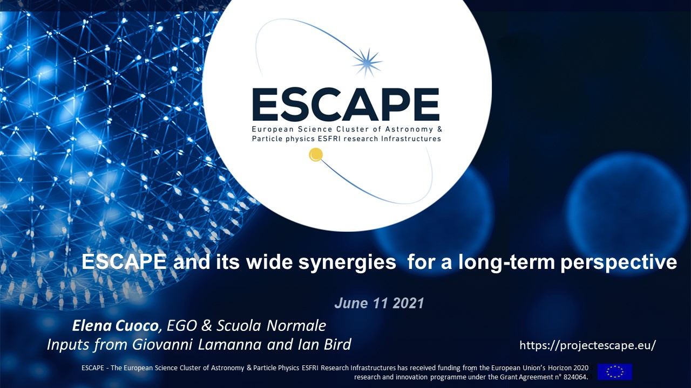

Slide 66


Slide 67
ESCAPE cluster main goals
Improve access to data and tools to unlock innovation for the society at large.
Provide data with FAIR principles: Findable, Accessible, Interoperable, Reusable
Build a European cross-border and multi-disciplinary open innovation environment for science, while connecting EOSC and ESFRI.
Facilitate interdisciplinary and networked research between different ESF/RI and digital SME
Adoption of common approaches for data management
Educate and train the scientific and wider user communities

Slide 68
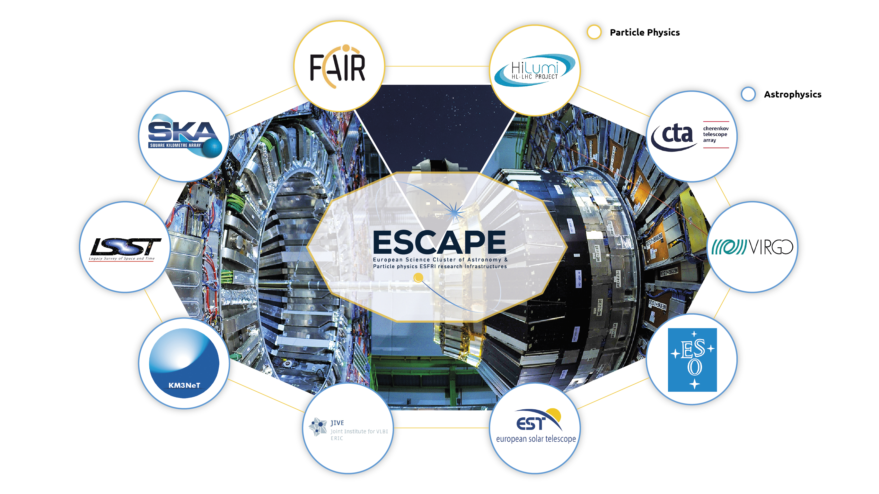
ESCAPE PARTNERs
The ESCAPE cluster comprises world-class research facilities in astronomy and particle physics. ELT, CTA, SKA, KM3NeT, EST, HL-LHC, FAIR, JIV-ERIC, LSST, EGO-Virgo.
(Credit: ESCAPE)

Slide 69






























ESCAPE consortium
31 partners (including 2 SMEs)
7 ESFRI projects & landmarks: CTA, ELT, EST, FAIR, HL-LHC, KM3NeT, SKA
2 pan-European International Organizations: CERN, ESO (with their world-class established infrastructures, experiments and observatories).
2 European research infrastructures: EGO and JIV-ERIC
1 involved initiative/infrastructure: EURO-VO
4 supporting European consortia: APPEC, ASTRONET, ECFA and NuPECC.
Budget: 15.98 M€
Started: 1/2/2019
Duration: 48 months (end date 31/1/2023)
Coordinator: CNRS-LAPP
Formal commitment of their legal entities and management boards required by EC

Slide 70
ESCAPE consortium
Each RI legal entity commits together with a sub-set of associated national stakeholders.
The Director of each ESFRI/ RI is a member of the ESCAPE Supervisory Committee (E-SC)
The Chairs of national thematic consortia of Universities and Research Institutes such as APPEC, ASTRONET, ECFA, NuPPEC and an ESA representative in the ESCAPE External Advisory Board (E-EAB)
As per H2020 INFRAEOSC-04-2018 call - CLUSTER MEMBERSHIP and PARTNERSHIP

Slide 71
ESCAPE Work Programme
Data Lake:
Build a scalable, federated, data infrastructure as the basis of open science for the ESFRI projects within ESCAPE.
Software Repository:
Repository of "scientific software" as a major component of the “data” to be curated in EOSC.
Virtual Observatory:
Extend the VO FAIR standards, methods and to a broader scientific context; prepare the VO to interface the large data volumes of next facilities.
Science Platforms:
Flexible science platforms to enable the open data analysis tailored by and for each facility as well as a global one for transversal workflows.
Citizen Science:
Open gateway for citizen science on ESCAPE data archives and ESFRI community

Slide 72








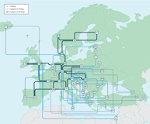


ESCAPE EOSC cell
Promoting, implementing and committing to Open Science
TSP’s
RI-Specific Science Platforms
Catalogue & Repository of resources
Datasets
Software & services
Tutorials
Training
Publications
Virtual Observatory
Science Platforms
Workflows, notebooks, deployment platforms, packaging
Citizen Science
Data Lake
FAIR data management
Content discovery and delivery
HPC
HTC
Grid clusters, etc
Private/public clouds
Commercial clouds
Notes:
Data Lake:
Build a scalable, federated, data infrastructure as the basis of open science for the ESFRI projects within ESCAPE. Enable connection to compute and storage resources.
Software Repository:
Repository of "scientific software" as a major component of the “data” to be curated in EOSC. Implementation of a community-based approach for the continuous development of shared software and for training of researchers and data scientists.
Virtual Observatory:
Extend the VO FAIR standards, methods and to a broader scientific context; prepare the VO to interface the large data volumes of next facilities.
Science Platforms:
Flexible science platforms to enable the open data analysis tailored by and for each facility as well as a global one for transversal workflows.
Citizen Science:
Open gateway for citizen science on ESCAPE data archives and ESFRI community

Slide 73

Why Science Cluster?
Build a Community
Interdisciplinary
Virtual Research Environment in EOSC framework
Cross-Domain R&D
FAIR data
Open to External Stakeholder (digital SME)
support synergies
enhance researchers’ participation in EOSC
reaching new communities and Research Infrastructures
future prospective for sustainability
Notes:
The Science “Cluster” is a very powerful concept:
Recognising synergies to build a coordinating community platform;
Integrating Physicists , data-scientists, computer science researchers, and digital SMEs;
ESCAPE is Virtual Research Space for Open Science, committed to EOSC implementation and sustainability;
ESCAPE is a platform for cross-domain R&Ds and FAIR-data uptake in response to the European Data Strategy.
The ESCAPE communities support the evolution of the work-programme:
supporting synergies (strong inter-cluster dialogue towards a shared vision)
enhancing researchers’ participation in EOSC
leveraging synergies, reaching new communities and Research Infrastructures (RIs)
evaluating future prospective for sustainability and role of the cluster

Slide 74


Enhance researchers’ participation in EOSC
…through (Test) Science Projects - TSPs
  Originally part of the ESCAPE work programme, proposed to validate ESCAPE services for Open Science at the end of the project, ESCAPE-TSP concept finds consensus and evolves for a larger impact.
Stimulating and/or cooperating inter-domain open science (JENAA)
“bench” concept to enhance researchers’ participation in open science and cross-domain scientific research (and guiding the EOSC architecture).
Included in EOSC Future

Slide 75
Enhance researchers’ participation in EOSC
TSPs are multi-domain science integration across ESCAPE
demonstrate new cutting edge open science capabilities, making use of the services implemented within ESCAPE
feedback on the capabilities delivered by ESCAPE
benefit real science goals in exploring synergies between the ESFRIs and largely among three scientific communities Astrophysics/Astroparticle, accelerator-based Particle and Nuclear Physics (supported by consortia of EU member states, Universities/Institutes )
1. Dark Matter Science Project
2. Extreme Universe & Gravitational waves Science Project
A top-down endorsement for a bottom-up approach based on Expression of Interests (EoI) subscribed by researchers

Slide 76
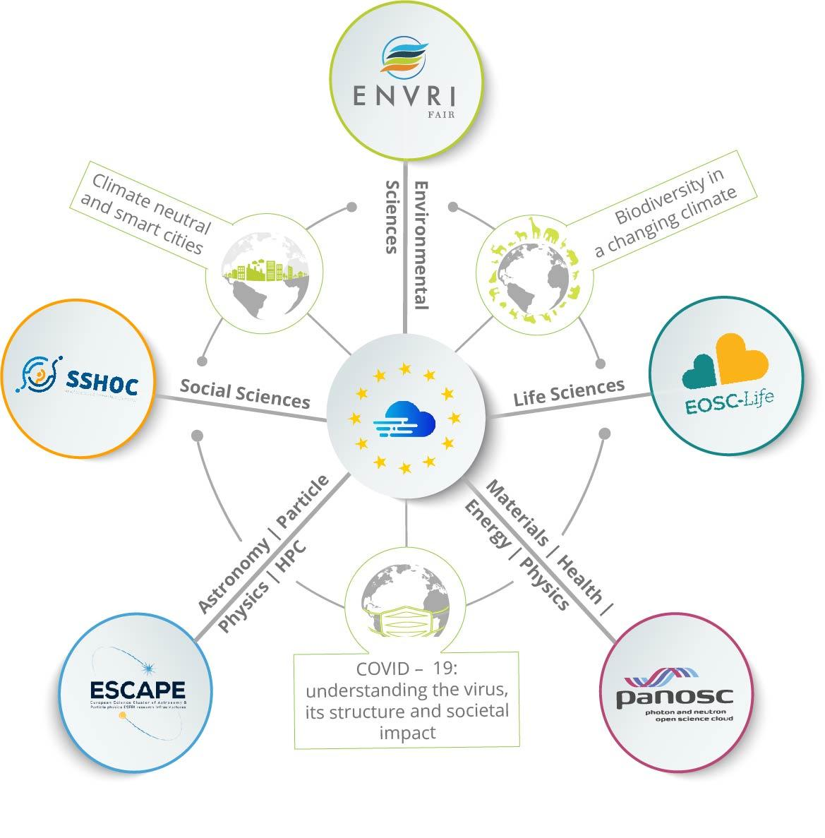






Reaching new communities
Synergy between Science Clusters
&
e-infrastructures
EOSC Service Delivery
Innovation capacity and procurement
Architecture and Interoperability
Design and Development of Portal Layers
Training and Skills
Integration of Community Services and Products
Dark Matter
Extreme Universe

Slide 77








Reaching new communities
ESCAPE Innovation Capacity and Procurement
Co-developments with digital SMEs, e.g.
Wavefier: real-time Machine Learning Classifier for transient signals in Gravitational Waves
Gamma-Learn: real-time Machine Learning pipeline for Gamma-ray astronomy
Combining ESCAPE with European Regional Development Fund programme ( ex. cooperation, training and innovation schemes for Society and Economy - IDEFICS @ LAPP)
Leveraging industrial ICT cooperation schemes (within ESCAPE ESFRI RIs)
ESCAPE results and actions for Open Science are reaching out (ex. Discussions in progress with ASTRI, DUNE, GANIL-SPIRAL2, FCC et al.) and becoming global (e.g. USA, Japan, etc.)

Slide 78
Future perspectives and role of Cluster
Certified open archive to be exploited by any new Big Science research facility to share innovation, practices and methods.
Any digital object from R&D and innovation works within the ESCAPE community should be FAIR and accessed from a single entry point
[…]
Outlook into the future (e.g. Horizon Europe) :
ESCAPE community proposals for EOSC connections with the Common European Data Spaces.
Industrial (manufacturing), health and skills data space
Green deal and Energy data space
Notes:
Certified open archive to be exploited by any new Big Science research facility (e.g. FCC) to share innovation, practices and methods about energy/water/heat management, environmental protection, etc.
Any digital object from R&D and innovation works within the ESCAPE community should be FAIR and accessed from a single catalogue (ex.: Solid-state, gaseous detectors et al. legacy data for further innovation; green technologies for detectors; nuclear and particle physics for health and society; co-creation with industries; interdisciplinary nuclear physics application; interconnections among astronomical telescopes and geoscience; new global EU approaches on micro-electronics, HPC, firmware and Quantum Computing/Technology

Slide 79
Future perspectives and role of Cluster
“Science Cluster” scheme is a potential model of “coordinating structure”, because it combines the top-down and bottom-up
ESCAPE towards a sustainable large domain platform, shaping and operating within EOSC

Slide 80
ESCAPE Future
Synergies
Communities overlap (astro/pp/np), new experiments mix communities
Common Funding Agencies
Co-located computing facilities
Strength and benefits
European Strategy for Particle Physics had strong input from ESCAPE domains
Consortia: ECFA, APPEC, NuPECC, Astronet, (+ JENAA) coordinate at a high level, and oversee ESCAPE
Strong coordinated voice and support to EC and EOSC Association.
Federated, collaborative infrastructures optimise use of available funding

Slide 81
ESCAPE Future
ESCAPE intends to remain as a collaboration after the end of the current project
Sustained thematic consortium for the sustainability of EOSC
Additional thematic RI’s are interested in participating
Many potential collaborative actions
Data Management at Exascale
Common software challenges
Cross-fertilisation of software tools and services
Building a platform for multi-messenger astronomy and cross-domain collaborations
Connection of data infrastructure to heterogenous computing

Slide 82
ESCAPE long term activity
Services for integration of the Exabyte scale data infrastructure supporting Open Science and FAIR data;
Interoperable data-analysis platform
Development and sustainability of the services for the software catalogue and workflow
Partnership with EuroHPC/Prace/FENIX to provide the services for integration of Data-Lake with HPC resources;
Collaborative scientific environment. Include new ESFRI and SME
Global integration of some of the above with global partners in USA, Australia and Africa

Slide 83
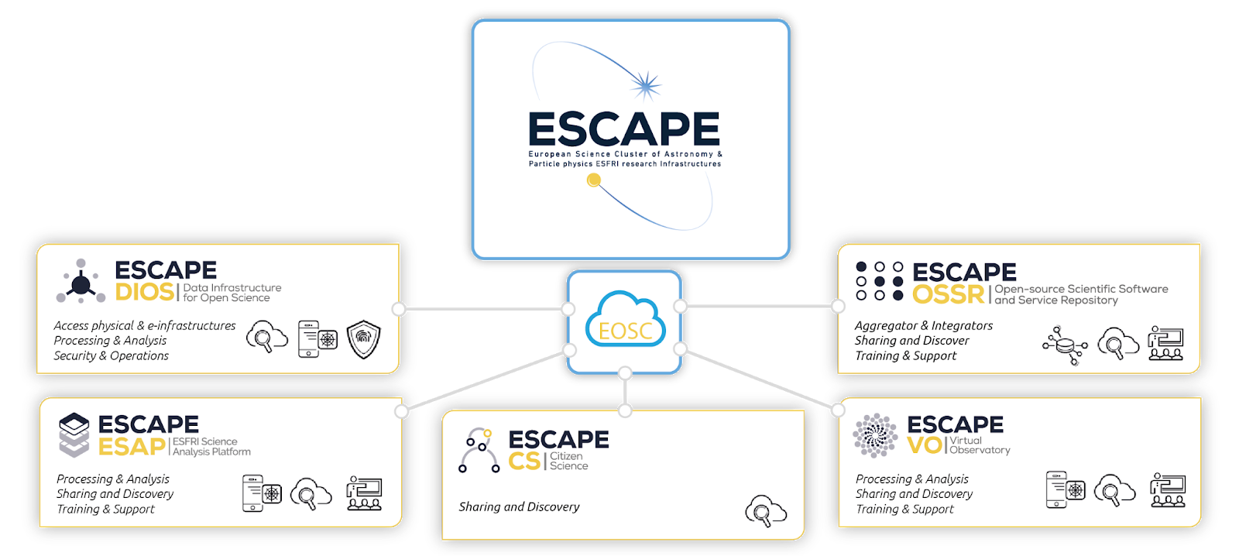
Summary
ESCAPE brings together Astronomy, Astrophysics, Astro-Particle, High Energy and Nuclear Physics communities
Broader synergies within a large scientific community and for innovation/society
Broader synergies with the other Science Clusters , e-infrastructures for EOSC

Slide 84
Thank you!
elena.cuoco@ego-gw.it

Slide 85
Elena Cuoco
ESCAPE General Assembly Chair
Questions & Anwsers
Ian Bird
ESCAPE Technical Coordinator
Giovanni Lamanna
ESCAPE Project Coordinator

Slide 86

COFFEE BREAK
11:05 - 11:20
Grab your Coffee now ;)
#ESFRI_SC2021

Slide 88
Questions & Anwsers
Rudolf Dimper
PaNOSC Project Coordinator
Patrick Fuhrmann
ExPaNDS Project Coordinator

Slide 90
Questions & Anwsers
Ron Dekker
SSHOC Project Coordinator
Carsten Thiel
SSHOC

Slide 92
Social Sciences and Humanties Open Cloud
Realising the Social Sciences and Humanities part of the European Open Science Cloud

Slide 93









Project:
Type of action & funding:
Research and Innovation action
(INFRAEOSC-04-2018)
Partners: 48
(23 beneficiaries + 25 LTPs)
SSH ESFRI Landmarks and Projects
& international SSH data infrastructures
Project budget:
€ 14,455,594.08
Project website: www.SSHOpenCloud.eu
Duration: 40 months
(January 2019 – 30 April 2022)
Objectives:
creating the social sciences and humanities (SSH) part of European Open Science Cloud (EOSC)
maximising re-use through Open Science and FAIR principles (standards, common catalogue, access control, semantic techniques, training)
interconnecting existing and new infrastructures (clustered cloud infrastructure)
establishing appropriate governance model for SSH-EOSC

Slide 94
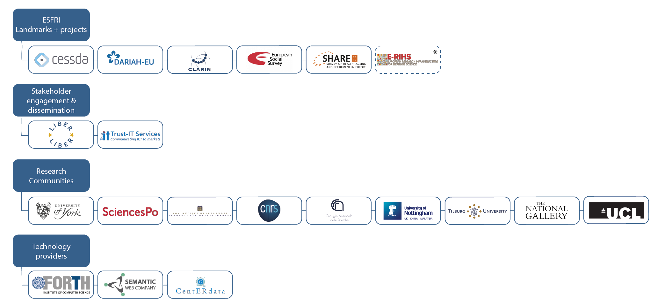
SSHOC Partners
*E-RIHS is not a legal partner in the SSHOC project but we connect to the E-RIHS community through the Institutum Archaeologicum Germanicum.

Slide 95
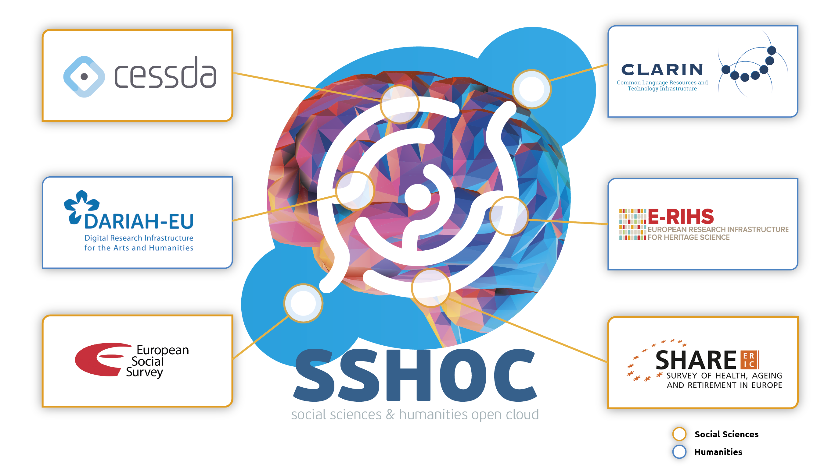
ESFRI domain distribution

Slide 96
Tools & Services after SSHOC – ca. 40 potential cross-domain functionality
Tools & Services
  Virtual collection manager – for composing combinations of tools & data
  Metadata conversion between (SSH) standards
  Aioli Platform for documenting and annotating cultural heritage artefacts
  SSHOC Trust Support (for certification of EC trusted repositories)
SSH Open Marketplace
  The Social Sciences and Humanities’ gateway to EOSC
Training
  Training Discovery Toolkit
  Directory of Trainers
Website
  Entrypoint to EOSC

Slide 97
Potential Collaboration Activities
Pillar A & B – from SSHOC perspective
Pillar A: Inter-Cluster common data services co-developments
Technical
  Processing of sensitive data in the cloud
  AAI, incl. CESSDA-INSTRUCT Science Project in EOSC Future
  FAIR testing tools (e.g. F-UJI in FAIRsFAIR)
  Data Citation (Scholix, connecting publications and data – and software)
Virtual Research Environments (how to set up VRE’s)
  Remote access solutions
  EOSC Future for pilots/pathfinders through Science Projects
Training with certification
  Directory of Trainers

Slide 98
Potential Collaboration Activities
Pillar A & B – from SSHOC perspective
Pillar B: Delivery Content to EOSC with Science Projects
Data Spaces (focus on content, not technology)
  COVID – Infectious Diseases, e.g. BY-COVID (submitted) Use Cases (Life & Social)
  Ecosystems (bio, eco, …)
  Cultural Heritage (Humanities-PaNOSC)
  Democracy: Linked Open Data & Knowledge Graph
Co-creation
  International organisations (DDI, RDA, ARDC (Australia), OECD, …)
  GAIA-X partners on specific themes
  Citizens

Slide 99
EOSC Association & EC
How to position in EOSC Association
  HE Work Programme on Research Infrastructures
  Working Groups
  General Assembly
Towards ESFRI, ERIC-Forum, other umbrella organisations
EC RTD and CNECT

Slide 100
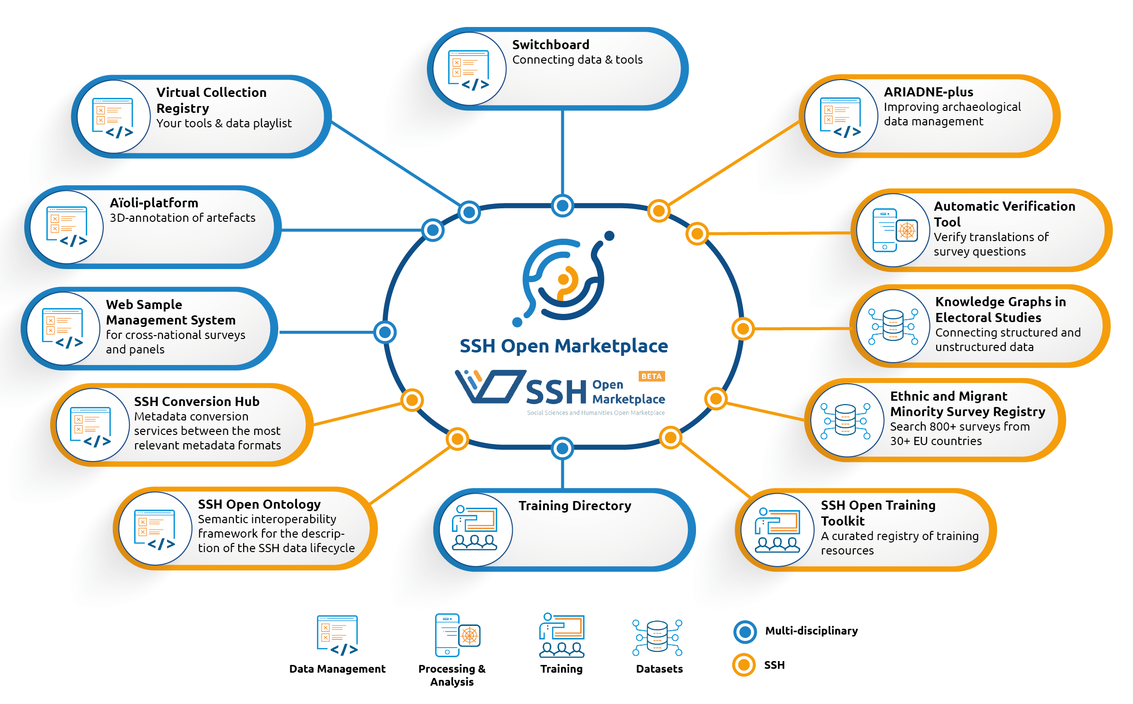
SSHOC Key Exploitable Results

Slide 101









Thank you for your attention!
Join our community
https://www.sshopencloud.eu
@SSHOpenCloud
info@sshopencloud.eu
/in/sshopencloud

Slide 103
ESFRI Science Clusters
position statement on expectations
and long-term commitment in Open Science
Giovanni Lamanna
11 June 2021

Slide 104
PSD2

Slide 105
The glossary …
Data: any digital object (including software, algorithms, analysis services, workflows, ..)
Virtual Research Environment (VRE): thematic collaborative digital environment used by scientists, which enables FAIR community-based scientific research, training, innovation, cross-fertilisation and open science (… vs the idea of a “marketplace”)
EOSC Association: established as a legal entity on 29th July 2020 aimed at bringing together all relevant stakeholders to co-design and deploy a European Research Data Commons where data are FAIR, and also as open as possible.
SRIA: Strategic Research and Innovation Agenda (SRIA) of the European Open Science Cloud (EOSC)
(https://www.eosc.eu/sites/default/files/EOSC-SRIA-V1.0_15Feb2021.pdf)

Slide 106
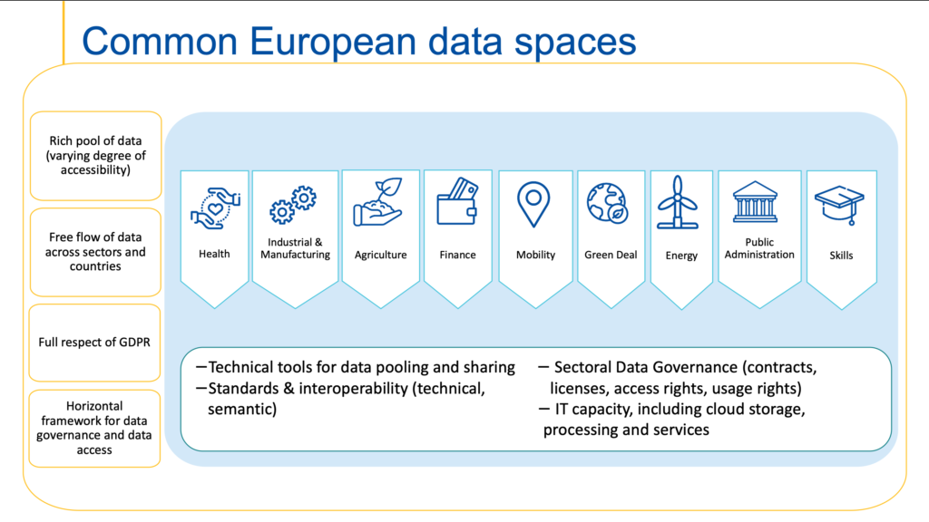
The glossary …
European Data Spaces: “…The European strategy for data aims at creating a single market for data that will ensure Europe’s global competitiveness and data sovereignty. Common European data spaces will ensure that more data becomes available for use in the economy and society, while keeping companies and individuals who generate the data in control.
Data is an essential resource for economic growth, competitiveness, innovation, job creation and societal progress in general…”

Slide 107
… and a preamble
Preamble
Science Clusters (lessons learned and in progress):
- one of the EC's most effective and innovative network tools (we need to pursue the
successful and effective cooperative approach);
- Science Cluster sustainability is a question addressed to the RIs and communities, while
the sustainability of EOSC (for science) depends on the maturity of our VREs and a set of a few of
our core services.

Slide 108
Science Clusters in the European research and innovation landscape
Position I: General Role and positioning of Science Clusters
The Science Clusters are engines for Interdisciplinarity.
Their cross-fertilization environment has bridged sociological and technical barriers.
The Science Clusters have potential to shape the future EOSC agenda and the Horizon-Europe framework evolution as well as operationalising the European Research Area (ERA).
The Science Clusters occupy a unique position between EOSC, ESFRI RIs and scientific communities.
Three momenta mark the success of the Science Clusters -> We all want to keep on them for the future.
Top-Down: The (ESFRI) RIs legal entities joining efforts together
Bottom-Up: The concerned scientists willing to pursue the cross-fertilization in science and innovation
Horizontally: The Universities and Institutes leveraging the inter-domain potential… to be fully exploited
around new academic/training schemes based on data-research

Slide 109
Science Clusters in the European research and innovation landscape
Position II: Science Clusters in EOSC and Open Science landscape
The Science Clusters uniquely capable to address the challenges of open research data being at the same time data producers and consumers.
The Science Clusters are a key part in developing mid-level multidisciplinary tools and platforms.
The Science Clusters’ track record of integrating infrastructures can be a significant asset for the EOSC. The majority of the EOSC Association members are EU member States Universities and Research Institutes: science and the support of research communities as the EOSC major aim!
It is of primary importance that the EOSC implementation roadmap, as well as its governance, make
reference to domain-based scientific communities and to the Science Clusters supported by them.

Slide 110

Science Clusters in the European research and innovation landscape
Position III: Science Clusters in scientific and RI communities
An infrastructure of “Web of FAIR Data and Services for Science” risks to be incomplete and ineffective without “community-governed” open-science commons platforms co-developed and operated by scientists
(VRE vs Marketplace).
The Science Clusters build and maintain key community-centred initiatives. The five Science Clusters have recently committed to co-steer shared actions to engage more researchers in the EOSC and in cooperation
with pan-European e-infrastructure organizations in the H2020 EOSC-Future project.
(i) Supporting consolidation actions; (ii) building multi-domain Science Projects (SPs);
(iii) making the EOSC a federation of VREs for the sustainability of EOSC.
The Science Clusters also provide a rapid and efficient platform for joining the RI services within or even cross clusters for important societal challenges. Recent COVID-19 projects demonstrate rapid response and capability for science-based societal and economic resilience in Europe.

Slide 111
Common statements of the five Science Clusters
The Science Clusters are willing to operate and adapt their thematic open-science resources in EOSC towards four urgent needs:
  making science always central, solid and inclusive of its social and cultural dimension, as collective knowledge to be nurtured;
  leveraging crosscutting and cluster cross-domain projects connected with European sectoral data spaces;
  providing training, committing to education and engaging citizens in science;
  exploring the way to translate their excellence in data-research into economic value.

Slide 112
A work plan for the future of the Science Clusters
Clusters as “platforms”
Science Clusters would continue to evolve, driven by the scientific need.
“Platform” infrastructure refers to the potential long term (further than the H2020 Grants’ duration) mission/structure of a cluster to develop, operate and exploit its community-based VRE, combining the RIs steering with the national Univ./Institutes consortia participation.
The platforms, internally and collectively, will study, define and set up a series of new task forces. They will also structure their commitment to Horizon Europe

Slide 113
A work plan for the future of the Science Clusters
Supporting the “EOSC Association mandate” and the European Commission
While many Science Clusters’ partners are members of the EOSC Association, and in the EOSC governance,
the Science Cluster would bring in addition the collective scientific community expectations.
The Science Clusters would propose to link directly to the EOSC Association Board of Directors, supporting
it in the evolution of the EOSC roadmap.

Slide 114
A work plan for the future of the Science Clusters
There is a prompt need and opportunity to support the Science Clusters further (in 2022-2025) within Horizon Europe framework
H2020 and potential Horizon Europe funded actions (aligned with the EOSC-SRIA Stage2 -to- Stage3)
General Objectives (GO):
- consolidation of thematic data infrastructures (cluster VREs, platforms and a “few core services”) as parts of a federation.
Specific Objectives (SO):
- relevant scientific results from clusters;
- increased number of RIs;
- enhance researchers uptake of OS and widening dimension.
Operational Objectives (OO):
- sustainable operation of the deployed cluster as a “platform infrastructure”;
- continuous promotion, extension and hosting of inter-domain FAIR Science Projects (new Open Science Objectives).
Science Cluster GO
H2020 Cluster projects
EOSC-Future
Science Cluster SO
Science Cluster OO
2021
2022
2023
2024
2025
2026
2027
EOSC-SRIA Stage2 Stage3

Slide 115
Pillar A
Proposing two major approaches (Pillar A & B) in the Horizon Europe framework:
Pillar A - Inter-cluster common data services co-developments
(from GO to SO)
The sustainability of the five clusters is built through the structuring of their wide cooperative VRE intended as the implementation goal for an effective and successful operation of EOSC. VREs need to become fully operative.
Some of the most successful achievements of the Science Clusters are the key data services within EOSC for “data provision, discovery, and exploitation”, e.g. catalogues, analysis frameworks, FAIR data archives, solving research communities/themes challenges. Envisaging inter-cluster projects is also relevant for interoperability and commons.
Consolidating a “few core services” per cluster to become part of the EOSC sustainable core services.

Slide 116
Pillar B
Pillar B - Delivering Content to EOSC
(from SO to OO)
The next step (starting from 2023) in the Science Cluster agendas will be to uptake emerging and concrete “Open Science Objectives”; further than the current (test) Science Projects in EOSC-Future.
A ‘matrix’ based on ‘two methods’…
Open Science Projects (OSP)
  to continue bridging barriers to open science within a large scientific community;
  to leverage the pan-European cluster action towards more global commitments as well as regional initiatives*.
Cross-Cluster Open Science Projects (COSP)
  are envisaged to be tackled by focusing on topical aspects within one cluster supported by complementary contributions from all clusters;
  to leverage the inter-cluster coordination for the regional initiatives* emerging from OSP.

Slide 117
Pillar B
Pillar B - Delivering Content to EOSC
(from SO to OO)
.. And along a series of ‘vertical’ missions (laying in the capacity of the ESFRI RIs partners):
Wide innovation potential with industry (including SMEs).
Affirmation and extension of a prominent Europe role more internationally.
Structuring education and training-by-doing offers to facilitate work insertion of young generations as well as to participate in the European resilience plan.
Supporting ‘Science & Technology Policy for Society’ as well as ‘data/cloud business capacities’ (e.g. by engaging with GAIA-X).
The Science Clusters would explore how to commit with EC for European Data Spaces […]

Slide 118
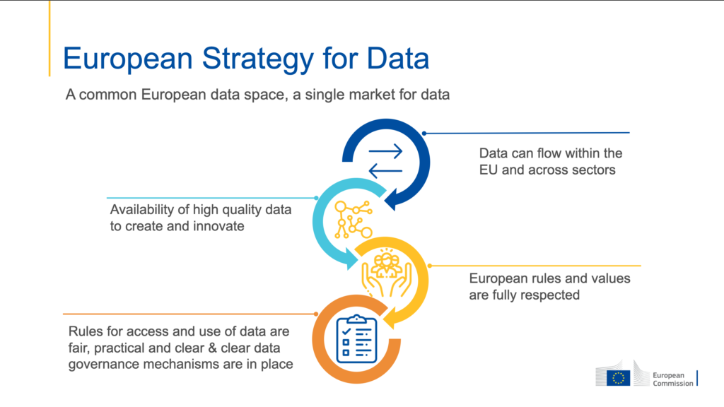
Pillar B (Data Spaces)
Examples ?
…with (in some cases) an ‘ESCAPE’ filter, to demonstrate that is possible even for the most distant science domain (for an external observer…) to be concerned by Data Spaces prospective.
ESFRI facilities in PaNOSC and ESCAPE to support EU’s industry; as well as global coordination for innovation, e.g. Quantum Computing as a service and for tech. R&D; algorithms and standards for Industry 4.0; AI; HPC.
Aligned with ENVRI-Fair data as well as to use the major potential of data of all other Clusters in support of circular economy, RIs construction and geo./environment implications […]
A series of actions by SSHOC, but also data to improve accountability of public spending for research; management and sustainability of Big Science RIs through socio-economic impact model analyses.
Cross-sector sharing of data for an unifying, forward-looking approach of any Big Science facility for energy efficiency, water management, etc.
Health data essential for EOSC-Life advances but also link with nuclear et al. facilities for preventing/treating diseases
Science Data to reduce the skills mismatches between the education and training systems and the labour market needs.

Slide 119

Conclusions
Science Clusters position statement is about:
Expectation:
Accelerate the discoveries and increase scientific value
Enable opportunities offered by the digital revolution
Commitment:
Shape and operate platforms for data interoperability
Sustain the federation of RIs for excellence science
Widen impacts of Open (Data) Science
Cooperation:
EOSC Association and EC
Inter-domain and cross-disciplines
SMEs for co-developments
Society at large
Inclusiveness:
Attracting more thematic and emerging RIs
Lead a regional as well as international alliance in Science
Universities, Institutes and citizens

Slide 121

The EOSC Association: Advancing Open Science
Prof. Marialuisa Lavitrano
EOSC Association vice president
Email: info@eosc.eu
11th June 2021
ESFRI science clusters’ workshop
Slides by EOSC Association

Slide 122
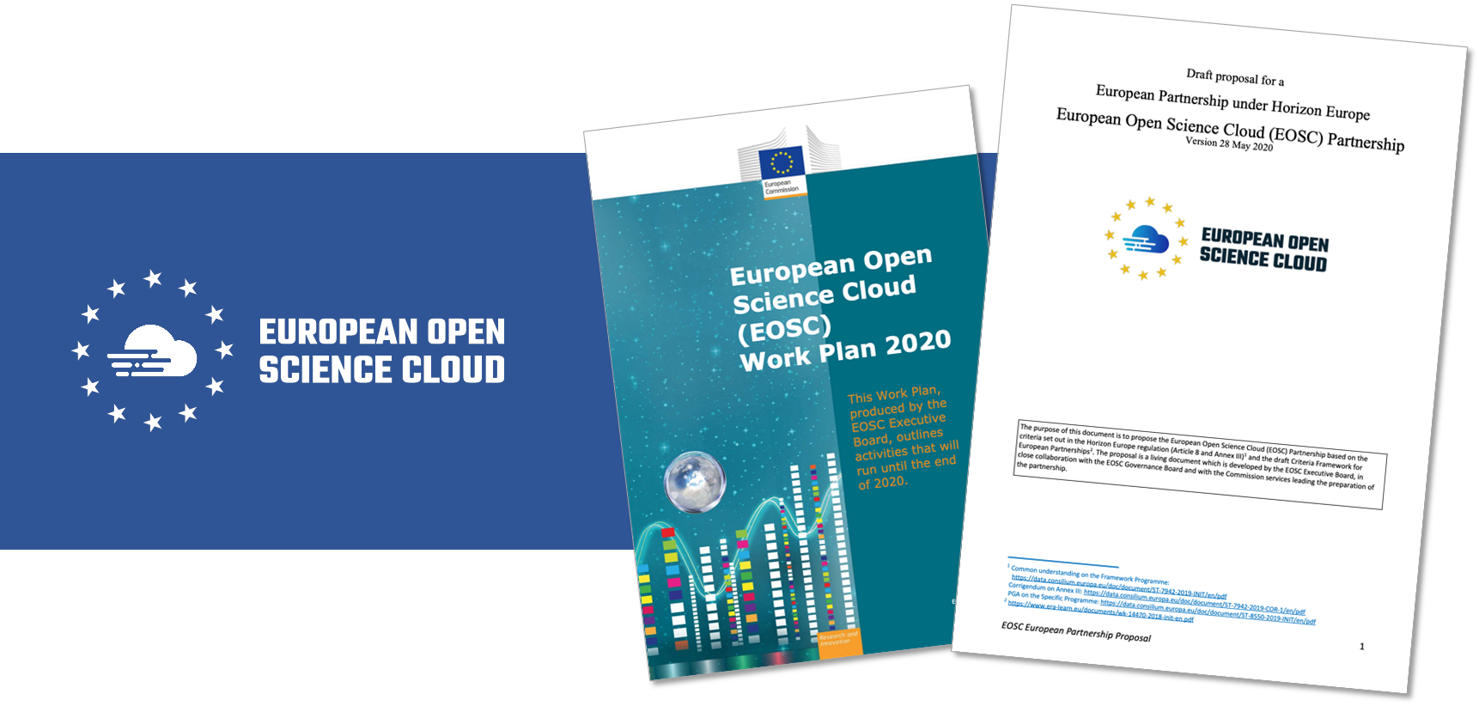
Where do we come from?
The shared vision between the EC, MS&AC and a large community
The decision of the governing bodies to institute a Co-programmed Partnership as the best instrument to collectively achieve this vision
Notes:
The shared vision between the EC, MS&AC and a large community
The decision of the governing bodies to institute a Co-programmed European Association as the best instrument to achieve that vision “to overcome the fragmentation and to provide a framework for collaboration and pooling of resources at European, national, regional and institutional levels.”
This instrument requires the incorporation of a new legal entity: the EOSC Association which will have as members all relevant stakeholders in the EOSC ecosystem and will enter into a contractual agreement with the European Commission to direct the Partnership under Horizon Europe

Slide 123
EOSC Governance Model 2021-2027
The new governance model agreed with EU countries for the next EOSC implementation phase after 2020 will be tripartite including:
The EU represented by the Commission
The European research community represented by the EOSC Association
EU countries and countries associated with Horizon Europe represented through a Steering Board to be set up in 2021 outside of the EOSC Association
European Commission
EOSC Association
Steering Board
Joining the EOSC Association
=
Joining the EOSC Partnership!

Slide 124
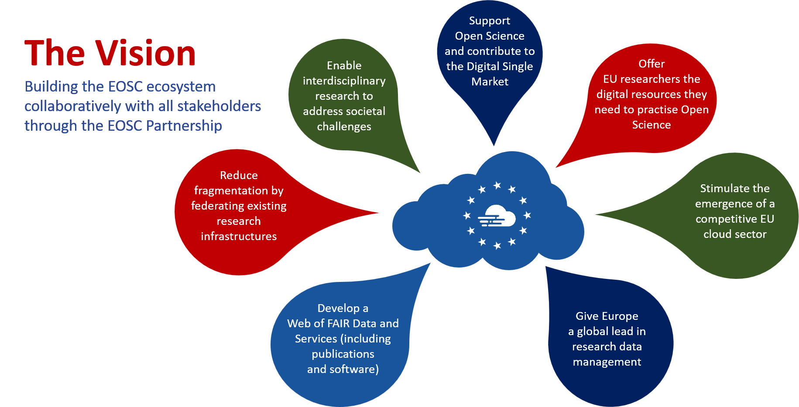
6/11/21

Slide 125
Priorities for EOSC implementation Stage 1 2021-2022
  Ensure that Open Science practices and skills are rewarded and taught, becoming the new normal
  Enable the definition of standards, and the development of tools and services, to allow researchers to find, access, reuse and combine results
  Establish a sustainable and federated infrastructure enabling open sharing of scientific results

Slide 126
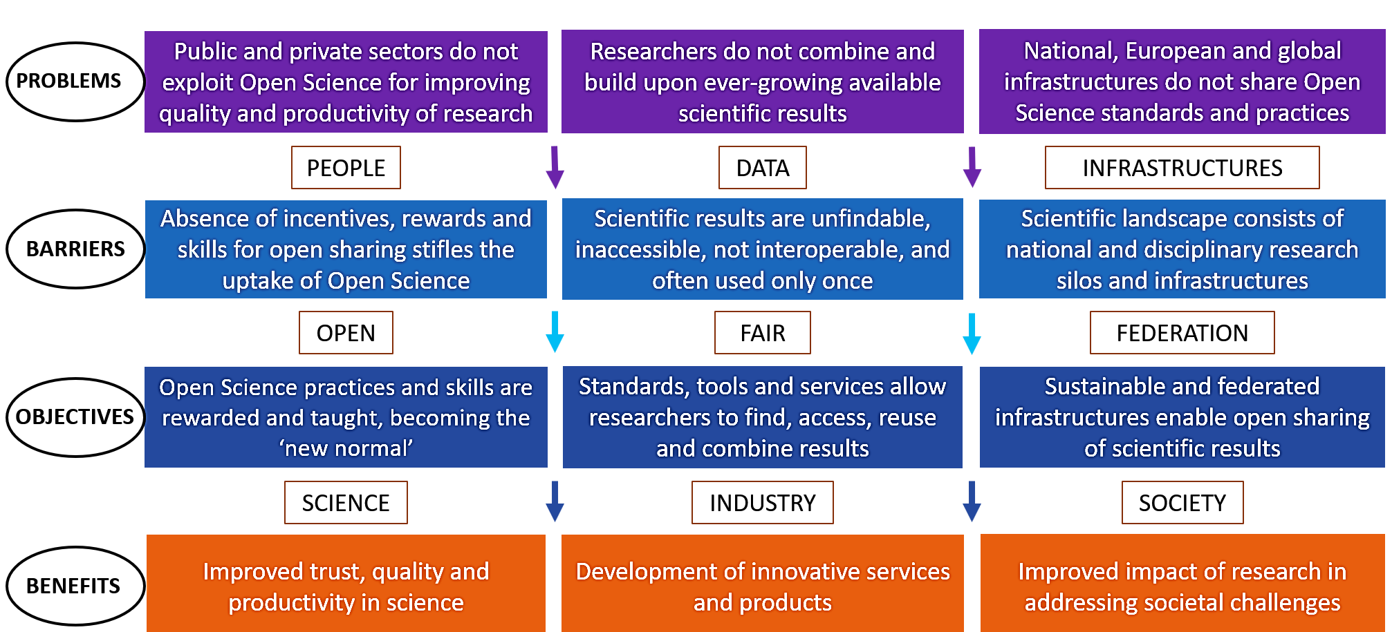
EOSC-ecosystem objectives tree
(EOSC Strategic Research Implementation Agenda v1.0)

Slide 127
Guiding principles for EOSC
The overarching principle for developing EOSC is that research has to be at the centre of the EOSC initiative.
Multi-stakeholderism
EOSC will succeed if and only if it follows a multi-stakeholder approach;
Openness
EOSC will ensure research artefacts be ‘as open as possible, as closed as necessary’;
FAIR principles
EOSC research artefacts need to be findable, accessible, interoperable and reusable;
Federation of infrastructures
EOSC will federate existing and upcoming data- and e-infrastructures;
Machine-actionable
EOSC will strike the right balance between machines and people in delivering the services that will serve the needs of European scientists.
Notes:
The shared vision between the EC, MS&AC and a large community
The decision of the governing bodies to institute a Co-programmed European Association as the best instrument to achieve that vision “to overcome the fragmentation and to provide a framework for collaboration and pooling of resources at European, national, regional and institutional levels.”
This instrument requires the incorporation of a new legal entity: the EOSC Association which will have as members all relevant stakeholders in the EOSC ecosystem and will enter into a contractual agreement with the European Commission to direct the Partnership under Horizon Europe

Slide 128
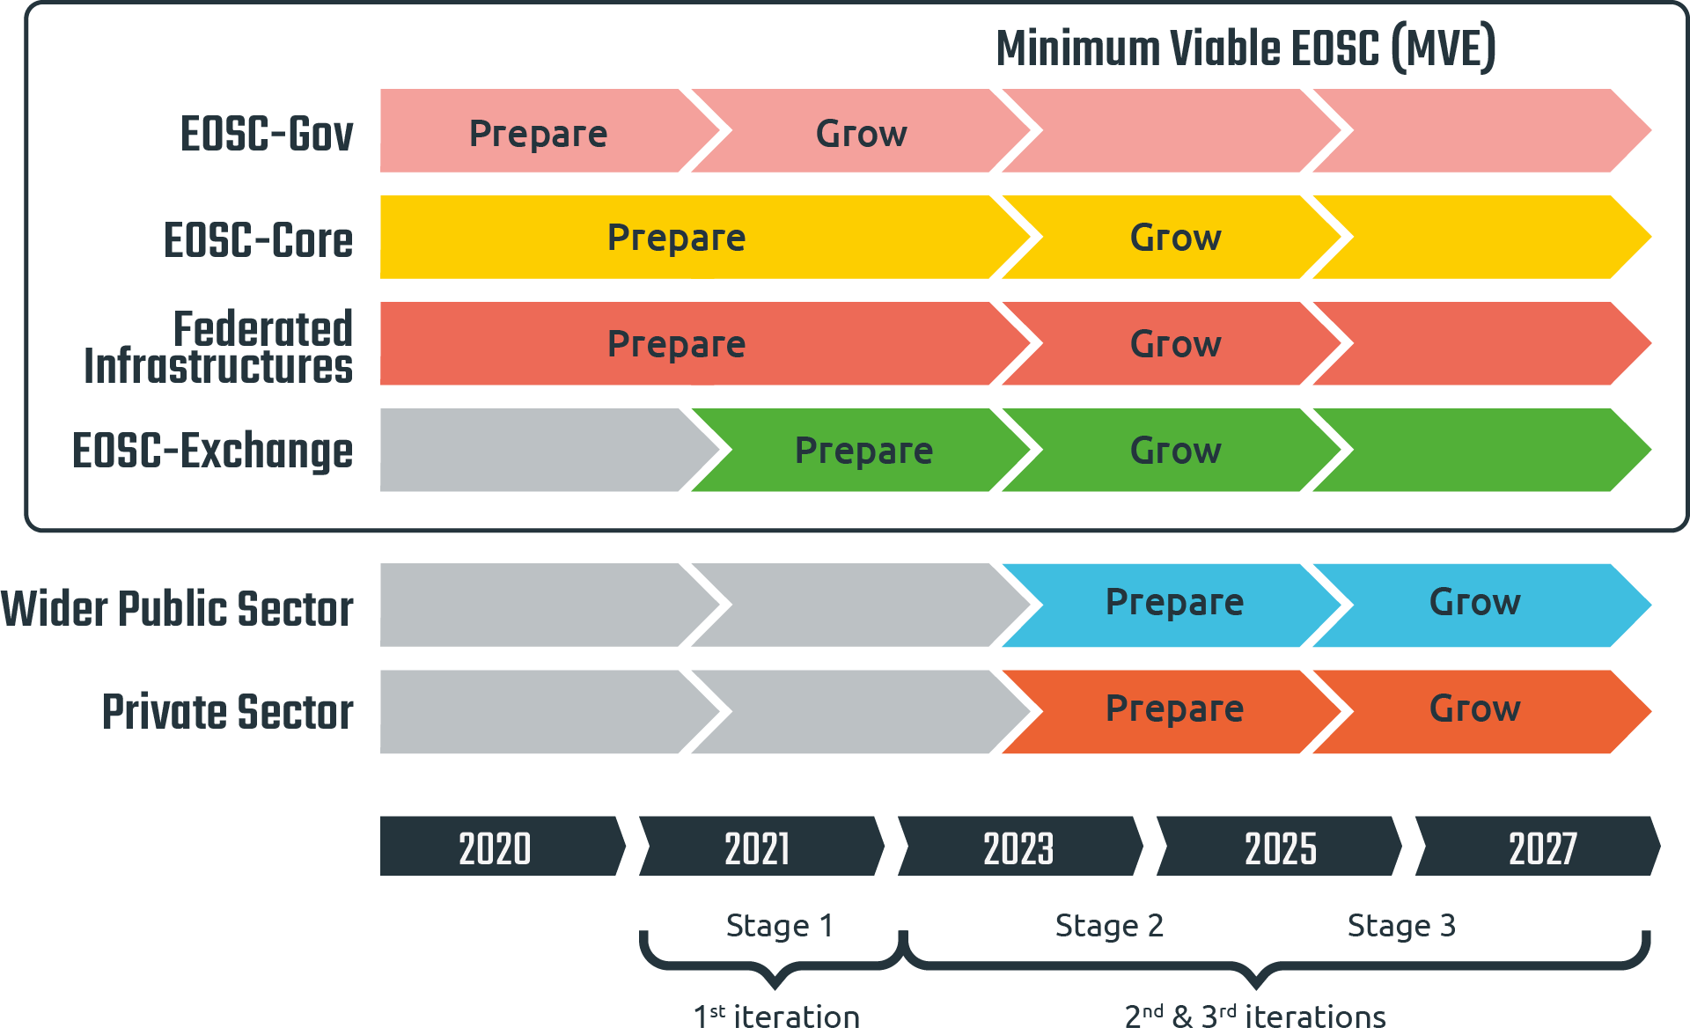
Timeline of EOSC iterations towards a MVE
(EOSC Strategic Research Implementation Agenda v1.0)

Slide 129
The EOSC Association
Four founding members (CESAER, GEANT, GARR, CSIC)
Was started as AISBL* on Wednesday 29th July 2020
Obtained Royal Decree on Friday 11th September 2020
First General Assembly on 17-12-2020 elected President and Board
Research Performing; Research Funding and Service Proving organisations
Now 153 members and 63 observers (62% - 8% - 30%) (April 2021)
A European Co-programmed Partnership, between the EC and the EOSC Association, MoU to be signed 23 June 2021
Joining the EOSC Association = Joining the EOSC Partnership!
*international non-profit association under Belgian law
Notes:
The shared vision between the EC, MS&AC and a large community
The decision of the governing bodies to institute a Co-programmed European Association as the best instrument to achieve that vision “to overcome the fragmentation and to provide a framework for collaboration and pooling of resources at European, national, regional and institutional levels.”
This instrument requires the incorporation of a new legal entity: the EOSC Association which will have as members all relevant stakeholders in the EOSC ecosystem and will enter into a contractual agreement with the European Commission to direct the Partnership under Horizon Europe

Slide 130
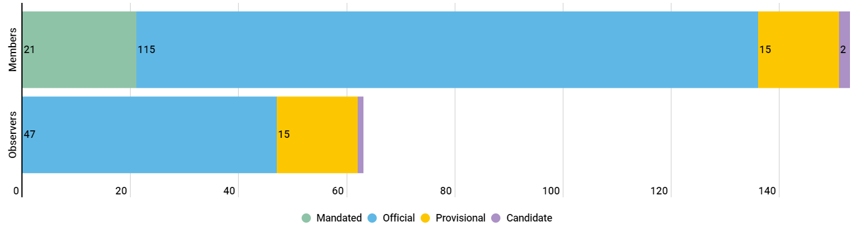
EOSC membership by status
As of the end of April 2021
Members: 153
Observers: 63
Notes:
The Association is comprised of Members and Observers. All Members have a presence in an EU Member State (MS) or Associated Country (AC), or any other country associated with the EU Framework Programme for Research and Innovation. Observers may be established outside this area.

Slide 131


EOSC Association membership geographical spread
153 Members
~63 Observers
How to join the Association: https://www.eosc.eu/join-association
6/11/21

Slide 132









Board of Directors
Karel Luyben, CESAER & President
Klaus Tochtermann, ZBW & Director 3-year mandate
Marialuisa Lavitrano, University Milano – Bicocca & Director 3-year mandate
Suzanne Dumouchel, CNRS & Director 3-year mandate
Sarah Jones, GÉANT & Director 2-year mandate
Ignacio Blanquer, UPV & Director 2-year mandate
Ronan Byrne, HEAnet & Director 1-year mandate
Bob Jones, CERN & Director 1-year mandate
Wilhelm Widmark, University of Stockholm & Director 1-year mandate

Slide 133
The EOSC Association
Mission: Advancing Open Science to accelerate the creation of new knowledge, inspire education, spur innovation and promote accessibility and transparency
To provide a single voice for advocacy and representation for the broader EOSC stakeholder community.
To promote the alignment of European Union research policy and priorities with activities coordinated by the Association.
To enable seamless access to data through interoperable services that address the entire research data life cycle, from discovery to storage, management, analysis and re-use across borders and scientific disciplines
Notes:
The shared vision between the EC, MS&AC and a large community
The decision of the governing bodies to institute a Co-programmed European Association as the best instrument to achieve that vision “to overcome the fragmentation and to provide a framework for collaboration and pooling of resources at European, national, regional and institutional levels.”
This instrument requires the incorporation of a new legal entity: the EOSC Association which will have as members all relevant stakeholders in the EOSC ecosystem and will enter into a contractual agreement with the European Commission to direct the Partnership under Horizon Europe

Slide 134
What are the EOSC Advisory Groups / Task Forces
A structure to allow Association members and others to help steer the implementation of EOSC
Groups should liaise with EOSC projects and offer feedback and advice
Identify strategic gaps and areas for investment to input to SRIA
EOSC Association members can propose and lead groups. Externals can also be members
Task Forces are groups within the AGs who undertake activities to implement certain aspects of EOSC according to their topic

Slide 135
Task Force topics
Implementation of EOSC
Rules of Participation compliance monitoring
PID policy and implementation
Researcher engagement and adoption
Technical challenges on EOSC
Technical interoperability of data and services
Infrastructure for quality research software
AAI Architecture
Metadata and data quality
Semantic interoperability
FAIR metrics and data quality
Research careers and curricula
Data stewardship curricula and career paths
Research careers, recognition and credit
Upskilling countries to engage in EOSC
Sustaining EOSC
Defining funding models for EOSC
Long-term data preservation

Slide 136
The role of science clusters in EOSC
The science clusters (ENVRI-FAIR, EOSC-Life, ESCAPE, PaNOSC, SSHOC) are making major contributions to the EOSC as the key means of engaging research Infrastructures and their user communities
The EOSC roadmap (SRIA version 1) foresees contributions from the science clusters that stretch beyond the lifetime of the science cluster projects

Slide 137
Science Clusters contributions to EOSC objectives
Engage with researchers and promote the adoption of open science practices by research communities
Participate in the definition of standards, and the development of tools and services that allow researchers to find, access, reuse and combine results
Establish a sustainable and federated infrastructure enabling open sharing of scientific results

Slide 138

EOSC Symposium 2021
EOSC Ecosystem explored
Focus on AG topics and engagement with the community
Registration & Programme

Slide 139

Any questions?
Thanks!

Slide 141
Wrap-Up & Take-Aways
Giovanni Lamanna
11 June 2021

Slide 142


Take Aways
We need science clusters that are fully integrated with EOSC and with their data FAIR by design, with emphasis on the “I”.
Interoperability of relevant research data within each ESFRI Science Cluster would be great, interoperability between the ESFRI Science Clusters would be marvelous

Slide 143





Take Aways
ENVRI-FAIR empowers environmental sciences to interoperability and interdisciplinarity for reaching EOSC open science targets and responding to grand societal challenges.
EOSC-Life builds the operational processes that link up life science research outputs to the missions' objectives and the open data targets of EOSC.
ESCAPE brings the astronomy, particle and nuclear physics communities together to build next generation cross-domain facilities to answer fundamental questions about the Universe, and to bring our expertise on distributed Exabyte-scale data management and analysis to the benefit of the EOSC.
The scientific communities using the analytical facilities need an EOSC which enables seamless interaction with open data for open science.
The overall impact and end-result of SSHOC will be a Social Science and Humanities data ecosystem in which researchers and other interested parties have seamless access to high quality data.

Slide 144
Wrap-Up
All involved RIs would like to see the Science Clusters pursuing their programmes and their cross-domain visions contributing to EOSC and more largely to Open Science in Europe.
A plan to include this perspective in Horizon Europe framework was expected.
Continuous synergies with EC and EOSC Association is relevant.
Cooperative link with the EOSC Association board is desired.
The European Data Spaces stimulate cross-disciplinary projects among the Science Clusters.
More topical concertation (among clusters and RIs) and exploration (with EC) to plan.
This Workshop initiates a series of further occasions for periodical cross-border discussions.
Openness and inclusiveness towards all partners and the scientific community at large to preserve.

Slide 145
Thank
you!

