Slide 1
Environmental research infrastructure cluster
Ari Asmi, Co-coordinator ENVRI FAIR
Andreas Petzold, Coordinator ENVRI FAIR
Notes:
Very good day to everyone present here and welcome to the first session of ENVri week 2021. This session will walk you through what happened in the world of EOSC during last year. Despite the Corona virus pandemic and the sudden change in everybody’s lifestyle, EOSC activities didn’t drop or cease. Au contraire. EOSC realm has been very very active. We will have three speakers today (Andreas, Ari and myself), each will have 10 minutes for his presentation, saving 15 minutes at the end for discussions, which I encourage you participate. Please raise your hand or post your question in the chat.
That being said, allow me to introduce our first speaker: me! My presentation will provide you a general overview of EOSC 2020 and will set the stage for Andreas and Ari, who will go into a bit more detailed information on a couple of specific EOSC activities..
Let’s start with what has ended and finish with what has began.

Slide 2
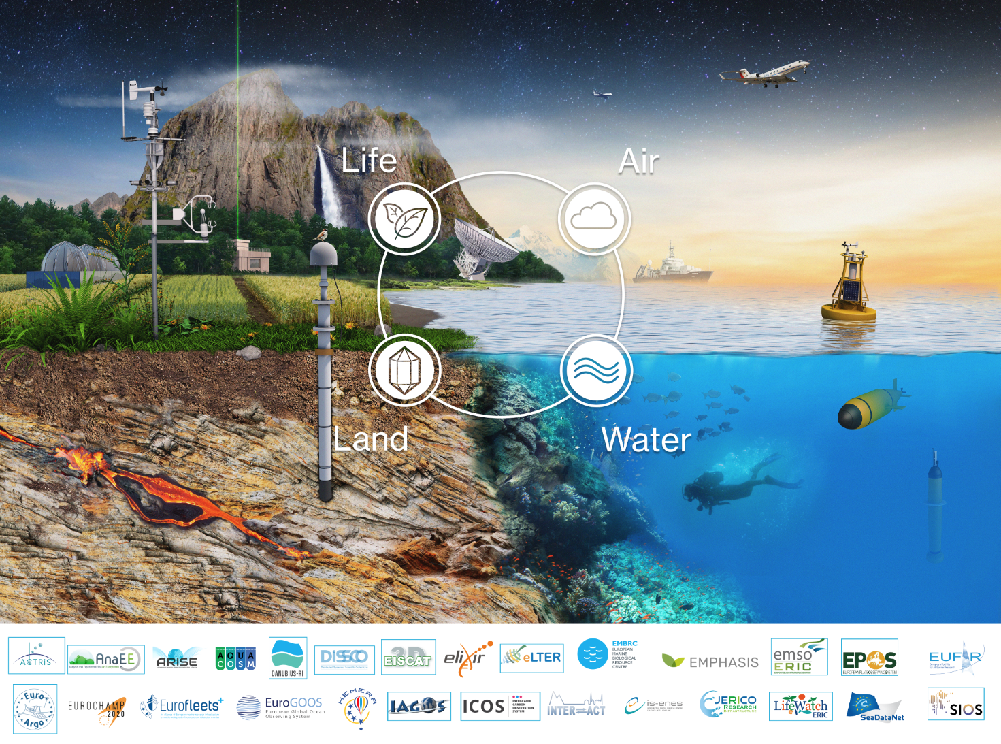
Characteristics of Environmental R. infrastructures
Interdisciplinarity highly relevant
Answering societal needs is only possible via collaboration
Wide range of disciplines
Societal challenges need multidisciplinary methods
Multiple infrastructures
High importance to society, economy and resilience
High level of specialization requires each RI to concentrate on their main tasks and user communities
Observations often unique - huge datasets

Slide 3
ENVRI Cluster
ENVRI FAIR does not include all ENVRI community cluster RIs
Products of ENVRI FAIR are shared to all
All are in the strategic integration activities
There are also many development activities for new RIs, and RI extensions underway

Slide 4
Cluster projects in ENVRI domain
2011-2014
2015-2019
2019-2023
Data service harmonization
Joint observation technologies
Societal impact enchancement
Access harmonization
(virtual, data)
Common strategic alignment, visibility & stakeholder engagement
Notes:
Key messages: Long history of collboration
Much more activites beyond data – good experiences on most
Projects have increased in size, but participation from RIs was limited in last call

Slide 5
ENVRI in the landscape

Slide 6
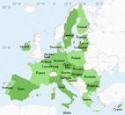
Overview of ENVRI in the landscape
ESFRI RIs
OPEN SCIENCE
SOCIETY
SCIENCE COMMUNITIES
Joint development and harmonization
Supporting interdisciplinarity
Create potential for new user communities
Direct technical support
Training and education
Connection to wide user communities
Disciplinary best practices and standards
Creating RI services from generic services
Demonstrators and documentation
Platforms for discovery and interdisciplinary workflows
Harmonization of interfaces and access across ENVRI Ris
More advanced RI services across ERA
Resilience and adaptation services
Commercial and societal use of RI services
Operationalization of key services
Societal engagement
ESFRI RIs
EOSC & OS
Science
Society

Slide 7
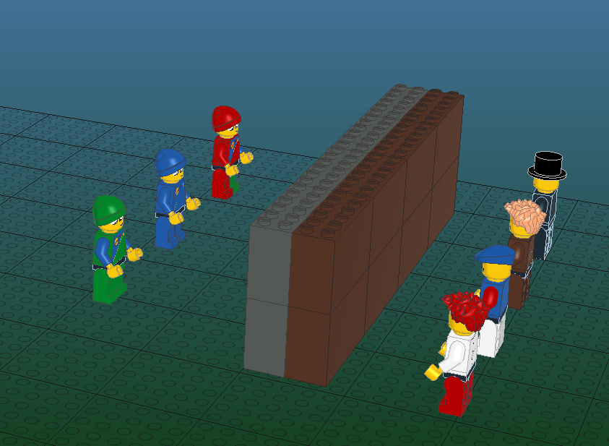
“Overcoming barriers” metaphor
Research infrastructures
User communities
…
Not understandable
Hard to access
Hard to find

Slide 8
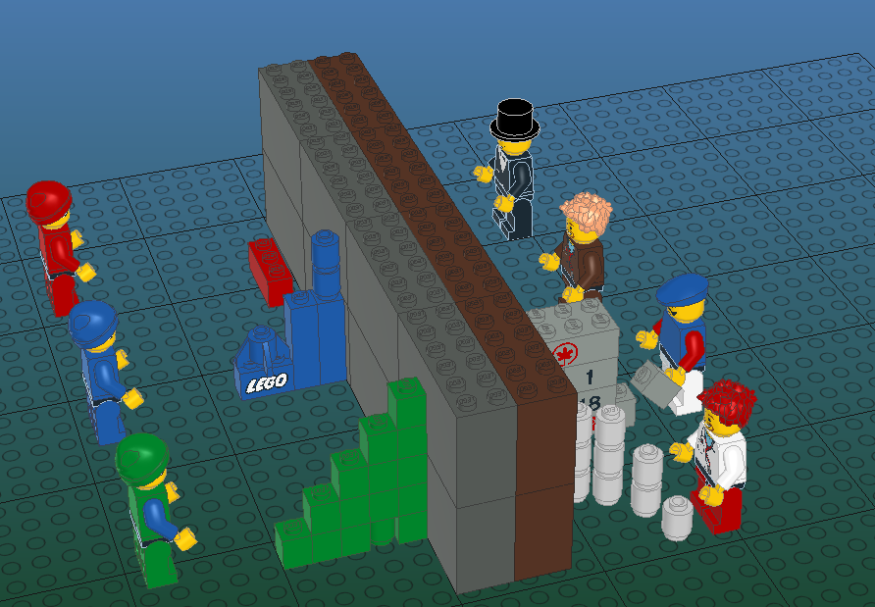
Overcoming barriers (Before ENVRIs)
The main infrastructure mission is to provide
Specialized services for
Specialized users
This is mandated by funders and solutions were often ”narrow” in the sense of provision and usability
Lack of use
Provision under
construction
specialized provision
Specialized or ad-hoc
usage

Slide 9
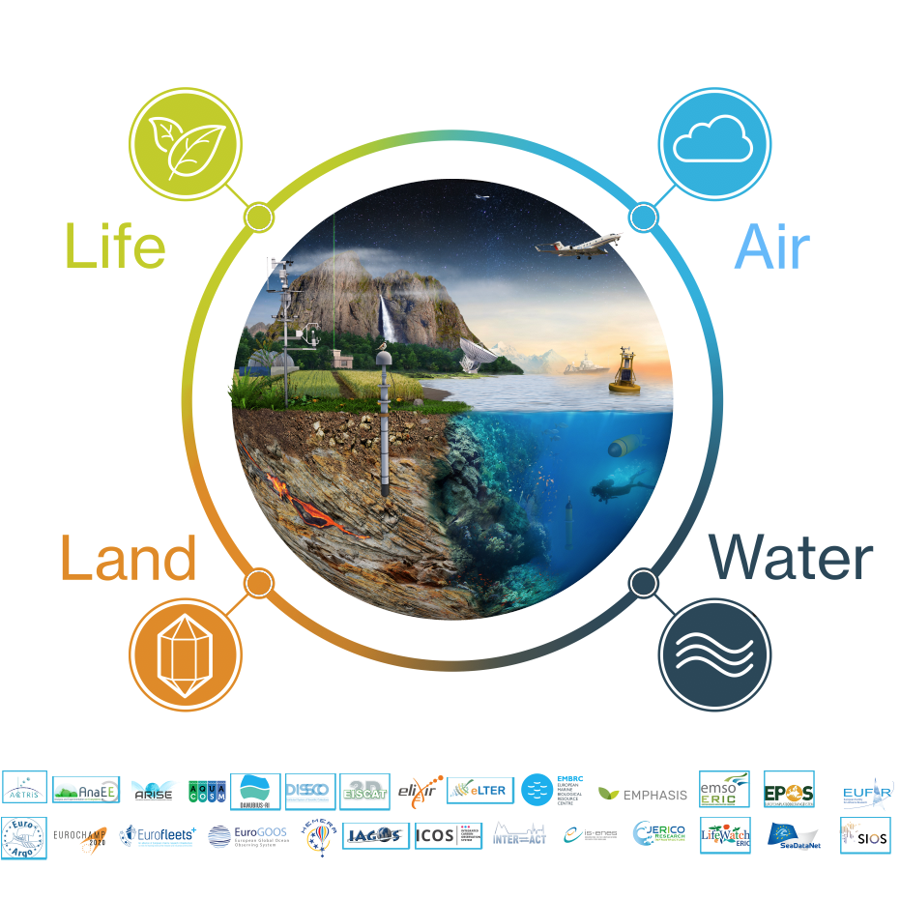
What has ENVRI FAIR (and previous ENVRI projects) achieved?

Slide 10
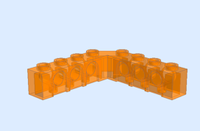
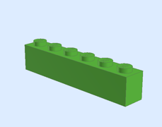
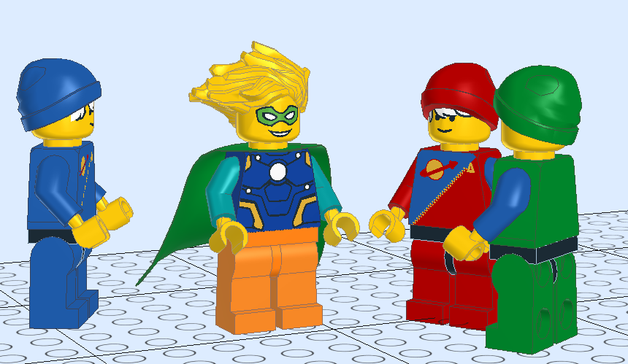
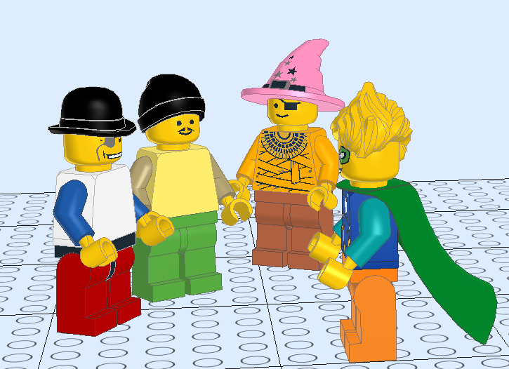
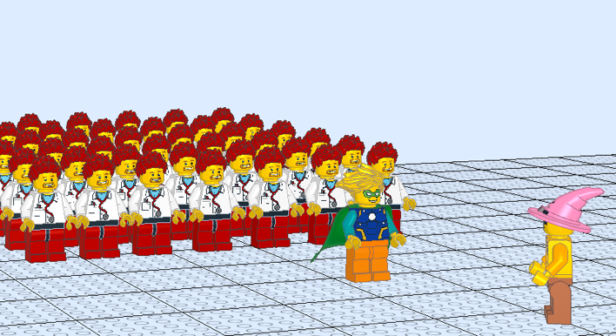
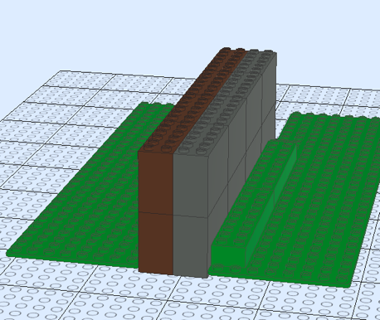
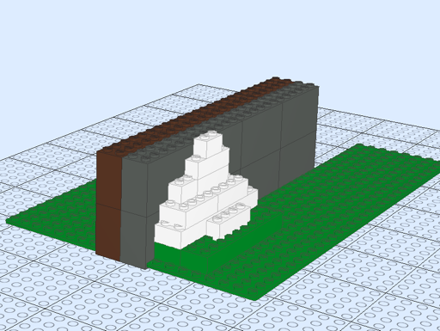
EOSC and Open science
REPRESENTING ENV NEEDS &
PARTICIPATING IN DEVELOPMENT
DOMAIN HARMONIZATION
BRINGING EXISTING USER COMMUNITIES
FROM GENERIC EOSC SERVICES TO SPECIFIC DOMAIN SOLUTIONS

Slide 11
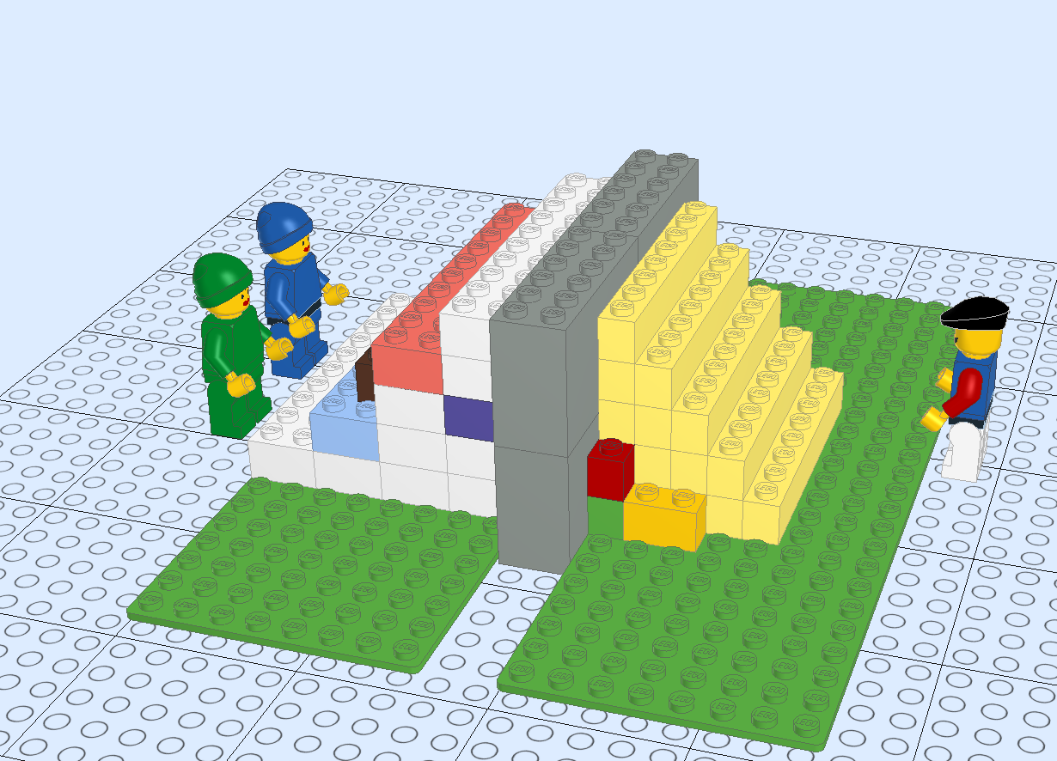
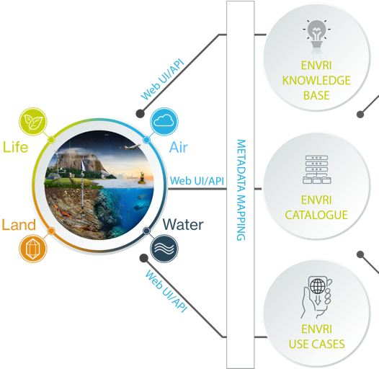
ENVRI-hub
Resource for knowledge, services and digital assets
quick discovery of data, services and assets
sharing of engineering practices, technologies and knowledge
ENVRI Community Research Infrastructures
Machine actionable interface to the ENVRI ecosystem
cataloguing all RIs in the ENV domain
accessing RIs datasets via metadata search
interface to EOSC and other users (e.g. Copernicus)
RI repositories host their own data
SEARCH
NOTEBOOKS
KNOWLEDGE
METADATA
DISCOVERY
EOSC CORE
Scientific demonstrators and use cases
Made accessible as executables and VREs in Jupyter notebooks
EOSC PLATFORM

Slide 12
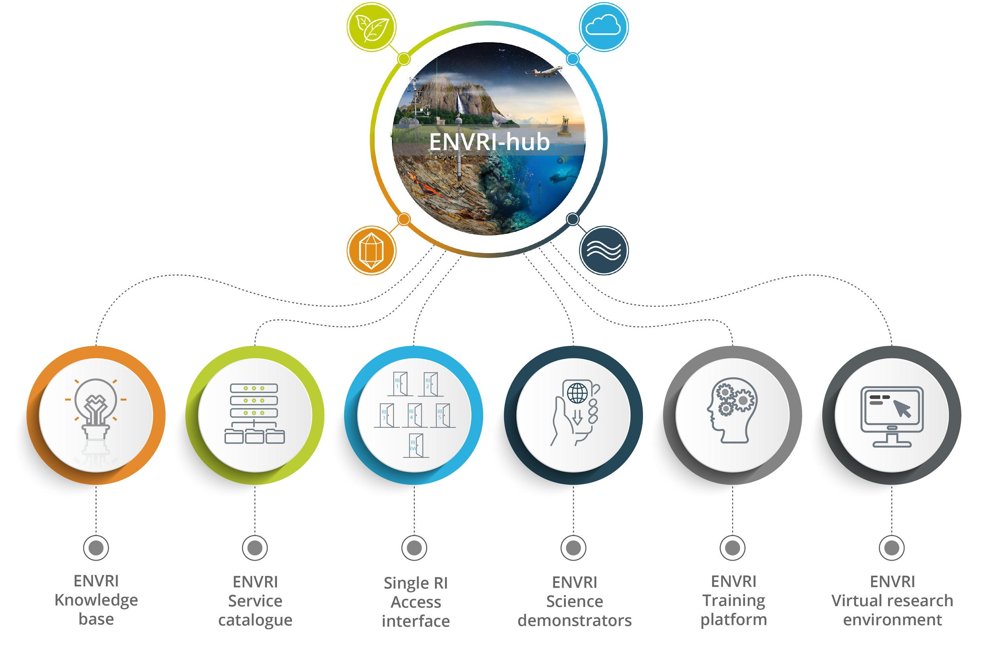

Slide 13
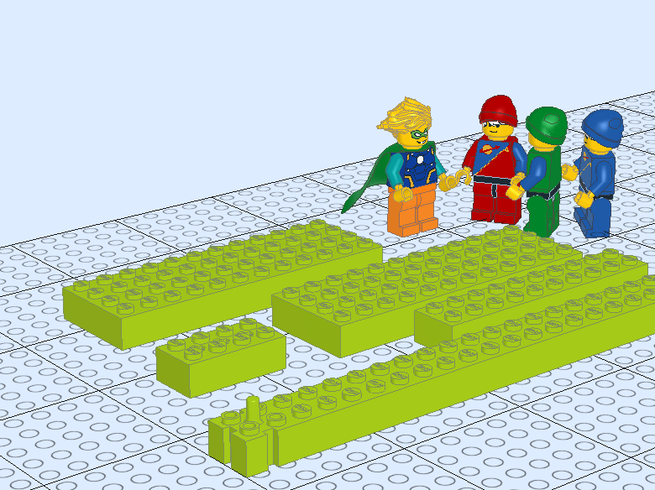
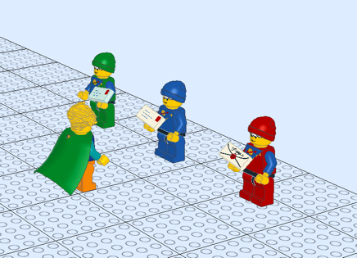
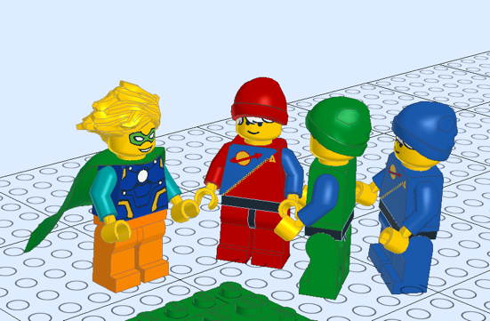
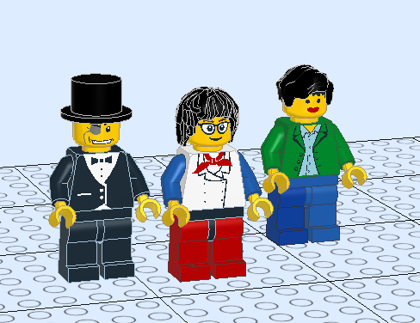
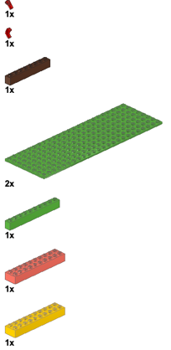
For ESFRI infrastructures
DOMAIN HARMONIZATION
TRAINING DOCUMENTATION
JOINTLY DEVELOPED INTEROPERABLE TOOLS
NEW USER GROUPS FROM MULTIDICIPLINARY SERVICES
EXISTING “PARTS LIST” FOR SOLUTIONS

Slide 14
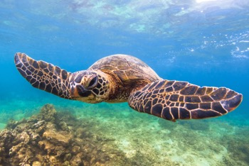
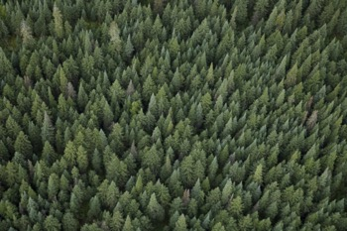
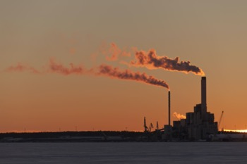
Interdisciplinarity: Dashboard on the State of the Environment
Upcoming demonstrator in the EOSC FUTURE
Easily understandable real-time environmental indicators which inform public and policy makers on the state of the environment.
An input of environmental indicators to SSHOC Science Project (Climate neutral and smart cities)

Slide 15
From science to operational services and decision support
Science is based on curiosity and ingenuity, but societal support need operational and sustained services
ENVRI Cluster platforms can help to create the interdisciplinary services, which can combine the RI services for operationalization
Uptake to e.g. COPERNICUS programme is an important way for long term decision making support
ENVRI RIs
Other RIs
Research
Scientists
Workflows
Research products
Service contracts
Operational and international services
Society
Citizens
Companies
Decision making

Slide 16
Looking into future

Slide 17
END OF THE CLUSTER
REINFORCEMENT OF THE CLUSTER
Existing RI-adopted services will keep running and contribute to EOSC
The developed “pieces” exist and can be used further
HUB platform sustainability still undecided
Potential divergence in new RI services particularly on new RIs
Decreased potential for interdiciplinary societal, economic benefits
Decreased societal resilience
HUB platform can be extended to national level RIs, researchers
HUB can support Horizon Europe projects
New ESFRI RIs and new RI services can be made multidisciplinary more efficiently
Convergence of RI services for societal benefit
Increased potential for societal, economic interfaces
Increased societal resilience

Slide 18
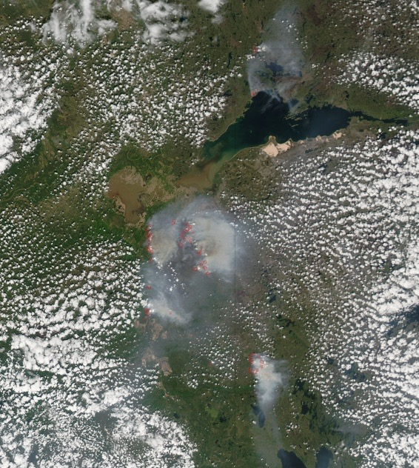
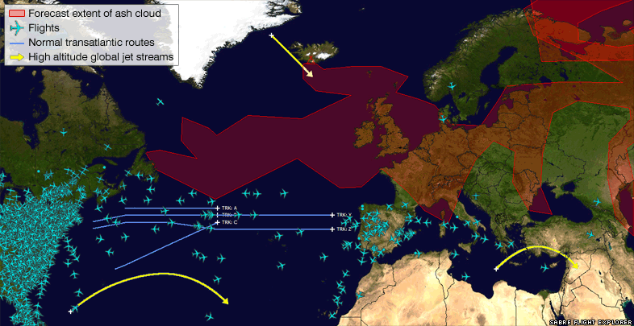
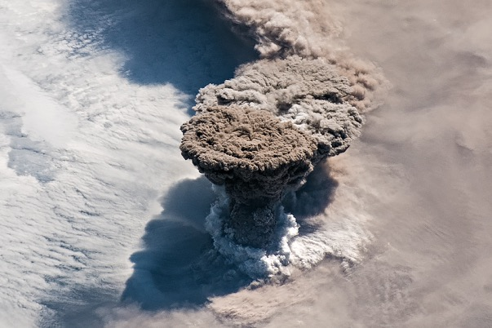
Societal resilience – Volcanic ash & forest fire smoke
In 2010 Europe was not prepared for quick response to the Volcanic Ash Crisis
Capability to respond exists now in ENVRI RIs
Common platforms, collaboration networks, methods, plans
New challenges can come any time – requiring an interdisciplinary framework
Alberta fires May – June 2019
https://eoimages.gsfc.nasa.gov/images/imagerecords/50000/50947/Canada_amo_2011159_lrg.jpg
Raikoke eruption 22 June 2019
https://earthobservatory.nasa.gov/images/145226/raikoke-erupts

Slide 19
Overview of ENVRI in the landscape
ESFRI RIs
User communities
Best practices and standards
Science services from EOSC services
Demonstrators and documentation
Joint development and harmonization
Supporting interdisciplinarity
Create potential for new user communities
Direct technical support
Training and education
OPEN SCIENCE
Resilience and adaptation services
Commercial and societal use of RI services
Operationalization of key services
Societal engagement
Platforms for discovery and workflows
Harmonization of interfaces and access
Advanced RI services across ERA
SOCIETY
Science
communities
Joint development and harmonization
Supporting interdisciplinarity
Create potential for new user communities
Direct technical support
Training and education
Connection to wide user communities
Disciplinary best practices and standards
Creating RI services from generic services
Demonstrators and documentation
Platforms for discovery and interdisciplinary workflows
Harmonization of interfaces and access across ENVRI Ris
More advanced RI services across ERA
Resilience and adaptation services
Commercial and societal use of RI services
Operationalization of key services
Societal engagement
ESFRI RIs
EOSC & OS
Science
Society

Slide 20
Specialization and generalization
Disciplinary
excellence
Disciplinary
excellence
Joint cluster action
Helping RIs to provide for generalized users
Direct RI linking
Multidiciplinary answers
Scales poorly &
misses connections
Ad hoc solutions
Temporary and hard to repeat
Societal needs
Disciplinary
excellence
Disciplinary
excellence

