Slide 1
ESFRI Science Clusters
position statement on expectations
and long-term commitment in Open Science
Giovanni Lamanna
11 June 2021

Slide 2
PSD2

Slide 3
The glossary …
Data: any digital object (including software, algorithms, analysis services, workflows, ..)
Virtual Research Environment (VRE): thematic collaborative digital environment used by scientists, which enables FAIR community-based scientific research, training, innovation, cross-fertilisation and open science (… vs the idea of a “marketplace”)
EOSC Association: established as a legal entity on 29th July 2020 aimed at bringing together all relevant stakeholders to co-design and deploy a European Research Data Commons where data are FAIR, and also as open as possible.
SRIA: Strategic Research and Innovation Agenda (SRIA) of the European Open Science Cloud (EOSC)
(https://www.eosc.eu/sites/default/files/EOSC-SRIA-V1.0_15Feb2021.pdf)

Slide 4
The glossary …
European Data Spaces: “…The European strategy for data aims at creating a single market for data that will ensure Europe’s global competitiveness and data sovereignty. Common European data spaces will ensure that more data becomes available for use in the economy and society, while keeping companies and individuals who generate the data in control.
Data is an essential resource for economic growth, competitiveness, innovation, job creation and societal progress in general…”

Slide 5
… and a preamble
Preamble
Science Clusters (lessons learned and in progress):
- one of the EC's most effective and innovative network tools (we need to pursue the
successful and effective cooperative approach);
- Science Cluster sustainability is a question addressed to the RIs and communities, while
the sustainability of EOSC (for science) depends on the maturity of our VREs and a set of a few of
our core services.

Slide 6
Science Clusters in the European research and innovation landscape
Position I: General Role and positioning of Science Clusters
The Science Clusters are engines for Interdisciplinarity.
Their cross-fertilization environment has bridged sociological and technical barriers.
The Science Clusters have potential to shape the future EOSC agenda and the Horizon-Europe framework evolution as well as operationalising the European Research Area (ERA).
The Science Clusters occupy a unique position between EOSC, ESFRI RIs and scientific communities.
Three momenta mark the success of the Science Clusters -> We all want to keep on them for the future.
Top-Down: The (ESFRI) RIs legal entities joining efforts together
Bottom-Up: The concerned scientists willing to pursue the cross-fertilization in science and innovation
Horizontally: The Universities and Institutes leveraging the inter-domain potential… to be fully exploited
around new academic/training schemes based on data-research

Slide 7
Science Clusters in the European research and innovation landscape
Position II: Science Clusters in EOSC and Open Science landscape
The Science Clusters uniquely capable to address the challenges of open research data being at the same time data producers and consumers.
The Science Clusters are a key part in developing mid-level multidisciplinary tools and platforms.
The Science Clusters’ track record of integrating infrastructures can be a significant asset for the EOSC. The majority of the EOSC Association members are EU member States Universities and Research Institutes: science and the support of research communities as the EOSC major aim!
It is of primary importance that the EOSC implementation roadmap, as well as its governance, make
reference to domain-based scientific communities and to the Science Clusters supported by them.

Slide 8
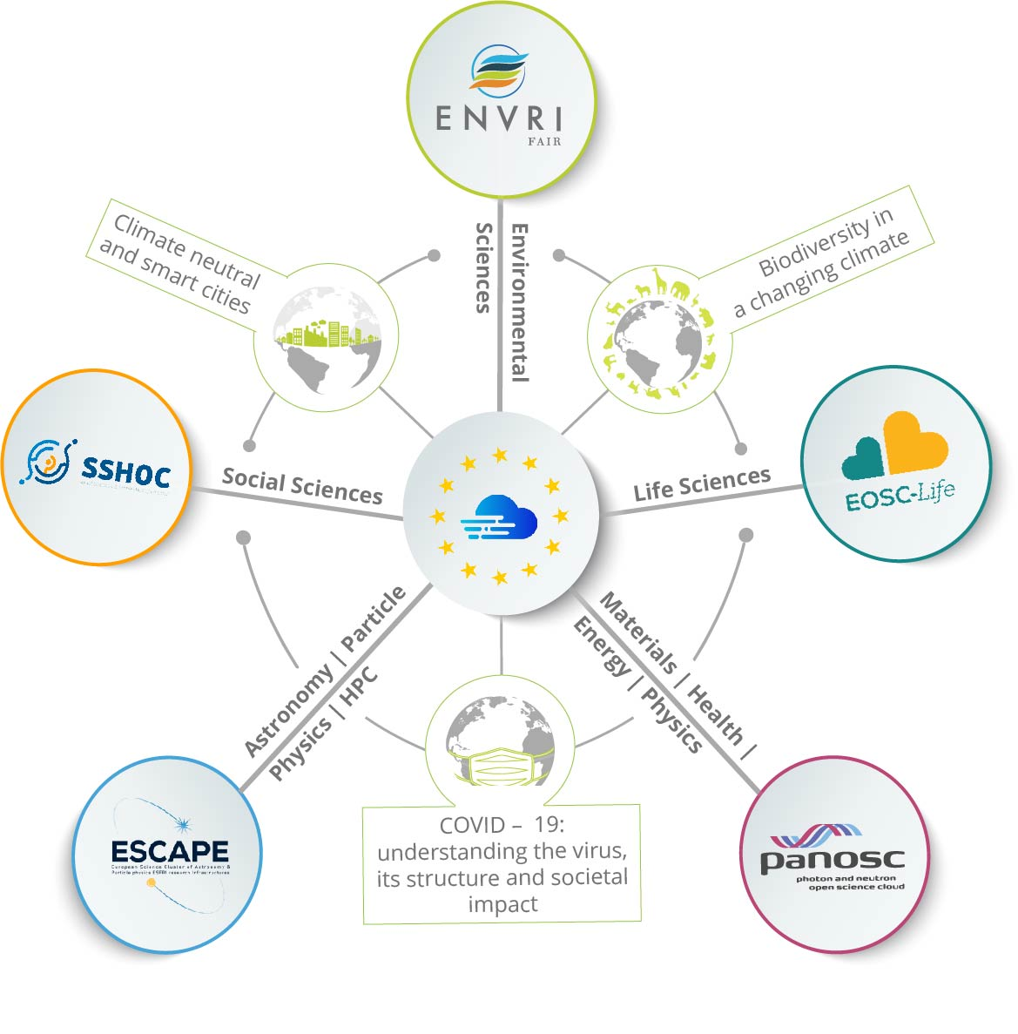
Science Clusters in the European research and innovation landscape
Position III: Science Clusters in scientific and RI communities
An infrastructure of “Web of FAIR Data and Services for Science” risks to be incomplete and ineffective without “community-governed” open-science commons platforms co-developed and operated by scientists
(VRE vs Marketplace).
The Science Clusters build and maintain key community-centred initiatives. The five Science Clusters have recently committed to co-steer shared actions to engage more researchers in the EOSC and in cooperation
with pan-European e-infrastructure organizations in the H2020 EOSC-Future project.
(i) Supporting consolidation actions; (ii) building multi-domain Science Projects (SPs);
(iii) making the EOSC a federation of VREs for the sustainability of EOSC.
The Science Clusters also provide a rapid and efficient platform for joining the RI services within or even cross clusters for important societal challenges. Recent COVID-19 projects demonstrate rapid response and capability for science-based societal and economic resilience in Europe.

Slide 9
Common statements of the five Science Clusters
The Science Clusters are willing to operate and adapt their thematic open-science resources in EOSC towards four urgent needs:
making science always central, solid and inclusive of its social and cultural dimension, as collective knowledge to be nurtured;
leveraging crosscutting and cluster cross-domain projects connected with European sectoral data spaces;
providing training, committing to education and engaging citizens in science;
exploring the way to translate their excellence in data-research into economic value.

Slide 10
A work plan for the future of the Science Clusters
Clusters as “platforms”
Science Clusters would continue to evolve, driven by the scientific need.
“Platform” infrastructure refers to the potential long term (further than the H2020 Grants’ duration) mission/structure of a cluster to develop, operate and exploit its community-based VRE, combining the RIs steering with the national Univ./Institutes consortia participation.
The platforms, internally and collectively, will study, define and set up a series of new task forces. They will also structure their commitment to Horizon Europe

Slide 11
A work plan for the future of the Science Clusters
Supporting the “EOSC Association mandate” and the European Commission
While many Science Clusters’ partners are members of the EOSC Association, and in the EOSC governance,
the Science Cluster would bring in addition the collective scientific community expectations.
The Science Clusters would propose to link directly to the EOSC Association Board of Directors, supporting
it in the evolution of the EOSC roadmap.

Slide 12
A work plan for the future of the Science Clusters
There is a prompt need and opportunity to support the Science Clusters further (in 2022-2025) within Horizon Europe framework
H2020 and potential Horizon Europe funded actions (aligned with the EOSC-SRIA Stage2 -to- Stage3)
General Objectives (GO):
- consolidation of thematic data infrastructures (cluster VREs, platforms and a “few core services”) as parts of a federation.
Specific Objectives (SO):
- relevant scientific results from clusters;
- increased number of RIs;
- enhance researchers uptake of OS and widening dimension.
Operational Objectives (OO):
- sustainable operation of the deployed cluster as a “platform infrastructure”;
- continuous promotion, extension and hosting of inter-domain FAIR Science Projects (new Open Science Objectives).
Science Cluster GO
H2020 Cluster projects
EOSC-Future
Science Cluster SO
Science Cluster OO
2021
2022
2023
2024
2025
2026
2027
EOSC-SRIA Stage2 Stage3

Slide 13
Pillar A
Proposing two major approaches (Pillar A & B) in the Horizon Europe framework:
Pillar A - Inter-cluster common data services co-developments
(from GO to SO)
The sustainability of the five clusters is built through the structuring of their wide cooperative VRE intended as the implementation goal for an effective and successful operation of EOSC. VREs need to become fully operative.
Some of the most successful achievements of the Science Clusters are the key data services within EOSC for “data provision, discovery, and exploitation”, e.g. catalogues, analysis frameworks, FAIR data archives, solving research communities/themes challenges. Envisaging inter-cluster projects is also relevant for interoperability and commons.
Consolidating a “few core services” per cluster to become part of the EOSC sustainable core services.

Slide 14
Pillar B
Pillar B - Delivering Content to EOSC
(from SO to OO)
The next step (starting from 2023) in the Science Cluster agendas will be to uptake emerging and concrete “Open Science Objectives”, further than the current (test) Science Projects in EOSC-Future.
A ‘matrix’ based on ‘two methods’…
Open Science Projects (OSP)
to continue bridging barriers to open science within a large scientific community;
to leverage the pan-European cluster action towards more global commitments as well as regional initiatives*.
Cross-Cluster Open Science Projects (COSP)
are envisaged to be tackled by focusing on topical aspects within one cluster supported by complementary contributions from all clusters;
to leverage the inter-cluster coordination for the regional initiatives* emerging from OSP.

Slide 15
Pillar B
Pillar B - Delivering Content to EOSC
(from SO to OO)
.. And along a series of ‘vertical’ missions (laying in the capacity of the ESFRI RIs partners):
Wide innovation potential with industry (including SMEs).
Affirmation and extension of a prominent Europe role more internationally.
Structuring education and training-by-doing offers to facilitate work insertion of young generations as well as to participate in the European resilience plan.
Supporting ‘Science & Technology Policy for Society’ as well as ‘data/cloud business capacities’ (e.g. by engaging with GAIA-X).
The Science Clusters would explore how to commit with EC for European Data Spaces […]

Slide 16
Pillar B (Data Spaces)
Examples ?
…with (in some cases) an ‘ESCAPE’ filter, to demonstrate that is possible even for the most distant science domain (for an external observer…) to be concerned by Data Spaces prospective.
ESFRI facilities in PaNOSC and ESCAPE to support EU’s industry; as well as global coordination for innovation, e.g. Quantum Computing as a service and for tech. R&D; algorithms and standards for Industry 4.0; AI; HPC.
Aligned with ENVRI-Fair data as well as to use the major potential of data of all other Clusters in support of circular economy, RIs construction and geo./environment implications […]
A series of actions by SSHOC, but also data to improve accountability of public spending for research; management and sustainability of Big Science RIs through socio-economic impact model analyses.
Cross-sector sharing of data for an unifying, forward-looking approach of any Big Science facility for energy efficiency, water management, etc.
Health data essential for EOSC-Life advances but also link with nuclear et al. facilities for preventing/treating diseases
Science Data to reduce the skills mismatches between the education and training systems and the labour market needs.

Slide 17
Conclusions
Science Clusters position statement is about:
Expectation:
Accelerate the discoveries and increase scientific value
Enable opportunities offered by the digital revolution
Commitment:
Shape and operate platforms for data interoperability
Sustain the federation of RIs for excellence science
Widen impacts of Open (Data) Science
Cooperation:
EOSC Association and EC
Inter-domain and cross-disciplines
SMEs for co-developments
Society at large
Inclusiveness:
Attracting more thematic and emerging RIs
Lead a regional as well as international alliance in Science
Universities, Institutes and citizens

