Slide 1
Open Science the new “modus operandi” for research
ESFRI Science Clusters' Long Term Commitments to Open Science 11 June 2021
Kostas GLINOS
Head of Open Science RTD.G4
Directorate-General for Research and Innovation
European Commission

Slide 2
1. Why we need Open Science
To make Science
more efficient (better sharing of resources),
more reliable and robust (better reproducibility, open scrutiny),
more responsive to societal demands (involvement of societal actors)
more trusted by society
Covid-19 illustrates both the necessity and success of practicing open science

Slide 3
2. The EC commitment to Open Science
Improve the practice of R&I
Openly accessible scholarly publications
Early sharing of all research outputs
All data FAIR, RDM
Reproducible results
Societal engagement and responsibility
Develop proper enablers
Rewards and incentives to adopt Open Science practices, with appropriate metrics
Appropriate skills and education, including for research integrity
Open Research Infrastructures including the European Open Science Cloud (EOSC)
ERA Communication
Provisions on Open Science under Horizon Europe
EOSC in the Horizon Europe RI WP
EOSC and other data strategies

Slide 4
2.1 Open Science in the ERA Communication
Deepening the ERA The Commission will: (Action 9)
Incentivise open science practices by improving the research assessment system.
Launch, via the Horizon Europe Programme, a platform of peer-reviewed open access publishing;
Analyse authors’ rights to enable sharing of publicly funded peer-reviewed articles without restriction;
Ensure a European Open Science Cloud that is offering findable, accessible, interoperable and reusable research data and services (Web of FAIR); and
Citizen Engagement The Commission will: (Action 13)
Organise with Member States and stakeholders Europe-wide participatory citizen science campaigns to raise awareness and networking, crowdsourcing platforms and pan-European hackathons, in particular in the context of Horizon Europe Missions. The Commission will develop with Member States best practices to open up science and innovation to citizens and youth.

Slide 5
2.2 Towards a new ‘modus operandi’ for Science
The dominant current system
Rewarding individual competing scientists
Publish as much and as fast as possible
Excellence defined largely on the basis of where scientists publish
Incentivises researchers to produce specific outputs (mainly publications)
- Use of quantitative metrics
Increasing influence of commercial players from access to publications
- supported by proprietary services and analytics
FROM → TO
Open Science
Rewarding collaboration and sharing
Share knowledge/data as early and as openly as possible
Composite definition of excellence
Incentivises researchers to share, collaborate, increase quality and impact;
- Use of qualitative and quantitative metrics
Avoid lock-in over public-funded R&I output, ensuring autonomy of RPOs
- supported by open services, analytics and science graphs
→
→
→
→
→
Notes:
• There is concern about the increasing influence of commercial players over many aspects of research and education, from access to publications, to supply of data storage, search functionalities and information gathering. A level playing field needs to be maintained so that the independent role of universities in the knowledge system is not eroded.
• Universities play a crucial role in generating and diffusing knowledge, and preserving their autonomy is fundamental for them to fulfil their research and teaching mission, to advance science and maintain EU leadership in R&I and to foster a vibrant economy.
• The Commission is committed to implement actions that will help universities maintain control and avoid lock-in over information that is of vital importance for their strategic autonomy and to preserve the public knowledge space.
• The Commission is committed to improve and maximise access to and re-use of research data, and to support a public infrastructure to secure knowledge and data sharing as a public good.

Slide 6
2.3 Open Science under HE
Open Science embedded across the FP (OA, RDM, Citizen Engagement, etc.)
Evaluation of proposals (excellence –methodology-, quality & efficiency of implementation )
Grant Agreement, guidelines
Reporting—during the project’s lifetime
Work programmes
Strengthening of the obligations with respect to open access and focus on responsible RDM in line with FAIR
→ to foster the adoption of Open Science practices
providing open access to research outputs
early and open sharing of research
research output management
participation in open peer-review
measures to ensure reproducibility of research outputs
involving all relevant knowledge actors including citizens, civil society and end users in the co-creation of R&I agendas and contents (such as citizen science)
…

Slide 7
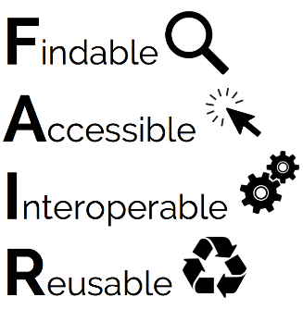
2.3 Open Science under HE - requirements
OA to peer-reviewed publications under Horizon Europe
deposition in a trusted repository and immediate open access
retain IPR and open licences [CC BY (or equivalent)]
publication fees (APCs/BPCs) refundable only in full open access publishing venues
Metadata of deposited publications open under CC0 or equivalent
OA to research data, in line with the FAIR principles
Data Management Plan (DMP) as a living document constantly updated
deposit data in a trusted repository (federated in EOSC if required) and link to publications
ensure open access ASAP under CC BY or CC0 (or equivalent), unless exceptions apply → “as open as possible, as closed as necessary”
OA to other research outputs (software, algorithms, protocols, workflows, models)
If required by the call conditions: provide digital or physical access
It is recommended to include other research outputs in the DMP

Slide 8
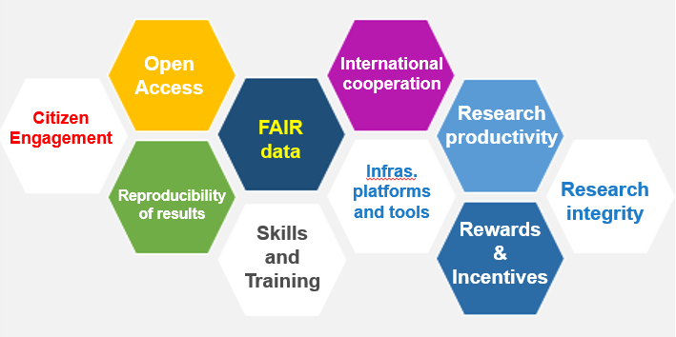
2.4 EOSC in the HE Research Infrastructures WP
INFRADEV Developing , consolidating and optimizing the European Research Infrastructures landscape
INFRAEOSC Enabling an operational, open and FAIR, EOSC ecosystem
European Open Science Could
Enable Open Science Commons
INFRASERV Research Infrastructure services to support health research, accelerating the green and digital Transformation, and advance frontier knowledge
INFRATECH Next generation of scientific instrumentation, tools and methods and advanced digital solutions
through the EOSC European Co-Programmed partnership
INFRANET Network connectivity in research and education – enabiling collaborations without boundaries

Slide 9
2.4 EOSC in the HE Research Infrastructures WP
European Co-Programme partnership and Horizon Europe programming
Implementation of the SRIA
Implementation levels
EC MS
Strategic R&I Agenda
SO1. Open Science practices becoming ‘the new normal
SO2. Sustainable and federated infrastructures
SO3. Standards, tools and services to find access, reuse and combine results
Destination INFRAEOSC / EOSC-Association
Partnership
Governing Board
Partnership MoU
European
National
EOSC Association
Institutional

Slide 10
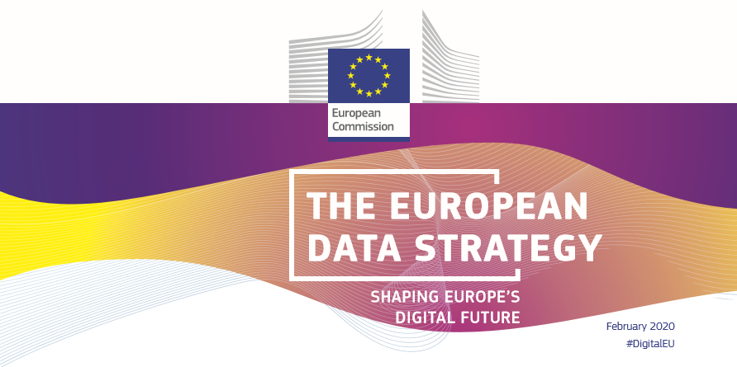
2.4 EOSC and other data strategies
The European Data Strategy
The EU will create a single market for data by:
Setting clear and fair rules on access and re-use of data;
Investing in next generation standards, tools and infrastructures to store and process data;
Joining forces in European cloud capacity;
Pooling European data in key sectors, with EU-wide common and interoperable data spaces;
Giving users rights, tools and skills to stay in full control of their data.
“EOSC is the basis for a science, research and innovation data space that will bring together data resulting from research and deployment programmes and will be connected and fully articulated with the sectoral data spaces.” (European Data Strategy, COM(2020) 66 final)
Health
Industrial & Manufacturing
Agriculture
Finance
Mobility
Green Deal
Energy
Public Administration
Skills
EOSC: a crosscutting data space for Research and Innovation
Notes:
Creating a single market for data will make the EU more competitive globally and will enable innovative processes, products and services. Industrial and commercial data are key drivers of the digital economy. The European Data Strategy will make more data available for use in the economy and society, while keeping those who generate the data in control.

Slide 11
3. RIs in the EOSC ecosystem
2020 ESFRI WHITE PAPER - MAKING SCIENCE HAPPEN
RIs major promoters of Open Science providing FAIR and quality certified Open Data
Continue to support the development of EOSC
increased FAIR and open data sharing
facilitate the cross disciplinary research and the exploitation of data interoperability
availability to stimulate inter-disciplinary and transdisciplinary research to achieve the societal goals
EOSC to take full advantage of ESFRI best practices and services
data management, storage and curation….
RIs are major data-producers
ESFRI science clusters
ESFRI individual infrastructures
EOSC-ESFRI cluster projects
Will achievements be sustainable?
Challenge: interoperability of data and services

Slide 12
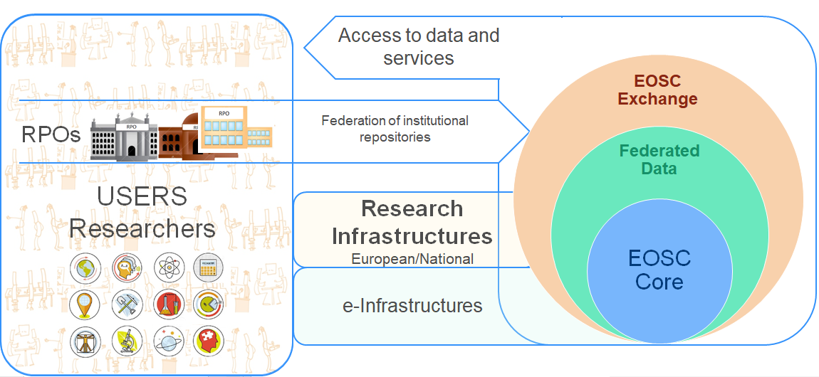
3. RIs in the EOSC ecosystem
EOSC-Core
generic services common to all
are they common yet? → different AAI among RIs?
EOSC-Exchange
generic services
domain specific services
(1) RIs are providers of data and services (e.g. data services, research products..)
(2) RIs are users of data and services provided by/through EOSC
increasing interdisciplinary research → increasing cross-domain use? → access? cost? scalability?
services in federated environments → more access and use? → AAI? cost? scalability?
maintenance of domain specific services → an in-kind contribution to EOSC?

Slide 13
Thank you
© European Union 2020
Unless otherwise noted the reuse of this presentation is authorised under the CC BY 4.0 license. For any use or reproduction of elements that are not owned by the EU, permission may need to be sought directly from the respective right holders.
Notes:
Update/add/delete parts of the copy right notice where appropriate.
More information: https://myintracomm.ec.europa.eu/corp/intellectual-property/Documents/2019_Reuse-guidelines%28CC-BY%29.pdf

Slide 14
EOSC in H2020
infraEOSC
INFRAEOSC-04-2018 - Connecting ESFRI infrastructures through Cluster projects
INFRAEOSC-02-2019 - Prototyping new innovative services
INFRAEOSC-06-2019-2020 - Enhancing the EOSC portal
INFRAEOSC-03-2020 - Integration and consolidation of the EOSC Portal
INFRAEOSC-05-2018-2019 - Support to the EOSC Governance
ENVRI-FAIR EOSC-Life ESCAPE PaNOSC SSHOC
FAIRsFAIR EOSCsecretariat
EOSC-Nordic EOSC-Pillar EOSC-synergy ExPaNDS NI4OS-Europe
COS4CLOUD
CS3MESH4EOSC
INODE NEANIAS TRIPLE
INFRAEOSC-07-2020 - Increasing the service offer of the EOSC Portal
C-SCALE DICE EGI-ACE OpenAIRE Nexus RELIANCE
EOSC Enhance
EOSC-Future
24 e-Infra prj
25 infraEOSC prj
400M€
INFRAEOSC-04
95 M€
Building blocks:
AAI
Portal
Services
FAIR principles impl.
Interoperability among clusters
e-Infrastructures
EINFRA-1-2014 - Managing, preserving and computing with big research data
EINFRA-22-2016 User driven e-infrastructure innovation
AARC2 AGINFRA PLUS HIRMEOS MSO4SC OpenAIRE-Connect OpenRiskNet
EINFRA-8-2014 GÉANT
EarthServer-2 EGI-Engage EUDAT2020 INDIGO-DataCloud OpenMinTeD PhenoMeNal
EINFRA-21-2017 - Platform-driven e-infrastructure innovation
DARE DEEP-HybridDataCloud EUXDAT FREYA PPI4HPC PROCESS XDC
EINFRA-12-2017 - Data and Distributed Computing e-Infrastructure for Open Science
EOSC-hub OpenAIRE-Advance
policy
international cooperation
RDA

