Slide 1

Development of the Electronics and Time Synchronization for
Hyper-Kamiokande
IN2P3, CEA, ICRR, The Tokyo University
stefano russo
2021 Joint Workshop of TYL/FJPPL and FKPPL
11/05/2021

Slide 2
Neutrino Research Motivations
Neutrino’s secrets are gradually revealed.
1998 Discovery of non-zero neutrino mass @ Super-Kamiokande
2011 All three neutrinos are mixing each other.
However, there is a lot of questions still open:
We still don’t know which neutrino is heaviest (mass hierarchy problem).
We don’t know whether neutrino and anti-neutrino oscillations are different (CP violation).
CP violation may be related to the origin of the matter dominant universe.
Neutrinos are also an excellent astrophysical probe to “see” very far events.

Slide 3
Hyper-Kamiokande physics program
Atmospheric neutrino
Neutrino mass hierarchy
Solar neutrinos
Interior of the sun
Accelerator neutrinos
CP violation
Supernova neutrinos
Evolution of the universe
Proton decay
Grand Unification

Slide 4
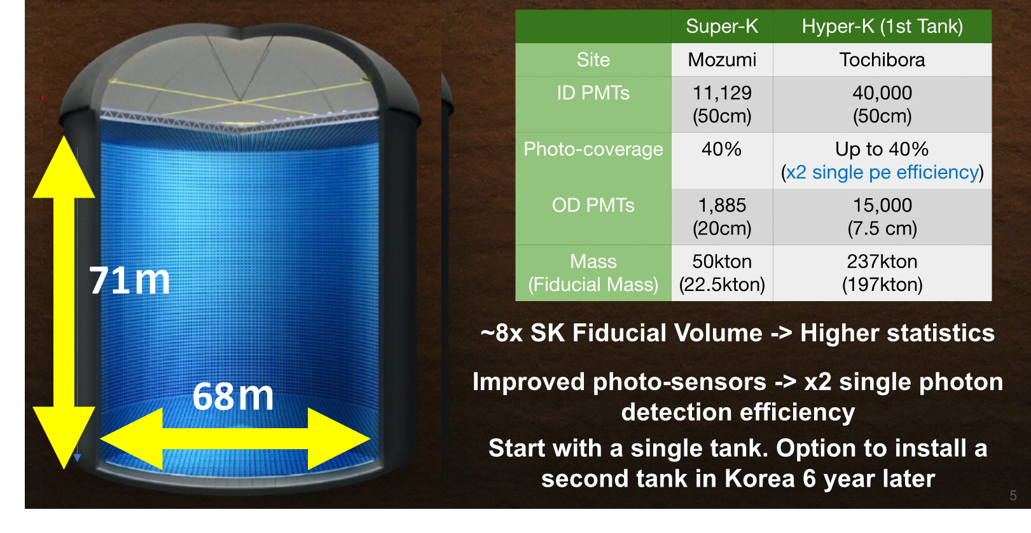
Hyper-Kamiokande
Hyper-K
detection efficiency and timing resolution
Start operation in 2027

Slide 5
Hyper-K Electronics and Synchronization System
Events are reconstructed from Cherenkov ring by means of PMTs. Time synchronization and digitization are essential.
This development group is presenting the whole chain.
The total number of PMTs is up to 50.000 read with more than 2.000 Front-End board.
Hyper-K is expected to be operated for >20 yrs. Long term stability and durability are essential.

Slide 6
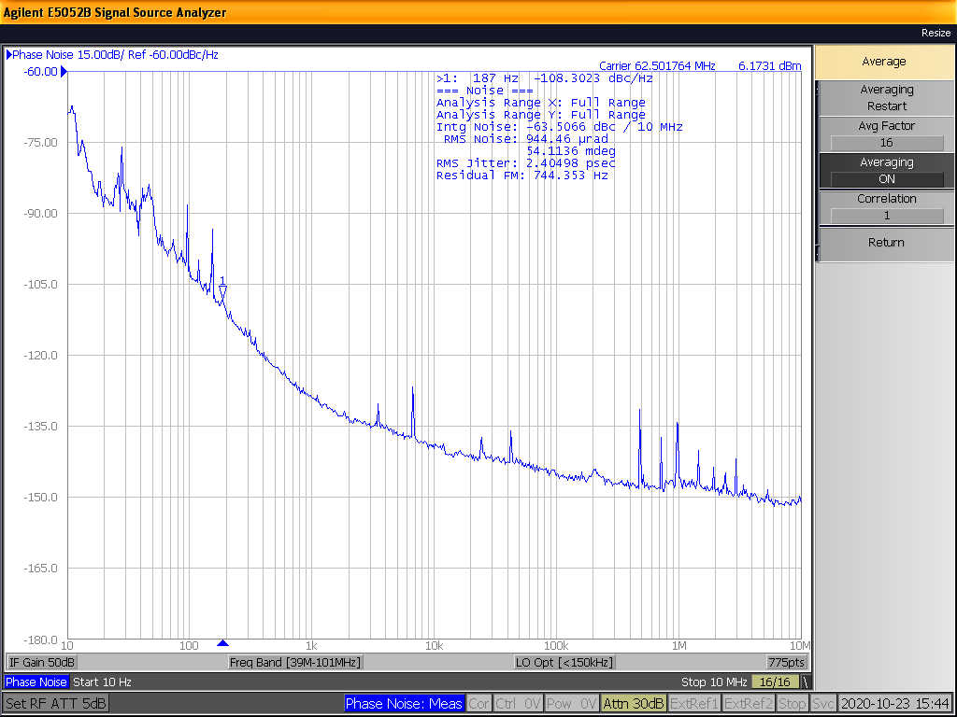
Time Distribution Full System Block Scheme
Total Jitter 2.4 ps
Proof of concept established, requirements meet, prototypes under development

Slide 7
First Integration Test
France-Japan joint effort
Test still ongoing total Jitter measure coming soon

Slide 10
Conclusions
IN2P3, CEA and University of Tokyo have established a very strong collaboration in spite of very difficult working conditions (pandemic).
The work is progressing following the plans and great results have already been achieved.
We look forward to restart traveling to speed-up even more our development
and integrated tests.

Slide 11
Backup

Slide 13
The Local Time Base
This study in collaboration with SYRTE Lab, part of the Paris Observatory (https://syrte.obspm.fr)

Slide 14


GNSS/UTC – Key components
Time distribution
GNSS receiver
Atomic
clock
Atomic Clock
Multi GNSS receiver and Antenna
Distribution system between Atomic Clock and GNSS receiver
Software correction for UTC correlation

Slide 15
The Time distribution Network

Slide 16
Requirements
Clock to all FE synchronous and phase deterministic with the source.
Jitter at FE < 100 ps.
Bidirectional data exchange link for critical slow control (100 Mbps minimum).
Extra bandwidth can be useful.

Slide 17
Time Distribution Basic Concepts
Two concepts are subject of our R&D:
  Direct distribution SK-like.
  Clock embedded into data (clock and data recovery concept)
    Custom solution
    White Rabbit

Slide 18
Direct distribution
Clock is sent directly on one dedicated fiber.
Time information is sent on another fiber in form of counters.
Master
Slave
Clk ? MHz*
Clk ? MHz*
Clk ? MHz*
0x0B
0x16
0x0B
0x16
0x0B
0x16
Data
Data
Data

Slide 19
Clock and data recovery
8b10b
encoder
Deserializer
(clock recovery)
8b10b
decoder
Serializer
Clk 125 MHz*
Clk 125 MHz*
Clk 1.25 GHz*
Clk 125 MHz*
1101001011
0110101011
0110101011
1101001011
10 possible
phases
0x0B
0x16
0x0B
0x16
Serial data 1.25 GHz*
Data 8bits
Data 10bits
Data 8bits
*Not in scale
The phase distance is only dependent on the lasers and fiber that connect the master and slave.
Temperature variations are negligible in our case
Custom solution
White Rabbit solution
The phase distance between the sent and reconstructed clock is continuously compensated

Slide 20
CERN White Rabbit
A possible architecture
2 Gbps Eth links
DAQ
2 Gbps Eth links
clock distribution edge
WR switch
WR switch
…
FE
FE
FE
FE
…
…
…
…
…
…
24
24
24
24
14
14

Slide 21
Custom Solution - 1
A possible architecture (same as WR)
2 Gbps Eth links
DAQ
2 Gbps Eth links
clock distribution edge
Custom Concentrator
Custom Concentrator
…
FE
FE
FE
FE
…
…
…
…
…
…
24
24
24
24
14
14

Slide 22
First R&D results

Slide 23
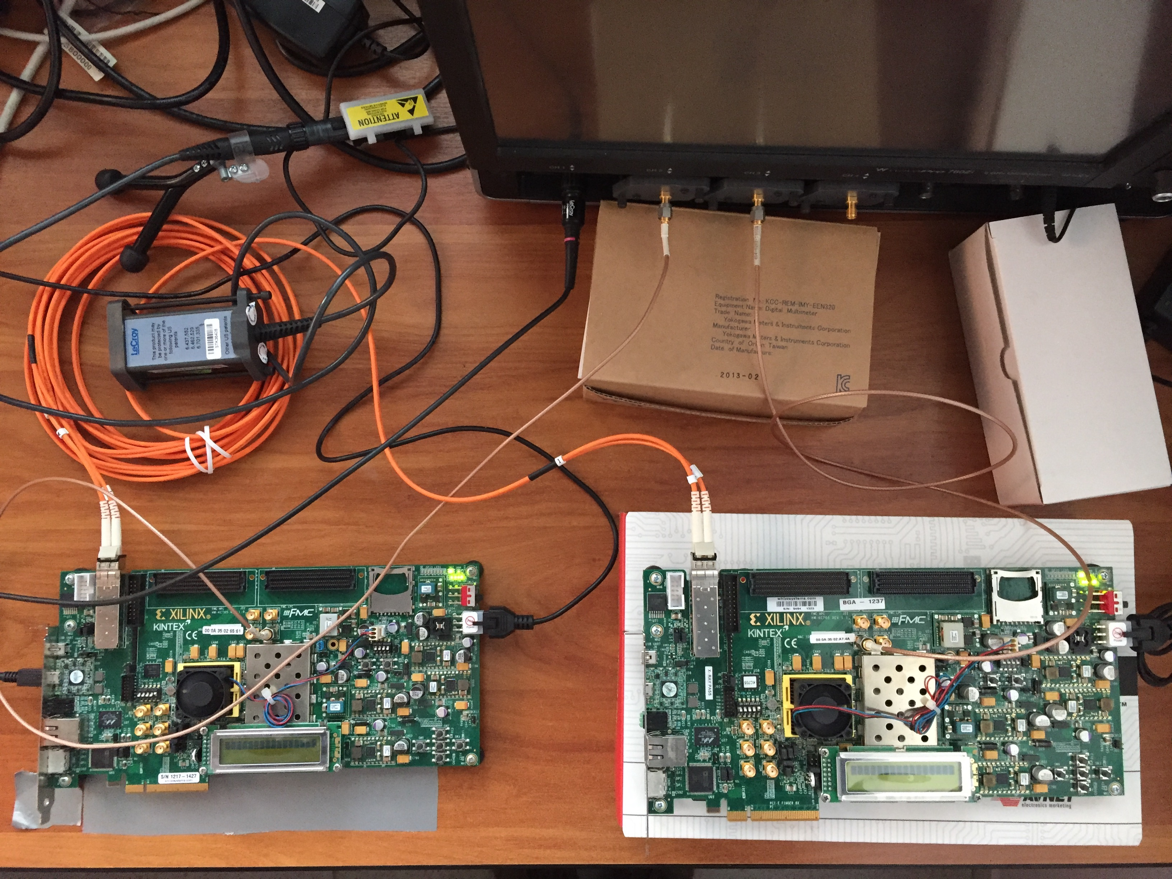
First Jitter Test on Custom Solution
Tx clk
Rx clk
Test done with 2 Xilinx EVB KC705
And the Lecroy scope
Wavepro 760Zi 6 GHz 40Gsps
RX board
TX board
The clock is sent embedded into data from the board on the right and reconstructed by the board on the left

Slide 24
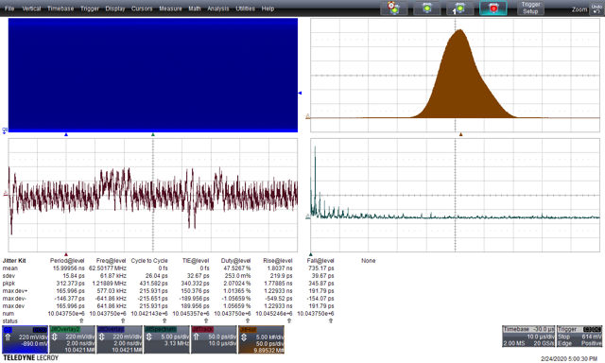
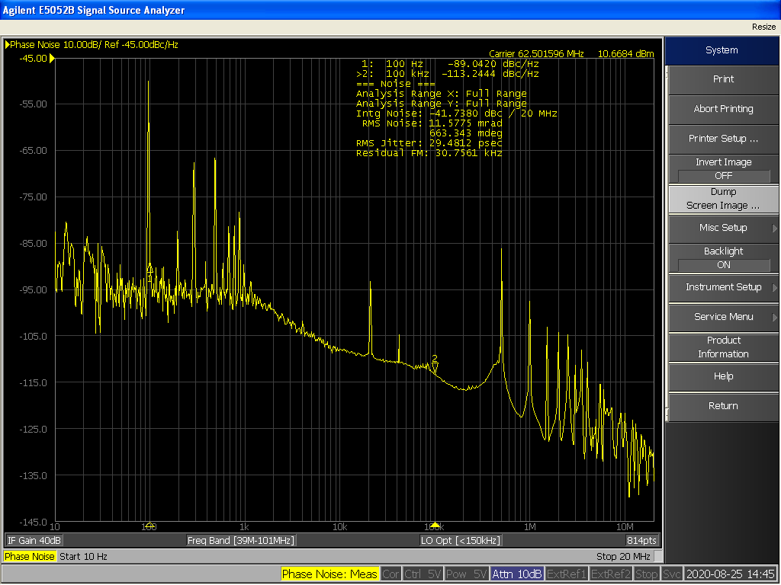
TX clock Time Interval Error
Time Domain
Frequency Domain
Time Interval Error 32 ps rms
RMS noise 29.5 ps
Noise at 500 kHz
and its harmonics

Slide 25
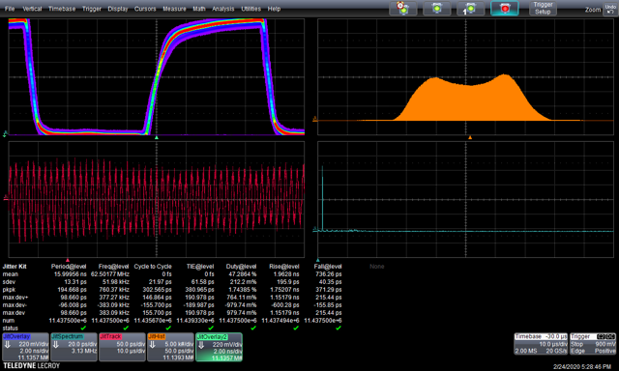
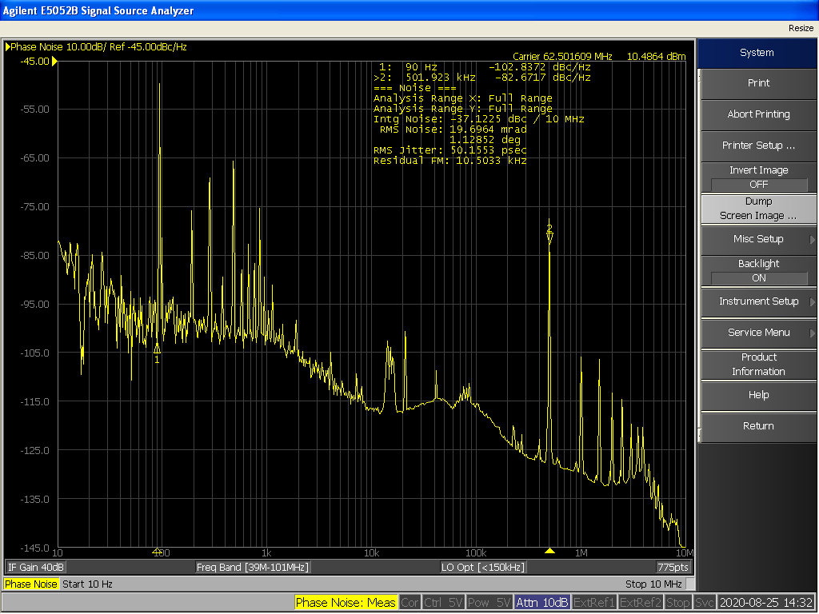
RX clock Time Interval Error (time domain)
Time Domain
Frequency Domain
Time Interval Error 61.5 ps rms
RMS noise 50.1 ps
More noise at 500 kHz and its harmonics
due to DC\DC modulation

Slide 26
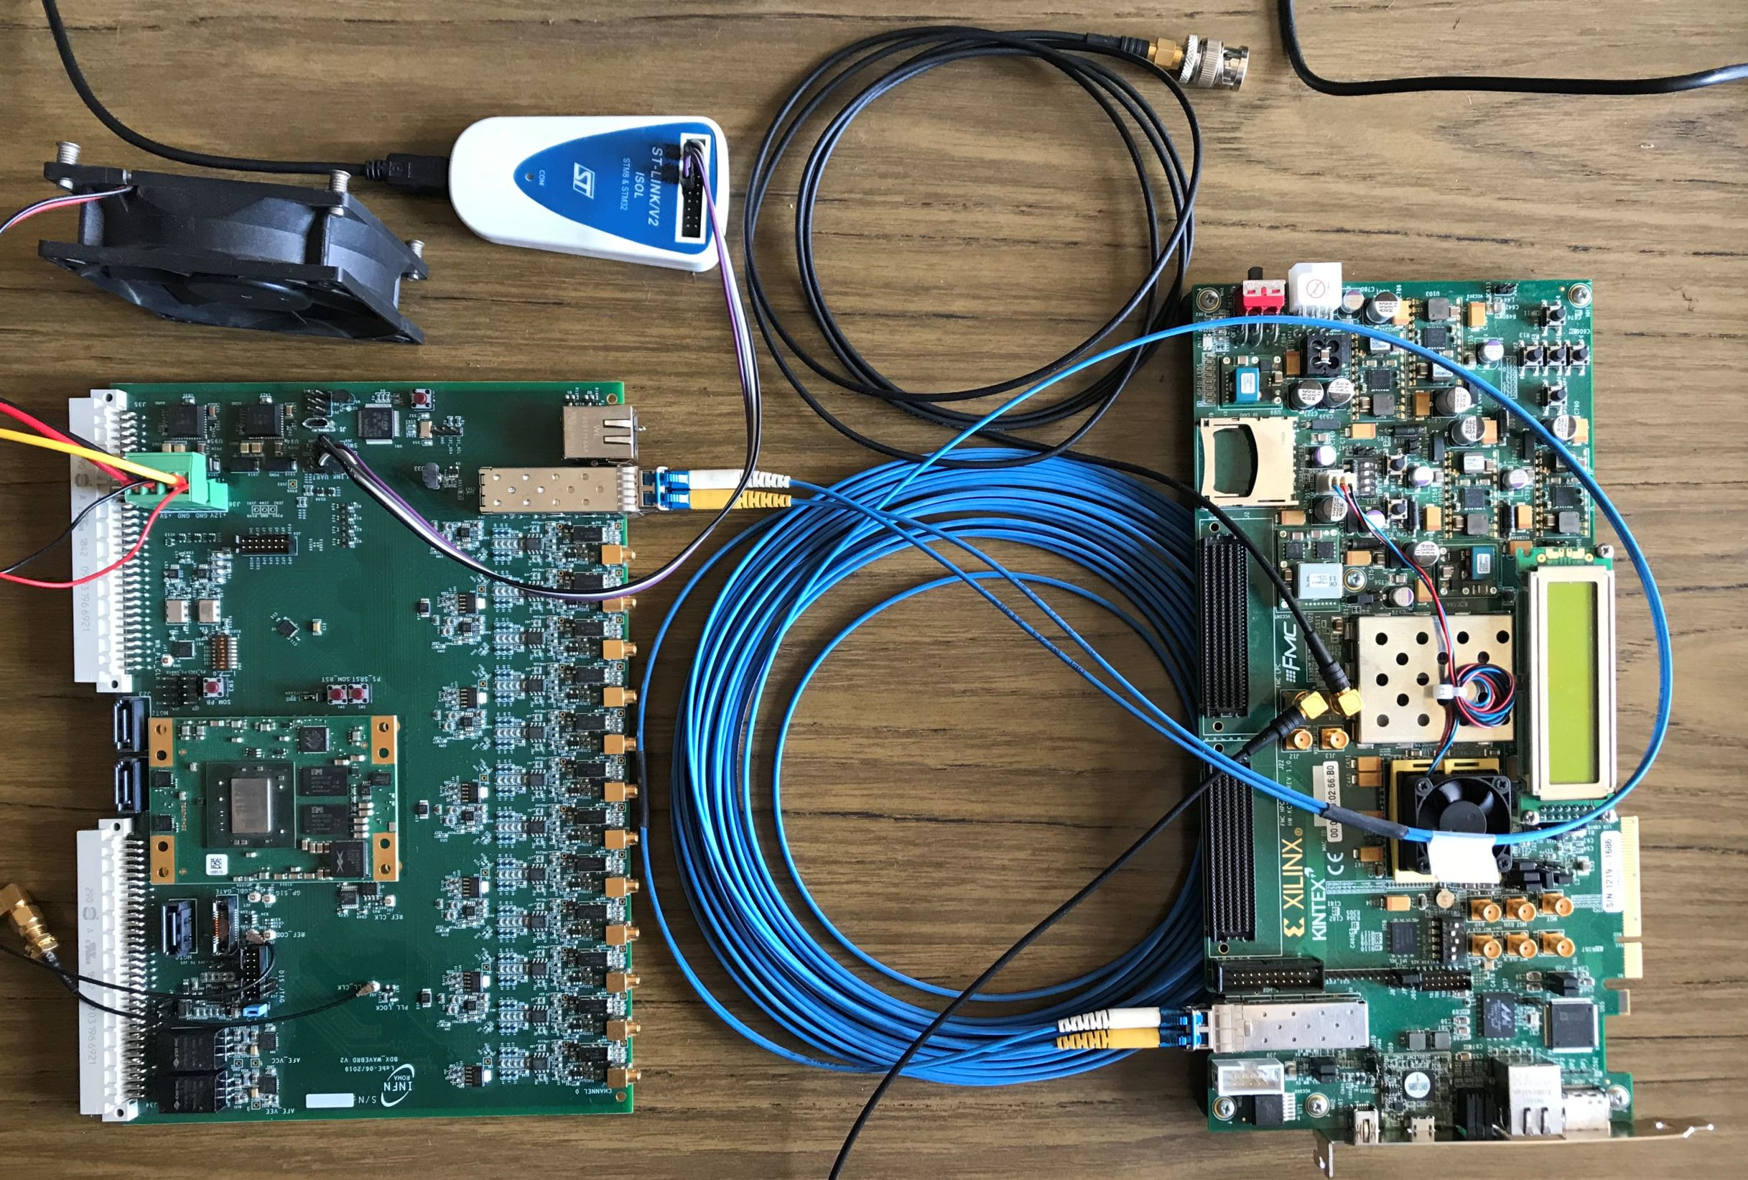
Custom solution: Jitter Test on KC705-Waveboard
TX board
RX board
The TX board is the same KC705 while the RX board is a custom board developed by INFN-Roma for BDX experiment (zynq 7000)

Slide 27
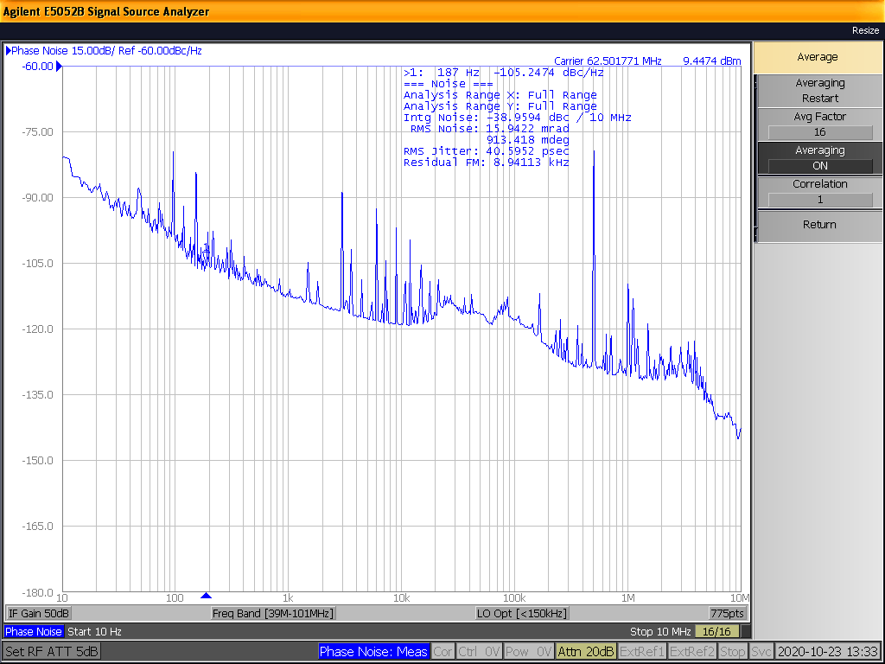
RX clock Time Interval Error (Frequency Domain)
Still noise at 500 kHz due to the TX side. There are no spurious from the RX board.
RMS noise 40.6 ps (with KC705 was 50.1)

Slide 28
RX clock Time Interval Error Cleaned by PLL
The received clock is sent to the jitter cleaner PLL SI5345 and its output is measured
RMS noise 2.4 ps

