Slide 1
ESCAPE & EOSC-Future towards the TSPs kick off
Giovanni Lamanna
LAPP/CNRS-IN2P3
ESCAPE-TSP internal meeting , 3rd May 2021
https://projectescape.eu/

Slide 2
E2F PMs
We all act within the ESCAPE (extended) consortium and participate to the EOSC-Future WP6 global aims.

Slide 3
E2F PMs
We all act within the ESCAPE (extended) consortium and participate to the EOSC-Future WP6 global aims.
EOSC-Future WP6 (ESCAPE) by partner
FAU | Kay Graf (kay.graf@fau.de) | 16,50
CNRS-LAPP | Giovanni Lamanna (giovanni.lamanna@lapp.in2p3.fr), Ian Bird (ian.bird@lapp.in2p3.fr) | 47,00
CNRS-CPPM | Paschale Coyle (coyle@cppm.in2p3.fr) | 6,00
CNRS-CDS | Mark Allen (mark.allen@ASTRO.UNISTRA.FR) | 10,00
CERN | Simone Campana (simone.campana@cern.ch) | 34,00
EGI LTP (NWO-ASTRON) | Michiel van Haarlem (haarlem@astron.nl), Zheng Meyer Zhao (meyer@astron.nl), Jason Hessel (hessels@astron.nl), John Swinbank (swinbank@astron.nl) | 39,00
EGI LTP (NWO-Nikhef) | David Groep (davidg@nikhef.nl) | 5,00
INFN | Tommaso Boccali (Tommaso.Boccali@cern.ch) | 20,00
Scuola Normale PISA | Elena Cuoco (elena.cuoco@ego-gw.it) | 24,00
Uni. Lund (CNRS-LAPP) | Caterina Doglioni (caterina.doglioni@cern.ch) | 24,00
Uni Amsterdam | Gianfranco Bertone (gf.bertone@gmail.com) | 24,00
Tot |  | 249,50

Slide 4
E2F PMs
We all act within the ESCAPE (extended) consortium and participate to the EOSC-Future WP6 global aims.
EOSC-Future WP6 (ESCAPE) by focus/task
SKA (NWO) | 24,00
Km3Net (FAU, CNRS, INFN, NWO) | 21,5
CTA (CNRS) | 23,00
LHC (CERN, Lunds Uni., CNRS) | 28,00
Darkside (INFN) | 10
Virgo (Scuola Normale, INFN) | 24
GW/Astro. (G. Bertone, S. Markoff) (Uni. of Amsterdam) | 24
Consolidation ESCAPE-WP5 (NWO) | 15,00
Consolidation ESCAPE-WP4 Virtual Observ. (CDS) | 10,00 | +10 in WP9
Consolidation ESCAPE-WP1 Tech Coor (LAPP) | 12,00
Consolidation ESCAPE-WP3 (FAU & LAPP & Scuola Normale) | 22
Consolidation ESCAPE-WP2 (CERN) | 18
EOSC-Future Management (LAPP) | 18
 | 249,50

Slide 5
E2F PMs
Further resources (PMs) not funded by EC are declared, expected or under discussions:
INFN : postdoc and data scientists PMs
LAPP/CNRS : postdoc and data scientists PMs
Lunds University/C.D. team: postdoc PMs
From other partners, e.g. CTAO/CTA Cons. (TBD)
From other experiments, e.g. Nuclear physics (TBC)
Cooperation with colleagues aiming to take part to the 2 corresponding JENAA EoIs and concerned by the
ESCAPE Open-Science VRE.
EOSC-Future partners (mainly pan-European e-infrastructures and national data centres)

Slide 6

6

Slide 7
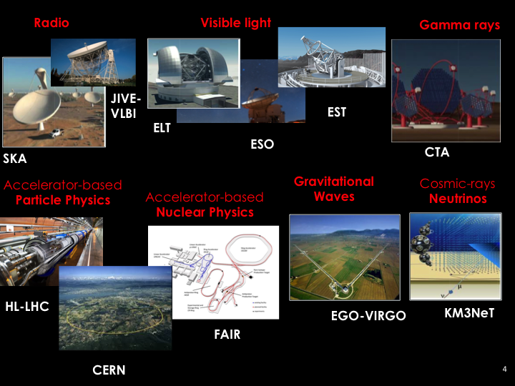
ESCAPE ESFRI projects, landmarks and a few more RIs

Slide 8
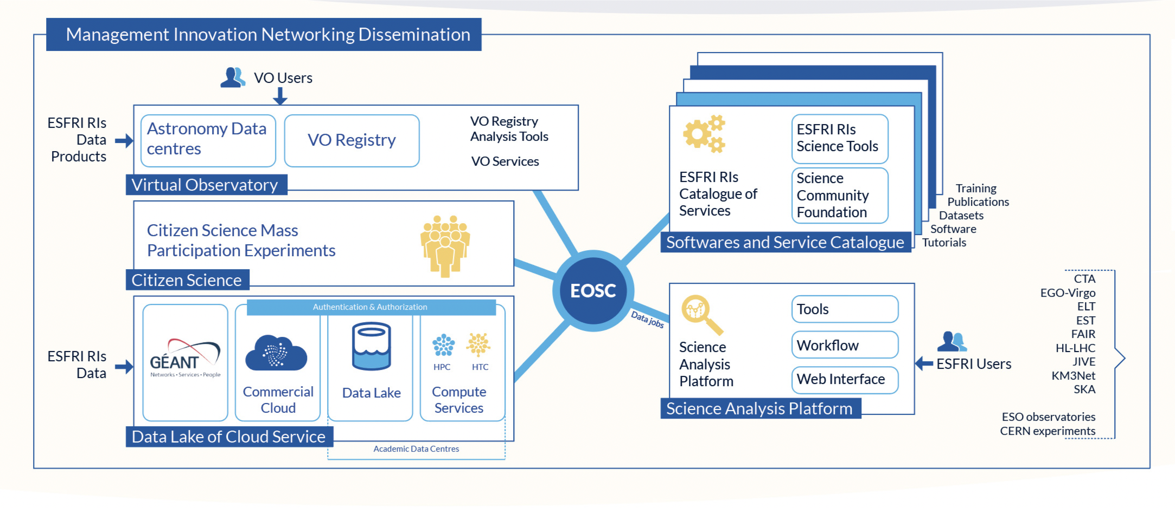
ESCAPE final goal: building a community-based EOSC cell
8

Slide 9


ESCAPE Work Programme
Data Lake:
Build a scalable, federated, data infrastructure as the basis of open science for the ESFRI projects within ESCAPE. Enable connection to compute and storage resources.
Software Repository:
Repository of "scientific software" as a major component of the “data” to be curated in EOSC. Implementation of a community-based approach for the continuous development of shared software and for training of researchers and data scientists.
Virtual Observatory:
Extend the VO FAIR standards, methods and to a broader scientific context; prepare the VO to interface the large data volumes of next facilities.
Science Platforms:
Flexible science platforms to enable the open data analysis tailored by and for each facility as well as a global one for transversal workflows.
Citizen Science:
Open gateway for citizen science on ESCAPE data archives and ESFRI community
9

Slide 10
ESCAPE TSPs participating to the JENAA EoIs
Dark Matter TSP:
understand the nature of dark matter by collecting data, analysis pipelines and results from complementary astronomy, particle and nuclear physics sources on a broad platform that will be ultimately be hosted on the EOSC Portal.
exploit synergies and complementarities across different communities, creating a unique link between dark matter as a fundamental science question and the Open Science ESCAPE services needed to answer it.
Extreme Universe TSP:
do ‘frontier’ multi-messenger science to understand extreme matter and particle processes in strongly curved space-time.
combine astronomy and e-infrastructures and focus on data organisation
organise data from different wavelengths/messengers - and different types of extreme astrophysical transients (SNe, GRBs, FRBs, TDEs) - so that they can be easily gathered, analysed and modelled holistically, and not remain fragmented as present.
Linked to two corresponding JENAA EoIs
(with already about 1000 subscribed scientists)
10

