Slide 1



High-resolution calorimetry for the FCC:
Motivations, possibilities and exploration for French involvement
Suzanne GASCON-SHOTKIN
Reunion FCC-Contacts
March 19, 2021 updated April 30, 2021
Remerciements: R. Aleksan, E. Auffray-Hillemanns, C. Dujardin, A. Iyer, K. Lebbou, M.T. Lucchini, C. Tully

Slide 2
The physics case for a high-resolution calorimeter for FCC (-ee): Measurements
Study of CP with
multiple-neutral modes
What’s behind it: Pairing of photons to accurately reconstruct π₀
M.T, Lucchini 4th FCC Workshop, Nov 2020
R. Aleksan, FCC-France Jan 2021
High-resolution calorimeter needed to
see signal
S. GASCON-SHOTKIN FCC-Contacts 19/3/2021
2

Slide 3
The physics case for a high-resolution calorimeter for FCC (-ee): Searches
Low-mass ALPs : Poor recoil mass resolution could fake a signal
R. Aleksan, FCC-Physics March 15 2021
What’s behind it: Brem recovery enabling Z→ee to achieve 80% of Z→mumu resolution
M.T, Lucchini 4th FCC Workshop, Nov 2020
PNGB close in mass to Z (background from ee fakes)
A. Iyer, FCC-France Jan 2021
S. GASCON-SHOTKIN FCC-Contacts 19/3/2021
3
Notes:
.

Slide 4
Improving the DR concept with a crystal or crystal-fiber ECAL (context: IDEA)
M.T, Lucchini 4th FCC Workshop, Nov 2020
S. GASCON-SHOTKIN FCC-Contacts 19/3/2021
4

Slide 5
Improving the DR concept with a crystal or crystal-fiber ECAL (context: IDEA)
M.T, Lucchini 4th FCC Workshop, Nov 2020
S. GASCON-SHOTKIN FCC-Contacts 19/3/2021
5

Slide 6
Improving the DR concept with a crystal or crystal-fiber ECAL: some options
PWO from CMS ECAL
Replace bulk crystals with crystal fibers for one or both ECAL layers. Advantages:
  Much higher transverse granularity possible (almost 1 order of magnitude: O(cm) vs O(mm))
  Dual-readout possible with ‘panachage’ of Cerenkov-emitting and scintillating fibers (Dual emission also possible for bulk, R&D ongoing to study best way to separate 2 components either through emission or timing separation) or with doped plastic fibers with dual emission media not dense enough for homogenous calorimeter
  Enables high-precision (10s of ps) timing while conserving excellent stochastic term (~bulk)~3%/sqrt(E) typical of homogeneous ECALs (R₀, X₀ material-dependent only)
  SiPM or PMT readout, limited degradation of resolution (see later)
  Mechanical ‘alveolar’ structure would have to be developed
Crystal fibers developed in Crystal Clear Collaboration (see later), ‘bundle’ concept for illustration purposes only
S. GASCON-SHOTKIN FCC-Contacts 19/3/2021
6

Slide 7
Improving the DR concept with a crystal or crystal-fiber ECAL: Readout with SiPMs
M.T, Lucchini 4th FCC Workshop, Nov 2020
S. GASCON-SHOTKIN FCC-Contacts 19/3/2021
7

Slide 8
Improving the DR concept with a crystal or crystal-fiber ECAL: Readout with SiPMs
M.T, Lucchini IAS2021, Jan 2021
S. GASCON-SHOTKIN FCC-Contacts 19/3/2021
8

Slide 9
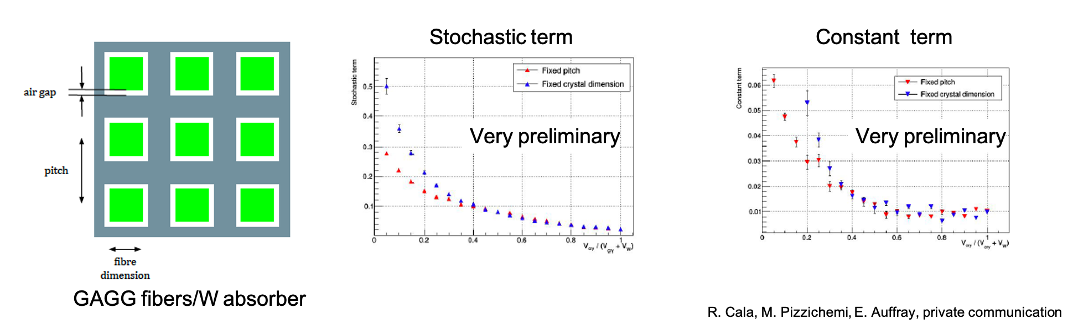
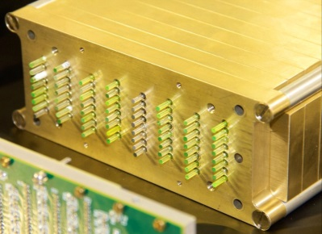
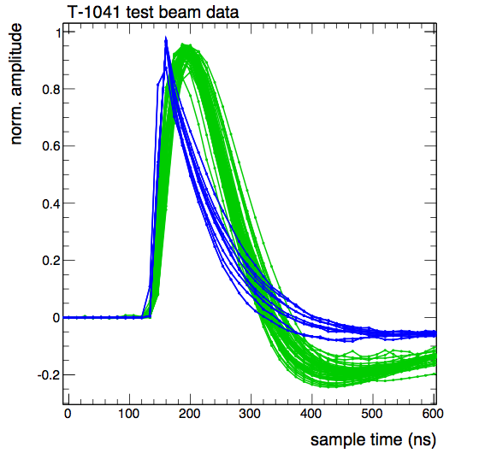


R&D Efforts at CERN and in France
Dr. Etiennette AUFFRAY-HILLEMANNS (Senior physicist, CERN): section leader of EP-CMX-Detector Applications Group and spokesperson Crystal Clear Collaboration (RD18)
Dual Readout developments
Beam
Cerenkov
(LuAG)
Scintillation (LuAG:Ce)
E. Auffray-Hillemanns, FCC-Physics March 15 2021+ private communication
R&D in CERN EP-RD WG3 calorimetry for LHCb calorimeter phase II upgrade
Simulation,
Good separation of
Scintillation & Cerenkov
S. GASCON-SHOTKIN FCC-Contacts 19/3/2021
9

Slide 10
R&D Efforts at CERN and in France
Institut Lumiere-Matiere (UMR 5306, UCBL-CNRS), Luminescence group: Dr. Kheirreddine LEBBOU (DR), responsible for Crystal Growth activity, and Prof. C. DUJARDIN, responsible for Scintillators & Phosphors characterisation activity
Cutting-edge research in bulk crystal, crystal fiber and nanomaterial scintillator production and characterization, large-scale fiber production capabilities with French industrial partners.
Historical collaboration within Crystal Clear Collaboration, most recenty on DR and SPACAL developments, ANR INFINHI (2010-2014) + ScintLab’ IRP Laureate (2020-2025)
S. GASCON-SHOTKIN FCC-Contacts 19/3/2021
10

Slide 11
Going forward: Possible FR participations
Historically much expertise in certain French HEP labs in R&D, production test and operation of large homogeneous high-resolution calorimeters: (L3 BGO, CMS PbWO₄….)
  IP2I: Development and characterization of photodetection devices and readout electronics (including ASICs)
  LLR: Development of mechanical structures and thermal sensors
  CEA IRFU: Development of sophisticated crystal transparency monitoring systems with lasers
Already a strong history of collaboration with E. Auffray-Hillemanns (CERN-EP-CMX-DA group) on CMS and within Crystal Clear Collaboration (interest in timing from CCC member C.Morel (CPPM))
could join with:
ILM (UMR 5306, UCBL-CNRS), Luminescence group: C. Dujardin and K.
Lebbou, a unique national resource, very interested in participating (invitation wkshp)
Discussions with consequential US community (colleagues from L3/CMS): ‘CALVISION’ Consortium DoE proposal (CALorimetry using cerenkoV and Inorganic Scintillation InnOvatioN)
Note IHEP group from Beijing (mostly working on bulk crystals currently)
S. GASCON-SHOTKIN FCC-Contacts 19/3/2021
11

