Slide 1
ECFA R&D roadmap, and introduction to Solid State devices requirements
FCC-contacts meeting, 30/04/2021
D. Contardo

Slide 2
ECFA R&D roadmap mandate
Request of the European Particle Physics Strategy Update 2020:
https://europeanstrategyupdate.web.cern.ch
ECFA roadmap process:
https://indico.cern.ch/event/957057/
Existing documentation:
ESPP Briefing book https://arxiv.org/abs/1910.11775
DOE Basic Research Needs Study for HEP: https://science.osti.gov/-/media/hep/pdf/Reports/2020/DOE_Basic_Research_Needs_Study_on_High_Energy_Physics.pdf

Slide 3
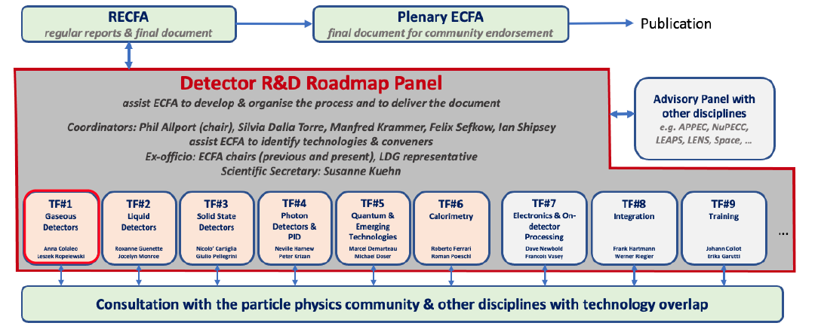
ECFA R&D roadmap process
8 Task forces to collect feedback from the community: 2 co-conveners and a panel of experts
https://indico.cern.ch/event/957057/program
Expert panel
D. Contardo
Expert panel
C. de la Taille
Co-convener J. Collot
Great material resource
06/05/2020
Co-convener R. Poeschl 07/05/2020
A session on “Input from future facilities” restricted to conveners and group of experts:
but material public here: https://indico.cern.ch/event/957057/page/21634-input-from-future-facilities
A public symposia for each task force: https://indico.cern.ch/event/957057/program
A list of questionnaires for national contacts and the community: https://indico.cern.ch/event/957057/page/21912-questionnaires

Slide 4
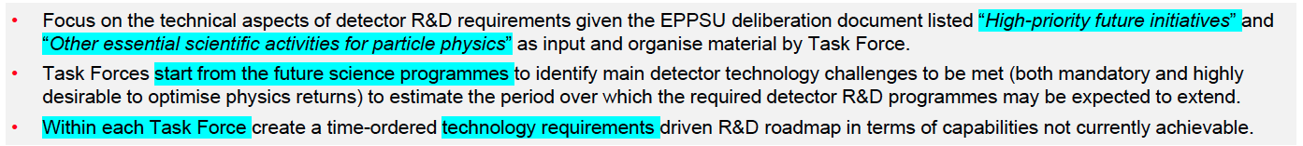
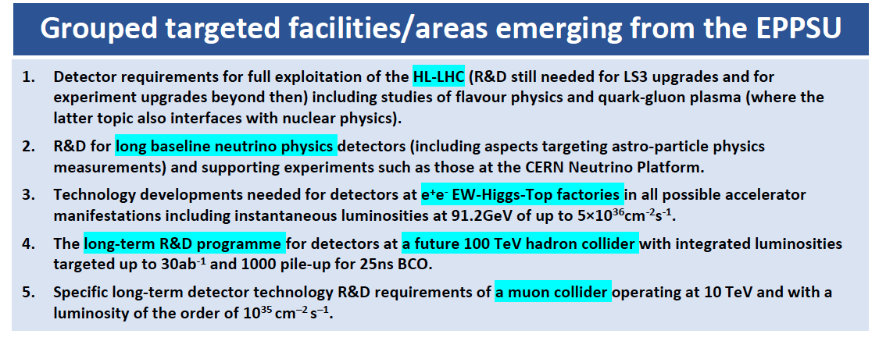
ECFA R&D roadmap focus

Slide 5
ECFA R&D roadmap focus

Slide 6
ECFA R&D roadmap timeline
J.C. Brient
D. Contardo
IN2P3 prospective:
GT08: https://indico.cern.ch/event/957057/program
“ Colloque de restitution” at Giens, 20 – 23 Oct. 2021

Slide 7
Discussion today on the status of solid state detectors for the first step of TF3 work:
  Timeline of needs according to the list of targets identified by ESPP (slides 4-5)
  Based on the talk I gave at the TF3 symposium
Requirements for future solid state devices at accelerator experiments
ECFA roadmap detector R&D, TF3 solid state devices symposia
D. Contardo, 23/04/2021

Slide 8
Outline
More than 20 projects presented in session of “input from future facilities”: https://indico.cern.ch/event/957057/page/21634-input-from-future-facilities
Here a snapshot of most demanding requirements, timescales and technology approach
  Future collider experiments are representative of needs, hence the focus of this talk

Slide 9
Project timescales for new solid sate devices
Projects | Timescale | Vertex Det. | Tracker | Calorimeter | Time of Flight
Panda (Fair/GSI) | 2025 | ✓
CBM (Fair/GSI) | 2025 | ✓
NA62/KLEVER | 2025 | ✓
ALICE | 2026-27 (LS3) – 2031 (LS4) | ✓ | ✓ | ✓ | ✓
Belle-II* | 2026 | ✓ |  |  | ✓
LHCb | 2031 (LS4) | ✓ | ✓
ATLAS-CMS | 2031 (LS4) - 2035 (LS5) | ✓ |  |  | ✓
EIC | 2031 | ✓ | ✓ | ✓ | ✓
ILC | 2035 | ✓ | ✓ | ✓ | ✓
CLIC | 2035 | ✓ | ✓ | ✓ | ✓
FCC-ee | 2040 | ✓ | ✓ | ✓ | ✓
Muon-collider | > 2045 | ✓ | ✓ | ✓ | ✓
FCC-hh | > 2050 | ✓ | ✓ | ✓ | ✓
Projects representative of most demanding requirements, timescales reflect target for installation/start of operation – progress in specifications and state of approval can be at different stages**
  R&D completion typically ≃ - 5 years for construction, and including typically ≃ 5 years system engineering on top or in // to technology demonstration***
  Upgrade programs earlier than future colliders provide opportunities to iterate technologies and mature systems in real operation environments
* Belle-2 may have another upgrade in 2030
** Alternative technology options are also considered for calorimetry and time of flight
*** To minimize time and cost several parameters need to be tested at once in few prototype iterations

Slide 10
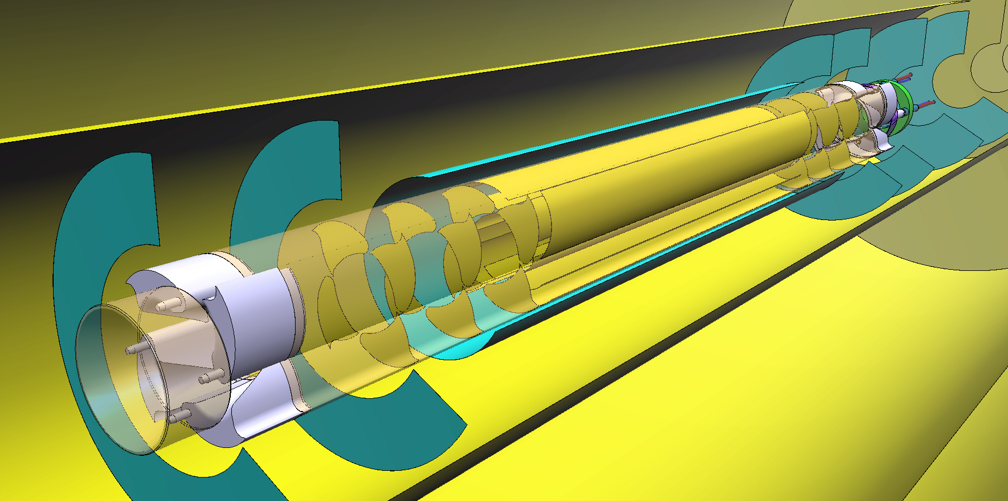
Vertex Detectors high position precision
Most demanding are ALICE and ILC, CLIC, FCC-ee colliders
  FCC-ee target: σ(d₀)/d₀ ≃ 2(20) µm at 100(1) GeV (90∘), flavor physics benefit with higher precision
Drivers are hit position precision (σ_{hit}), multiple scattering (X/X₀), layer configuration*
  ALICE ITS3 target: σ_{hit} ≃ 3 µm, X/X₀ ≃ 0.05% / layer
    10-20 µm pixel pitch, thickness down to 20 µm**
    12” wafers (10 x 28 cm sensors), power ≃ 20 mW/cm² for gas flow cooling (TF7 and TF8)
MAPs with stitching process in 65 nm node (TowerJazz)
digital part of readout could be outside acceptance
Retractable concept to approach beam at 5 mm inside Beam Pipe
No PCB
From C. Gargiulo TF8 Symposia
ALICE ITS2: ALPIDE 30 µm pitch, 50 µm thick, σ_{hit} ≃ 5 µm, X/X₀ ≃ 0.3% / layer (of which only < 20 % from sensors, 16 mm bending test encouraging
* Beam pipe X/X₀ can depend on operating condition, ex x 2 thicker for FCC-ee compared to ILC for beam background reduction
** Charge sharing is an optimization of pitch, active thickness, pixel design and process, track angle, B-field

Slide 11
Vertex Detector medium rate & timing* requirements
ALICE, CBM** (Fair), Belle-2***, EIC, ILC, FCC-ee Colliders rates ≲ 100 MHz/cm²****
  Achieved in MAPS demonstrators with different power: ex. ALPIDE ≃ 40 mW/cm² at ≃ 10 MHz/cm², MIMOSIS (CBM) ≃ 60 mW/cm² at ≃ 70 MHz/cm²…
ALICE Run-4, CBM, EIC, ILC, FCC-ee timing precision ≃ 1 – 10 µs
  Existing systems, consistent with power consumption of above examples
Belle-2, ALICE-run-5 timing precision ≃ 100 ns, Panda (Fair) ≃ 10 ns
  Achieved in MAPS demonstrators, but more challenging for power consumption
Power consumption is a challenge to go down to ≲ 0.1 % X/X₀ per layer *****
  Technology node, power distribution and readout architecture (see also TF7)
    Large size sensors is a new territory
* “Medium” range is relatively large, exact specifications are driven by background rates defining number of integrated bunch crossing, options
exist to go down (or closer) to BC timestamps: ILC 0.5 µs, ALICE 25 ns, FCC-ee 20 ns (at Z), Belle-2 4ns
Also driving readout architecture: ALICE, CBM, ee-colliders w/o trigger, options w/ for ALICE and FCC-ee; Belle-2 w/ trigger
** CBM also considering stitching, 180 and 65 nm
*** Belle-2 considering current 180 nm TJ technology at this stage (eg σ_{hit} ≃ 5 µm, X/X₀ ≃ 0.1%)
**** Ballpark value, each experiment is different and architecture for power dissipation can be different
***** Power pulsing to lowering consumption possible at ILC and CLIC

Slide 12
Vertex Detector high rates & medium/high timing requirements
NA62, LHCb, ATLAS, CMS, CLIC rates ≃ 1 to 5 GHz/cm², timing precision 25 ns to resolve BC at LHC, 5 ns for beam background CLIC*, NA62 & LHCb ≲ 50 ps**
  ATLAS - CMS replacing inner layers (for radiation tolerance) can benefit from tracking precision improvement and also ≲ 50 ps timing for physics precision and pile-up mitigation
Challenge to reach GHz with current MAPS node (> 100 nm), also to reduce pitch below 50 µm at these rates in hybrid technology (≃ limit with RD53 65 nm technology) and/or to implement high time resolution (TF7)
  28 nm node technology MAPS (for high rates) and ASICs (to reduce hybrid pitch)
  3D integration also an option for both technologies, hybridization at low pitch
* Bunch Crossings at CLIC every 0.5 ns
** Consider 2D/3D/LGAD hybrid sensors with 65-28 nm technology, LGADs not in small pitch yet and not yet rad. tol. at level of LHCb

Slide 13
Vertex Detector radiation tolerance
ALICE, CBM, BELLE-2, EIC, ILC, CLIC, FCC-ee: NIEL ≲ 10¹⁵ neq/cm² and TID ≲ 100 MRad
  Well within HV-CMOS radiation tolerance*
LHCb, ATLAS, CMS: NIEL ≃ 2-5 10¹⁶ neq/cm² and TID ≃ 1 Grad
  Marginally compatible with current hybrid technology requiring - inner layer replacement(s)
  Limiting ability for low radius and forward η coverage
Challenge to enable MAPs to these levels (ex to be considered in ATLAS/CMS inner layer replac.)
  Lower technology nodes (65 nm – 28 nm)… process-design developments
Improvements of hybrid technology (would benefit LHCb)
  Smaller pitch and thinner planar/3D sensors, improved process and design
  Lower ASIC node 28 nm
* Even consistent for ILC, CLIC and FCC-ee with standard process rad. tol. ≃ 10¹³ MeV neq/cm² and TID ≃ 3 MRad

Slide 14
Tracker transverse momentum (p_{T}) precision
Most demanding are ILC, CLIC, FCC-ee
  Initial FCC-ee target: σ(p_{T})/p_{T}² ≲ 5 x 10⁻⁵ GeV⁻¹ p_{T} ≳ 100 GeV (90∘), not yet Beam Energy Spread limit at Z-peak energy
Drivers are: number of measured hits & position precision (σ_{hit}), B-Field* and lever arm, multiple scattering (X/X₀)
CLD and IDEA FCC-ee concpets
90º
DC volume
Different detector concepts
  Full Si, O(10) hits high σ_{hit}
  TPC/DC, O(100) hits low σ_{hit} with Si wrap-up layer at r_{out} (for high σ_{hit} at large lever arm)
σ(p_{T})/p_{T} = ap_{T} ⊕ b/sin^{1/2}(θ)
BES @Z
F. Bedeschi at FCC week Jan. 2020
* FCC-ee B-field limited to 2T at Z-peak, can be higher at other energies; ILC -CLIC at 3T

Slide 15
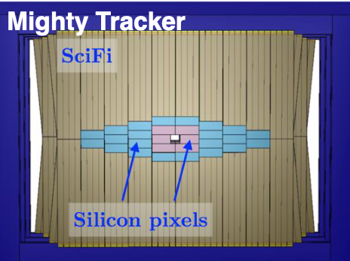
Tracker sensor requirements
Ballpark optimization target: σ_{hit} ≃ 7 µm at ≃ 1% X/X₀ per layer
  Longitudinal granularity and coordinate precision is not constraining
    eg strip-sensor are well suited (so far with hybrid technology)
  Large area layers require powerful cooling & relatively strong mechanical supports (TF8)
    X/X₀ (limiting factor to σ_{hit} benefit) is more difficult to minimize than in VD
MAPS large area trackers can be a new paradigm to improve σ_{hit} and X/X₀
  Present radiation tolerance of HV-CMOS is sufficient for inner radii in LHCb tracker layers
  Stitching for sensor size, longer pixels and/or grouping of pixels preserving low power
LHCb post LS4: first large scale application 30 m²
Alice 3 (LS4) – MAPS 20 µm pitch - BC timing 25 ns - 10¹³ neq/cm²
UT upstream magnet 6 m²
MT at low r within SciFi 20 m²
50 x 150 – 100 x 300 pitch
≲ 5 x 10¹⁴ neq/cm²

Slide 16
Time of Flight precision requirements
Particle Identification (PID) dedicated layer(s)
  ALICE 3 (post LS4), targeting σ_{t} ≃ 20 ps for 3σ π/K up to 5 GeV/c
  Belle-2, FCC-ee similar requirement to cover dE/dx crossing at low P, better resolution highly desirable to extend PID potential to higher P
4D tracking for track collision time association
  Dedicated layer(s) or implementation in VD and/or tracking layers*
  ATLAS/CMS HGTD/MTD σ_{t} ≲ 30 ps (pile-up mitigation) desirable for high η LGADS replacement in LS4-LS5 (for rad. tol.)
  LHCb pile-up mitigation for vertex precision
  Options for e-e colliders to reduce beam backgrounds and improve 1st, 2nd, 3rd vertices identification, to be balanced with impact on X/X₀
  FCC-ee at σ_{t} ≃ 6 ps can allow to correct √s variation within bunches
Develop designs with fast signal collection, small stochastic fluctuation
  w/o amplification (MAPS, Hybrids 2D/3D)**, w/ amplification LGADS***, SPADS (TF4)
  Improve radiation tolerance, develop LGADs with pixel pitch,
Develop fast FE (TF7)
  Pre-amp with similar rise time as signal, high resolution TDC and clock distribution, with low power in high channel density (technology nodes 65 – 28 nm)
ALICE
FCC-ee
* Number of layers in tracking systems would improve track time resolution, also for PID
** NA62 VD achieved σ_{t} ≃ 100 ps and CMS HGC σ_{t} ≃ 50 ps with current 2D hybrid sensor technology
*** Currently σ_{t} ≃ 25 ps limited by Landau fluctuation

Slide 17
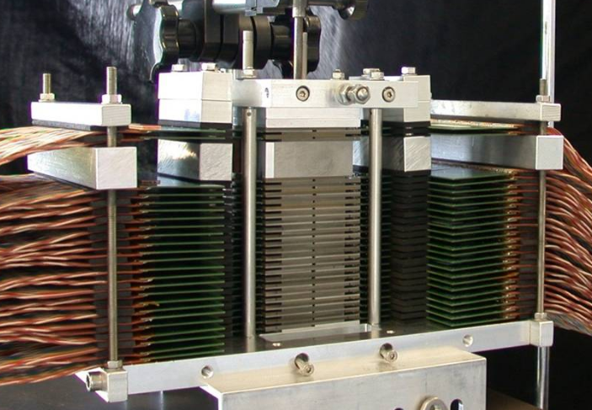
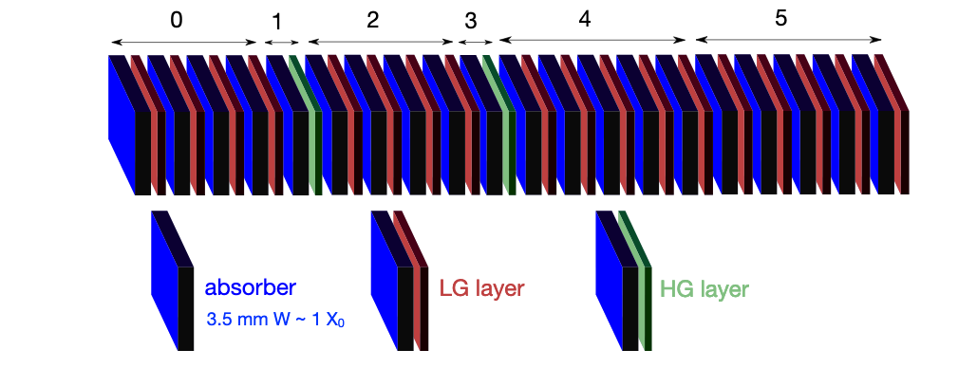
Calorimetry requirements
ILC, FCC-ee EM calorimeter sections*
  PFlow concept: energy of charged particles from tracker, minimize overlaps of showers with fine transverse granularity, allow dynamic em/had compensation
  & calibration corrections with high longitudinal granularity
  CALICE (ILC) 2500 m² of Si-sensors in 30 layers embedded in W absorber, hybrid sensor with 5 x 5 mm² pads, high dynamic range analog readout, energy resolution measured with realistic prototypes:
    σE(EM)/√E ≃ 16%/√E ⊕ 1% - σE(had)/√E ≃ 44%/√E ⊕ 2% - σE/E Jets ≃ 3.5 % (50 GeV) jets
  High time resolution potential not yet exploited to consider shower time development**
Challenge to improve sampling fraction for EM energy resolution (TF6)
  Monolithic pad design, 3D integration, new power distribution, photonics could help (TF7)
MAPS digital layers for particle counting*** could be a new paradigm
  ALICE (LS3) FOCAL foresees a heterogenous design
Calice Si/W prototype
* also small size beam/lumi. calorimeters in very forward regions ** σ_{t} ≃ 50 ps demonstrated for CMS HGC
*** Could also allow improving shower simulation parameters
MIMOSA MAPs prototype
20 layers, 4 x 4 cm²

Slide 18
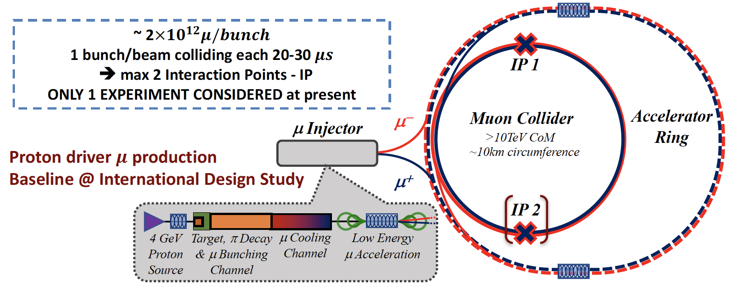
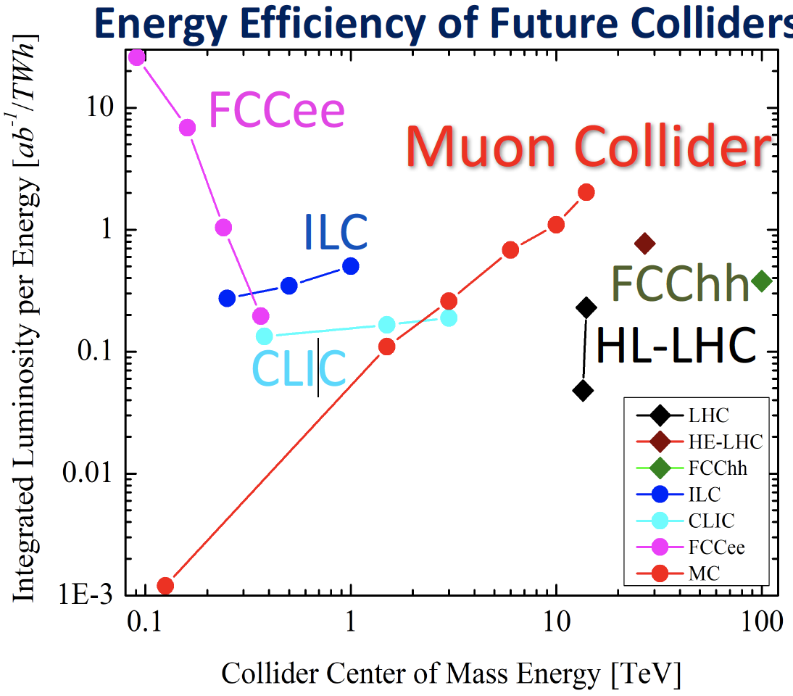
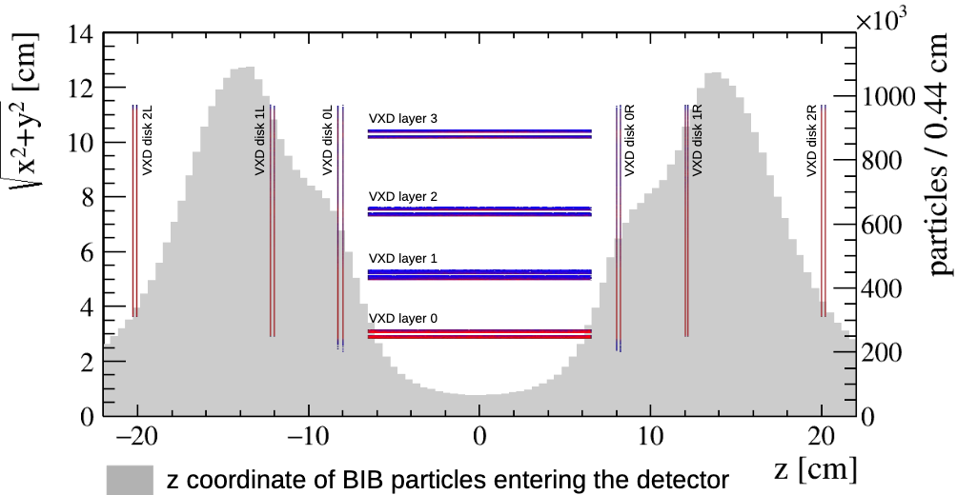
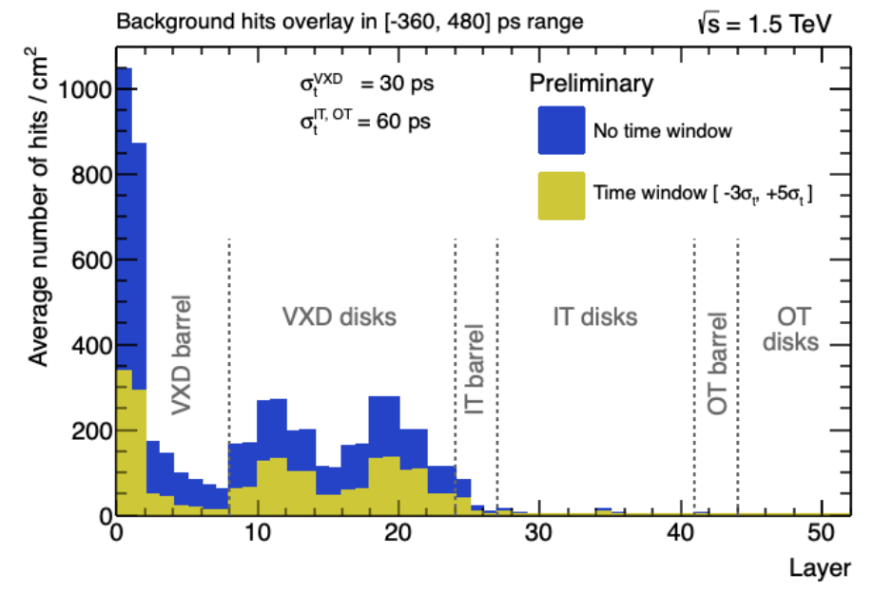
Muon collider
Luminosity 2 x 10³⁵ cm⁻²s⁻¹ at 10 TeV
Challenge in high rate continuous Beam Induced Background from muon decays interacting in machine elements
General requirement for VD and tracker at ILC, CLIC, FCC-ee apply, with special configuration for background rejection
  Barrel length - doublet sensor concept (CMS-p_{T} like modules) to reject non IP pointing tracks
  σ_{t} ≃ 10 ps to eliminate out of time hits
Fluence preliminary estimates indicate that NIEL could be beyond current HV-CMOS MAPS capability
High granularity and timing performance also required in calorimeters for background rejection

Slide 19
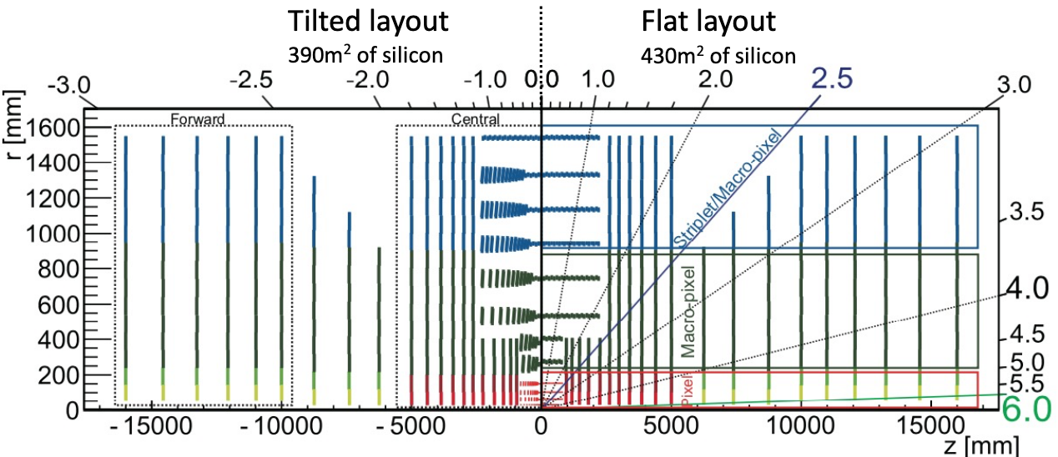
FCC-hh requirements
New territory of operation conditions
  L = 30 x 10³⁴ cm⁻² s⁻¹ – 30 GHz of collisions - 1000 per BC - 30 ab⁻¹ integrated
  Physics coverage up to η = 6
Tracking requirements
  <0.4> ps vertex separation and <130> µm
  ≃ BP MS resolution limit for 1 GeV/c p_{T} at η = 2
  Track rates 30 GHz/cm² (r = 2.5 cm)
  Granularity close to FC-ee with pitch ≃ 25 µm
  Precision will be limited by ability to minimize X/X₀
  σ_{t} ≃ 5 ps would be required to recover HL-LHC like effective pile-up
  Fluence 10¹⁸ neq/cm² and TID 30 GRad at 2.5 cm*
New paradigms needed for radiation tolerance**
  R < 30 cm out of reach of currently used hybrid sensor technologies
  Current MAPS and LGADS marginally at level of rad. tol. for outermost layers
New paradigms needed for rates (TF7)**
* Forward calorimetry requires up to x 2-5 higher rad. tol. – timing at similar level as for tracking could also be needed to mitigate pile-up
** HE-LHC @ 2 HL-LHC would also need new technologies

Slide 20
Summary
More detailed summary of requirements and timescales for new features can be prepared
  Current requirements are not in asymptotes of physics performance
  They can top-up from one project to another according to combined technical progress
    Ex. improvement of IP - p_{T} precision is typically a compromise of hit position precision & X/X₀,
    Low power consumption at high rates and/or high timing resolution can further enable measurement precision and background rejection
Candidate technologies and developments in following talks of this symposium

Slide 21
Some projects not discussed but presented at input session
Amber (successor of COMPASS): new paradigm to operate at cryogenic target, timeline 2026 – MAPS candidate, challenge for cooling and electronics (TF7 – TF8)
NA60+ 2025 (LS3) VD interest in large size MAPS (stitching) of similar performance as for other projects
TauFV at CERN: VD very similar to LHCb upgrade-2, possibly shorter timescale 2026-2027
Mu3e PSI: VD with MAPS possible upgrade on timescale 2026

