Slide 1
Dynamics and Thermic of the natural nuclear reactors of Oklo
Dynamique et thermique des réacteurs nucléares d’Oklo
By Gautier Daviau

Slide 2
Outlook
Introduction
Models studied
Application: Inter-reactor effects

Slide 3
Outlook
Introduction
Models studied
Application: Inter-reactor effects

Slide 4
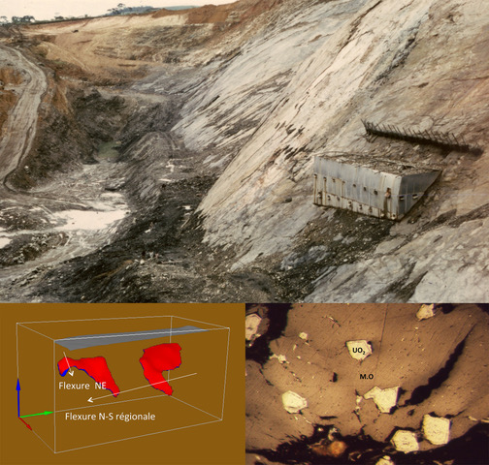
Discovery Of Oklo

Slide 5
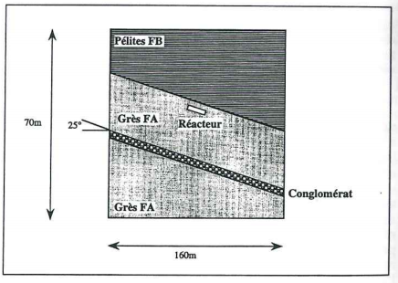
What are natural nuclear reactors ?
Inception
Uranium deposit with MO
Layered Structure
2 billon years was 2 km deep
45°-degree angle for the MO
Operating reactor
Temperature anti-reactivity
Pressure to keep the water inside
Need a stable poison/fuel usage to stay on
Compaction from the desilification

Slide 6
Internship’s aims
Simulation of the inception of a reactor
Simulation of the dynamics of the operating reactor: Desilification and Compaction
Reactor to reactor interactions

Slide 7
COMSOL Multiphysics

Slide 8
Outlook
Introduction
Models studied
Application: Inter-reactor effects

Slide 9
Structure of the Simulations
Inception
Diffusion of the Organic Matter
Fixation of the Organic Matter
Diffusion of the Uranium
Fixation of the Uranium
Operating reactor
Neutronics model (point kinetics)
Thermals model
Desilification
Diffusion of the silica
Compaction

Slide 10
Inception Model

Slide 11
Simulation’s Initialization
2D
Column structure
Sandstone+ conglomerate
Arbitrary concentration: gaussian
Better mesh around the reactor

Slide 12
Simulation of the diffusion
Equations from COMSOL
Equations used
c is the concentration, epsilon is the porosity, s the saturation, rho is the mass of the matter dissolute, De is the diffusion factor. R and S are the terms for the reactions and the sources. U is the velocity field.

Slide 13
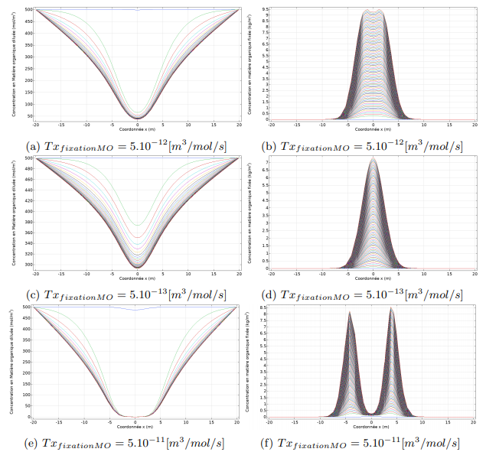
Results of the diffusion of Organic matter

Slide 14
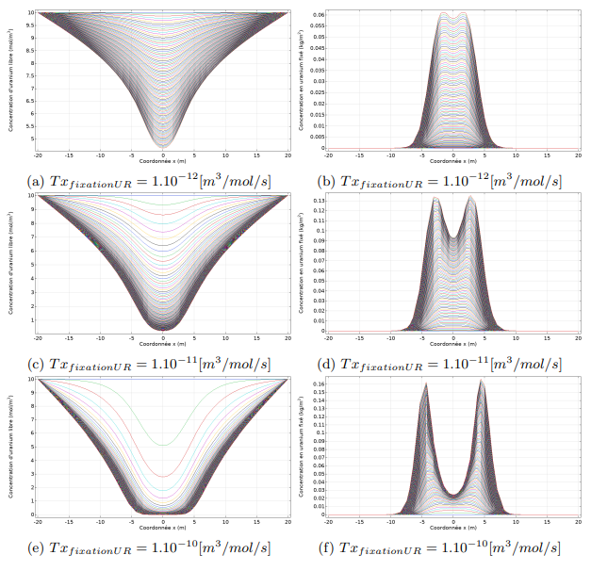
Results of the diffusion of Uranium

Slide 15
The neutronics Model
Equations of point kinetics
Power of the natural reactor
n is the number of neutrons, Beta is the total delayed neutron fraction, rho is the reactivity, xf is the average energy released per fission, Lambda is the mean generation time.

Slide 16
Operating reactor Model

Slide 17
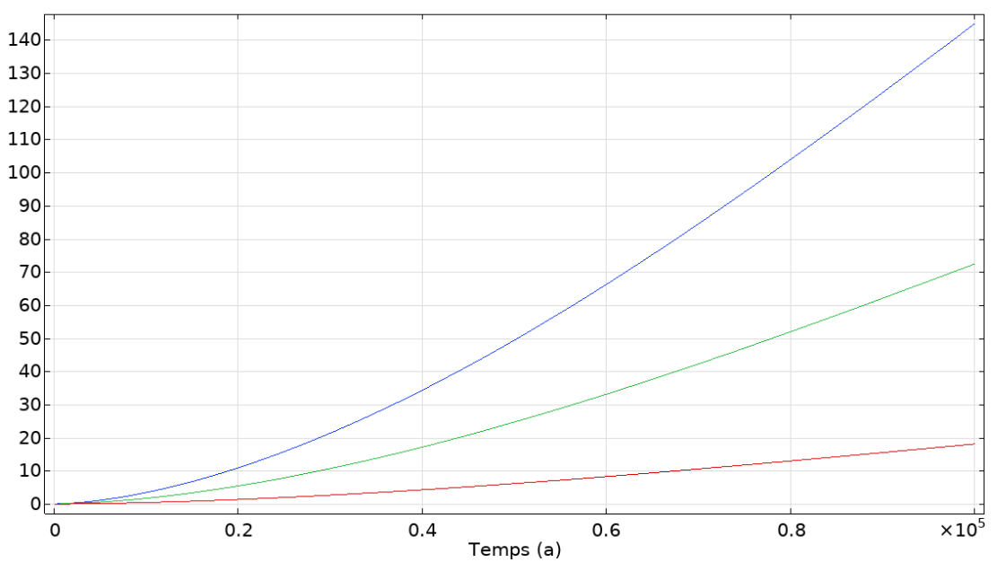
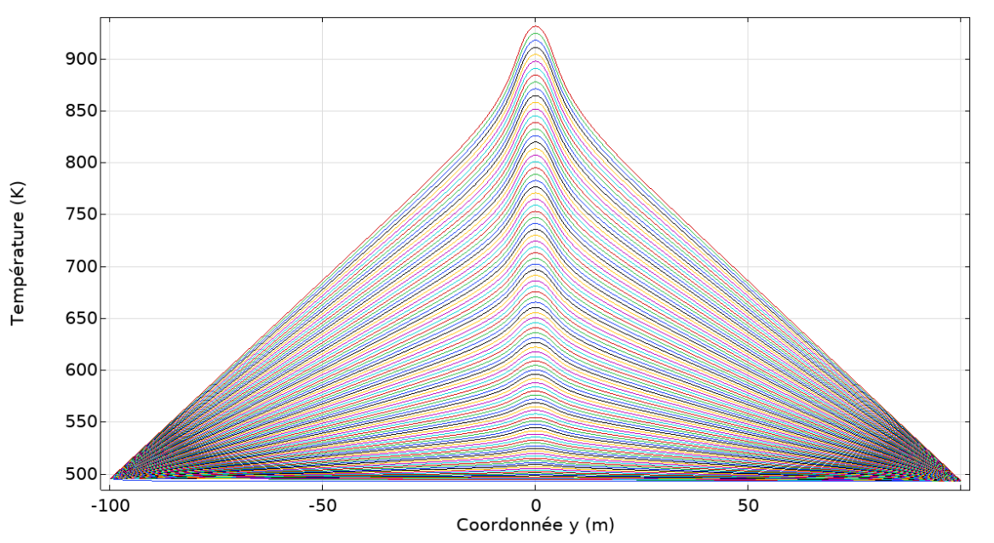
Results of the Thermical Model
Search of the right value of the reactivity
Temperature aimed is around 1000 K
Temperature anti reactivity

Slide 18
Simulation of the Desilification

Slide 19
Results of the Desilification
Mass of fixed Silica Concentration of free Silica

Slide 20
Simulation of the compaction
Each column has its own velocity
Index on the Msi
Average on the area

Slide 21
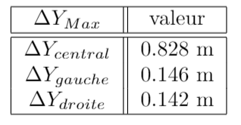
Results
Concentration en Uranium

Slide 22
Outlook
Introduction
Models studied
Application: Inter-reactor effects

Slide 23
Initialization of the model

Slide 24
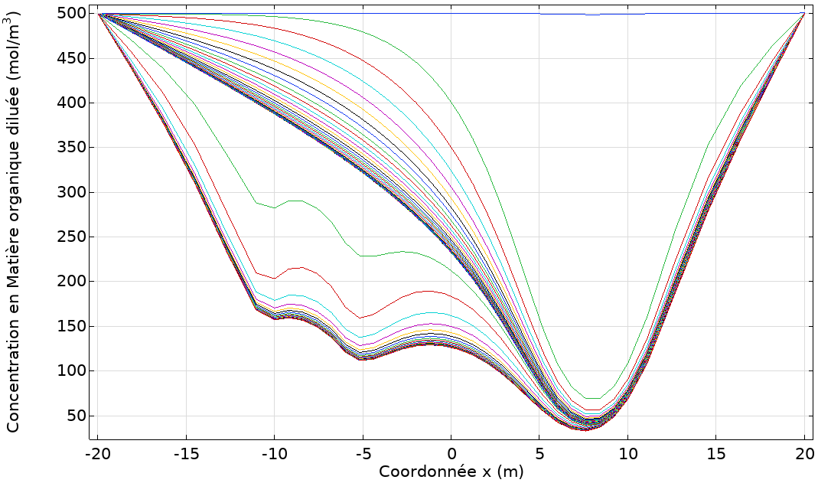
Concentration of free Organic matter

Slide 25
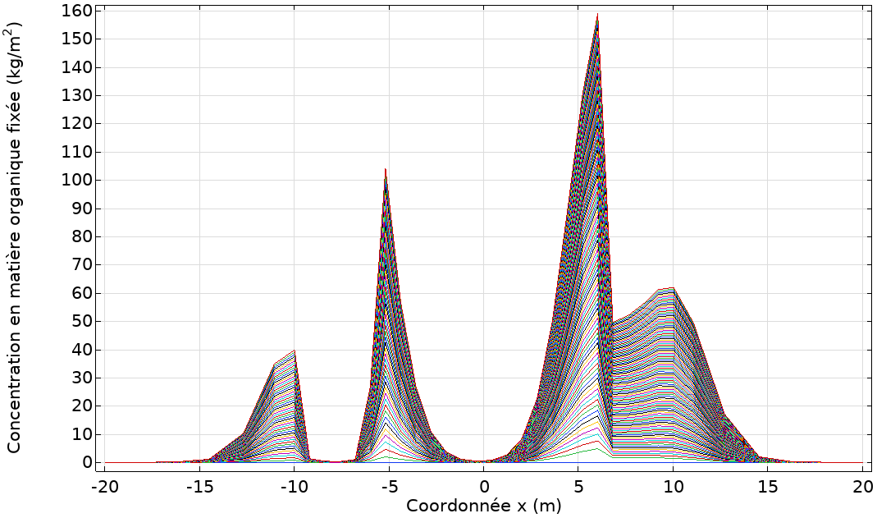
Masse of fixed Organic matter

Slide 26
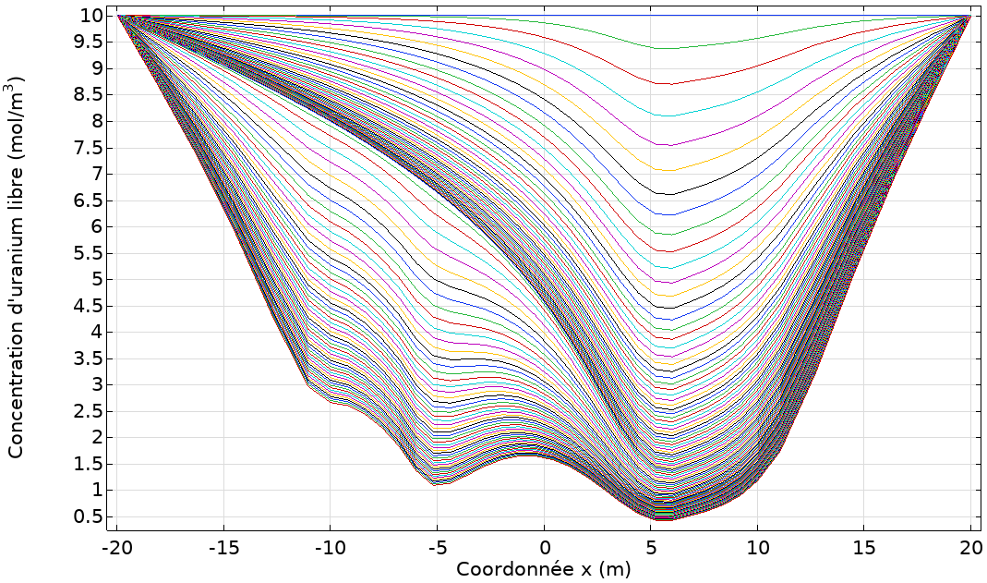
Concentration of free Uranium

Slide 27
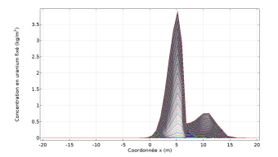
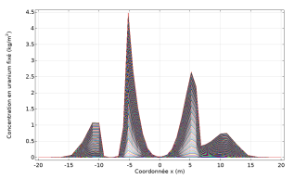
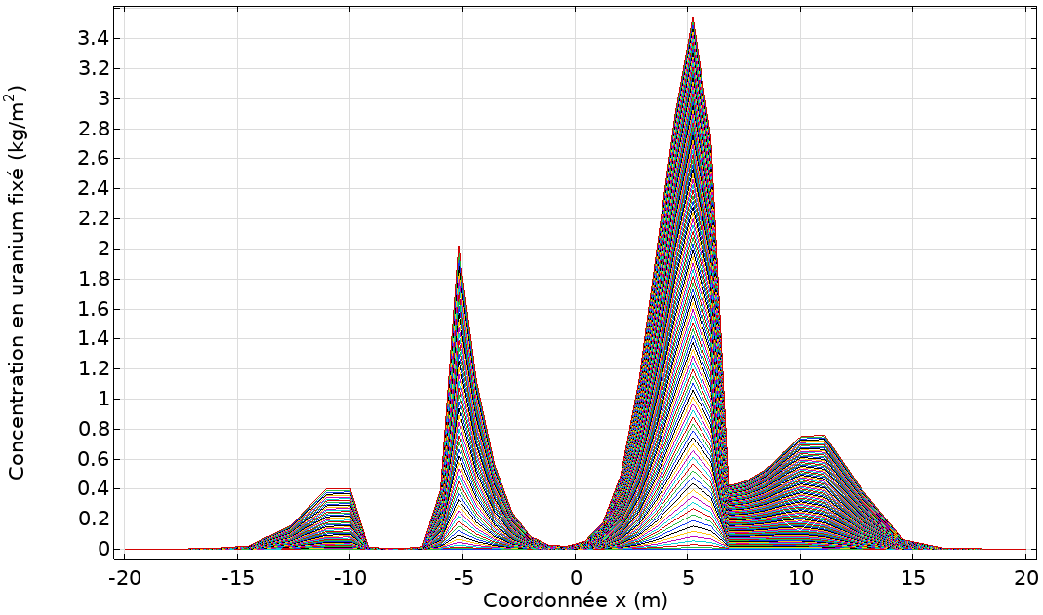
Masse of fixed Uranium

Slide 28
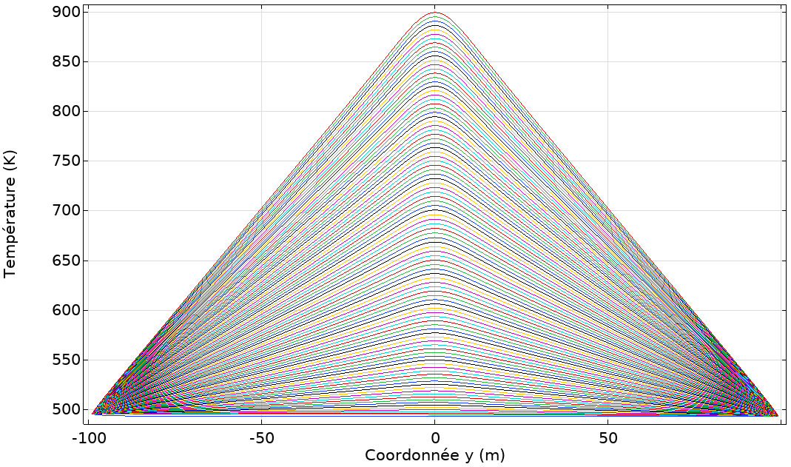
Temperature

Slide 29
Conclusion and Perspectives
Multiples layered model created
Adaptable model (multiple inputs)
Simple but interesting data can be extracted
Perspectives
End of a reactor
Better neutronic
Plutonium
45° angle plan (on a large scale)

Slide 30
Thank you for your attention

Slide 31
Bibliography

