Slide 1
WP2 lapp status
Frederic Gillardo, Lapp/CNRS
23 April 2021

Slide 2
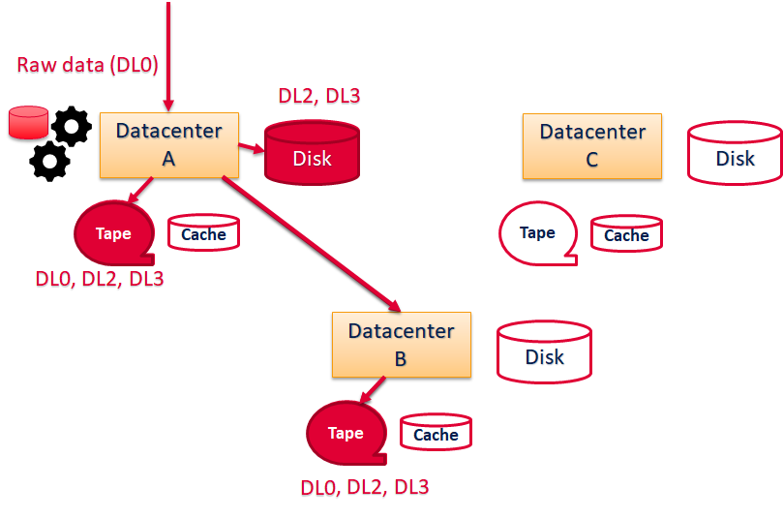
Data Challenge 2021 discussion 1/3
Data Management: acquisition, injection, replication, lifecycles
Similar to data challenge 2020 with additional feature :
rse onsite in la palma
Attach metadata to files
Volume of 100 TB (last test was 40TB)

Slide 3
Data Challenge 2021 discussion 2/3
Data Processing: Production (DL0 to DL3).
Execute jobs on the grid using dirac.
Query files using condition on metadata
Processing pipe:
CtaPipe
GammaLearn to test GPU
Data processing: User Analysis. Processing of DL3 on notebooks. Activity targeting, “small” resources: online notebooks, personal computer. Driven together with WP5: ESAP and Data Lake integration.

Slide 4
Data Challenge 2021 discussion 2/3
Open Questions:
CTA Data : MC and real data (if needed data can be duplicated)
Metadata for DL0 , DL1, DL3 (for now I use ObsID and TelID on DL0)
Notes:
Besions similaire : Volume / fichier et de donnée (plusieur PB million fichier) Production onsite (SKA, LSST)
Regle de replication
QoS (tape)
FAIR
Authentification …

