Slide 1
The CERN Neutrino Platform
25th May 2021, IN2P3 Kickoff meeting
Marzio Nessi, CERN & University of Geneva

Slide 2
Some history

Slide 3
2013: a intense discussion year
<2013 : Several proposals or letter of interest submitted to the CERN program committees : ICARUS-NESSiE (SPSC-P-347) for the search of sterile neutrinos, LAGUNA-LBNO consortium (SPSC-E-007) to demonstrate a new generation of neutrino detectors of double-phase LAr TPC with prototypes
CERN management (end 2012) asked us for a feasibility study to provide a neutrino beam (short baseline + charged beam test facility) at CERN in the medium term (~4 years) with 2 experimental facilities (near and far). Main goal : satisfy the existing requests and allow new detectors/ideas to come forward
In March 2013 we submitted to the CERN management a LOI for a Short Baseline Facility at CERN (CENF) : first beam in late 2017, far and near detector facility, SPS 100 GeV proton beams, investment ~80-100 MCHF → this generated an avalanche of discussions and opinions in the CERN and in the neutrino community …. and a lot of passion !!!

Slide 4
2013-14 : three major statements/events
European Strategy : “CERN should develop a neutrino program to pave the way for a substantial European role in future long-baseline experiments”
US P5 Report : “The U.S. will host a world-leading neutrino program that will have an optimized set of short- and long-baseline neutrino oscillation experiments, and its long-term focus is a reformulated venture referred as the Long Baseline Neutrino Facility (LBNF)”
APPEC Paris meeting dedicated to Large Neutrino Infrastructures, where most FAs and leaders in the field where present.
CERN broke symmetry and announced that it will freeze all types of Neutrino beams at CERN (Short and Long Baseline) in favor of common activities in US and Japan

Slide 5
Emerging ν Landscape
no ν beams at CERN!
Long and Short Baseline facilities in the USA and in Japan ?
-> CERN ν Platform
Assist the various groups in their R&D phase (detectors and components) in the short and medium term and give coherence to a fragmented European Neutrino Community
Provide to the ν community a test beam infrastructure (charged particles)
Bring R&D at the level of technology demonstrators in view of major technical decisions
Support the short & long baseline activities (infrastructure & detectors)

Slide 6
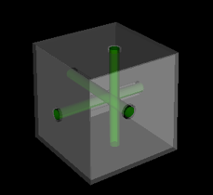
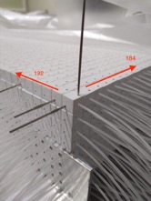
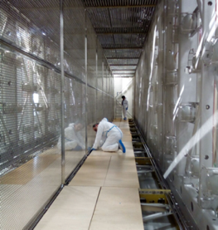
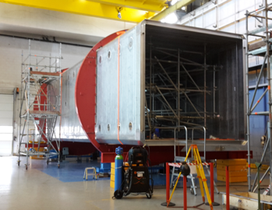
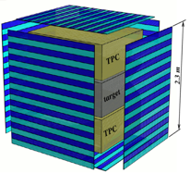
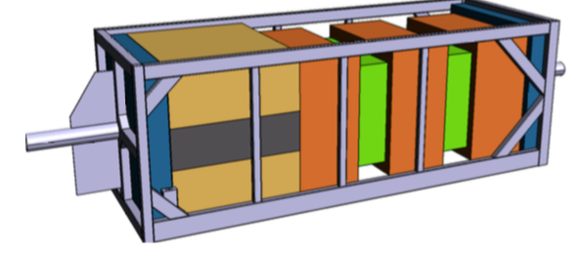
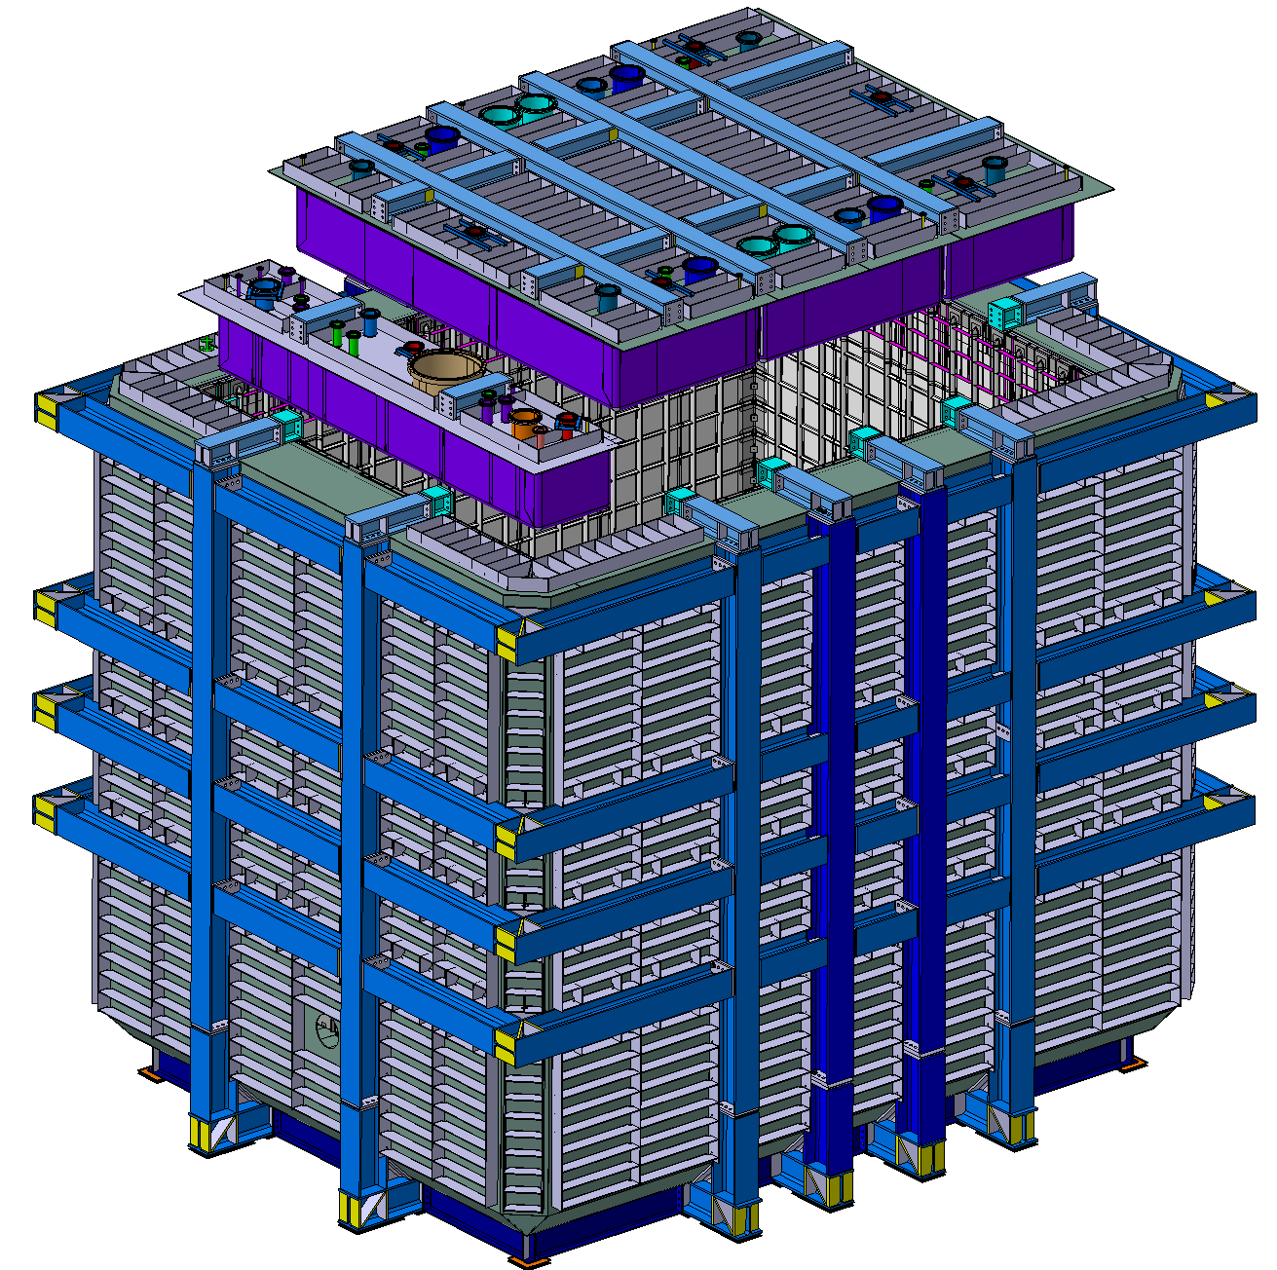
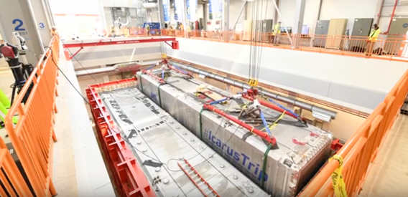
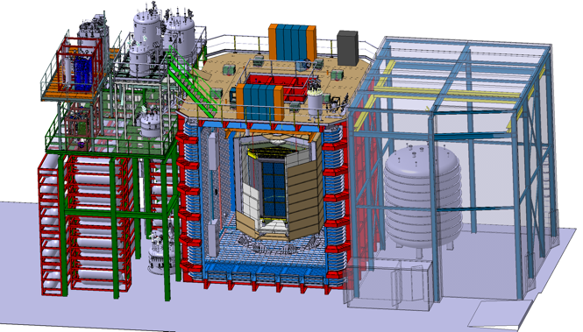
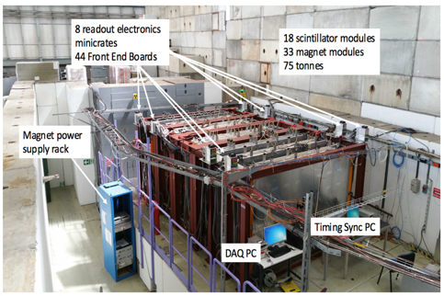
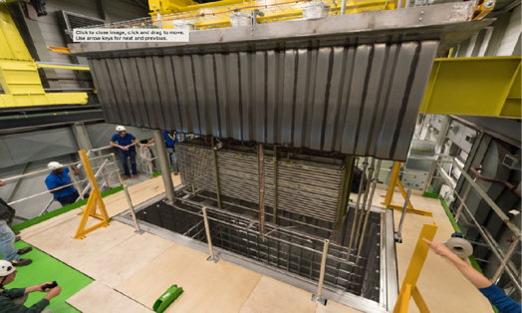
Some examples
SBND at FNAL
TOF
horizontal TPCs
Super-FGD
New !
T2K near Detector Upgrade
ICARUS reshaped and installed at FNAL
DARKSIDE at LNGS
WAGASCI / Baby MIND spectrometer
311 : DP TPC demonstrator

Slide 7
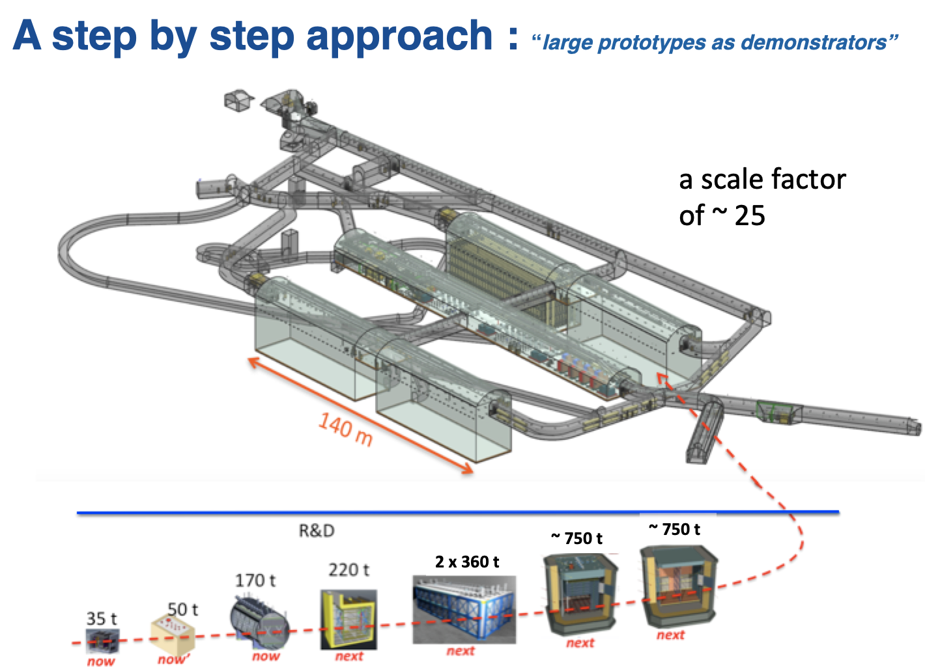
Towards LBNF/DUNE
ProtoDUNE DP
ProtoDUNE SP
311
micro-booNE
SBND
ICARUS

Slide 8
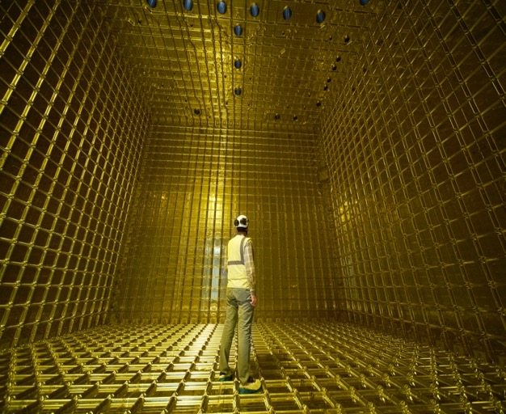
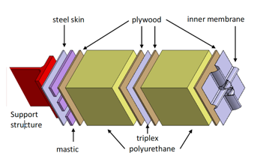
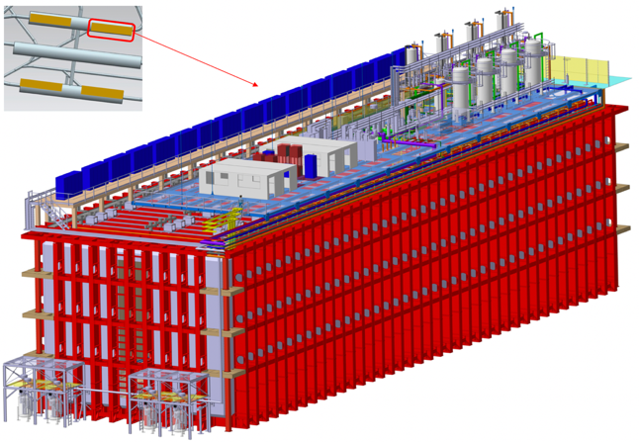
First step: Demonstrate LNG cryostat technology
LNG technology
LBNF/DUNE 17’500 t of LAr
ProtoDUNE 750 t of LAr

Slide 9
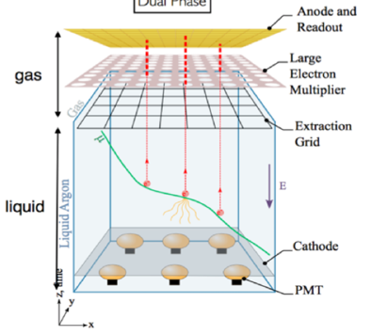
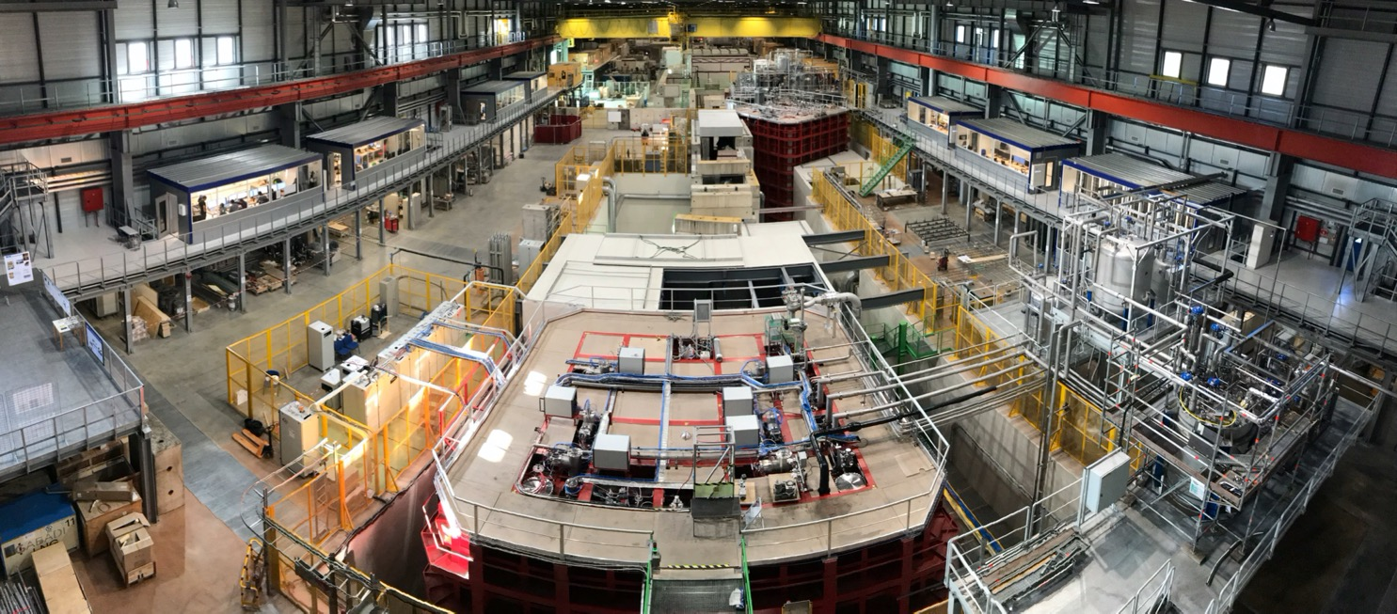
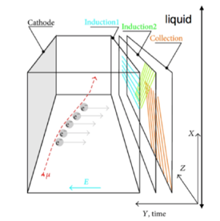
ProtoDUNEs @ CERN NP
TPC double Phase
TPC single Phase
TPC Prototypes at the scale 1:20, with modules at the DUNE scale
Two technologies investigated (LAr single phase, LAr double phase)

Slide 10
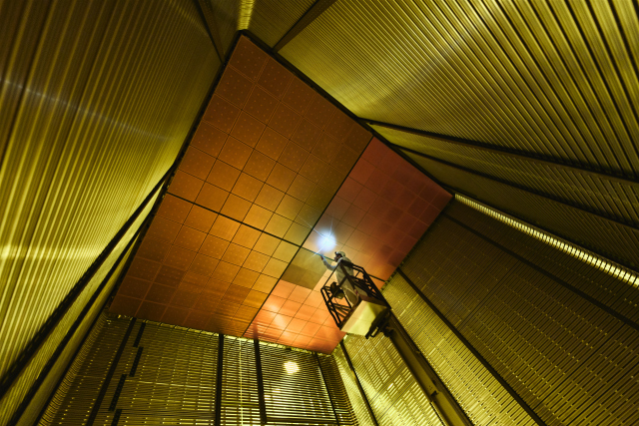
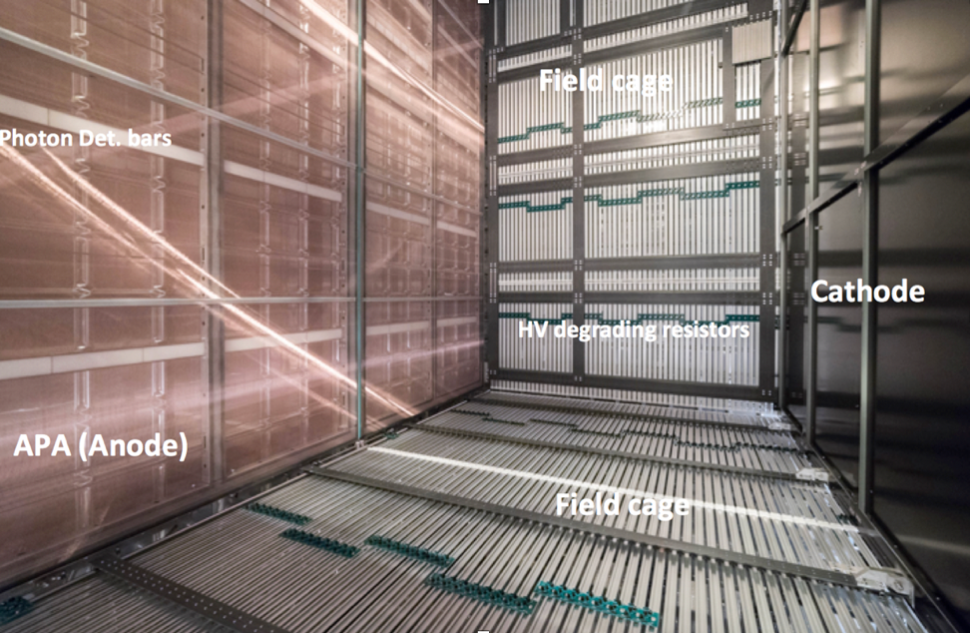
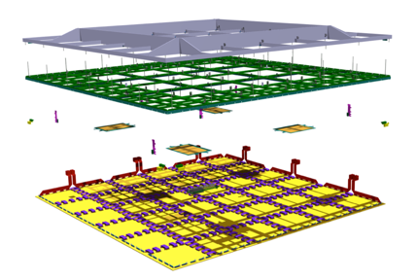
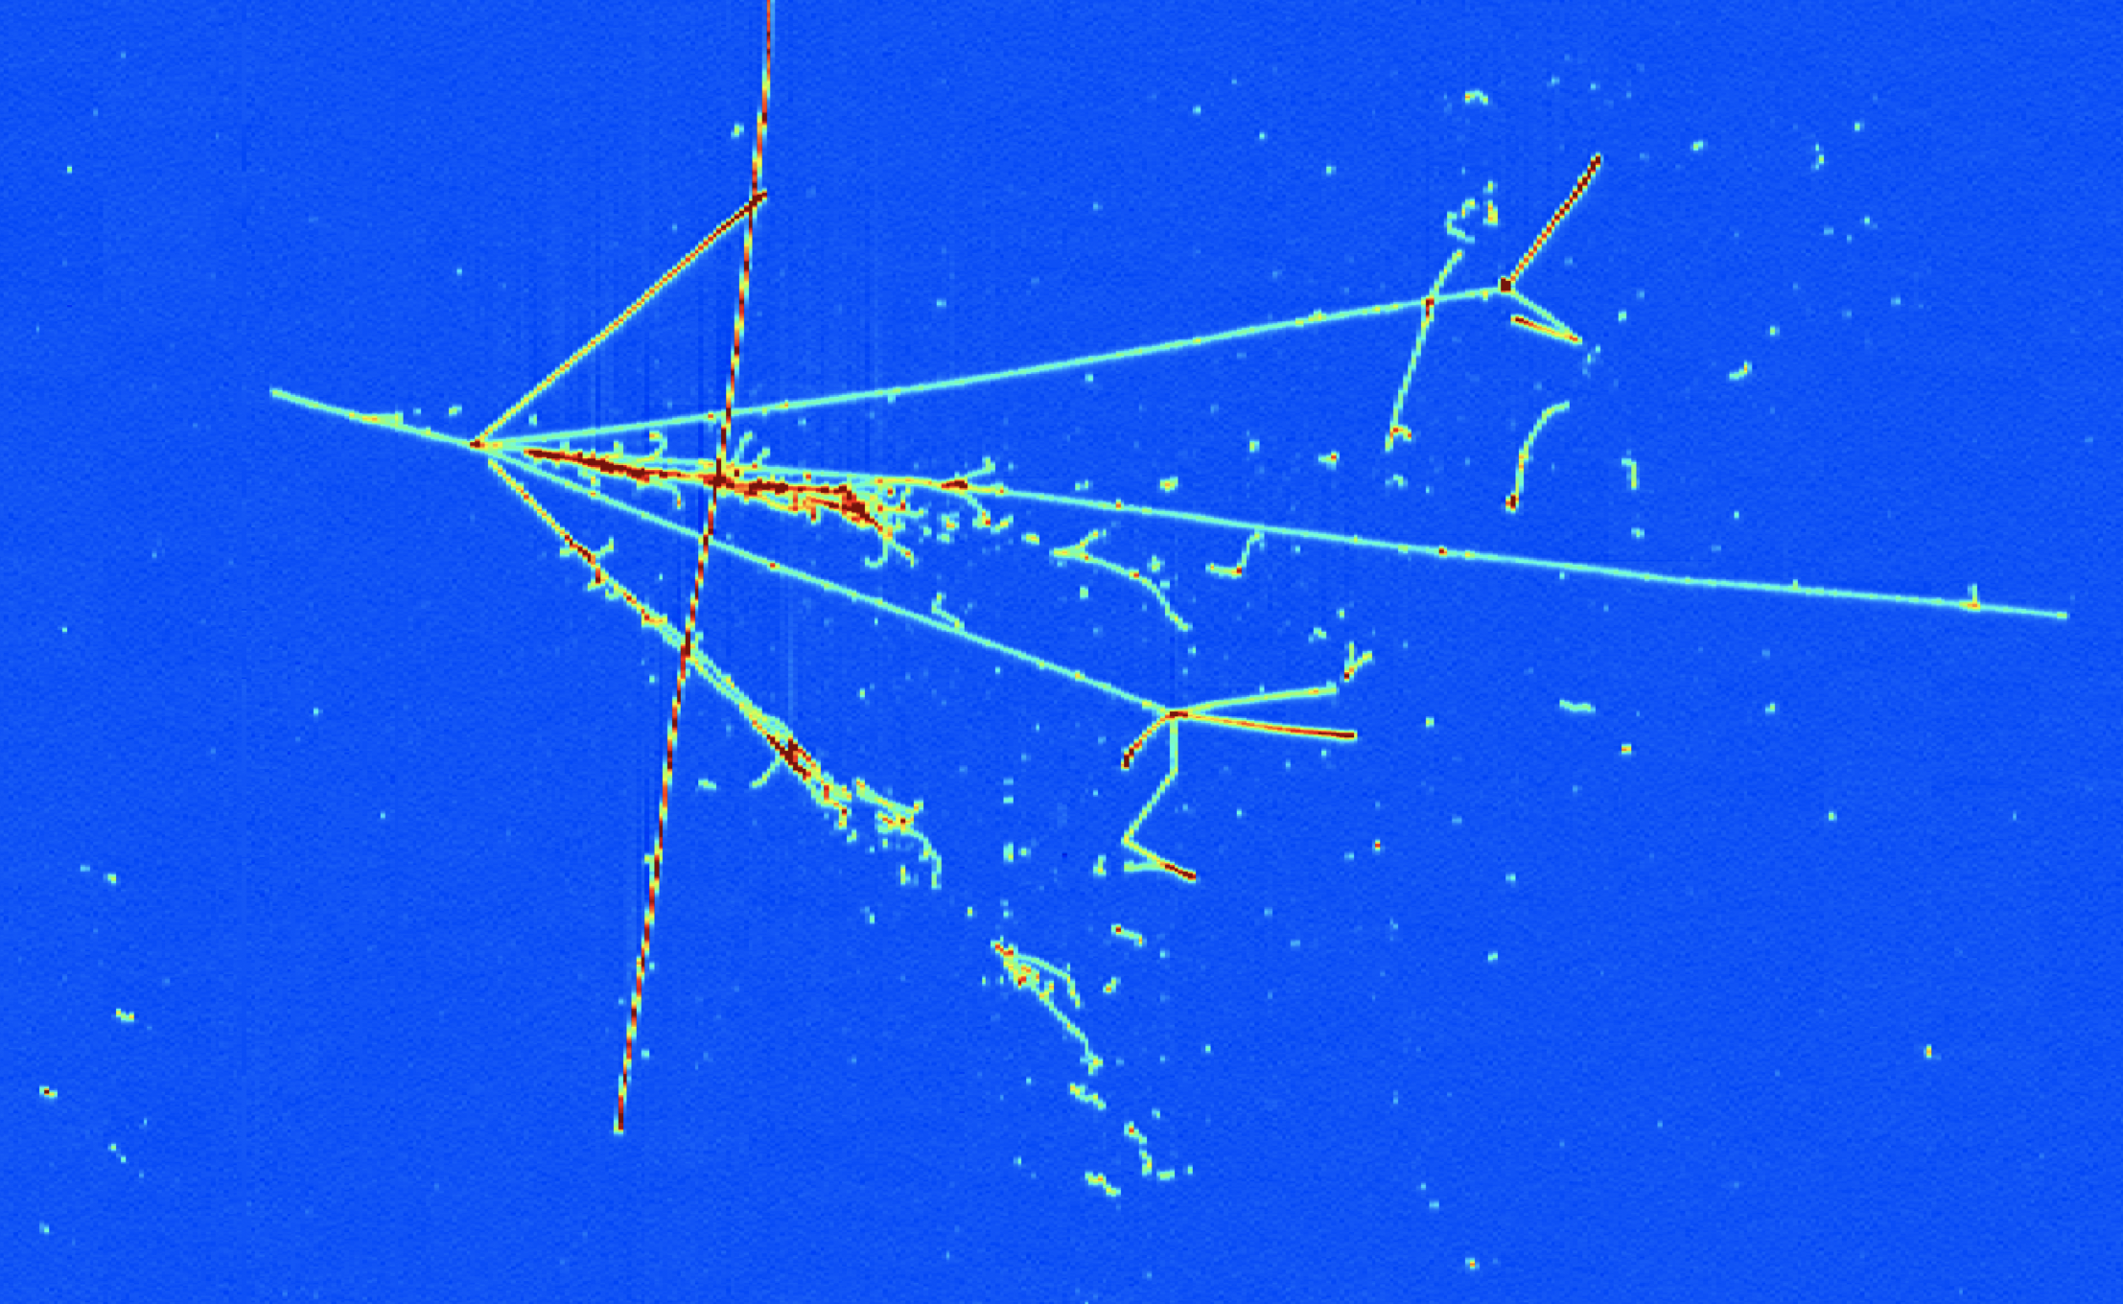
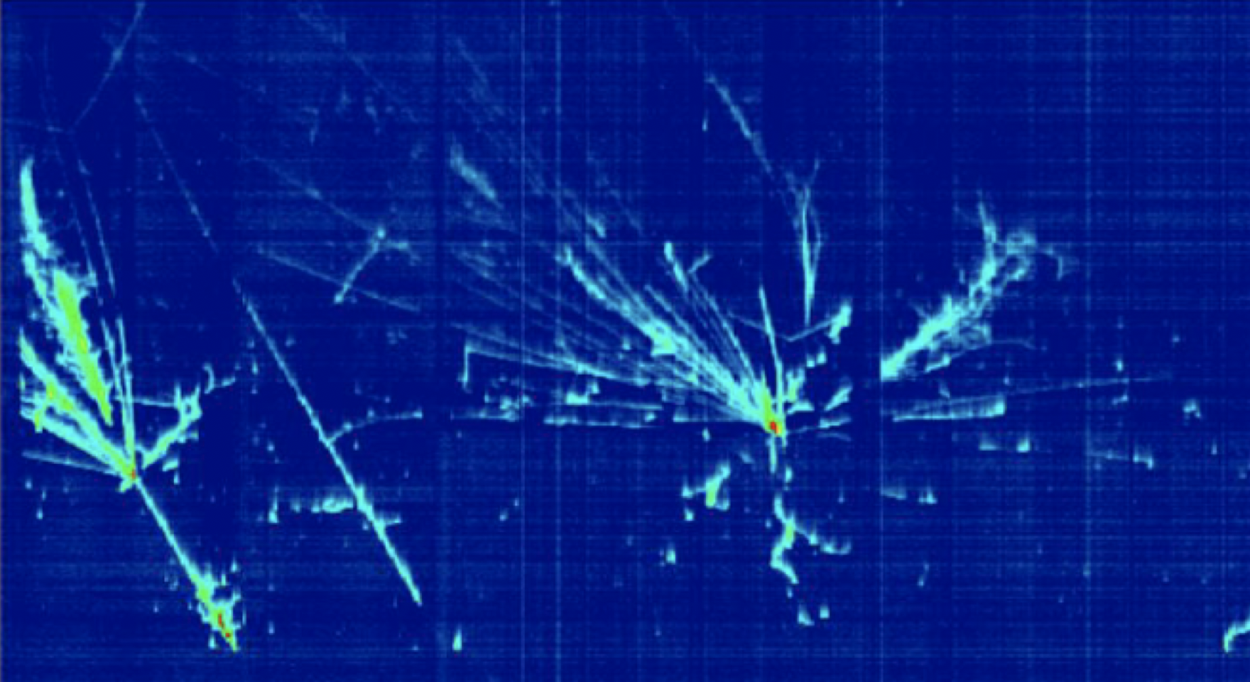
ProtoDUNEs @ CERN NP
LEMs + anodes
TPC Prototypes at the scale 1:20, with modules at the DUNE scale
Two technologies investigated (LAr single phase, LAr double phase)
Very good performance demonstrated (LAr purity, S/N, ID, tracking)

Slide 11
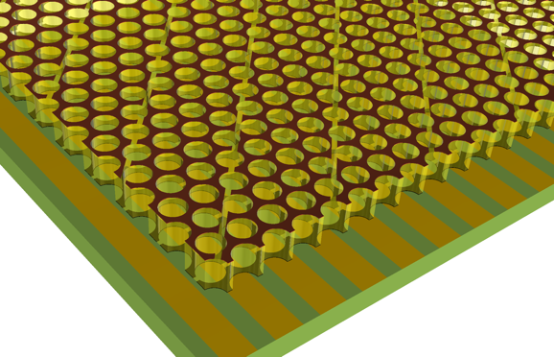
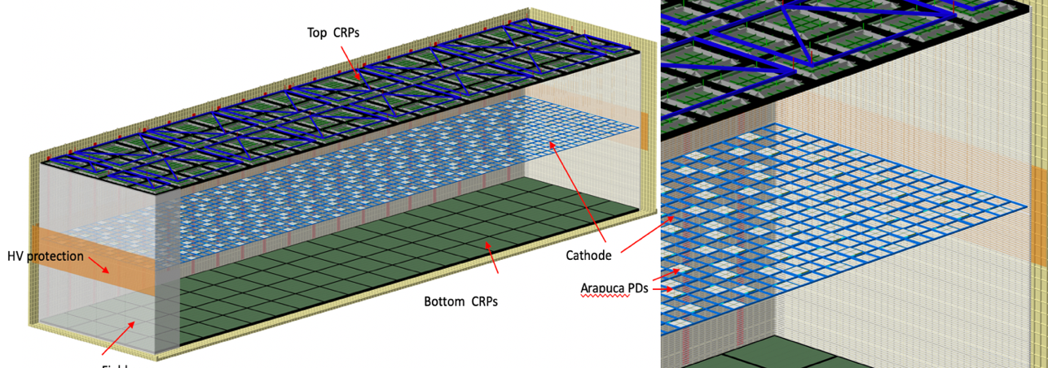
Next steps @ CERN NP
New ANODE concept, inspired from DP experience
Double phase concept simplified and evolved to a Vertical Drift new detector which profits from the lessons learned in both protoDUNEs
Arapuca PDs
Field cage

Slide 12
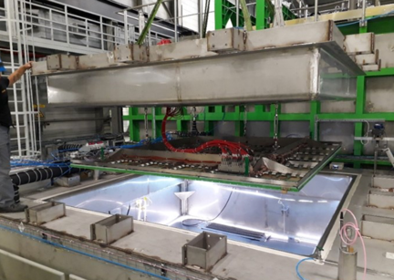
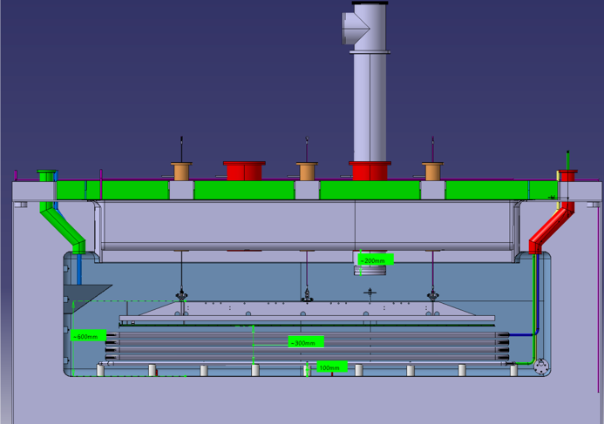
Why a Vertical Drift detector ?
A natural evolution of the double phase TPC
The LAr purity reached in the two protoDUNEs has open a new scenario
The electronics noise performance will grant the necessary S/N
One can build on the important French R&D effort for the DP
Most of components can be industrially constructed (cost effective)
CERN can provide the necessary infrastructure (test cryostat, clean rooms, ..) necessary to qualify a TPC VD module in 2021 and later a large protoDUNE cryostat for Module-0 (2022-2023)

Slide 13
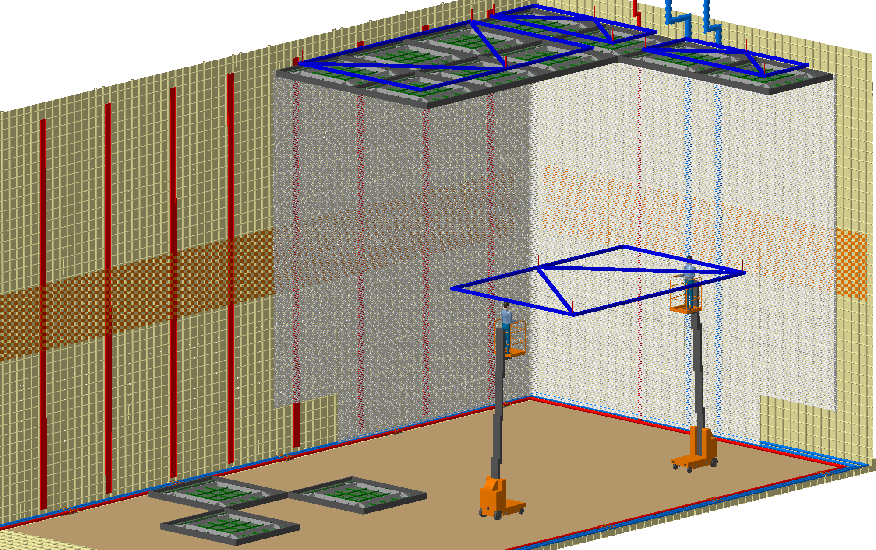
Why a Vertical Drift detector ?
A natural evolution of the double phase TPC
The LAr purity reached in the two protoDUNEs has open a new scenario
The electronics noise performance will grant the necessary S/N
Once can build on the important French R&D effort of the DP
Most of components can be industrially constructed (cost effective)
Potentially much easier and faster to install in DUNE (9 months)
In 6 steps, from top to bottom
No major infrastructure necessary (clean rooms)
Easy logistic
Limited manpower

Slide 14
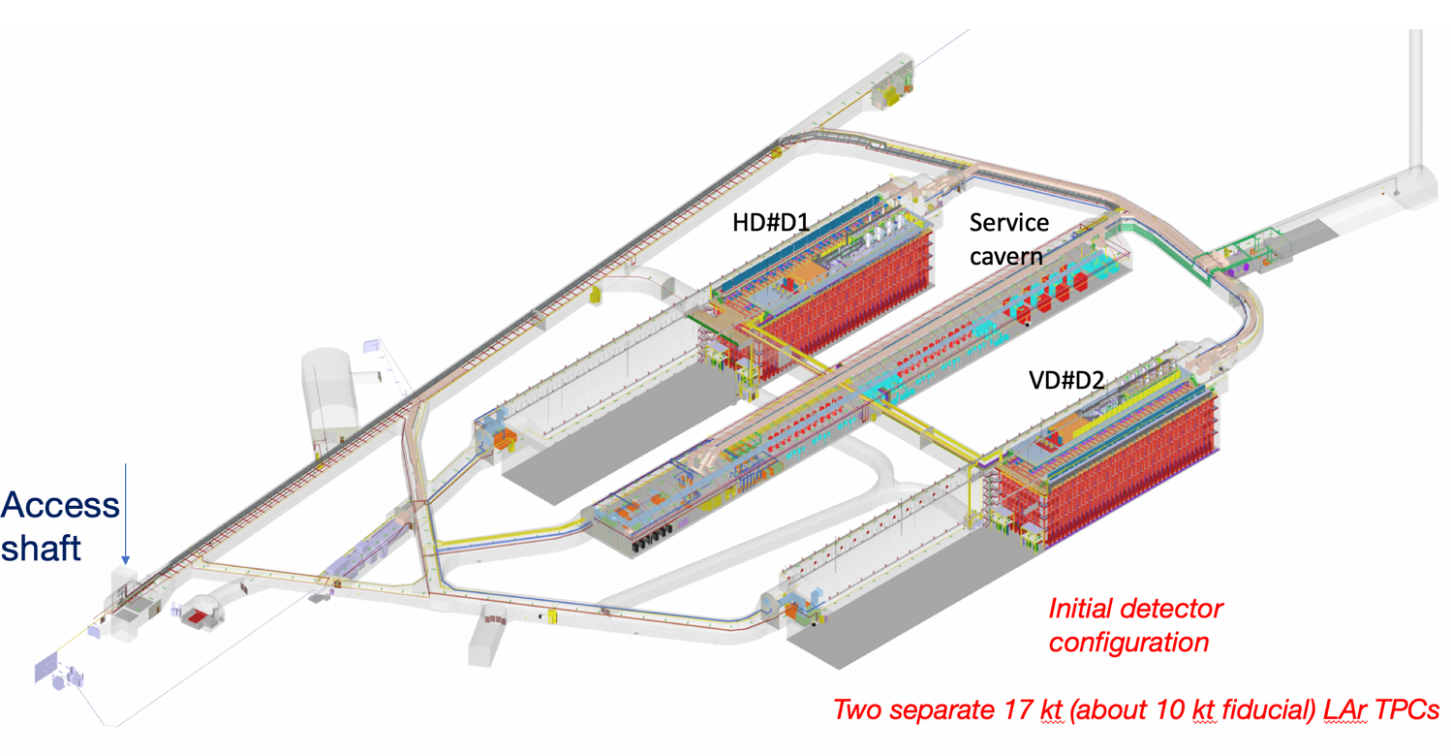
Next steps @ CERN NP
Single Phase horizontal drift
Single Phase vertical drift
1.5 Km
Construction and assembly of two large cryostat underground

Slide 15
NP@CERN
Many ν detectors constructed with excellent performances
Several detectors still in construction
NP has done an important contribution to the infrastructure (Cryostats, Cryogenics, Engineering, …)
NP as an effective way to organize internationally R&D and demonstrators, at the service of the entire ν community

