Slide 1
BINGO: Bi-Isotope 0ν2β Next Generation Observatory
Hawraa Khalife
IRFU (CEA)
GDR DUPhy 31/05/2021

Slide 2
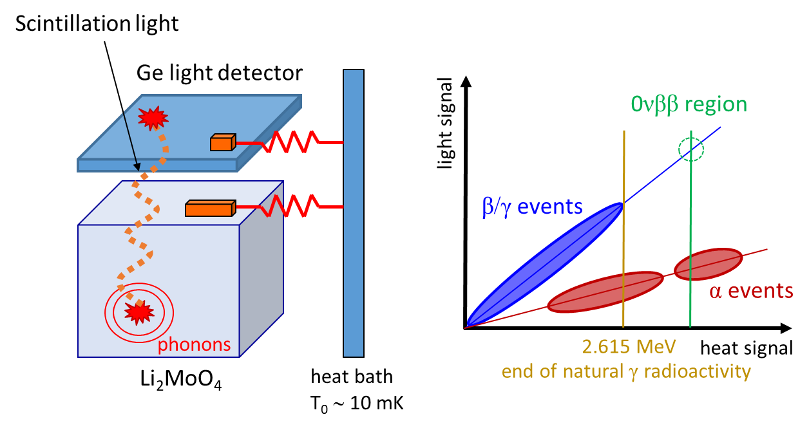
What is BINGO?
BINGO will set the grounds for a large scale bolometric experiment searching for neutrinoless double-beta decay (0ν2β) using revolutionary technologies
It aims to reduce dramatically the background in the region of interest, which is one of the most limiting factors for current and future 0ν2β experiments
Two promising isotopes: ¹⁰⁰Mo embedded in Li₂MoO₄ and ¹³⁰Te embedded in TeO₂
Dual heat-light readout: a main absorber faced by a light detector (CUPID technology)
Reject the α background component, thanks to the lower light output of αs compared to β/γ

Slide 3
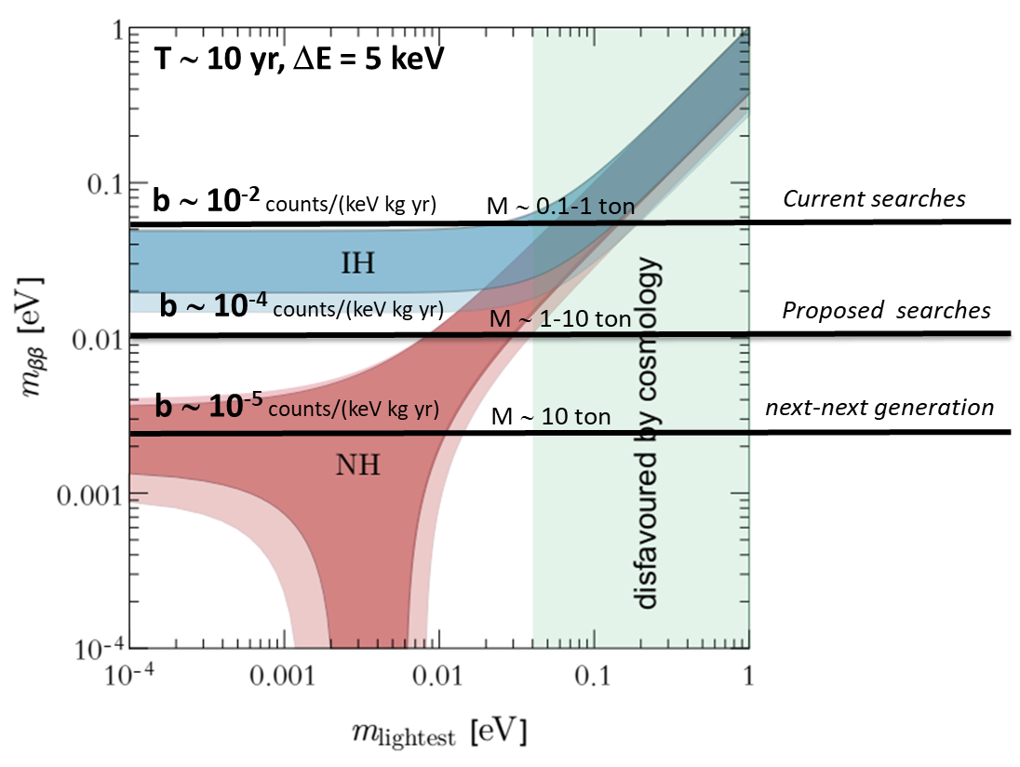
Foreseen sensitivity on effective Majorana mass
number of background counts
$b$ =
$M$ × $t$ × $∆E$
BINGO objective
$M$: detector mass
$t$: time of measurement
$BI$: background index
$ΔE$: energy resolution of the detector (FWHM)

Slide 4
Bolometric compounds
CUORE
TeO₂ & Li₂MoO₄
CUPID-Mo
Both have:
Excellent energy resolution
High internal radio-purity
Easiness in crystallization
Very poor scintillator
(Cherenkov light only)
↓
Use Neganov-Luke LD
isotope | Q -value | Isotopic abundance
¹⁰⁰Mo | 3034 keV | 9.6 %
¹³⁰Te | 2527 keV | 34 %
Below the endline of the γ natural radioactivity (2615 keV)
↓
Active shields
Bi-Isotopic approach: observation in 2 candidates → discovery + confirmation

Slide 5
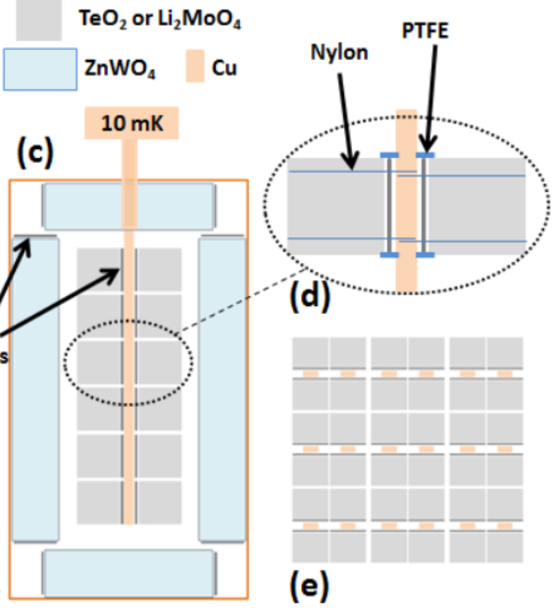
Background reduction techniques: assembly
A revolutionary detector assembly:
Reduce the Cu material seen by the main absorber → reduction of the total surface radioactivity contribution
Having a compact assembly → anticoincidence cuts
BINGO test assembly
Ge light detector
NTD (thermistor)
Nylon wire
2 cm side cubic Li₂MoO₄
Light detectors
Li₂MoO₄
Or
TeO₂
Cu
Ci

Slide 6
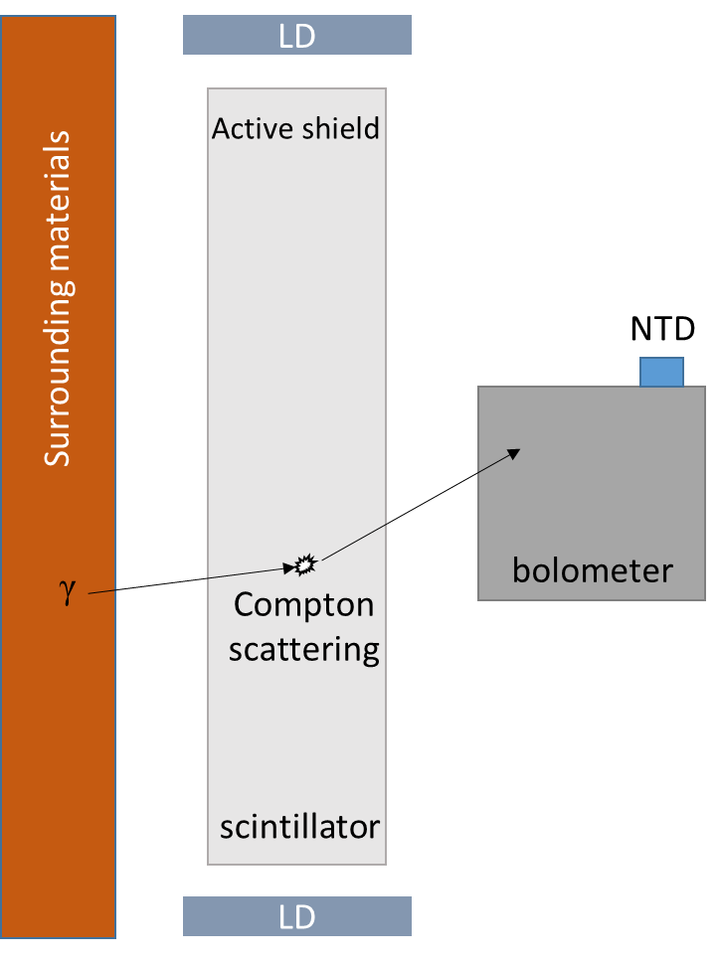
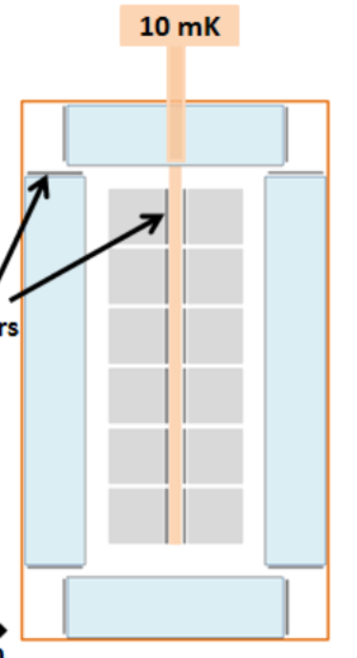
Background reduction techniques: active shield
Use an active shield, based on ZnWO₄ or BGO scintillators
Suppress the external gamma background (specifically essential for TeO₂)
If the 2615 keV γ deposit a small amount of energy in the surrounding material (∼80 keV) and the rest in TeO₂ → bkg in ROI (2527 keV)
Light detectors
35cm
ZnWO₄ or BGO
active shield
Essential requirements to suppress the background from the ROI of TeO₂:
Very low energy threshold of the light detector → low threshold of ZWO or BGO
Neganov-Luke LD to increase signal to noise ratio → low threshold
The nominal BINGO expected threshold is 50 keV (to be confirmed with a devoted MC)

Slide 7
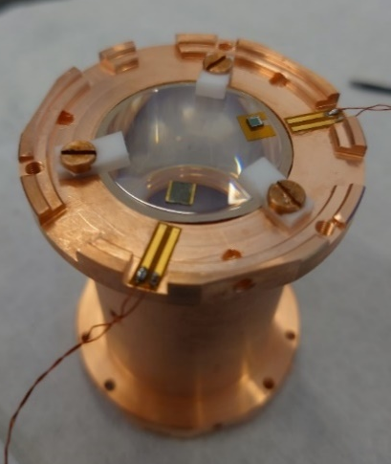
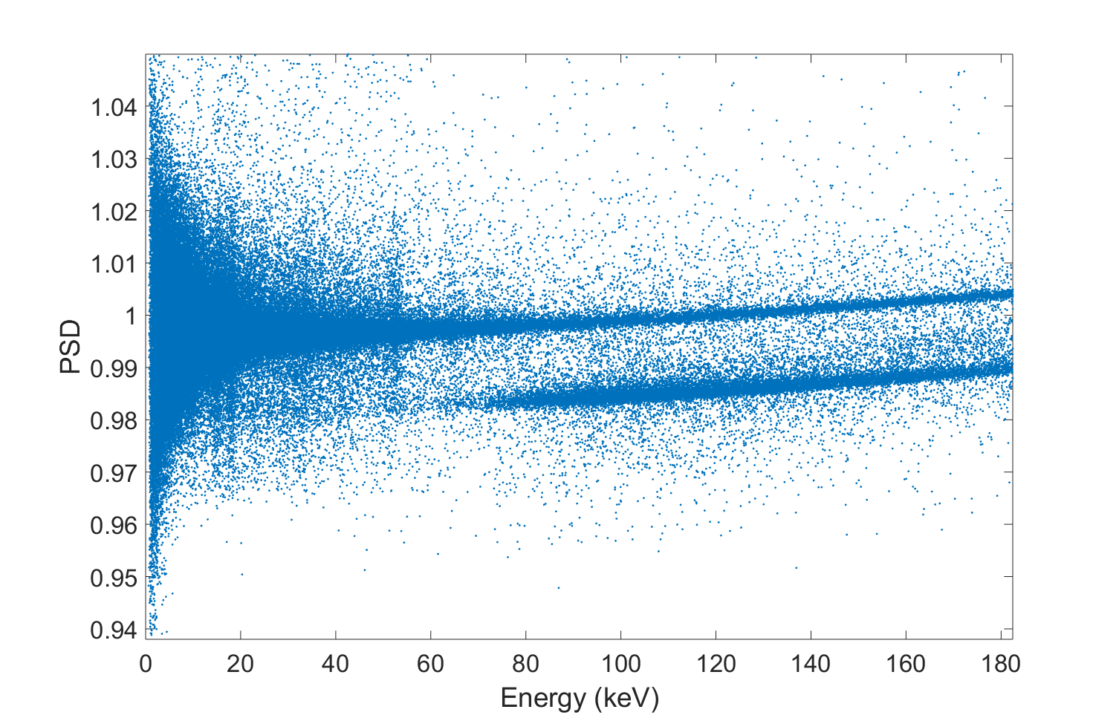
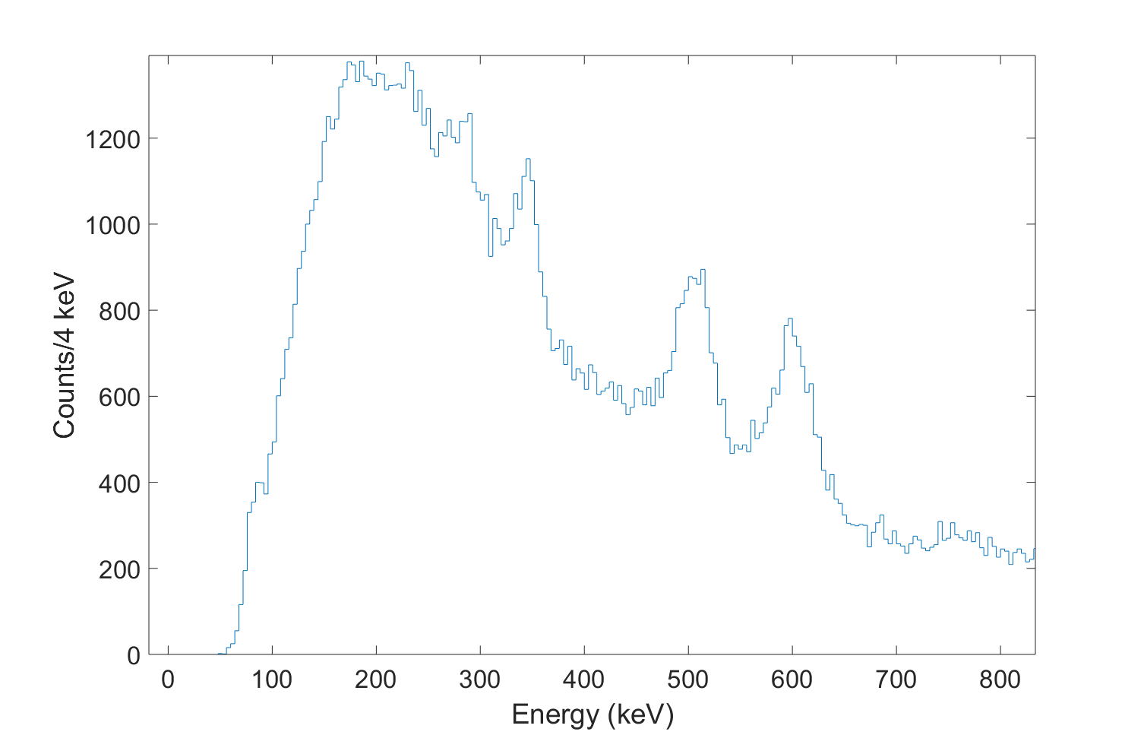
BGO test
D: 30mm
H: 60mm
SiO coated LD
Estimate the LY and threshold by looking only into the light channel
gammas
LY∼28 keV/MeV
352 keV
Ann+511 keV
570 keV+609 keV
Estimated threshold (5σ_{bsln})∼10 keV
muons
Threshold estimation needs more study, based on implementing a way to estimate the trigger efficiency.
Calibrated light channel / LY

Slide 8
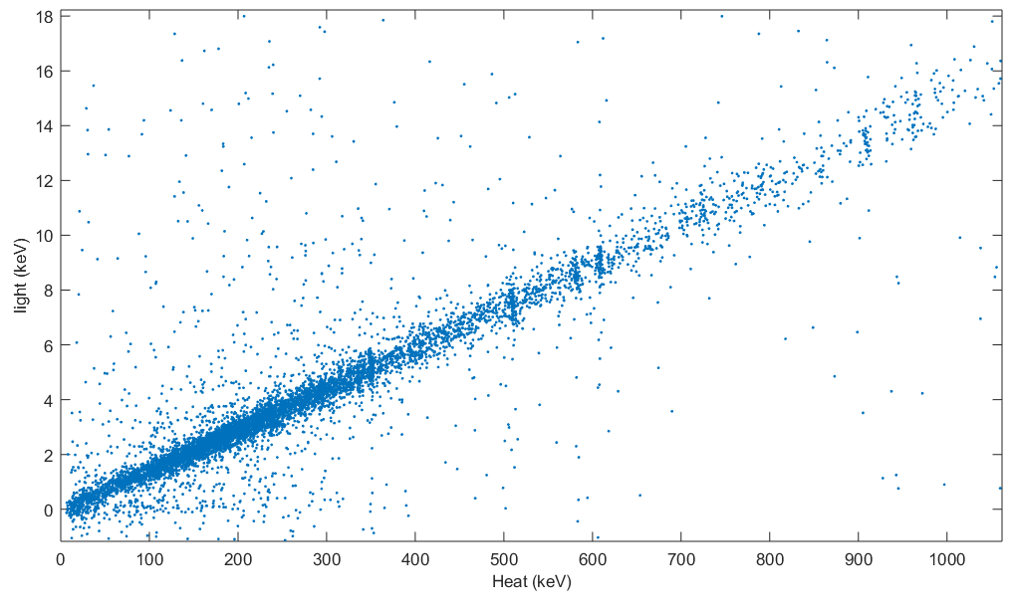
ZnWO₄ test
ZWO: 1 cm side cube
Square normal light detector: 45×45×0.35 mm
Covered with SiO (increase light collection)
Heat-light scatter plot
γ lines
LY ∼ 15 keV/MeV
Threshold ∼ 62 keV

Slide 9
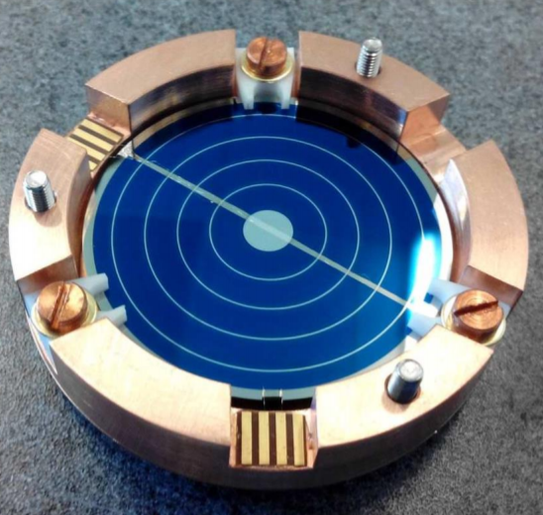
Neganov-Luke light detector
NL LD is important to:
Detect the Cherenkov light emitted by TeO₂ crystals
Be used for the active shield to increase signal to noise ratio → lower energy threshold
R&D :
Study new geometries for electrodes to have an excellent amplification capability
Fabrication protocol suitable for large scale production
Al electrodes are evaporated on a Ge wafer
Applying a voltage difference on these electrodes makes the e-h pairs created by an event to drift
Amplification of the signal : 𝐸 = 𝐸₀ (1 + $\frac{qV}{\text{ε}}$)

Slide 10
Tools to mitigate the various background
combination of methods
isotope | Surface alpha contamination | Surface beta contamination | External gamma background | 2ν2β random coincidence
Li₂MoO₄ | Double readout (heat+scintillation) | Innovative detector structure | Already mitigated by high Q­‐value | Pulse shape + Highly performant light detector (NL)
TeO₂ | Double readout (heat+Cherenkov) Highly performant light detector (NL) | Innovative detector structure | Internal ZWO/BGO shielding | Already mitigated by long 2ν2β half-life

Slide 11
Conclusion
BINGO is a promising project towards the meV scale of the effective Majorana mass
New technology that allows to reach b∼10⁻⁵ counts/(keV kg yr)
The proposed solutions will have a high impact on next-generation bolometric tonne-scale experiments, like CUPID.

Slide 12
Backups

Slide 13
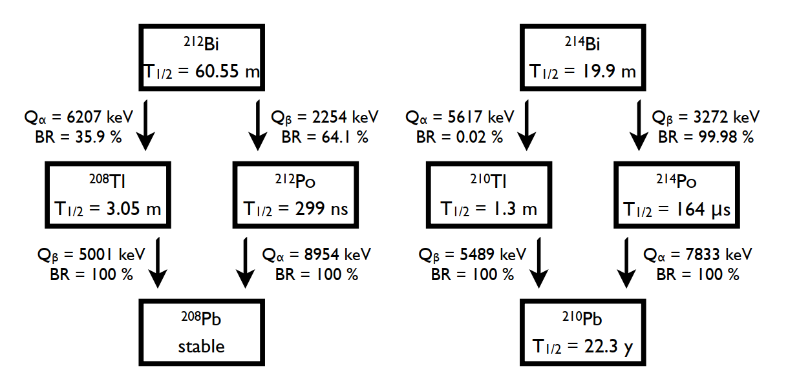
²³²Th
²³⁸U
BiPo events (α+β): not harmful
Unresolved coincidence in ²¹²Bi (²¹⁴Bi) and ²¹²Po (²¹⁴Po) due to slow bolometric response → registered as a single event (8-11 MeV, far from Q_{ββ})
Delayed events of ²⁰⁸Tl (²¹⁰Tl) β’s can be rejected by an off-line gate after ²¹²Bi (²¹⁴Bi) α’s

Slide 14
BGO vs. ZWO for the veto
Well known material
https://www.crystals.saint-gobain.com/sites/imdf.crystals.com/files/documents/bgo-material-data-sheet.pdf
Available in large size
Very good light yield (8000-10000) photons/MeV)
Radiopurity to be verified
²⁰⁷Bi (Q-value: 2398.2 keV)
Extremely radiopure (<0.17 uBq/kg in ²²⁸Th)
Scintillator tested by the DAMA group
Very good light yield (9300 photons/MeV)
Large sizes to be demonstrated

