Slide 1
Brief Overview of EOSC-Future
WP2 Meeting – 10th March 2021
Ian Bird (LAPP)

Slide 2
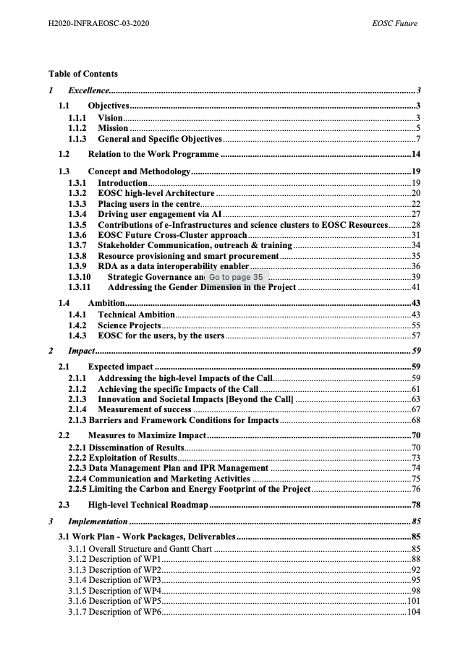
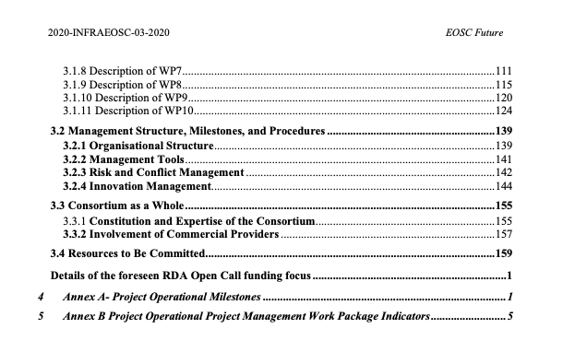
Proposal / GA
Re-submitted 12/02/21
  Addresses EC criticisms
  May still expect a further round of updates (tbc)
4 task forces worked several weeks to do the updates
Now a much clearer technical vision
Science Projects a key ingredient
  Some resistance …
  “TSP” ➔ “SP”

Slide 3
What is EOSC-Future?
Essentially it is a first implementation of EOSC
  Integrating – e-Infrastructures, Research Infrastructures (ESFRIs, etc. – science clusters)
    11 Founding members: Technopolis as coordinator
    Clusters: ENVRI-Fair, EOSC-Life, ESCAPE, PANSOC, SSHOC
    e-infras: EGI, GEANT, EUDAT, OpenAire, RDA
  Plus outputs of previous EOSC-xxx projects
    EOSC-Hub, EOSC-Pilot, EOSC-Enhance, ARCHIVER, OCRE, etc.
  And connecting to other current EOSC projects
    In particular INFRAEOSC-07 projects providing resouces
So it is complex …. Lots of collaboration needed
And the only project funded under this call
Important in that EOSC-Future will shape the EOSC for us

Slide 4
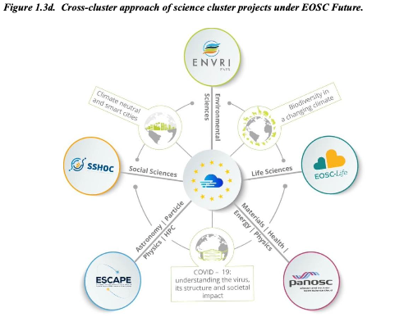
Science projects in EOSC-Future
The call is within the EC directorate that funds e-infrastructures (DG-CNCT)
  Science, RI’s and clusters are within DG-RTD
There is sensitivity to having science projects in an “infrastructure” project, and the RI’s have significant funding
  But it is for Science (EO –Science –C)
  There is strong support from DG-RTD
  Science projects bring the data, the research infrastructures and the scientists
  Important that we show that the proto-EOSC responds to our needs

Slide 5
Project actors
EOSC Future will improve and enhance the federated entry point to EOSC and the EOSC-Core capabilities behind it. It will deliver an EOSC interoperability framework and a set of EOSC-Core services enabling:
Users (researchers, research organisations) to find, compose, and reuse resources (e.g., services, research publications, data, software, etc.) across disciplines and communities through a shared resource sharing framework;
Providers of resources to describe and publish their resources through EOSC into multiple locations including EOSC Portal
Researchers to gain access to resources beyond their discipline of practice and across disciplines with a single set of credentials.
Research communities to describe their Open Science practices and implementation roadmaps via common frameworks and be inspired by Open Science roadmaps shared by other communities.
Policy makers (including funders, organisations, and ministries) to access the overall up-to- date view of EOSC resources to build, implement, and consult Open Science indicators (such as for openness and FAIRness).
Industry actors (such as SMEs and large enterprises) to access, value, reuse, and build innovation out of research results and procure their resources to Providers and EOSC end users.
Researchers to share their scientific results as openly as possible and get recommendations for EOSC resources (such as services) or research entities (such as authors or projects) that may be of use to them.

Slide 6
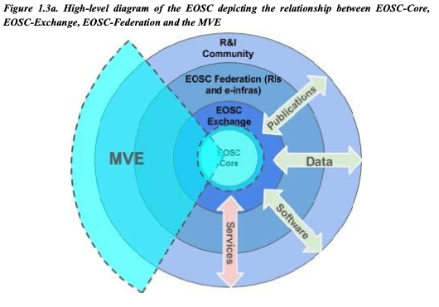
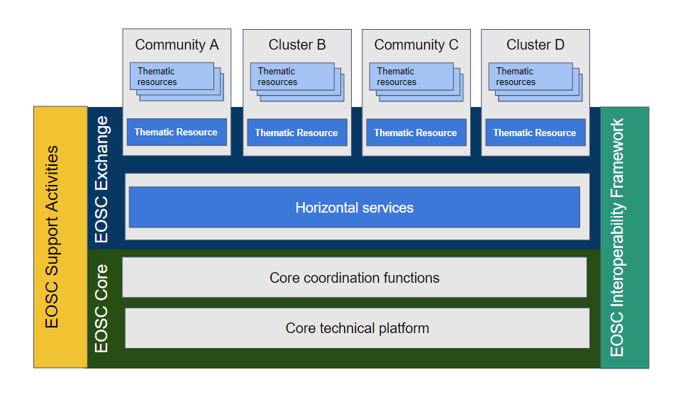

Slide 7
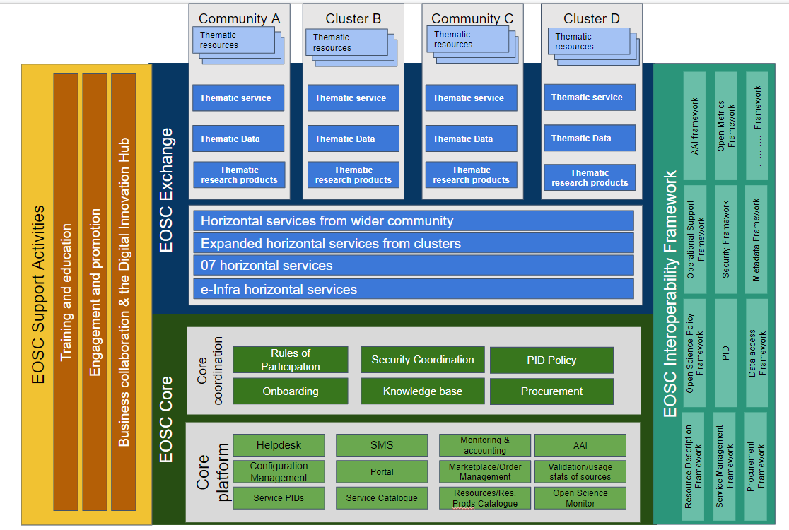

Slide 8
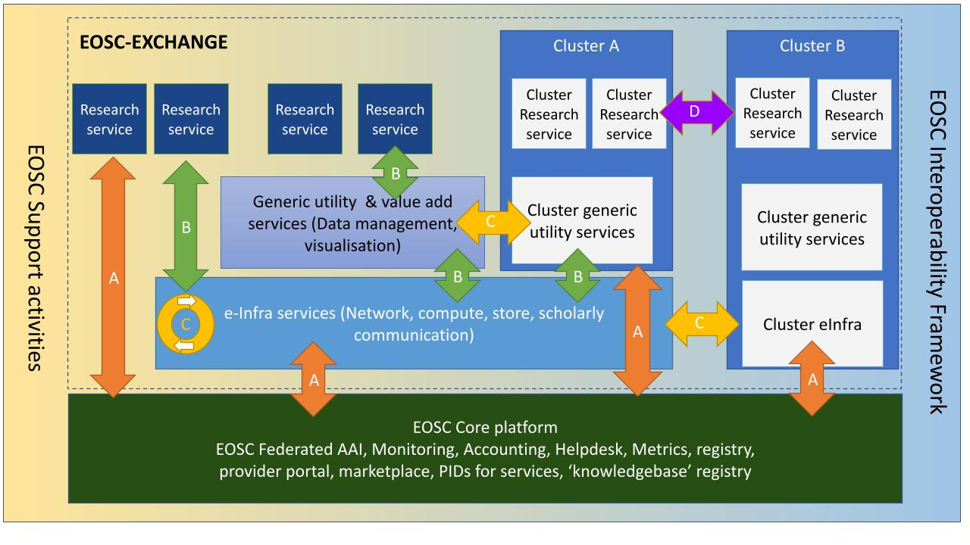

Slide 9
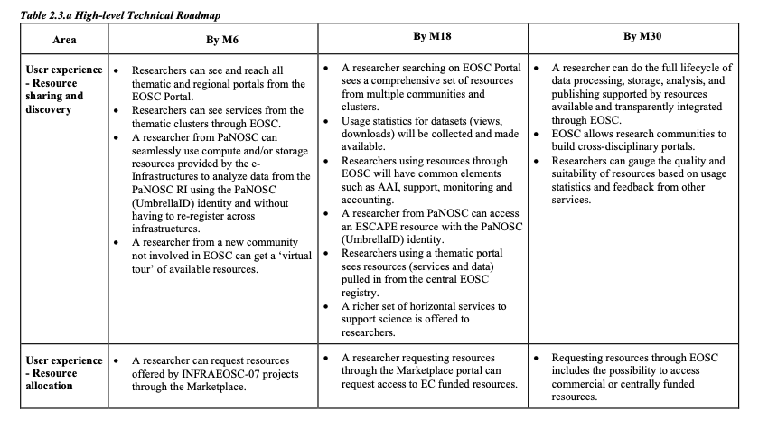
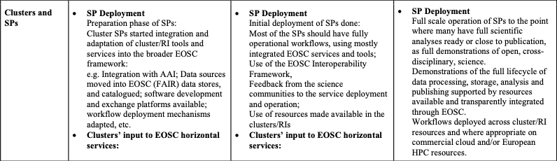
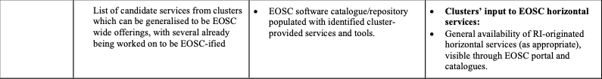
Few high level milestones:
Tie in:
  Technical deliverables, checkpoints
  TSP implementations
  User engagement
  Procurement actions/integrations with other projects (07 etc.)

Slide 10
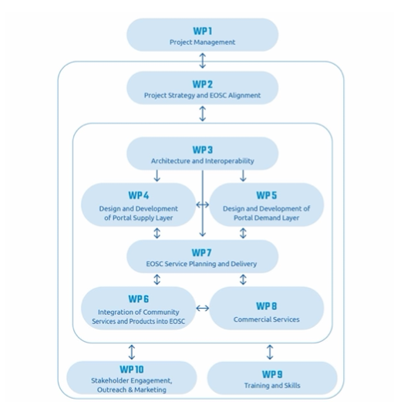
ESCAPE TSP’s

Slide 11
WP6 – includes TSP’s
Objectives
The objectives of WP6 are threefold, as reflected in the three tasks it contains:
To coordinate and implement the pipeline which populates the EOSC with Providers and their Resources (services, data sets and other research products).
To improve the offerings of Providers (including scientific communities) in EOSC by integrating their Resources into the EOSC-Core functions.
To bring together research communities from the scientific clusters with each other and with the EOSC Portal and EOSC-Core and validate the EOSC vision through innovative and focused Science Projects which highlight added value, multidisciplinarity and composability of EOSC Resources.
This WP populates, connects, and supports both the supply and the demand use sides of the EOSC, ensuring there are valuable resources to empower digital research in Europe.
Task 6.3 - Demonstrating EOSC Value through Cross-domain Research Science Projects (LIFEWATCH, CNRS, DESY, EATRIS, EGI, ELIXIR/EMBL, ESRF, EUDAT, GÉANT, ILL, ICOS, MARIS, OpenAIRE, PSI, CERN, FAU, INFN, SNS, UVA)
This task addresses the need to widen the user base and is intended to foster increased use of EOSC by research communities, either by composing services out of existing scientific content and e- Infrastructure services or by bringing in additional services they use for their research into EOSC. Tasks 6.1 and 6.2 ensure that services can be properly integrated in the EOSC. The scope of this task is to move beyond the topic-specific competence centres and to consider cross-domain, interdisciplinary Science Projects (SPs). This will help to grow EOSC by involving/connecting/linking with more research communities and scientific disciplines, preventing the creation of silos, de-fragmenting communities and supporting Open Science.
Large, cross-domain and mature catalogues, prepared in detail by the Science Clusters ready to be integrated at the start date of EOSC Future. They are flagships of community engagement and they tackle critical scientific and societal challenges.

Slide 12
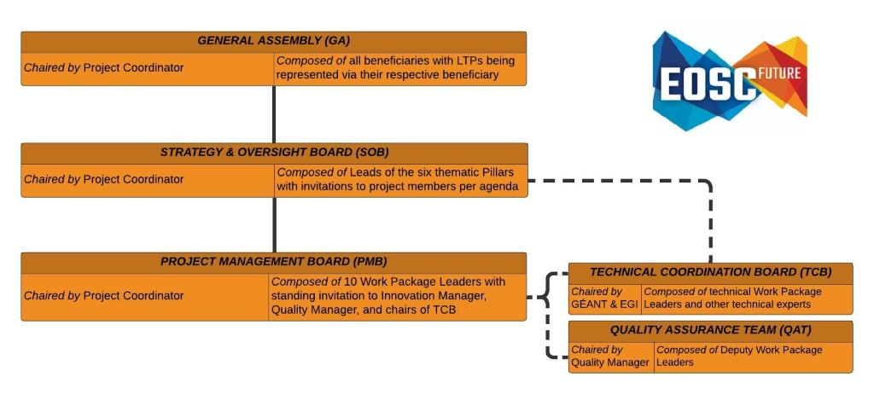
Governance

Slide 13
Status
Last week – significant feedback from EC reviewers
Yet more needed to address criticisms
  State of the Art, Composability,
  Milestones/Deliverables
  15-day deadline – end of next week
…

