Slide 1
Systematic tests on fast pigtails DWV Test and Budget Resistance Test May, 2021 Monday the 10th

Slide 2
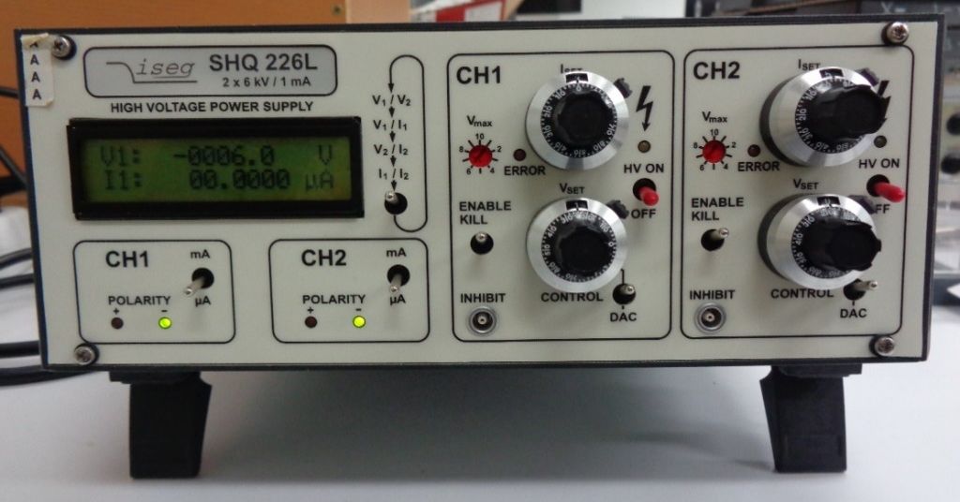
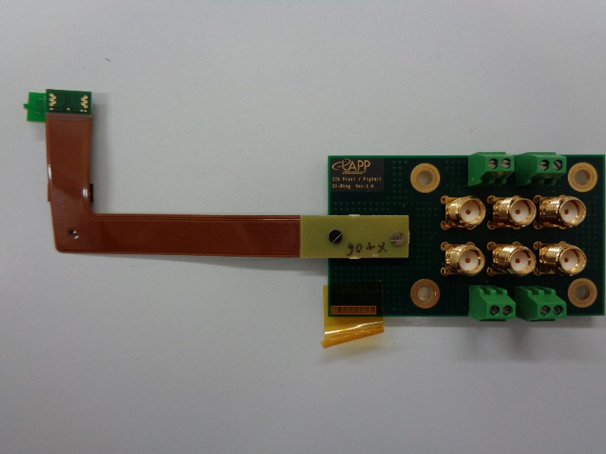
Dielectric Withstanding Voltage test
Test of the pigtails X -
Time = 2h20
Test of the pigtails X +
Time = 2h
BM25 plug
Pre-setting of 750V
Observation of the leakage current over 1 minute
BM25 plug

Slide 3
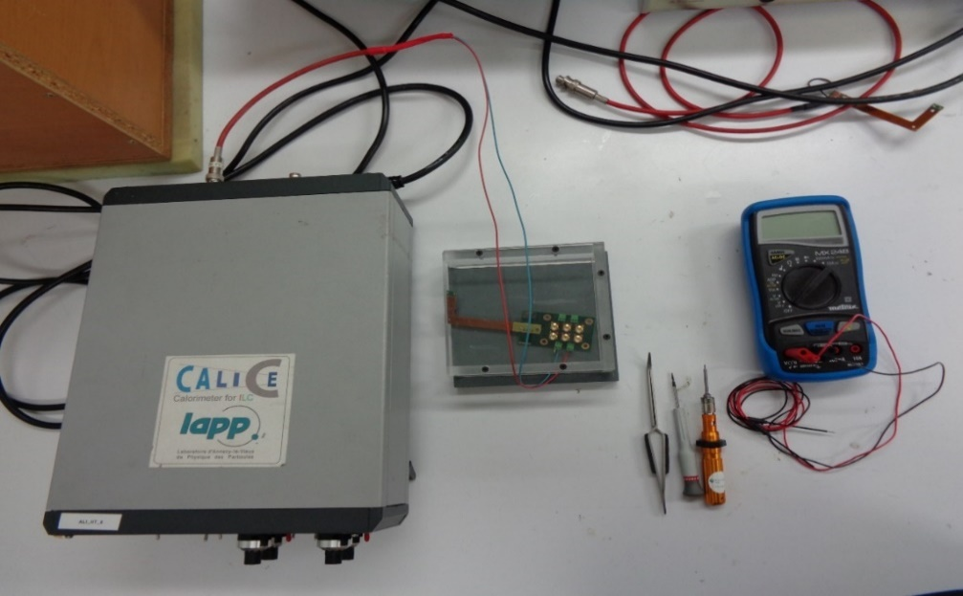
Dielectric Withstanding Voltage test
Results :
Continuity test = validated for each pigtails on the first time
the first thirty seconds, we notice a leakage current around 0.0010 / 0.0020uA which eventually stabilizes and disappears at the end of the minute (between 0 and 0,0003 uA)

Slide 4
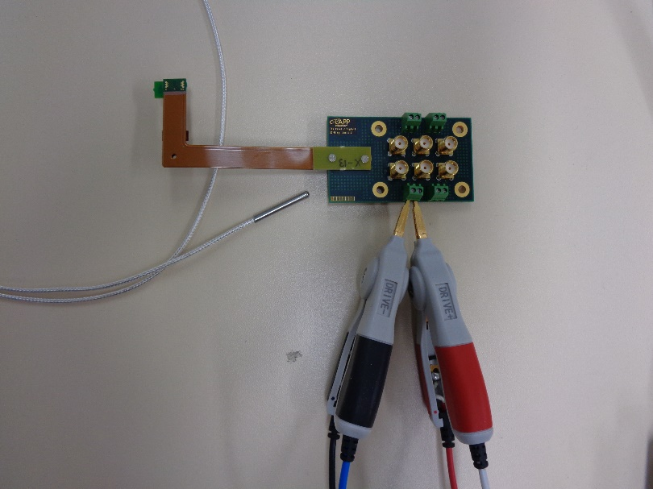
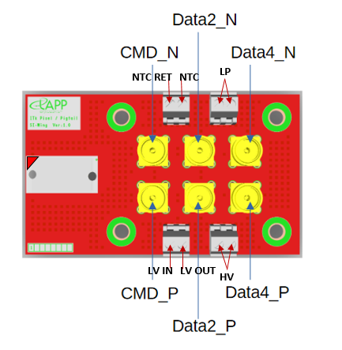
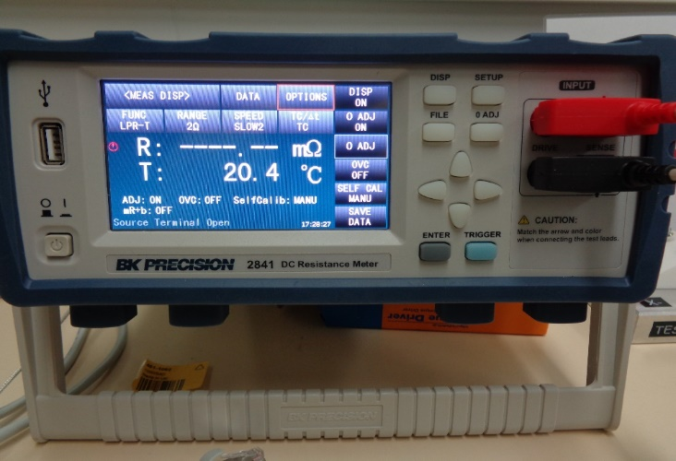
Budget Resistance Test : procedure
BM25 plug
Temperature probe

Slide 5
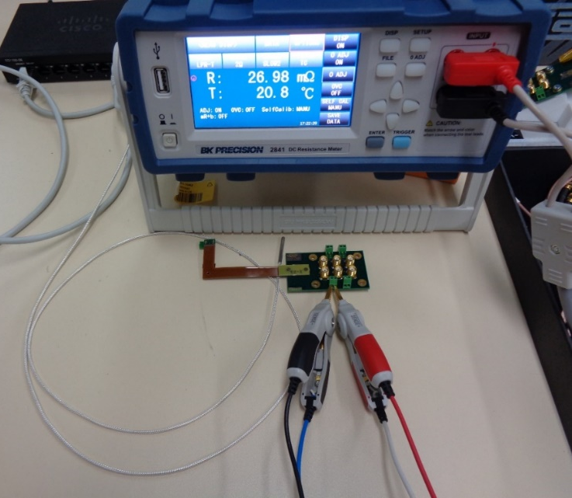
Budget Resistance Test : results and notes
Pigtail X-
Average | 25,2857576 mΩ
Variance | 0,39512519
Standard deviation | 0,62858984
Maximal Value | 27,12 mΩ
Minimal Value | 24,57 mΩ
- Uniform values on a same set of measure
- Between two sets : some differencies between values of the same DUT
Pigtail X+
Average | 24,7248485mΩ
Variance | 0,31658201
Standard deviation | 0,56265621
Maximal Value | 25,99 mΩ
Minimal Value | 23,64 mΩ

Slide 6
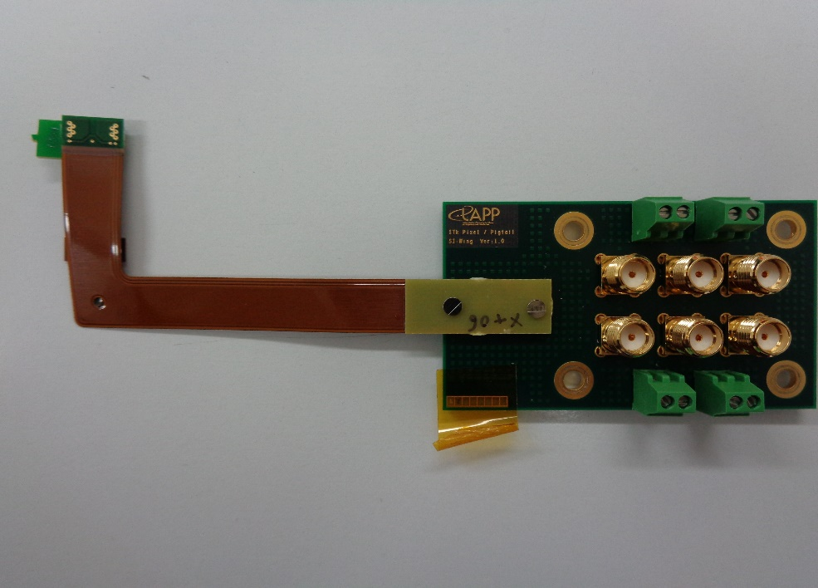
Budget Resistance Test
Board resistance = 9,36mΩ
Plug resistance = 4mΩ
Flex + Z-ray resistance | X- | X+
Average | 11,92mΩ | 11,36mΩ
Maximal value | 13,76mΩ | 12,63mΩ
Minimal value | 11,21mΩ | 10,28mΩ

