Slide 1
ESCAPE & Commercial Cloud
Frederic GILLARO <frederic.gillardo@lapp.in2p3.fr>

Slide 2
Cloud - objectives
Industrial and Commercial involvement (Slide from Simone .C Escape Kick Off)
Commercial storage can be added to the data lake
Commercial computing can be integrated with the data lake as extra processing capacity
In the data lake model, for both compute and storage there is no lock-in to the vendor
Deliverable MS11 on 12/21

Slide 3
Cloud – Uses Cases
Defined on 05-Feb-2021 with Xavier, Stephane, Nadine
Commercial Cloud is used as additional storage resources for the DataLake:
Spawn a VM with a RSE in the cloud (could be apache, dCache )
Move data to/from this RSE using RUCIO
Use Cold / Hot storage type
Commercial Cloud is used as opportunistic computing resources on data stored in datalake
A scientist needs to perform analysis from the cloud using Jupyter.
A reconstruction job is run on the cloud (DIRAC?)

Slide 4
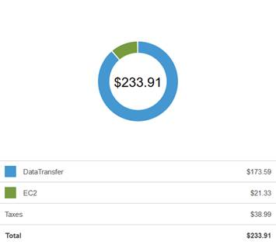
Work done / Cost
Set up an escape’s account on AWS, escape project pay for it.
First test : transfer 2 TB of data cost 200 $ (egress cost mainly)
Set up a partnership between Commercial Cloud and Escape (no need to pay)
Meetings with google teams
Applied for cloudbank (A cloud broker pilot project to explore the use of commercial cloud services)
https://indico.cern.ch/event/1021544/
Atlas, CMS, ALICE, Escape
GCP and AWS ☺

Slide 5
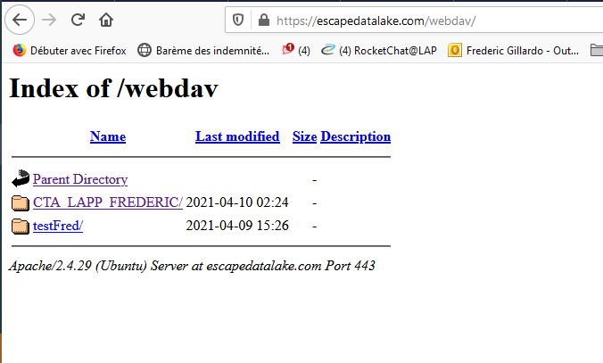
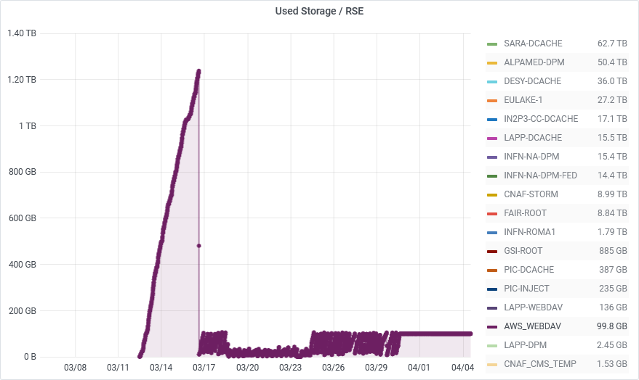
Work done / Storage
Publication from Atlas
Seamless integration of commercial Clouds with ATLAS Distributed Computing
Fernando Barreiro Megino, Harinder Singh Bawa, Kaushik De, Johannes Elmsheuser, Alexei Klimentov, Mario Lassnig, Cédric Serfon , and Tobias Wegner
Use S3 storage
RUCIO support S3 with signed URL
Google Cloud Storage supports signed S3 URLs just like AWS. We need this support primarily for rucio clients to upload to and download from GCS, since we cannot distribute the GCS access keys to our users.
https://github.com/rucio/rucio/issues/1054
An additional challenge was posed by the X.509 certiﬁcate infrastructure of the Google CloudStorage. The Cloud provider Certiﬁcate Authority(CA) has to be trusted to allow third party copy transfers. Amazon uses the DigiCert CA which is available in IGTF, however Google does not as they use their own CA. Up to now there are still ongoing discussions to get the Google CA included in IGTF. There exists a workaround where one can set up a frontend with their own CA, however that incurs additional charges and is thus not recommended.
Escape solution : Use a Rse (apache, dCache…) as a middleware
Spawn an ec2 instance
Configure network : Open https port (webdav)
Map to DNS name: escapedatalake.com
Grid certificate for domain name
Instantiate apache in docker container

Slide 6
Next step / storage
Mount storage
EBS (Elastic Block Store) natively supported :
Solid state drives (SSD)
Hard disk drives (HDD) (1 PB / year = 500 K€)
Mount S3 storage using fuse
Amazon S3 Standard (Hot)
Amazon S3 Standard-Infrequent Access
Amazon S3 Glacier
Amazon S3 Glacier Deep Archive (1 PB / year = 12 K€, retreive : 2,5 K€)
Evaluate performance scale / change location of rse

Slide 7
Next steps
Use GCP
Implement computing use case using CTA pipe
Write documentation / provide recipes (Chef)

Slide 8
Thank you !

