Slide 1
WP3
Thomas Vuillaume, 29/03/2021

Slide 2
ESCAPE School
Confirmed courses:
  Python and notebooks, Enrique Garcia
  Test driven developments, pytest, Max Noe
  Open Science introduction Rachael Ainsworth
  Version control, git, continuous integration, Max Noe
  Reproducible data science in practice, Arturo Sanchez Pineda
  Numpy, Tamas Gal
  Pandas, Tamas Gal,
  Matplotlib, Tamas Gal
  Scipy, Axel Donath
  Astropy, Axel Donath
  Gammapy, Axel Donath
  Intro to machine learning, Martino Sorbaro
  Introduction to Julia, Tamas Gal
  Intro to deep learning, Mikael Jacquemont
  Spark, Julien Peloton
Still TBC or looking for:
  Debugging and profiling (Karl Kosack, TBC)
  VSCode or Pycharm
  Uproot/pyroot
  GW open science

Slide 3
ESCAPE School – preliminary program
CET??

Slide 4
ESCAPE School
Organisation:
https://forge.in2p3.fr/projects/escape-lapp/wiki/ESCAPE_summer_school
slack: https://join.slack.com/t/escape-school/shared_invite/zt-oh5v9593-GOhnvatYcBh4VhYBLF0XVQ
GitLab: https://gitlab.in2p3.fr/escape2020/schools/school2021
Indico: https://indico.in2p3.fr/event/20306/
Aiming for registration before the end of April

Slide 5
WP3 status update
https://indico.in2p3.fr/event/23966/timetable/
Guidelines for ESCAPE publications:
  properly archive in an as open archive as possible (gold/green open access if possible); the preference is the ESCAPE Zenodo community if no other archive is used;
  NB: https://open-research-europe.ec.europa.eu launched
  make sure that the publication is found by OpenAire (guaranteed if the preferred solution is chosen)
  ESCAPE deliverables should be made publicly available on OSSR ESCAPE Zenodo community

Slide 6
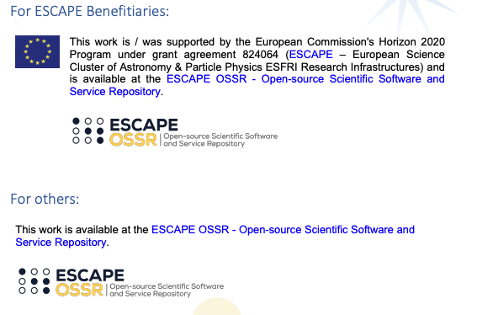
WP3 status update
https://indico.in2p3.fr/event/23966/timetable/
Reference template for the ESCAPE OSSR

Slide 7
WP3 – discussions for an MoU between ESCAPE and ESFRIs for data sharing
Several projects need access to ESFRIs internal data
In particular CTA, KM3NeT and Virgo/LIGO for multi-messenger analysis
Discussions to make an MoU
Need to define more precisely the needs and datasets associated

