Slide 1
WP2 lapp status
Frederic Gillardo, Berkay Turk, Arturo Sanchez
Lapp/CNRS
12 April 2021

Slide 2
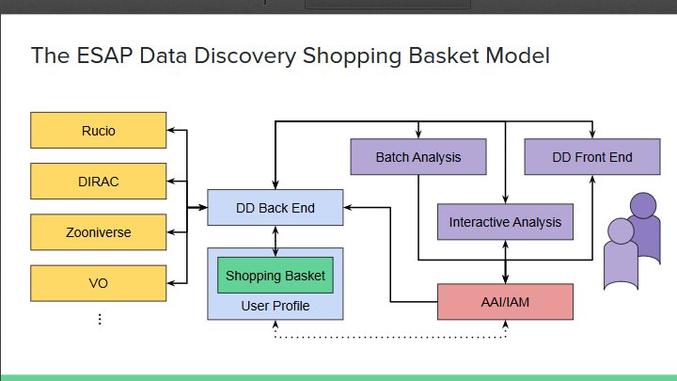
WP2 général topic
DAC21: Data and Analysis Challenge (November 2021) https://docs.google.com/document/d/1gRjSe82nlDWdtXf0wB1Sl4bfXg7FK_xftZbnu6dU6so/edit
CTA : Meeting organized by Nadine on 20th April
WP2/WP5 meeting: https://indico.in2p3.fr/event/23869/
Cloud
Partnership AWS/Google and ESCAPE via CERN
Berkay fixed an issue with apache-webdav hash function from DESY’s implementation
https://escapedatalake.com/webdav/
https://monit-grafana.cern.ch/d/qByShefGk/fts-transfers?orgId=51
ESCAPE Demo at the ExPaNDS review

Slide 3
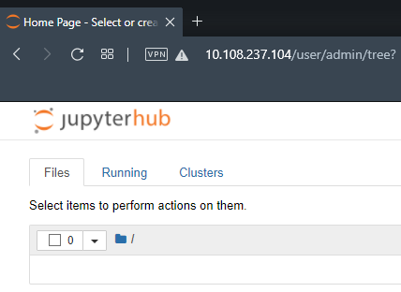
Work Done(Berkay)
Kubernetes
Self training continues
Successfully created a JupyterHub instance
Default settings
Continue with customization
Authentication
WebDAV
An issue which causes upload error has been fixed
The source of the problem was a misconfiguration of a module
Solved and reported to the developer of the module (DESY)
Uploaded Gitlab repository
Notes:
Besions similaire : Volume / fichier et de donnée (plusieur PB million fichier) Production onsite (SKA, LSST)
Regle de replication
QoS (tape)
FAIR
Authentification …

Slide 4
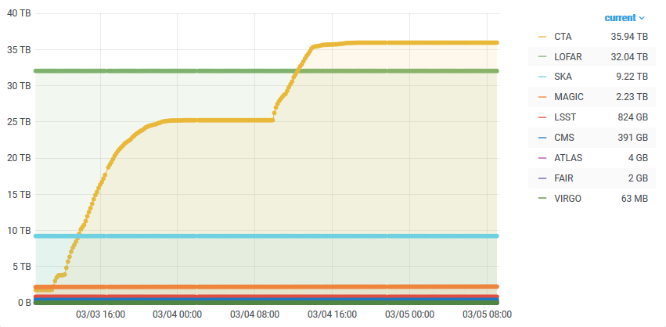
Work Done(Frederic)
Cloud / deliverable M30 end of may
GCP : Meetings with google team and CERN to get access to google resources for free
AWS : Working to install an RSE on AWS (not yet trusted by dataLake) but …
Install an apache server in container
use a grid certificate
URL : escapedatalake.com/webdav
static IP
Publicly available / Firewall rule
Declare this new rse as AWS-WEBDAV in RUCIO
DIRAC
Run CTA ingest workflow using an singularity image on CVMFS,
no download / no conversion
20 TB in 8 h =>5,5 Gb/s / limit for 1 rse
DR 5,5TB / 30h =>0,4 Gb/s
https://gitlab.in2p3.fr/escape2020/wp2/escape_cta/-/tree/master/dirac
Notes:
Besions similaire : Volume / fichier et de donnée (plusieur PB million fichier) Production onsite (SKA, LSST)
Regle de replication
QoS (tape)
FAIR
Authentification …

Slide 5
Work Done(Arturo)
Continue working on the implementation of the ATLAS Open Data examples on the CTA-based container
One example running
ROOT yet need to be importable from a notebook
Running on lapp-esc03
Add more datasets to the Datalake: they are the needed ATLAS Open Data samples (completing the set that Stephane added for the Hyy analysis example)
~160 GB will be added in total
Scope used: ATLAS_OD_EDU (for ATLAS Open Data for EDUcation)
Source of the datasets: http://opendata.atlas.cern/samples-13tev/ & http://opendata.atlas.cern/samples-8tev/
Notes:
Besions similaire : Volume / fichier et de donnée (plusieur PB million fichier) Production onsite (SKA, LSST)
Regle de replication
QoS (tape)
FAIR
Authentification …

