Slide 1
Recent Achievements on Time Distribution System R&D
stefano russo LPNHE Paris,
Fabrizio Ameli INFN Roma,
HK meeting 04/03/2021

Slide 2
Proposed Architecture
The time distribution system consists of 2 main parts:
A system that generates the local time base correlated to the Universal Time Coordinated (UTC).
A distribution network that delivers the clock to all the front-end nodes and establish a communication link for critical slow control.
For each of the two I’ll present the actual R&D status and future plans

Slide 3
The Local Time Base

Slide 4
GNSS/UTC
Time distribution
GNSS receiver
Atomic
clock
Thanks to the close and fruitful collaboration with SYRTE (https://syrte.obspm.fr) colleagues we are working to define the architecture most suitable for HK.

Slide 5
GNSS/UTC – Key components
Time distribution
GNSS receiver
Atomic
clock
Atomic Clock
Multi GNSS receiver and Antenna
Distribution system between Atomic Clock and GNSS receiver
Software correction for UTC correlation (if needed)

Slide 6
Atomic Clock
Time distribution
GNSS receiver
Atomic
clock
The atomic clock is the foundation of the local time base
Needs to be as stable as possible
A good tradeoff between cost and performance could be a “Passive Hydrogen Maser”
Frequency stability: 5⁻¹³s @ 1s, 4⁻¹⁵s @ 1day
Jitter equivalent: 0.5 ps on RF signals, <40 ps on PPS
Frequency Drift: 1⁻¹⁵s per 1day (many 1⁻¹³s in a year)
The main problem of this kind of atomic clocks is the medium-long term frequency drift
(can be mitigated by the GNSS receiver)

Slide 7
Multi GNSS Receiver and Antenna
The GNSS receiver is needed to:
accord the local base to UTC
Correct the medium/long term drifts of the atomic clock
Time distribution
GNSS receiver
Atomic
clock
The GNSS receiver is driven by the atomic clock to enhance stability.
The performances are heavily dependent by the antenna field of view (site orography).
The less satellites are available the less precision is achieved (position and corrections).
A multi GNSS receiver provides a larger satellites catalog (not only GPS but also GALILEO and QZSS/ Michibiki (みちびき))
A common view technique could be developed to “trigger” the far detector when the beam is active
A mobile system is needed to study the orography (before start) and check the ”resident” system (every 2/3 years)

Slide 8
Summary and next steps
We have purchased a Septentrio PolaRX5TR multi GNSS receiver and an antenna.
We’ll characterize the system against a “level 1 UTC station” (SYRTE) as soon the pandemic will allow (delayed).
After a first R&D phase we are planning to test it in situ at Super-Kamiokande site (details under discussion).
To better exploit the Japanese constellation we could benefit of a contact with the Japan institute responsible for UTC (NICT?)
To be done:
It would be great to exchange ideas with T2K colleagues so we can learn from them and study the compatibility with the JPARC equipment for common view.
Early access to the HK site to study its characteristics and test the satellite signals.

Slide 9
The Time distribution Network

Slide 10
Requirements
Clock to all FE synchronous and phase deterministic with the source.
Jitter at FE < 100 ps.
Bidirectional data exchange link for critical slow control (100 Mbps minimum).
Extra bandwidth can be useful.

Slide 11
Time Distribution Basic Concepts
Two concepts are subject of our R&D:
Direct distribution SK-like (see Izumiyama-san talk).
Clock embedded into data (clock and data recovery concept)
Custom solution
White Rabbit

Slide 12
CERN White Rabbit
A possible architecture
8* links
DAQ
8* links
clock distribution edge
WR switch
WR switch
…
FE
FE
FE
FE
…
…
…
…
…
…
24
24
24
24
8*
* These numbers depend on the bandwidth
8*

Slide 13
Custom Solution - 1
A possible architecture (same as WR)
1 Gbps Eth
DAQ
1 Gbps Eth
clock distribution edge
Custom Concentrator
Custom Concentrator
…
FE
FE
FE
FE
…
…
…
…
…
…
24
24
24
24
8*
* These numbers depend on the bandwidth
8*

Slide 14
Custom Solution - 2
A possible architecture (clock fanout)
1 Gbps Eth
DAQ
1 Gbps Eth
clock distribution edge
Custom Concentrator
Alternative CLK fanout
Custom Concentrator
FE
FE
FE
FE
…
…
…
…
…
…
24
24
24
24
8*
* These numbers depend on the bandwidth
8*

Slide 15
Custom Solution
Possible connection schemes
Custom Concentrator
16 connections to FE
1 up to 10 Gb Ethernet for slow control
TE0808
Total of 53 concentrator for the Inner detector.
~130 keuros
~10 distributors for OD ~15keuros
FPGA cost ~1000 euros
Board cost ~1500 euros
FE
FE
…
…
…
16

Slide 16
Custom Solution
Possible connection schemes
Custom Concentrator
Zynq
32/48 connections to FE
2 up to 10 Gb Ethernet to slow control
A7200
A7200
A7200
Total of 18 concentrator for the Inner detector.
~75 keuros
~5 distributors for OD ~12keuros
FPGA cost ~1500 euros
Board cost ~2500 euros
FE
FE
…
…
…
32/48

Slide 17
Board Set for the Custom Solution
Trenz TE080
Xilinx Ultrascale+ ZU9EG
Motherboard with 2 SFP+ and RJ45
Expansion with 4 SFP+
This board set will allow to build a time distributor module connected to 6 FEs.
It could be used for the IWCE at CERN.
The firmware development has started.

Slide 18
Summary of the Test Campaign

Slide 19
Test on Custom Solution

Slide 20
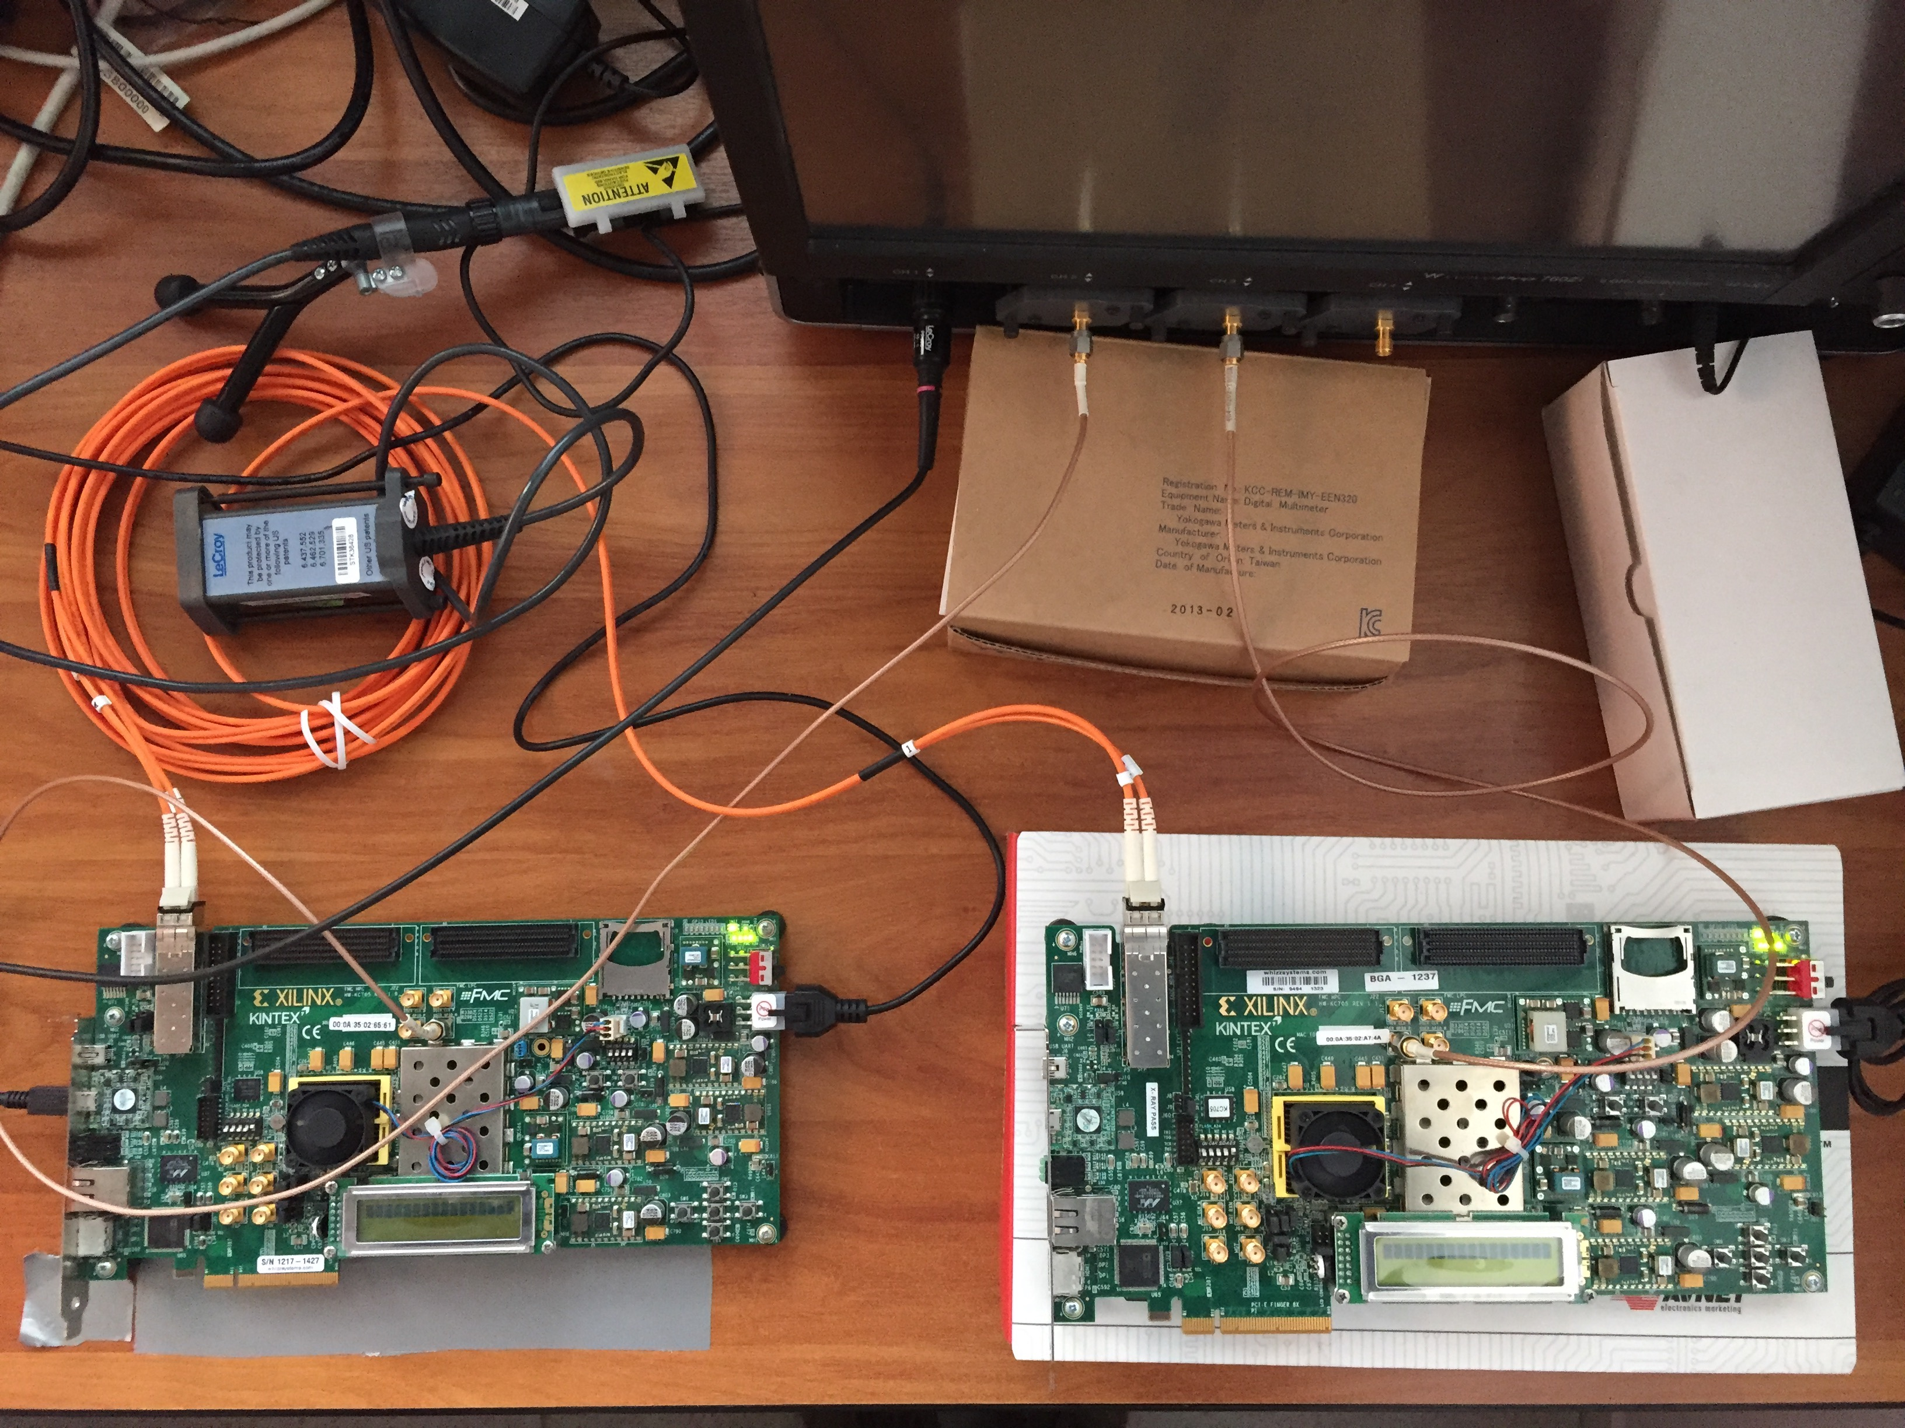
First Jitter Test on Custom Solution
Tx clk
Rx clk
Test done with 2 Xilinx EVB KC705
And the Lecroy scope
Wavepro 760Zi 6 GHz 40Gsps
RX board
TX board
The clock is sent embedded into data from the board on the right and reconstructed by the board on the left

Slide 21
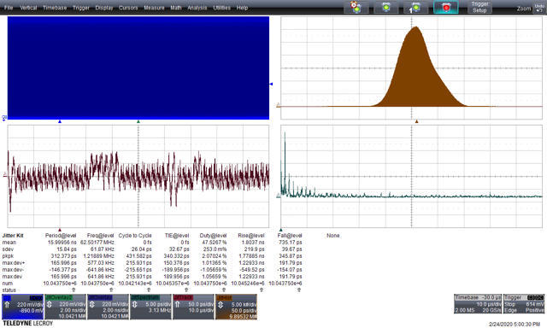
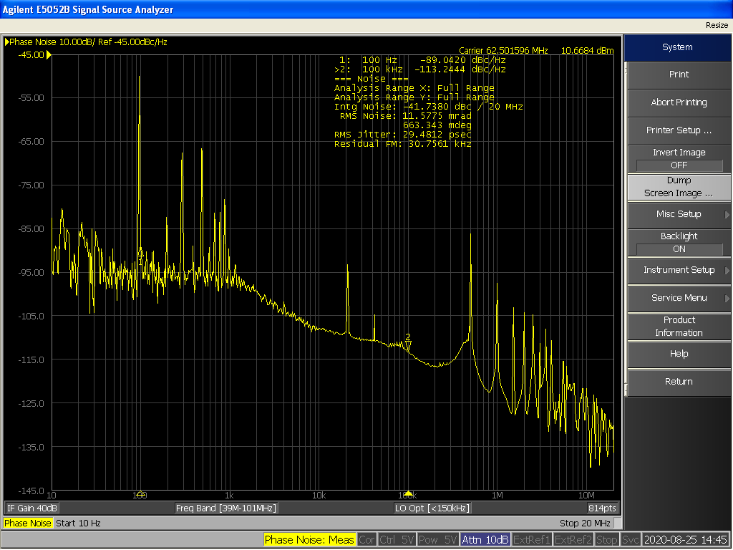
TX clock Time Interval Error
Time Domain
Frequency Domain
Time Interval Error 32 ps rms
RMS noise 29.5 ps
Noise at 500 kHz
and its harmonics

Slide 22
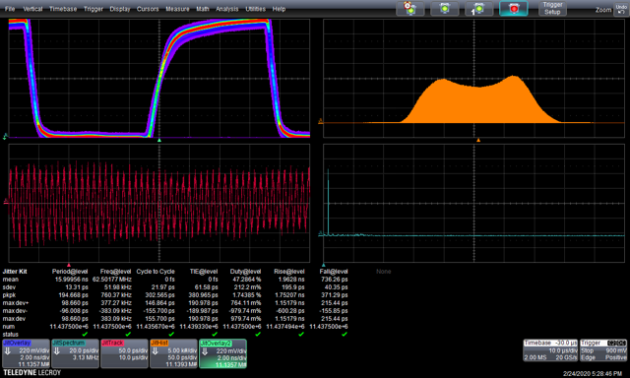
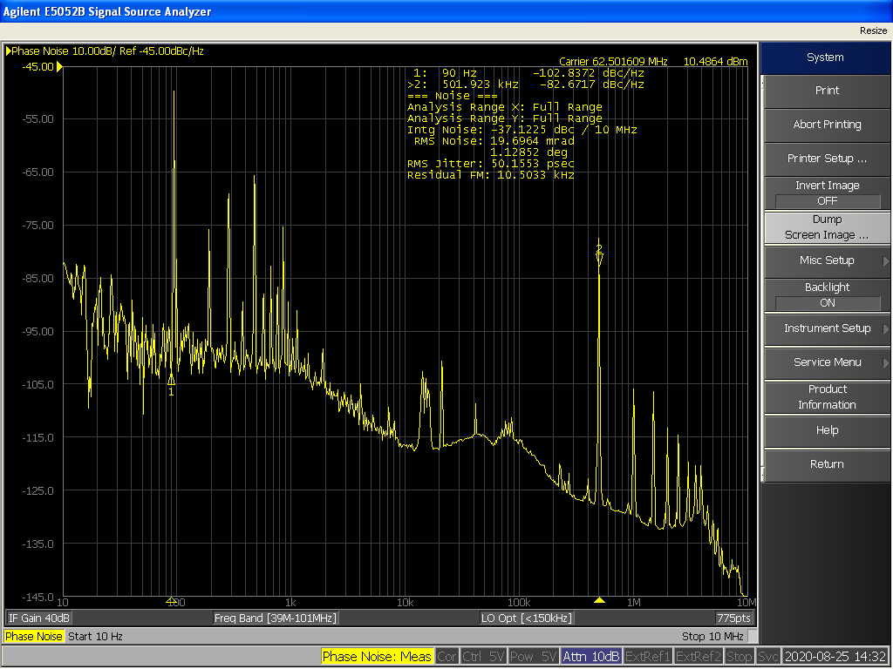
RX clock Time Interval Error (time domain)
Time Domain
Frequency Domain
Time Interval Error 61.5 ps rms
RMS noise 50.1 ps
More noise at 500 kHz and its harmonics
due to DC\DC modulation

Slide 23
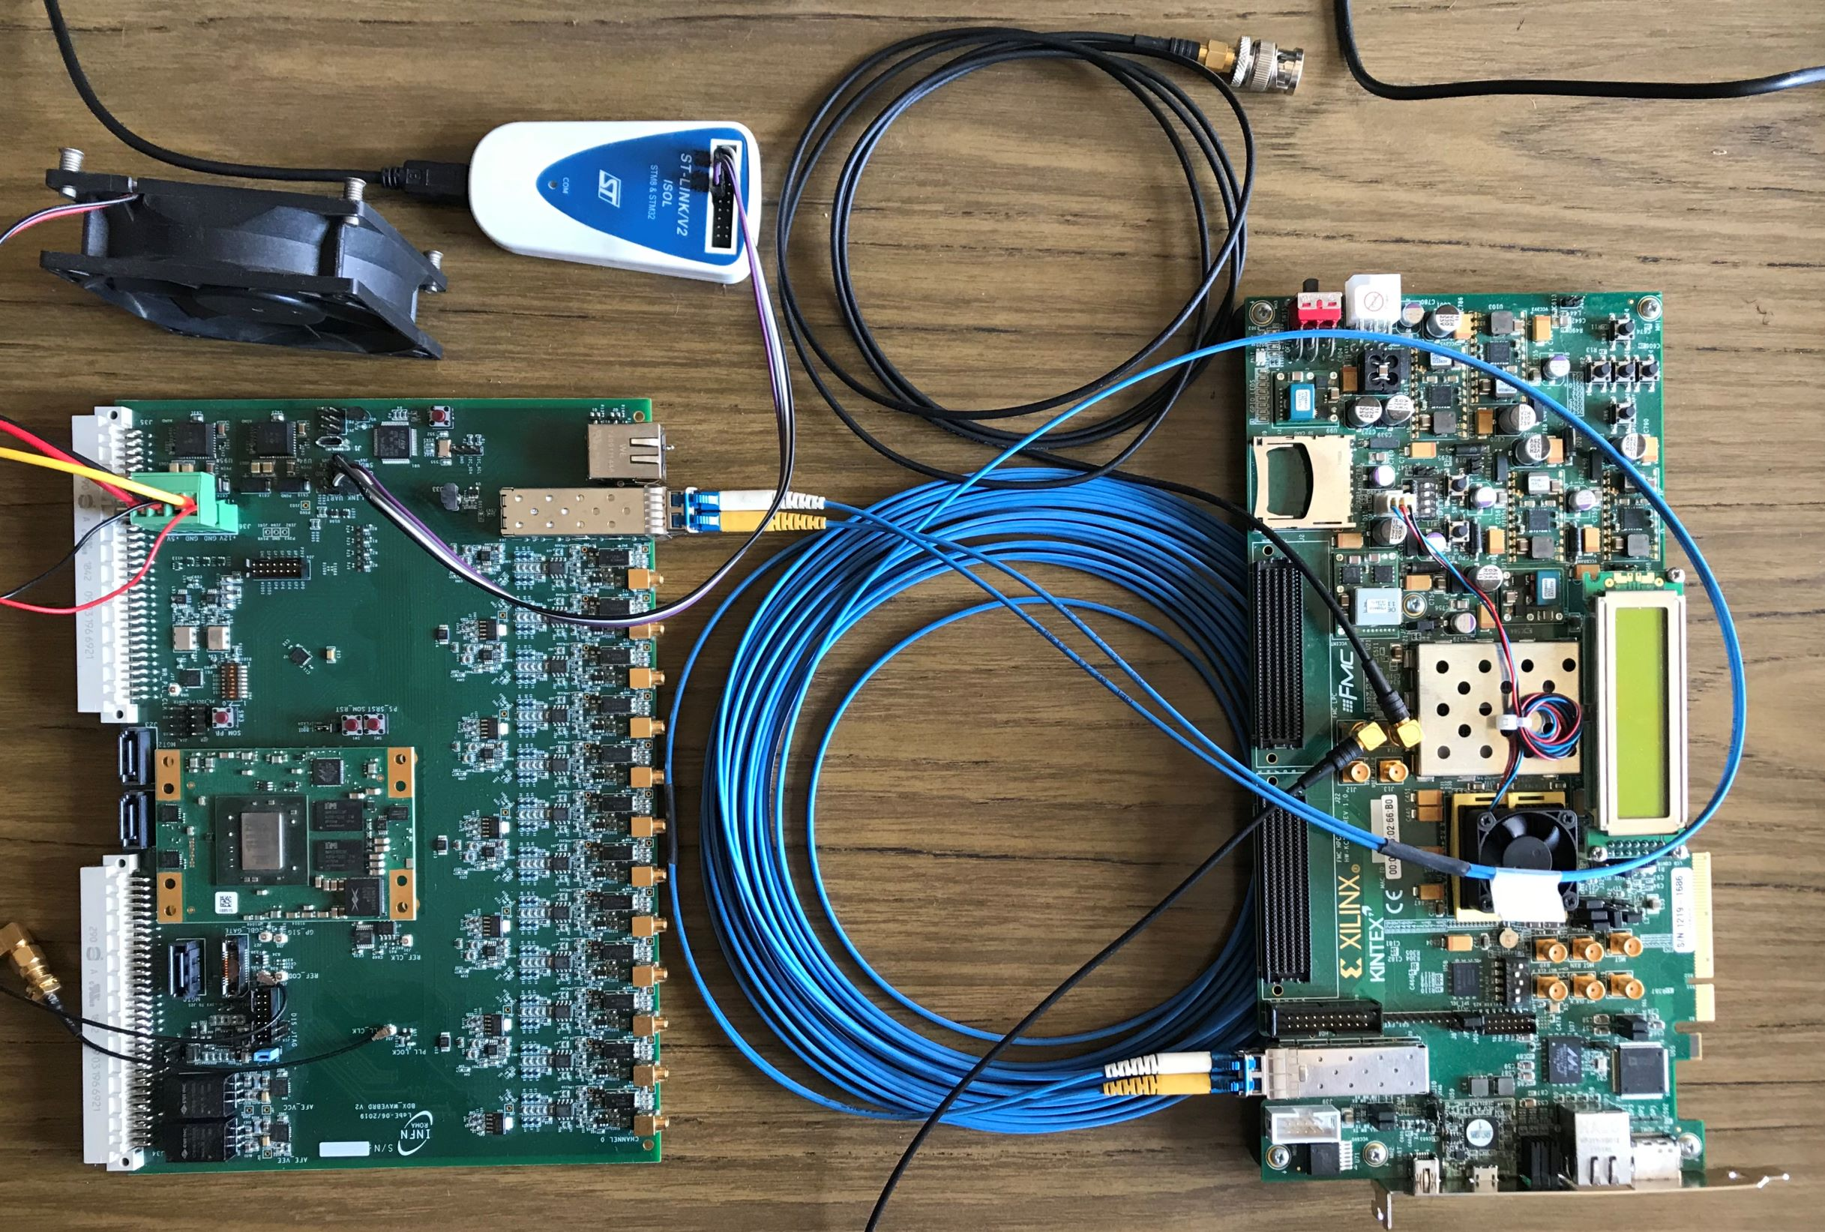
Custom solution: Jitter Test on KC705-Waveboard
TX board
RX board
The TX board is the same KC705 while the RX board is a custom board developed by INFN-Roma for BDX experiment (zynq 7000)

Slide 24
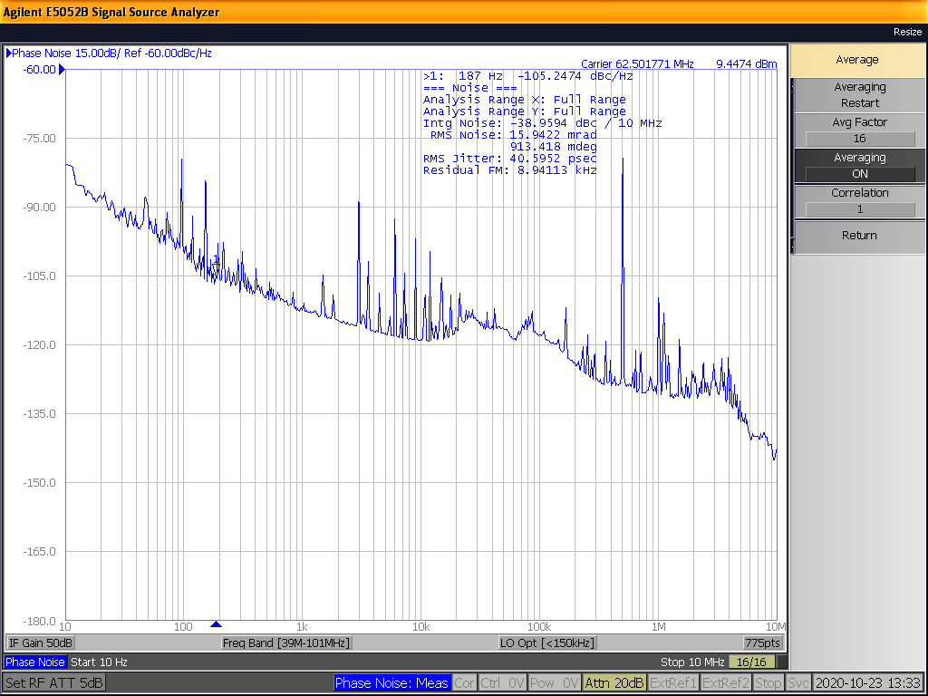
RX clock Time Interval Error (Frequency Domain)
Still noise at 500 kHz due to the TX side. There are no spurious from the RX board.
RMS noise 40.6 ps (with KC705 was 50.1)

Slide 25
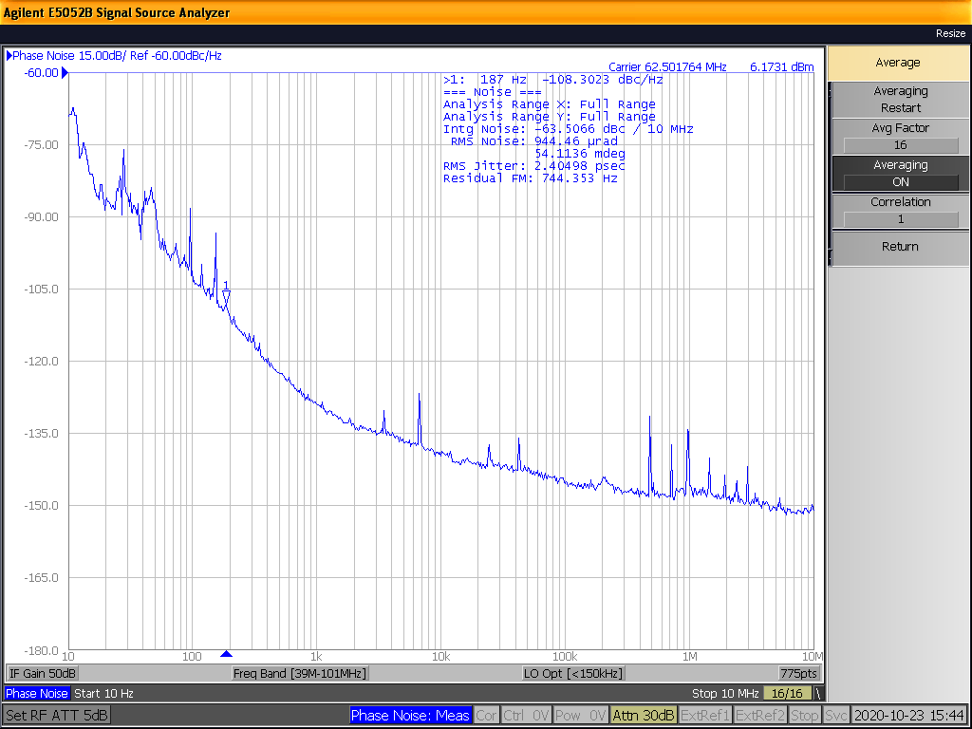
RX clock Time Interval Error Cleaned by PLL
The received clock is sent to the jitter cleaner PLL SI5345 and its output is measured
RMS noise 2.4 ps

Slide 26
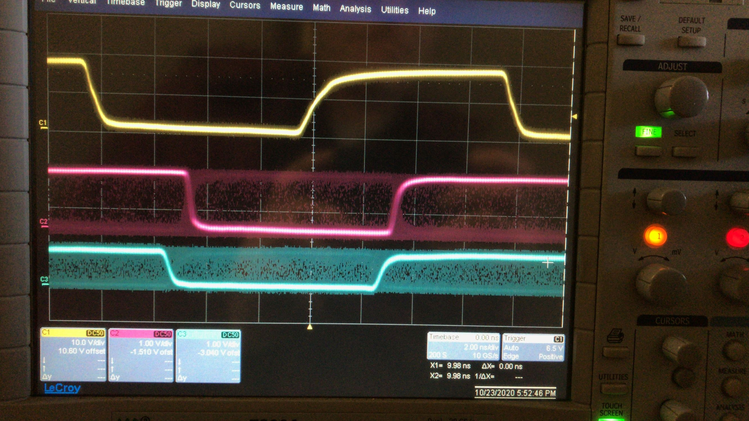
Phase Stability After Reset Test
TX clock
RX clock
RX clock after PLL
The phase difference between TX and RX remains constant after each reset

Slide 27
Test on White Rabbit

Slide 28
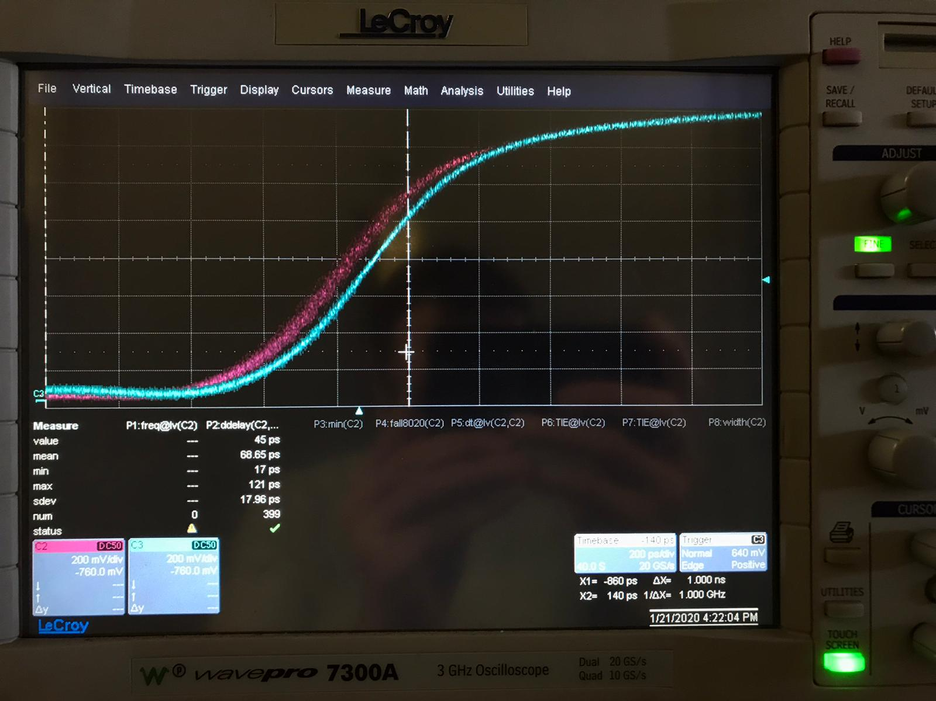
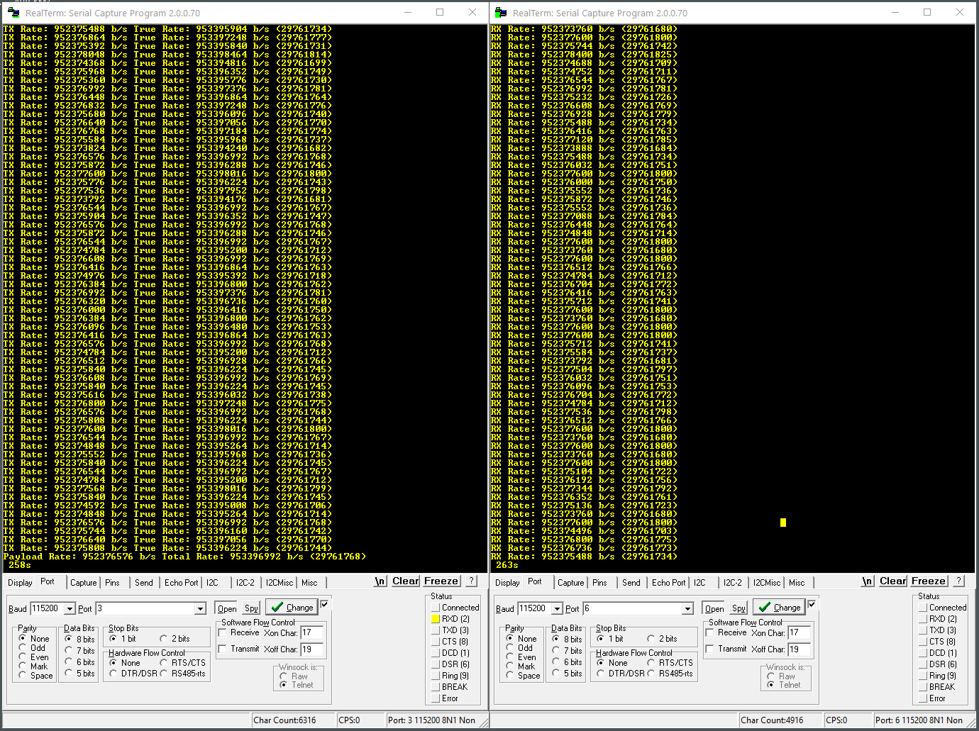
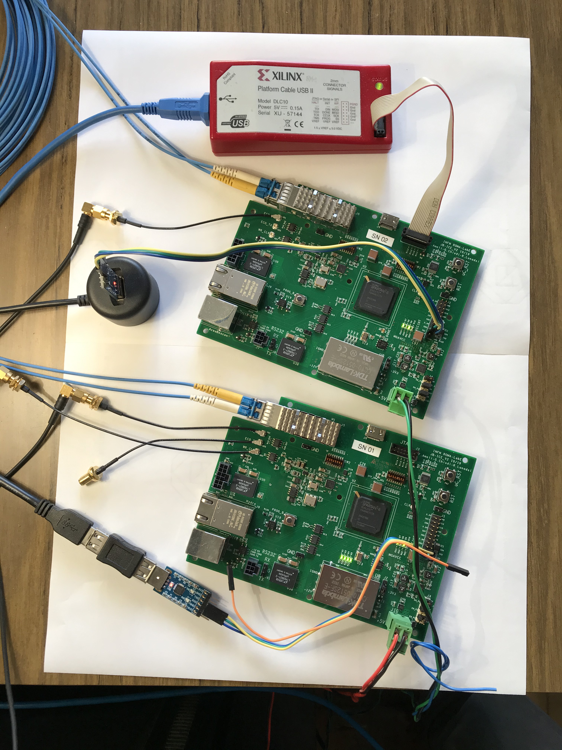
White Rabbit R&D
PPS total jitter = 17.96 ps
Measured sustained bandwidth > 953Mbps

Slide 29
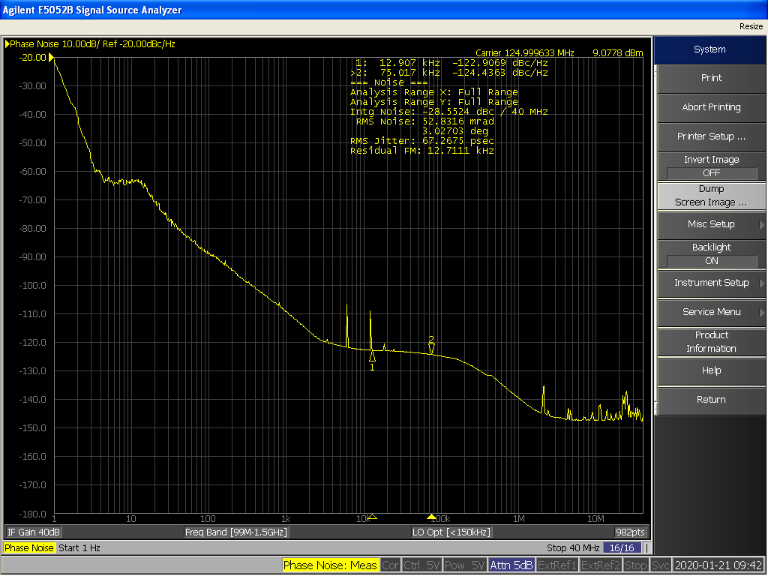
White Rabbit R&D
The total jitter on reconstructed clock is 67.26 ps RMS
The biggest part is concentrated between 1 and 10 Hz

Slide 30
White Rabbit R&D
The total jitter on reconstructed clock is 67.26 ps RMS
The biggest part is concentrated between 1 and 10 Hz

Slide 31
Conclusions
The R&D program is almost concluded. The proof of concept test has shown that our technology is perfectly fitted for the requirements
The last phase has started (according to the schedule):
Test our distribution against the FE. Work in progress with QTC and discrete. The other 2 groups are welcome to join
The final prototype for the custom solution is under design. The distributor EVB delivery is a bit late due to difficulty in producer stock (autonomous drive market?) but still on schedule
WR switch already available to make the final test
We should discuss about the time distribution end point in the vessel. An intermediate step could be temporary end-point board
We look forward to start travelling again so we can speed up the integration and final tests

Slide 32
One Last thing…
We would like to better evaluate the impact of the time distribution on the final charge and time measures to:
Justify and cross check the actual experimental constraints.
Have a better understanding of our instrument (before and during operation).
To do that we are thinking to build/use a very simple simulation tool to study that.
All ideas, suggestions and help are very welcome!!!

Slide 34
GNSS to local time distribution link
Time distribution
GNSS receiver
Atomic
clock
The local atomic clock drives the GNSS receiver with 10 MHz and 1 PPS signals.
This link must be synchronous and phase deterministic to have good stability results.
A system able to compensate a very long fiber path is needed (same R&D as the local time distribution).
The final choice will be taken once the antenna and receiver location will be decided.

Slide 35
Software correction for UTC correlation
Time distribution
GNSS receiver
Atomic
clock
The time base will be correlated to the UTC using the GNSS receiver.
If a great precision is needed software algorithms can be used to correct satellites data using “time products” distributed by the UTC consortium.
These “time products” and therefore the corrected data would be available every week.
The need of this kind of techniques will be defined once we’ll establish the experimental constraints and study the site (antenna position).

Slide 36
Cost estimation (updated)
Time distribution
GNSS receiver
Atomic
clock
As today the price of the system is:
Atomic clock: 60/70 KEuro
GNSS receiver: 13 Keuro
Antenna + cable: 5 Keuro
Clock distribution system: 6 KEuro
TOTAL: ~100 Keuro
Prices and performances may vary in the future so we’ll buy the equipment just before deployment

Slide 37
Direct distribution
Clock is sent directly on one dedicated fiber.
Time information is sent on another fiber in form of counters.
Master
Slave
Clk ? MHz*
Clk ? MHz*
Clk ? MHz*
0x0B
0x16
0x0B
0x16
0x0B
0x16
Data
Data
Data

Slide 38
Clock embedded into data
Clock, time information and payload data are sent on the same fiber encapsulated in a protocol
8b10b
encoder
Deserializer
(clock recovery)
8b10b
decoder
Serializer
Clk 125 MHz*
Clk 1.25 GHz*
Clk 125 MHz*
Clk 125 MHz*
1101001011
0110101011
0110101011
1101001011
10 possible
phases
0x0B
0x16
0x0B
0x16
Serial data 1.25 GHz*
Data 8bits
Data 10bits
Data 8bits
*Not in scale
The link’s lock is established and the reconstructed clock is generated after power-up or reset
The clock is reconstructed from the data stream but there are 10 possible phases to lock on

Slide 39
Clock and data recovery - Custom solution
8b10b
encoder
Deserializer
(clock recovery)
8b10b
decoder
Serializer
Clk 125 MHz*
Clk 125 MHz*
Clk 1.25 GHz*
Clk 125 MHz*
1101001011
0110101011
0110101011
1101001011
10 possible
phases
0x0B
0x16
0x0B
0x16
Serial data 1.25 GHz*
Data 8bits
Data 10bits
Data 8bits
*Not in scale
The phase distance is only dependent on the lasers and fiber that connect the master and slave.
Temperature variations are negligible in our case

Slide 40
Clock and data recovery – white rabbit
8b10b
encoder
Deserializer
(clock recovery)
8b10b
decoder
Serializer
Clk 125 MHz*
Clk 125 MHz*
Clk 1.25 GHz*
Clk 125 MHz*
1101001011
0110101011
0110101011
1101001011
10 possible
phases
0x0B
0x16
0x0B
0x16
Serial data 1.25 GHz*
Data 8bits
Data 10bits
Data 8bits
*Not in scale
The phase distance between the sent and reconstructed clock is continuously compensated

Slide 41
Clock and data recovery – comparison
Custom Solution
White Rabbit
No external circuit required on FE (only FPGA ser-des).
The phase difference is not compensated.
Custom design (but we have expertise).
Distribution custom boards needed (EVB could be used).
Link speed and the data protocol are flexible
defined by FPGA configuration.
An external circuit to compensate the phase is required on the FE.
Phase difference is compensated.
Design provided by CERN.
Distribution boards are off-the-shelf (WR switches).
Link protocol is 1 GbE (the data flow can be lower).

