Slide 1

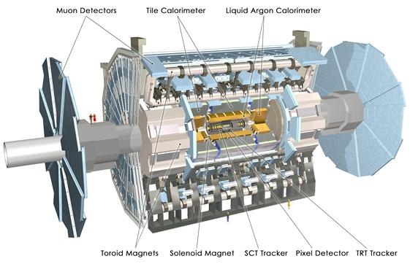


ATLAS muon chamber upgrade
D. Attié, T. Alexopoulos, M. Boyer, P. Colas, J. Derré, F. Diblen,
E. Ferrer Ribas, T. Geralis, A. Giganon, I. Giomataris, F. Jeanneau, K. Karakostas, S. Kirch, E. Ntomari, P. Schune, M. Titov, W.Wang
Within the MAMMA collaboration
Arizona, Athens(U, NTU, Demokritos), Brookhaven,
CERN, Harvard, Istanbul, Naples, CEA Saclay, Seattle, USTC Hefei, South Carolina, St. Petersburg, Shandong, Stony Brook, Thessaloniki
Paul Colas, Shuoxing Wu / CEA Saclay, USTC Hefei

Slide 2
Increase LHC luminosity (guess)
L x10
NOW 7 TeV
END 2011 increase energy

Slide 3
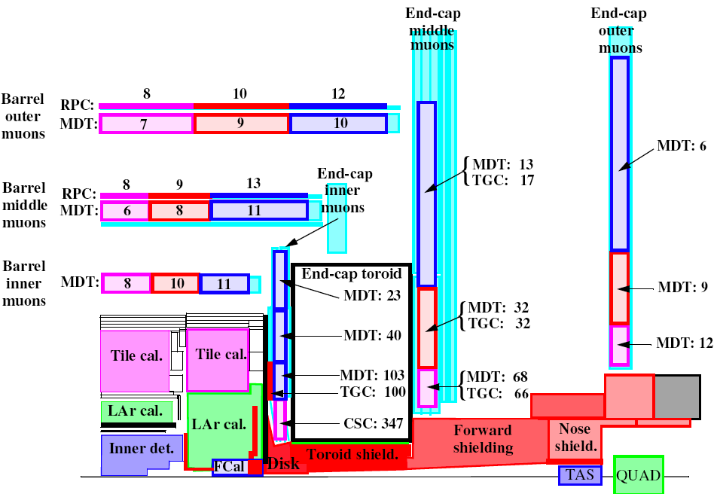
Muon chambers
L^{sLHC} = 10 × L^{LHC} = 10³⁵ cm².s⁻¹
→Increase in proportion of the neutron, photon and hadron background
Replacement or upgrade of the muon forward chambers
Requirements:
MICROMEGAS
Fast and efficient ion collection
TPC mode possible: sensitivity to incidence angle.
« bulk » production process suitable for large surfaces
High rate capability (≤ 10 kHz.cm-2)
Spatial resolution ~100 µm (θ ≤ 45 °)
Time resolution ~few nanosecond
Level1 triggering capability
Radiation hardness and good ageing properties
Large surface

Slide 4
Resistive anode detectors are more stable:
Standard SLHC2 (2mm) (@10KHz):
R6(1mm,400kΩ/ resistive strip) (@10KHz):
SLHC2: HV=400 V (Gain ~3000): current when sparking < 0.4 μA
voltage drop< 5%
R6: HV=390 V (Gain ~3000): current when sparking < 0.08 μA
voltage drop<0.5%

Slide 5
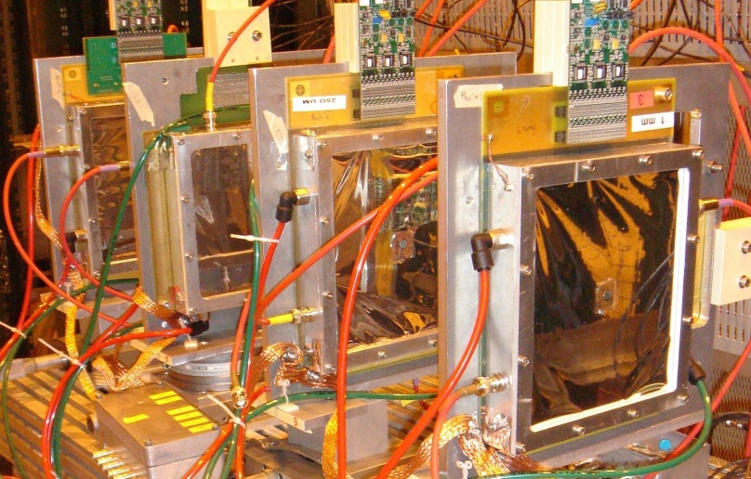
The Saclay test beam set up at CERN:
Telescope:
3 X-Y detectors(10 x 10 cm²)
Aim: Test different resistive film detectors manufactured by Rui De Oliveira at CERN and compare behaviour to non-resistive detectors
Electronics: GASSIPLEX
DAQ: realised by Demokritos
Gas: 95%Ar + 3% CF₄ + 2% isobutane
SPS-H6
120 Gev π+
Detectors in test
Resistive
Non-Resistive
Beam
1 mm
0.25 mm
1 mm
X
Y
X
Y
X
Y
Tested detectors:
Standard bulk detectors; Resistive coating detectors; Segmented mesh detector

Slide 6
Summary of tested detectors:
Type | Name | Properties:
Standard bulk: | SLHC3 | 1mm pitch
 | SLHC2 | 2mm pitch
Resistive coating: | R3&R4 | 2mm,2MΩ/ ,kapton+insulator
 | R5 | 2mm,250MΩ/ ,resistive paste
 | R6 | 1mm,400KΩ/ , resistive strip
 | R7 | 0.5mm, tens of KΩ/ , resistive pad
Segmented mesh | S1 | 1mm pitch,8 segmentations

Slide 7
Sparking behavior of resistive detector R3:
Standard SLHC2 (2mm) (@10KHz):
Resistive R3(2mm,2MΩ/ ) (@10KHz):
SLHC2: HV=400 V (Gain ~3000): current when sparking < 0.4 μA
voltage drop< 5%
R3: HV=410 V (Gain ~3000): current when sparking < 0.2 μA
voltage drop<2%

Slide 8
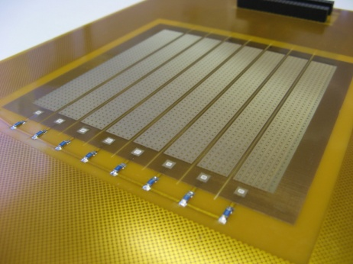
Sparking behavior of S1:
Seven,eight sparking
six sparking
five sparking
four sparking
three sparking
two sparking
one sparking
Standard bulk: SLHC2
S1:

Slide 9
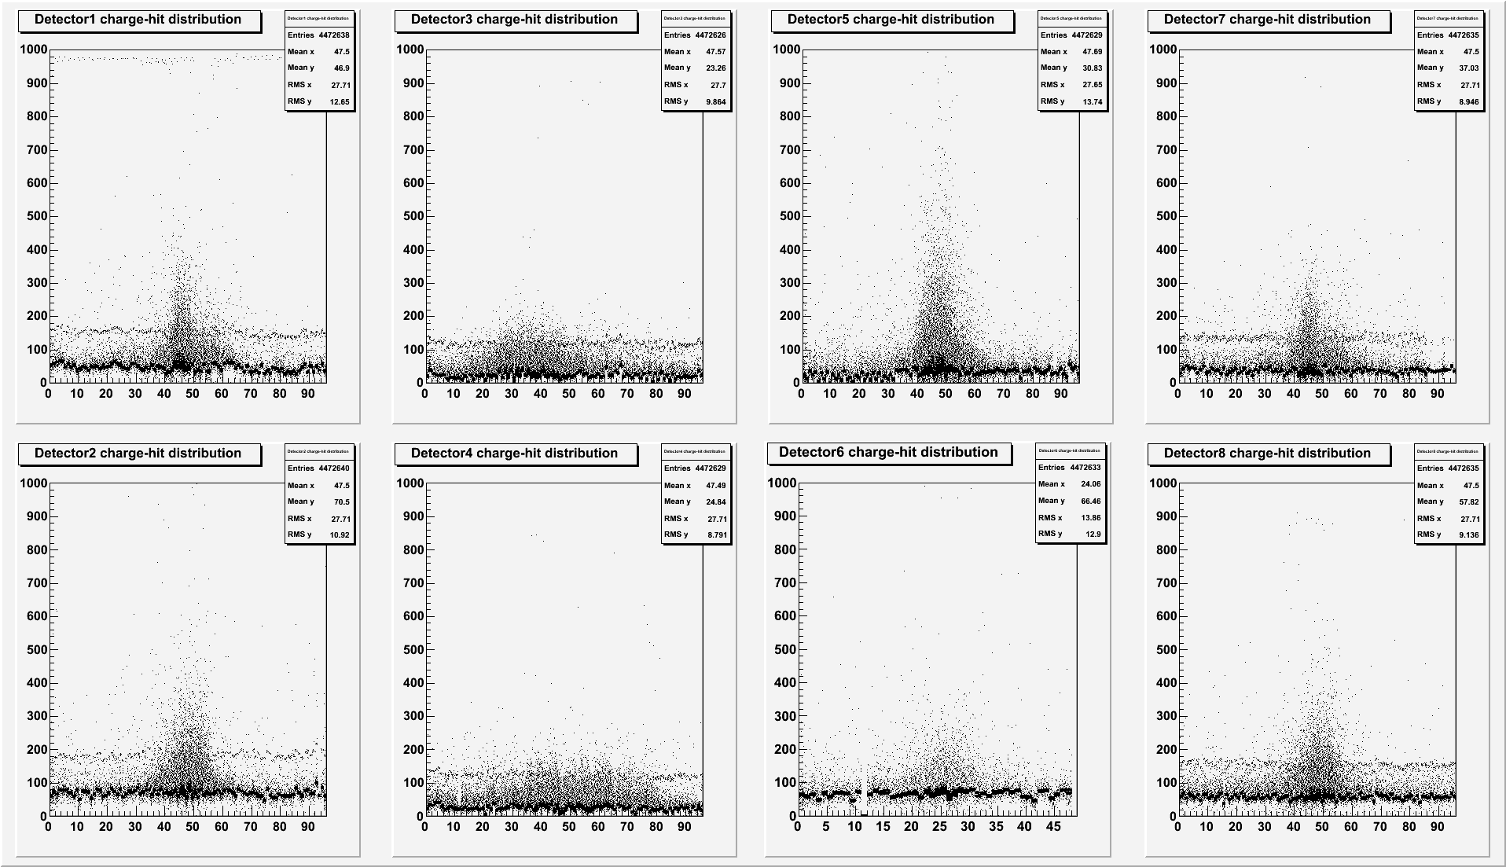
Charge vs. channel number:
1mm
250μm
R6
1mm
1mm
250μm
R3
1mm
Pedestal shift in standard MM (telescope) due to sparks.
No pedestal shift in resistive detectors (R3&R6).

Slide 10
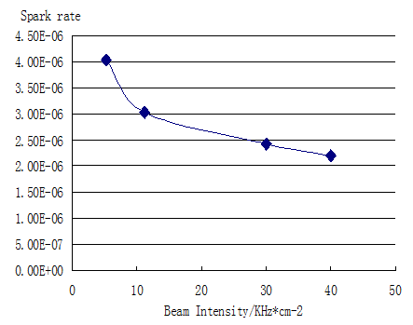
Spark rate vs mesh voltage and beam intensity:
R3(2mm, 2MΩ/ ):
Spark rate vs beam intensity
Very low and very high resistivity give the largest spark rate
O(1 MΩ / □) give the lowest spark rate, stable with voltage

Slide 11
Detector performance at same gas gain (~3000):
Detector | type | Spark rate | Spark current /μA | Voltage drop
SLHC2 | standard | 7*E-5 | 0.4 | 5%
R3 | 2 M Ω/ resistive kapton | 9.6*E-6 | 0.2 | 2%
R6 | 400K Ω/ resistive strip | 6.4*E-6 | 0.08 | 0.5%
R5 | 250 M Ω/ resistive paste | 1.6*E-4 | 0.1 | 1.5%
R7 | tens of K Ω/ resistive pad | 5.9*E-4 | 0.35 | 4.5%

Slide 12
R6 (1mm, 400KΩ/ ) efficiency :
@beam intensity of 11kHz/cm2:
@voltage of 400V:
>98%
drop<3%

Slide 13
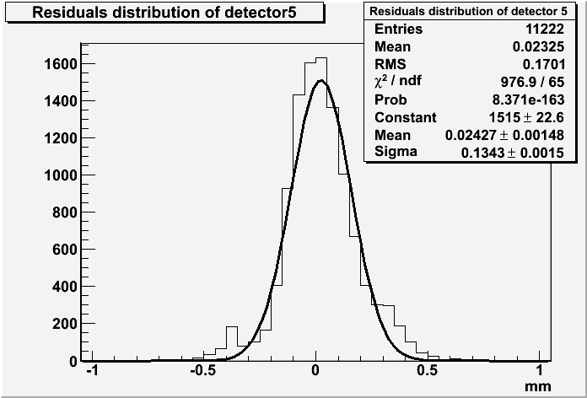
Resolution:
MM
MM
MM
•Residuals of MM cluster position and extrapolated track from MM telescope:
•Convolution of:
- Intrinsic MM resolution
- Track resolution (extrapolated)
- Multiple scattering
beam
1mm
0.25 mm
MM under test
1mm
~98μm
R6(1mm pitch, 400kΩ/ )
δ=134μm
δmm= 91±2.2μm

Slide 14
R6(1mm 400kΩ/ resistive strip) resolution vs mesh voltage and beam intensity:
Mesh voltage:
Beam intensity:

Slide 15
Cluster size (mean of distribution) :
R3 : 2mm , 2 M Ω/ Resistive kapton +insulator
R6 : 1mm , 400 k Ω/ Resistive strip
SLHC2: 2mm standard bulk

Slide 16
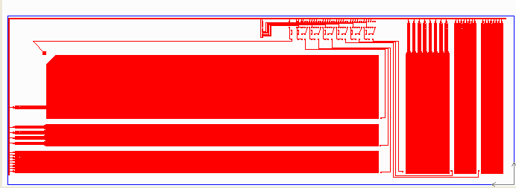
Future
More beam tests in the telescope with 10 new detectors in Summer 2010
R&D toward large surfaces : honeycomb cathode, voltage distribution on a segmented mesh, etc…
Background study with real ATLAS data
Starting R&D on electronics (Brookhaven, Saclay)
CERN MPGD workshop upgrade in progress, with AIDA support
Plan to insert a test panel in the ATLAS cavern soon
1.2 m x 0.4 m prototype with various strip dimensions

Slide 17
Conclusion and outlook:
Resistive coating is a successful method to reduce the micromegas spark rate and limit the change in mesh voltage and current.
Good spatial resolution<100μm can be reached with a resistive strip coating detector of 1mm pitch.
High efficiency (>98%) can be achieved with resistive strip coating micromegas detector, and efficiency drops less than 3% when increasing the beam intensity from 5KHz to 40KHz . R6 can operate at high gain up to 30000 without loosing efficiency.
R&D and studies will continue within the MAMMA collaboration

Slide 18
Back up slides

Slide 19
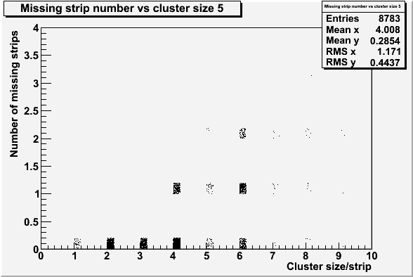
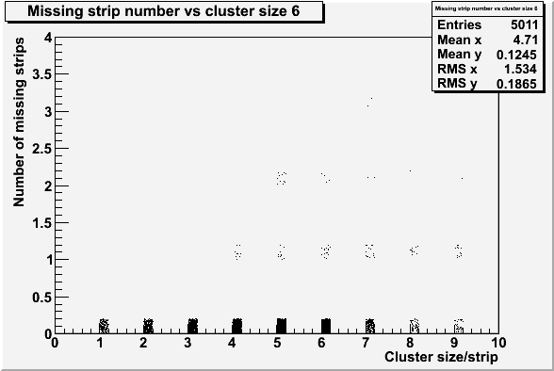
Number of missing strips in cluster:
R6( 1mm, 400 KΩ/ ):
R3( 2mm, 2 mΩ/ ):
19

Slide 20
Probability to have missing strips in cluster and number of missing strips:
20

Slide 21
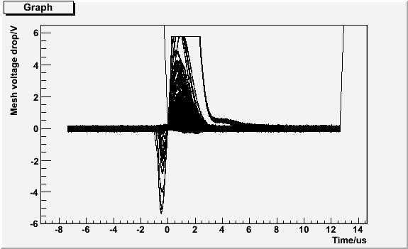
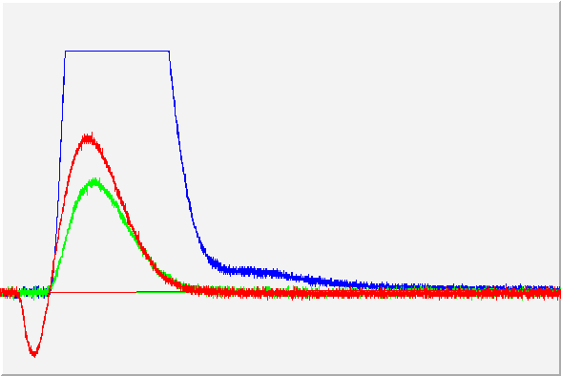
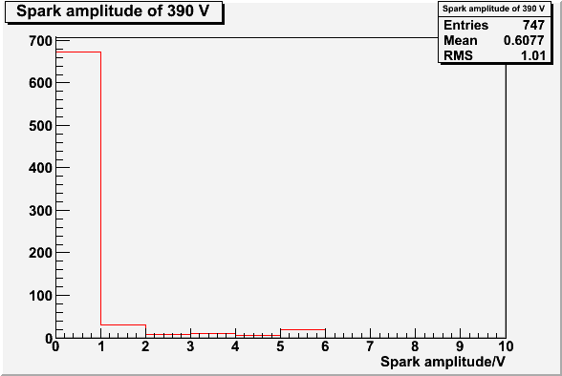
Sparks in R7(few tens of kΩ/ Resistive pads):
All the ‘sparks’ in R7:
Three ‘spark’ type:
‘Spark’ amplitude distribution:

Slide 22
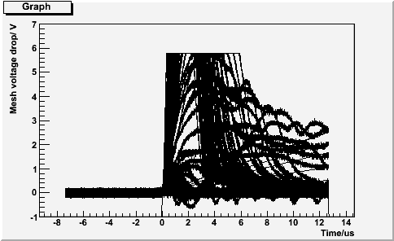
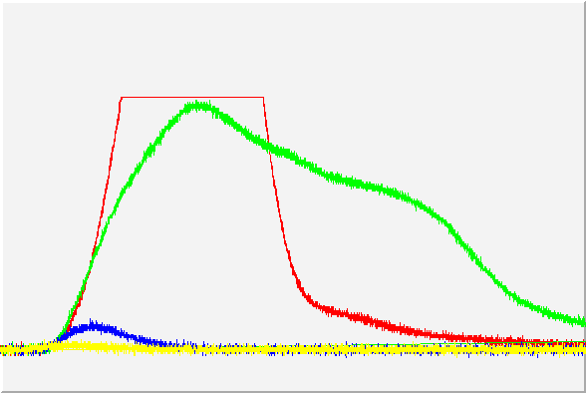
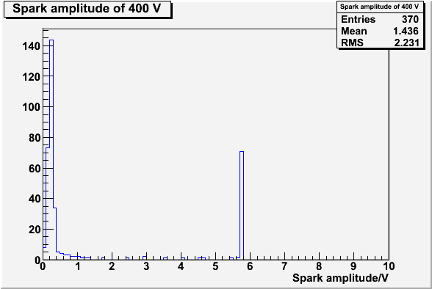
Sparks in R5(250 MΩ/ Resistive kapton):
All the ‘sparks’ in R5:
Four ‘spark’ type:
‘Spark’ amplitude distribution:

Slide 23
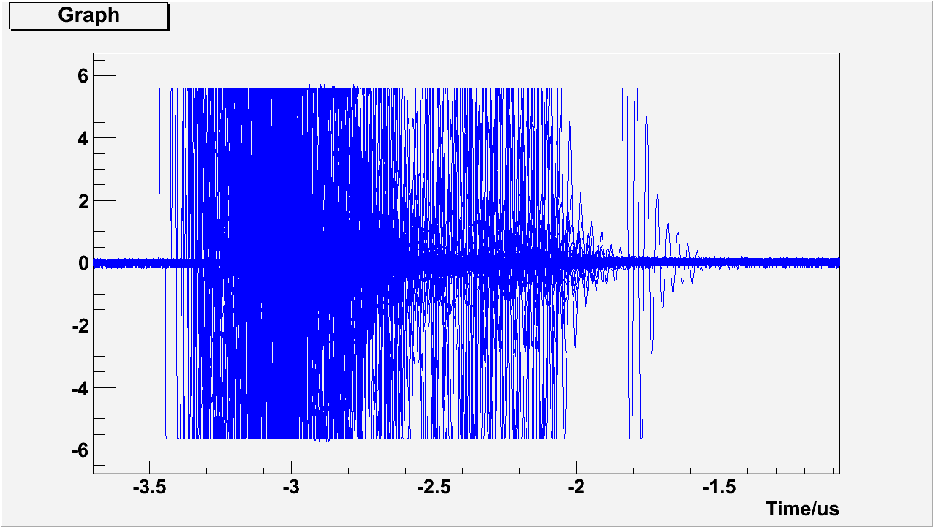
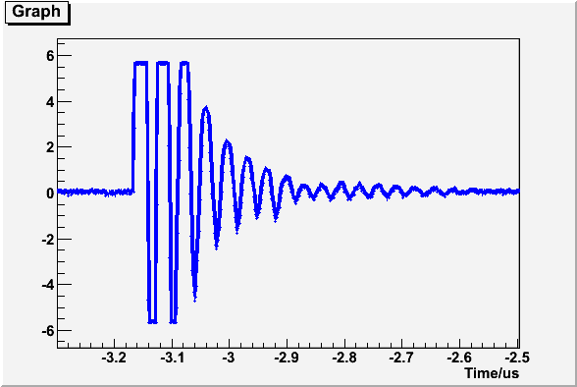
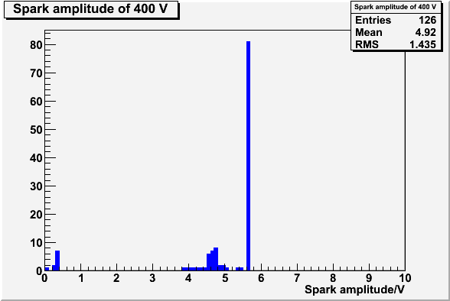
Sparks in SLHC2(standard bulk):
All the ‘sparks’ in SLHC2:
One ‘spark’ type:
‘Sparks’ amplitude distribution:

Slide 24
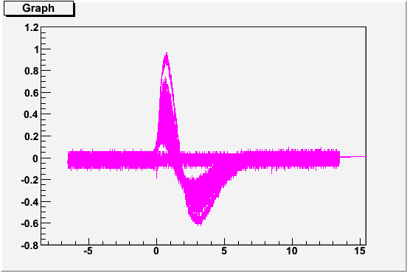
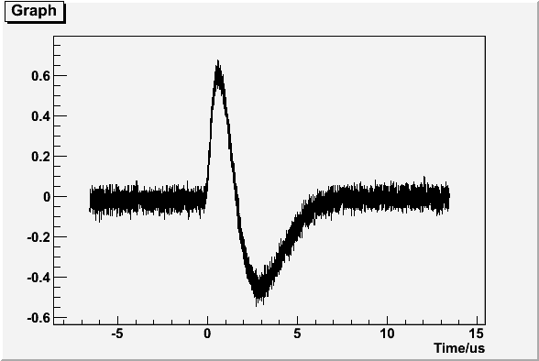
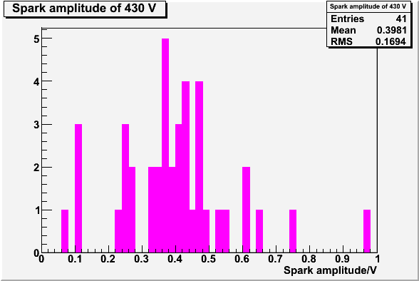
Sparks in R3(2 MΩ/ resistive kapton):
All ‘sparks’ in R3:
One ‘spark’ type:
‘sparks’ amplitude distribution:

Slide 25
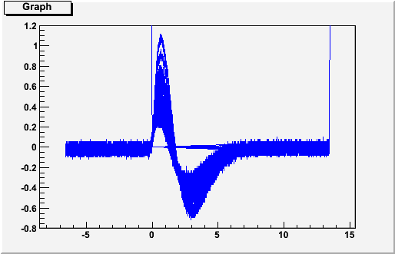
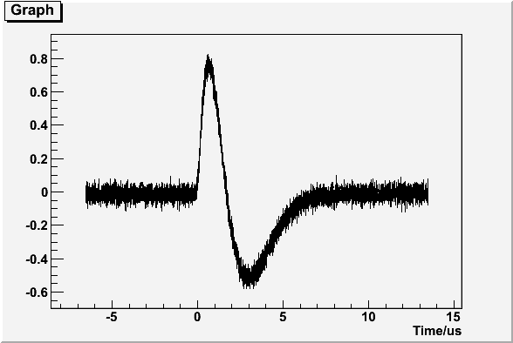
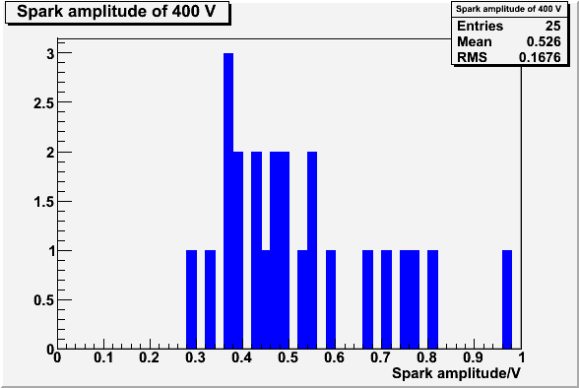
Sparks in R6(400 kΩ/ resistive strip):
All ‘sparks’ in R6:
One ‘spark’ type:
‘sparks’ amplitude distribution:

Slide 26
Spark amplitude vs voltage and beam intensity:
R5 vs voltage:
R7 vs voltage:
SLHC2 vs voltage:
R3 vs voltage:
R5 vs voltage:
R3 vs intensity:

