Slide 1
LAPP Status Update
Berkay TURK & Nadine Neyroud & Frédéric Gillardo & Stephane Jezequel & Arturo Sanchez Pineda & Frédérique Chollet
LAPP / CNRS
ESCAPE / WP2
24 / 02 / 2021

Slide 2

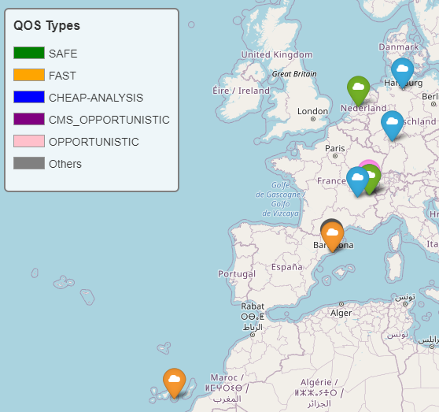
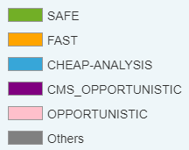
CTA Use Case
CTA Ingest
  File upload to an RSE On Site
  File Replication to 2 different RSEs Off Site
  File Deletion on the RSE On Site
  Lifetimes of replications can be specified
  2 Implementations as Script
    Bash
    Python
RSE_ONSITE
SITE=LAPP-WEBDAV&QOS=FAST
RSE_OFFSITE_1
SITE=PIC-DCACHE&QOS=FAST
RSE_OFFSITE_2
SITE=IN2P3&QOS=CHEAP-ANALYSIS

Slide 3
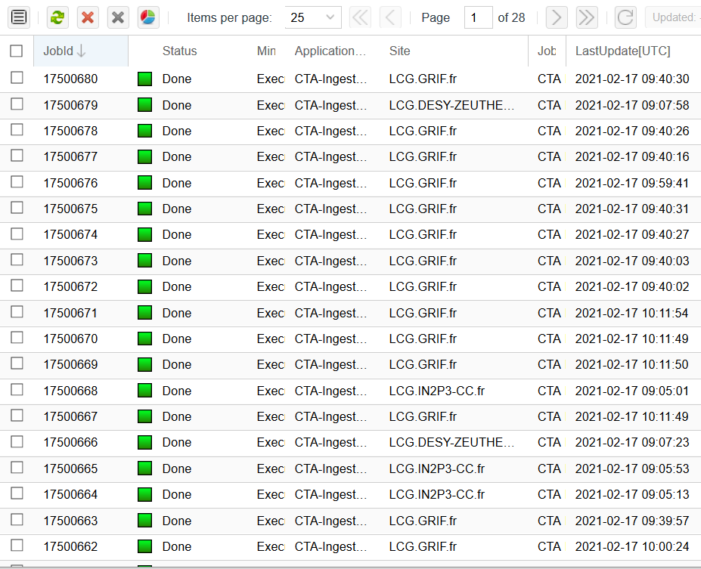

CTA Use Case
Ingest in several ways
  Shell Script on the single computer
    For Dress Rehearsal Day
  HTCondor
    The workload manager of LAPP
  Commercial Cloud (AWS)
    Scripts have been run on the cloud instance with 2TBs of data
    Cost 200 € for the test
  DIRAC
    Scripts have been run on several sites
    Successfully run the ingest
      Uploaded 4 TBs in 2 hours
    CTA Ingest on DIRAC

Slide 4

CTA Use Case
CTA Rucio Ingest
  Rewritten in Python
  Has been containerized
    (runs with a single line of code)
Next Step for CTA
  Query and retrieve data / need metadata support from Rucio
    In contact (Rizart and Martin)
Rucio Ingest : https://gitlab.in2p3.fr/CTA-LAPP/cta-rucio-ingest-python
Apache Server : https://gitlab.in2p3.fr/CTA-LAPP/cta-apache-server
CTA Apache Server
  WebDAV Protocol
  SSL Configuration
  OpenID Authentication
  Digest Module (by DESY)
    (Data Integrity Check)

Slide 5

ATLAS Use Case
Arturo is taking over the job done by Stephane Jezequel
  His implementation of ATLAS Open Data exercise
  Validates running in multiple sites using the local Xcache (e.g. Lyon, IN2P3-CC)
Using a container to access and interact with the Datalake Package (manage Datasets, files) in the Datalake using a JupyterLab instance
Installing ROOT-CERN analysis framework (set of C++ libraries) inside the container
  Needed for the several ATLAS Open Data (particles physics) analysis examples

Slide 6
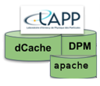
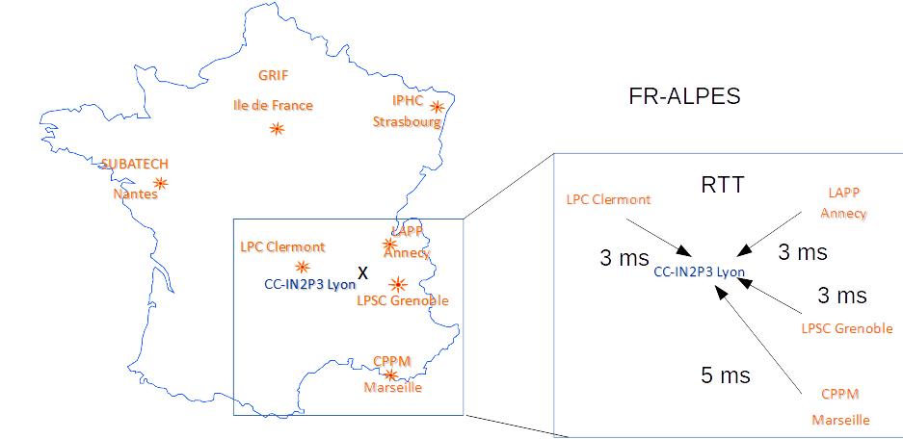
RSE : ALPAMED-DPM
DPM federation prototype
  4 ATLAS Tier 2 sites from South-East of France
  Running latest DOME version (1.14.2)
  No more file locality within the federation
    Legacy stack decommissioned
  OIDC will be configured (ASAP)
Needs for good WAN connectivity
  4 x 10 GB/s is expected ( 2 x 10 GB/s at LAPP )
  Should improve all sites with 10 GB/s
What is next in 2021
  Move the head-node in Lyon
  Reinforce collaboration with CC-IN2P3
  Progress on optimizing operational cost
  Common management of storage federation
ALPAMED

Slide 7

RSE : LAPP-WEBDAV (APACHE)
OpenID Authentication
  Successfully configured
  Disabled for now
    Does not work in pairs with X.509 ( Had conversation with Paul Millar)
    Token support in the ESCAPE in a few weeks
An issue on Apache
  Stops responding when it runs for a long time
  Does not give a clue in log files
  Restarting the service solves the issue in a few seconds

Slide 8
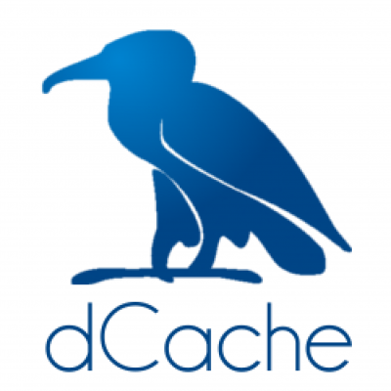
RSE : LAPP-DCACHE (DCACHE)
OpenID Authentication
  Successfully configured
  Up and running
  Issue solved with activating pinManager
  dCache error logs were not so clear ( common opinion with Paul )
Enlarge the disk space
  Probably between 50-100TBs

