Slide 1
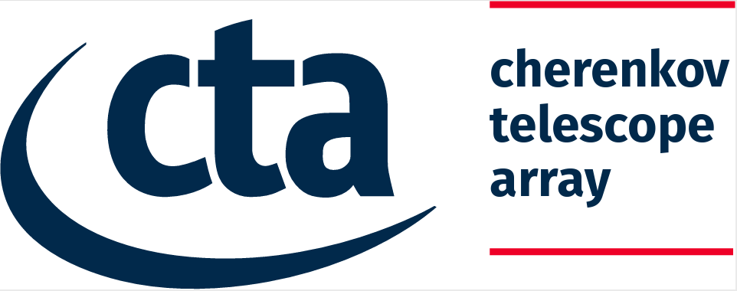
CTA Partners and Roles
CTA partners:
IFAE-PIC: Javier Rico, Cosimo Nigro , Gonzalo Merino, Jordi Delgado, Augustin Bruzzese
LAPP-CNRS: Nadine Neyroud, Frederic Gillardo, Berkay Turk, Thomas Vuillaume, Enrique Garcia
LUTH-ObsParis: Catherine Boisson, Mathieu Servillat
MPIK: Axel Donath
UCM: Jose Luis Contreras, Daniel Nieto
CTAO: Matthias Fuessling, Gareth Hughes, Nadine Neyroud
Or by WP:
WP2 (data lake):
PIC (Merino, Delgado), LAPP (Gillardo, Neyroud), CTAO (Neyroud, Hughes)
WP3 (software and data repository):
IFAE (Rico, Nigro), UCM (Contreras, Nieto), LAPP (Vuillaume, Garcia), CTAO (Füßling, Hughes)
WP4 (Virtual Observatory):
LUTH-ObsParis (Boisson, Servillat), CTAO (Fuessling, Hughes)
WP5 (science platform):
PIC (Merino, Delgado), UCM (Contreras, Nieto), CTAO (Füßling, Hughes)

Slide 2
CTA
WP3 (OSSR):
Contribution to setup of OSSR repository infrastructure (gitlab, zenodo) and guidelines for software sharing
Thomas Vuillaune [LAPP], Enrique Garcia [LAPP], Matthias Fuessling [CTAO]
D3.7 “License, provenance and metadata guidelines for the software and service repository” (document)
Thomas Vuillaume (lead author), Enrique Garcia [LAPP] (co-author)
“Workshop on Open-source Software Lifecycles” Thomas Vuillaume [LAPP] (co-organisation)
Contribution to CONCORDIA (CORSIKA on containers, one of the data management use cases)
Daniel Nieto Castaño [UCM] (development)
Software: Various software contributions to OSSR by CTA partners (not all official CTA software): CTLearn, gLike, hipeCTA, GammaLearn, AGNpy, CONCORDIA & gammapy
WP2 (DIOS):
CTA data lake use cases and needs in DIOS Nadine Neyroud [LAPP/CTAO]
Testing of CTA use cases alongside those of MAGIC (La Palma) during the dress rehearsals Frederic Gillardo [LAPP], Berkay Turk [LAPP], Agustin Bruzzese [IFAE]
Contribution to D2.2 assessing the performance of the pilot data lake implementation.

Slide 3
CTA
WP4 (CEVO):
Leading contribution to Provenance Data Model and Implementations (intended as common development between ESFRIs), helped organise or took part in:
- IVOA online meeting May 2020
- Provenance Workshop Sept 2020
- IWAPP Innovative workflows in Astro & Particle Physics March 2021
Catherine Boisson, Mathieu Servillat [ObsParis]
WP5 (ESAP):
Gammahub platform linked/integrated with ESAP
Javier Rico, Cosimo Nigro, Jordi Delgado [IFAE]
Lead of focus group 5 DIRAC on ESAP (links to task T5.3 & T5.4)
Gareth Hughes, Matthias Füßling [CTAO]

Slide 4
General Summary
CTA contributions in all work packages WP2-WP5
CTA use cases and needs well represented in WP2, WP3, WP4
CTA use cases for data lake, one data management use case (simulations on ESAP), comment methods for data management in WP4 (provenance)
CTA use cases in WP5 need more work
CTA contributions beyond CTA use cases in all WPs
Current challenge: connection of the use cases within each WP to other WPs and to the overall ESCAPE use cases, connection to the TSPs, and further consolidation with other ESFRIs

