Slide 1
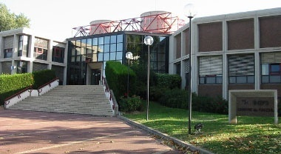
Visit of CMS Computing Management at CC-IN2P3

Slide 2
The "extra" time allowed by LHC delay has been used in order to strengthen the infrastructure and the critical computing services
Special emphasis has been put on Storage
The price to pay was a temporary degradation of the service quality and stability
All the necessary stability is being restored now

Slide 3
Main improvement
HPSS migration
TReqs development and deployment
pNFS → Chimera migration
AFS
Still to be done:
New batch system will be deployed in 2010
New product selection phase is currently going on
Should be transparent for Grid applications

Slide 4
We had a big unexpected problem with CMS dedicated support during the summer
A lot of efforts from Farida Fassi and David Bouvet to try to overcome the difficulties but the manpower was not enough
A new CMS support person has been hired but he will start only in December

Slide 6
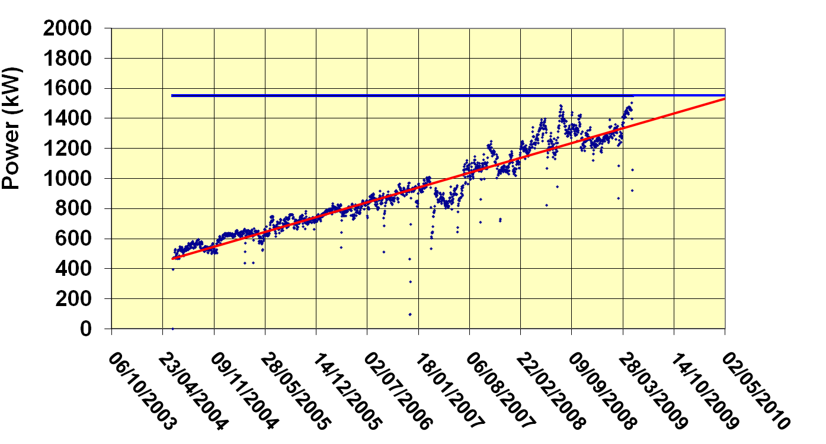
Electrical Power
Slope: 500W / day
3 transformers: 1550 kW recently upgraded to 3000 kW
A 800 kW rental transformer has been installed during the summer
Work in 2007 / 2008:
New main patch panel
New UPS
Improvement of the battery system
880 kW Diesel generator
Electricity distribution reshuffling
New power factor corrector

Slide 7
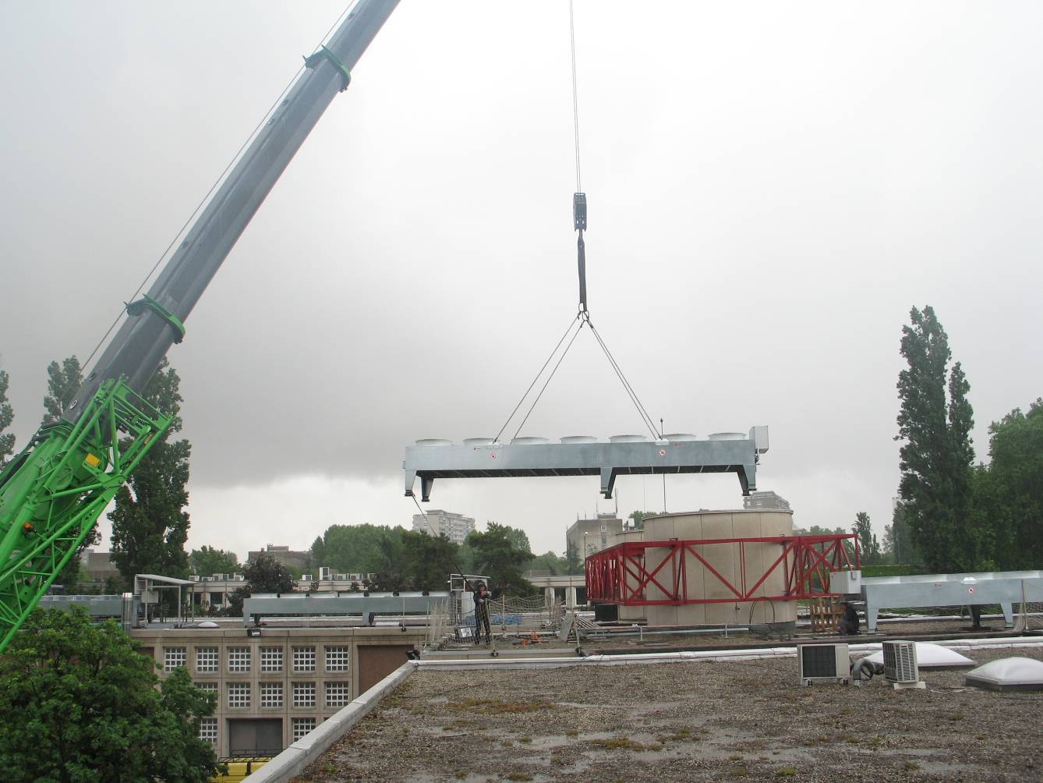
Cooling System
Infrastructure work in 2008 / 2009 – electricity + cooling : 500 k€
We have a 3rd chiller (600 kW theoretical cooling power)
+ some work on the second chiller to decrease the noise level (currently above the environmental limit)
In a week from now we will have the whole cooling capacity installed
We will be at the maximum allowed cooling capacity ➔ we will have to stay within this cooling budget until we get the new computer room

Slide 8
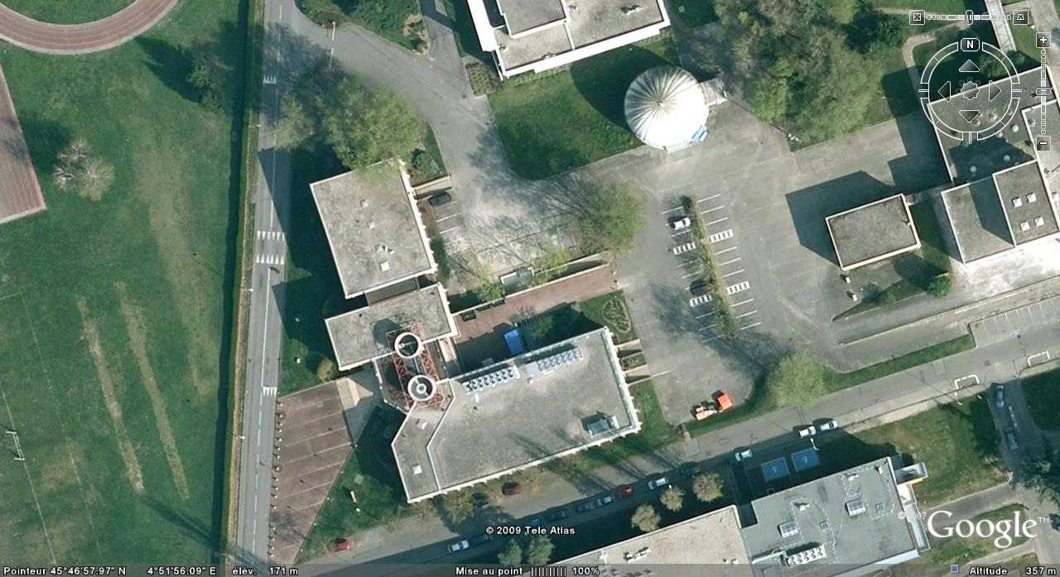
New building
Emprise future extension
New building
32 m x 28 m
Computer Room

Slide 9
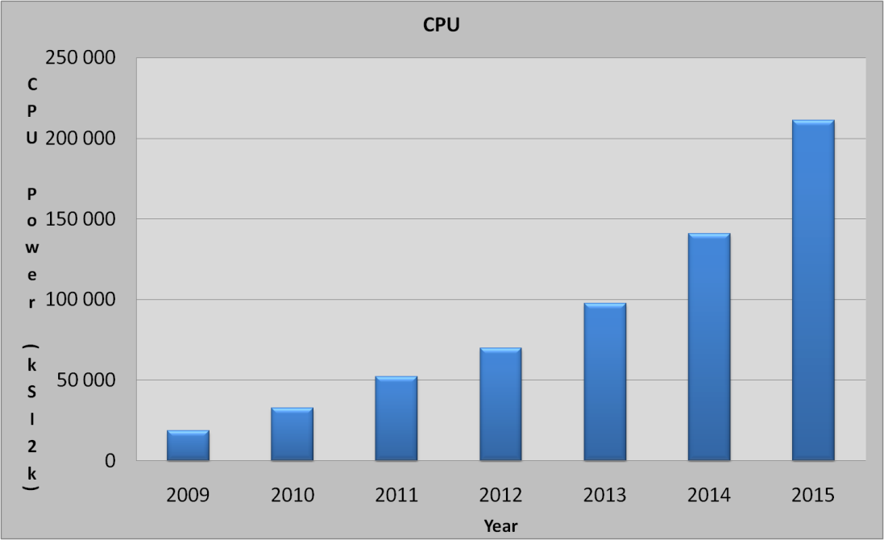
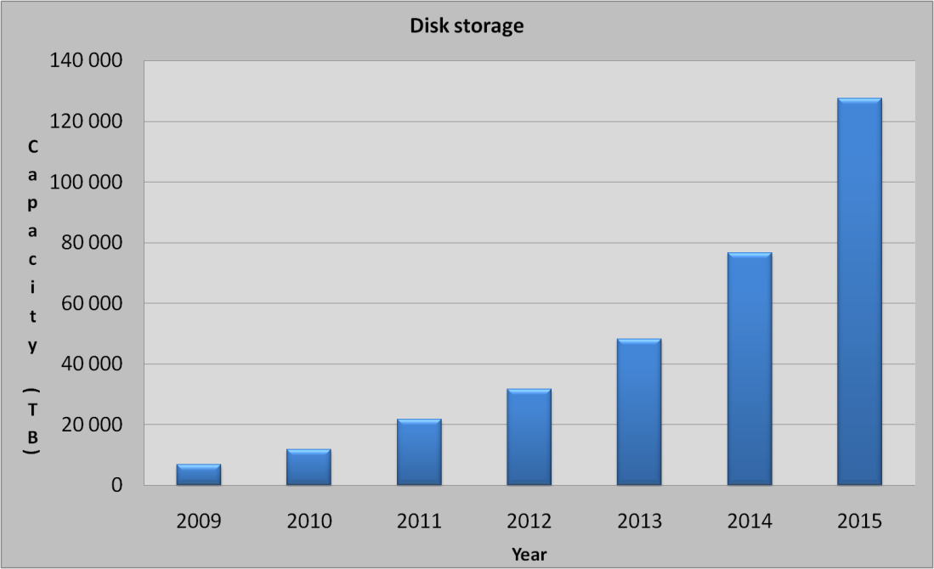
Needs
Build a simple computing model with the following ingredients:
Serve ~40 groups with "standards needs"
Fulfill LHC computing commitments and provide first class analysis capability
Expect a very significant growth of the Astroparticle community needs (LSST for instance)
Deduce computing capacity
Add some capacity for network, services, etc.

Slide 10
Needs (2)
Assume Moore law is still valid
Extrapolate up to 2019
indicated power is for computing only
power for cooling has to be added
End up with:
2011
50 racks
600 kW
2015
125 racks
1.5 MW
2019
216 racks
3.2 MW
On top of the existing computer room (1 MW)
Due to budget constraints the new computer room will have to start with a limited power
➔ Modular design – Easily scalable
Chilled water and electricity distribution should be designed for the 2019 target value
Equipment: transformers, chillers, UPS etc… will be added later

Slide 11
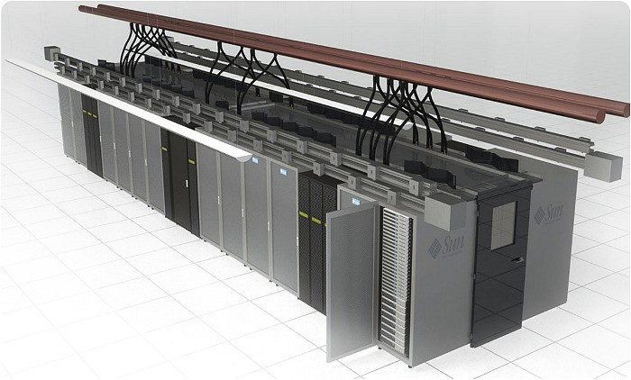
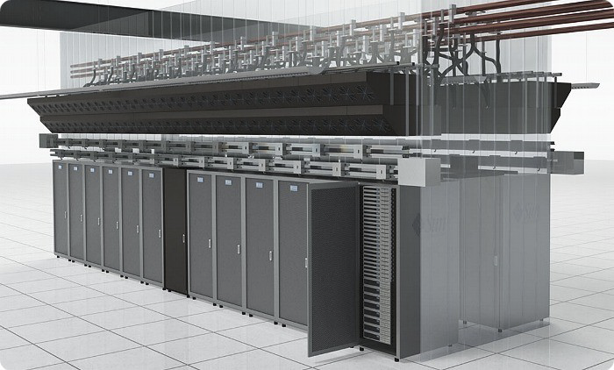
Design consideration
The 2 storey building will be devoted to computing equipment (no offices)
First storey: Services (UPS, Chillers, etc.) - 900 m²
Second Storey: Computer room - 900 m²
We decided to give up with raised floor
Every fluids will come from the top: Chilled water – Power – Network

Slide 12
Schedule
5 out of 15 "design and build" teams have been retained after a first selection phase
Preliminary design documents received last Monday
Final choice will be done by Friday October 30
Hope to begin construction work at spring time
New building delivery early 2011
The main risk is related to the French environmental regulation that may delay the project (6 – 12 months)
If the delay is too large, we may have to host some computing equipment outside CC-IN2P3 ➔ Expensive !

