Slide 1
Stackup proposition for the new front-end board
LLR-team
02/05/21

Slide 2
FEV12 Stackup
CLK_5M
CLK_40M
TRIG_EXT
RAZ_CHN
VAL_EVT
START_ACQ
DOUT
TRANSMITTON
CHIPSAT
SR_CK
CK_READ
IN_PREAMP

Slide 3
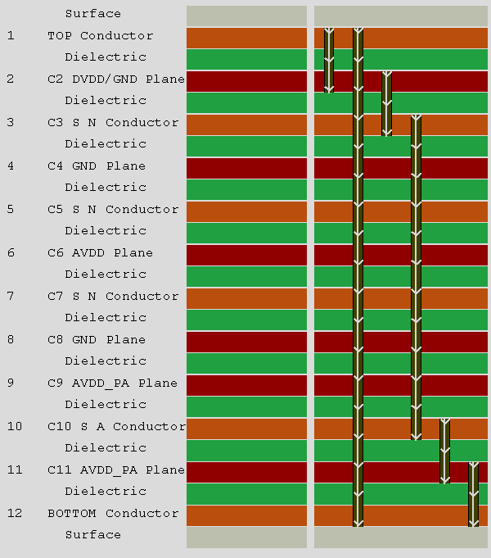
FEV13 Stackup
CLK_5M
CLK_40M
TRIG_EXT
RAZ_CHN
VAL_EVT
CHIPSAT
START_ACQ
DOUT
TRANSMITTON
SR_CK
CK_READ
IN_PREAMP

Slide 4
Vocabulary
For next discussion,
- VDD = VDDA GLOBAL
- VDDI = VDDA_PA LOCAL
- VDDA = VDDA LOCAL
- VDDD = VDDD

Slide 5
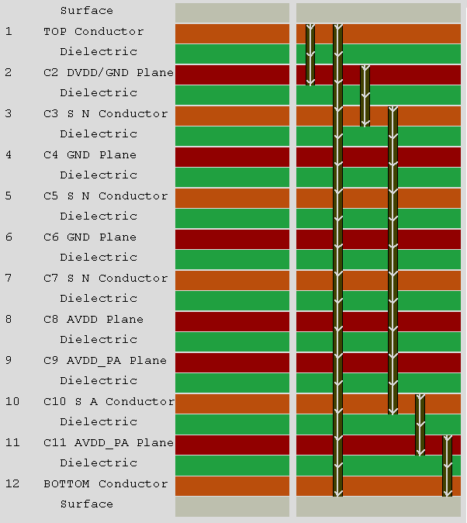
New front-end board Stackup #2
CLK_5M
CLK_40M
TRIG_EXT
RAZ_CHN
VAL_EVT
CHIPSAT
START_ACQ
DOUT
TRANSMITTON
SR_CK
CK_READ
AVDD
global + local
IN_PREAMP

Slide 6
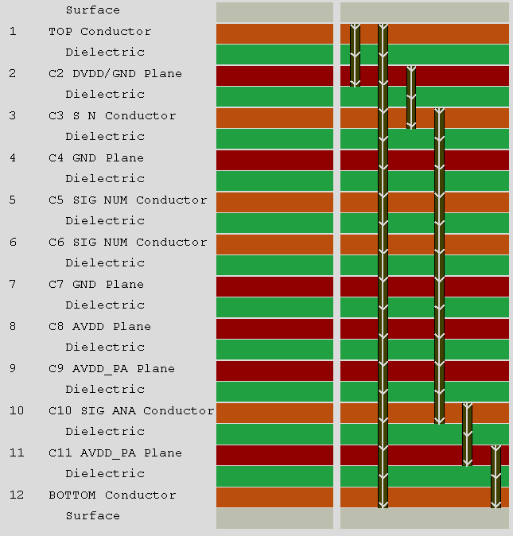
New front-end board Stackup #1
CLK_5M
CLK_40M
TRIG_EXT
RAZ_CHN
VAL_EVT
CHIPSAT
START_ACQ
DOUT
TRANSMITTON
SR_CK
CK_READ
AVDD (global + local)
IN_PREAMP
Shielding vdda_pa

Slide 7
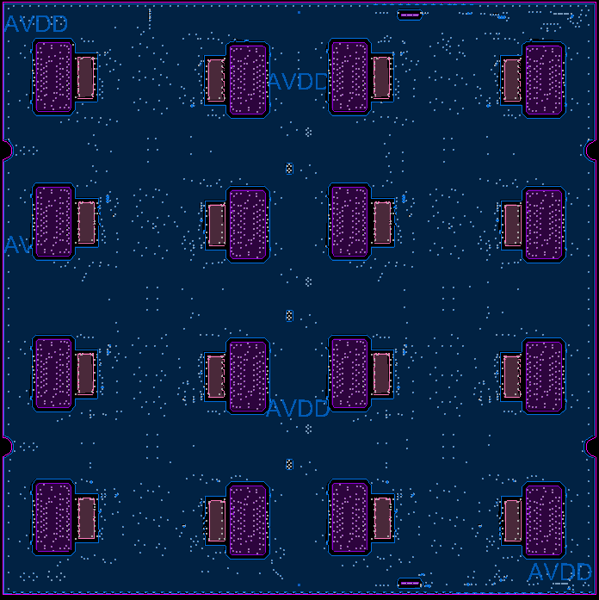
Ideas of VDDA (layer 8 for #1)
Purple = vdda_pa local
Pink = vdda local
Blue = vdda global
To reduce impedance of AVDD, we need a specific layer without analog signals !

Slide 8
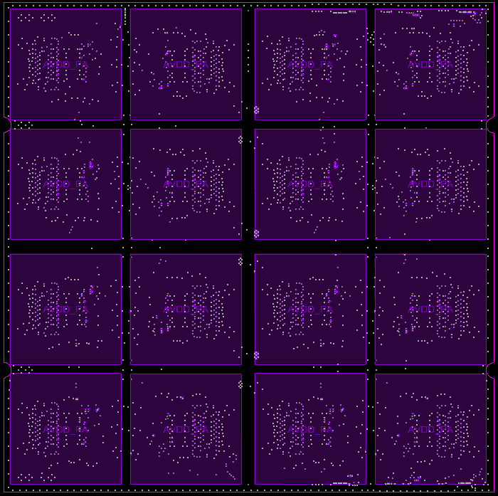
Ideas of VDDA_PA (layer 9&11)
Local vdda_pa for chip 15
Local vdda_pa for chip 14
To reduce capacitance between vdda_pa layers, we need a gap of x mm and/or add gnd guardring

Slide 9
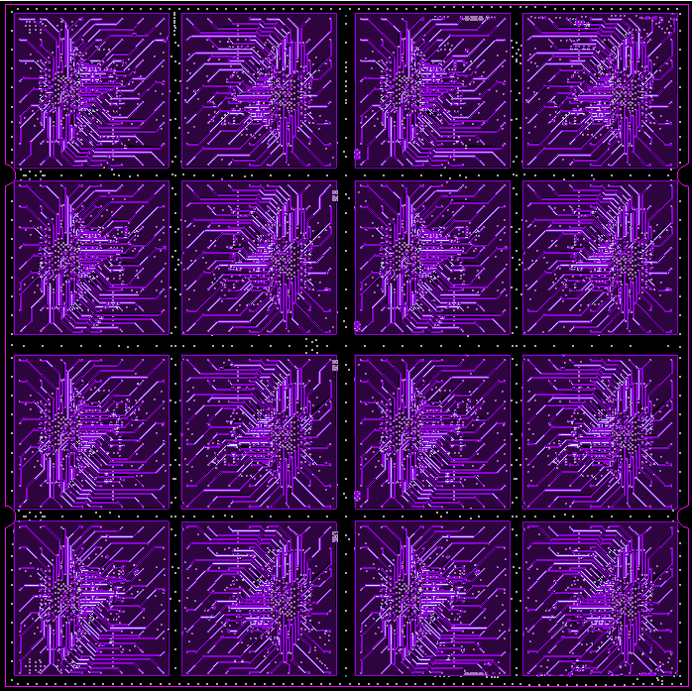
Ideas of VDDA_PA (layer 10 )
IN preamp signal for chip 15 and shielding
IN preamp signal for chip 14 and shielding
To reduce capacitance between vdda_pa layers, we need a gap of x mm and/or add gnd guardring

