Slide 1
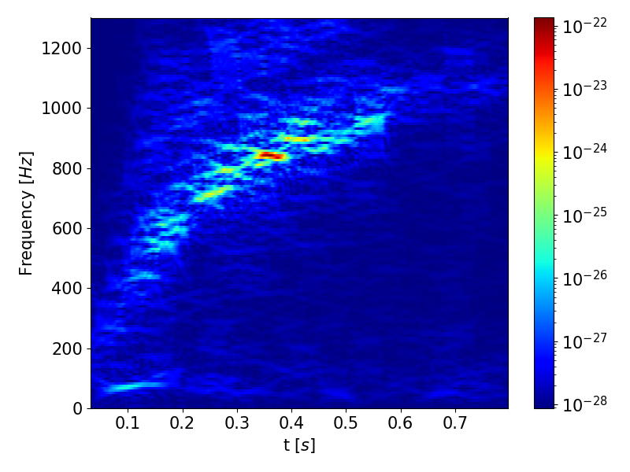
HANGAR AT VIRGO
DATA VERSIONING WITH HANGAR
Open Source with Git-like semantics
Keep track of changes to data
Zero-cost branching
Merging between branches
Abstracted storage of data files on disk
Pushing and pulling changes to remotes
Possibility to store and access time-frequency datasets with different spectrogram parameters
Access datasets based on distance and source properties
Decreased training time by removing «on the run» spectrogram generation
Reduced disk usage at VIRGO
HANGAR IN A VIRGO ML PIPELINE
Core-Collapse Supernova Classification
Store full science segments based on GPS starting times
Store individual time series or spectrogram samples around triggers

Slide 2
HANGAR AT VIRGO
HANGAR IN A VIRGO ML PIPELINE (UPDATE 1)
New test on O2 noise from publicly available dataset + core-collapse supernovae.
HANGAR IN A VIRGO ML PIPELINE
Previously tested outside Virgo environment, due to firewall issue, on simulated detector gaussian background + core-collapse supernovae
HANGAR IN A VIRGO ML PIPELINE
(UPDATE 2)
Installed into Docker container, along with WDF and pycbc library
For usage in Virgo computing environment Docker built into a singularity image. Tested positively.

