Slide 1
WP4 Technology Forum 2
Concluding Session

Slide 2
Welcome to Technology Forum 2.
A meeting of the whole Work Package – month 27 of 48. 59 participants
Interaction with invited experts (EUDAT, Radio, Applications, VO)
Interaction with WP3 (Software), WP5 (Platform)
Reports on progress
From the Review held in November 2020
From the individual tasks 4.1, 4.2, 4.3
From the partners and also invited contributions
Hack-a-thon sessions – working meeting!!
Prepare for the 2nd half of the ESCAPE
Prepare for the upcoming IVOA Interoperability meeting (May 2021)

Slide 3
Hackathons
VO and Solar data / services
Provenance
ESFRI Requirements for VO
Validation of VO services
pgsphere
Cross-WP topics – VO and platforms and software

Slide 4
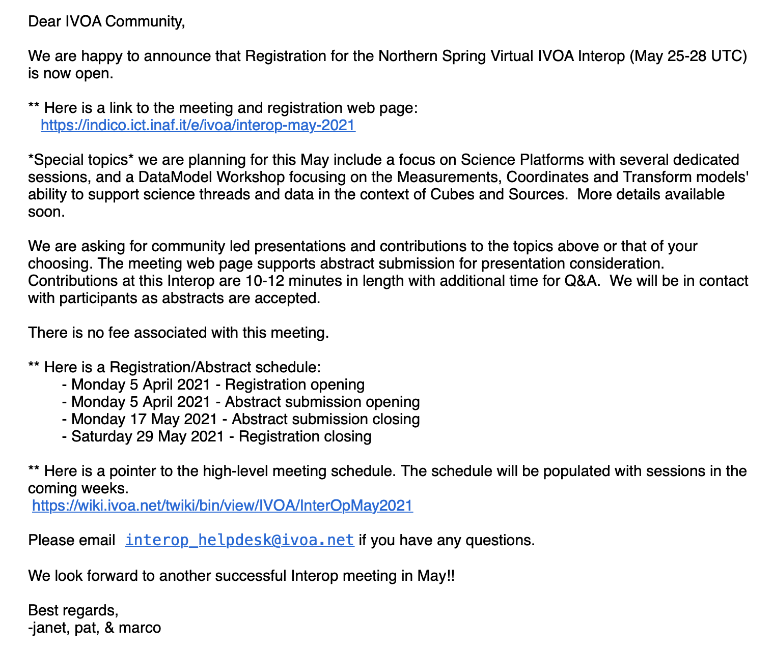
Preparation of IVOA Interoperability Meeting. (MS 25)
Announced for May 25-28 (UTC)
Registration Open now
Abstracts – May 17
What ESCAPE topics ?
Who will participate ?
note “focus on Science Platforms”
note the DM workshop

Slide 5
2nd half of ESCAPE
Cross-WP activities emphasised
Initial results and prototypes have been developed – time to share and discuss
WP3 – 4 – 5 interaction here very useful for understanding current status
idea of an All-Hands meeting - possibly associated with GA in Sept 2021
Ideas proposed for cross-WP coordination in a training event (~mid 2022)
Project level coordination
ESFRI activities in the WPs and Technical coordination
Test science cases – The user perspective
WP4 – need to express relevant activities as science cases
EOSC is maturing – expect more activities in EOSC related meetings
Explaining VO as an established infrastructure with well defined interfaces
Task 4.1 – adapt to match the possibilities offered by EOSC

Slide 6
Calendar : Deliverables and Milestones
◉◉◉
◉
✓
◉◉
✓
◉ WP specific meetings
◉◉
✓
◉
◉◉◉
◉ Technology Forum – Strasbourg, 4-6 Feb, 2020
✓
✓
◉◉
✓
✓

Slide 7
On-line School
Upcoming:
IVOA Interoperability Meeting – May 2021
Hands-on Workshop for Data Providers
June ~23-25, 2021 - To be announced soon!
ESCAPE and open participation
General assembly probably ~Sept 2021 – expect update of Work Plan!! (All partners expected to provide input and status and plans)
WP4 2nd School – Science with interoperable data
(Schedule for Q2 2022??)
IVOA Interoperability Meeting – November 2021
Task 4.3 Demonstration - ~ Jan 2022
We are here
Technology Forum 2
TBD
TBD
TBD
6 Month no-cost extension to January 2023
October 2022

Slide 8
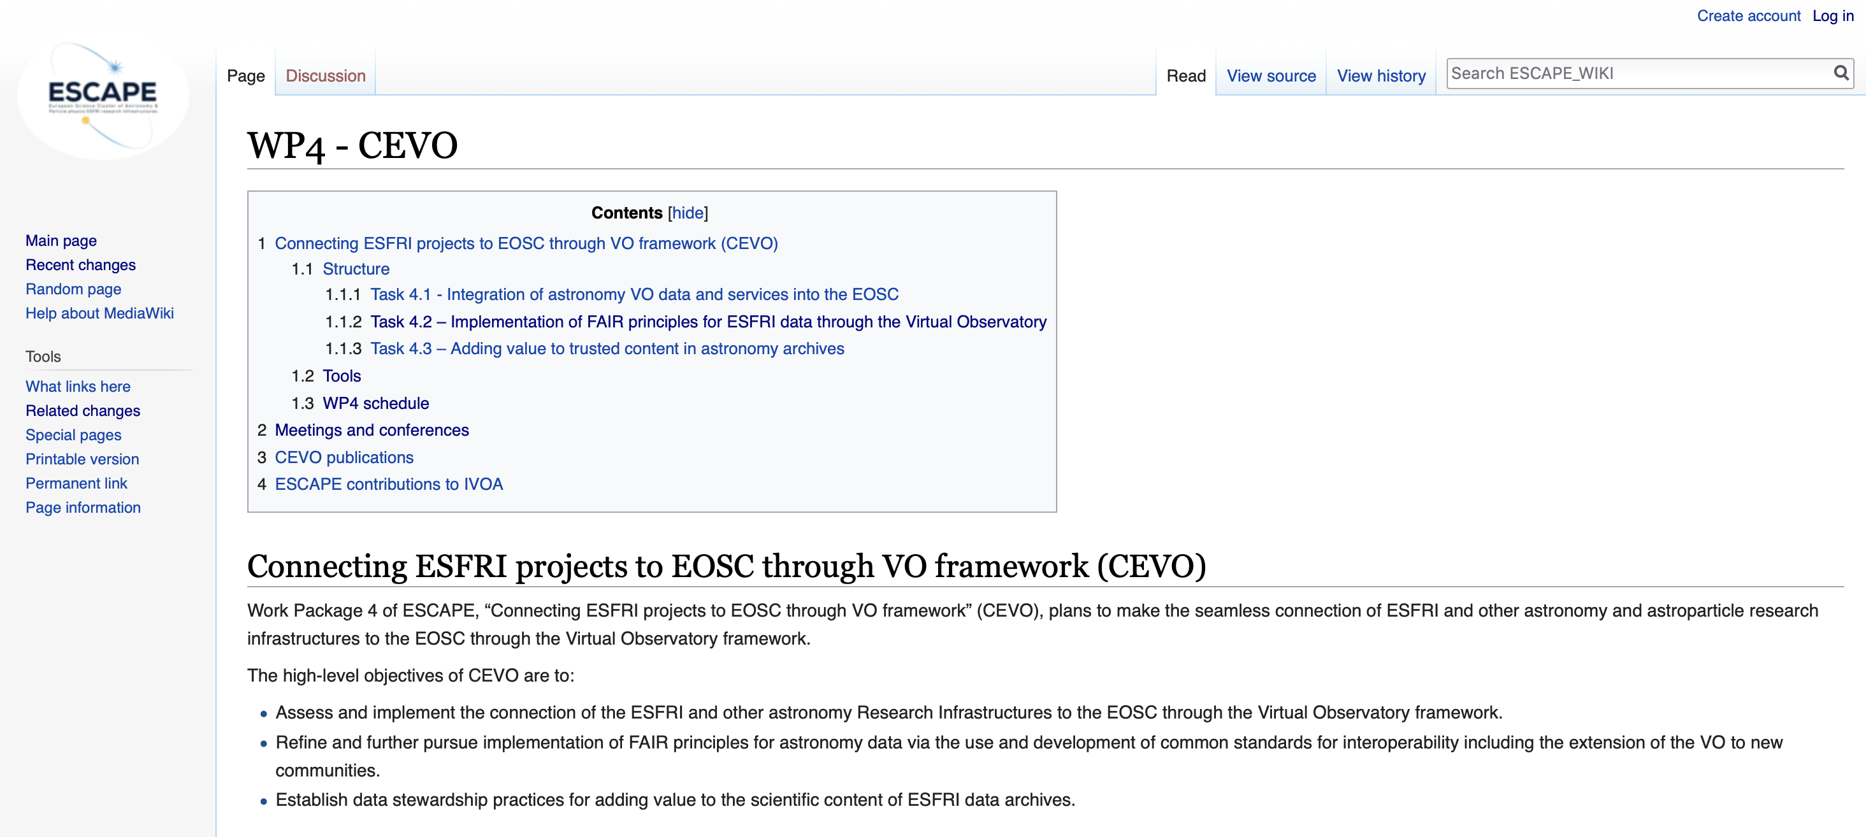
Please keep up to date with Wiki pages:
https://wiki.escape2020.de/index.php/WP4_-_CEVO

Slide 9
Updating information on the wiki
Collecting the papers published relevant to WP4
Listing events where you present ESCAPE WP4 topics (and a copy of slides is appreciated)
Links to all meetings – and please use the Indico where useful
Please let us know any requests you have for information to include there

Slide 10
Thanks for your participation !!

