Slide 1
WP2 lapp status
Frederic Gillardo, Berkay Turk, Arturo Sanchez
Lapp/CNRS
01 March 2021

Slide 2
WP2 meeting update
Documentation under gitlab https://gitlab.in2p3.fr/escape2020/wp2

Slide 3
Work Done(Berkay)
OpenID issue for apache (need to disable it for now)
Working to fix an issue on lapp-esc03
Presentation of LAPP’s status update during WP2 meeting
Notes:
Besions similaire : Volume / fichier et de donnée (plusieur PB million fichier) Production onsite (SKA, LSST)
Regle de replication
QoS (tape)
FAIR
Authentification …

Slide 4
Work Done(Arturo)
Using the DataLake client container from the lapp:
start implementing the ATLAS Open Data examples using samples in the Data Lake (replicated by Stephane Jezequel)
the examples correspond to Jupyter notebooks and C++ analysis code.
ROOT, git, and other software were added to the container to get those examples running.
Keep in contact with the personnel at CERN working on the same project.
Review the previous work done by Muhammad Aditya Hilmy (September 2020) regarding the ATLAS Open Data example
How to write a proper "Tutorial" to get the examples working by a hypothetical user
Notes:
Besions similaire : Volume / fichier et de donnée (plusieur PB million fichier) Production onsite (SKA, LSST)
Regle de replication
QoS (tape)
FAIR
Authentification …

Slide 5
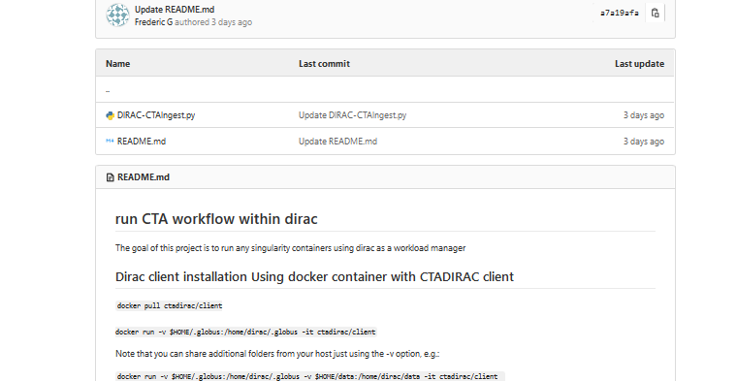
Work Done(Frederic)
Cloud
Meeting with google team to set up a partnership ESCAPE-GOOGLE on 24/02
DIRAC
Run CTA ingest workflow, upload 4 TB using 5 sites in 2 hours
https://gitlab.in2p3.fr/escape2020/wp2/escape_cta/-/tree/master/dirac
Notes:
Besions similaire : Volume / fichier et de donnée (plusieur PB million fichier) Production onsite (SKA, LSST)
Regle de replication
QoS (tape)
FAIR
Authentification …

