Slide 1


Time Synchronization Schemes for the Future Hyper-Kamiokande experiment
stefano russo
Journée projets LPNHE
02/02/2021

Slide 2
Neutrino Research Motivations
Neutrino’s secrets are gradually revealed.
1998 Discovery of non-zero neutrino mass @ Super-Kamiokande
2011 All three neutrinos are mixing each other.
However, there is a lot of questions still open:
We still don’t know which neutrino is heaviest (mass hierarchy problem).
We don’t know whether neutrino and anti-neutrino oscillations are different (CP violation).
CP violation may be related to the origin of the matter dominant universe.
Neutrinos are also an excellent astrophysical probe to “see” very far events.

Slide 3
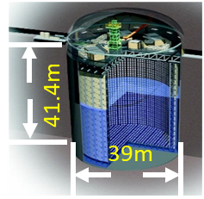
Kamiokande’s Story
In 1983 the first Kamiokande experiment was built.
  (Nobel prize award in 2002 for first-ever detection of astrophysical neutrinos)
In 1996 Super-Kamiokande was built (newer and bigger) and today It is still taking data.
  (Nobel prize award in 2015 for neutrino oscillations)
Super-Kamiokande statistic is limited so a newer bigger
experiment will be built: Hyper-Kamiokande capable to acquire:
10x atmospheric neutrinos
10x solar neutrinos
10x accelerator neutrinos from JPARC
(@ 500kW neutrino mode).
Compared to Super-Kamiokande
Hyper-Kamiokande
71ｍ
Super-K
68ｍ

Slide 4
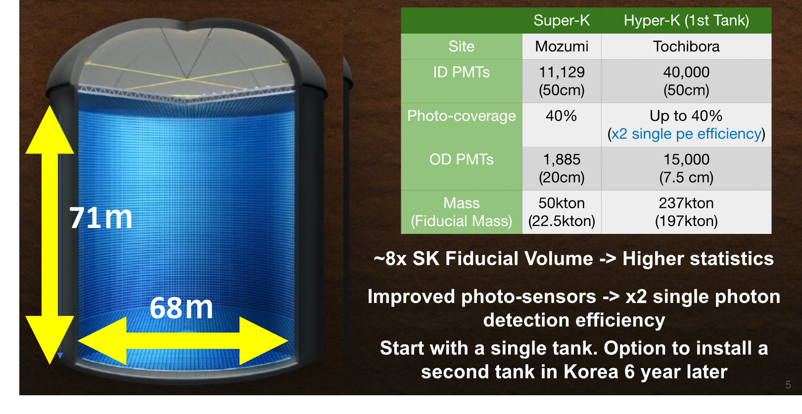
Hyper-Kamiokande
Start operation in 2027

Slide 5
Hyper-Kamiokande physics program
Atmospheric neutrino
Neutrino mass hierarchy
Solar neutrinos
Interior of the sun
Accelerator neutrinos
CP violation
Supernova neutrinos
Evolution of the universe
Proton decay
Grand Unification

Slide 6
HK organization

Slide 7

French contribution on Hyper-K Electronics
The French groups are involved on the HK electronics
on both time distribution and Front-End digitizer.
The time distribution system is developed by LPNHE
(and CEA-Saclay with a different scheme)
The digitizer's development is carried out by the LLR with the Omega’s help to develop the chip.

Slide 8
LPNHE Neutrino Group
Scince:
  A. Blanchet, A. Blondel, J. Dumarchez, C. Giganti, M. Guigue, J-M. Levy, M. Martini, L. Mellet, V. Nguyen, B. Popov, S. Suvorov, U. Yevarouskaya, M. Zito
Technology:
  s. russo, V. Voisin.
More contributions will be welcome/expected when the experiment will enter in the construction phase

Slide 9
Hyper-K Electronics and Synchronization System
Events are reconstructed from Cherenkov ring
by means of PMTs. Time synchronization is essential.
The total number of PMTs is up to 55.000 read with
more than 2.000 Front-End board.
Hyper-K is expected to be operated for >20 yrs.
Long term stability and durability are essential.

Slide 10
Proposed Architecture
The time distribution system consists of 2 main parts:
A system that generates the local time base correlated to the Universal Time Coordinated (UTC).
A distribution network that delivers the clock to all the front-end nodes and establish a communication link for critical slow control.
The R&D is carried out by IN2P3 (FR), INFN (IT) and Tokyo University (JP)

Slide 11
The Local Time Base
This study in collaboration with SYRTE Lab, part of the Paris Observatory (https://syrte.obspm.fr)

Slide 12


GNSS/UTC – Key components
Time distribution
GNSS receiver
Atomic
clock
Atomic Clock
Multi GNSS receiver and Antenna
Distribution system between Atomic Clock and GNSS receiver
Software correction for UTC correlation

Slide 13
Atomic Clock
Time distribution
GNSS receiver
Atomic
clock
The atomic clock is the foundation of the local time base
Needs to be as stable as possible
A good tradeoff between cost and performance is a “Passive Hydrogen Maser”
  Frequency stability: 5⁻¹³s @ 1s, 4⁻¹⁵s @ 1day
  Jitter equivalent: 0.5 ps on RF signals, <40 ps on PPS
  Frequency Drift: 1⁻¹⁵s per 1day (many 1⁻¹³s in a year)
The main problem of this kind of atomic clocks is the medium-long term frequency drift
(can be mitigated by the GNSS receiver)

Slide 14
Multi GNSS Receiver and Antenna
The GNSS receiver is needed to:
  accord the local base to UTC
  Correct the medium/long term drifts of the atomic clock
Time distribution
GNSS receiver
Atomic
clock
The GNSS receiver is driven by the atomic clock to enhance stability.
A multi GNSS receiver provides a larger satellites catalog (not only GPS but also GALILEO and QZSS/ Michibiki (みちびき))
A common view technique will be developed to “trigger” the far detector when the beam is active
A mobile system is needed to study the orography (before start) and check the ”resident” system (every 2/3 years)
The Septentrio PolaRx 5 has been selected and a full characterization will start soon

Slide 15
The Time distribution Network

Slide 16
Requirements
Clock to all FE synchronous and phase deterministic with the source.
Jitter at FE < 100 ps.
Bidirectional data exchange link for critical slow control (100 Mbps minimum).
Extra bandwidth can be useful.

Slide 17
Time Distribution Basic Concepts
Two concepts are subject of our R&D:
  Direct distribution SK-like.
  Clock embedded into data (clock and data recovery concept)
    Custom solution
    White Rabbit

Slide 18
Direct distribution
Clock is sent directly on one dedicated fiber.
Time information is sent on another fiber in form of counters.
Master
Slave
Clk ? MHz*
Clk ? MHz*
Clk ? MHz*
0x0B
0x16
0x0B
0x16
0x0B
0x16
Data
Data
Data

Slide 19
Clock and data recovery
8b10b
encoder
Deserializer
(clock recovery)
8b10b
decoder
Serializer
Clk 125 MHz*
Clk 125 MHz*
Clk 1.25 GHz*
Clk 125 MHz*
1101001011
0110101011
0110101011
1101001011
10 possible
phases
0x0B
0x16
0x0B
0x16
Serial data 1.25 GHz*
Data 8bits
Data 10bits
Data 8bits
*Not in scale
The phase distance is only dependent on the lasers and fiber that connect the master and slave.
Temperature variations are negligible in our case
Custom solution
White Rabbit solution
The phase distance between the sent and reconstructed clock is continuously compensated

Slide 20
CERN White Rabbit
A possible architecture
2 Gbps Eth links
DAQ
2 Gbps Eth links
clock distribution edge
WR switch
WR switch
…
FE
FE
FE
FE
…
…
…
…
…
…
24
24
24
24
14
14

Slide 21
Custom Solution - 1
A possible architecture (same as WR)
2 Gbps Eth links
DAQ
2 Gbps Eth links
clock distribution edge
Custom Concentrator
Custom Concentrator
…
FE
FE
FE
FE
…
…
…
…
…
…
24
24
24
24
14
14

Slide 22
Custom Solution - 2
A possible architecture (clock fanout)
2 Gbps Eth links
DAQ
2 Gbps Eth links
clock distribution edge
Custom Concentrator
Alternative CLK fanout
Custom Concentrator
FE
FE
FE
FE
…
…
…
…
…
…
24
24
24
24
14
14

Slide 23
First R&D results

Slide 24
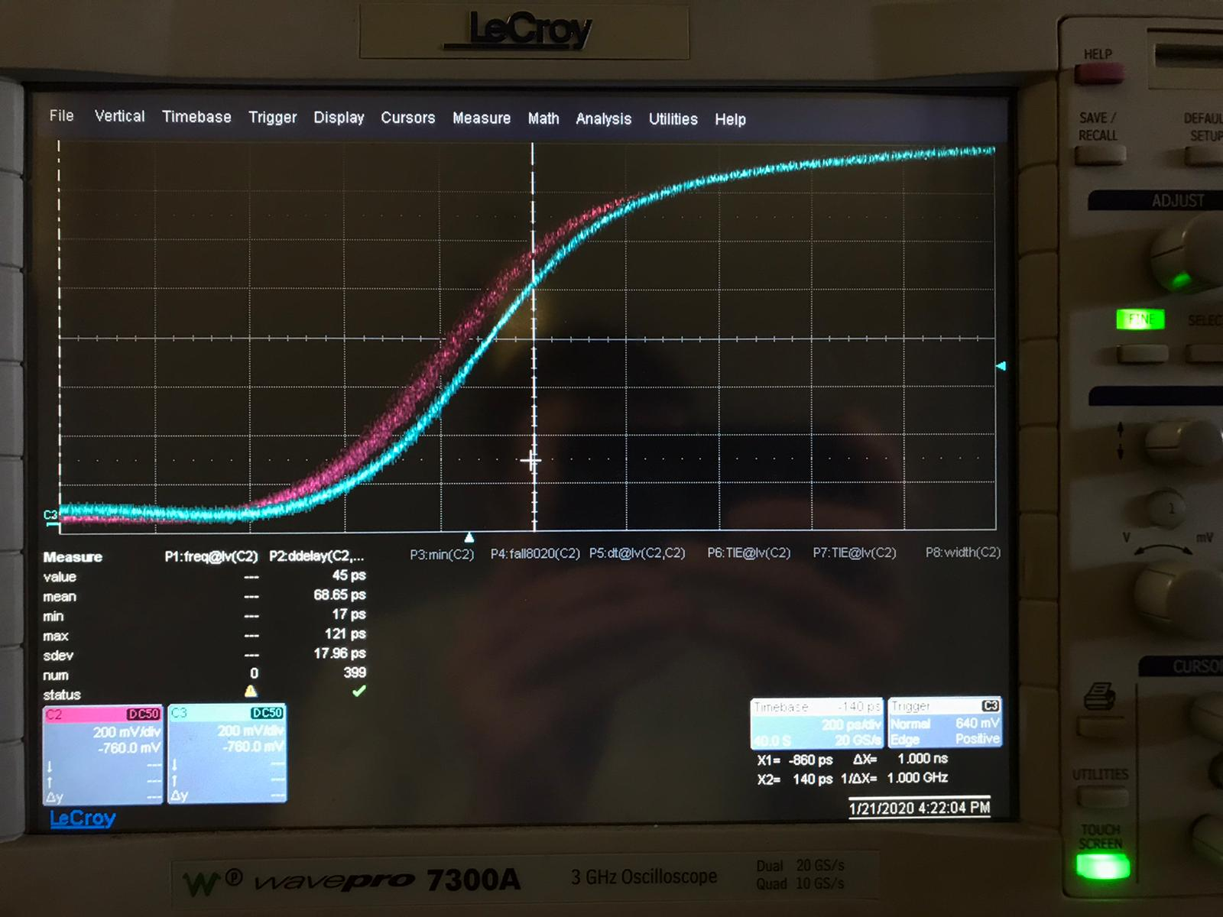
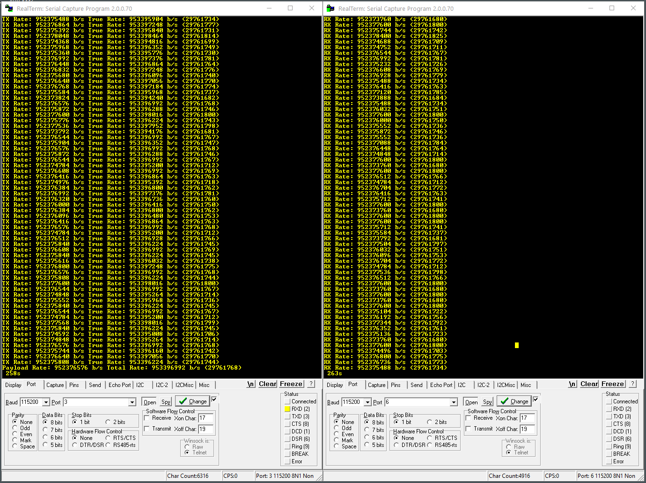
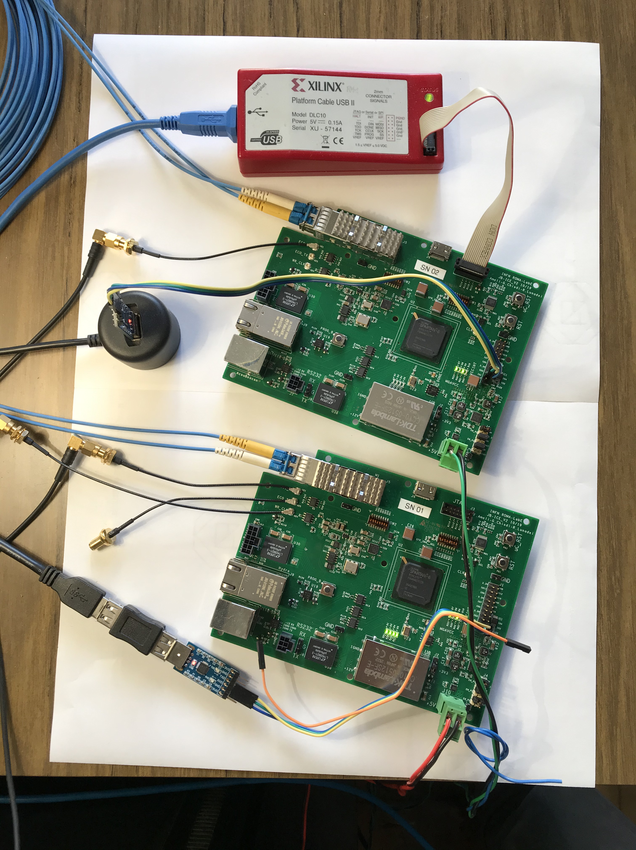
White Rabbit R&D
PPS total jitter = 17.96 ps
Measured sustained bandwidth > 953Mbps

Slide 25
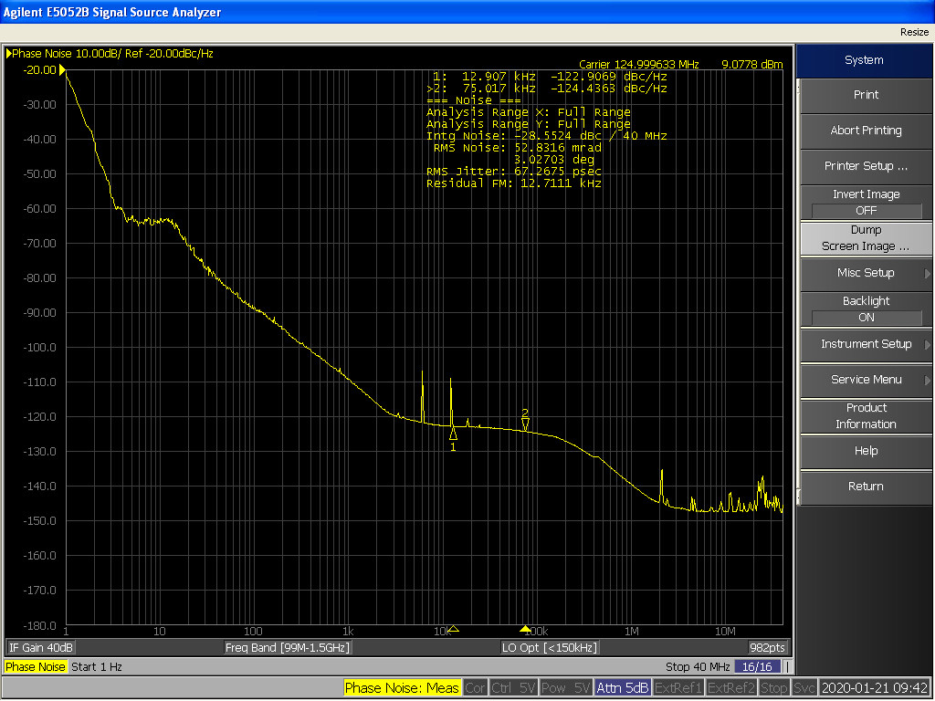

White Rabbit R&D
The total jitter on reconstructed clock is 67.26 ps RMS
The biggest part is concentrated between 1 and 10 Hz

Slide 26
White Rabbit R&D
The total jitter on reconstructed clock is 67.26 ps RMS
The biggest part is concentrated between 1 and 10 Hz

Slide 27
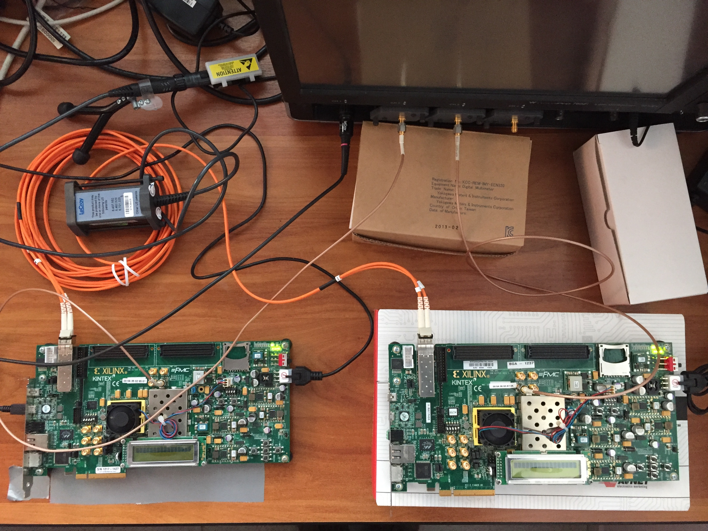
First Jitter Test on Custom Solution
Tx clk
Rx clk
Test done with 2 Xilinx EVB KC705
And the Lecroy scope
Wavepro 760Zi 6 GHz 40Gsps
RX board
TX board
The clock is sent embedded into data from the board on the right and reconstructed by the board on the left

Slide 28
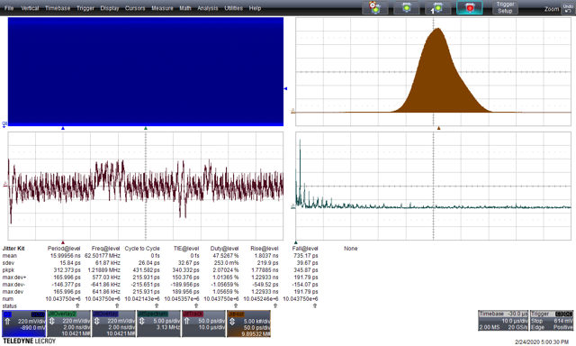
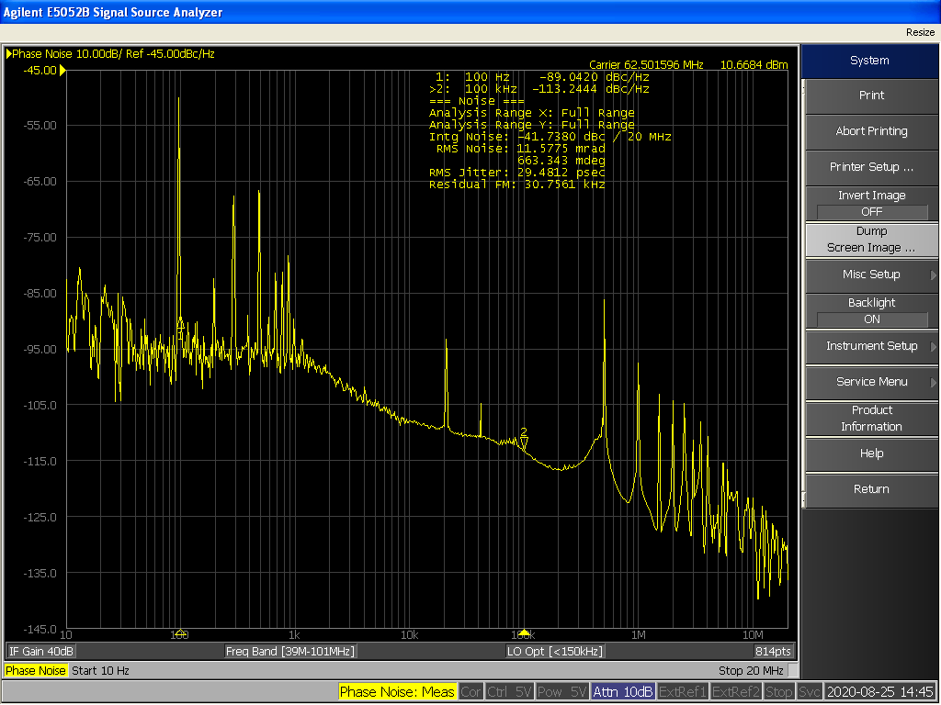
TX clock Time Interval Error
Time Domain
Frequency Domain
Time Interval Error 32 ps rms
RMS noise 29.5 ps
Noise at 500 kHz
and its harmonics

Slide 29
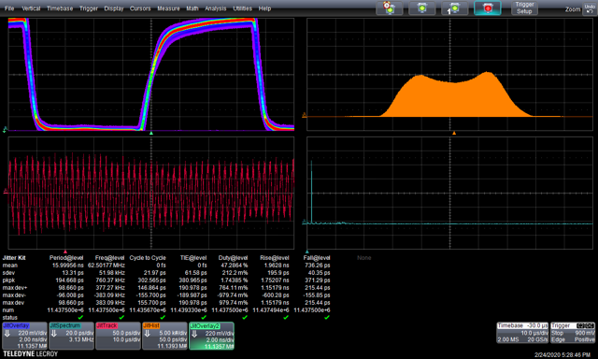
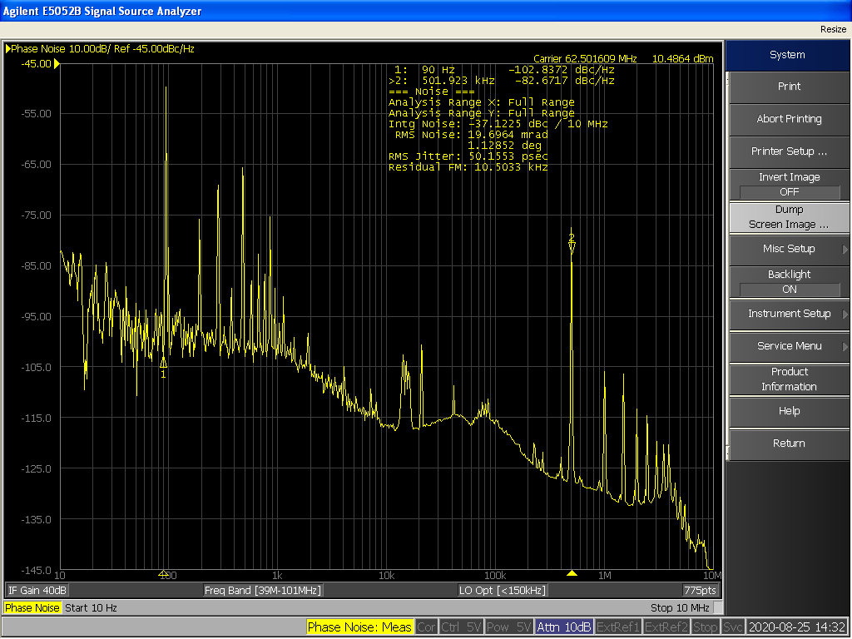
RX clock Time Interval Error (time domain)
Time Domain
Frequency Domain
Time Interval Error 61.5 ps rms
RMS noise 50.1 ps
More noise at 500 kHz and its harmonics
due to DC\DC modulation

Slide 30
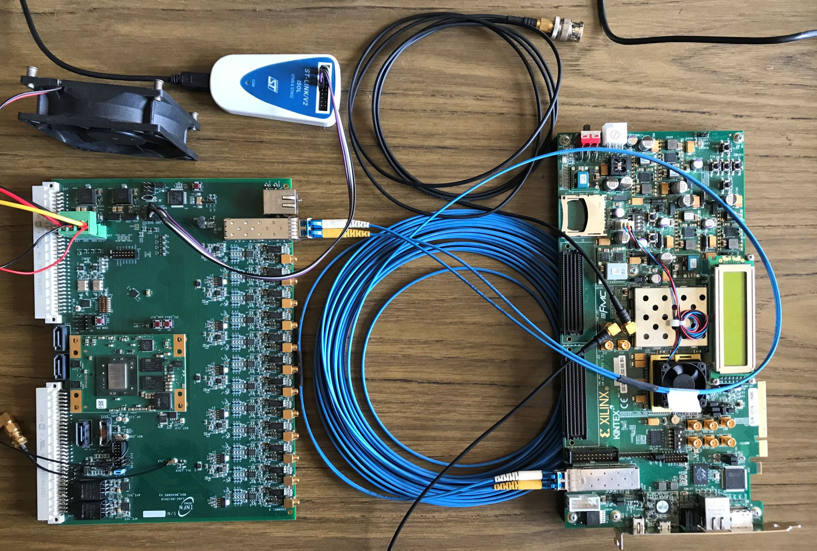
Custom solution: Jitter Test on KC705-Waveboard
TX board
RX board
The TX board is the same KC705 while the RX board is a custom board developed by INFN-Roma for BDX experiment (zynq 7000)

Slide 31
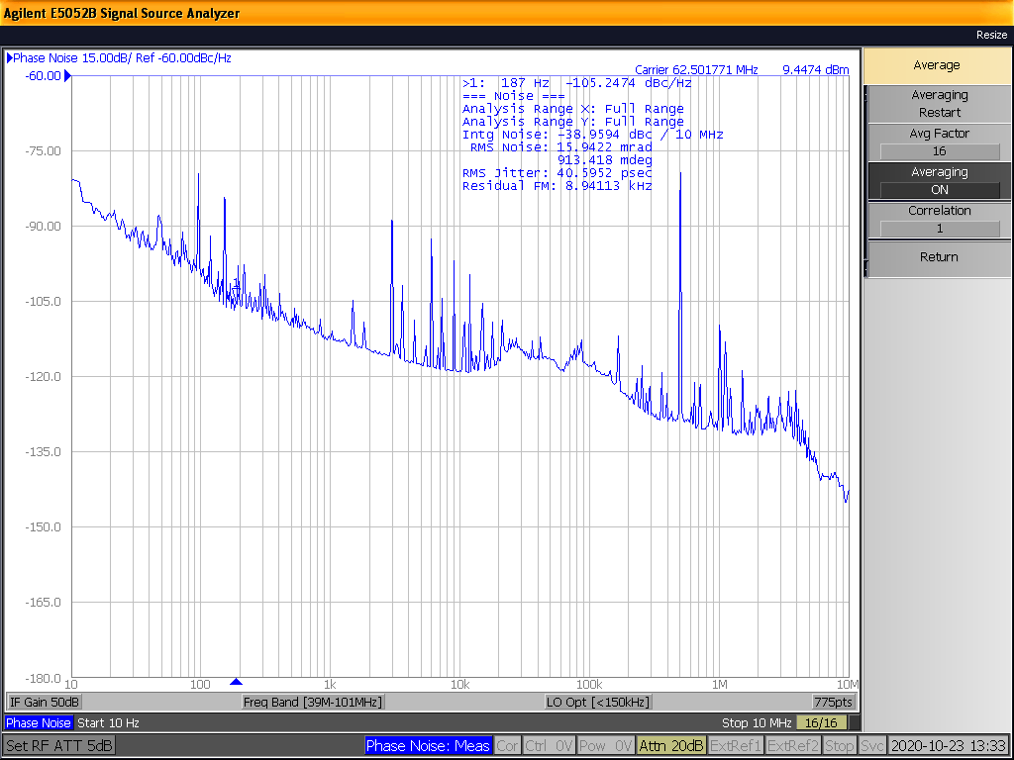
RX clock Time Interval Error (Frequency Domain)
Still noise at 500 kHz due to the TX side. There are no spurious from the RX board.
RMS noise 40.6 ps (with KC705 was 50.1)

Slide 32
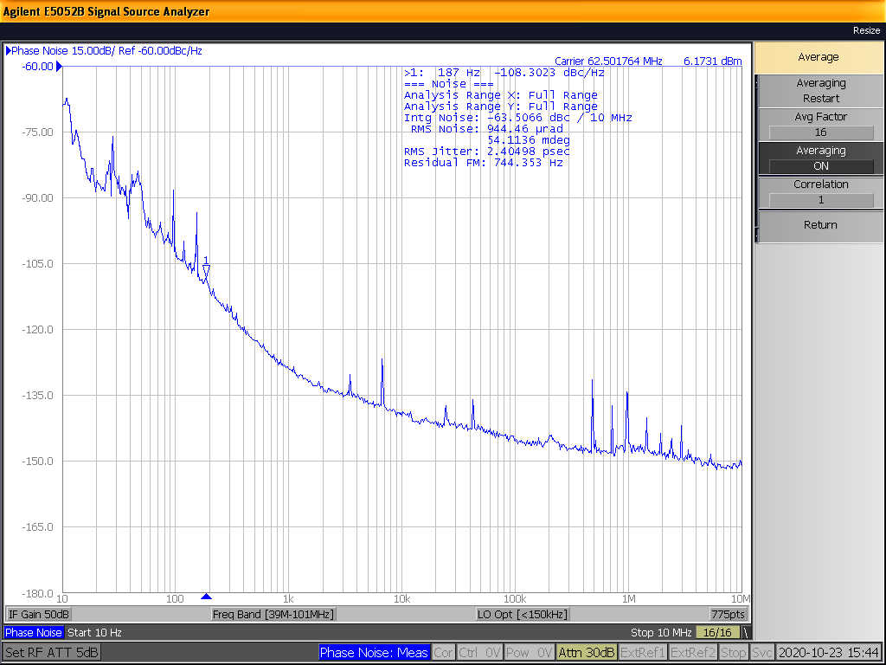
RX clock Time Interval Error Cleaned by PLL
The received clock is sent to the jitter cleaner PLL SI5345 and its output is measured
RMS noise 2.4 ps

Slide 33
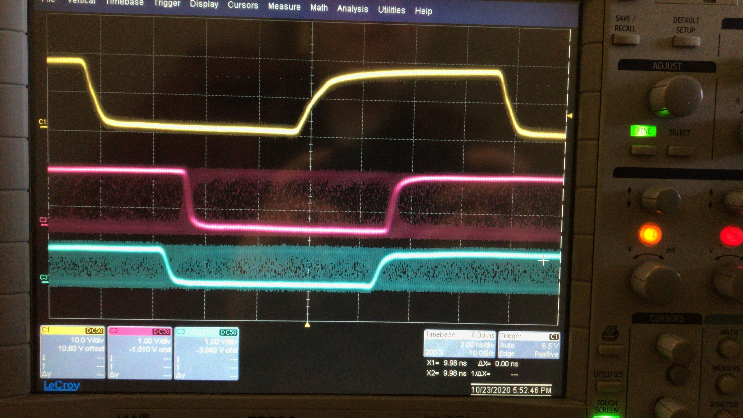
Phase Stability After Reset Test
TX clock
RX clock
RX clock after PLL
The phase difference between TX and RX remains constant after each reset

Slide 34
Tentative Electronics’ schedule

Slide 35
Conclusions
The R&D program is progressing well and the results are encouraging.
Soon clock recovery solutions will be tested on the FEs.
The GNSS receiver will be characterized against the “official French time” at SYRTE.
When the pandemic situation will allow travels we are panning to install the GNSS receiver on the SK site.
The final prototype based on an evaluation board is under development.

