Slide 1
Meeting FC-CPPM, 26 Janvier 2021
Claude Vallée
DERNIERES NOUVELLES DE L’ILC
International Development Team
JAHEP ILC Steering Committee
Next dates

Slide 2
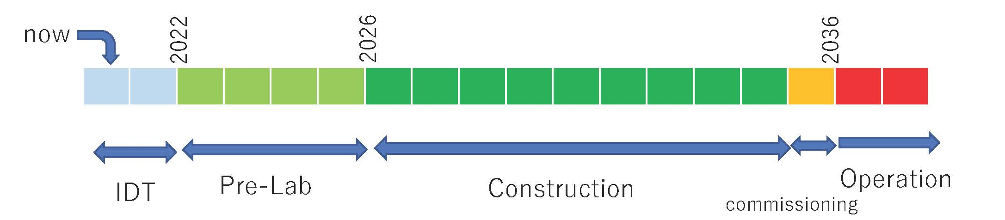
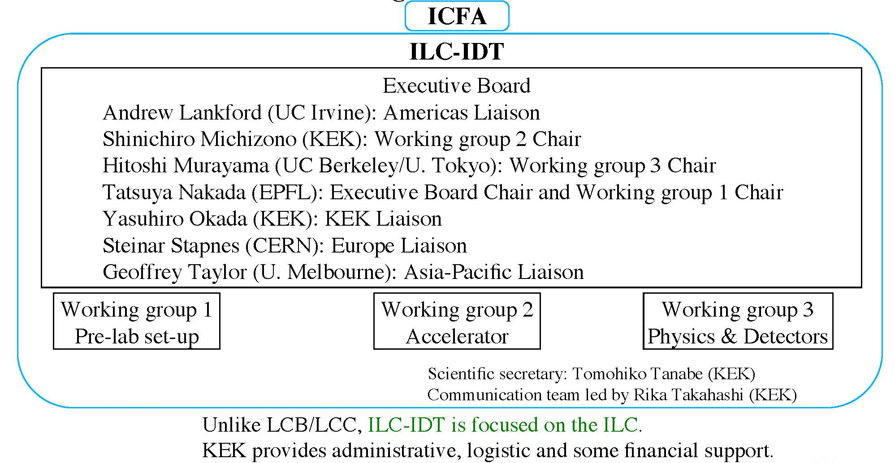
ILC TIMELINE and IDT STRUCTURE

Slide 3
ILC TIMELINE and IDT STRUCTURE
Under constitution,
not yet public

Slide 4
Membership still evolving

Slide 5
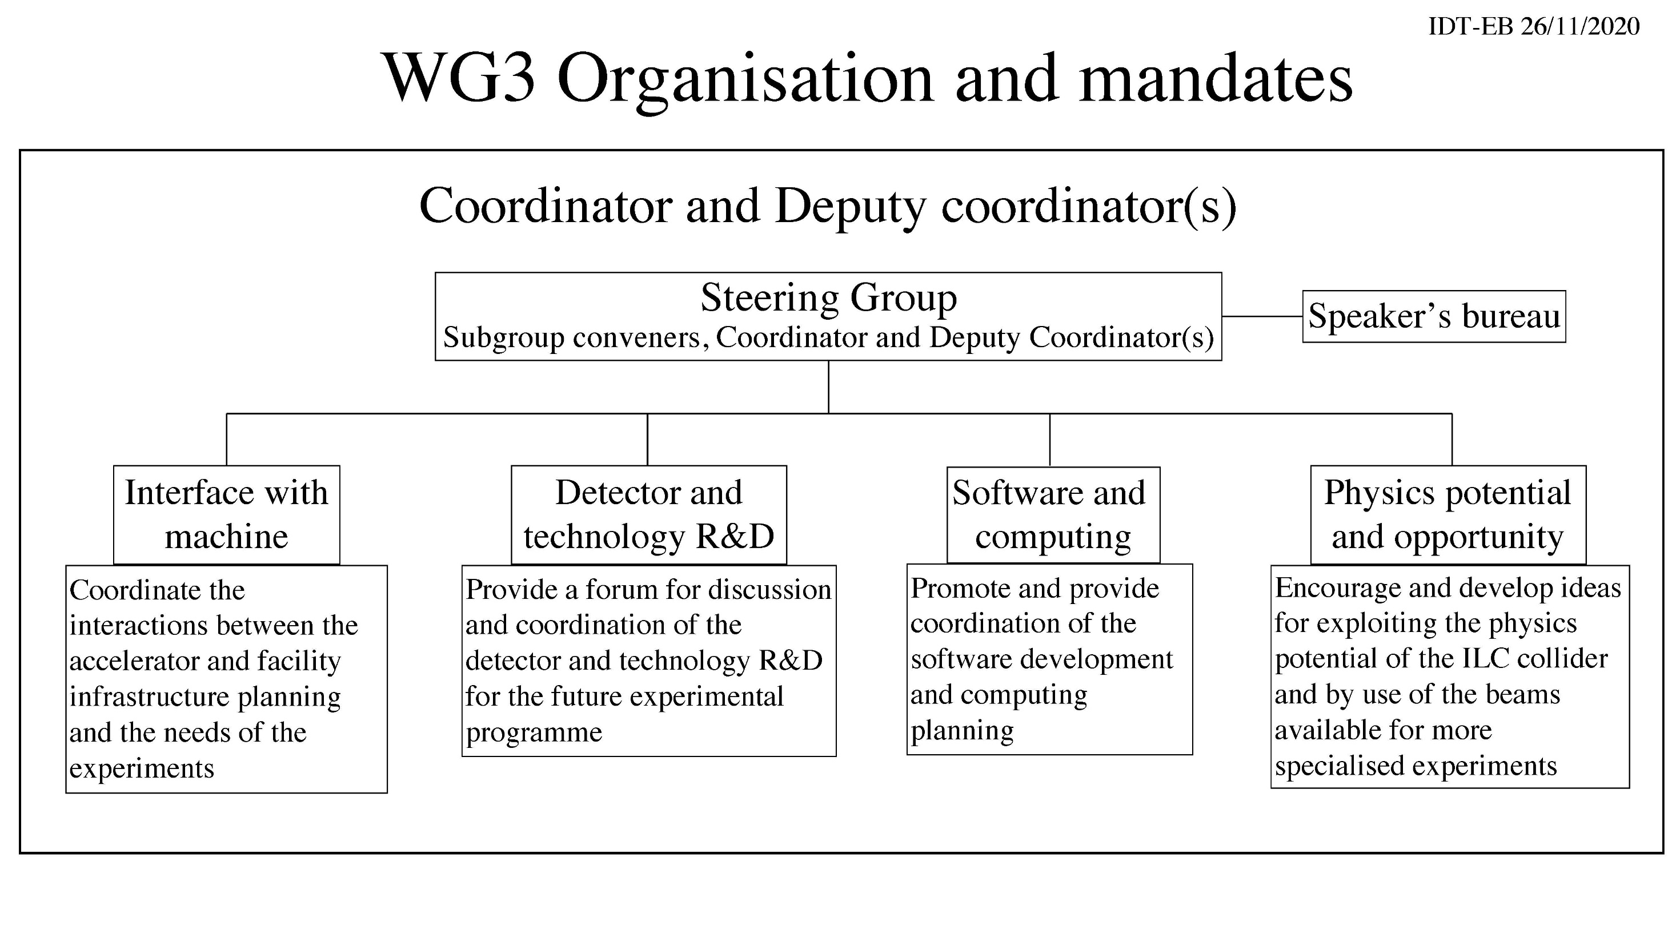
Hitoshi Murayama Jenny List and C.V.
Steering group and conveners under nomination process
(more news at tomorrow ILC-EU meeting)

Slide 6
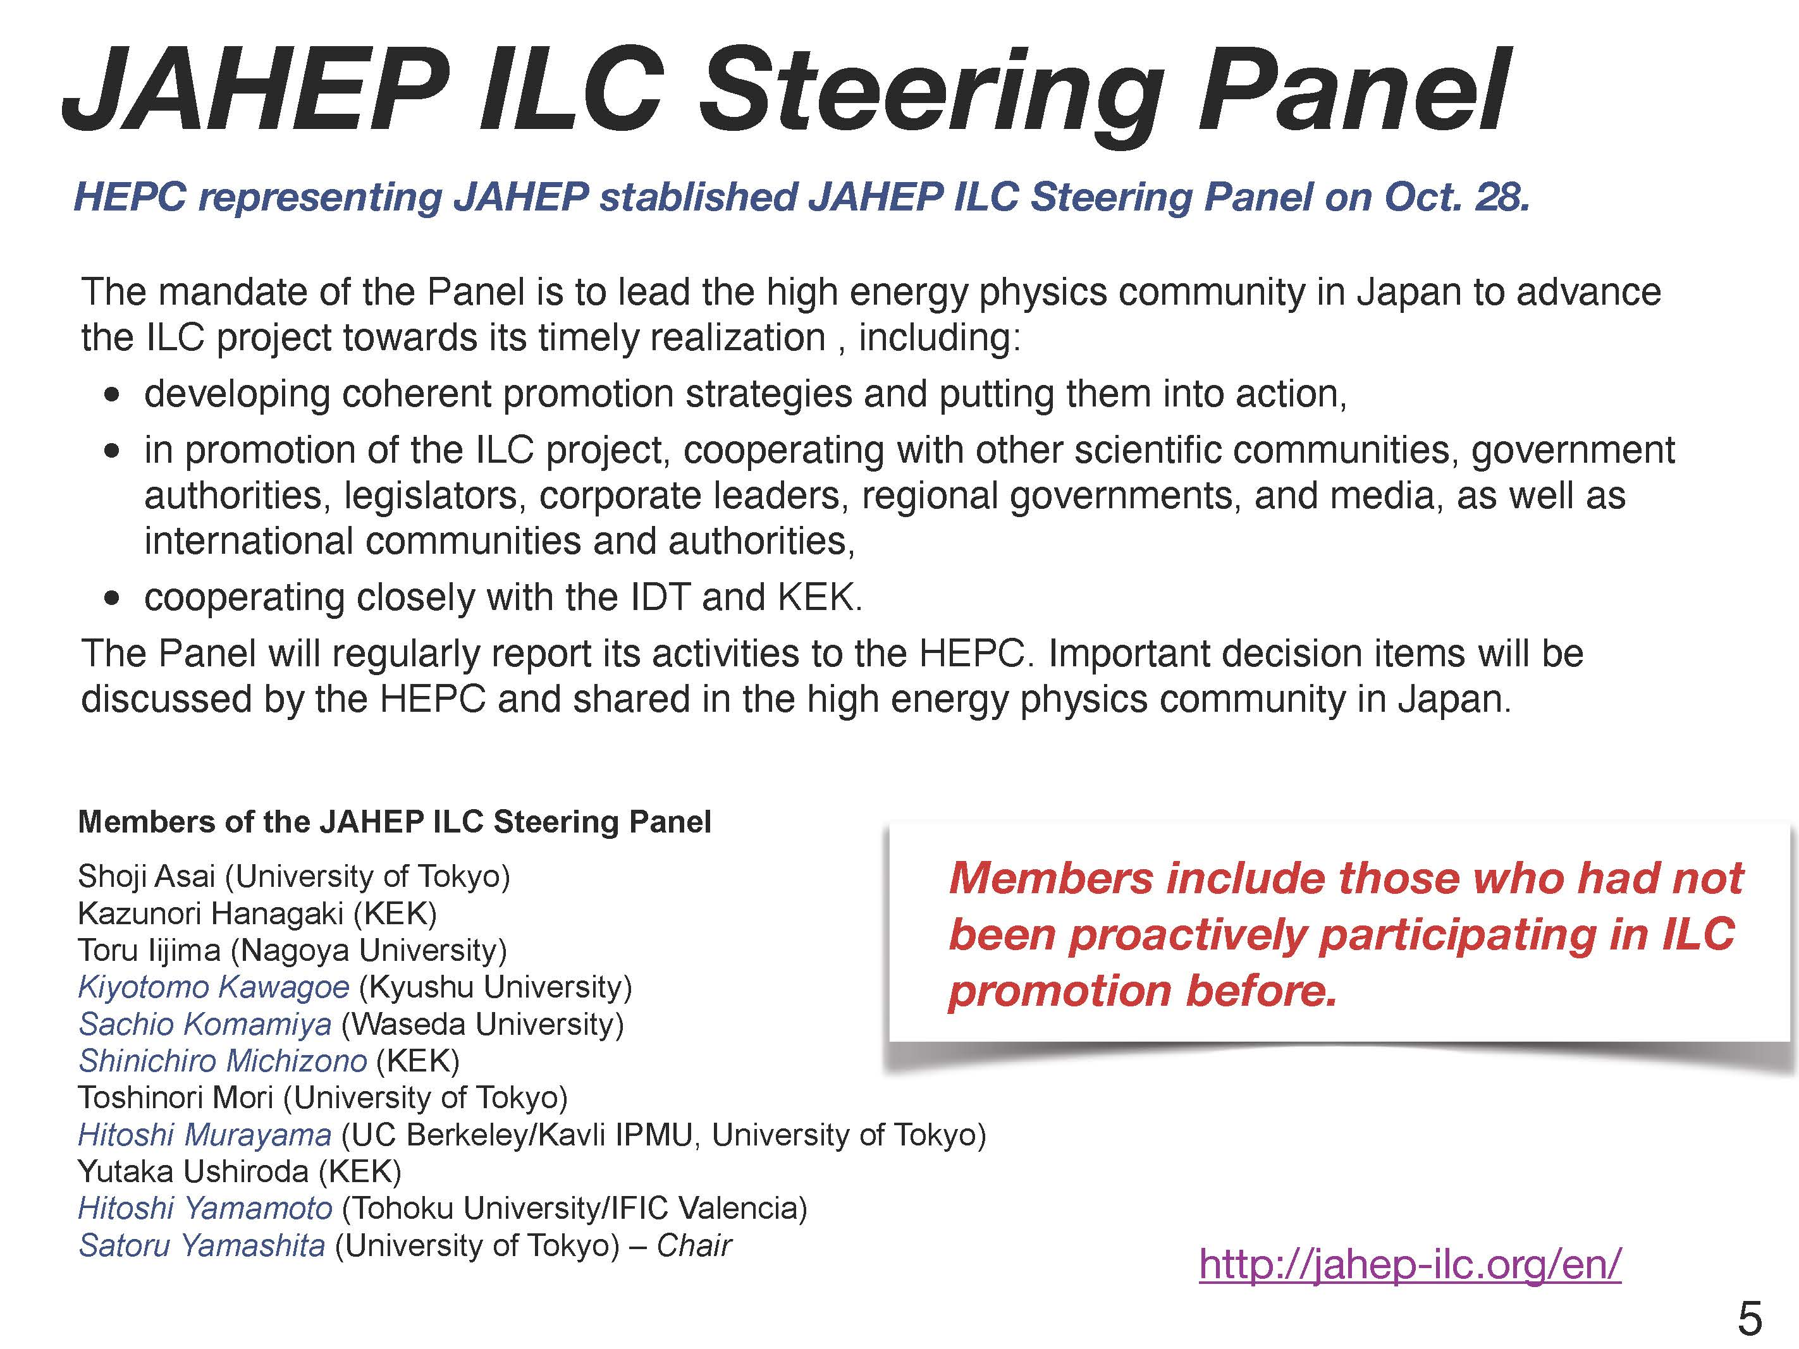

Slide 7
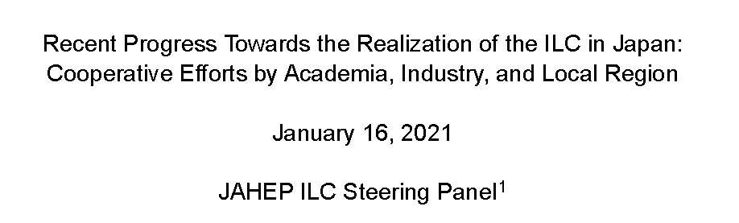
Status report recently released
File accessible on http://jahep-ilc.org/files/ILC_JP_update_20210116_E.pdf
No breaking news
but a comprehensive description of the situation and prospects in Japan

Slide 8
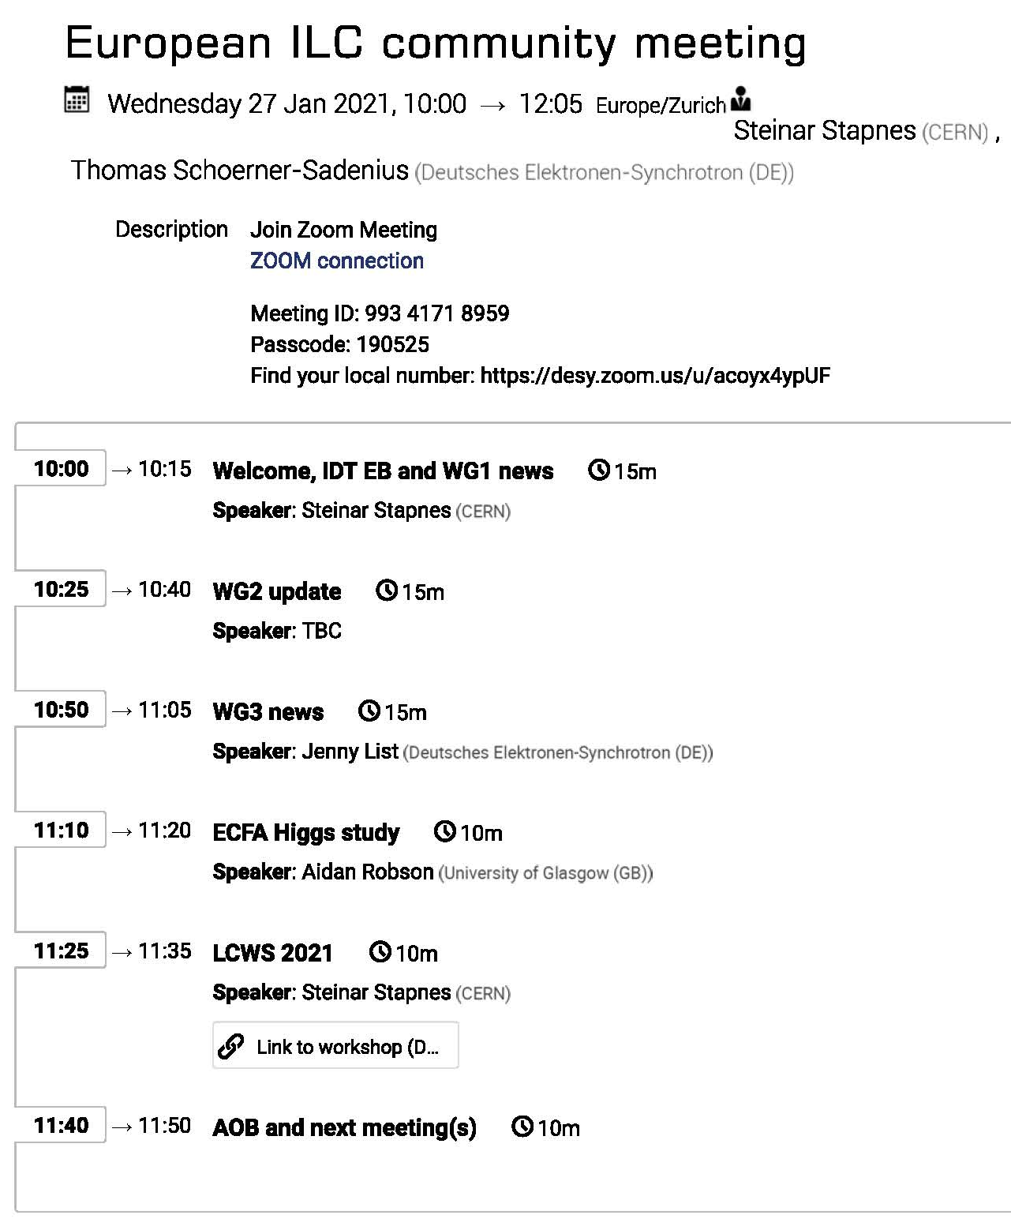
Next dates:
Tomorrow: ILC-EU meeting
https://agenda.linearcollider.org/event/9020/
More news expected
on the
IDT working groups

Slide 9
