Slide 1
WP2 lapp status
Frederic GILLARDO, Berkay Turk
Lapp/CNRS
18 January 2019

Slide 2
WP2 meeting
Fridays @ 9h30
Visio link:
https://meeting.lapp.in2p3.fr/b/fre-npd-jry-tfv
Minute report:
https://docs.google.com/document/d/15TjF7yeS8YtVElR6KyYDxgo-sEn-Utt61ZdtHqRs0ss/edit#heading=h.cn60c28t87zj
Participant :
Berkay T, Arturo S, Stephane J, Nadine N
Frederique C, Philippe S from MUST
Notes:
Besions similaire : Volume / fichier et de donnée (plusieur PB million fichier) Production onsite (SKA, LSST)
Regle de replication
QoS (tape)
FAIR
Authentification …

Slide 3
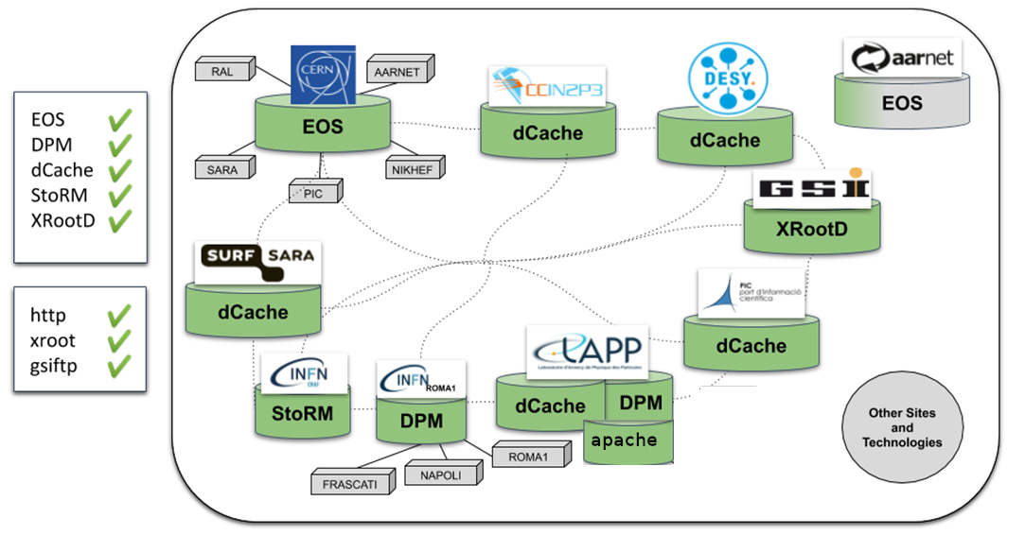
Today’s DataLake deployment

Slide 4
Curent work
Investigate some replication error (Frederic)
https://gitlab.in2p3.fr/CTA-LAPP/cta-rucio-cmd/
using htCondor to simulated load
“Retry” seems to work so fare (just missing monitoring)
Package the apache as docker container (using only DockerFile) (Berkay)
Rewrite CTA’s ingest script using python(Berkay)
Issue with Datalake not deleting files (working with Ricardo)
Notes:
Besions similaire : Volume / fichier et de donnée (plusieur PB million fichier) Production onsite (SKA, LSST)
Regle de replication
QoS (tape)
FAIR
Authentification …

Slide 5
Comming work
Dev:
Commercial cloud (requested by Xavier but useful for us)
In contact Natalie L to validate the payment
Application (scaling + distant location)
CTA ingest
Lapp-webdav
Dirac running singularity containers (In contact with Luisa)
Discussion:
Metadata & openID support in the dataLake (Need to contact Xavier)
Notes:
Besions similaire : Volume / fichier et de donnée (plusieur PB million fichier) Production onsite (SKA, LSST)
Regle de replication
QoS (tape)
FAIR
Authentification …

Slide 6
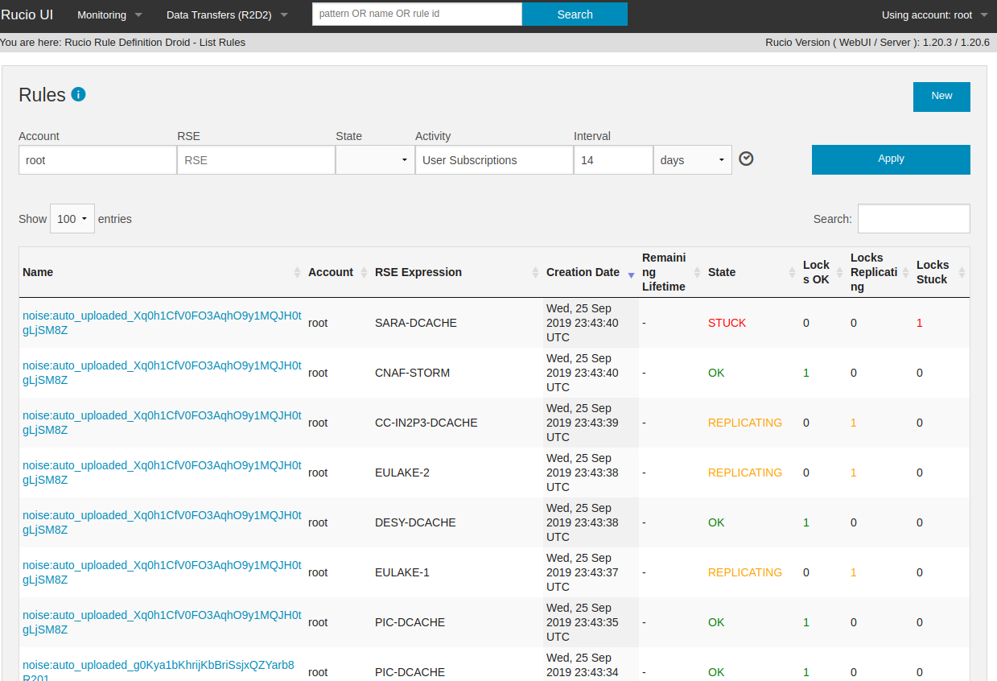
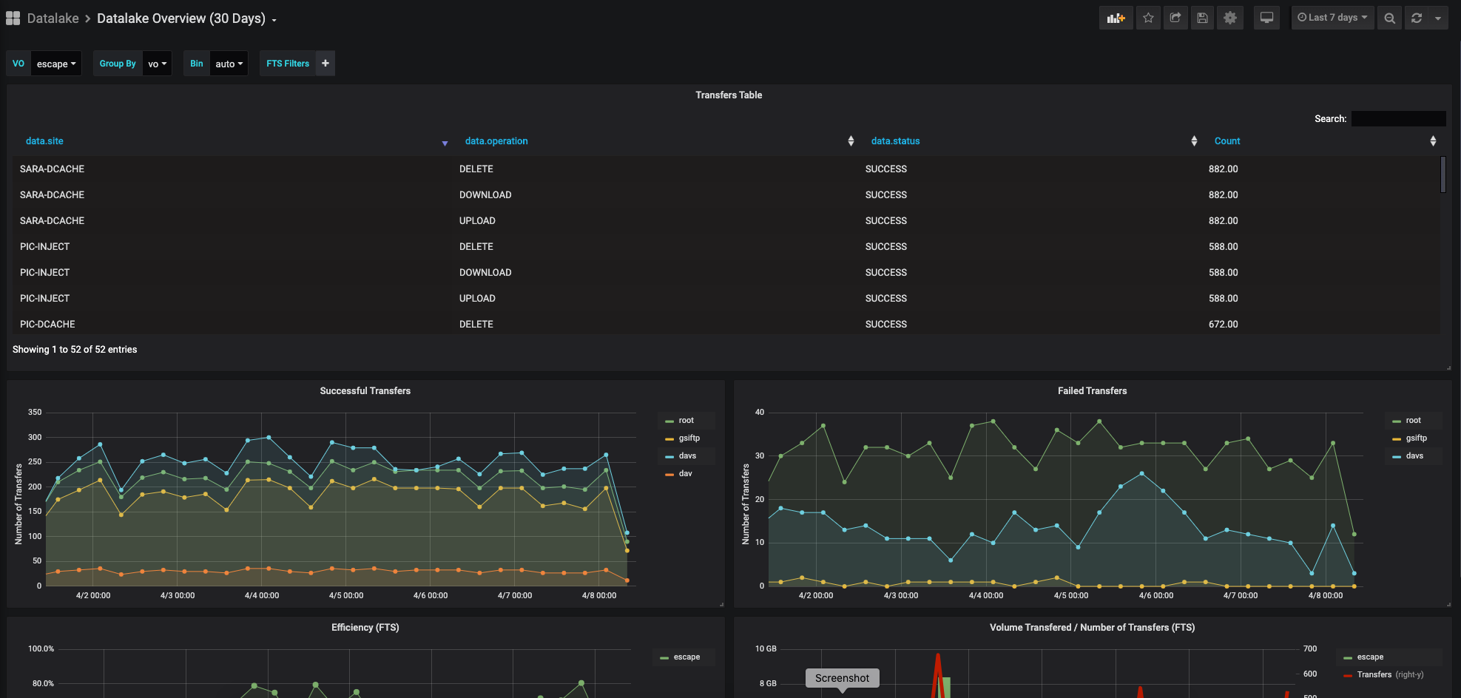
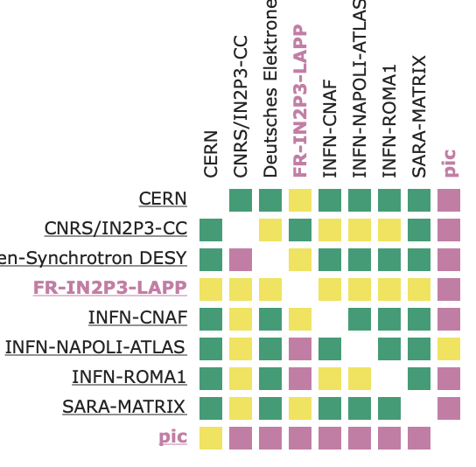
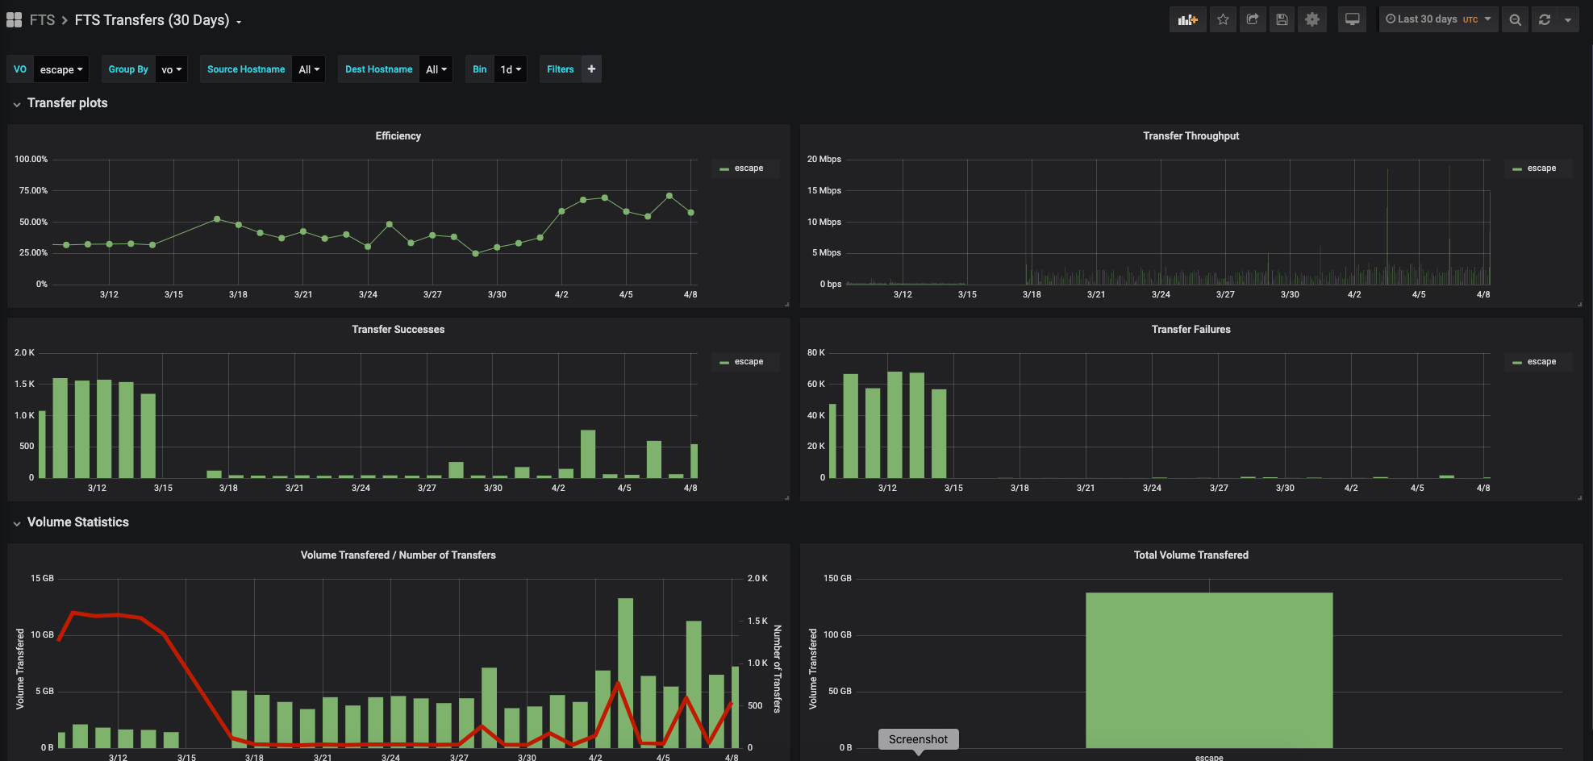
Monitoring from datalake
Rucio WebUI as interface for ESCAPE users
ESCAPE DataLake dashboard
FTS dashboard
low level network monitoring

Slide 7
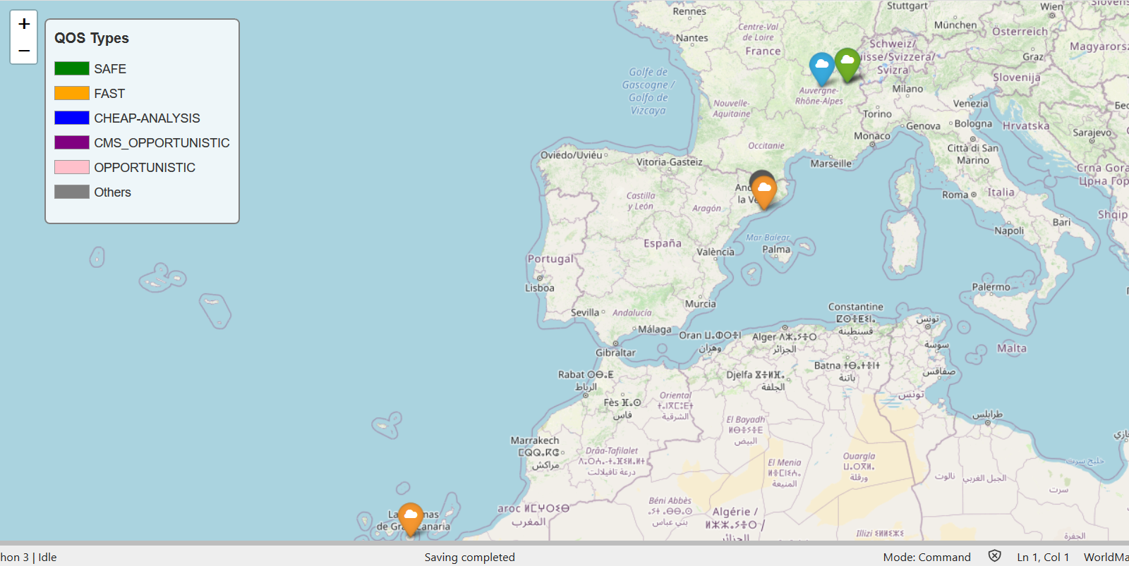
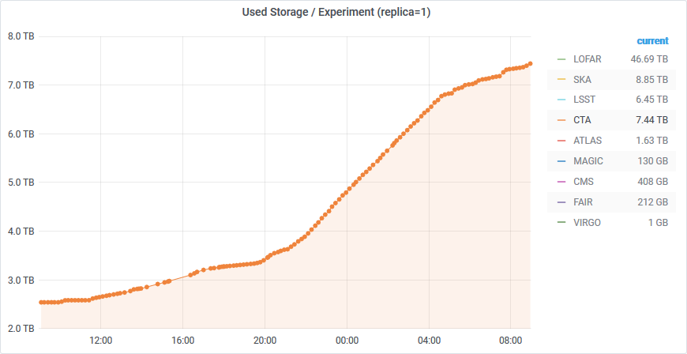
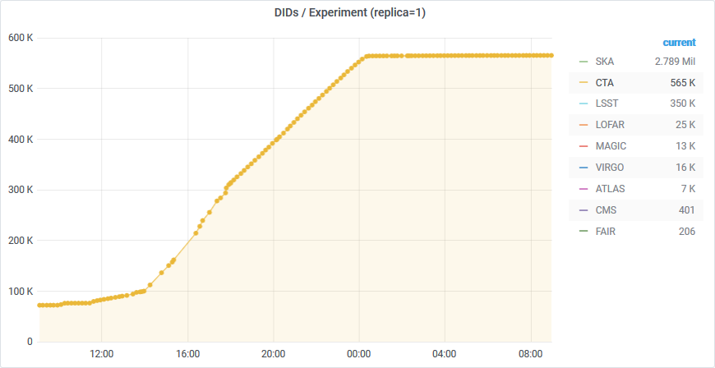
First data challenge 17/11/2020
Simulation of ingest for ~ 1 night of data from one site (5,5TB, 500 000 files):
All experiments :
73 TB
3,5 Millions de fichiers

Slide 8
Road Map
Phase 1 : Test if the DataLake interface can implement the CTA’s archive interface:
Targeted date : end Q2 2020
Ingest : Done
manage metadata to file : Blocked with current version of RUCIO
Replication policy : Done
OpenID authentication: Not yet tested
Retrieve files : Done
Phase 2 : use the DataLake ‘s interface in in batch job to pull and push files using a Singularity container
Targeted date : end Q4 2020
Data challenge : Use storage resources from LAPP, CC-IN2P3, PIC
Archive jobs are executed on MUST ressources using htcondor as job manager
Phase 3 : use Dirac with the DataLake interface (RUCIO/DIRAC integration)
Targeted date : end Q1 2021
Using the DIRAC instance from the CC-IN2P3
Step 1 - execute singularity containers implementing OAIS interface in DIRAC to access and retrieve data
Step 2 - implement a RUCIO catalog in DIRAC
Phase 4 : use CTA partners infrastructures
Targeted date : end Q2 2021
Setup a datalake end point in La Palma for the ingest operation
Execution of CTA pipe

