Slide 1
Reunion Meca, ITK module loading
Equipe ITK le 20/Jan/2021

Slide 2
Foreword
Is that necessary to load with high accuracy? → Yes
Why? The accuracy is driven by the gap between two adjacent modules on a longeron in the detector Z direction which is 0.3mm → this seems to be large but I will explain later why this require a high accuracy on loading
What high accuracy means? On atlas pixel detector, Module placement accuracy of ±0.06mm was reached on the barrel staves, On IBL ±0.1 mm accuracy was reached, but on both detectors module loading was sequential therefore errors could propagate on the local support without reducing the module gap or risking module clashes. By experience getting better than ±0.05mm of accuracy is difficult and require large amount of work on tooling and processes
Why not deciding to load with the best accuracy we could achieve, to perform a metrological survey and then decide where the module will be integer ? This could be done, but require to know the accuracy spreading to evaluate how many module can go on Longerons and how many on inclined ring. But in practice, this will not be possible on ITK → Loading and integration will be done in parallel → there is phases where we will concentrate on longeron integration and phases on rings → we will not have the luxury to select which local support will be populated as function of our loading quality

Slide 3
Control each steps of the loading to track inaccuracy
One key operation during the module loading will be the cell alignment on the tool and the module alignment on the tool → Both operations are manual so can induce inaccuracy
Inaccuracy will come from tool, the process, and the parts to assemble
In the current qualification process we will check the tool absolute accuracy, the process repeatability, and individual parts absolute accuracy → these 3 elements will help us to estimate the global loading accuracy
Our goal is also to have a significant statistical analysis to get the right picture of the loading accuracy

Slide 4
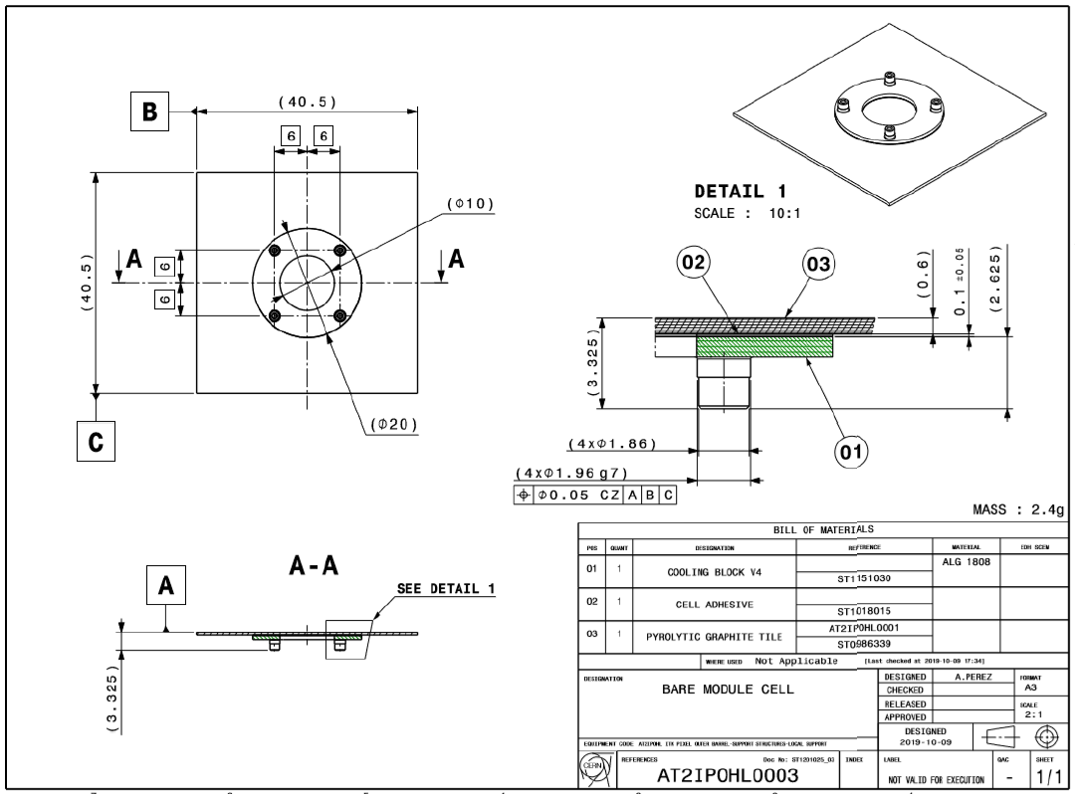
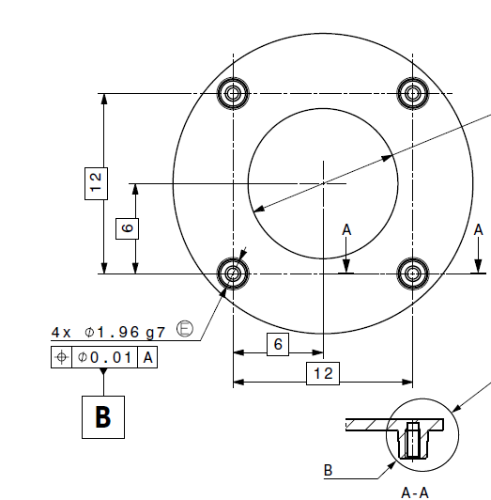
First → Cell placement on the tool repeatability and Accuracy
Metrology reference syst
Thanks to the Al cell provided by Diego we where able to start the cell installation accuracy and repeatability
The first action was to measure one of the cell which will be used as reference piece for the measurements
These pieces are precise and within the specified accuracy of the cooling blocs
Cell reference syst

Slide 5
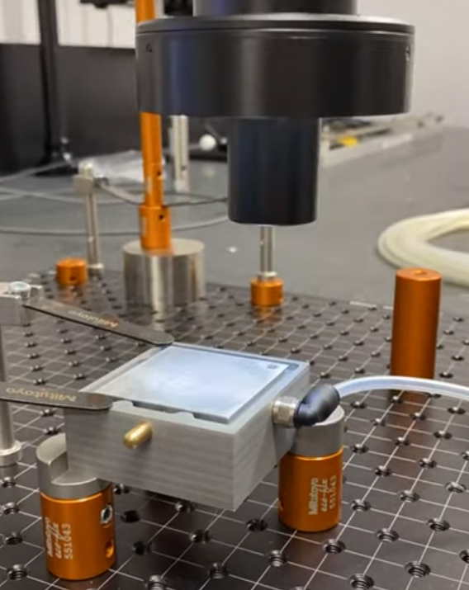
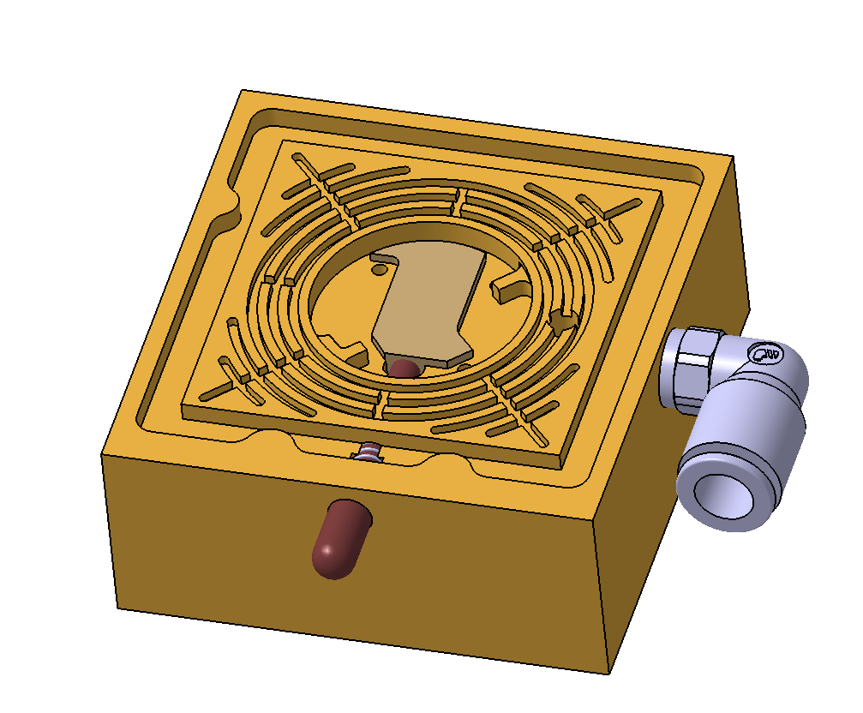
Cell placement in holing tool repeatability
This measurement started last week, the goal is to get enough statistical data to evaluate the placement manual accuracy
To guarantee the best measurement accuracy the tool frame is measured and on fiducial glued on the top right is measured on the cell after manual placement and vacuum activation.
Measurement movie HERE
Z=0 reference plan which correspond to cell back side
X
X
Fiducial on top corner of the cell
Tool Reference Syst

Slide 6
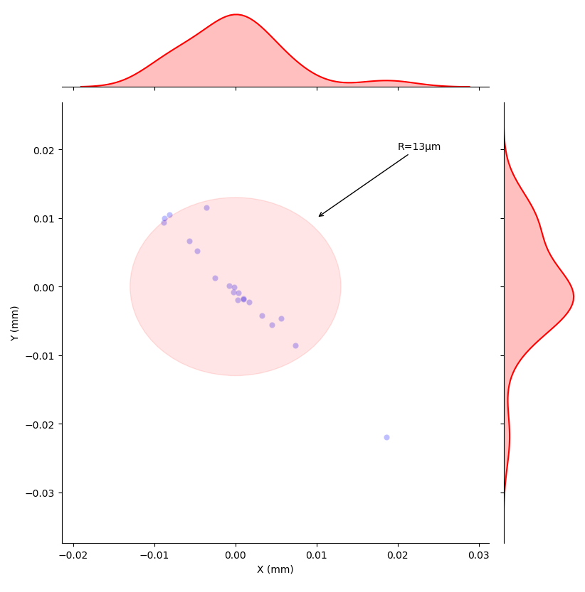
Cell repeatability results
the current plot shows the error in both direction of the fiducial measurements (error is calculated for example in X direction as follow (Position X measure value – Mean X measurement value) this is not the absolute error measurement (this will be done later)
We achieved 13µm repeatability accuracy (not bad)
I will come back on the linear correlation of the repeatability errors
If our target is to reach ±50µm Loading accuracy this mean that 26% of the accuracy will be involved by the cell mounting into the tool

Slide 7
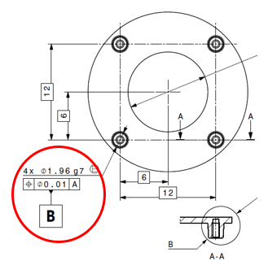
Some explanations
This value seems far from the accuracies shown on the cooling block drawing (e.g. g7 tolerances correspond to -2 µm -12µm on the pins diameter
But we need to consider the lever harm between the cooling block and the cell edge
For example 5 um misplacement at the pin level will involve 16um at the edge corner
Cooling block
Alignment pins
16µm
5µm
Cell corner

Slide 8
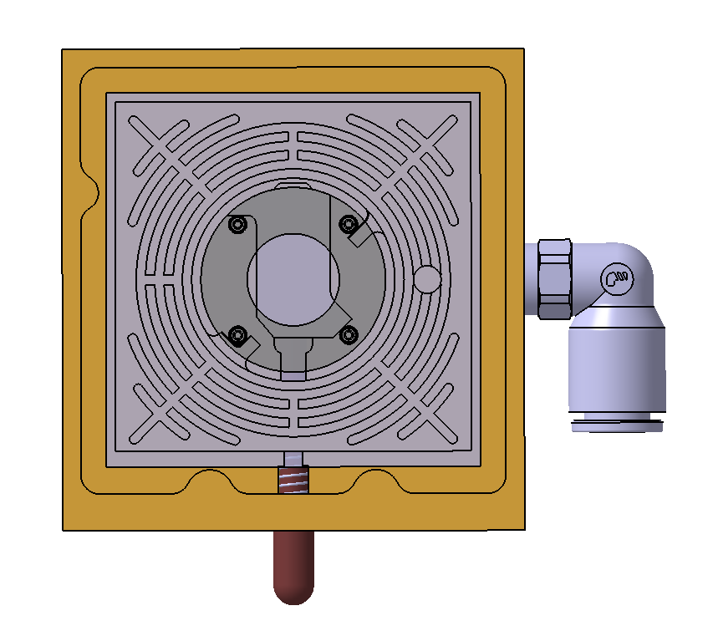
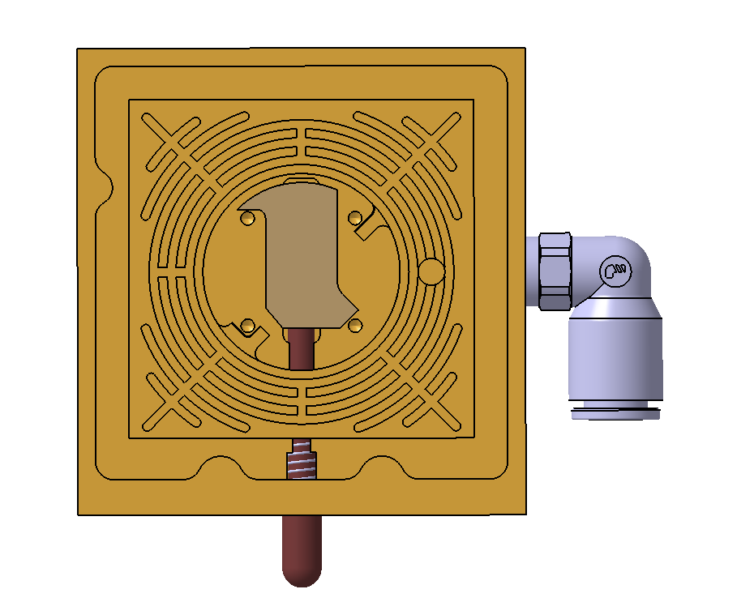
Some explanation
We do not have a clear explanation for this linear correlation
This could be involved by a small rotation of the cell inside to tool du to the fact that the pressure tool is not isostatic
A new pressure system is under design to test the impact of contacting directly the two reference pins instead of the adjacent ones. Some gap will be added to get flexibility and avoid hyperstaticity
Measured points are very close to the correlation line, we expect to be able to reduce by a factor 2 or 3 the cell mounting repeatability if we can avoid these potential rotations
Cell rotation around the V contact
Pressure points
New Pressure points

Slide 9
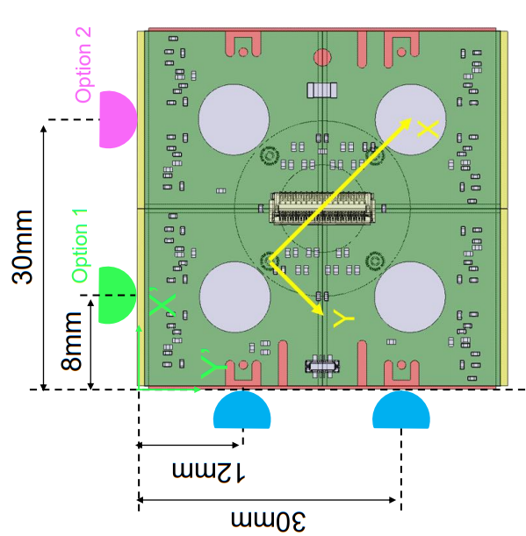
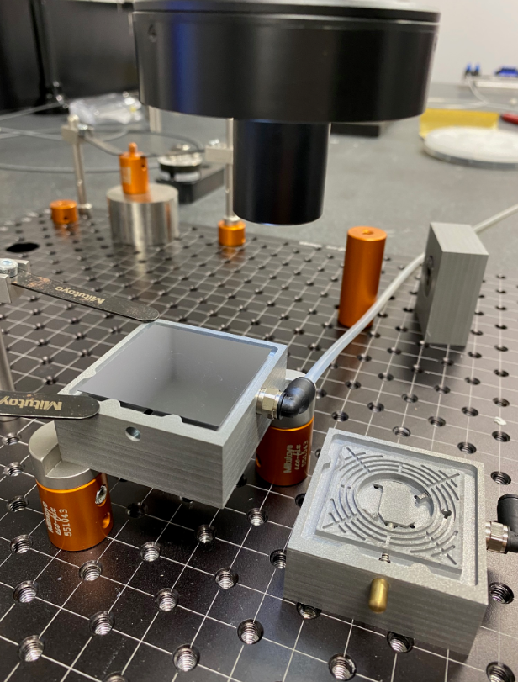
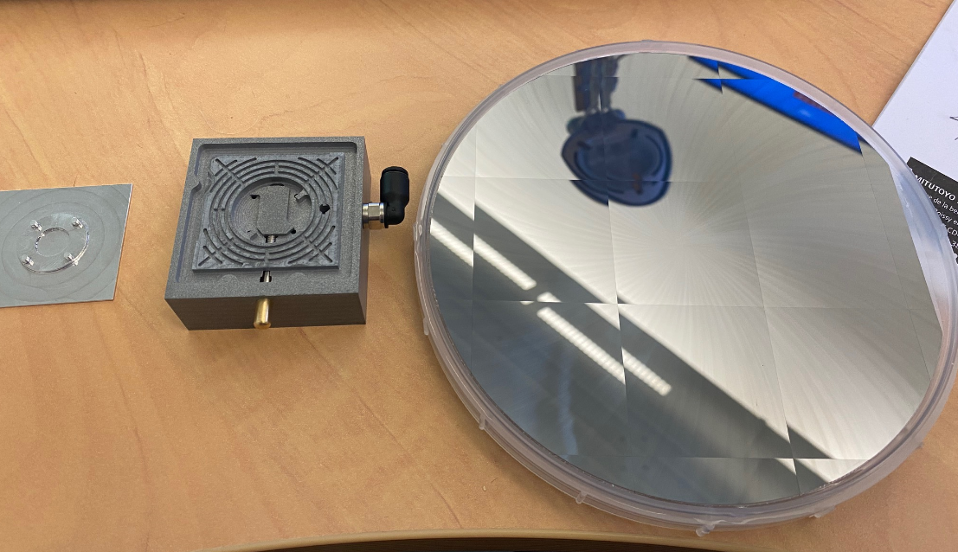
Module placement repeatability
The same tool will be used to place the module before picking it up with the bridge. Two options was considered for the alignment pins position
Option 1
Option 2

Slide 10
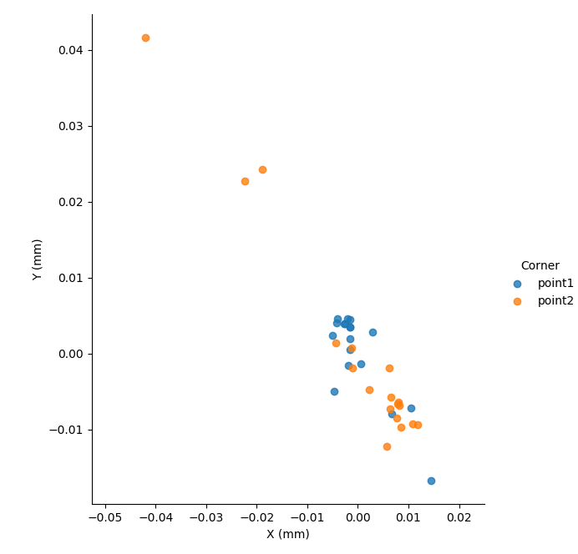
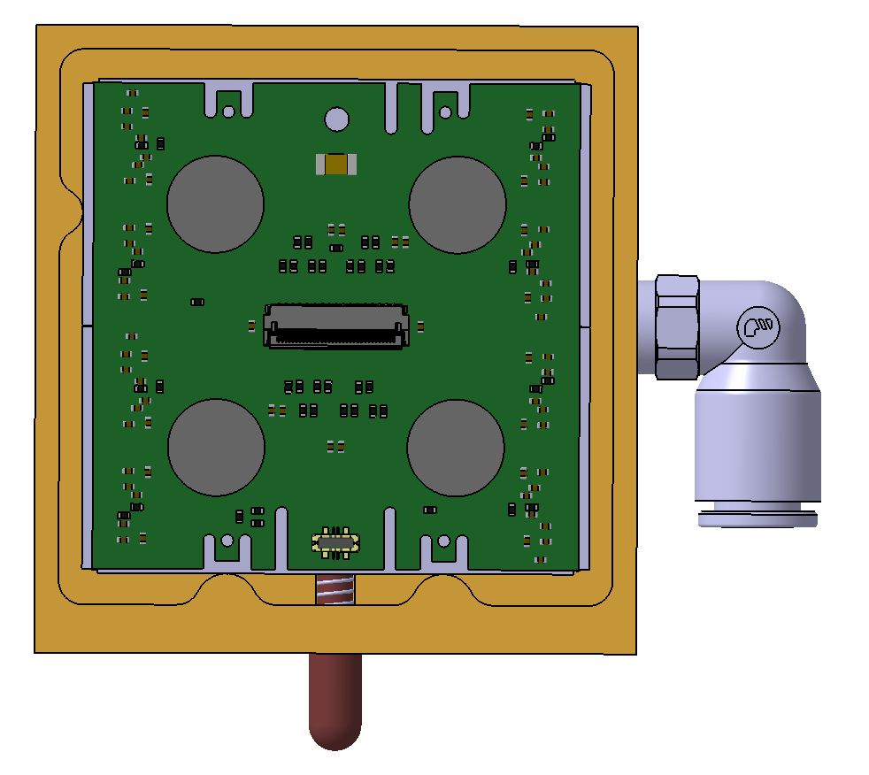
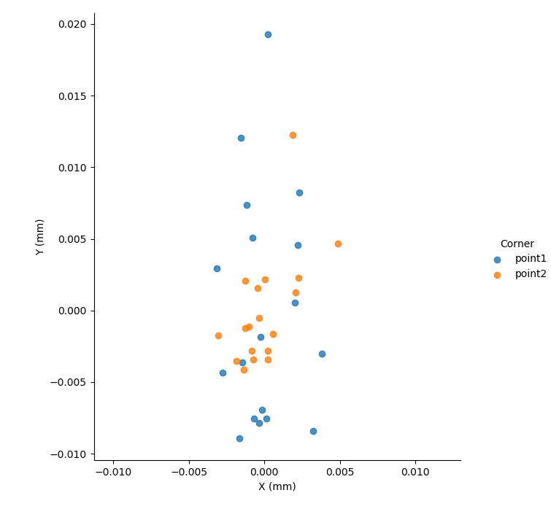
Module Placement repeatability
The present error plot shows error relative to mean measurement value. The absolute value measurement has not been computed yet, but will be studied
Option 2
Point 1
Option 1
Y
Point 2
X

Slide 11
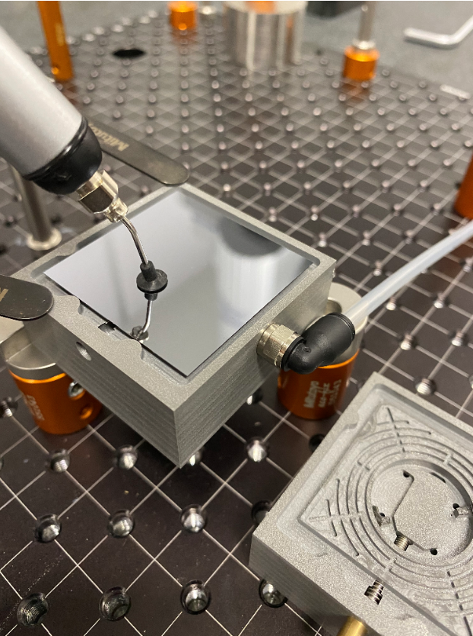
Some explanation
Option 1 provide a better control of placement in measurement frame X direction
Option 2 we can observe some rotations of the module more difficult to manage
In the current placement process we used vacuum stencil to press the module in contact with the alignment pins → Due to the fact that the vacuum valve is not aside the tool we are obliged to release the pressure to activate the vacuum → We think that maintaining the manual pressure will improve a lot the accuracy. By releasing the pressure before the vacuum activation, we think that there is a module bounce on the contacts
We have the possibility @ CPPM to measure the module position at each step (Measurement take less than 1’,this will improve a lot the accuracy), But our goal is to show that accuracy can be reached even with a blind assembly because all sites will not have access to measurement facilities during loading

Slide 12
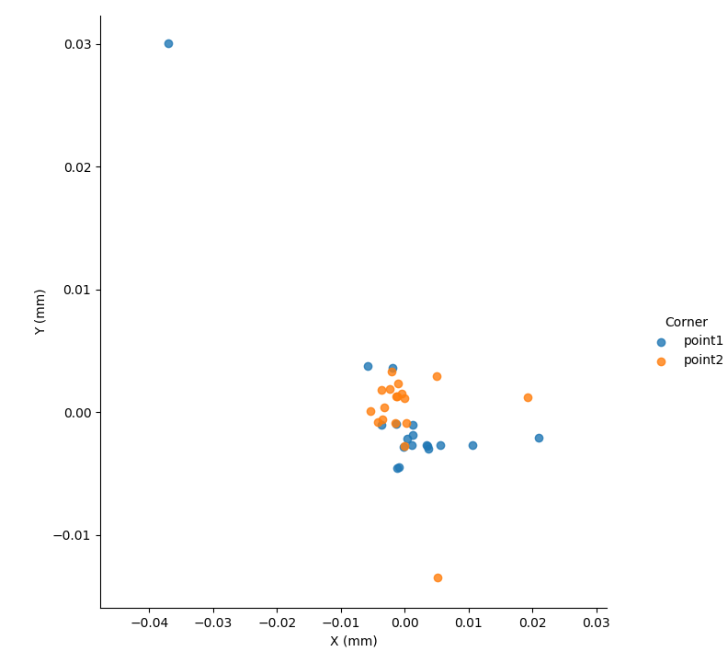
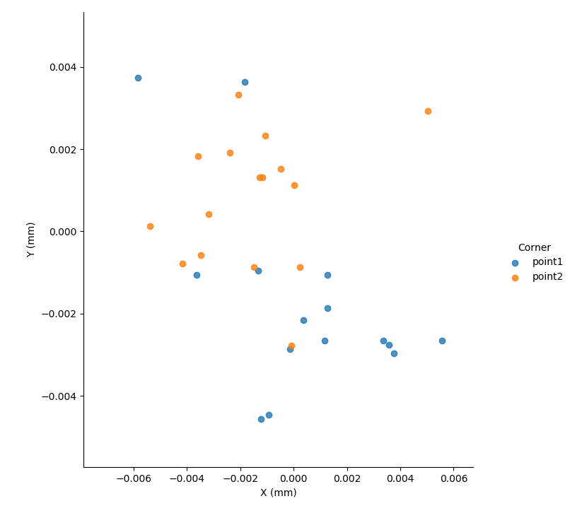
New measurements with constant pressure applied
75% of the points inside ±0.006 mm
Mean Y=-0.00022
Sigma Y=0.0095
Mean X=-0.00048
Sigma X=0.0042

Slide 13
Some thought
With option 1 even in a blind configuration we can control accurately the X direction
In our case the most critical direction will be the Y direction which correspond to Z in the detector reference frame
We could decide to rotate by 90° the pin location to improve our tooling
Current solution
Proposed solution

Slide 14
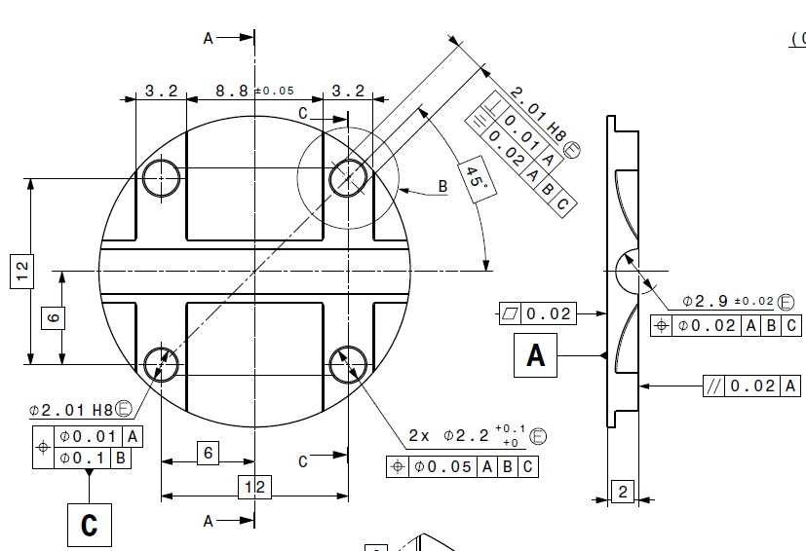
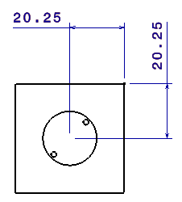
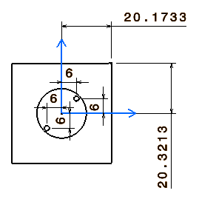
Cooling bloc / base bloc design accuracy
In all measurements done up to now, module rotations can induce huge displacement in X/Y direction
Up to now all cooling bloc or base bloc measured shows a very high accuracy within the defined tolerances
The current fixation scheme, the cell alignment and fixation will be done close to its center, and the critical area will be on the cell edges → there is a lever harm which amplify all central placement inaccuracy to the edges
In the current design the cooling bloc pins are Diam 1.96 mm (-0.002 -0.012) and base blocs holes are Diam 2 mm (0 +0.014) after Ni plating this represent a gap of 0.066 mm in Diameter → this can involve a misplacement of the cell edge of 77µm
2x0.077mm will represent ~50% of the module clearance and will constrain the module loading accuracy
We may gain advantages to push bloc pins to 2mm g6 or g7 this would permit to relax the constrain on our assembly

Slide 15
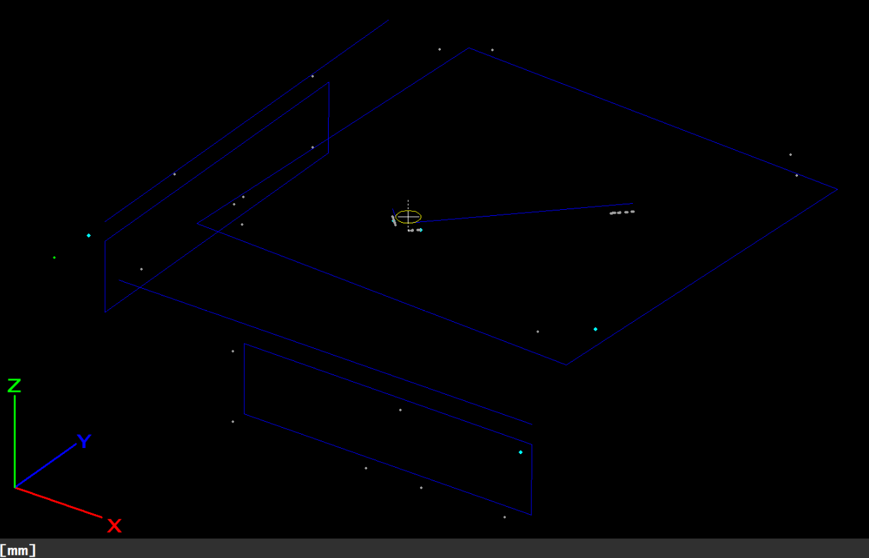
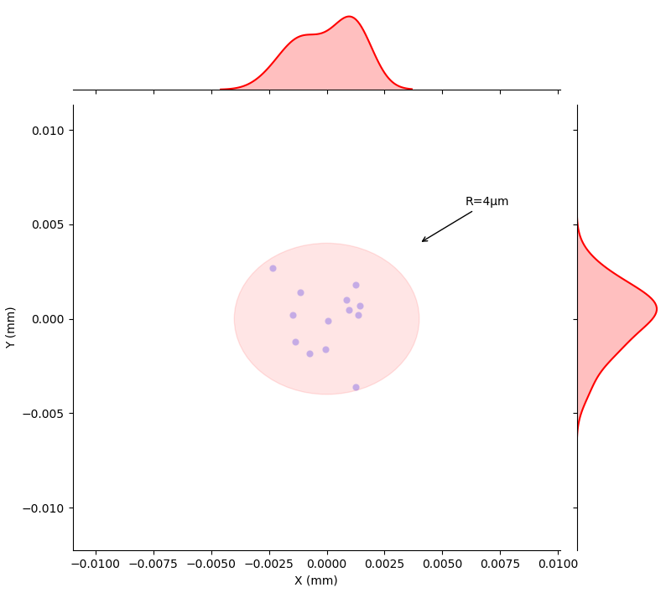
Absolute positioning measurement
The first action made was to measure the cell reference system by measuring the V and Flat contact surface in the tool and to construct the Cell frame
Cell frame repeatability measurement

Slide 16
Absolute positioning measurement
SI Tile is measured to know the real dimensions
Ideal Dimensions
Real Dimensions
41.1 mm
41.1563 mm (+56µm)
42.2 mm
42.2447 mm (+44µm)

Slide 17
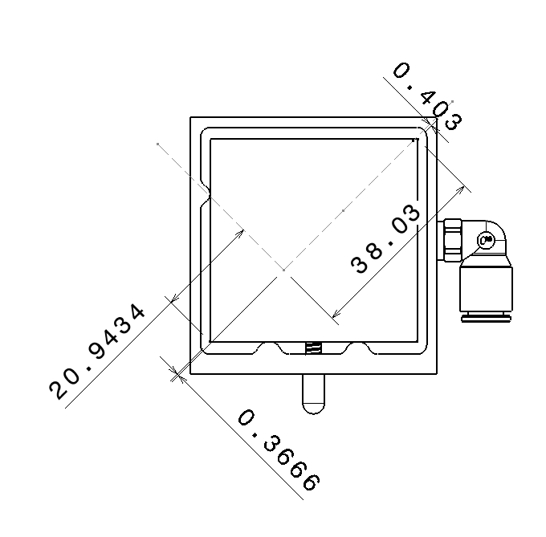
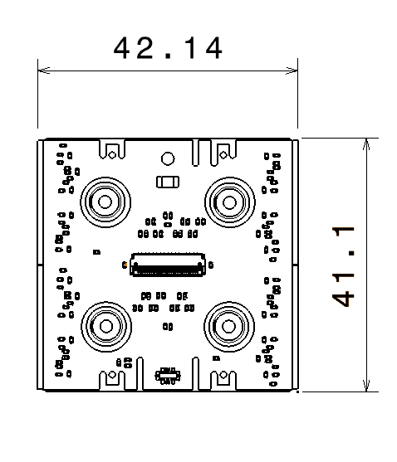
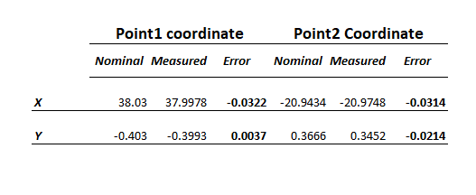
Absolute positioning measurement
The current tool was designed for RD53A modules which has different dimensions that ITKPIXV1 modules
The current module placement accuracy in cell frame has been measured over 20 assembly and measurement
This measurement integer, placement repeatability, cell geometrical error and tool geometrical error
Corner coordinate with real SI tile dimensions
RD53 Module Dimensions

Slide 18
Conclusion
Accuracy measurement will go on at cppm
This permit to define the best loading procedure
In the coming days we will:
Measure the Si tile dimensions → Done
Measure the relative repeatability changing the process as proposed→ Done
Measure the absolute accuracy of Cell mounting and module placement→ Done
Measure the module pick up and placement accuracy and repeatability
The final qualification will be done loading the Si tile on Al cell and measure the final position
We would like also to check the operator dependence which will help us to define and write the loading procedure

Slide 19
Cell loading Qualification Step 1 Stencil and Automatic deposition
Laurence Caillat, Jean-Philippe Logier, Elisabeth petit, Eric Vigeolas
Cell Loading meeting Jan the 14th 2021

Slide 20
Forewords#1
Step 1 qualification was presented September the 3rd by Diego
Results presented in this talks do concerns only glass tile loading on Aluminium cells the graphite loading has nt been done yet
In the following slide results obtained on 5 Aluminium cells loaded with the stencil technic and 5 Aluminium cells loaded with the automatic technic will be presented
Some statistical results will be shown, we are conscious that 5 is not statistically significant we will perform further assemblies to improve our measurements
In order to save material (cells and glass tiles) after each assembly we wait the load stabilization before performing the measurements and cleaning the parts for further assembly
A lot of measurements are made thanks to the scanning system we had on our MMT, this is very helpful for the qualification step but will not be used in production phase. All assembly was made blind without intermediate measurements or corrections.

Slide 21
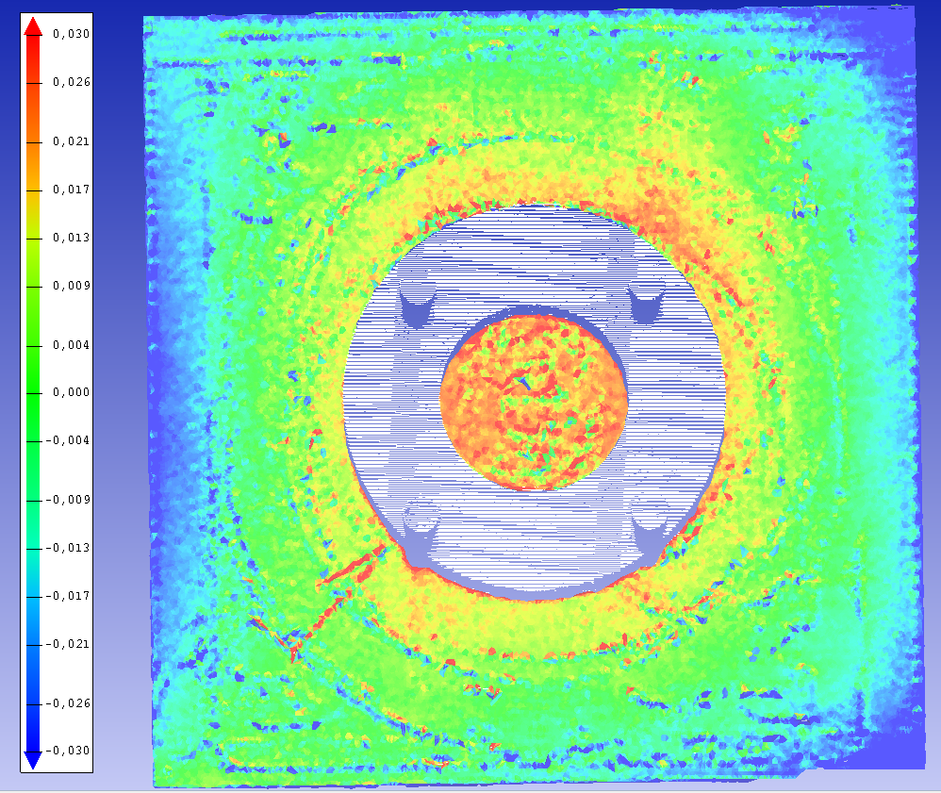
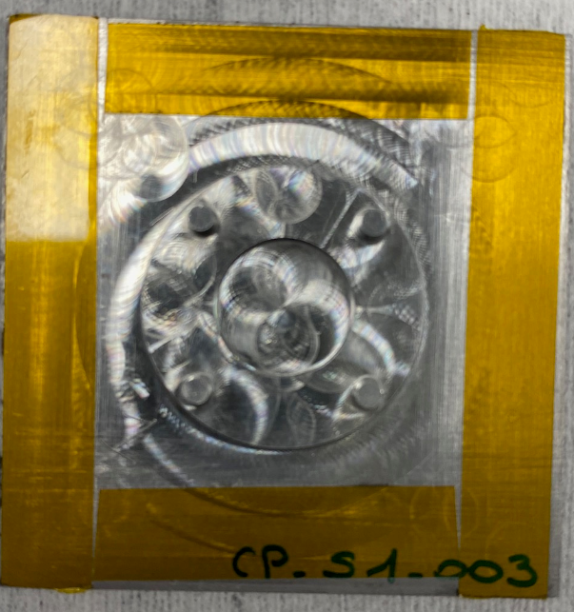
Forewords#2
We had a lot of difficulties with the Aluminium Cells at the beginning to hold them in the vacuum chuck → cell still moving even with vacuum on (this was not observed in the past with the TPG cells)
A lot of discussion in December with Dai who encounter also some problems to perform Step 1 with the Al cells
In our case the problem comes from the back side of the cell which is not flat
To solve this problem we decided to apply a Kapton tape on the Cell edges to permit the cell vacuum and stabilization
Cell back side scanning → 0.05mm bow in the center

Slide 22
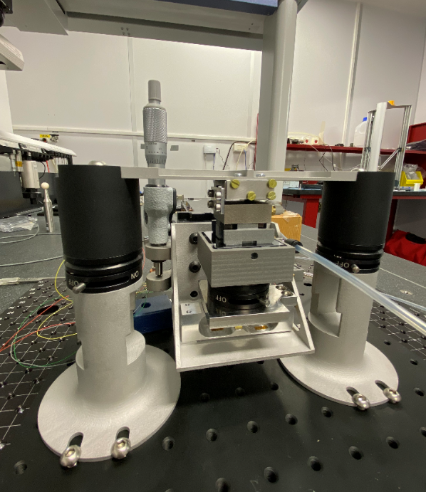
Loading tool procedure
Parallelism correction part
Fix part of the tool
CPPM tool has the capability to adjust the parallelism between the module and the cell
The top part of the tool, called bridge is fix and hold the module
The bottom part of the tool can move vertically thanks to a manual precision stage
For both stencil and automatic deposition the loading technic consist to load the glass tile at constant load (500 grams) not at constant cell position
The process consist to place down the cell after the glue deposition and to move up the cell up to 500grams applied for then stop and wait
Load Cell
Moving part of the tool

Slide 23
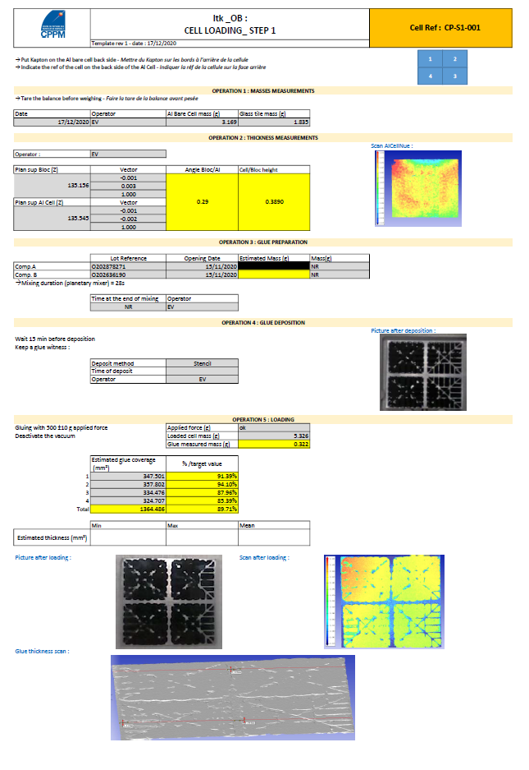
Quality control
We took the opportunity of this test campaign to train the quality control during loading thanks to Laurence help
Logbook has been used to record all actions, operator name, date, hour, time, all data recorded, and all observations which could help to understand the process quality
Datasheets has been created to record all data before and after loading
These datasheets contains a lot of informations and measurements, these datasheets will be improved and some data may be removed or added when the process will be well controlled
We started to write the loading procedure (French and English foreseen)
Two persons made the loading test (Jean-Philippe made the automatic deposition and I made the mask one) with Laurence help who controlled that all steps was correctly done→ Very soon Francoise will perform some additional assembly to increase the statistics
This is important to have several persons loading to evaluate the procedure dependence to operators
A local data server will be set at CPPM to store all data during loading

Slide 24
Datasheet
Operator, date and parts mass measurements
Cell geometry control on the vacuum chuck before glue deposition (cell flatness and relative angle from top surface of the cell and the vacuum chuck)
Glue components mass measurement, Glue preparation operator, time at end of mixing(will explain this later)
Deposited glue mass measurements
Glue deposited before loading picture
Glue coverage measurements
After loading picture and scanning
Glue thickness measurements

Slide 25
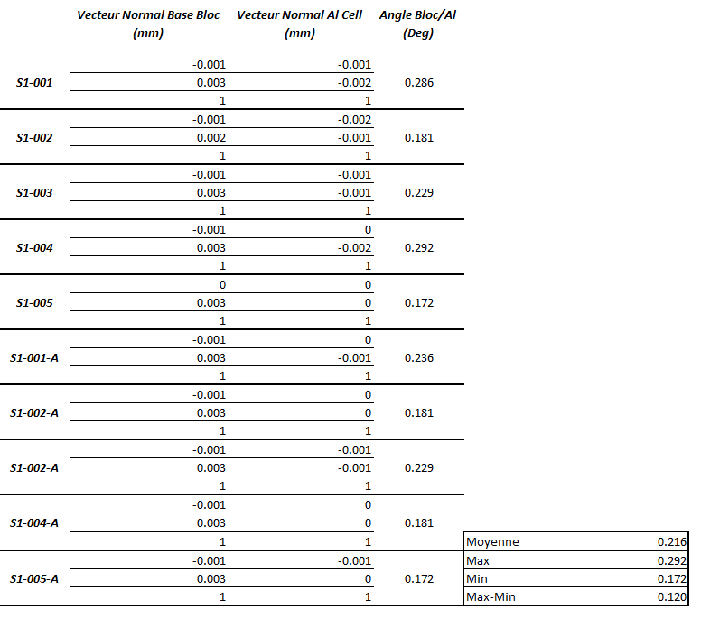
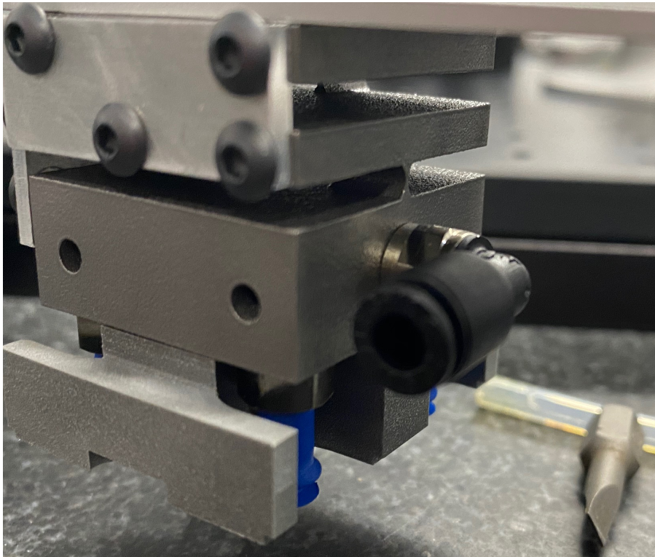
Cell geometry on vacuum chuck
The following measurement summarized the Al cell top surface angle to top vacuum chuck bloc surface angle
The angle from cell to cell vary by 0.12°, this is a variation in thickness of ±0.021mm from edge to edge of the glass tile
We decided to used the parallelism correction part for each loading to improve the thickness variations
Not too bad this is the same cells after several manipulations
α

Slide 26
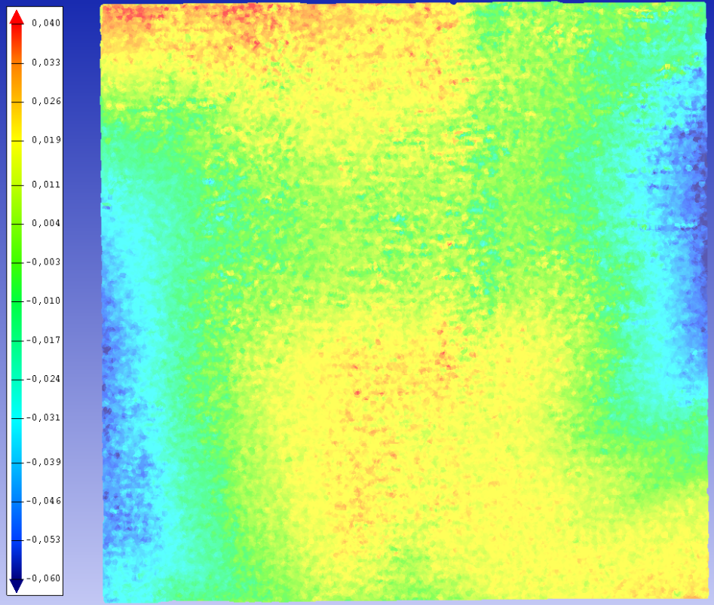
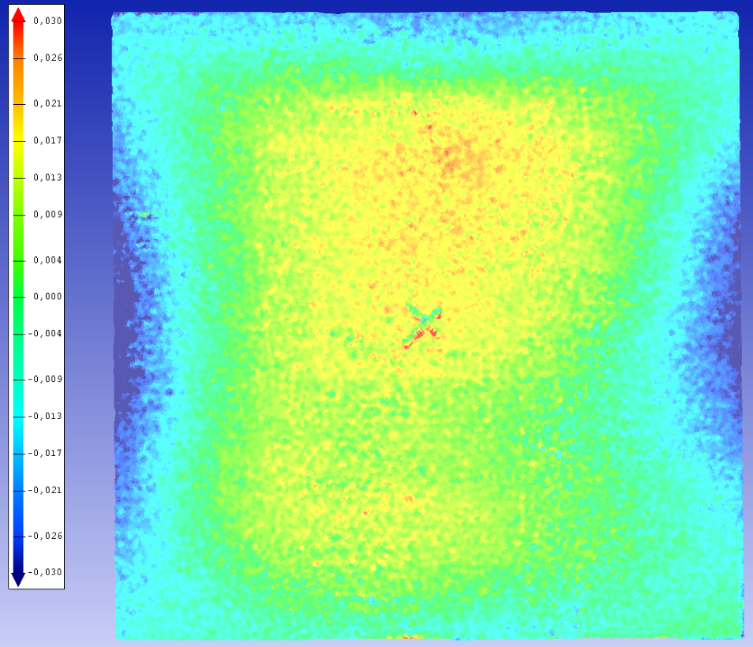
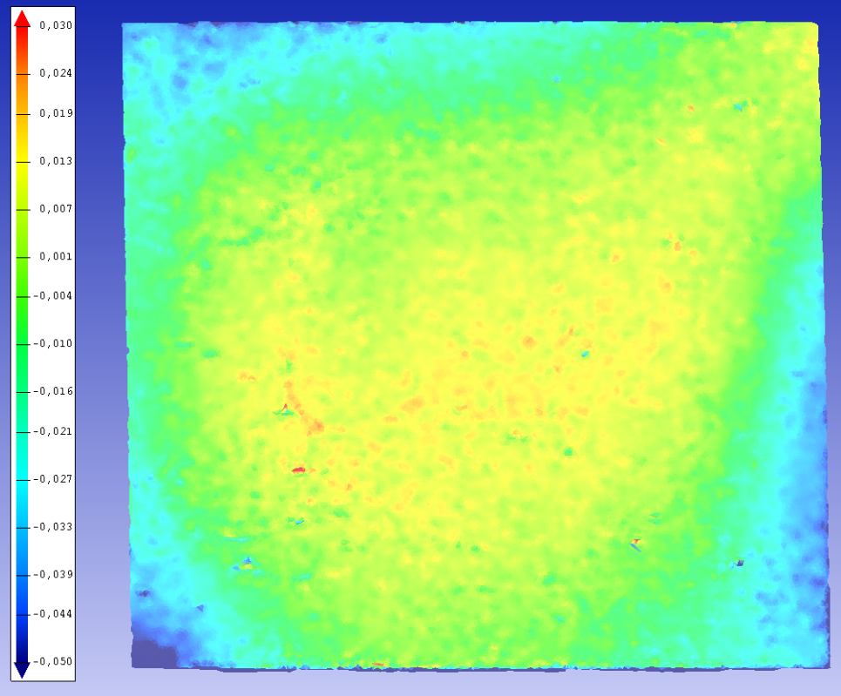
AL Cell Flatness
Al Cells are not flat → about 0.05mm planarity with borders effects

Slide 27
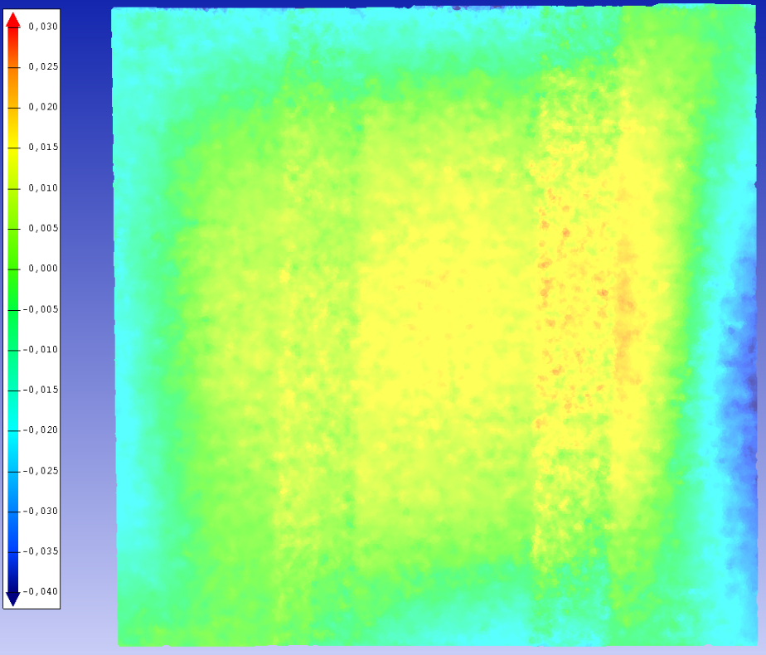
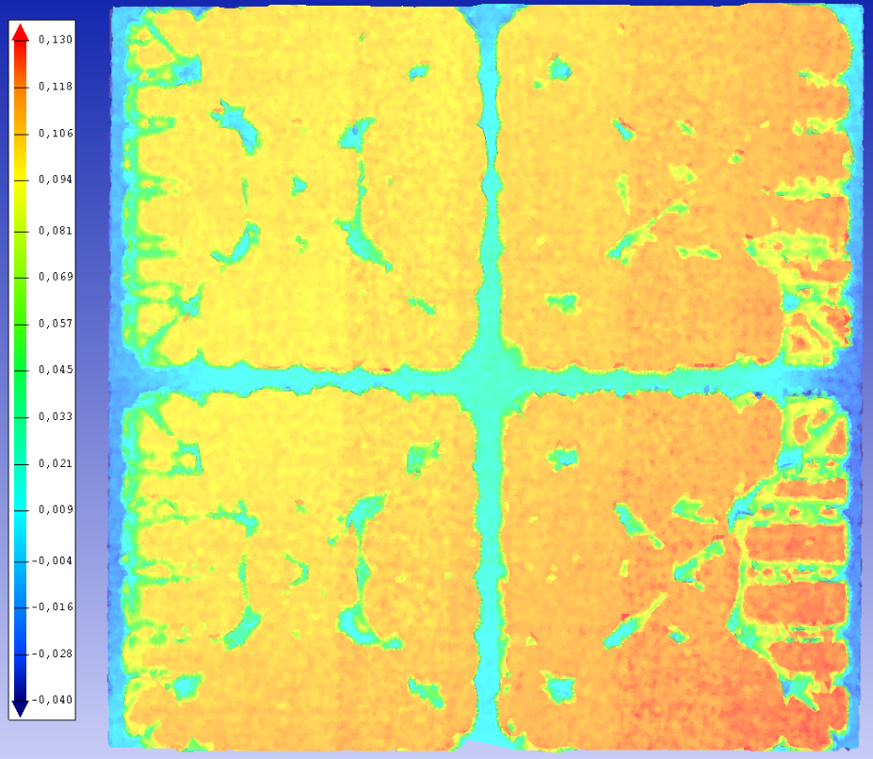
Al Flatness effect
Flatness impact the glue surface which makes the qualification hard to run with these cells as discussed with Dai
This impact has only be observed with the mask deposition, this is less the case for the automatic deposition

Slide 28
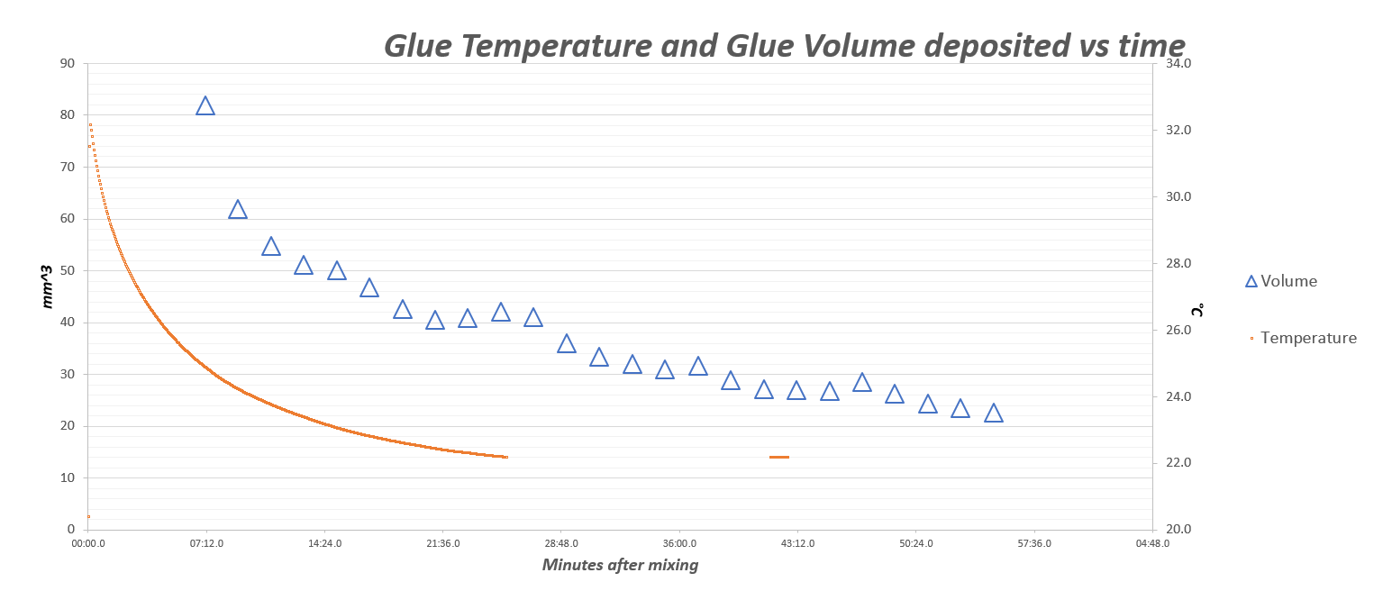
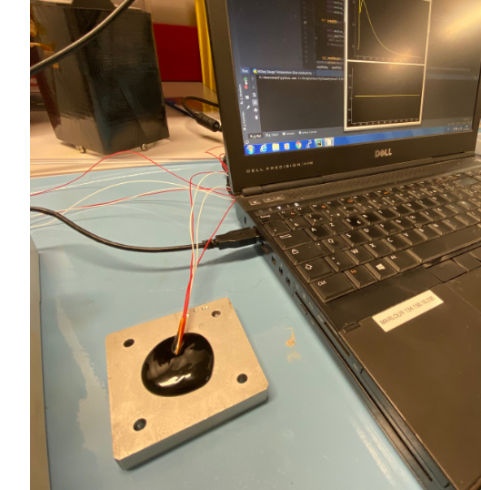
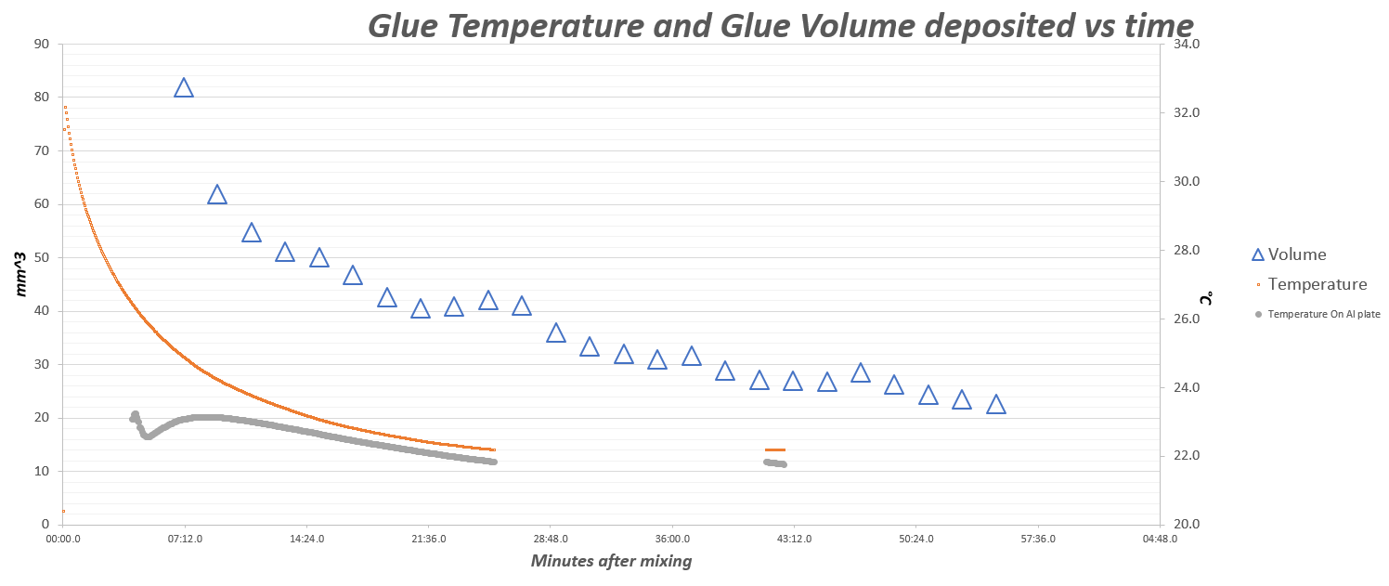
Glue management for both processes
Following the measurement made on the glue viscosity vs glue temperature, we decided to wait systematically 15’ after orbital mixing and before mask deposition of automatic deposition
A test was done placing the glue on a Al plate to cool it down faster, it works → We did not use this during the loading test this will be studied later if necessary
Deposition Start

Slide 29
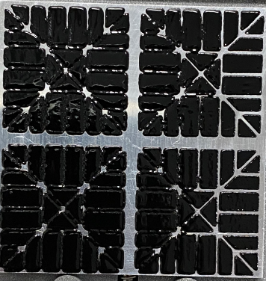
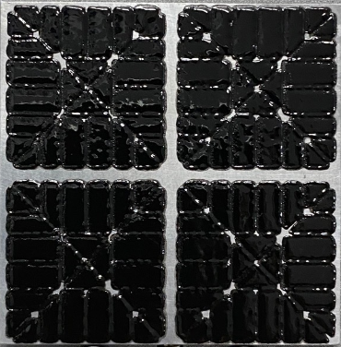
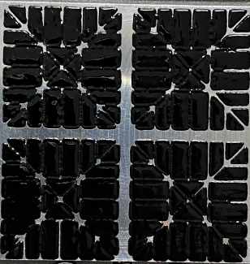
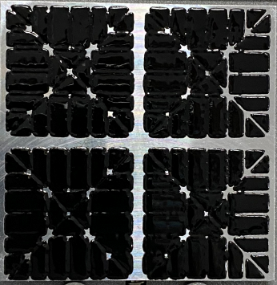
Mask deposition quality before loading
We did not succeed to have the same quality than Unige and KEK was showing after mask deposition
Need to notice that we do have less experience with this technic than with the automatic deposition

Slide 30
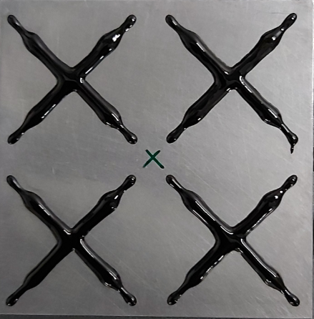
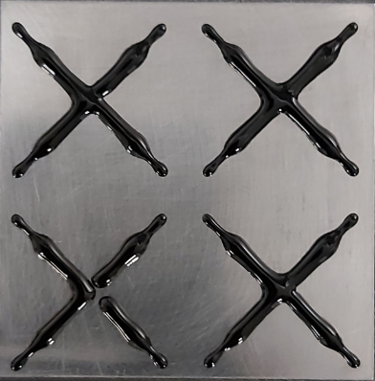
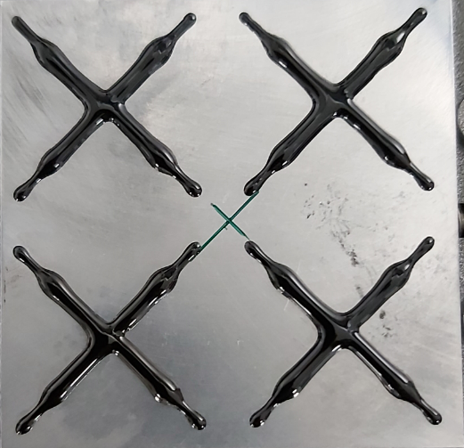
Automatic deposition quality before loading
We forgot to record some pictures → we need a check list in the procedure

Slide 31
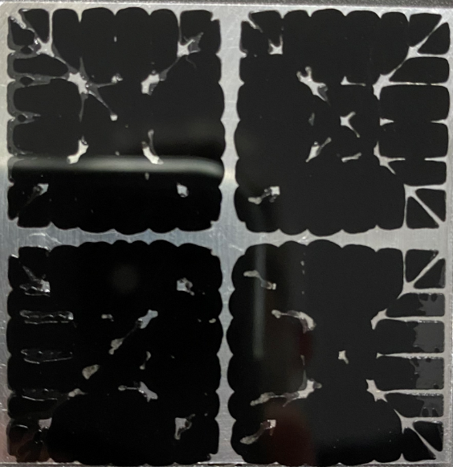
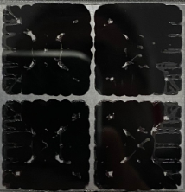
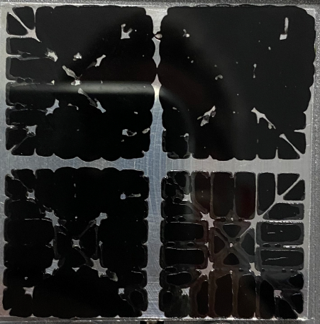
Mask deposition after loading

Slide 32
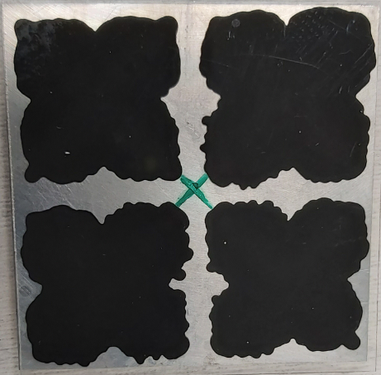
Automatic deposition after loading
Similar problem some photo missing
Hopefully the scans are available for all mask and automatic deposition

Slide 33
Glue Mass measurement summary
Stencil deposition
Automatic deposition
More repetitive quantity with automatic process
Less glue with the automatic process we are working on improving this (change de pattern)
This is preliminary we need more data for real statistics analysis

Slide 34
Glue Surface Measurements
We use the scanning software to measure the surface
It is done by meshing the point cloud and measuring the mesh surface
In parallel Elisabeth is working on root to evaluate the surfaces directly with the point cloud
For the stencil surface, holes and surfaces which are not in contact with the glass are automatically removed

Slide 35
Surface Measurements
Similar remarks concerning the lack of data
Automatic deposition is more regular than stencil but less surface covered
We will work on the pattern optimization to improve the automatic deposition

Slide 36
Glue thickness CP-S1-001 mask & Automatic

Slide 37
Glue thickness CP-S1-002 mask & Automatic

Slide 38
Glue thickness CP-S1-003 mask & Automatic

Slide 39
Glue thickness CP-S1-004 mask & Automatic

Slide 40
Glue thickness CP-S1-005 mask & Automatic

Slide 41
Observations
We need to admit that we lack experience with the stencil deposition
We observed in many cases that the glue was not in contact with the glass and tried to take it into account in the surface measurements, but not easy
We prefer the Automatic deposition which is more simple, less operator dependent and without cleaning necessary of the tool after deposition

Slide 42
Conclusions
We will select the automatic process as baseline for the loading technic
We need to improve this technic → see next slide
We will keep working any how on the stencil technic to improve our experience
We do thinks that our tool and process is enough advanced for heaters loading → What is your opinion?
In the coming week, Françoise (as new operator) will proceed to new loadings in order to increase the statistic. We will use the new pattern and new glue management
The 500 grams process is arbitrary, we would like to evaluate the consequence to reduce this value to minimize the module stress
We recorded the load behavior for both deposition technic , I ll present the curve next meeting, this is very different from stencil to automatic process

Slide 43
Automatic deposition
Parallely to the loading trial we were performing, Jean-Philippe took the initiative to design a heating head for the automatic printer we hacked to print the glue → He took the heat head of the printer (which is equipped already with a controlled system)
The idea is to maintain the glue at constant temperature during deposition to keep as constant as possible its viscosity → this is a good idea because working during summer or during winter may impact the glue viscosity → this will shorten the glue time usage, but we will control that
Our goal is to flatten the volume deposition versus time → as we control the time after glue mixing we will adapt the device speed as function of the time to compensate the glue polymerization
Our dream what ever is the ambient temperature
Heating head
Ambient temperature
Glue at 35°C during deposition
Not a measurement jus a sketch

