Slide 1
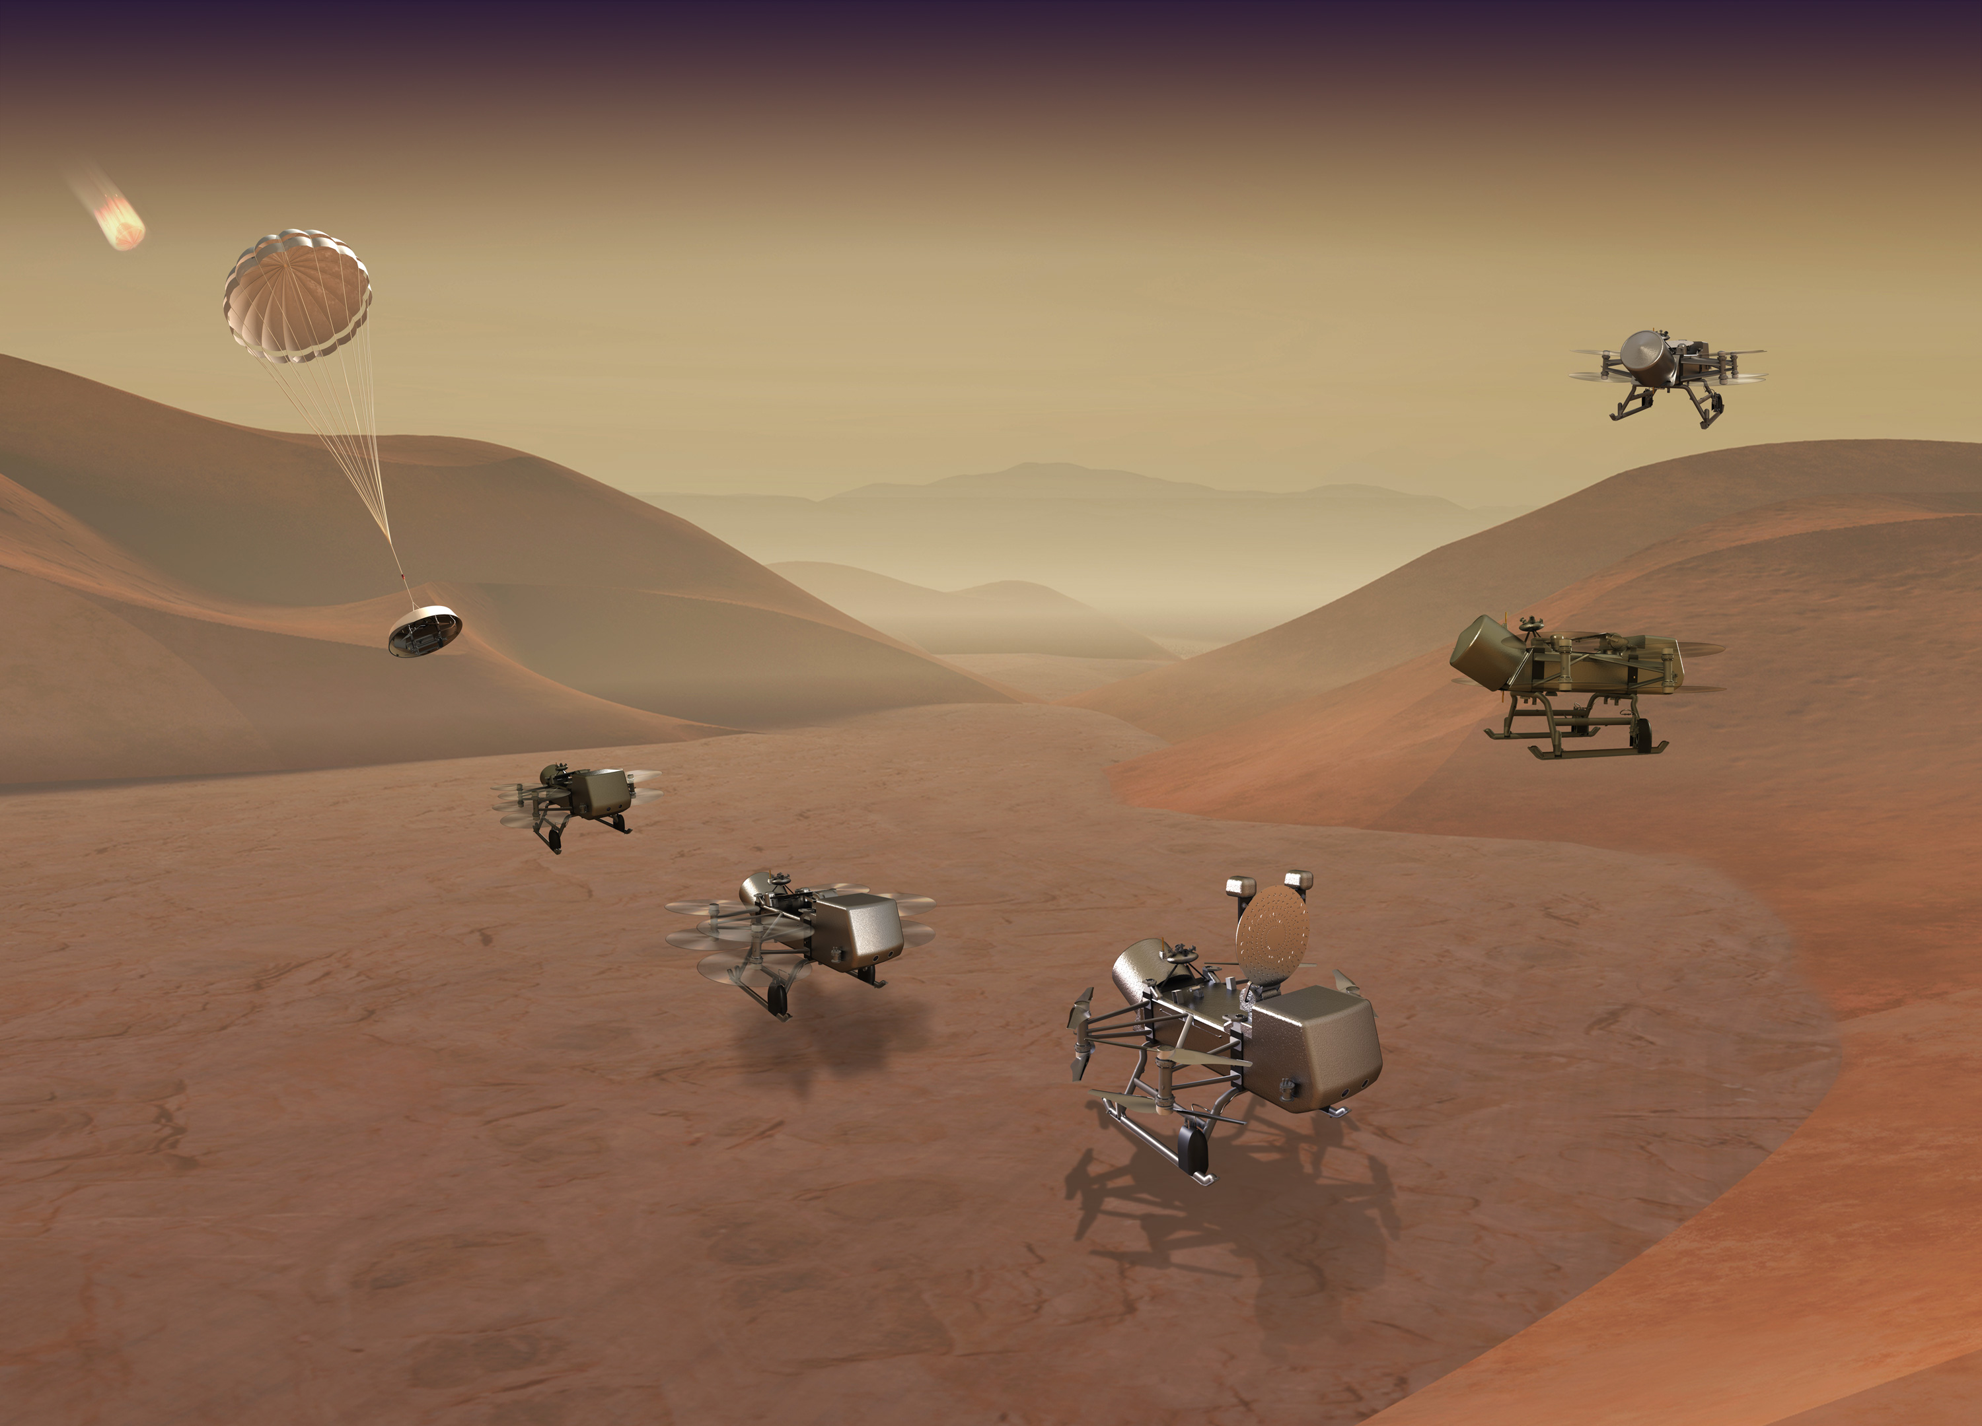
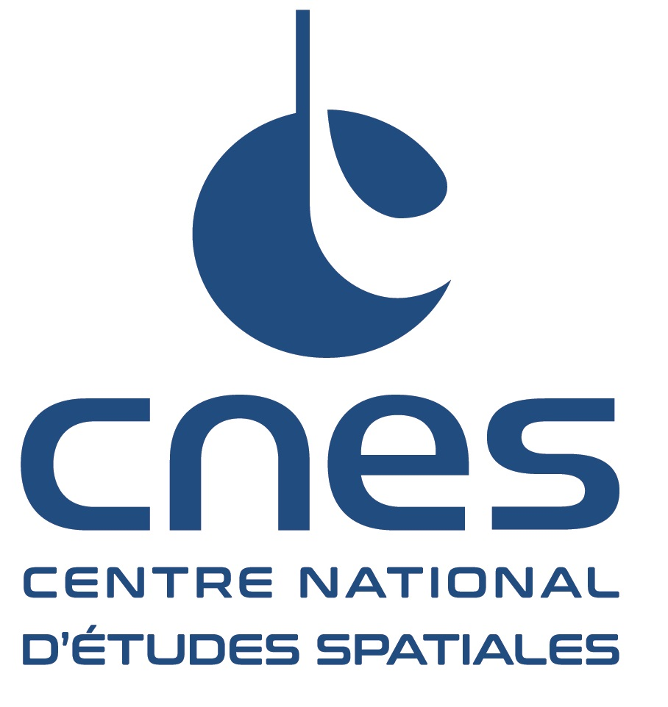


Derivatization of amines :
preparation for Dragonfly mission
Valentin Moulay
1st year PhD Student
Image credit : John Hopkins APL

Slide 2
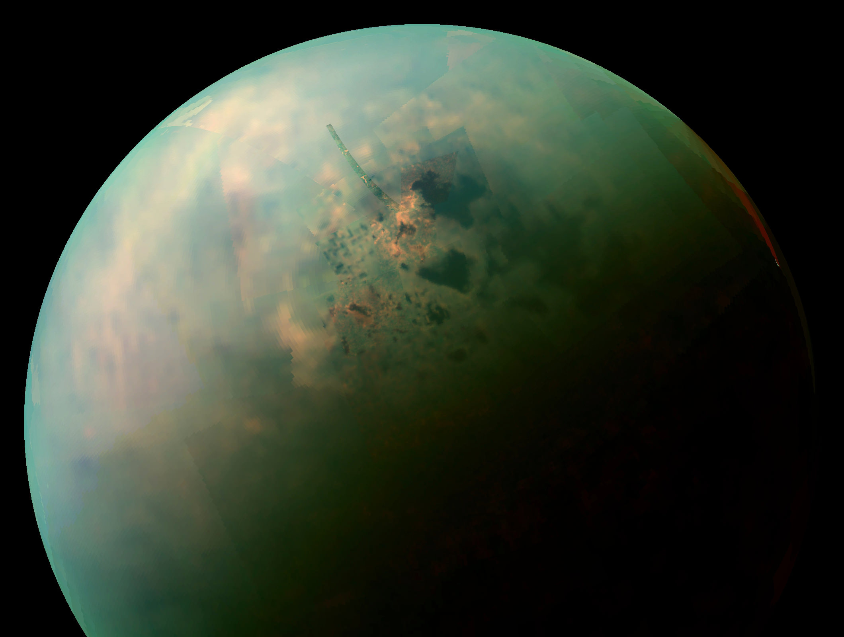
Titan : high potential for astrobiology
› Only moon with a thick atmosphere, 2nd planetary body with
an nitrogen based atmosphere (and few percents of CH4)
› Atmosphere : site of a complex organic chemistry.
(Niemann et al., 2005, Neish et al., 2010)
› Stable liquide currently on the surface (methane and ethane)
› Global subsurface ocean (Sohl et al., 2003)
Near-infrared color mosaic from Cassini. NASA/JPL-Caltech/University of Arizona/University of Idaho
Ideal place to test habitability, prebiotic chemistry and the ubiquity and diversity of life
Notes:
› Saturn’s largest moon

Slide 3
Titan : a complex atmospheric organic chemistry
› Atmosphere composed mainly of N2 (95 to 98%) and few percents of CH4 (2 to 5%°). Absence of oxygenated molecules.
› Reductive organic chemistry C-H-N.
➱Formation of complex chemical species in the atmosphere in liquid and solid form (aerosols).
› Sedimentation of the haze at the surface (Raulin et al., 2012).
Processus chimiques dans l’atmosphère de Titan. Source : Raulin et al., 2012
Notes:
Préciser les espèces chimiques complexes : amines, nitriles, hydrocarbures aliphatiques, imines.

Slide 4
Titan : biomolecules at the surface
› Liquid water at the surface (cryovolcanism and meteorite impact)
→ hydrolysis of aerosols and condensed species
› Formation of complex oxygenated molecules
of interest for biology (Piling et al., 2009, Neish et al., 2010, Cleaves et al., 2014) :
- amino acids
- nucleic acids
- nitrogenous bases
Presence of biomolecules and development of a prebiotic chemistry. But how to confirm that ?
Methane cycle and surface processes on Titan. Source : Raulin et al., 2012
Notes:
Détailler les processus de surface : cryovolcanisme et cratère d’impact qui nous intéressent principalement. H₂O-NH₃ qui réalise l’hydrolyse sur les aérosols ayant sédimenter formant ainsi des molécules portant des atomes d’oxygènes. Possible de former des acides aminés : alanine, glycine, acide aspartique et des acides nucléiques : adenine et uracile.
Voilà notamment pourquoi Titan suscite autant d’intérêt et qu’une mission spatiale a été sélectionnée par la NASA pour aller explorer sa surface.

Slide 5
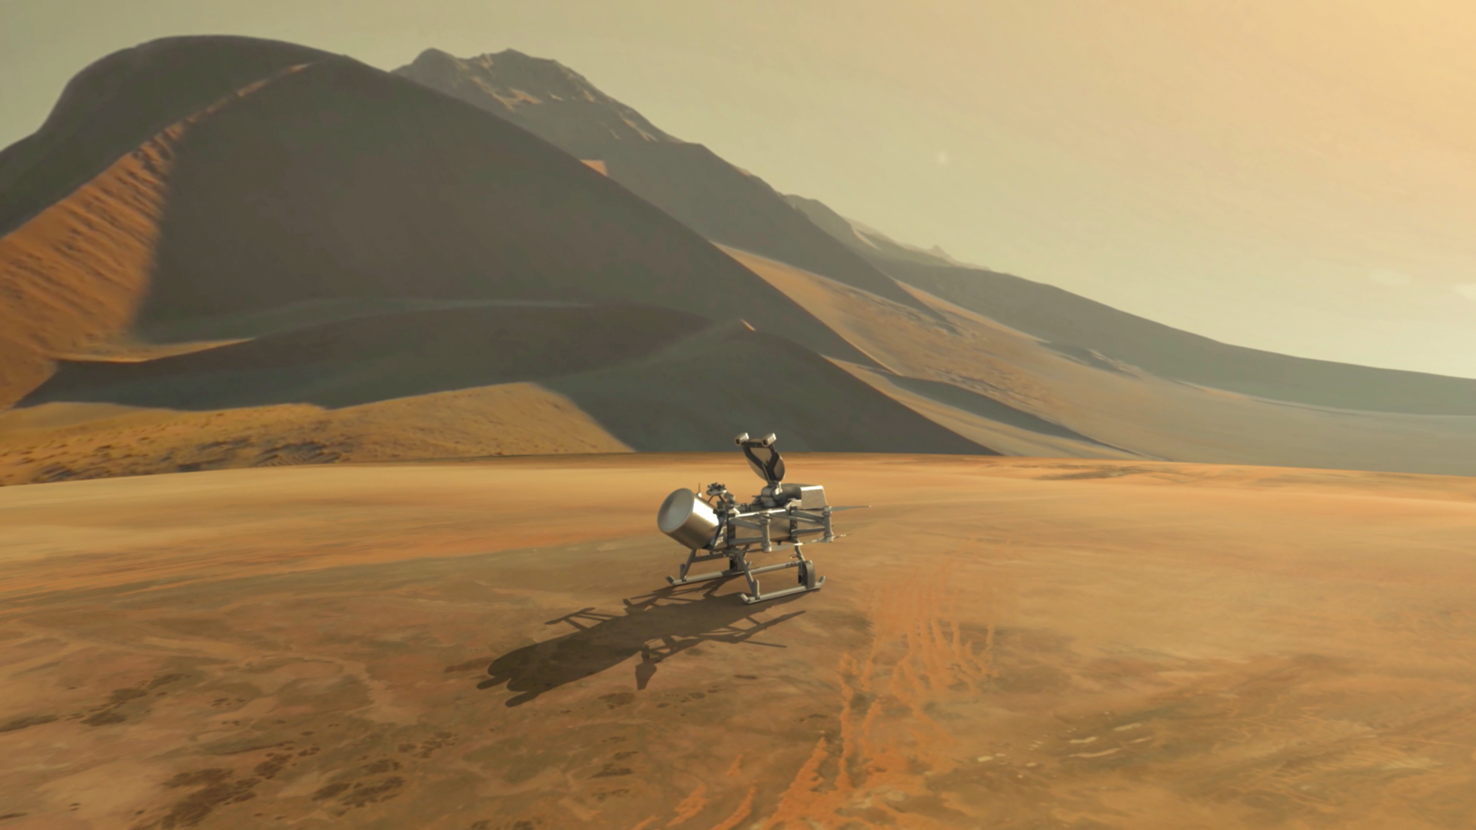
Dragonfly mission
› Main goal :
Search for organic bioindicators and prebiotic chemistry at the surface.
› Probe
Rotorcraft to explore and characterize
differents environments at the surface of Titan.
› 4 instruments onboard
DraMS : chemistry analyzer
- DraGMet : Environmental conditions
DraGNS : elementary analyzer
DragonCam : camera
Dragonfly probe on the Titan’s surface. Image Credit : John Hopkins APL

Slide 6
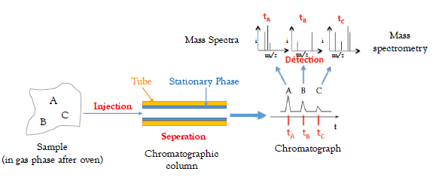
DraMS : a gaz chromatograph mass spectrometry
GC → separation of the chemical species.
MS → Molecular structure
GC + MS → Proper identification of the molecule in a sample
Schematic principle of GCMS
But some molecules can not be directly analyse by GCMS, especially the too polar ones (like the amines). How do to so ?
Notes:
Préciser rapidement les différents environnements.

Slide 7
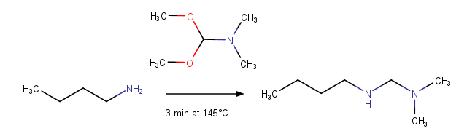
DraMS : a gaz chromatograph mass spectrometry
Derivatization chemical (DMF-MDA here)
In chemical terms
Refractory molecule
Volatile molecule
Example of derivatization on butylamine
The aim is to mask labile hydrogens on polar functions (-OH, -NH_{x} …) to avoid hydrogen bounds and polarity → Volatily is steeply increased, molecule can be analyse by GCMS.

Slide 8
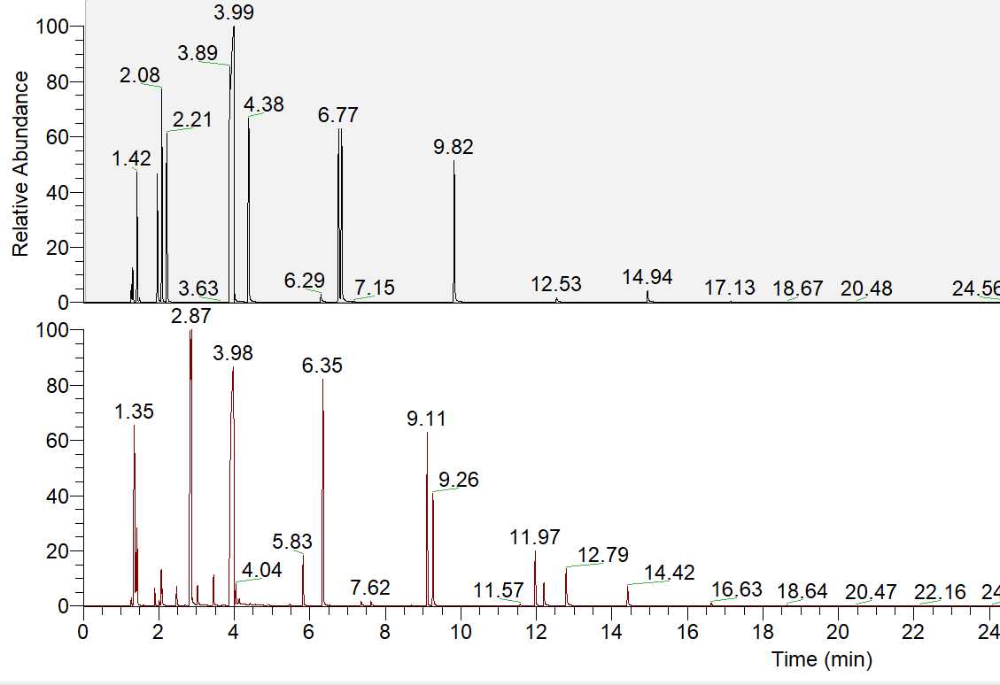
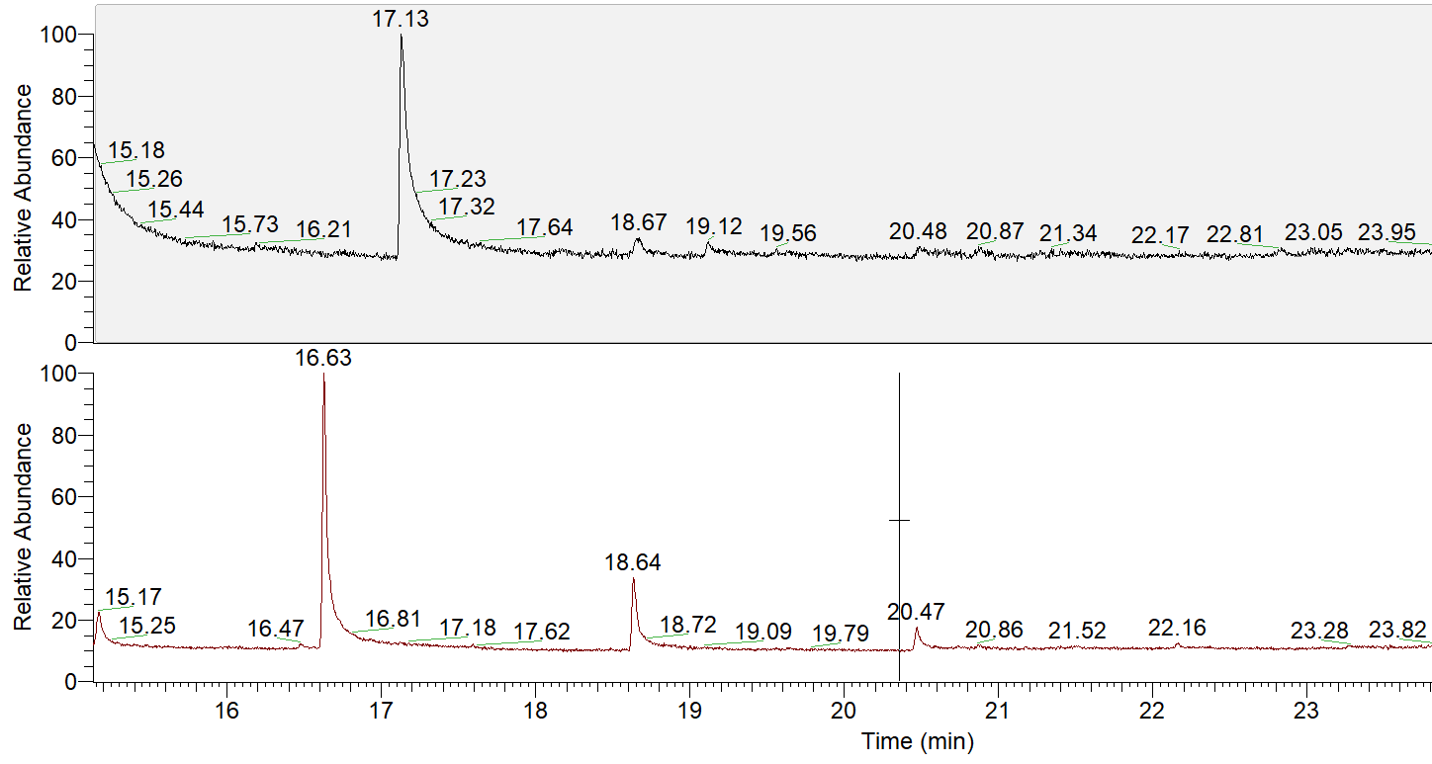
Identification of the derivatized amines
1
2
Linear primary amines → Dimethylformamidination
Linear secondary amines → Methylation, formylation and dimethoxymethylation.
Top chromatogram is a mix of amines without derivatization and the one below with derivatization
1 : Decylamine
2 : Decylamine dimethylformamidinated
Notes:
Préciser rapidement les différents environnements.

Slide 9
Derivatization of amines : quantitative aspect
Almost a ratio of 10 between the two conditions for a same amount of amine injected
Derivatization improves detectability and quantification
Calibration curve : pentylamine pure VS pentylamine derivatized
Notes:
Préciser rapidement les différents environnements.

Slide 10
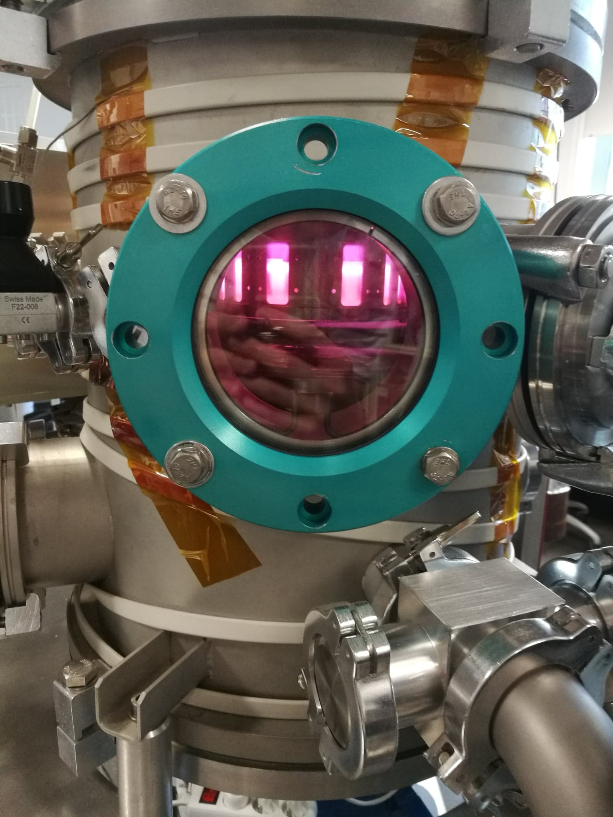
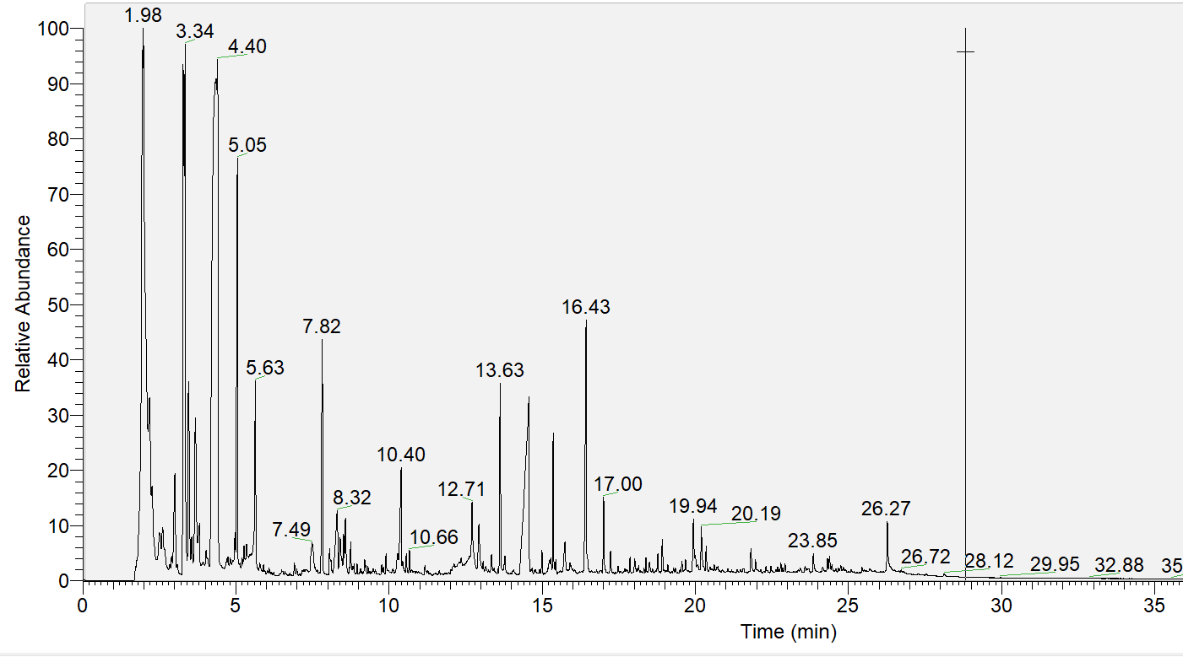
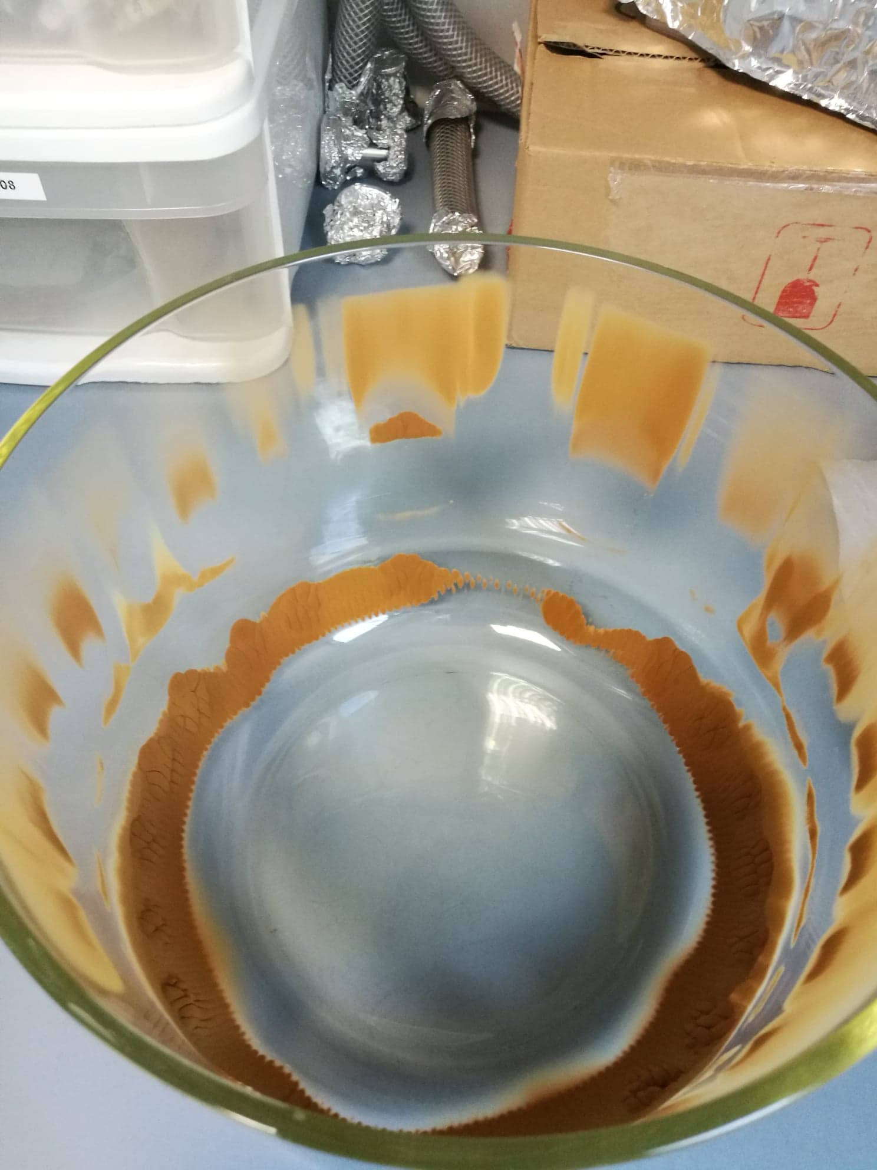
Derivatization of tholins : a complex sample
PAMPRE experiment
Titanian tholins to be collected (5% CH₄, 95% N₂)
Chromatograph of titanian tholins
Notes:
Préciser rapidement les différents environnements.

Slide 11
Conclusion and perspectives
Derivatization + GCMS → detection and identification of the derivatized amines. Quantification is clearly improved.
Perspectives :
- In-depth study on the optimisation of derivatisation depending on the kind of molecules
- Advanced analysis of tholins
- Coupling derivatization with the other processes on Dragonfly : pyrolysis, thermochemolysis. Improving the range of target coumpounds.
Detection of amines on Titan will be possible and thus nitrogenated biomolecules too.
Notes:
Préciser rapidement les différents environnements.

Slide 12
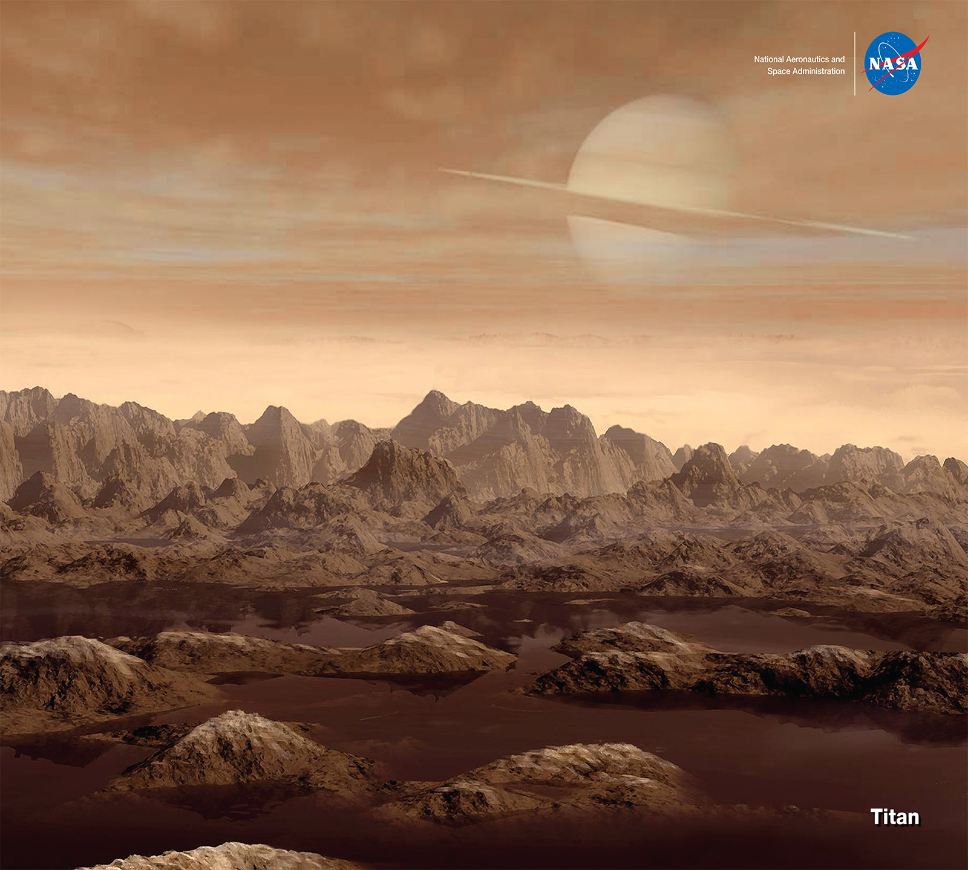
Thank you for your attention
Questions ?
Artist’s Concept

Slide 13
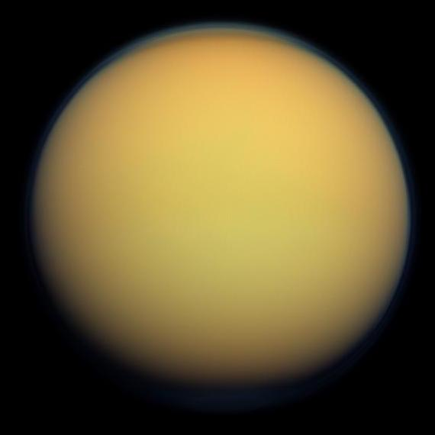
Titan in a real color
NASA/JPL-Caltech/Space Science Institute

Slide 14
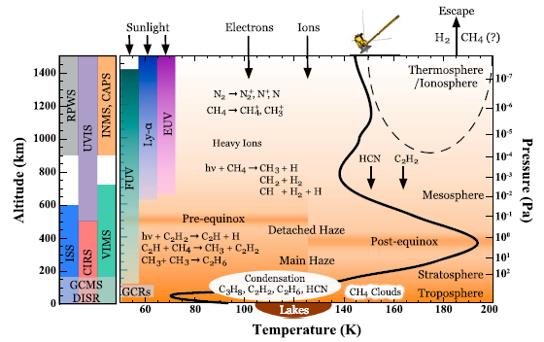
Photochemistry a little bit more detailed

