Slide 1
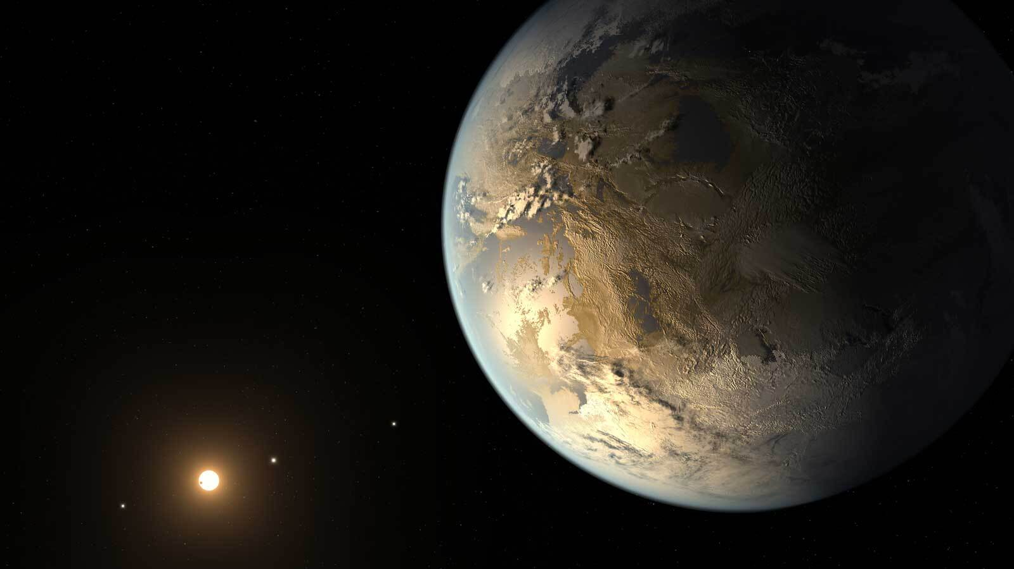

Characterization the atmosphere of two warm Neptune-like planets HD 106315 c and HD 3167 c with the HST/WFC3 Camera
Amélie GRESSIER
Supervised by Emmanuel Marcq (LATMOS),
Jean-Philippe Beaulieu (IAP) and Benjamin Charnay (LESIA)
amelie.gressier@latmos.ispl.fr
©NASA
Amélie Gressier WG-ARIEL– 04/02/2021 1

Slide 2
1. Introduction
An exoplanet is a planet outside our solar system that orbits a different star from the Sun.
Milky Way: 200 billions stars
~1 exoplanet per star in the Milky Way
4341 exoplanets confirmed on 01/28/2021
https://exoplanetarchive.ipac.caltech.edu
Characterizing the atmosphere : only ~1 % of the detected exoplanets
Amélie Gressier WG-ARIEL– 04/02/2021 2

Slide 3
1. Introduction
Transmission and emission spectroscopy
Starlight filters trough planet atmosphere during the transit
Planet thermal emission and reflection blocked during eclipse
Amélie Gressier WG-ARIEL– 04/02/2021 3

Slide 4
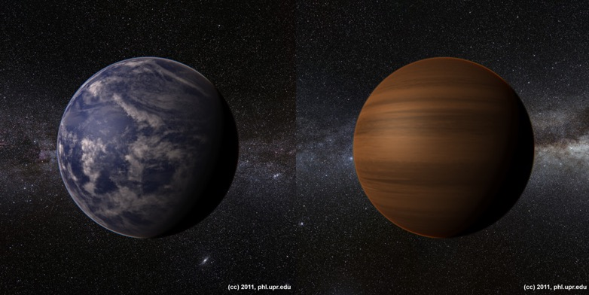
1. Context
What exoplanets are made of?
Is a Super-Earth a rocky planet with an Earth-like atmosphere or can it be dominated H-dominated?
Sub-Neptune:
    retained its primary atmosphere H₂, He (2.3 g/mol)?
    contains heavier elements ?
    formed elsewhere and migrated ?
Super-Earth:
has a secondary atmosphere formed by outgassing (>2.5 g/mol) H₂O, CO₂,CH₄ … ?
    retained its primary atmosphere H₂, He?
    formed in-situ?
    is a remnant core of a gaseous planet ?
© 2011, phl.upr.edu
Amélie Gressier WG-ARIEL– 04/02/2021 4

Slide 5
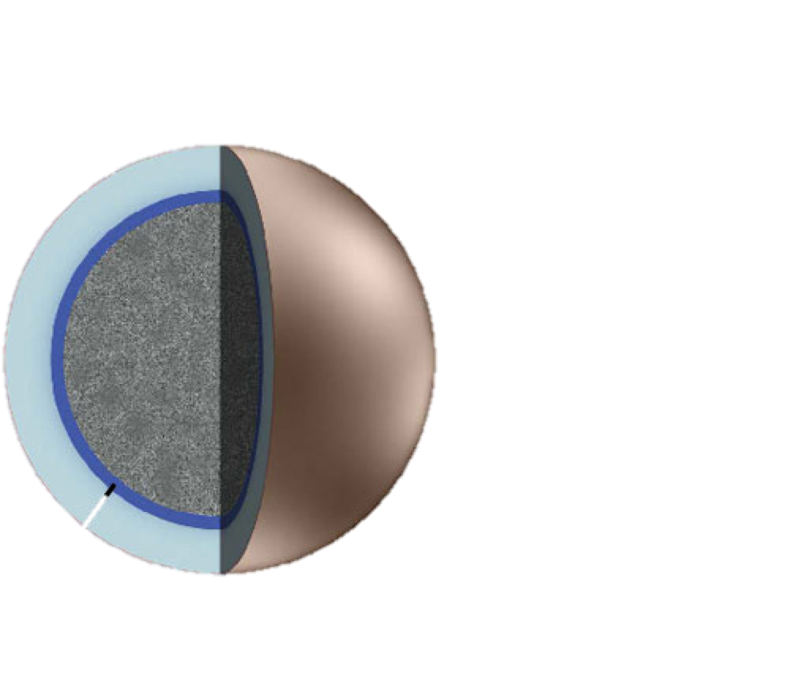
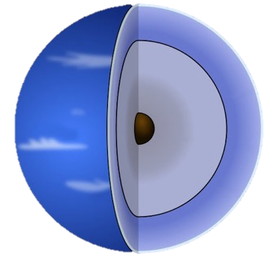
1. Context
Same density
Different atmospheric signatures
rocky
Mass-Radius diagram are not enough
icy
Probe the atmosphere !
Lopez et al 2016; Valencia et al 2013
Amélie Gressier WG-ARIEL– 04/02/2021 5

Slide 6
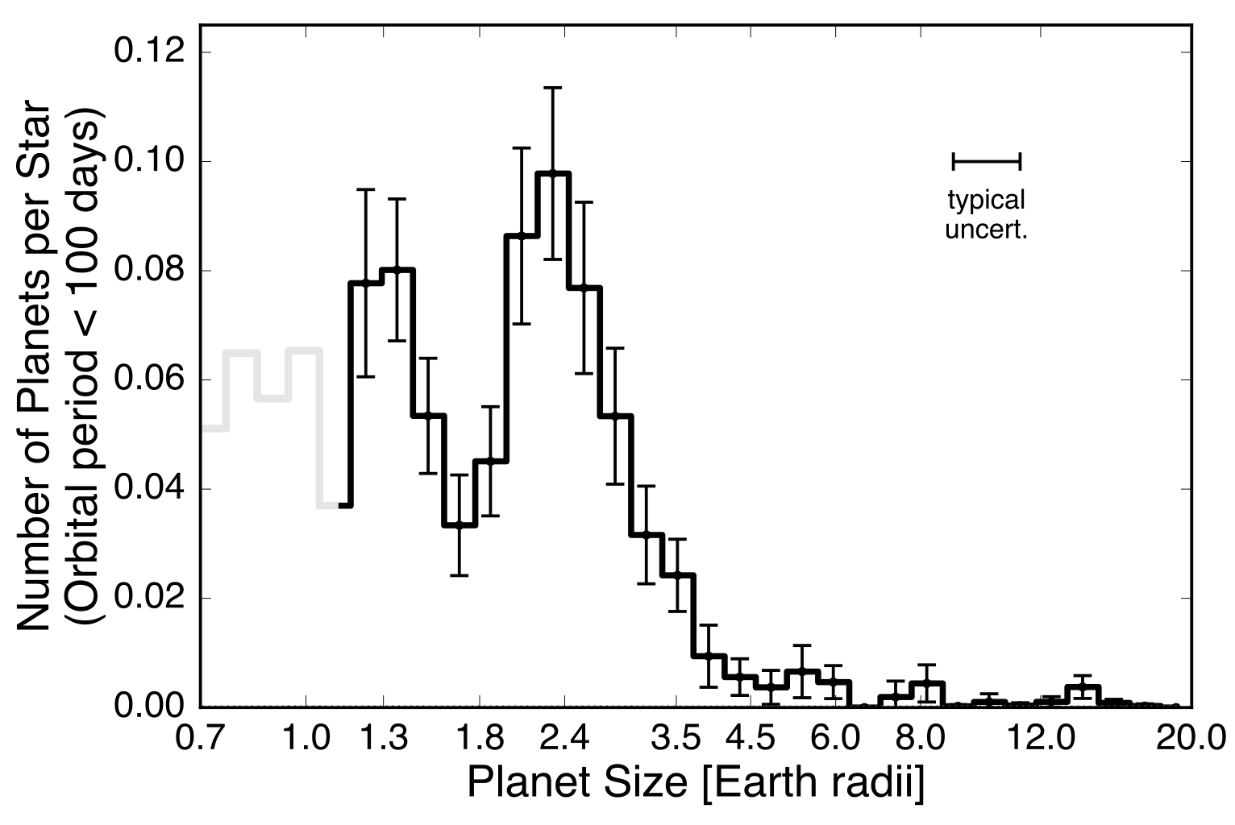
1. Context
rocky
volatile-rich
Adapted from Fulton et al 2017
Amélie Gressier WG-ARIEL– 04/02/2021 6

Slide 7
2. Atmospheric characterization
  1. Planets
HD 106315 c
Crossfield et al 2017,
Rodriguez et al 2017,
Barros et al 2017
Star (this work)
F5V
R_{s} = 1.31 R⊙
M_{s} = 1.08 M⊙
T_{eff} = 6256 K
Parameters (this work)
R_{P} = 4.98 R⊕
M_{P} = 14.60 M⊕
T_{eq} = 835 K
a = 0.15 AU
System (this work)
- HD 106315 b 2.18R⊕, 11.6M⊕
HD 3167 c
Vanderburg et al 2016,
Christiansen et al 2017,
Gandolfi et al 2017
Star (Gandolfi et al 2017)
K0V
R_{s} = 0.84 R⊙
M_{s} = 0.88 M⊙
T_{eff} = 5286 K
Parameters (Gandolfi et al 2017)
R_{P} = 2.74 R⊕
M_{P} = 8.33 M⊕
T_{eq} = 518 K
a = 0.18 AU
System (Gandolfi et al 2017)
HD 3167 b 1.57R⊕, 5.69M⊕
HD 3167 d
rocky
volatile-rich
HD 3167 c
2.74 R⊕, 8.33 M⊕
T_{eq} = 518 K
a = 0.18 AU
HD 106315 c
4.98 R⊕,14.60 M⊕
T_{eq} = 835 K
a = 0.15 AU
Adapted from Fulton et al 2017
Amélie Gressier WG-ARIEL– 04/02/2021 7

Slide 8
2. Atmospheric characterization
  2. NIR observations
Planet ID PI Transit used Instrument
HD 106315 c 15333 I. Crossfield 4 HST/WFC3 G141 (1.1-1.7μm)
HD 3167 c 15333 I. Crossfield 5 HST/WFC3 G141 (1.1-1.7μm)
2 independent studies: Kreidberg et al 2020 (submitted) and Mikkel-Evans et al 2020 (accepted APJ)
  3. Data analysis with Iraclis
Iraclis publicly available python package (Tsiaras et al 2018)
Data reduction and calibration
Light curve extraction
Limb-darkening coefficient computation
White light curve (WLC) fitting
Spectra light curve (SLC) fitting
Single extraction aperture for visit 4 of HD 106315 c
Amélie Gressier WG-ARIEL– 04/02/2021 8

Slide 9
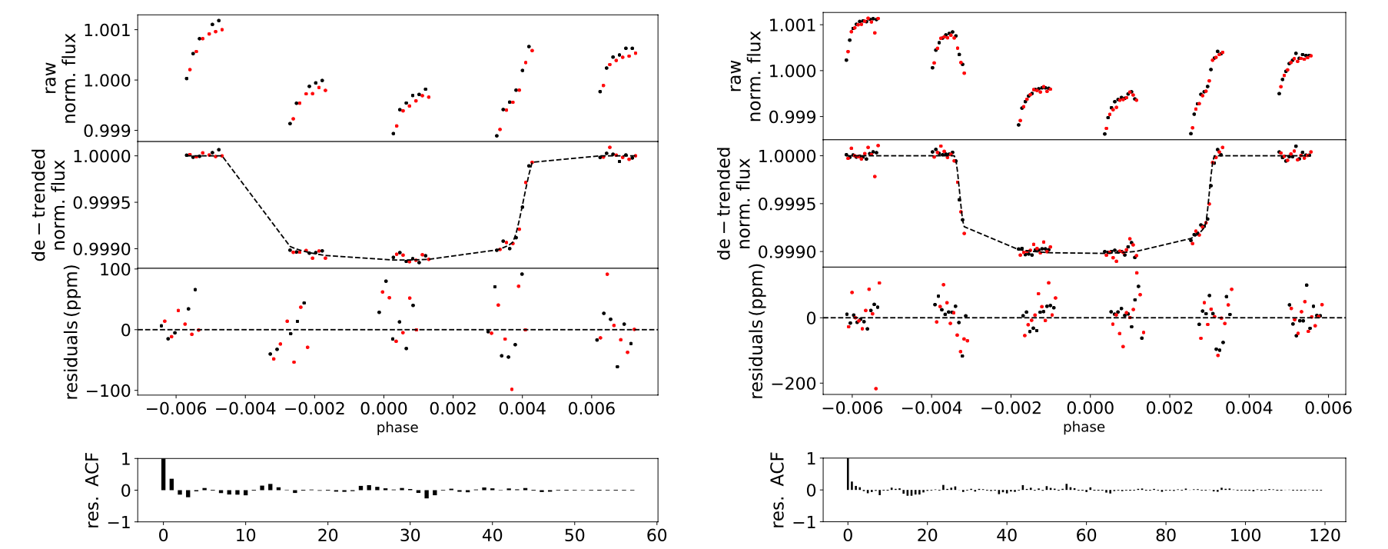
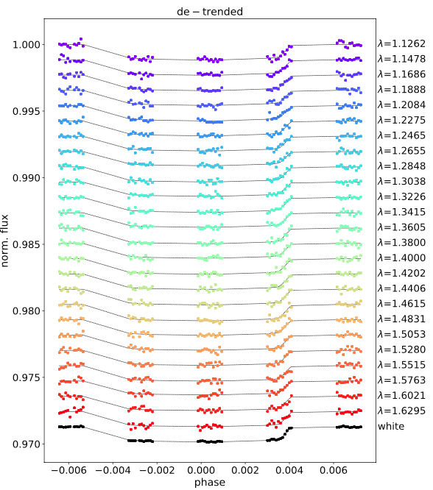
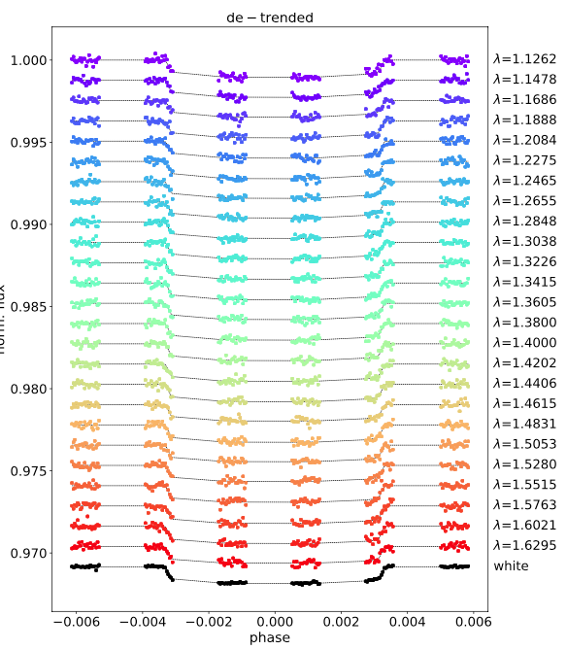
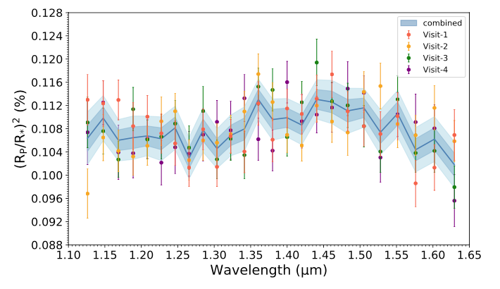
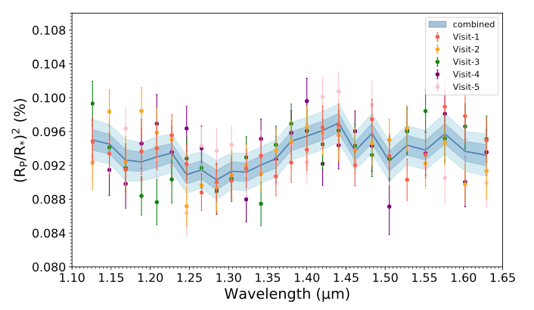
2. Atmospheric characterization
  3. Data analysis with Iraclis
Iraclis publicly available python package (Tsiaras et al 2018)
White-light curve fitting:
Fitted parameters : T0, R_{P}/R_{s}
Fixed values: P, ω, I a/R_{s}
Exclude the first orbit of each transit
2. Spectral light curve fitting: R_{P}/R_{s} fitted in all the channels using the WLC correction
3. Combining all the visits: transmission spectrum (1.1-1.7μm)
Visit 1 white-light curve fitting, spectral light curve fitting and combined transmission spectra for HD 106315 c and HD 3167 c .
Adapted from Guilluy et al 2021
Amélie Gressier WG-ARIEL– 04/02/2021 9

Slide 10
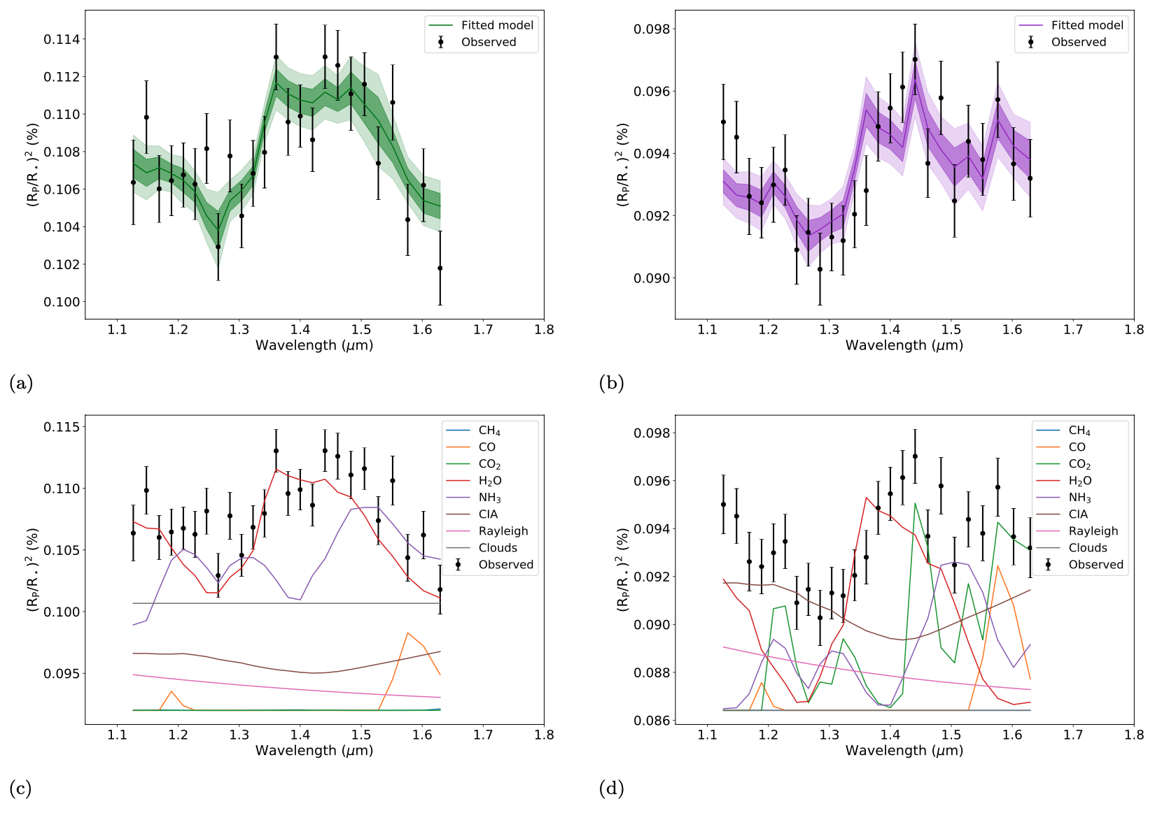
2. Atmospheric characterization
  4. Retrieval analysis
TauREX-3 publicly available Bayesian retrieval code (Al-Refaie et al 2019)
Line lists: ExoMol, HITRAN and HITEMP
Isothermal temperature/pressure profile
ADI : Bayes factor between the model and a flat-line
H₂O
H₂O
Setup
Parameter Priors
R_{P} ±50% R_{P}
T_{P} ±60% T_{eq}
P_{clouds} 10⁻²-10⁶ Pa
Opacities
H₂O, CO₂, CO, 10⁻¹²-10⁻² VMR
CH₄, NH₃
CIA (H₂-H₂, H₂-He)
Rayleigh
Results
HD 106315 c HD 3167 c
R_{P} 4.33 R⊕ 2.70 R⊕
T_{P} 630 K 440 K
log(P_{clouds}) 3.7 5.3
log(H₂O) -2.1 -4.1
log(NH₃) -4.3 <-5
log(CO₂) unconstrained -2.4
log(CO) unconstrained unconstrained
log(CH₄) <-5 <-5
μ 2.4 g/mol 2.4 g/mol
ADI 16.0 (~ 6σ) 9.6 (~ 5σ)
Best-fit spectra and opacity contributions for HD 106315 c and HD 3167 c
Adapted from Guilluy et al 2021
Amélie Gressier WG-ARIEL– 04/02/2021 10

Slide 11
2. Atmospheric characterization
  4. Retrieval analysis
Remove H₂O from the retrieval analysis
Compare ADI of the full model and the model w/o H₂O
Evaluate the water detection significance
Compute the amplitude of the spectrum in the water band
ADI results
HD 106315 c HD 3167 c
Full 16.0 9.6
No H₂O 1.8 6.0
Significance 5σ 3σ
A_{H2O} 1.38±0.26. 1.74±0.46
Water amplitude absorption (1.34 -1.49μm) regarding T_{eq} (500-1000 K) for planets with size R_{p}<6R⊕
$A_{H_{2}O}=\frac{Weighted mean∈\left[1.34−1.49\right]−Weighted mean \left[1.20−1.30\right]}{2R_{P}H/R_{∗}^{2} }$
Amélie Gressier WG-ARIEL– 04/02/2021 11

Slide 12
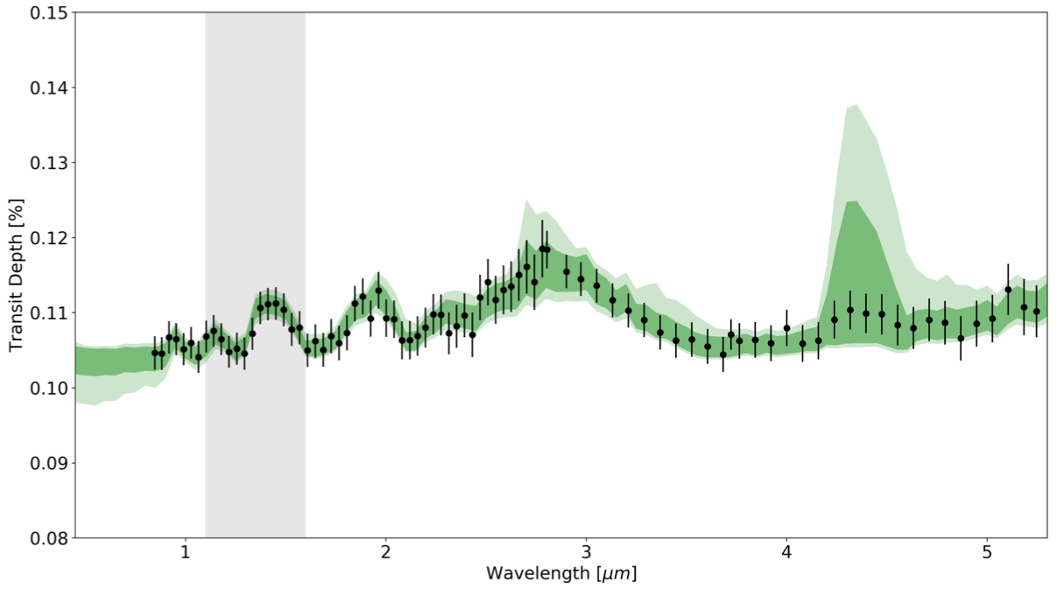
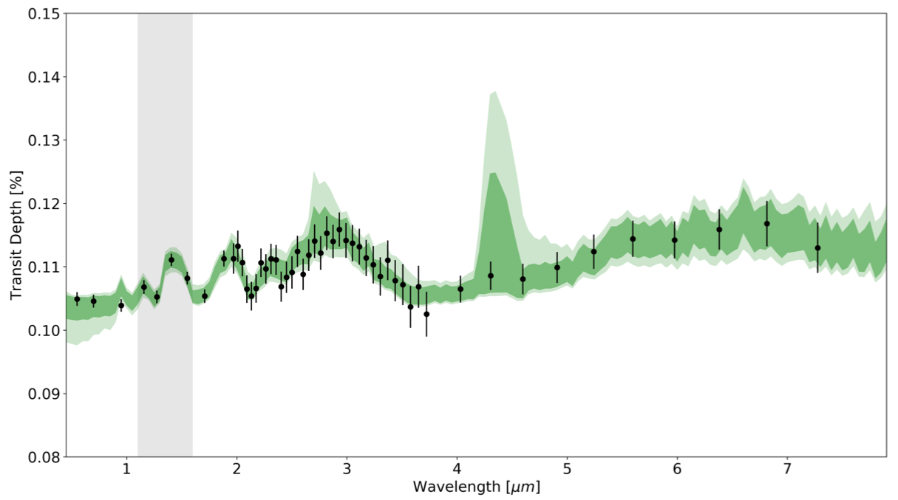
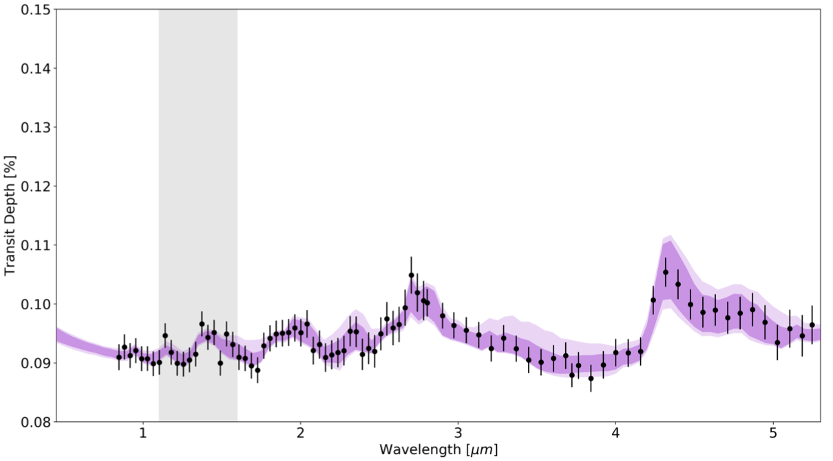
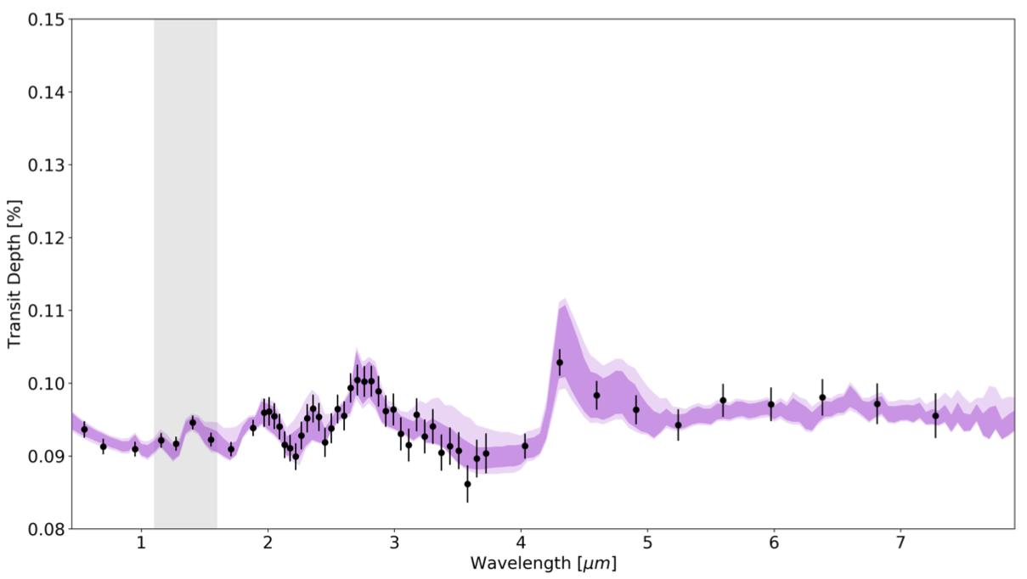
3. Future observations
HD 106315 c
JWST
HD 106315 c
ARIEL
HST/WFC3 best fit spectra as inputs
ARIEL
Simulations using ArielRad (Mugnai et al 2020)
10 transits observed by ARIEL
JWST
Simulations using ExoWebb (Edwards et al 2020)
1 transit NIRISS GR700XD + 1 transit NIRSpec G395M
Break degeneracies, constrain molecular abundances
CO₂ absorption 1.7-2.0μm and 4.0-5.3μm
HD 3167 c
JWST
HD 3167 c
ARIEL
JWST and ARIEL simulations for HD 106315 c and HD 3167 c using best fit atmospheric solutions obtained with HST/WFC3 G141 retrieval.
Adapted from Guilluy et al 2021
Amélie Gressier WG-ARIEL– 04/02/2021 12

Slide 13
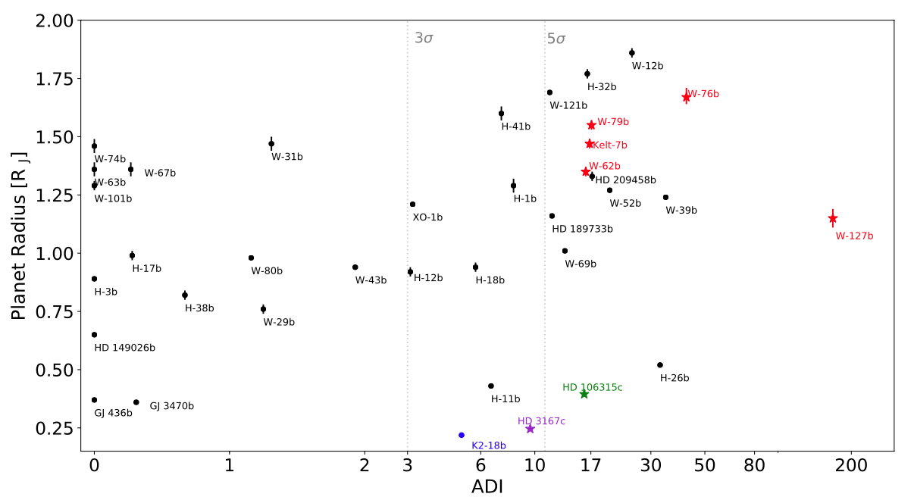
Conclusions
Significant atmospheric detection around two Neptune-liked planets
Significant H₂O detection
Carbon dioxide detection in HD 3167 c not fully explained
2D or 3D atmospheric retrievals necessary
2 interesting targets for JWST and ARIEL
More information on intermediate size planets in the Fulton gap
Planetary radius as a function of the significance of the atmosphere detection (ADI)
Adapted from Guilluy et al 2021
Amélie Gressier WG-ARIEL– 04/02/2021 13

