Slide 1






Status of the FCC project
(in 15 minutes)
Alain BLONDEL
LPNHE-Paris Sorbonne and UNIGE
With many thanks to all in the FCC collaboration
LHC
HL-LHC
PS
SPS
FCC
http://cern.ch/fcc
Work supported by the European Commission under the HORIZON 2020 projects EuroCirCol, grant agreement 654305; EASITrain, grant agreement no. 764879; ARIES, grant agreement 730871; and E-JADE, contract no. 645479
photo: J. Wenninger
photo: J. Wenninger

Slide 2
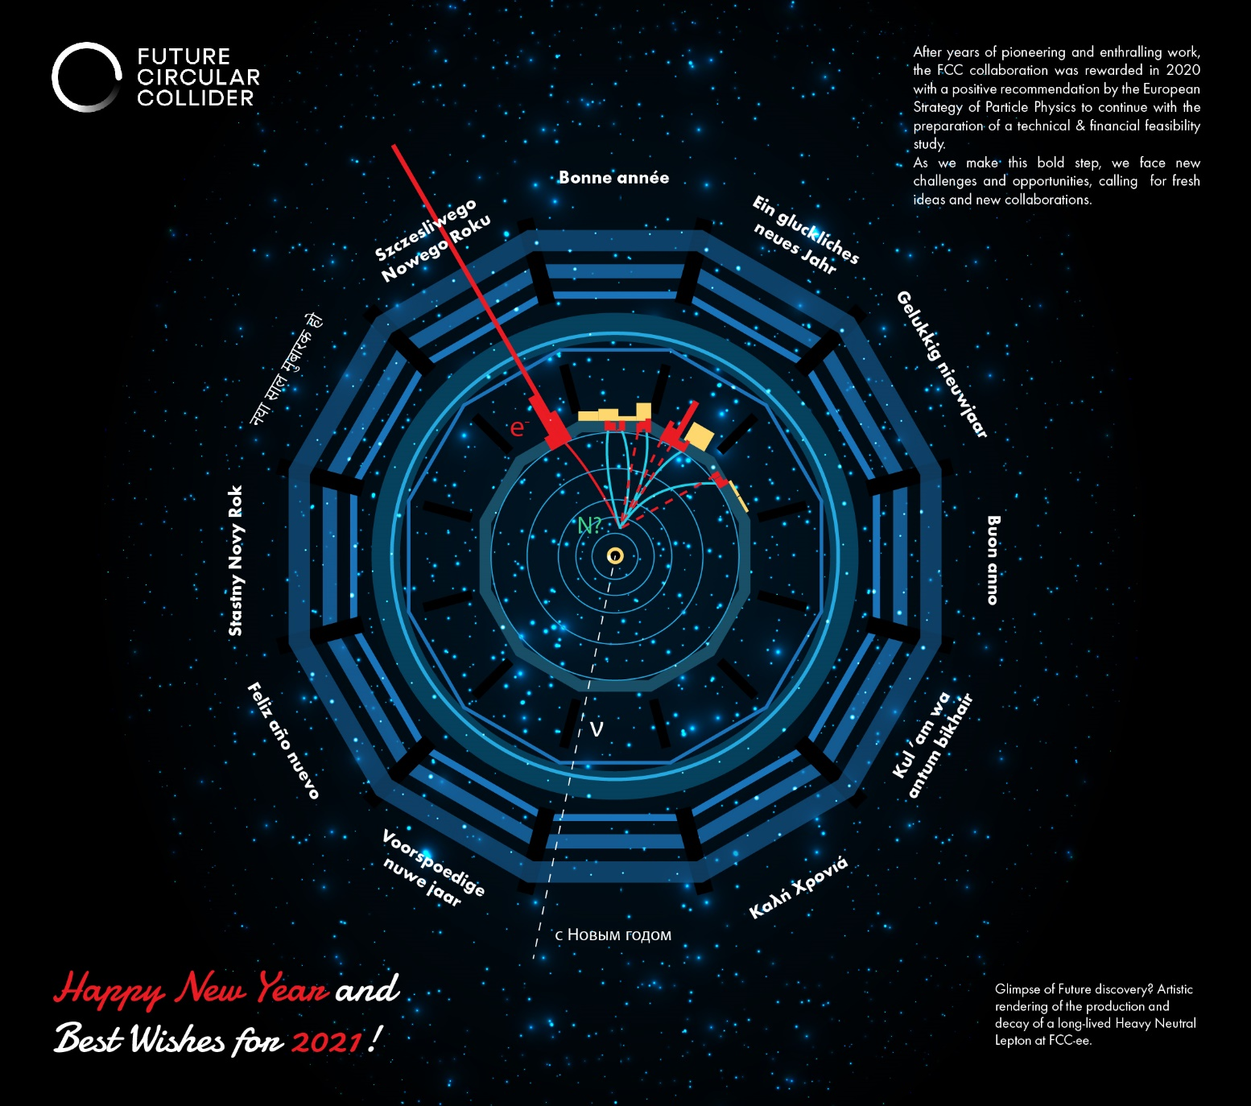

Slide 3
CDR + Documentation
FCC-Conceptual Design Reports:
  Vol 1 – Physics
  Vol 2 – FCC-ee,
  Vol 3 – FCC-hh,
  Vol 4 – HE-LHC
  1338 authors
  Preprints since 15 January 2019 on http://fcc-cdr.web.cern.ch/ and INSPIRE
  CDRs published in European Physical Journal C (Vol 1) and ST (Vol 2 – 4)
  ESPP summaries: FCC-integral, FCC-ee, FCC-hh, HE-LHC http://fcc-cdr.web.cern.ch/
  FCC-ee «Your questions answered» https://arxiv.org/abs/1906.02693v1
  “Circular vs linear, another story of complementarity” arXiv:1912.11871v2
  LOIs to Snowmass, challenges: https://indico.cern.ch/event/951830/
A public presentation of the CDR was given on 4-5 March
at CERN https://indico.cern.ch/event/789349/
+ FCC Phys. Workshop Jan 20 https://indico.cern.ch/event/838435/
FCC Phys workshop Nov 9-13 2020 https://indico.cern.ch/event/932973/
→ many further details can be found there!

Slide 4

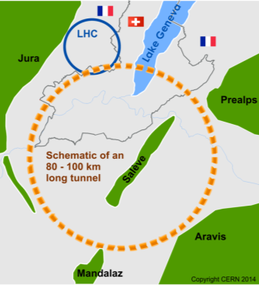
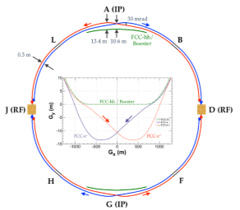
The FCC integrated program at CERN
inspired by successful LEP – LHC (1976-2038?) program
Comprehensive cost-effective program maximizing physics opportunities
Stage 1: FCC-ee (Z, W, H, tt) as first generation Higgs EW and top factory at highest luminosities.
Stage 2: FCC-hh (~100 TeV) as natural continuation at energy frontier, with ion and eh options.
Complementary physics
Integrating an ambitious high-field magnet R&D program
Common civil engineering and technical infrastructures
Building on and reusing CERN’s existing infrastructure.
FCC-INT project plan is fully integrated with HL-LHC exploitation
and provides for seamless continuation of HEP
FCC-ee
FCC-hh

Slide 5
FCC-INT timeline, compared with LEP/LHC
76
81 <- construction ->
89
2000
2010
2038
12 years operation
8+2 years installation
28 years operation
FCC-ee
64
20
running HL-LHC
2039
1
2
3
4
5
6
8
9
10
11
12
13
14
15
16
17
18
15 years operation
34
35
36
37
38
39
40
41
42
43
70
7
~ 25 years operation
Project preparation &
administrative processes
Permis-sions
Update
Permissions
Funding strategy
Funding and
in-kind contribution agreements
Funding and
in-kind contribution agreements
Geological investigations, infrastructure detailed design and tendering preparation
Tunnel, site and technical infrastructure construction
FCC-ee dismantling, CE & infrastructure adaptations FCC-hh
FCC-ee accelerator R&D and technical design
FCC-ee accelerator construction, installation, commissioning
FCC-hh accelerator R&D and technical design
FCC-hh accelerator construction, installation, commissioning
Set up of international experiment collaborations, detector R&D and concept development
FCC-ee detector technical design
FCC-ee detector
construction, installation, commissioning
FCC-hh detector R&D,
technical design
FCC-hh detector
construction, installation, commissioning
Superconducting wire and magnet R&D
SC wire and 16 T magnet R&D, model magnets, prototypes, preseries
16 T dipole magnet
series production

Slide 6
Z WW HZ tt
First step:
FCC-ee
LEPx10⁵!
Event
statistics :
E_{CM} errors:
Z peak E_{cm} : 91 GeV 5 10¹² e+e- → Z
WW threshold E_{cm} : 161 GeV 10⁸ e+e- → WW
ZH threshold E_{cm} : 240 GeV 10⁶ e+e- → ZH
‾tt threshold E_{cm} : 350 GeV 10⁶ e+e- →‾tt
LEP x 10⁵
LEP x 2.10³
Never done
Never done
<100 keV
<300 keV
2 MeV
5 MeV
Great energy range for the heavy particles of the Standard Model.

Slide 7

FCC-ee discovery potential and Highlights
Today we do not know how nature will surprise us. A few things that FCC-ee could discover :
EXPLORE 10-100 TeV energy scale (and beyond) with Precision Measurements
-- ~20-500 fold improved precision on many EW quantities
m_{Z,} m_{W}, m_{top} , sin² θ_{w}^{eff} , R_{b} , α_{QED} (m_{z}) α_{s} (m_{z} m_{W} m_{τ}), Higgs and top quark couplings
model independent «fixed candle» for Higgs measurements, ee-H coupling?
DISCOVER a violation of flavour conservation or universality and unitarity of PMNS @10⁻⁵
-- ex FCNC (Z --> μτ , eτ) in 5 10¹² Z decays and τ lifetime, BR in 2 10¹¹ Z→ τ τ
+ flavour physics (10¹² bb events) (B→s τ τ etc..)
DISCOVER dark matter as «invisible decay» of H or Z (or in LHC loopholes)
DISCOVER very weakly coupled particle in 5-100 GeV energy scale
such as: Right-Handed neutrinos, Dark Photons, ALPS, etc…
+ and many opportunities in – e.g. QCD (α_{s} @ 10⁻⁴, fragementations, H→ gg) etc….
NB Not only a «Higgs Factory»! «Z factory» and «top» are important for ‘discovery potential’

Slide 8
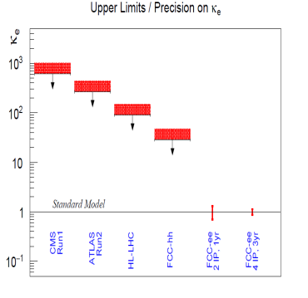
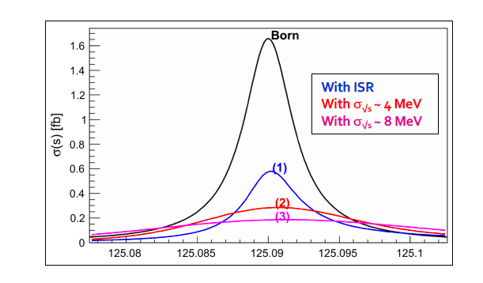
Something unique!
HUGE CHALLENGE
e+e- → H @ 125.xxx GeV requires
-- Higgs mass to be known to <5 MeV from 240 GeV run (CEPC group almost there)
-- Huge luminosity
-- monochromatization (opposite sign dispersion using magnetic lattice) to reduce σ_{ECM}
-- continuous monitoring and adjustment of E_{CM} to MeV precision (transv. Polar.)
-- an extremely sensitive event selection against backgrounds
-- a generous lab director to spend 3 years doing this and neutrino counting

Slide 9
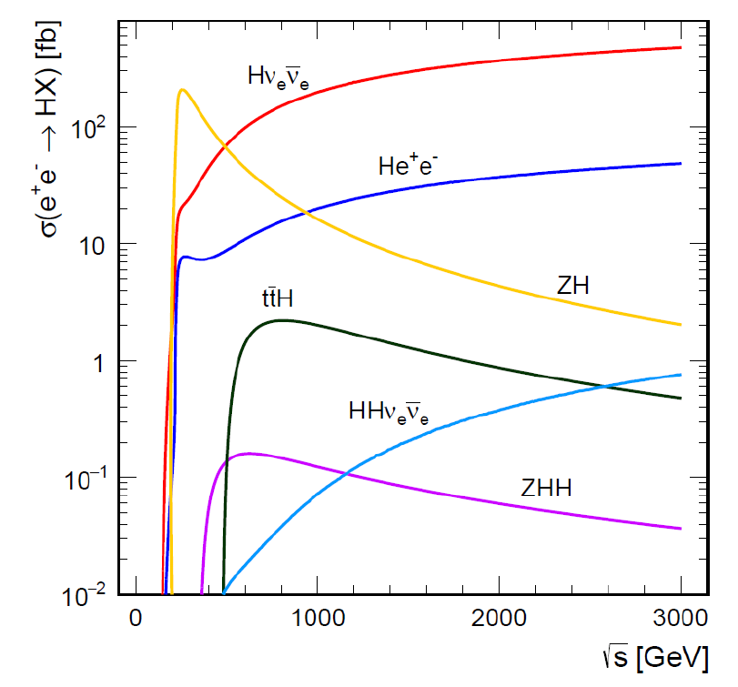
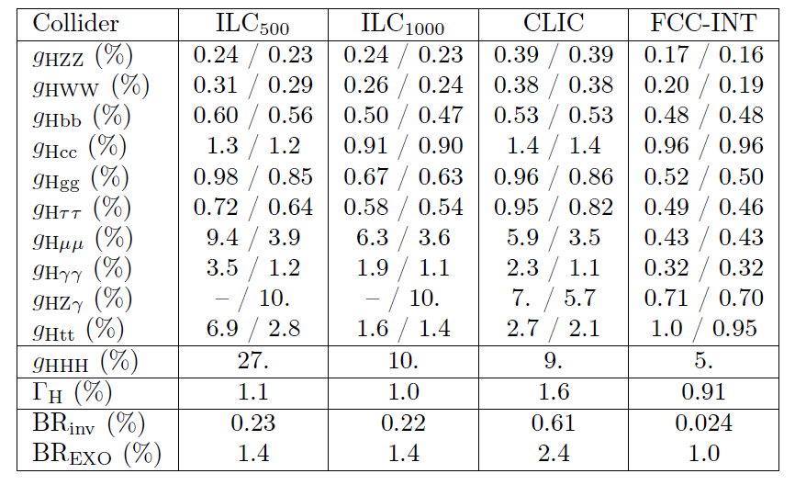
FCC-ee + FCC-hh unique complementarity
True in many domains and ways with energy vs precision and sensitivity, exemple for Higgs:
}
ee
}
hh
±2(stat)±~3(syst)
ee
hh
ee
FCC-hh > 10¹⁰ H produced, +
FCC-ee measurement of g_{HZZ}
g_{HHH} , g_{Hγγ} , g_{HZγ} , g_{Hμμ} , BR_{inv}
(*)see M. Selvaggi, 3d FCC physics workshop
arxiv:2004.03505v1
10% precision in 2-5 years of FCC-hh running

Slide 10
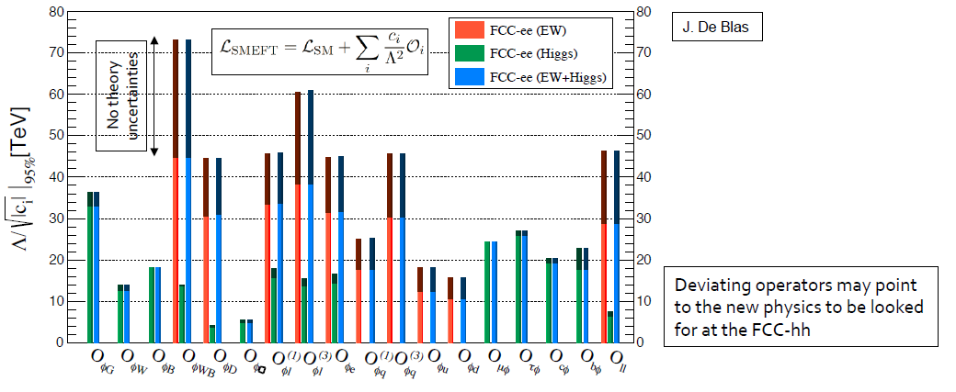
The opportunities
The challenges
Precision EW measurements:
is the SM complete?
-^- EFT D6 operators (some assumptions)
-^- Higgs and EWPOs are complementary
-^- top quark mass and couplings essential!
(the 100km circumference is optimal for this)
<-- systematics are preliminary
(aim at reducing to systematics)
<-- tau, b, and c observables still to be added
<-- complemented by high energy FCC-hh
Theory work is critical and initiated 1809.01830
Design detectors to match syst to stat errors

Slide 12
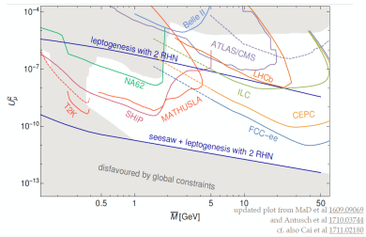
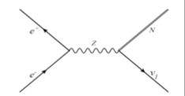
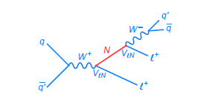
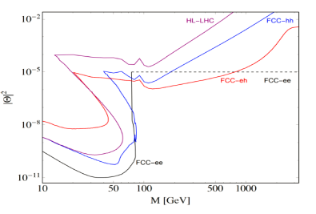

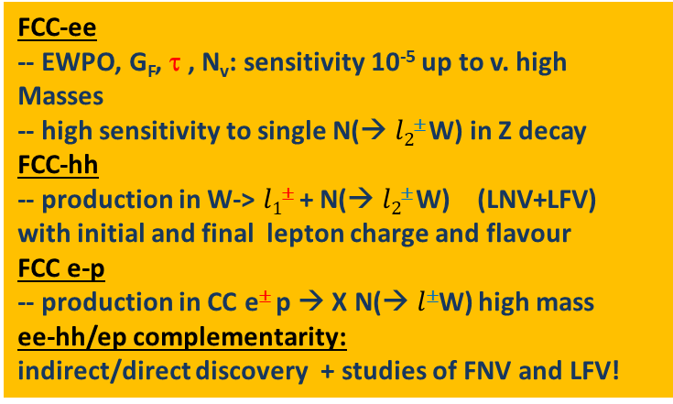
Heavy neutrinos
FCC-ee Z
+
or$l$±ν
(*)
-
FCC-hh
tau life-time and branching ratios
FCC-ee
-- EWPO, G_{F}, τ , N_{v}: sensitivity 10⁻⁵ up to v. high Masses
-- high sensitivity to single N(→ $l2$± W) in Z decay
FCC-hh
-- production in W-> $l1$± + N(→ $l2$± W) (LNV+LFV)
with initial and final lepton charge and flavour
FCC e-p
-- production in CC e± p → X N(→ $l$±W) high mass
ee-hh/ep complementarity:
indirect/direct discovery + studies of FNV and LFV!
Detached
vertices
Massive neutrino mechanisms for generating the matter-antimatter asymmetry in the Universe should be a central consideration in the selection and design of future colliders. (neutrino town meeting report to ESPP)

Slide 13


Our marching orders from ESPP 2020:
“Europe, together with its international partners, should investigate the technical and financial feasibility of a future hadron collider at CERN with a centre-of-mass energy of at least 100 TeV, and with an electron-positron Higgs and electroweak factory as a possible first stage. Such a feasibility study of the colliders and related infrastructure should be established as a global endeavour and be completed on the timescale of the next Strategy update.”
Every word and character counts: feasibility of the colliders (ee and hh) and related infrastructure.
-- FCC is the highest priority for Europe and its international partners

Slide 14
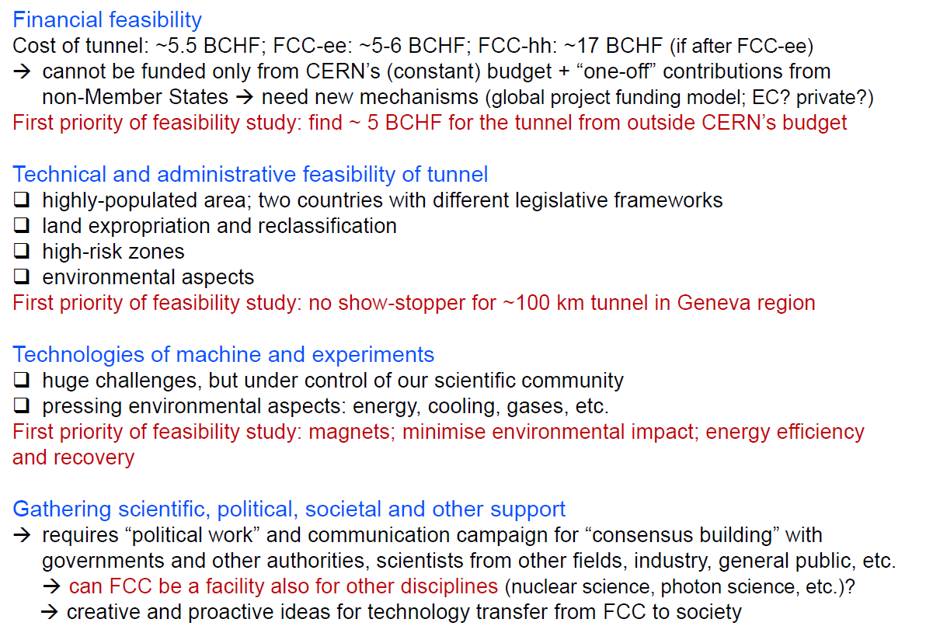
Moving Forward: FCC study in 2020-2026 towards ESPP 2025-27
Fabiola Gianotti
FCC workshop
Nov 2020
MOU with DOE dec. 2020
Note: there is no future for CERN if the current programme, in particular LHC and HL-LHC, is not successful

Slide 15
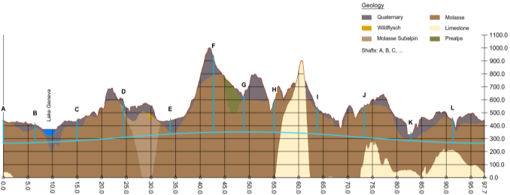
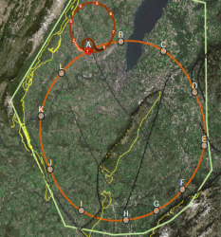
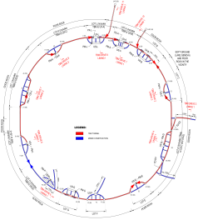
FCC implementation - footprint baseline
Present baseline position was established considering:
lowest risk for construction, fastest and cheapest construction
feasible positions for large span caverns (most challenging structures)
More than 75% tunnel in France, 8 (9) / 12 access points in France.
next step review of surface site locations and machine layout

Slide 16
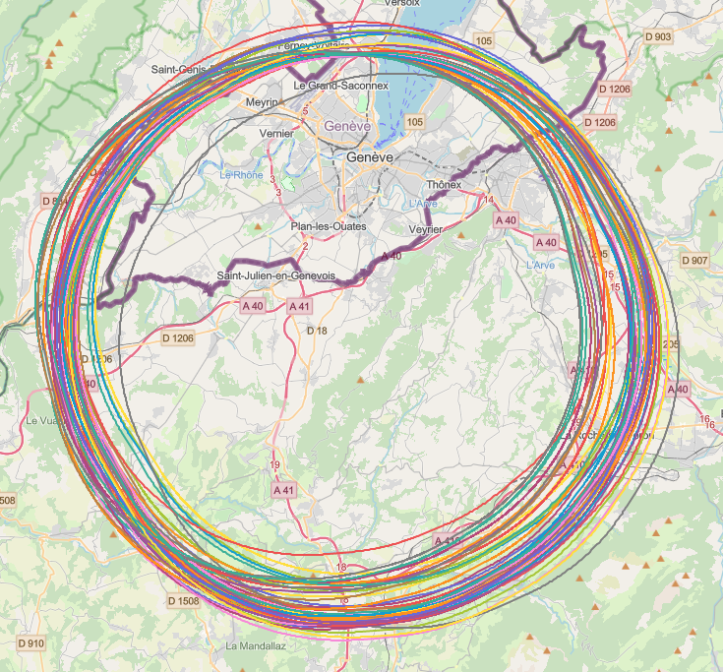
Collider placement optimisation
An overall layout and placement optimisation process across both host states that follows the "avoid-reduce-compensate" directive according to European and French regulatory frameworks.
Process integrates a diverse set of requirements and constraints, such as
  performance for the scientific research to be competitive at international scale
  civil engineering technical feasibility and subsurface constraints
  territorial constraints at surface and subsurface
  nature, accessibility, technical infrastructure and resource needs and constraints
  economic factors including the development of benefits for and synergies with the regional developments
Work takes place as a collaborative effort by technical experts at CERN, consultancy companies and government notified bodies

Slide 17
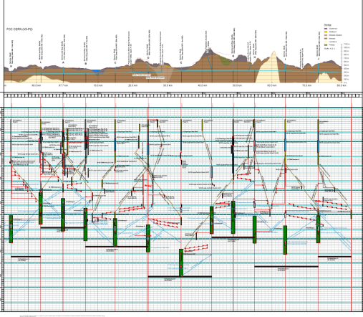
Civil Engineering studies
4.5yrs
6.5yrs
Total construction duration 7 years
First sectors ready after 4.5 years

Slide 18
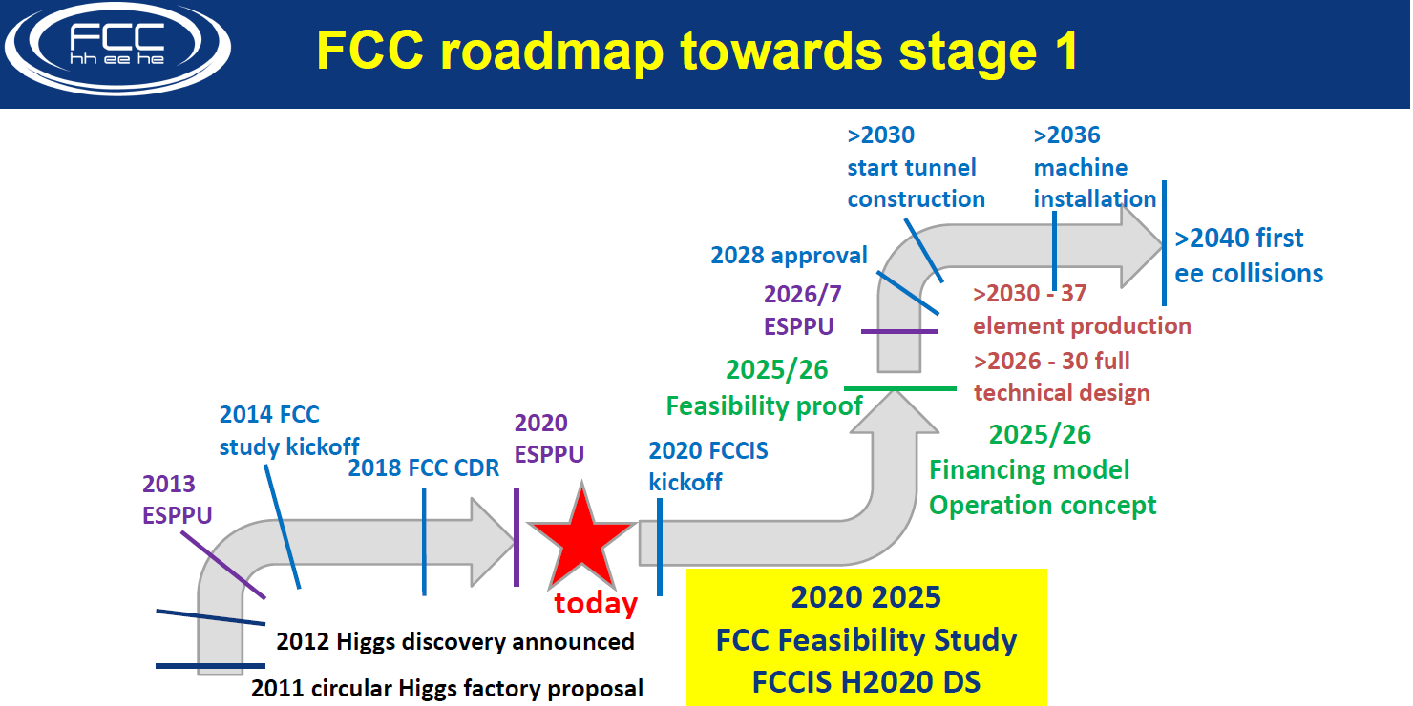

Slide 19
FCC-ee issues requiring further studies (Z, W, H factory)
Accelerator questions
Design for maximum energy efficiency.
Attainable vertical emittance in presence of various errors and with colliding beams, and further luminosity optimization. Alignment tolerances and alignment system.
Complete impedance model, with an evaluation of transverse multibunch resistive-wall instability and single-bunch longitudinal microwave instability. Ion and electron-cloud instabilities with mitigation measures. Design and performance of a bunch-by-bunch feedback system. Interplay of impedance and beam-beam effects.
Finalisation & completion of beam optics, incl. collimation, tuning flexibility, injection & extraction systems. Design for different # of collision points. Dynamic aperture optimizing.
Software tool for e⁺e⁻ optics with IR crossing angle, SR, beam-beam & beamstrahlung.
Collimation system ; collimation / masking and machine protection strategy.
Specification of beam instrumentation and required measurement precision/accuracy.
Optimization of the injector complex (higher-energy linac versus pre-booster, linac pulse)

Slide 20
FCC-ee issues requiring further studies (top factory)
Accelerator questions
Interaction region optimization and shielding of the hard synchrotron radiation including radiation from the final quadrupoles.
Beam-tail collimation for background control.
Further off-momentum dynamic aperture optimisation to maximize beamstrahlung lifetime.
Operational scenarios supporting higher luminosity and shorter beam lifetimes with more frequent injections.
Single-bunch beam instabilities with highest bunch charge.
RF system changes for collider and booster, with associated modified optics configuration.
Maximum energy efficiency.
Machine protection and radioprotection.

Slide 21
FCC-ee issues requiring further studies (energy calibration)
Accelerator questions
Develop & integrate tools for simulating orbit + optics correction processes plus simultaneous optimization of luminosity and polarization, including spin matching. Essential for confirming feasibility and operability of proposed data taking scheme.
Design of diagnostics allowing control of beam-beam offsets and measurement of IP residual dispersion. This diagnostics will help reduce centre-of-mass energy shifts; it should also benefit luminosity optimization.
Explore resonant depolarization process and its sensitivity to energy spread and synchrotron tune to optimize procedures and machine settings.
Detailed design of polarisation wigglers including proper management of the radiation.
Scrutinize and integrate the polarimeter design. Explore its use for Compton-backscattering based measurements precision & stability of momentum measurement.
Thoroughly assess and possible further reduce energy-point-to-energy-point systematic uncertainties. This involves, amongst others, development of energy model and thorough design of monitoring devices.

Slide 22
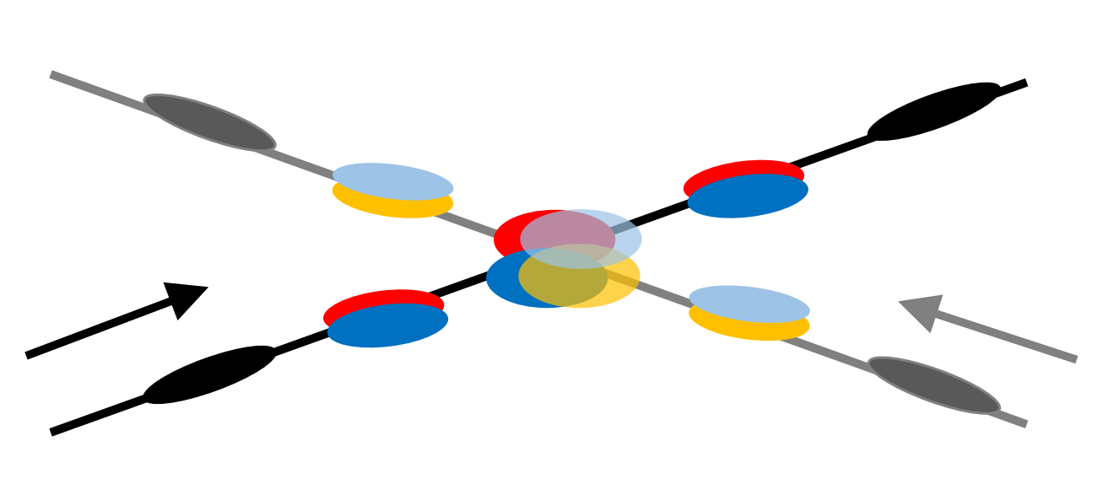
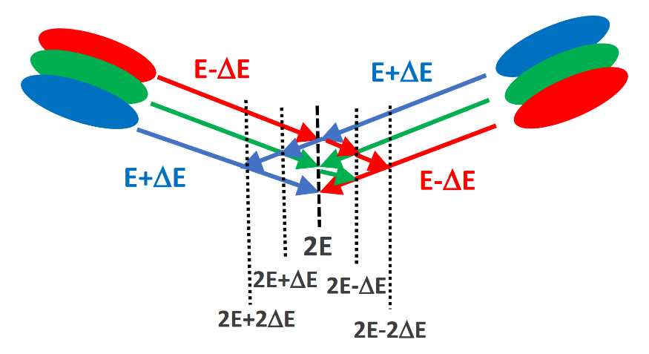
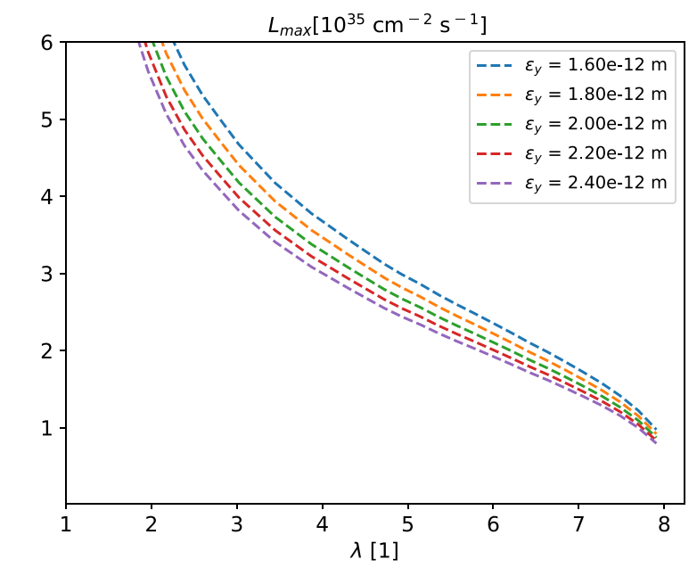
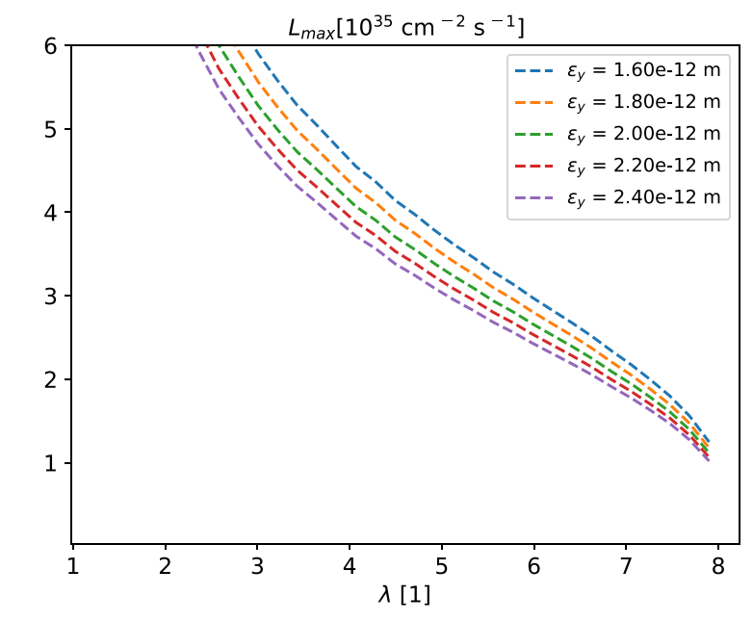
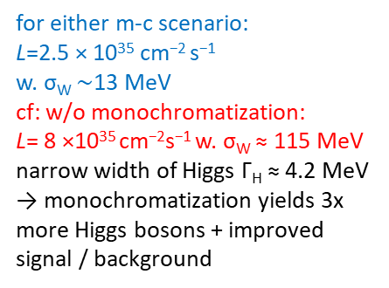
Accelerator questions
monochromatization scenarios for s-channel H production
with crab cavities
w/o crab cavities
A. Bogomyagkov, E. Levichev
PRAB 20, 051001 (2017)
for either m-c scenario:
L=2.5 × 10³⁵ cm⁻² s⁻¹
w. σ_{W} $\sim$13 MeV
cf: w/o monochromatization:
L= 8 ×10³⁵ cm⁻²s⁻¹ w. σ_{W} ≈ 115 MeV
narrow width of Higgs Γ_{H} ≈ 4.2 MeV → monochromatization yields 3x more Higgs bosons + improved signal / background
M.A. Valdivia, F.Z., 2020

Slide 23
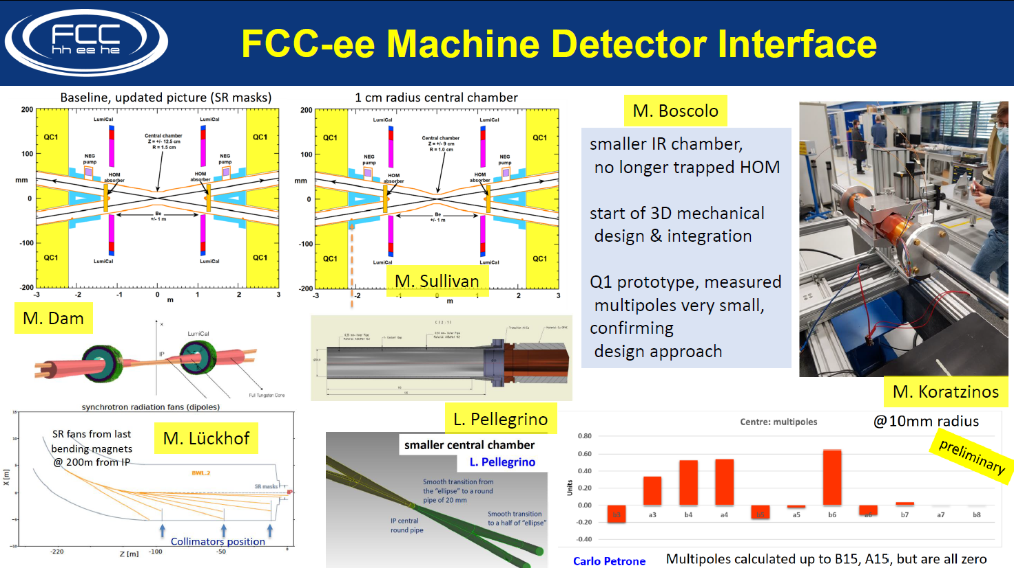

Slide 24



Accelerator questions (4IPcompatible?)
important for e⁺e⁻
question of superperiodicity
example 4 IPs
K. Oide
A
B
A
B
A
L
SP=1
SP=1
SP=2
L
SP=4
B
L
G
G
G
$$mQ_{x}+nQ_{y}=p$$
$$mQ_{x}+nQ_{y}=2p$$
$$mQ_{x}+nQ_{y}=4p$$
resonance condition for lattice errors (DA) and for beam-beam

Slide 25
Moving Forward: FCC study plans for 2020-2026 Towards ESPP 2025-27
Full plan in preparation....
Mike Lamont 2021-01-18
Essential element of PE&D (Physics Experiment and Detectors): Community building!
Installed a group of FCC national contacts (Chairs Greg Bernardi and Tadeusz Lesiak)
➔ contact, participation, MOU and plan of work (addendum)
Aim of PE&D: CDR+ in 2024 and proto collaboration EOIs for next ESPP

Slide 26
FCC PE&D
Bottom-up actions to widen the community support
"The greatest remaining challenge is the creation of a world-wide consortium of scientific contributors who reliably commit resources to the development and preparation of the FCC-ee science project from 2020 onwards" (from FCC ‘lepton collider’ submission to ESPP)
Restart study from Software + Physics and Performance→ Clément, Emmanuel
CERN will put in place dedicated effort in experimental and theoretical physics
Input to ECFA detector R&D road map https://indico.cern.ch/event/957057/
mandate includes Z factory FCC-ee has original (and new) requirements
"3. Technology developments needed for detectors at e+e- EW-Higgs-Top factories
including(..) 91.2 GeV of up to 5×10^{^36} cm-2s-1."
4. Building a network of national contacts in Europe and international partners
5. Participation to ECFA Physics Experiments and Detectors at ‘e+e- Higgs factories’

Slide 27
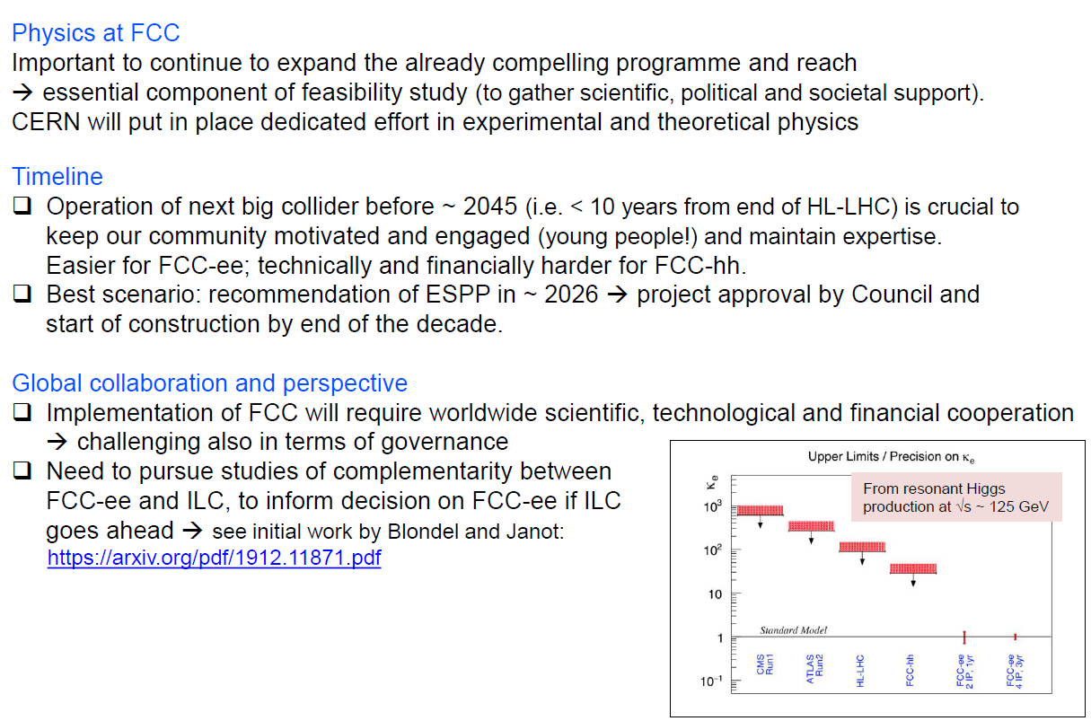
Fabiola Gianotti
FCC workshop
Nov 2020

Slide 28
Conclusions
For more complete info and monthly news
→ register to FCC-ee design study https://fcc-ee.web.cern.ch/ (Contact/Join us)
2. The conclusions of the ESPP are now being implemented at CERN (MTP)
-- large support for Magnet R&D (this is for FCC-hh)
-- similar support for FCC study (implementation, e+e- accelerator readiness)
-- support for detector R&D (Includes Higgs factory
-- support for Physics studies (EP + TH)
3. The studies must co-exist with HL-LHC and other physics which must be a success!
-- the studies are very challenging and stimulating,
provide opportunities for few-author publications etc...
→ enrich work on existing experiment, ideas etc..
-- the fact that CERN has a future is essential for the success of the present program.

Slide 29
SPARES

Slide 30
CHALLENGE 1 : why do we need a new accelerator after the LHC?

Slide 31
Particle physics has arrived at an important moment of its history
The expression ‘Standard Model’ appeared in 1976 after the discoveries of
-- neutrino Neutral currents (Z boson exchange) in 1973 and
-- Charmed particles (BNL, SLAC) in 1974-76
since then we have been discovering all the particles that have
electric charge or QCD charge, or weak isospin (SM couplings)
by increasing accelerator energies.

Slide 32
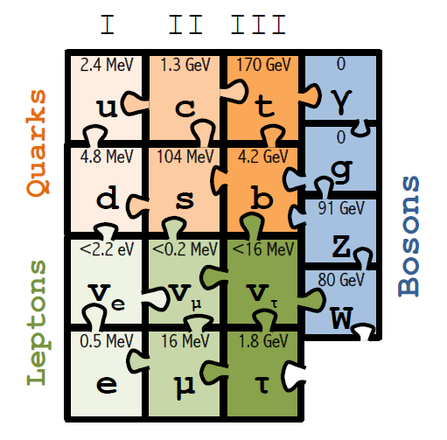
1989-1999: top mass predicted (LEP, mostly Z mass&width)
top quark discovered (Tevatron)
t’Hooft and Veltman get Nobel Prize 1999
(c) Sfyrla

Slide 33
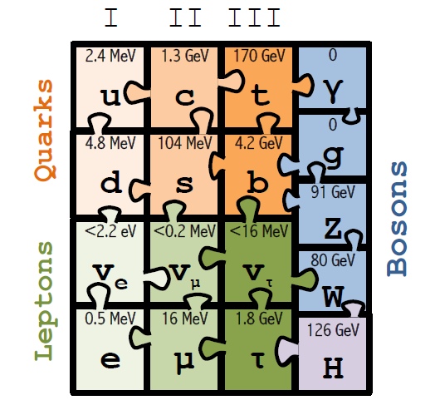
1997-2013 Higgs boson mass cornered (LEP H, M_{Z} etc +Tevatron m_{t} , M_{W})
Higgs Boson discovered (LHC)
Englert and Higgs get Nobel Prize 2013
NB in fact we know from
oscillations and cosmology
that all 3 neutrino masses
are less than ~0.1 eV
IT LOOKS LIKE THE
STANDARD MODEL
IS COMPLETE.....
(c) Sfyrla

Slide 34
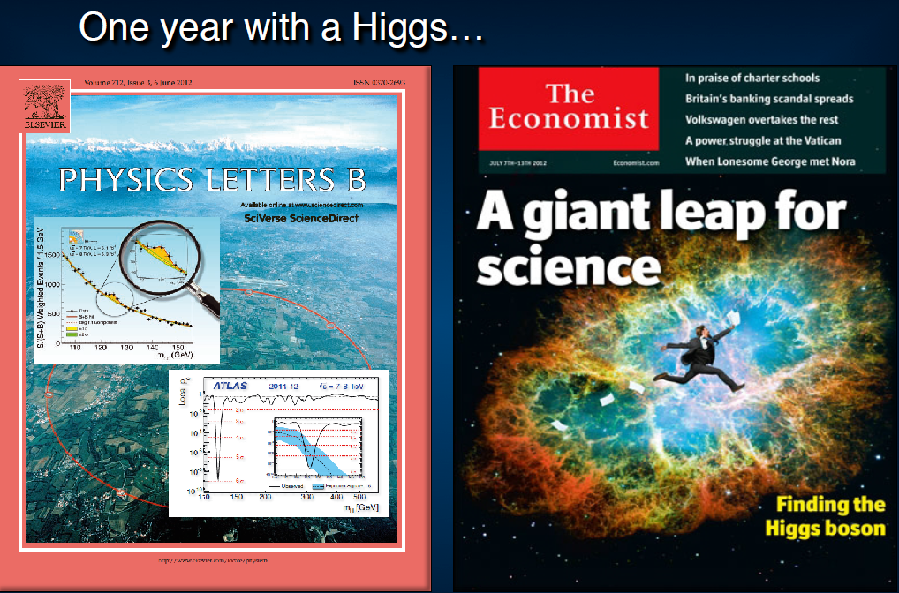
EIGHT YEARS AGO ALREADY

Slide 35
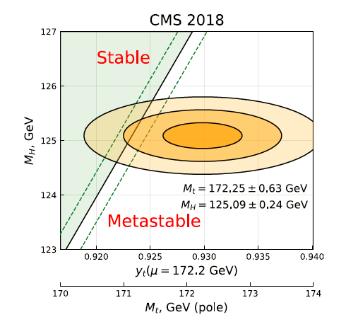
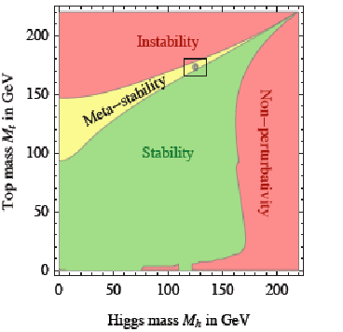
The Standard Model is a very consistent and complete theory.
It explains all known collider phenomena and almost all particle physics (except ν’s)
– this was beautifully verified at LEP, SLC, Tevatron and the LHC.
-- the EWPO radiative corrections predicted top and Higgs masses
assuming SM and nothing else
we can even extrapolate the Standard Model all the way to the the Plank scale :
FCC 2048

Slide 36
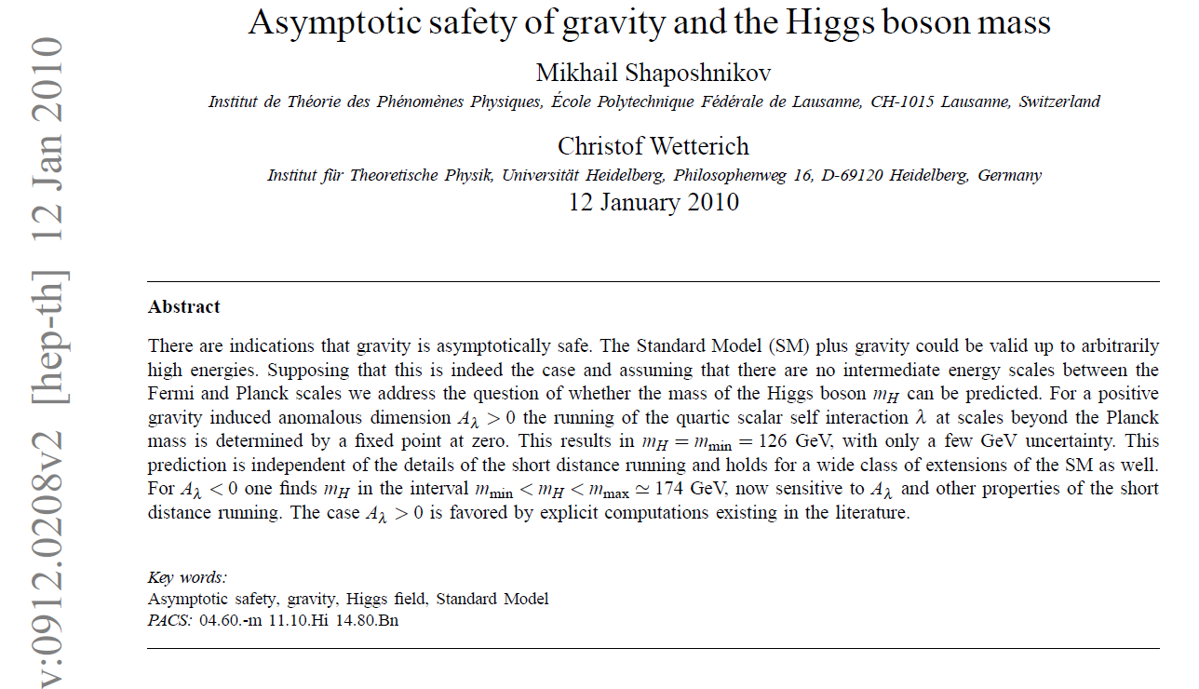
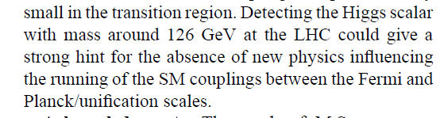
Is it the end?
Is it the end?

Slide 37
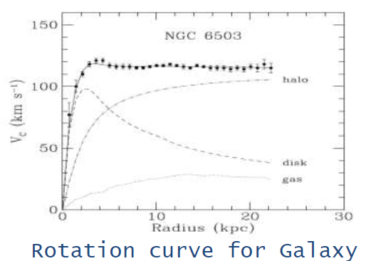
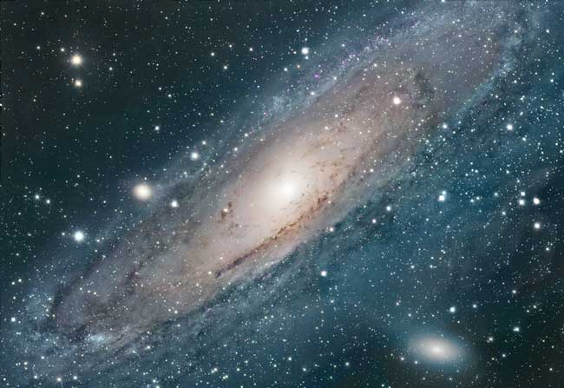
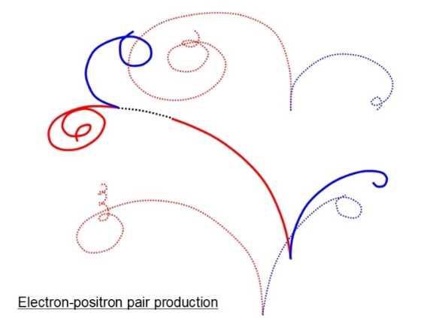
We cannot explain:
Dark matter
Standard Model particles constitute only 5% of the energy in the Universe
Were is antimatter gone?
What makes neutrino masses?
Not a unique solution in the SM --
Dirac masses (why so small?)
Majorana masses (why not Dirac?)
Both (the preferred scenarios, see-saw...) ?
➔ heavy right handed neutrinos?

Slide 38
Is it the end?
Certainly not!
-- Dark matter
-- Baryon Asymmetry in Universe
-- Neutrino masses
are experimental proofs that there is more to understand.
We must continue our quest, but HOW?
Direct observation of new particles (but not only!)
New phenomena (ex: Neutral currents, neutrino oscillations, CP violation.. )
Deviations from precise predictions
(ref. Uranus to Neptune, Mercury’s perihelion,
top and Higgs predictions from LEP/SLC/Tevatron/B factories, g-2, etc…)
To which, one can add many theoretical questions on the SM
these facts require
particle physics explanations.

Slide 39
The Physics Landscape
We are in a fascinating situation: where to look and what will we find?
For the first time since Fermi theory, WE HAVE NO SCALE
The next facility must be versatile with as broad and powerful reach as possible,
as there is no precise target
➔ more Sensitivity, more Precision, more Energy
FCC , thanks to synergies and complementarities, offers
the most versatile and adapted response to today’s physics landscape,

Slide 40
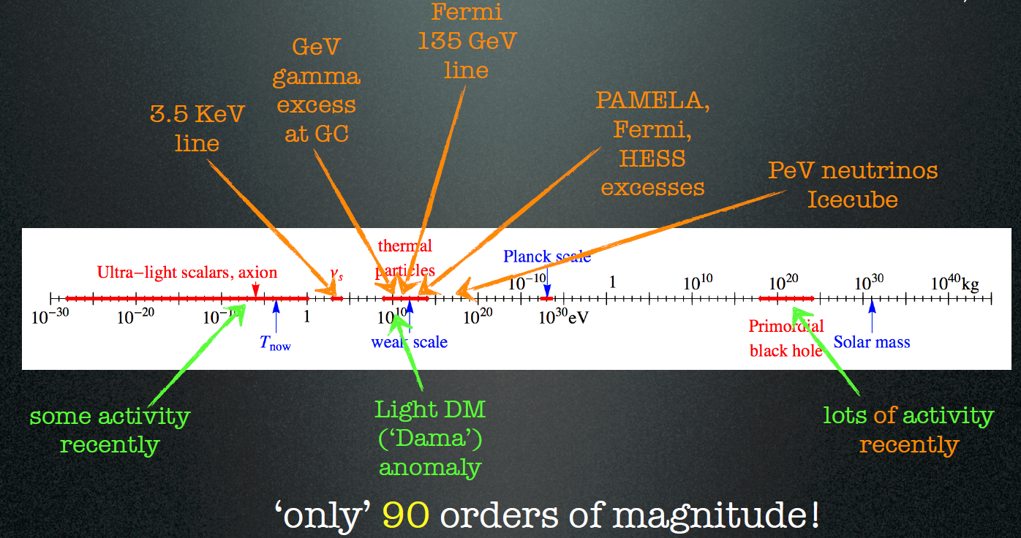
Dark Matter exists. It is made of very long lived neutral particle(s).
Plausible candidates:
indirect detection
direct detection
Particle physics
sterile neutrino
WIMP
UL scalar, axion
Systematic Errors on the Centre-of-mass Ene
Systematic Errors on the Centre-of-mass Ene
Systematic Errors on the Centre-of-mass Ene
Cirelli

Slide 41
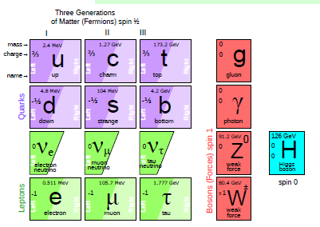
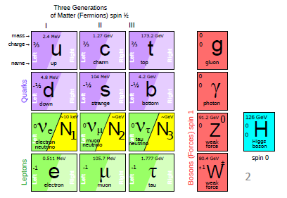
at least 3 pieces are still missing
Since 1998 it is established that neutrinos have mass (oscillations)
and this very probably implies new degrees of freedom
➔ «sterile», very small coupling to known particles
completely unknown masses (eV to ZeV), nearly impossile to find.
.... but could perhaps explain all: DM, BAU,ν-masses

Slide 42
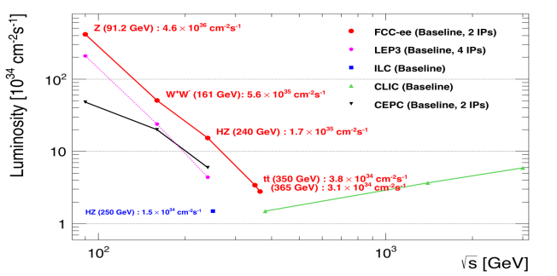
Z WW HZ tt
FCC-ee
LEPx10⁵!
Event
statistics :
E_{CM} errors:
Z peak E_{cm} : 91 GeV 5 10¹² e+e- → Z
WW threshold E_{cm} : 161 GeV 10⁸ e+e- → WW
ZH threshold E_{cm} : 240 GeV 10⁶ e+e- → ZH
‾tt threshold E_{cm} : 350 GeV 10⁶ e+e- →‾tt
LEP x 10⁵
LEP x 2.10³
Never done
Never done
<100 keV
<300 keV
2 MeV
5 MeV
Great energy range for the heavy particles of the Standard Model.

Slide 43
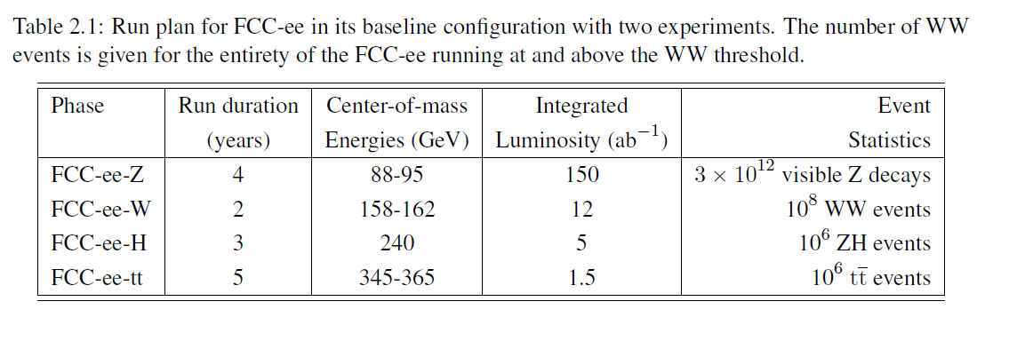
FCC-ee run plan
from the CDR
1. Obviously this is a working assumption; order of Z,W and H points can be changed, this
will all be decided close to turn on.
2. e+e- → H (ECM = m_{H}) unique, not in the schedule so far.
3. Transerse polarization → precision beam energy.
Longitudinal possible (for both beams) but not in CDR by choice

Slide 44
Physics at FCC-ee
HIGGS FACTORY
Higgs provides a very good reason why we need e+e- (or μμ) collider
2. ELECTROWEAK PRECISION ( 10⁻³ today → 10⁻⁵)
Z + WW + top required!
This is a test of the completeness of the SM
existence of weakly interacting new particles
3. Z FACTORY (5 10¹² Z)
High statistics for Heavy Flavours and Search for Feebly Coupled Particles
The place for ‘direct discovery’
+ comments on the synergy and complementarity of FCC-ee hh and eh

Slide 45
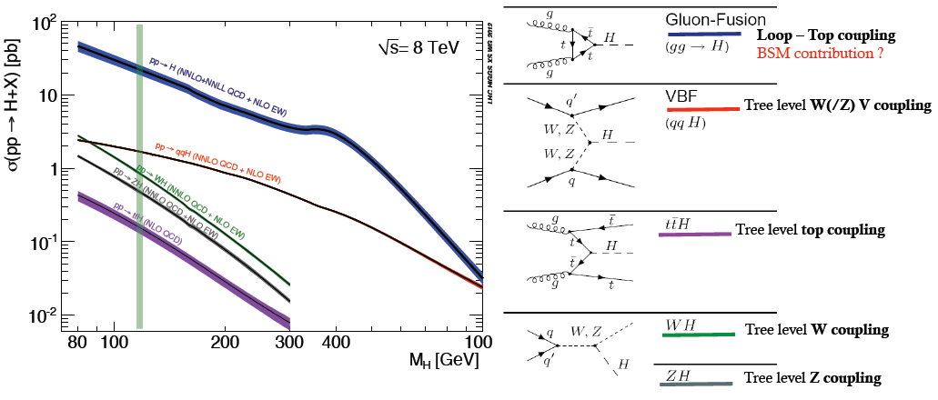
THE LHC is a Higgs Factory…BUT
~100 Million Higgs already produced… more than most “Higgs factory” projects.
difficult to extract the couplings because σ_{prod} uncertain and Γ_{H} is unknown
(invisible+ unmeasured channels) → must do physics with ratios.
σ_{i→f} ^{observed} ∝ σ_{prod} (g_{Hi} )²(g_{Hf})²
Γ_{H}
relative error scales with
1/purity and 1/√efficiency of signal
We don’t know this until measured directly

Slide 46
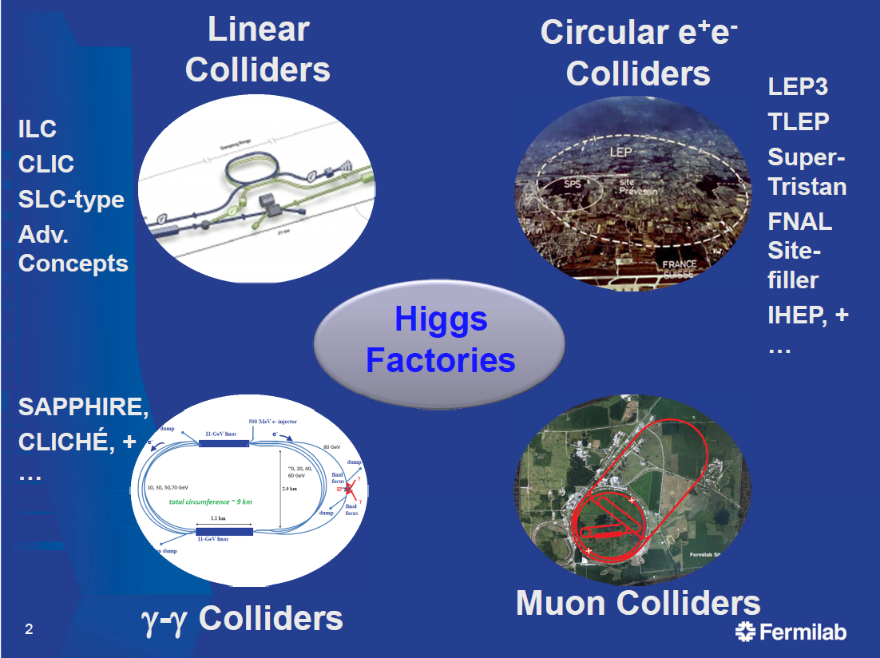
FCC-ee
CEPC

Slide 47
Higgs production mechanism
“higgstrahlung” process close to threshold
Production xsection has a maximum at near threshold ~200 fb
1.7 10³⁵/cm²/s ➔ 340’000 HZ events per year.
e⁻
H
Z – tagging
by missing mass
Z*
e⁺
Z
For a Higgs of 125GeV, a centre of mass energy of 240-250 GeV is optimal
➔ kinematical constraint near threshold for high precision in mass, width, selection purity

Slide 48
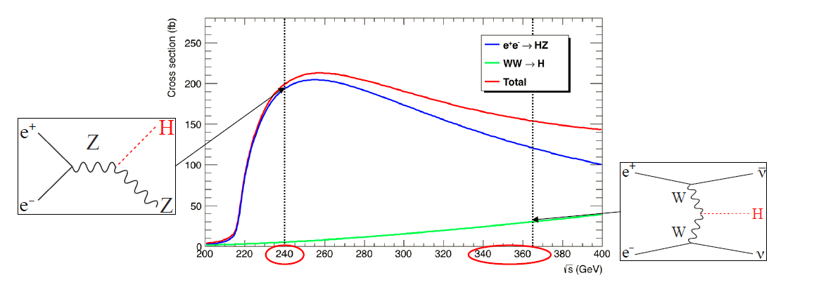
Higgs Production
LEP
10⁶ e+e- → ZH events with 5 ab-1
● Target : few per-mil precision, statistics-limited.
● Complemented with 200k events at √s = 350 – 365 GeV
Of which 30% in the WW fusion channel (useful for the Γ_{H} precision)

Slide 49
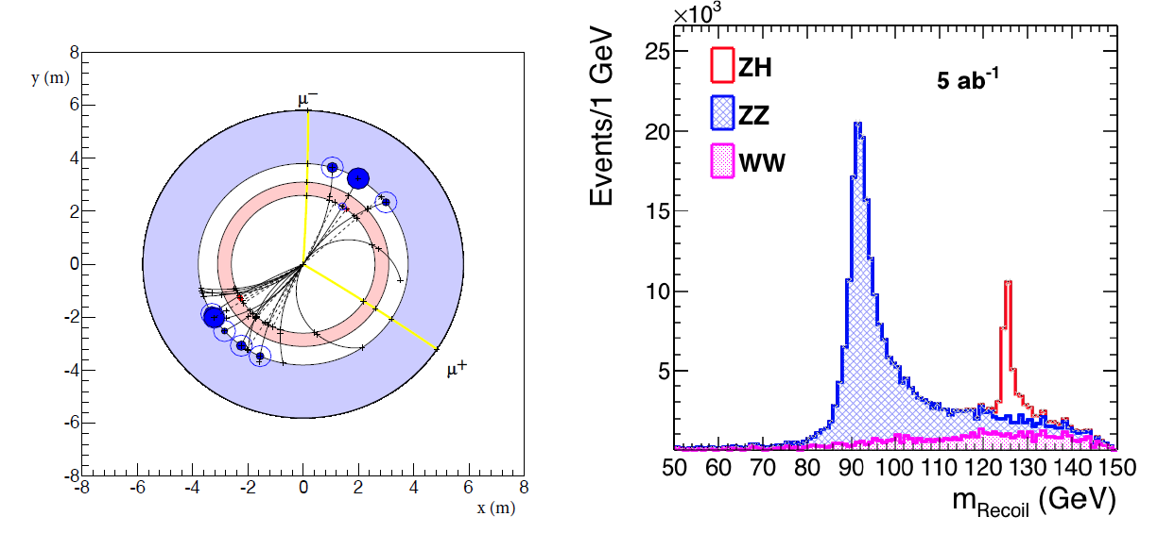
e+e- : Z – tagging by missing mass
total rate ∝ g_{HZZ}²
ZZZ final state ∝ g_{HZZ}⁴/ Γ_{H}
measure total width Γ_{H}
g_{HZZ} to ±0.2% and many other partial widths
empty recoil = invisible width
‘funny recoil’ = exotic Higgs decay
easy control below theshold
e⁻
H
Z*
e⁺
Z

Slide 50
High energy Higgs factories: ILC500, CLIC3000, FCC-hh.
FCC-ee + FCC-hh is unbeatable
}
ee
}
hh
±2(stat)±~3(syst)
ee
hh
ee
FCC-hh > 10¹⁰ H produced, +
FCC-ee measurement of g_{HZZ}
g_{HHH} , g_{Hγγ} , g_{HZγ} , g_{Hμμ} , BR_{inv}
(*)see M. Selvaggi, 3d FCC physics workshop,
9% precision in 3 years of FCC-hh running, 2004.03505v1

Slide 51
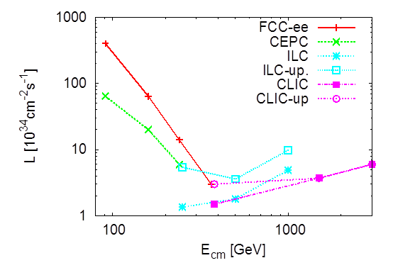
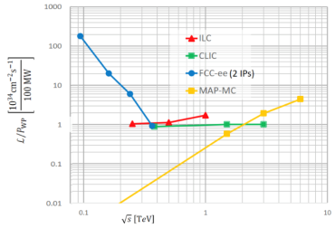
Circular vs linear complementarity
plots from Briefing Book
Luminosity
Luminosity/Power → Energy efficiency
cross-over ~350 GeV
Luminosity vs Energy circular below 365GeV linear above 365 GeV
Efficiency : 9 (5) GJ/Higgs at FCC-ee with 2(4)IP 50GJ/Higgs for ILC250 (first 15 years)
Beam polarization: circular: transverse → ppm beam energy calibration
linear: longitudinal : e- ±80% easy, (e+ ±30% difficult) → additional d.o.f
Monochromatization for e+e- → H (125 GeV)
Long term energy upgrade circular: pp, AA, e-h linear: High energy lepton collisions
Interaction points circular: 2-4 linear: 1 IP (at a time)
Run limited in time by arrival of hadron collider Run is open ended

Slide 52
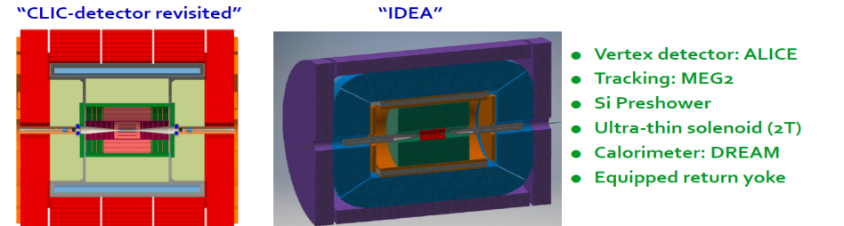
FCC-ee Detectors
Detectors can be done and work for the FCC-ee but physics optimization remains to be done.
Two integration, performance and cost estimates:
-- Linear Collider Detector group at CERN has undertaken the adaption of
CLIC-SID detector for FCC-ee
-- IDEA, detector specifically designed for FCC-ee (and CEPC)
MAPS
SiD at ILC, CLD at FCC-ee IDEA at FCC-ee & CEPC
Many challenges to come mainly because of the Z run.

Slide 53
Z WW HZ tt
FCC-ee
LEPx10⁵!
Event
statistics :
E_{CM} errors:
Z peak E_{cm} : 91 GeV 5 10¹² e+e- → Z
WW threshold E_{cm} : 161 GeV 10⁸ e+e- → WW
ZH threshold E_{cm} : 240 GeV 10⁶ e+e- → ZH
‾tt threshold E_{cm} : 350 GeV 10⁶ e+e- →‾tt
LEP x 10⁵
LEP x 2.10³
Never done
Never done
<100 keV
<300 keV
2 MeV
5 MeV
Great energy range for the heavy particles of the Standard Model.

Slide 54
The Z peak
Is the most unique, most challenging and (once you get used to it)
the most promising part of the program!
Trivia:
L = 230 /cm² /s and 35 nb of Z cross section corresponds to 80 kHZ of events with typ. 20 charged and 20 neutral particles
(all to be preciously and fully recorded, stored, reconstructed)
3 years at 10⁷ s /year = 2.4 10¹² evts per exp.
Processing time 1ms/evt → 240 years of processing…. + Monte Carlo.

Slide 56
FCC-ee discovery potential and Highlights
Today we do not know how nature will surprise us. A few things that FCC-ee could discover :
EXPLORE 10-100 TeV energy scale (and beyond) with Precision Measurements
-- ~20-100 fold improved precision on many EW quantities (equiv. to factor 5-10 in mass)
m_{Z,} m_{W}, m_{top} , sin² θ_{w}^{eff} , R_{b} , α_{QED} (m_{z}) α_{s} (m_{z} m_{W} m_{τ}), Higgs and top quark couplings
model independent «fixed candle» for Higgs measurements, ee-H coupling.
DISCOVER a violation of flavour conservation or universality and unitarity of PMNS @10⁻⁵
-- ex FCNC (Z --> μτ , eτ) in 5 10¹² Z decays and τ BR in 2 10¹¹ Z→ τ τ
+ flavour physics (10¹² bb events) (B→s τ τ etc..)
DISCOVER dark matter as «invisible decay» of H or Z (or in LHC loopholes)
DISCOVER very weakly coupled particle in 5-100 GeV energy scale
such as: Right-Handed neutrinos, Dark Photons, ALPS, etc…
+ and many opportunities in – e.g. QCD (α_{s} @ 10⁻⁴, fragementations, H→ gg) etc….
NB Not only a «Higgs Factory»! «Z factory» and «top» are important for ‘discovery potential’

Slide 61
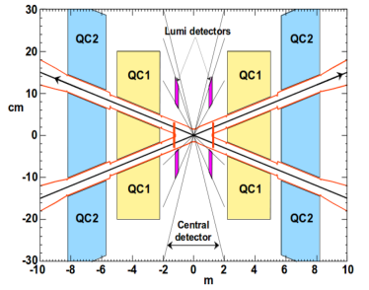


FCC-ee Interaction Region Design
A. Novokhatski, M. Sullivan, E. Belli, M. Gil Costa, and R. Kersevan, Unavoidable trapped mode in the interaction region of colliding beams, Phys. Rev. Accel. Beams 20, 111005 (2017)
M. Boscolo, H. Burkhardt, and M. Sullivan, Machine detector interface studies: Layout and synchrotron radiation estimate in the future circular collider interaction region, Phys. Rev. Accel. Beams 20, 011008 (2017)
heat loads: rad Bhabha (kW), beamstrahlung (MW), res. wall (kW), HOMs, quadr. synchrotron rad.
Q1 with shielding
solenoid
luminometer
IP
3D sketch of key IR systems over ﬁrst 3 m from IP
compensation
solenoid
stiff-skeleton cryostats?
M. Boscolo, N. Bacchetta, A. Bogomyagkov, H. Burkhardt, M. Dam, D. El Khechen, M. Koratzinos, E. Levichev, M. Luckhof, A. Novokhatski, L. Pellegrino, S. Sinyatkin, M. Sullivan, et al.
MDI limit:
100mrad

Slide 62
M. Boscolo
A. Jung, M. Mager
between vertex detector and beam pipe desing much progress in sight!

Slide 63
The opportunities
The challenges
Precision EW measurements:
is the SM complete?
-^- EFT D6 operators (some assumptions)
-^- Higgs and EWPOs are complementary
-^- top quark mass and couplings essential!
(the 100km circumference is optimal for this)
<-- systematics are preliminary
(aim at reducing to systematics)
<-- tau, b, and c observables still to be added
<-- complemented by high energy FCC-hh
Theory work is critical and initiated 1809.01830

Slide 64
Systematic errors
-- a common mistake that was often made in ‘studies’ in the past is to underestimate the creativity of a 100% dedicated team to deconstruct a delicate systematic errors problem .
➔ systematic uncertainties were grossly overestimated
example: in the 1986 LEP yellow report Z mass (width) errors were given as 50(20) MeV
In reality the total final errors were 2 (2) MeV. (i.e. close to the statistical ones)
As a consequence we argued in the 1988 yellow report (polarization at LEP) that we should have longitudinal polarization to measure ALR (and sin²θ^{eff}_{W} to +- 0.00035) (spin rotators etc..) because we could not measure sin²θ^{eff}_{W} better than +- 0.0008 (syst) otherwise.
(final LEP: +-0.00016 without longitudinal polarization) (CERN 86-02, 88-06)
In the end LEP measured the Z mass 800 times better than the W.A. of 1986!
- This conservative behaviour can have considerable consequences on detector design or on
the running plan e.g. (to scan or not to scan, longitudinal polarization or not…etc.)
Unless otherwise specified we would advocate the use of statistical errors (with appropriate
selection efficiencies and background subtractions) as the best way to assess the
physics potential of a facility.
It is however important to concentrate on finding the potential ‘show stoppers’
or ‘stumbling blocks’, to guide the detector R&D and detector requirements , and
Strong support for theoretical calculations will be needed if the program is to be successful

Slide 65
Electroweak Physics
Low Energy: the realm of FCC-ee
Highest luminosities at 91, 160 and 350 GeV
Transverse pol. at 91 and 160 GeV→Ecm calibration
m_{Z} (100 keV) Γ_{Z} (25 keV), m_{W} (<500 keV), α_{QED}(m_{Z}) (3.10⁻⁵)
and sin²θ_{w} at 310⁻⁶
Complete set of EW observables can be measured
Precision unique to FCC-ee + new physics sensitivity
a lot more potential to exploit
with good detector design than present treatment suggests
The reach for new physics depends on which new physics:
-- 1/Λ² new physics → 30-70 TeV
-- Heavy Neutrino → 500-1000 TeV
-- new non-degenerate doublet etc....
Challenge is to test specific models
and include all information including flavour

Slide 67
This measurement is sensitive to heavy neutrino mixing with the ν_{τ}

Slide 68
Don’t be shy! 0.004

Slide 69
Don’t be shy! 0.001
This corresponds to knowing
the radius of the vtx det to ± 5nm

Slide 70
More on TeraZ
The Flavour Factory
Progress in flavour physics wrt SuperKEKb/BELLEII requires > 10¹¹ b pair events,
FCC-ee(Z): will provide ~10¹² b pairs. “Want at least 5 10¹² Z…”
-- precision of CKM matrix elements
-- Push forward searches for FCNC, CP violation and mixing
-- Study rare penguin EW transitions such as b ➝s 𝜏+ 𝜏− , σπεχτροσχοπψ (προδυχε β−βαρψονσ, Β_{σ} …)
-- Test lepton universality with 10¹¹ 𝜏 decays (with 𝜏 lifetime, mass, BRs) at 10⁻⁵ level, LFV to 10⁻¹⁰
-- all very important to constrain / (provide hints of) new BSM physics.
need special detectors (PID); a story to be written!
The 3.5 × 10¹² hadronic Z decay also provide precious input for QCD studies
High-precision measurement of αs(mZ) with Rℓ in Z and W decay, jet rates, 𝜏 decays, etc. : 10 ⁻⁻ ³ ➝10 ⁻⁻ ⁴
huge √s lever-arm between 30 GeV and 1 TeV (FCC vs ILC), fragmentation, baryon production ….
Testing running of αs to excellent precision

Slide 71


Dark Sector at Z factory
With the Higgs discovery SM works perfectly, yet we need new physics to explain the baryon
asymmetry of the Universe, the dark matter etc… without interfering with SM rad. corr.
mediator
or
mixing
S. Gori
Dark photons, axion like particles, sterile neutrinos, all feebly coupled to SM particles

Slide 72

This picture is relevant to Neutrino, Dark sectors and High Energy Frontiers.
FCC-ee (Z) compared to the other machines for right-handed (sterile) neutrinos
How close can we get to the ‘see-saw limit’? can we improve acceptance and reach?
-- the purple line shows the reach for observing heavy neutrino decays (here for 10¹² Z)
-- the horizontal line represents the sensitivity to mixing of neutrinos to the dark sector,
using EWPOs (G_{F} vs sin²θ_{W}^{eff} and m_{Z}, m_{W}, tau decays) which extends sensitivity
to 10⁻⁵ mixing all the way to very high energies (500-1000 TeV at least). arxiv:2011.04725

Slide 73
2041 !

Slide 74

Similar situation for Axion-like-particles; Luminosity is key to the game
Complementarity with High energy lepton collider,
Much more left to explore at FCC-ee-Z and FCC-hh!

Slide 75
FCC main goals for 2020 - 2026
Overall goal:
Perform all necessary steps and studies to enable a definitive project decision by 2025/26, at the anticipated date for the next ESU, and a subsequent start of civil engineering construction by 2028/29.
This requires successful completion of the following four main activities:
Develop and establish a governance model for project construction and operation
Develop and establish a financing strategy, including in-kind contributions
Prepare and successfully complete all required project preparatory and administrative processes with the host states (debat public, EIA, etc.)
Perform site investigations to enable CE planning and to prepare CE tendering..
In parallel development preparation of TDRs and physics/experiment studies:
Machine designs and main technology R&D lines
Establish user communities, work towards proto experiment collaboration by 2025/26.

Slide 76
IMPORTANT MILESTONES AND EVENTS
-- reach out to all ‘European and International Partners’
-- complete organization of physics conveners within the next two months
-- nominations and volunteers welcome (contact AB and PJ)
-- completion of first case study(es) in spring 2021 → detector requirements (papers for snowmass)
-- Now till summer 2021:
interactions with AIDA-Innova, ECFA detector R&D road map, CERN-EP det. R&D initiative
(we have a first list of detector requirements beyond those inherited from ILC/CLIC)
-- decide on FCC Layout (compatible with 4 IRs or not) by summer 2021
-- FCC week in Mai-June 2021 (hopefully in person!) then annual event.
-- FCC-IS Physics Workshop in Winter 2022 in Liverpool
-- FCC-IS Physics Workshop in Winter 2023 in Poland
-- FCC-IS Physics Workshop in Winter 2024 in France
-- delivery of Physics and Experiments CDR ++ → END 2024
-- to serve as support for experimental proto-collaborations → EOI/LOIs for next ESPP

Slide 77
Physics Performance group & conveners
The FCC-ee PE&D SG approved a proposal for a Physics Performance group.
Patrizia Azzi and Emmanuel Perez have agreed to serve as coordinators
operation (see next slide)
1. Physics working groups (conveners) → establish list of BENCHMARK MEASUREMENTS
-- each can correspond to several case studies
-- group case studies from different measurements for efficiency/consistency
-- will start with the Z (as in the run plan)
2. Case study teams establish DETECTOR REQUIREMENTS for optimizing measurement,
and in particular matching exp. systematics with the expected statistical precision.
-- one team already started: c vs b/g jets in Higgs (and Z) decays
3. This requires simulations of detector setup (fast sim or full sim as appropriate)
with help/guidance from detector experts
Experimenters, if you want to participate this is where to start!

Slide 78
Conclusion
The next facility must be versatile with as broad and powerful reach as possible,
as there is no precise target
➔ more Sensitivity, more Precision, more Energy
FCC , thanks to synergies and complementarities, offers the most
versatile and adapted response to today’s physics landscape
Now… lets start designing the detectors!
Many opportunities and challenges are offered by the energy range
(from the Z pole to 100 TeV) and from the huge rates
5 10¹² Z FCC-ee to 10¹³ Ws, 10¹⁰ H at FCC-hh) offered by the FCC.
Let us not be shy and take on the challenges, both on theory and experiment

Slide 79
SPARES

Slide 80


FCC-ee basic design choices
Double ring e⁺e⁻ collider + injector ~100 km
follows footprint of FCC-hh, except around IPs
Asymmetric IR layout & optics to limit synchrotron radiation towards the detector
-- also separates detector from injector
Presently 2 IPs (alternative layout with 4 IPs under study), large horizontal x-ing angle 30mrad,
crab-waist optics
synchrotron radiation power 50 MW/beam
at all beam energies; tapering of arc magnet strengths to match local energy
common RF for $t\overline{t}$ running
K. Oide et al.
top-up injection: booster in collider tunnel
Beam Polarization and energy calibration, wigglers, polarimeters, depolarization kicker for Z and WW

Slide 81
FCC-ee Collider Parameters
parameter | Z | WW | H (ZH) | ttbar
beam energy [GeV] | 45 | 80 | 120 | 182.5
beam current [mA] | 1390 | 147 | 29 | 5.4
no. bunches/beam | 16640 | 2000 | 393 | 48
bunch intensity [10¹¹] | 1.7 | 1.5 | 1.5 | 2.3
SR energy loss / turn [GeV] | 0.036 | 0.34 | 1.72 | 9.21
total RF voltage [GV] | 0.1 | 0.44 | 2.0 | 10.9
long. damping time [turns] | 1281 | 235 | 70 | 20
horizontal beta* [m] | 0.15 | 0.2 | 0.3 | 1
vertical beta* [mm] | 0.8 | 1 | 1 | 1.6
horiz. geometric emittance [nm] | 0.27 | 0.28 | 0.63 | 1.46
vert. geom. emittance [pm] | 1.0 | 1.7 | 1.3 | 2.9
bunch length with SR / BS [mm] | 3.5 / 12.1 | 3.0 / 6.0 | 3.3 / 5.3 | 2.0 / 2.5
luminosity per IP [10³⁴ cm⁻²s⁻¹] | 230 | 28 | 8.5 | 1.55
beam lifetime rad Bhabha / BS [min] | 68 / >200 | 49 / >1000 | 38 / 18 | 40 / 18

Slide 82

FCC-ee design
based on lessons and techniques from past colliders
B-factories: KEKB & PEP-II:
double-ring lepton colliders,
high beam currents,
top-up injection
DAFNE: crab waist, double ring
SuperB-factories, S-KEKB: low β_{y}*
LEP: high energy, SR effects
VEPP-4M, LEP: precision E calibration
KEKB: e⁺ source
HERA, LEP, RHIC: spin gymnastics
L/IP
Marica Biagini
combining successful ingredients of several recent colliders
→ highest luminosities & energies

Slide 83




FCC-hh: highest collision energies
order of magnitude performance increase in both energy & luminosity
100 TeV cm collision energy (vs 14 TeV for LHC)
20 ab⁻¹ per experiment collected over 25 years of operation (vs 3 ab⁻¹ for LHC)
similar performance increase as from Tevatron to LHC
key technology: high-field magnets
from
LHC technology
8.3 T NbTi dipole
via
HL-LHC technology
12 T Nb₃Sn quadrupole
FNAL dipole demonstrator
14.5 T Nb₃Sn

Slide 84


FCC-tunnel integration in arcs
  FCC-ee FCC-hh
  5.5 m inner diameter

Slide 85


Slide 86


Slide 87


Slide 88
FCC-integrated cost estimate
Total construction cost FCC-ee (Z, W, H) amounts to 10,500 MCHF & 1,100 MCHF (tt).
Associated to a total project duration of ~20 years (2025 – 2045)
Total construction cost for subsequent FCC-hh amounts to 17,000 MCHF.
Associated to a total project duration of ~25 years (2035 – 2060) (FCC-hh stand alone 25 BCHF)

Slide 89

Civil Engeneering preparatory activities 2020 - 2030
Technical schedule of main processes leading to start of construction begin 2030ies
For proof of principle feasibility: High risk area site investigations, 2022 – 2024
Followed by update of civil engineering conceptual design and CE cost estimate 2025

