Slide 1








Introduction to FCC project (FCCee and R&D for FCChh)
French contribution
Antoine CHANCE, CEA Irfu
on behalf of the FCC collaboration and FCCIS DS team
FCC-FRANCE workshop
20-21 January 2021
Work supported by the European Commission under the HORIZON 2020 projects EuroCirCol, grant agreement 654305; EASITrain, grant agreement no. 764879; ARIES, grant agreement 730871, FCCIS, grant agreement 951754, and E-JADE, contract no. 645479
http://cern.ch/fcc

Slide 2
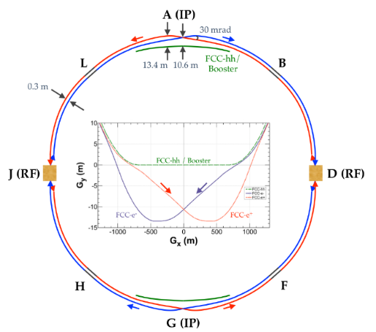
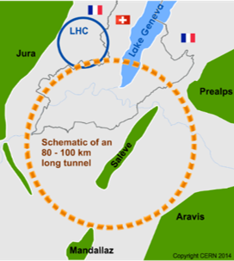

The FCC integrated program
Comprehensive cost-effective program maximizing physics opportunities
Stage 1: FCC-ee (Z, W, H, $\text{t}\overline{\text{t}}$) as Higgs factory, electroweak & and top factory at highest luminosities
Stage 2: FCC-hh (~100 TeV) as natural continuation at energy frontier, with ion and eh options
Complementary physics
Common civil engineering and technical infrastructures
Building on and reusing CERN’s existing infrastructure
FCC integrated project allows seamless continuation of HEP after HL-LHC
FCC-ee
FCC-hh
Notes:
The FCC study and program comprises of two accelerators: the Lepton Collider FCC-ee and the Hadron Collider FCC-hh.
The aim of this setup is devise a comprehensive, cost-effective program to maximizing the physics opportunities.

Slide 3
FCC-ee collider parameters (stage 1)
Parameter | Z | WW | H (ZH) | ttbar
beam energy [GeV] | 45 | 80 | 120 | 182.5
beam current [mA] | 1390 | 147 | 29 | 5.4
no. bunches/beam | 16640 | 2000 | 393 | 48
bunch intensity [10¹¹] | 1.7 | 1.5 | 1.5 | 2.3
SR energy loss / turn [GeV] | 0.036 | 0.34 | 1.72 | 9.21
total RF voltage [GV] | 0.1 | 0.44 | 2.0 | 10.9
long. damping time [turns] | 1281 | 235 | 70 | 20
horizontal beta* [m] | 0.15 | 0.2 | 0.3 | 1
vertical beta* [mm] | 0.8 | 1 | 1 | 1.6
horiz. geometric emittance [nm] | 0.27 | 0.84 | 0.63 | 1.46
vert. geom. emittance [pm] | 1.0 | 1.7 | 1.3 | 2.9
bunch length with SR / BS [mm] | 3.5 / 12.1 | 3.0 / 6.0 | 3.3 / 5.3 | 2.0 / 2.5
luminosity per IP [10³⁴ cm⁻²s⁻¹] | 230 | 28 | 8.5 | 1.55
beam lifetime rad Bhabha/BS [min] | 68 / >200 | 49 / >1000 | 38 / 18 | 40 / 18

Slide 4
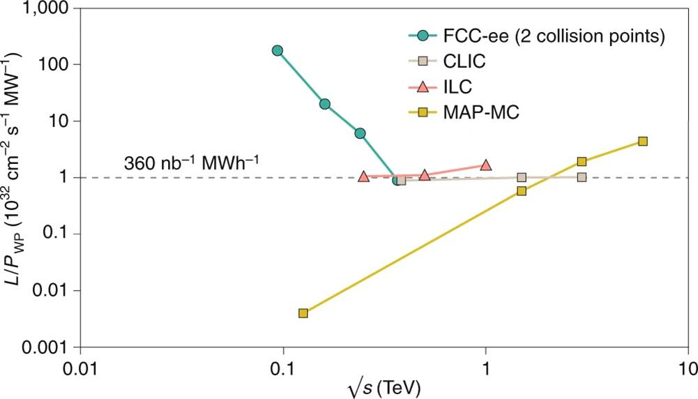
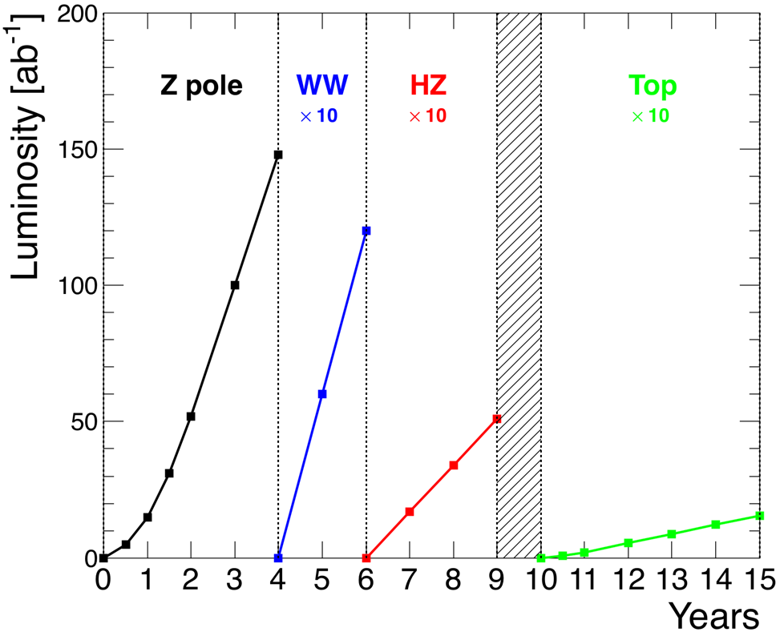
FCC-ee: efficient Higgs/electroweak factory
Luminosity L per supplied electrical wall-plug power P_{WP} is shown as a function of centre-of-mass energy for several proposed future lepton colliders.
Operation plan and integrated luminosity compliant with physics requirements at the four working points Z, WW, ZH, tt.

Slide 5
FCC-hh collider parameters (stage 2)
parameter | FCC-hh |  | HL-LHC | LHC
collision energy cms [TeV] | 100 |  | 14 | 14
dipole field [T] | 16 |  | 8.33 | 8.33
circumference [km] | 97.75 |  | 26.7 | 26.7
beam current [A] | 0.5 |  | 1.1 | 0.58
bunch intensity [10¹¹] | 1 | 1 | 2.2 | 1.15
bunch spacing [ns] | 25 | 25 | 25 | 25
synchr. rad. power / ring [kW] | 2400 |  | 7.3 | 3.6
SR power / length [W/m/ap.] | 28.4 |  | 0.33 | 0.17
long. emit. damping time [h] | 0.54 |  | 12.9 | 12.9
beta* [m] | 1.1 | 0.3 | 0.15 (min.) | 0.55
normalized emittance [μm] | 2.2 |  | 2.5 | 3.75
peak luminosity [10³⁴ cm⁻²s⁻¹] | 5 | 30 | 5 (lev.) | 1
events/bunch crossing | 170 | 1000 | 132 | 27
stored energy/beam [GJ] | 8.4 |  | 0.7 | 0.36

Slide 6
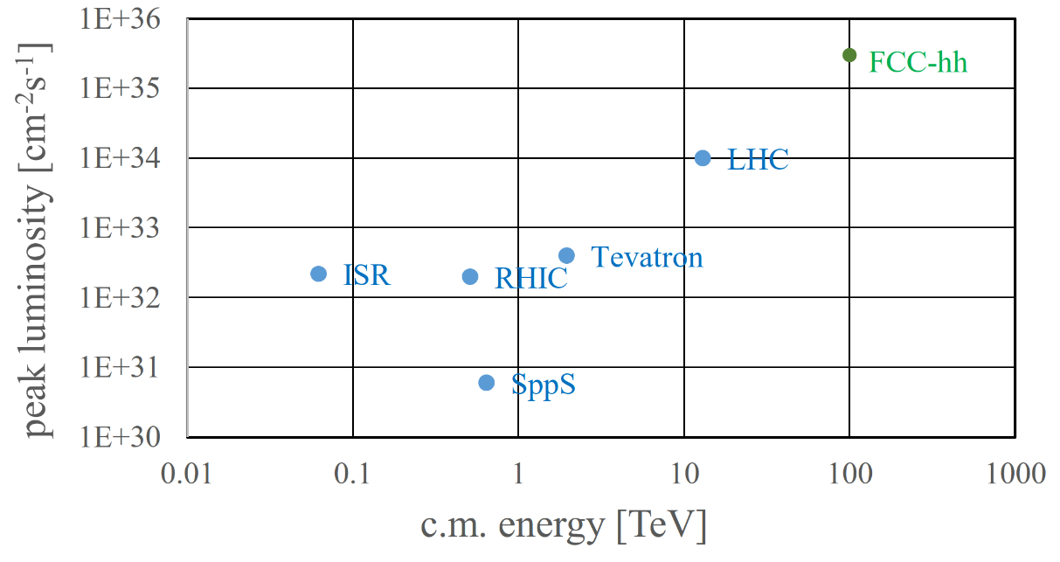
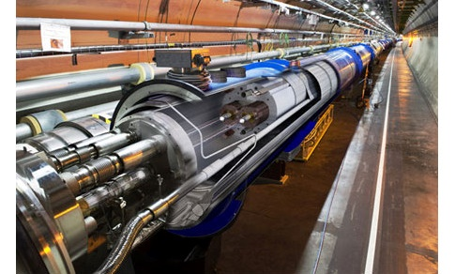
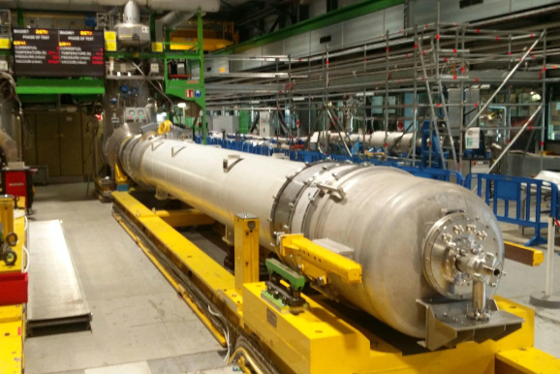
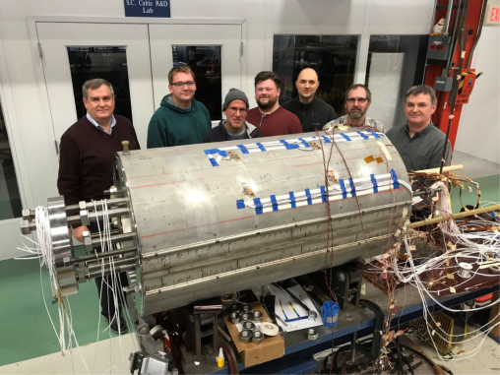
FCC-hh: highest collision energies
order of magnitude performance increase in both energy & luminosity
100 TeV cm collision energy (vs 14 TeV for LHC)
20 ab⁻¹ per experiment collected over 25 years of operation (vs 3 ab⁻¹ for LHC)
similar performance increase as from Tevatron to LHC
key technology: high-field magnets
→ see « HF magnets R&D » by Etienne Rochepault
from
LHC technology
8.3 T NbTi dipole
via
HL-LHC technology
12 T Nb₃Sn quadrupole
FNAL dipole demonstrator
14.5 T Nb₃Sn

Slide 7
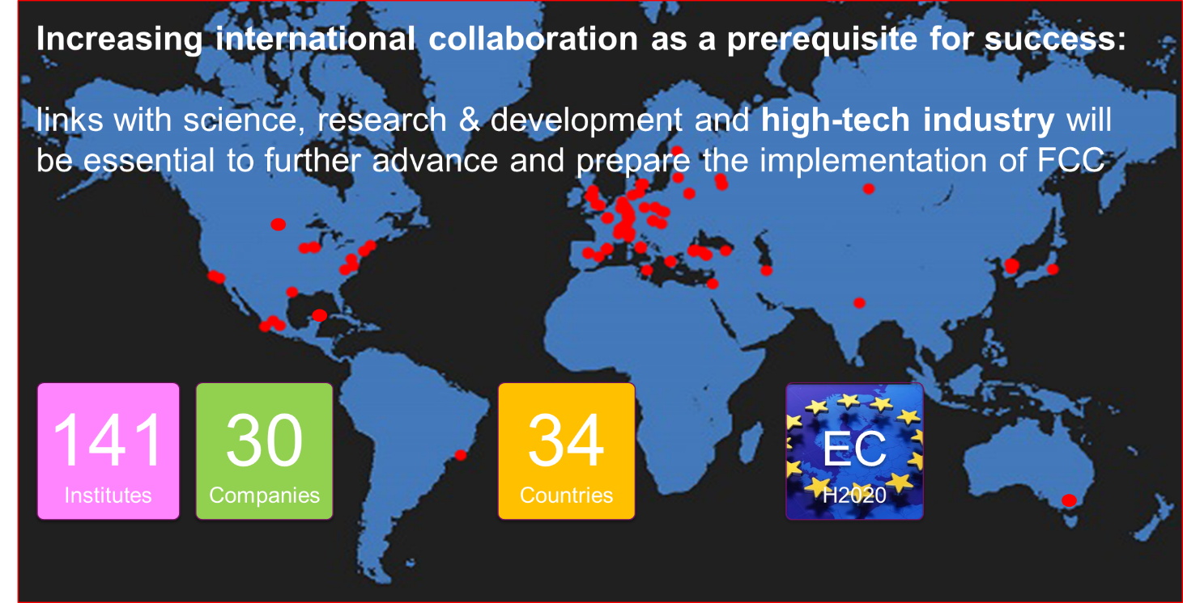
Status of Global FCC Collaboration

Slide 8
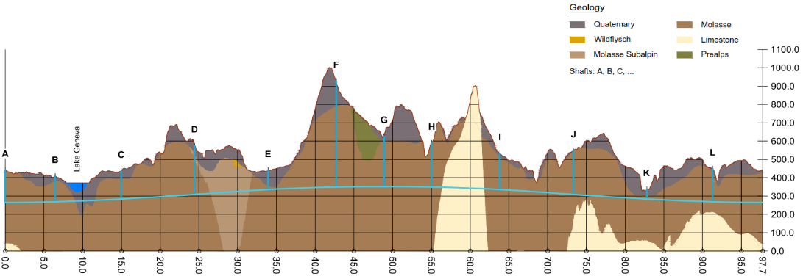
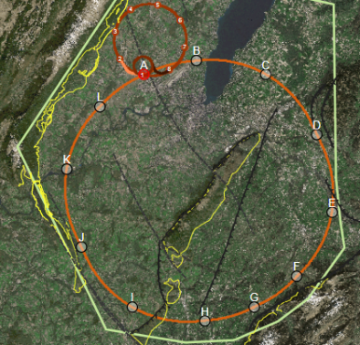
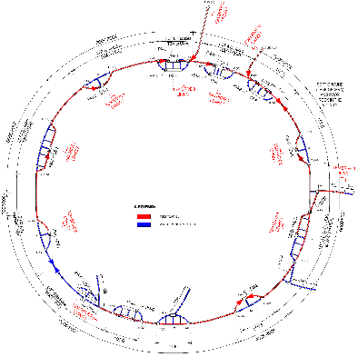
FCC implementation footprint baseline
Present baseline position was established considering:
Lowest risk for construction, fastest and cheapest construction
Molasse rock preferred for tunnelling, avoid limestone with karstic structures
90 – 100 km circumference
12 surface sites with few ha area each

Slide 9
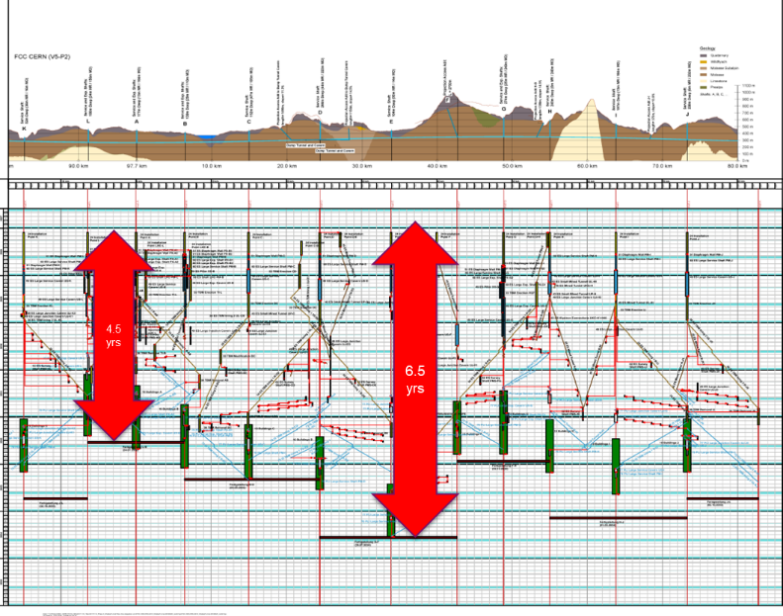
Civil Engineering construction schedule
Total construction duration 7 years
First sectors ready after 4.5 years

Slide 10
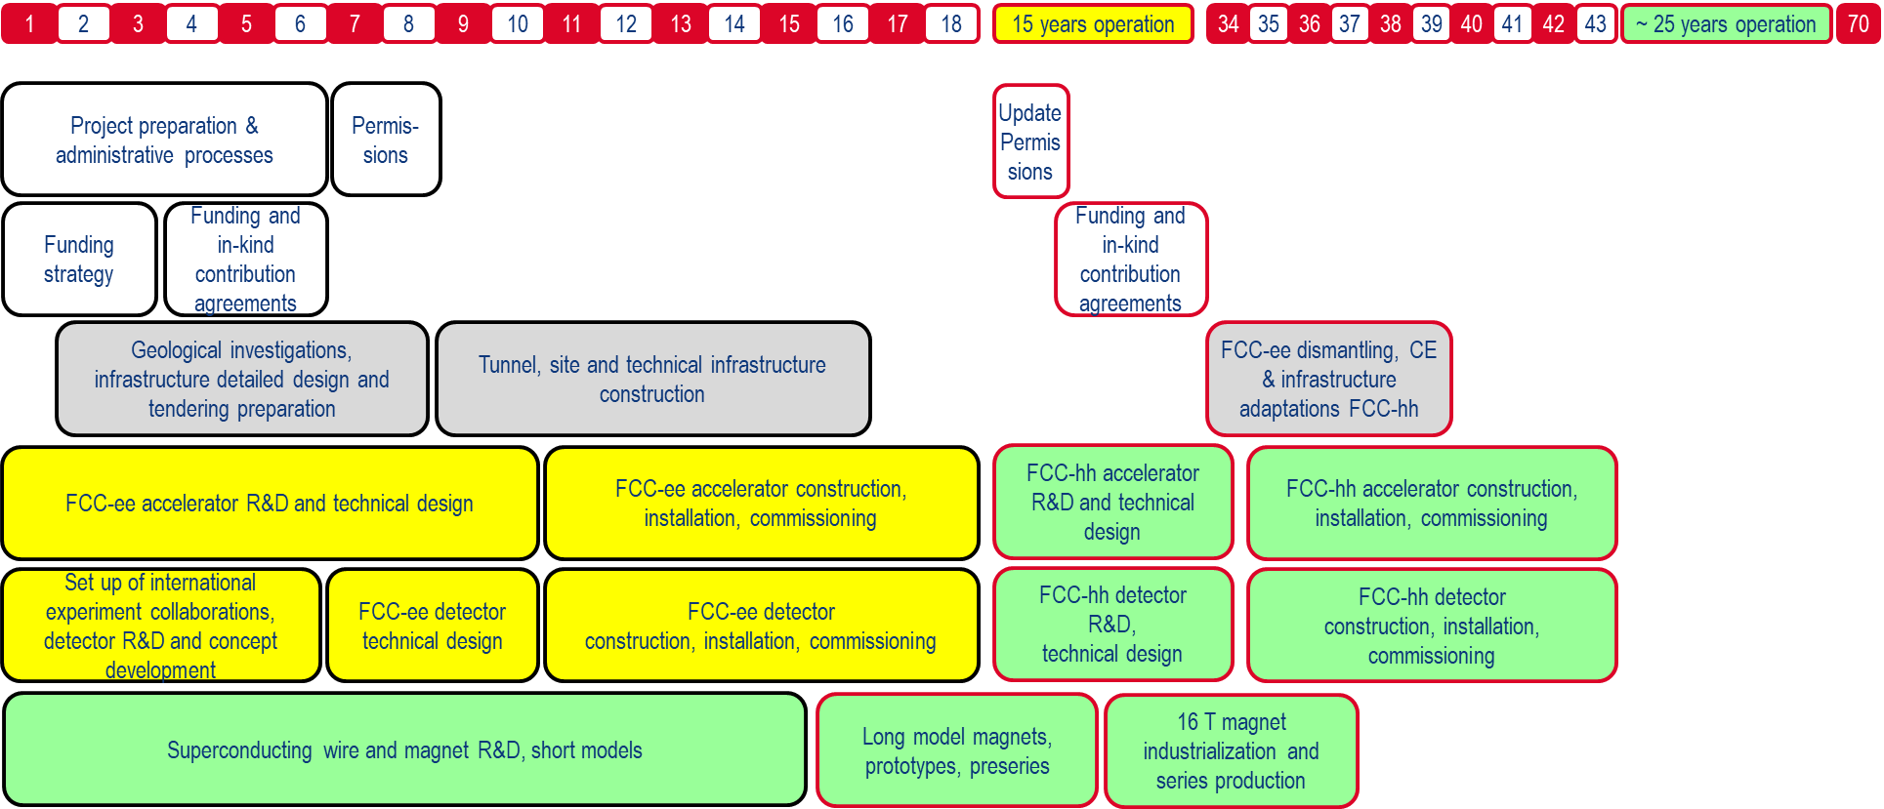
FCC integrated project technical schedule
engineering design, energy efficiency, maintainability
conductors & high-field magnet technology

Slide 11
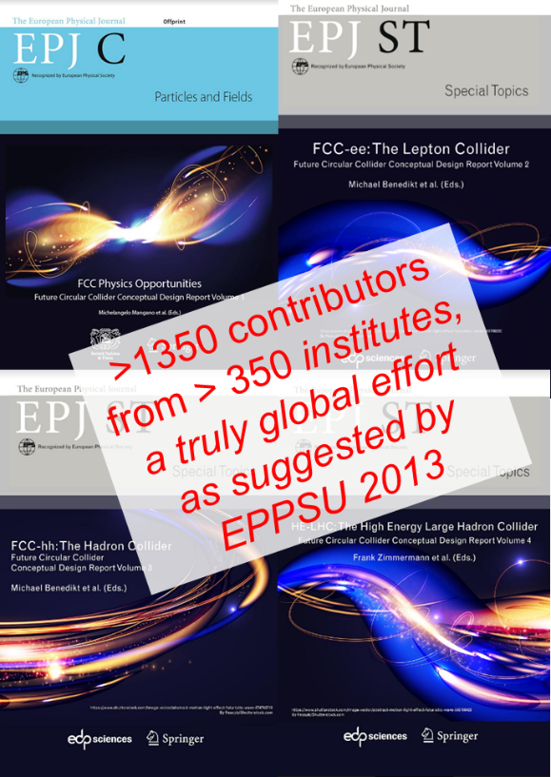
FCC CDR and Study Documentation
FCC-Conceptual Design Reports:
  Vol 1 Physics, Vol 2 FCC-ee, Vol 3 FCC-hh, Vol 4 HE-LHC
  CDRs published in European Physical Journal C (Vol 1) and ST (Vol 2 – 4)
  EPJ C 79, 6 (2019) 474 , EPJ ST 228, 2 (2019) 261-623 ,
  EPJ ST 228, 4 (2019) 755-1107 , EPJ ST 228, 5 (2019) 1109-1382
Summary documents provided to EPPSU SG
  FCC-integral, FCC-ee, FCC-hh, HE-LHC
  Accessible on http://fcc-cdr.web.cern.ch/

Slide 12
Feasibility Study of FCC integrated project
Feasibility study to be delivered end 2025 as input for ESPP Update expected for 2026/2027, to enable a project decision:
Feasibility study of the 100 km tunnel (infrastructure aspects, administrative aspects, local authorities, environment, energy, etc.)
High-risk areas site investigations included, to confirm principle feasibility
Host-state related processes, to allow start of construction early 2030ies.
CDR+ for colliders and injectors, including key technology proofs.
HFM program intermediate milestones, in line with long-term R&D plan.
Physics and experiments CDR + for FCC integrated project.
Financing concept & organization model for project and operation phases.
For all these activities the sequential nature of implementation of the colliders and the overall timeline needs to be taken into account!

Slide 13
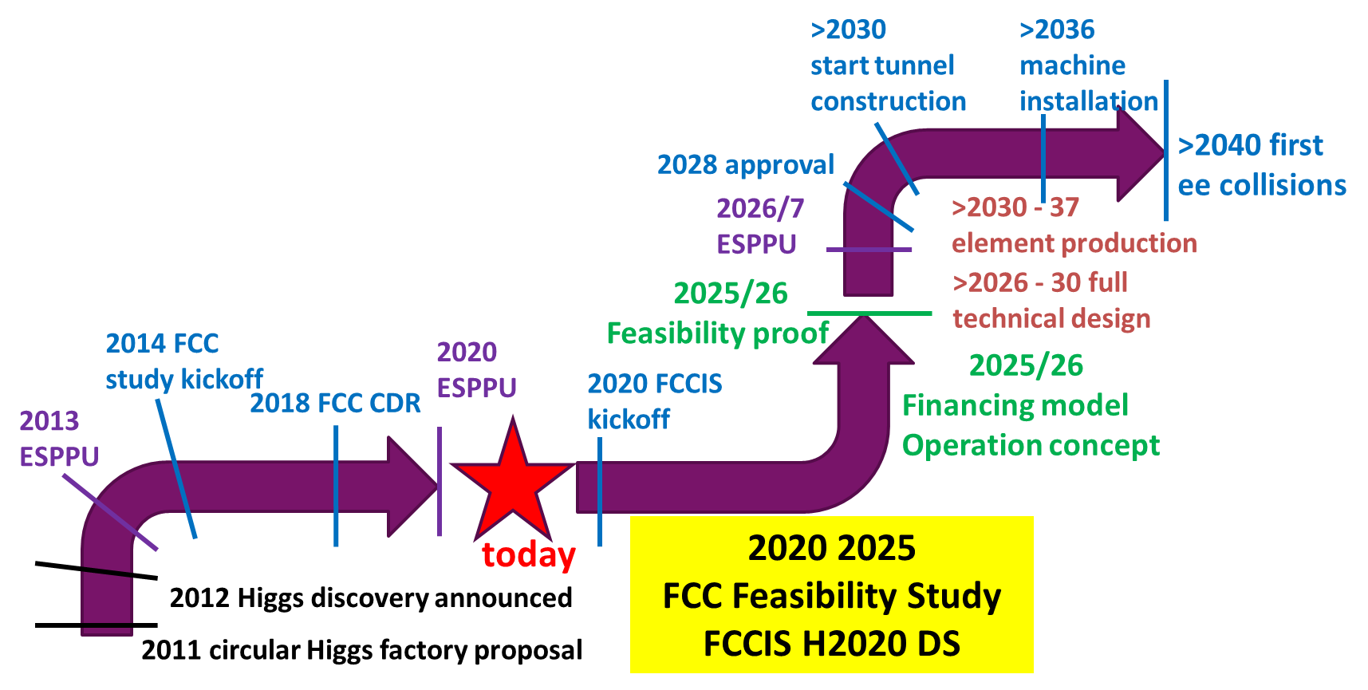
FCC roadmap towards stage 1

Slide 14
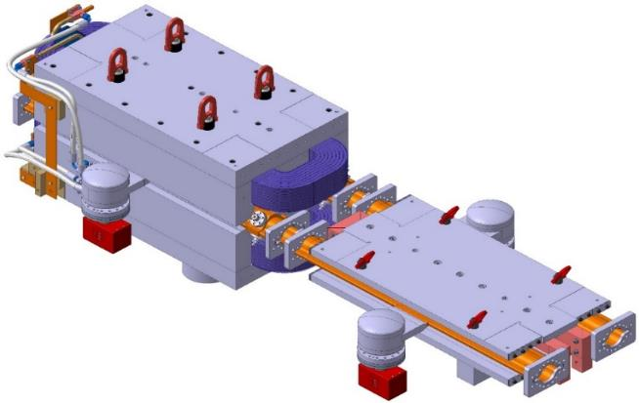
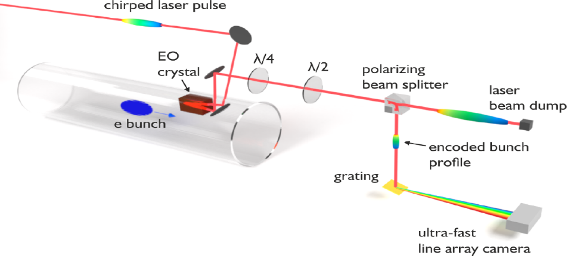
FCC key deliverables: prototypes by 2025
FCC-ee complete arc half-cell mock up
including girder, vacuum system with antechamber + pumps, dipole, quadrupole + sext. magnets, BPMs, cooling + alignment systems, technical infrastructure interfaces.
→ see « Stabilization and dynamic alignment issues in FCCee » by Gael Balik
→ see « Dynamics Vacuum for FCCee » by Suheyla Bilgen
key beam diagnostics elements
bunch-by-bunch turn-by-turn longitudinal charge density profiles based on electro-optical spectral decoding (beam tests at KIT/KARA) ; ultra-low emittance measurement (X-ray interferometer tests at SuperKEKB, ALBA)
beam-loss monitors (IJCLab/KEK?) ;
beamstrahlung monitor (KEK);
polarimeter ; luminometer

Slide 15
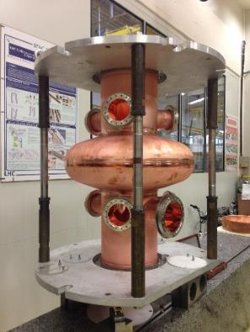
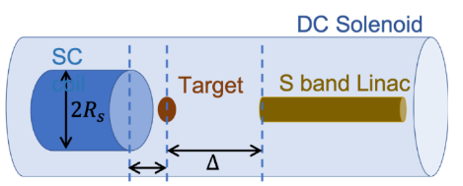
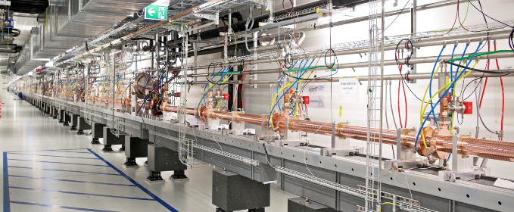
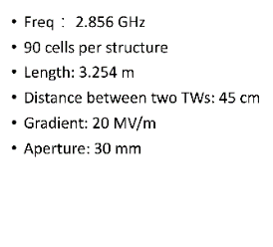
FCC key deliverables: prototypes by 2025
high-yield positron source
target with DC SC solenoid or flux
concentrator
400 MHz SRF cryomodule,
+ prototype multi-cell cavities for FCC ZH operation
High-efficiency RF power sources
→ see « Optimized positron production in FCCee » by Iryna Chaikovska
positron capture linac
large aperture S-band linac
beam test of e⁺ source & capture linac at SwissFEL – yield measurement
SwissFEL linac
Strong support from Switzerland via CHART II program 2019 – 2024 for FCC-ee injector, HFM, beam optics developments, geology and geodesy activities.

Slide 16
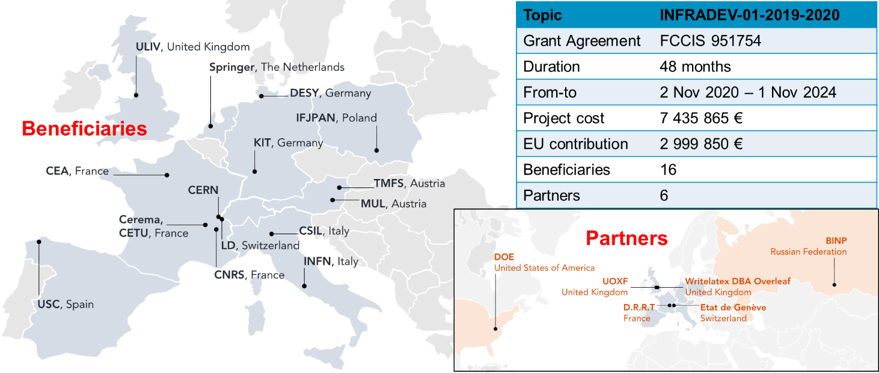
H2020 DS FCC Innovation Study
2020-24

Slide 17
Objectives and organisation of FCCIS (Description of Action)
Objectives:
O1: Design a circular luminosity frontier particle collider with a research programme to remain at the forefront of research
O2: Demonstrate the technical and organizational feasibility of a 100 km long, circular particle collider
O3: Develop an innovation plan for a long-term sustainable research infrastructure that is seamlessly integrated in the European research landscape
O4: Engage stakeholders from different sectors of the society
O5: Demonstrate the role and impact of the research infrastructure in the innovation chain, focusing on responsible resource use and managing environmental impacts
5 work packages:
WP1: study management,
WP2: collider design.
WP3: integrate Europe.
WP4: impact & sustainability
WP5: leverage & engage
→ see « Optics studies for the FCCee booster ring» by Barbara Dalena

Slide 18
Status and Outlook
1st phase of FCC design study completed → baseline machine designs, performance matching physics requirements, in 4 CDRs
Integrated FCC programme was submitted to the European Strategy Update 2019/20 → Request for feasibility study as basis for project decision by 2026/27.
Next steps: concrete local/regional implementation scenario in collaboration with host state authorities, accompanied by machine optimization, physics studies and technology R&D, performed via global collaboration and supported by EC H2020 Design Study FCCIS, to prove feasibility by 2025/26.
Long term goal: a world-leading HEP infrastructure for the 21st century to push the particle-physics precision and energy frontiers far beyond present limits.

Slide 19
French contribution
High-field magnets
  → see « HF magnets R&D » by Etienne Rochepault
Interaction region
  Nanobeams and Monochromatization
Injector complex
  Positron source
  → see « Optimized positron production in FCCee » by Iryna Chaikovska
  High-energy booster
  → see « Optics studies for the FCCee booster ring» by Barbara Dalena
Diagnostics
  Polarimetry. Studies have begun
  Luminometry: possible contribution under study.
Positioning + MDI (vibration mitigation)
→ see « Stabilization and dynamic alignment issues in FCCee » by Gael Balik
Vacuum dynamics
→ see « Dynamics Vacuum for FCCee » by Suheyla Bilgen

Slide 20
THANK YOU FOR YOUR ATTENTION !
Acknowledgement to Michael Benedikt for most of the slides

