Slide 1


Optics studies for the FCC-ee Booster ring: status and plan
Janvier 2021
A. Chance¹, B. Dalena¹, B. Haerer² and H. de Grandsaignes¹ (Phd student) (¹CEA, ²KIT )

Slide 2
Injection Parameters (as in CDR)
Total filling time of collider < 20 min
Continuous top-up injection into the collider (Beamstrahlung and radiative Bhabha losses)
Charge variation bunch to bunch < few %

Slide 3
Injectors complex
Injection energy into the booster 20 GeV (or 16 GeV )
Ramping similar to SPS: 80 GeV / s
Alternative: replace Linac + Pre Booster Ring with a Linac

Slide 4
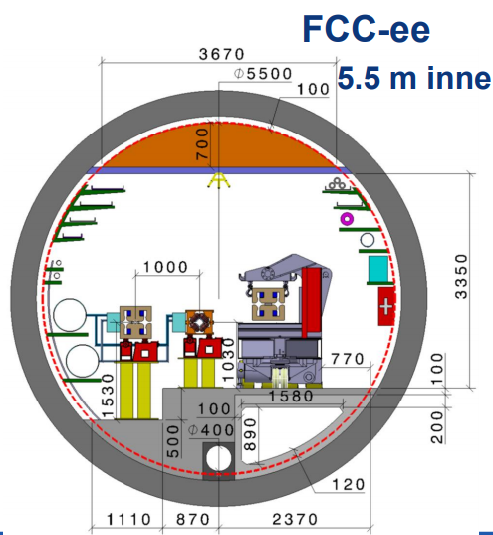
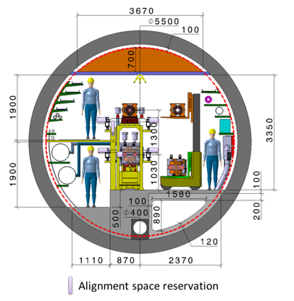
Layout constraints
FCC-hh
FCC-ee
High Energy Booster follows the FCC-hh footprint
Main Collider has a transverse offset of 1 m (alternative with collider that follows FCC-hh footprint and booster on top of it)
Booster bypass the FCC-ee detectors on the internal side of the cavern (following FCC-hh layout)

Slide 5
Booster arc cells
FODO cells of 54 m
Made of 4 dipole, 2 quadrupoles and 4 sextupoles
Including space for correctors, flanges and interconnections
90°/90°
⇒ Very challenging low dipole field
Booster Equilibrium rms emittance ≤ collider
Beam Energy [GeV] | Eq. Emittance [nm rad] 60°/60° | Eq. Emittance [nm rad] 90°/90° | Eq. Emittance Collider [nm rad]
45.6 (Z) | 0.235 | 0078 | 0.24
80 (W) | 0.729 | 0.242 | 0.84
120 (H) | 4.229 | 0.545 | 0.63
175 (tt) | 3.540 | 1.172 | 1.48
60°/60°
⇒ 60°/60° retained for Z and W operation (mitigation of MI and IBS)
⇒ 90°/90° required for H and ttbar operation

Slide 6
Sextupole schemes, working point and DA
Different schemes have been studied
best cancellation of geometric aberrations given by non-interleaved sextupoles scheme
need for less sextupoles
Fractional working point chosen .225/.29, based on Diffusion Rate given by frequency map analysis
It can be further optimized, also accounting for collective effects
Dynamic and momentum aperture, with quadrupole displacements, look OK
⇒ impact of wigglers to be studied
Courtesy of T. Tydecks

Slide 7
Insertions regions
Short straight sections of 1.4 km (PL,PA,PB,PH,PG,PF) are made of FODO cells of 56 m.
Injection to and extraction from the Booster
probably located in sections PL and PB
⇒ to be designed
RF cavities are located in sections PJ and PD, as in the collider, but they are staggered because of CM size
Wigglers are located in sections PJ and PD with RF cavities:
⇒ good for fast beam energy recovery
⇒ protection of the cavities from the wigglers’ radiation to be investigated

Slide 8
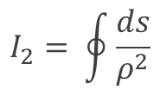

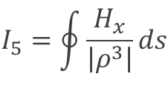
Damping Wigglers
Target damping time 0.1 s (to fulfill cycle time)
Wigglers reduce damping time and increase eq. emittance :
$$τ_{x}∝\frac{1}{E^{4}I_{2}}$$
$$I_{2}= \oint{\frac{ds}{ρ^{2}}}$$
$$I_{5}=\oint{\frac{H_{x}}{\left|ρ^{3}\right|}ds}$$
They mitigate IBS and MI too
A normal conducting wigglers foreseen
⇒ can be further optimized for poles length and for number of poles
It should be switched off during acceleration
Eddy current effect to be investigated
Total length of installed wigglers is of the > 100 m in the same straight line
Possible stimulated additional radiation and instability (like in FEL) to be studied

Slide 9
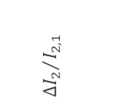
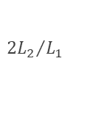
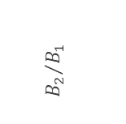
Alternative optics (proposed by Antoine Chance)
2 dipole families with two different curvatures,
proposed for the electron-ion collider (EIC)
Damping time can be reduced by playing on the ratio between the two different fields.
Advantages:
No impact on the layout
No need of damping wigglers
Higher dipole field at injection energy
Drawbacks:
Different orbit at different energies ⇒ reduction of beam stay clear?
More synchrotron radiation and in opposite direction of foreseen absorber (at injection) ⇒ vacuum quality to be investigated
$${B_{2}}/{B_{1}}$$
$${∆I_{2}}/{I_{2,1}}$$
$${{2L}_{2}}/{L_{1}}$$

Slide 10
Summary HEB status
(thanks to Bastian Haerer)
Two optics for the 4 operational scenarios:
  60°/60° for the Z and W
  90°/90° for the H and ttbar
Non interleaved sextupole scheme retained as baseline
  Best cancellation of geometric aberrations
  Less sextupoles required
Working point chosen .225/.29
  Allows for large DA and momentum aperture
Wigglers are needed to reduce damping time at injection and mitigate IBS and MI
  First design exists
A staging RF scenario with staggered cryomodules, with respect to collider, has been worked out

Slide 11
Next steps
Consolidate booster layout and correction schemes accordingly to the changes on FCC-hh and FCC-ee collider
Re-optimisation of working point
  taking into account also collective effects
Re-optimisation of the wigglers
  Reduce equilibrium emittance at Z
  Fast ramping down (Eddy current) at higher energies
  Check possible excitation of stimulated synchrotron radiation and beam instability (due to installation on straight line)
Protection of RF cavities from wigglers radiation
  Placed in the same insertions
Injection extraction lines to be done
Design and study an alternative optics, based on the EIC 2 dipoles family scheme
  Compare it with the solution with wigglers

Slide 12
Merci de votre attention

